Slide 1


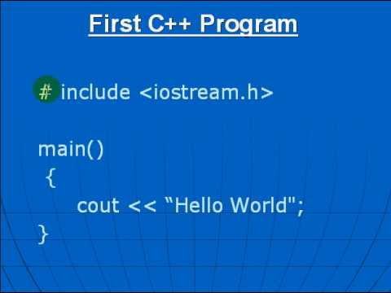

Al-Azhar University
Faculty of Engineering
Systems and Computer Engineering Dept.
Intelligent Systems Engineering Program
ENG 151
Computer Programming I
Prof. Ahmed Youssef

Slide 2
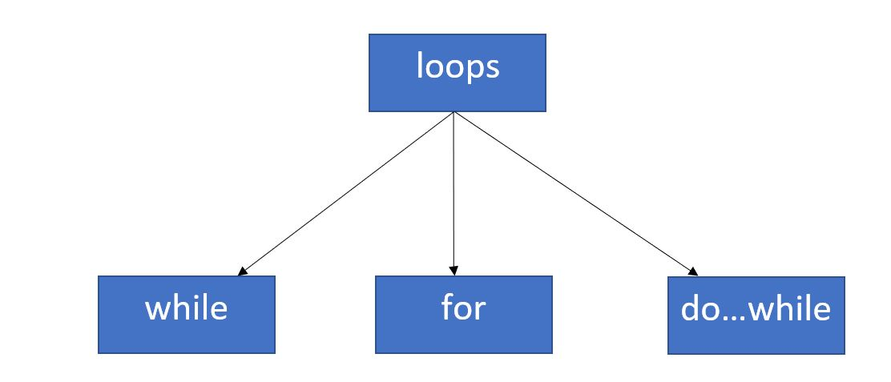
Al-Azhar University
Faculty of Engineering
Systems and Computer Engineering Dept.
Intelligent Systems Engineering Program
ENG 151
Computer Programming I
Control Statements Part 1

Slide 3
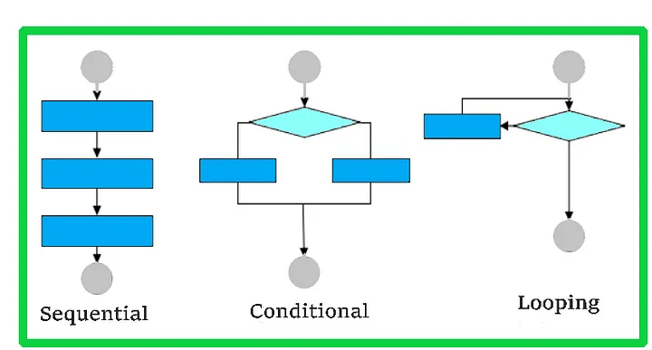
Control Structures

Slide 4
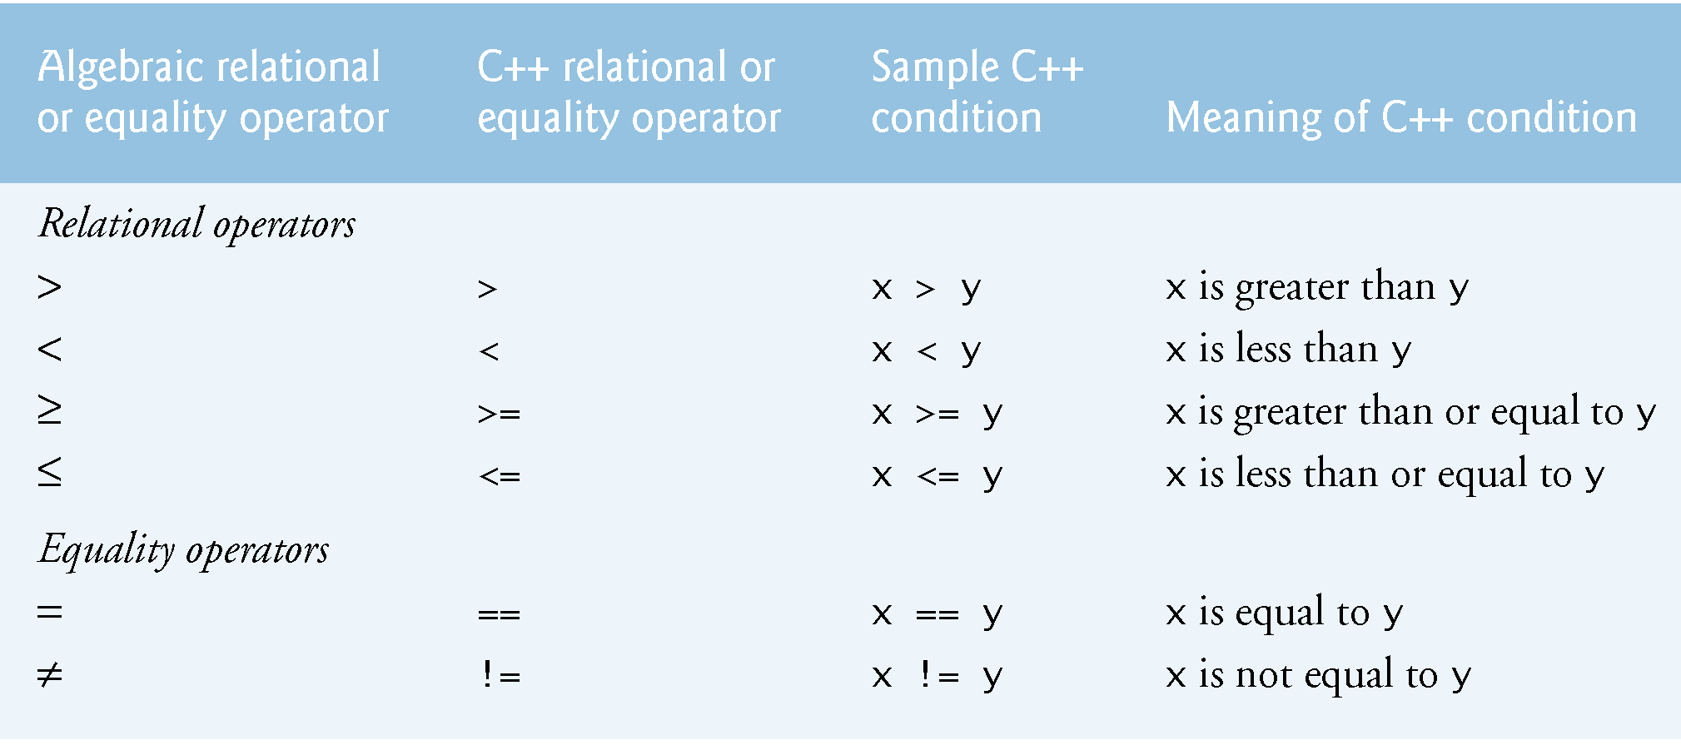
Relational Operators

Slide 5
Logical Operators
Operator | Meaning | Example | Result
&& | AND | (5 < 2) && (5 >3) | FALSE
|| | OR | (5 < 2) || (5 >3) | TRUE
! | NOT | ! (5 < 2) | TRUE

Slide 6
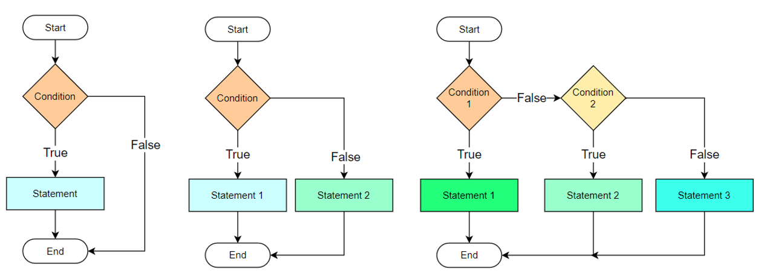
Conditional Statements

Slide 7
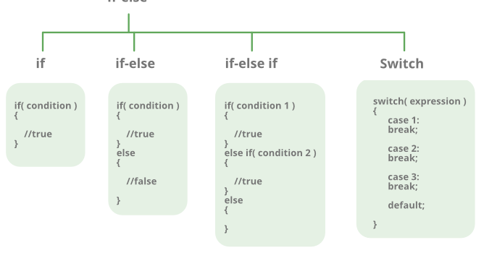
Conditional (Branching) Statements

Slide 8
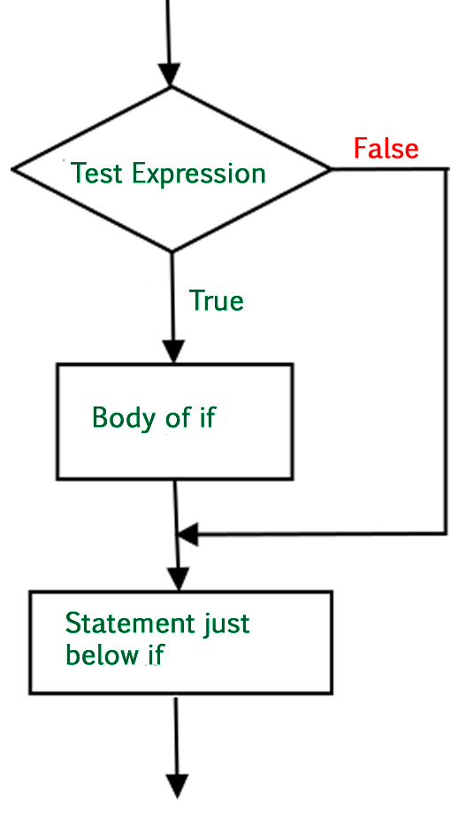
if - Syntax
if(Test_Expression)
{
// statement(s) will execute if
// the boolean expression is true
}

Slide 9
Example: Check if a number is positive
#include <iostream>
using namespace std;
int main() {
int num;
cout << "Enter a number: ";
cin >> num;
if (num > 0) {
cout << num << " is positive." << endl;
}
return 0;
}

Slide 10
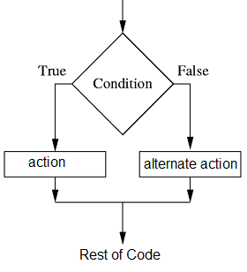
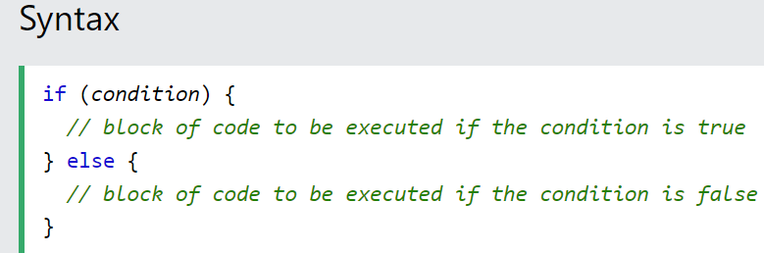
The else Statement

Slide 11
Example: Determine if a number is even or odd.
#include <iostream>
using namespace std;
int main() {
int num;
cout << "Enter a number: ";
cin >> num;
if (num % 2 == 0)
cout << num << " is even" << endl;
else
cout << num << " is odd" << endl;
return 0;
}
Notes:
Write a program that checks if a number is even or odd.

Slide 12
Example: Leap Year Checker
#include <iostream>
using namespace std;
int main() {
int year;
cout << "Enter a year: ";
cin >> year;
if (year % 4 == 0)
cout << year << " is a leap year" << endl;
else
cout << year << " is not a leap year" << endl;
return 0;
}
Notes:
Write a program to check if a year is a leap year.

Slide 13
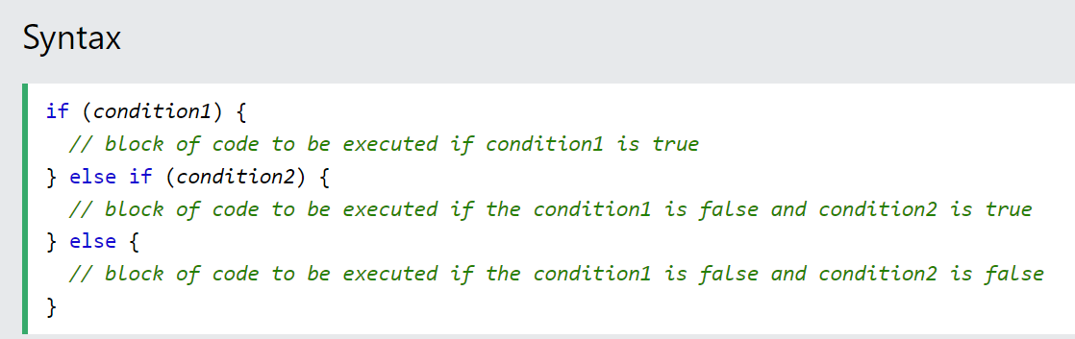
The else if Statement

Slide 14
Example: Positive or Negative Number
#include <iostream>
using namespace std;
int main() {
int num;
cout << "Enter a number: ";
cin >> num;
if (num > 0)
cout << "Positive number" << endl;
else if (num < 0)
cout << "Negative number" << endl;
else
cout << "Zero" << endl;
return 0;
}
Notes:
Write a program that takes a number as input and prints whether it's positive, negative, or zero.

Slide 15
Example: Largest of Three Numbers
#include <iostream>
using namespace std;
int main() {
int a, b, c;
cout << "Enter three numbers: ";
cin >> a >> b >> c;
if (a >= b && a >= c) {
cout << a << " is the largest" << endl;
} else if (b >= a && b >= c) {
cout << b << " is the largest" << endl;
} else {
cout << c << " is the largest" << endl;
}
return 0;
}

Slide 16
Example: Grade Calculator
#include <iostream>
using namespace std;
int main() {
int score;
cout << "Enter your score (0-100): ";
cin >> score;
if (score >= 90)
cout << "Grade: A" << endl;
else if (score >= 80)
cout << "Grade: B" << endl;
else if (score >= 70)
cout << "Grade: C" << endl;
else if (score >= 60)
cout << "Grade: D" << endl;
else
cout << "Grade: F" << endl;
return 0;
}
90-100 | A
80-89 | B
70-79 | C
60-69 | D
below 60 | F
Notes:
Write a program that takes a student's score (0-100) and outputs their grade

Slide 17
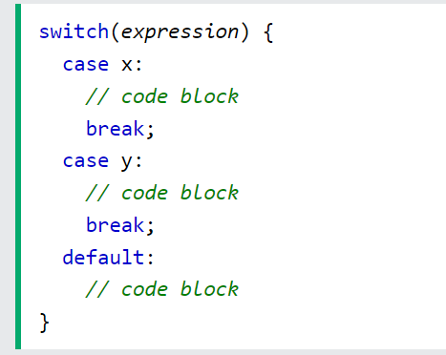
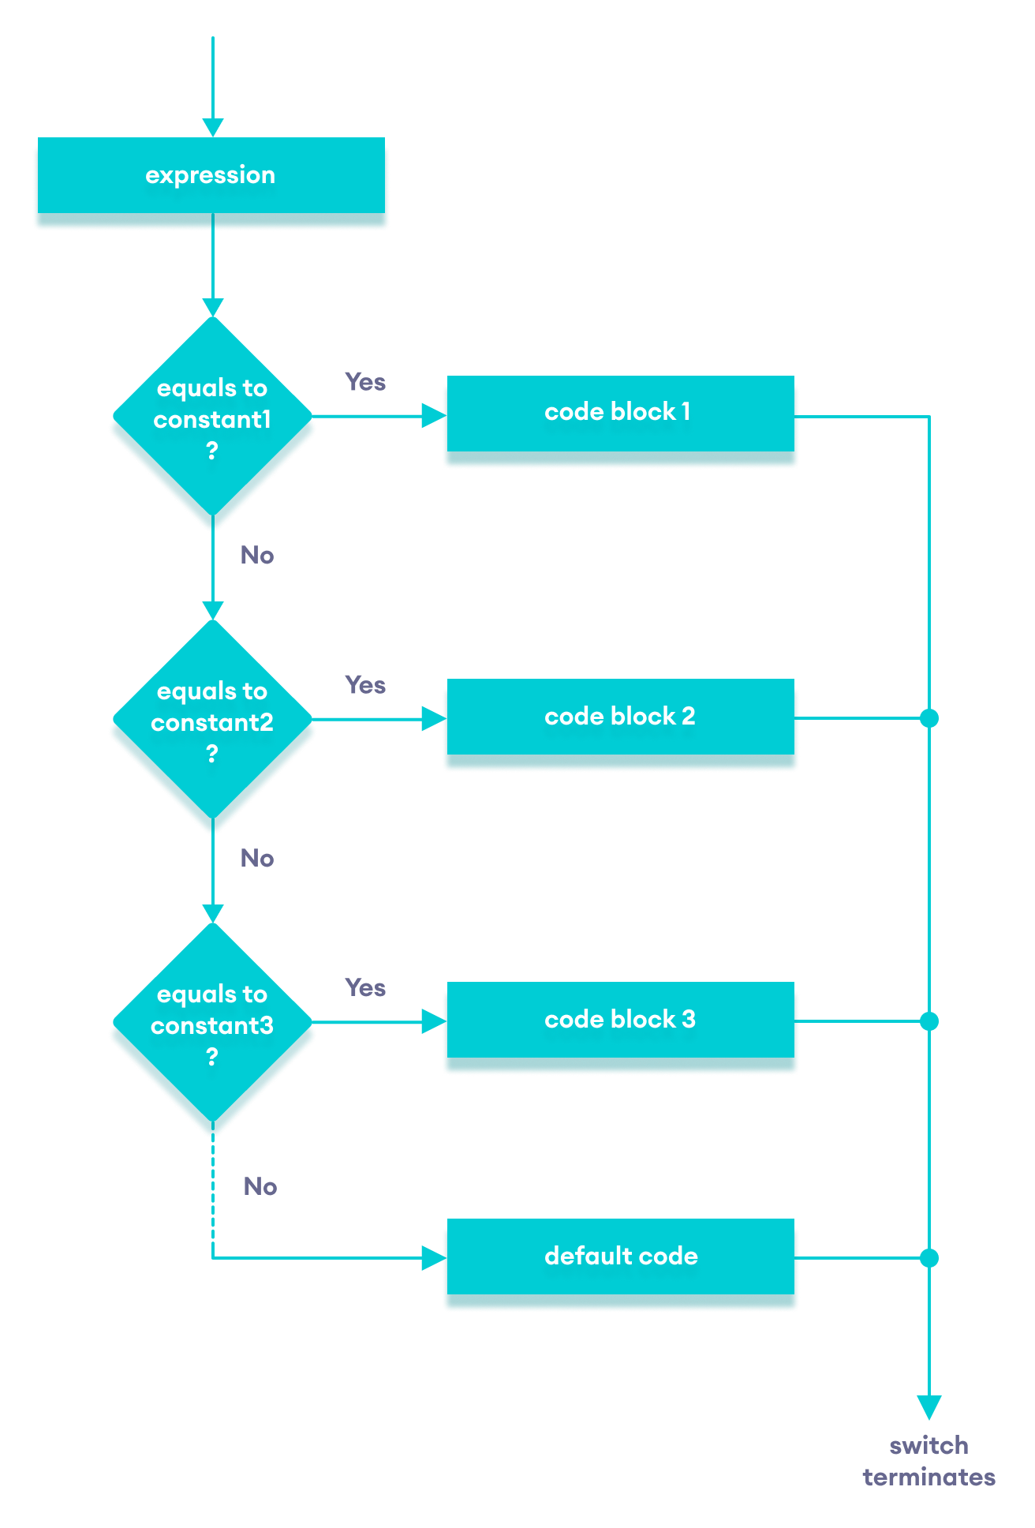
C++ Switch Statements

Slide 18
#include <iostream>
using namespace std;
int main() {
int day;
cout << "Enter day number (1-7): ";
cin >> day;
switch(day) {
case 1: cout << "Monday"; break;
case 2: cout << "Tuesday"; break;
case 3: cout << "Wednesday"; break;
case 4: cout << "Thursday"; break;
case 5: cout << "Friday"; break;
case 6: cout << "Saturday"; break;
case 7: cout << "Sunday"; break;
default: cout << "Invalid day number";
}
return 0;
}
Example: Day of Week Using Switch
Notes:
Problem: Write a program that takes a number (1-7) and prints the corresponding day of the week.

Slide 19
Example: Calculator Using Switch
#include <iostream>
using namespace std;
int main() {
char op;
float num1, num2;
cout << "Enter operator (+, -, *, /): ";
cin >> op;
cout << "Enter two numbers: ";
cin >> num1 >> num2;
switch(op) {

Slide 20
switch(op) {
case '+':
cout << num1 + num2;
break;
case '-':
cout << num1 - num2;
break;
case '*':
cout << num1 * num2;
break;
case '/':
if (num2 != 0)
cout << num1 / num2;
else
cout << "Error! Division by zero";
break;
default:
cout << "Invalid operator";
}
return 0;
}

Slide 21

Group Activity

Slide 22
Exercise 1
A shop offers a 10% discount if the purchase amount is more than 1000. Write a program that:
Asks the user to enter the purchase amount.
Display the final total cost after applying the discount (if any).

Slide 23
#include <iostream>
using namespace std;
int main() {
float quantity;
cout << "Enter the quantity: ";
cin >> quantity;
if (quantity > 1000) {
quantity = quantity * 0.9; // 10% discount
cout<<"Total cost after 10% discount:"<< quantity << endl;
} else {
cout << "Total cost: " << quantity << endl;
}
return 0;
}

Slide 24
Exercise 2
A student must have at least 75% attendance to be allowed to take the exam.
Write a program that:
Asks the user to enter the total number of classes held
Asks the user to enter the number of classes attended
Calculates the attendance percentage
Displays whether the student is allowed to take the exam or not allowed (if attendance is below 75%)

Slide 25
#include <iostream>
using namespace std;
int main() {
double total, Attend;
double per;
cout << "Enter the total number of classes : ";
cin >> total;
cout << "Enter the number of classes attended: ";
cin >> Attend;
per = (Attend / total) * 100;
if (per < 75) {
cout << "The student is not permitted to take the exam." << endl;
} else {
cout << "The student is eligible to take the exam." << endl;
}
return 0;
}

Slide 26
Exercise 3
A store offers discounts based on the total purchase amount as follows:
20% discount if the purchase amount is more than 10,000
10% discount if the amount is between 5,000 and 10,000
5% discount if the amount is between 1,000 and 5,000
No discount if the amount is less than 1,000
Write a program that:
Asks the user to enter the purchase amount
Applies the correct discount based on the amount
Displays the final cost after discount

Slide 27
#include <iostream>
using namespace std;
int main() {
float price, discount;
cout << "Enter the purchase amount: ";
cin >> price;
if (price > 10000) discount = price * 0.20;
else if (price >= 5000) discount = price * 0.10;
else if (price >= 1000) discount = price * 0.05;
else discount = 0;
cout << "Final cost after discount: " << price- discount;
return 0;
}

