Slide 1


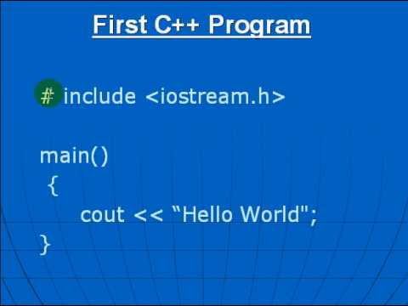

Al-Azhar University
Faculty of Engineering
Systems and Computer Engineering Dept.
Intelligent Systems Engineering Program
ENG 151
Computer Programming I
Prof. Ahmed Youssef

Slide 2
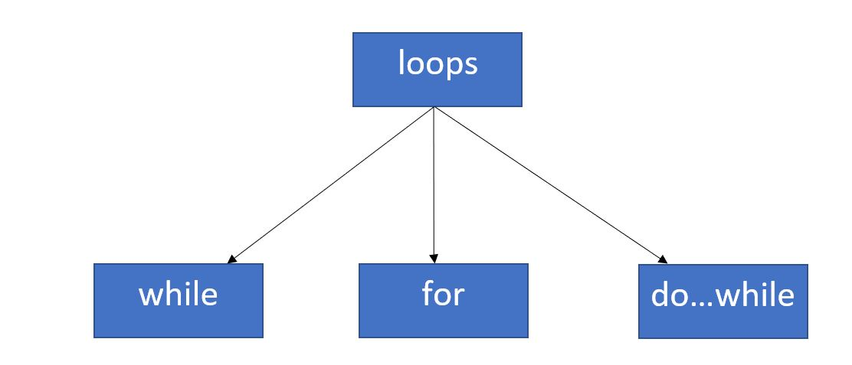
Al-Azhar University
Faculty of Engineering
Systems and Computer Engineering Dept.
Intelligent Systems Engineering Program
ENG 151
Computer Programming I
Iteration Statements (Looping)

Slide 3
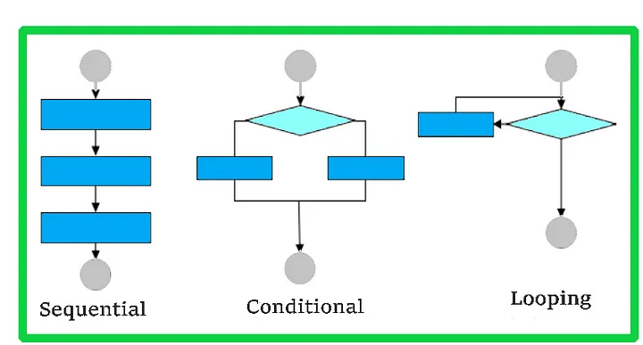
Control Structures

Slide 4
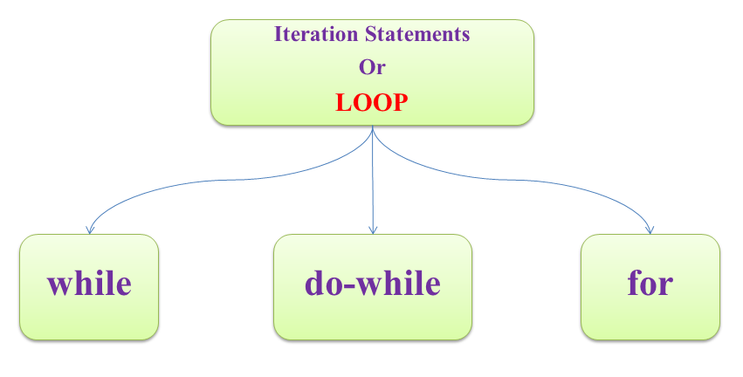
Iteration Statements (Looping)

Slide 5
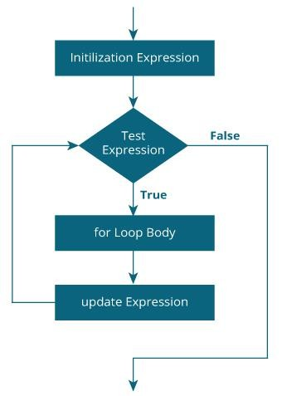
for Loop
for (initialization; condition; update)
{
// body of-loop
}
for (int i=0; i<=3; i++)
{
cout<<i;
}

Slide 6
Examples Using the for Statement
Count from 1 to 100 in increments of 1.
for (int i = 1; i <= 100; ++i)
Count from 100 down to 1 in decrements of 1.
for (int i = 100; i >= 1; --i)
Count from 7 to 77 in steps of 7.
for (int i = 7; i <= 77; i += 7)
Count from 20 down to 2 in steps of -2.
for (int i = 20; i >= 2; i -= 2)
Iterate over the sequence 2, 5, 8, 11, 14 , 17 , 20.
for (int i = 2; i <= 20; i += 3)
Iterate over the sequence 99, 88, 77, 66 , 55 , 44 , 33 , 22 , 11, 0.
for (int i = 99; i >= 0; i -= 11)

Slide 7
Find the sum of first n Natural Numbers
int num, sum=0;
cout << "Enter a positive integer: ";
cin >> num;
for (int i = 1; i <= num; ++i)
{
sum += i;
}
cout << "Sum = " << sum << endl;

Slide 8
Calculate Total Resistance in a Series Circuit
int n; // number of resistors
double R, totalResistance = 0;
cout << "Enter the number of resistors: ";
cin >> n;
for (int i = 1; i <= n; i++) {
cout << "Enter value of resistor " << i << ": ";
cin >> R;
totalResistance += R;
}
cout << "Total Resistance = " << totalResistance ;

Slide 9
Calculate Total Resistance in a Parallel Circuit
int n;
double R, Y=0, total_R;
cout << "Enter the number of resistors: ";
cin >> n;
for (int i = 1; i <= n; i++) {
cout << "Enter value of resistor " << i << ": ";
cin >> R;
Y += 1 / R;
}
total_R = 1 / Y;
cout << "Total Resistance = " << total_R ;

Slide 10
Exercise
Write a program to find the sum of all integers between 100 and 200 divisible by 9.

Slide 11
GCD / HCF of two numbers
GCD (Greatest Common Divisor) or HCF (Highest Common Factor) of two numbers is the largest number that exactly divides both numbers.
Input: a = 12, b = 16
Output: 4
Explanation: 4 is the largest number which divide both 12 and 16
Input: a = 11, b = 9
Output: 1
Explanation: 1 is the largest number which divide both 11 and 9

Slide 12
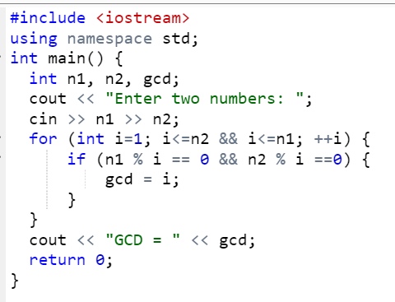

Slide 13
Least Common Multiple (LCM)
LCM = (N1 * N2) / GCD;

Slide 14
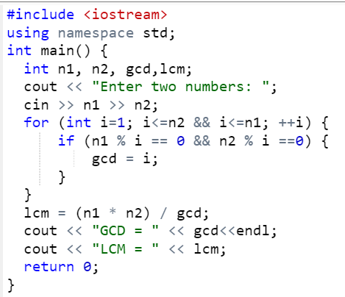
Notes:
#include <iostream>
using namespace std;
int main() {
int n1, n2, gcd,lcm;
cout << "Enter two numbers: ";
cin >> n1 >> n2;
for (int i=1; i<=n2 && i<=n1; ++i) {
if (n1 % i == 0 && n2 % i ==0) {
gcd = i;
}
}
lcm = (n1 * n2) / gcd;
cout << "GCD = " << gcd<<endl;
cout << "LCM = " << lcm;
return 0;
}

Slide 15
Nested for Loop
for (initialization; condition; increment)
{
for (initialization; condition; increment)
{
// set of statements for inner loop
}
//set of statement for outer loop
}

Slide 16
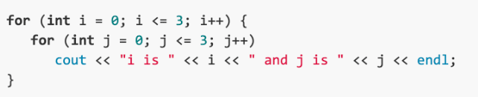
Nested for Loop
i is 0 j is 0
i is 0 j is 1
i is 0 j is 2
i is 0 j is 3
i is 1 j is 0
i is 1 j is 1
i is 1 j is 2
i is 1 j is 3
i is 2 j is 0
i is 2 j is 1
i is 2 j is 2
i is 2 j is 3
i is 3 j is 0
i is 3 j is 1
i is 3 j is 2
i is 3 j is 3

Slide 17
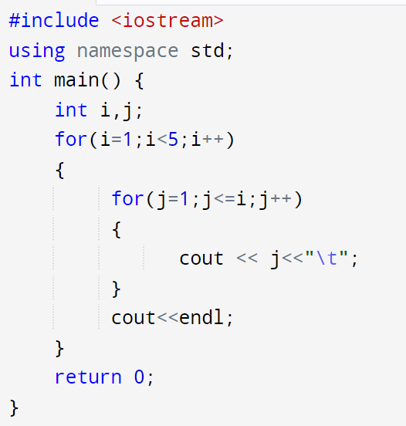
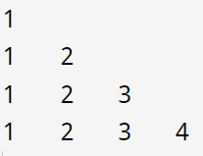
What is the output of the following program

Slide 18
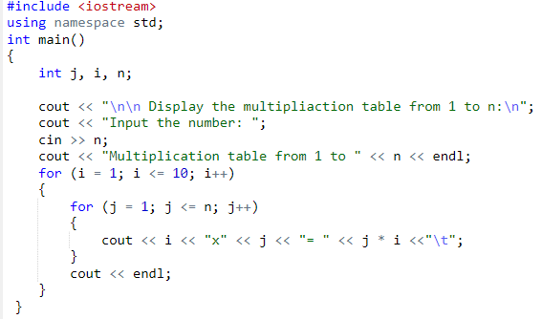
Example: Multiplication Table

Slide 19
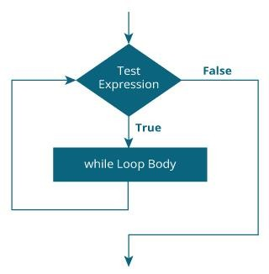
while Loop
while (condition)
{
// body of the loop
}
int n=5;
while (n>0)
{
cout << n << ", ";
--n;
}
cout << "FIRE!\n";

Slide 20
Find the number of digits from any number.
int num;
int a=0;
cout<<"Please Enter any number: ";
cin>>num;
while(num>0)
{
num=num/10;
a++;
}
cout<<"Number of digits in given number is: "<<a;

Slide 21
Write a C++ program to find the sum of positive numbers only.

Slide 22
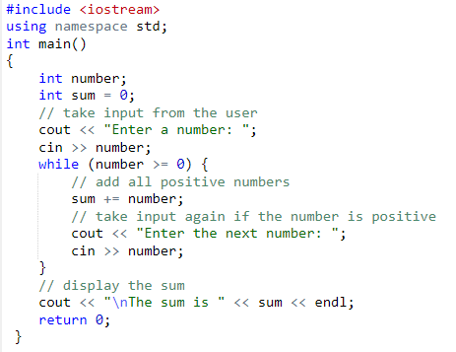

Slide 23
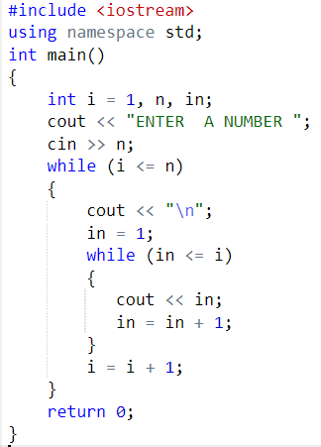

Example

Slide 24
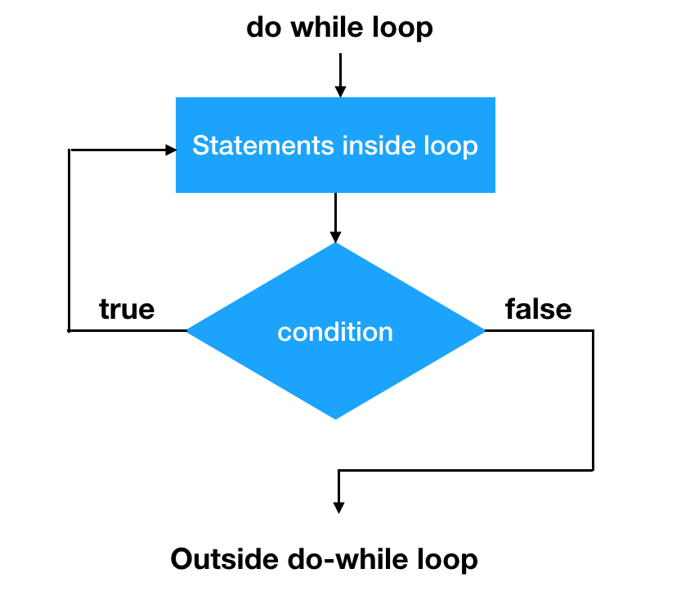
do … while Loop
do {
// body of loop;
}
while (condition);
int n=5; do
{
cout << n << ", ";
--n;
} while (n>0);
cout << "FIRE!\n";
Notes:
do {
// body of loop;
}
while (condition);

Slide 25
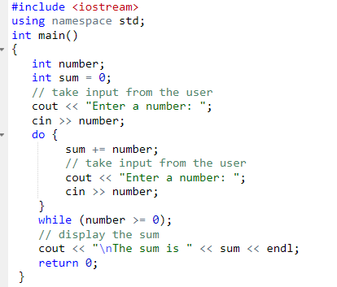

Slide 26
Infinite loop
for( ; ;)
while(true)
Don’t use:
for( int count=0;count<=5 ;++count);
while(count<=5 );

Slide 27
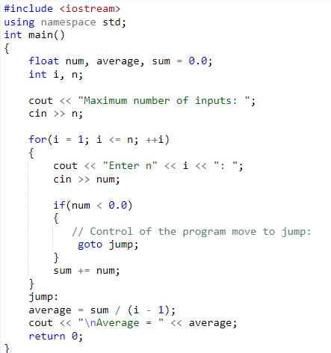
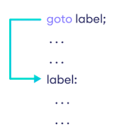
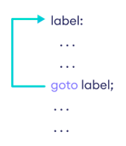
goto Statement

Slide 28
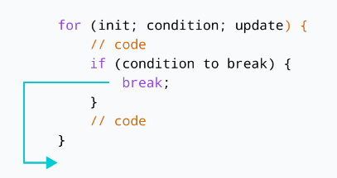
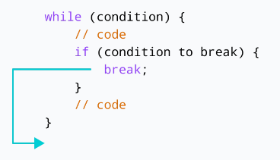
break Statement

Slide 29
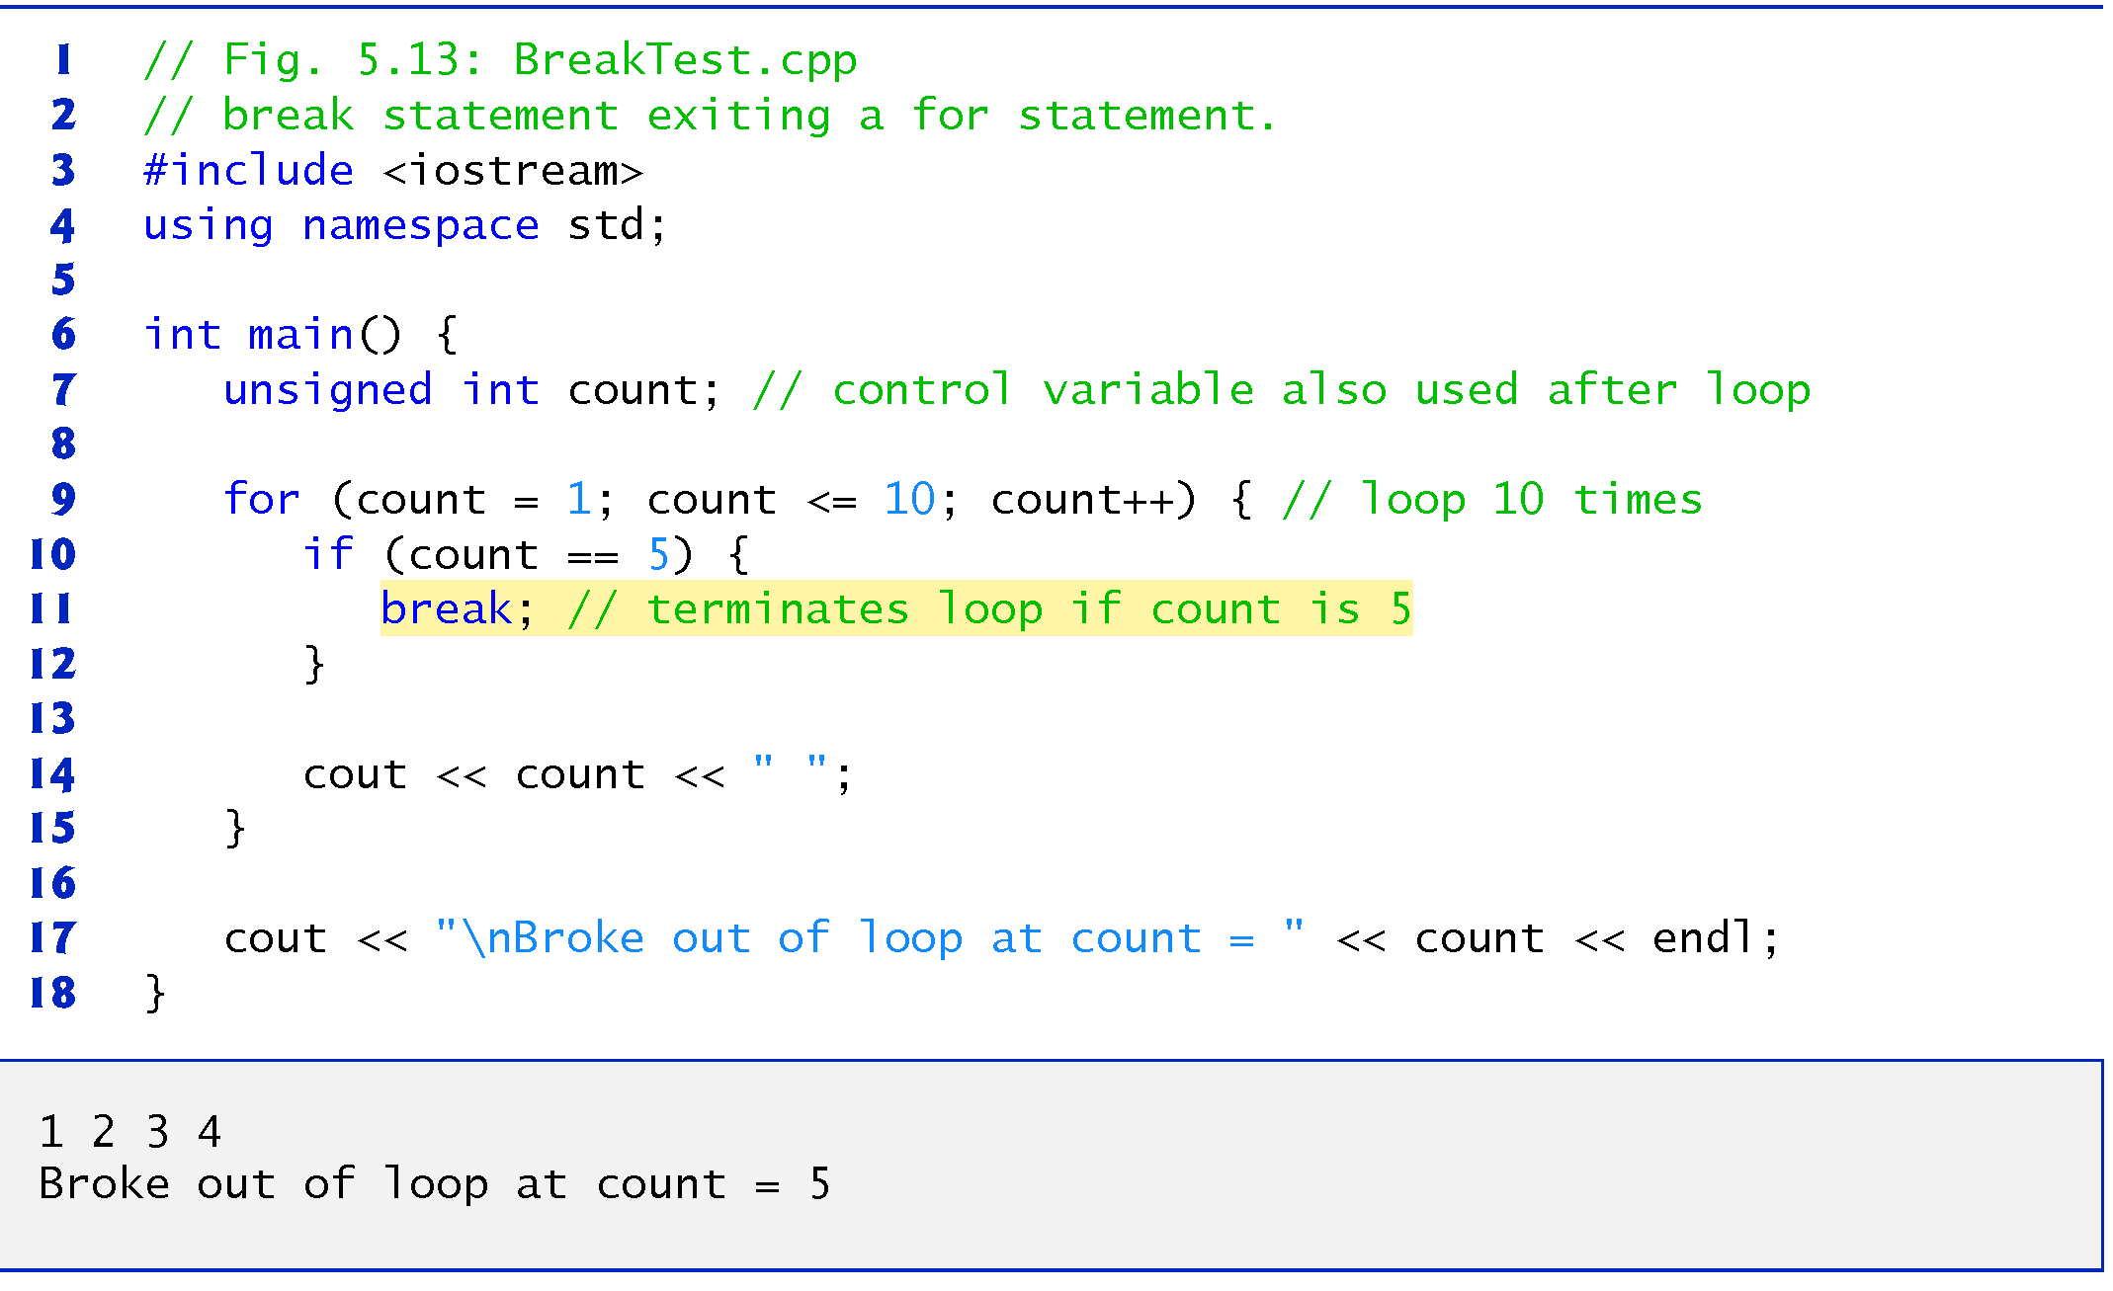

Slide 30
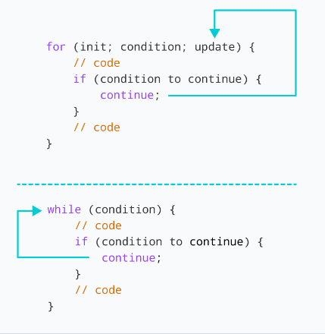
continue Statement

Slide 31
