Slide 1
C++ Programming:
From Problem Analysis to Program Design, Third Edition
Chapter 12: Classes and Data Abstraction

Slide 2
Objectives
In this chapter you will:
Learn about classes
Learn about private, protected, and public members of a class
Explore how classes are implemented

Slide 3

Classes
Class: collection of a fixed number of components
The components of a class are called members
The general syntax for defining a class:

Slide 4
Classes (continued)
Class member can be a variable or a function
If a member of a class is a variable
  It is declared like any other variable
In the definition of the class
  Cannot initialize a variable when you declare it
If a member of a class is a function
  Function prototype is listed
Function members can (directly) access any member of the class

Slide 5
Classes (continued)
class is a reserved word
Class defines a data type, no memory is allocated
Don’t forget the semicolon after the closing brace of the class

Slide 6
Classes (continued)
Three categories of class members
  private
  public
  protected
By default, all members of a class are private
If a member of a class is private
  It cannot be accessed outside the class

Slide 7
Classes (continued)
A public member is accessible outside the class
To make a member of a class public
  Use the label public with a colon
private, protected, and public are reserved words

Slide 8
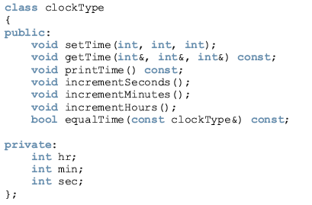

Slide 9
The class clockType has seven member functions: setTime, getTime, printTime, incrementSeconds, incrementMinutes, incrementHours, and equalTime. It has three member variables: hr, min, and sec.
The three member variables—hr, min, and sec—are private to the class and cannot be accessed outside the class.
The seven member functions—setTime, getTime, printTime, incrementSeconds, incrementMinutes, incrementHours, and equalTime—can directly access the member variables (hr, min, and sec).
In the function equalTime, the formal parameter is a constant reference parameter. That is, in a call to the function equalTime, the formal parameter receives the address of the actual parameter, but the formal parameter cannot modify the value of the actual parameter.
The word const at the end of the member functions getTime, printTime, and equalTime specifies that these functions cannot modify the member variables of a variable of type clockType.

Slide 10
Variable (Object) Declaration
Once a class is defined, you can declare variables of that type
In C++ terminology, a class variable is called a class object or class instance
The syntax for declaring a class object is the same as for declaring any other variable
clockType myClock;
clockType yourClock;

Slide 11

Accessing Class Members
Once an object is declared
  It can access the public members of the class
Syntax to access class members:
The dot (. ) is called the member access operator

Slide 12
Accessing Class Members (continued)
The class members that a class object can access depend on where the object is declared.
  If the object is declared in the definition of a member function of the class, then the object can access both the public and private members.
  If the object is declared elsewhere (for example, in a user’s program), then the object can access only the public members of the class.

Slide 13
Example: 1
// don’t forget to: #include <iostream> #include<string>
using namespace std;
class student {
private:
string name;
int grade;
public:
void setname() { cout<<"enter the st name:"; cin>>name; }
void printname(){ cout<<"the st name is:"<<name; }
void setgrade(){
cout<<"enter the grade: ";
cin>>grade;
grade=grade+5; }
void printgrade(){ cout<<" st grade is: "<<grade<<endl; }
};

Slide 14
Example: 1 (continue)
int main() {
student a, b;
a.setname();
a.setgrade();
b=a;
a.printname();
a.printgrade();
b.printname();
b.printgrade();
return 0;
}
Note:
cout<<a.grade;
is an illegal statement inside the main function, because grade is a private member of class a and can not be access outside the class scope.
Output: enter the st name:Omar
enter the grade: 88
the st name is:Omar st grade is: 93
the st name is:Omar st grade is: 93

Slide 15
Functions and Classes
Objects can be passed as parameters to functions and returned as function values
As parameters to functions
  Objects can be passed by value or by reference
If an object is passed by value
  Contents of data members of the actual parameter are copied into the corresponding data members of the formal parameter

Slide 16
In order to reference these identifiers, we use the scope resolution operator, :: (double colon).
In the function definition’s heading, the name of the function is the name of the class, followed by the scope resolution operator, followed by the function name.

Slide 17
Another way to rewrite Example 1:
using namespace std;
class student {
private:
string name;
int grade;
public:
void setname();
void printname();
void setgrade();
void printgrade();
};
void student::setname() { cout<<"enter the st name:"; cin>>name; }
void student::printname() { cout<<"the st name is:"<<name; }
void student::setgrade() { cout<<"enter the grade: "; cin>>grade;
grade= grade+5;
}
void student::printgrade() { cout<<" st grade is: "<<grade<<endl; }

Slide 18
Another way to rewrite Example 1:
void readdata(student& temp)
{
temp.setname();
temp.setgrade();
}
void writedata(student temp )
{
temp.printname();
temp.printgrade();
}
int main() {
student a, b;
readdata(a);
b=a;
writedata(a);
writedata(b);
return 0;
}
Output: enter the st name:Omar
enter the grade: 88
the st name is:Omar st grade is: 93
the st name is:Omar st grade is: 93

Slide 20
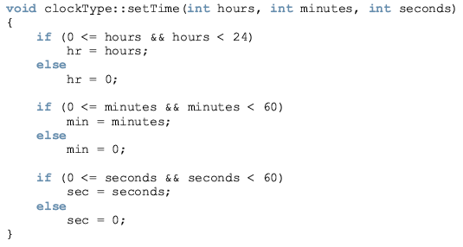
To call this function:

Slide 21
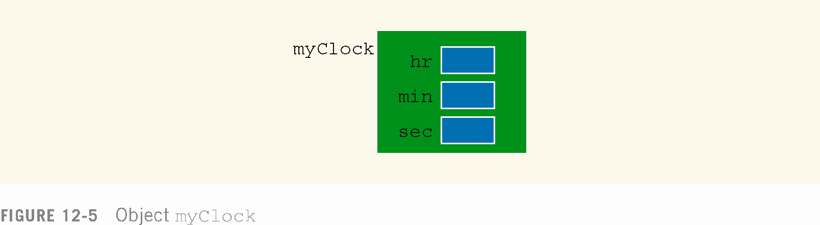
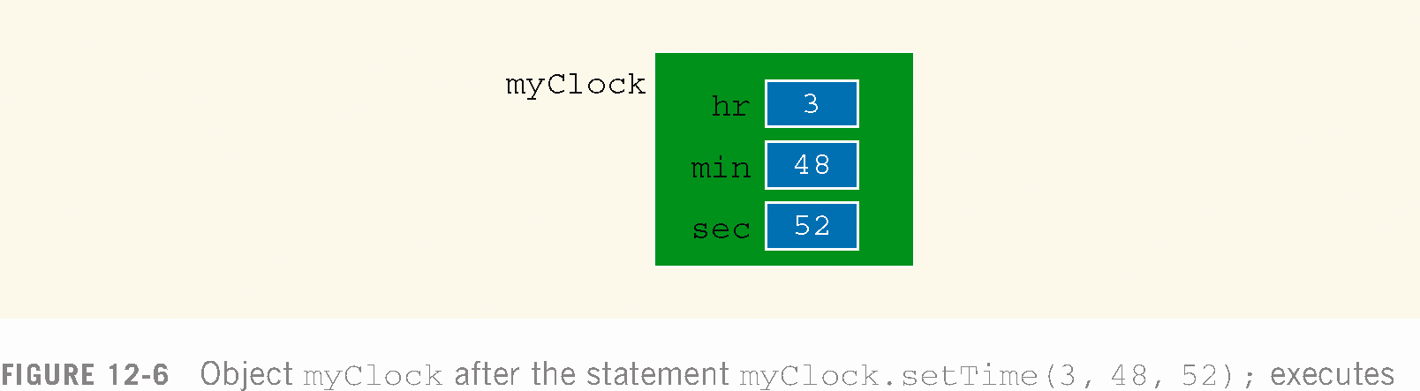

Slide 22
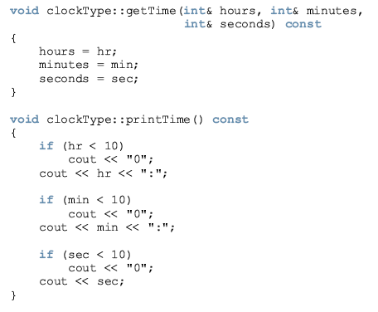

Slide 23
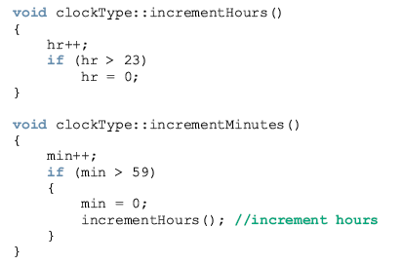

Slide 24
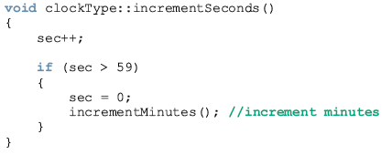

Slide 25
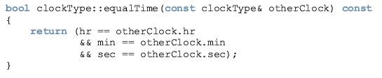
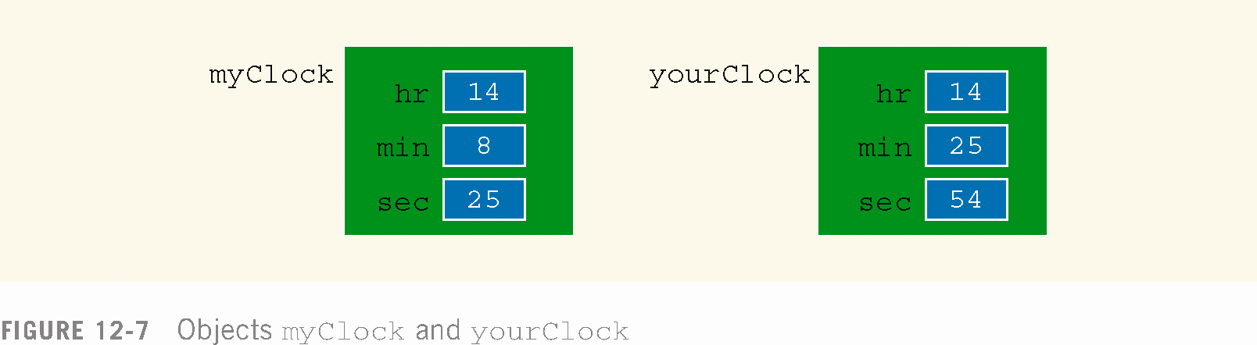
Suppose that myClock and yourClock are objects of type clockType, as declared previously. Further suppose that we have myClock and yourClock as shown in Figure 12-7.

Slide 26
Within the definition of this function, the object otherClock accesses the member variables hr, min, and sec.
However, these member variables are private. So is there any violation? The answer is no.
The function equalTime is a member of the class clockType and hr, min, and sec are the member variables.
otherClock is an object of type clockType.
Therefore, the object otherClock can access its private member variables within the definition of the function equalTime.

Slide 27
Once a class is properly defined and implemented, it can be used in a program.
A program or software that uses and manipulates the objects of a class is called a client of that class.
When you declare objects of the class clockType, every object has its own copy of the member variables hr, min, and sec.
In object-oriented terminology, variables such as hr, min, and sec are called instance variables of the class because every object has its own instance of the data.

Slide 28
Order of public and private Members of a Class
C++ has no fixed order in which you declare public and private members
By default all members of a class are private
Use the member access specifier public to make a member available for public access

Slide 29
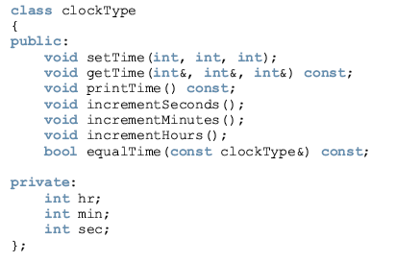
Example 12-3

Slide 30
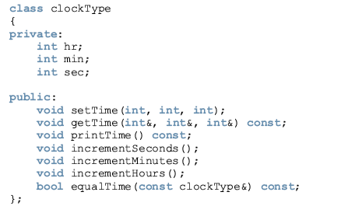
Example 12-4

Slide 31
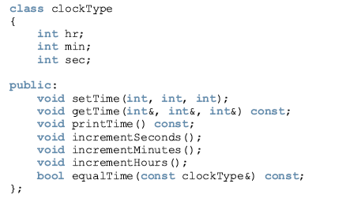
Example 12-5

Slide 32
Summary
Class: collection of a fixed number of components
Members: components of a class
Members are accessed by name
Members are classified into one of three categories: private, protected, and public
Class variables are called class objects or, simply, objects

Slide 33
Summary (continued)
The only built-in operations on classes are the assignment and member selection

