Slide 1
C++ Programming:
Program Design Including
Data Structures, Third Edition
Chapter 14: Overloading and Templates

Slide 2
Objectives
In this chapter you will:
Learn about overloading
Become aware of the restrictions on operator overloading
Examine the pointer this
Learn about friend functions

Slide 3
Objectives (continued)
Explore the members and nonmembers of a class
Discover how to overload various operators
Learn about templates
Explore how to construct function templates and class templates

Slide 4

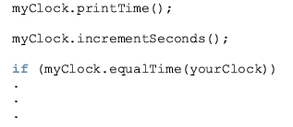

Slide 5
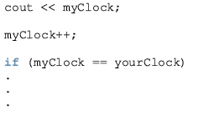
Would prefer to use the following statements instead of the previous statements

Slide 6
Operator Overloading
The only built-in operations on classes are assignment and member selection
Other operators cannot be applied directly to class objects
C++ allows you to extend the definitions of most of the operators to work with classes
This is called operator overloading

Slide 7
Operator Overloading (continued)
Can overload most C++ operators
Cannot create new operators
Most existing operators can be overloaded to manipulate class objects
Write an operator function to overload an operator

Slide 8
Operator Overloading (continued)
The name of the function that overloads an operator is the reserved word operator followed by the operator to be overloaded
For example, to overload >=, write a function called: operator>=

Slide 9
Syntax for Operator Functions
The syntax of an operator function heading:
The operator function is value-returning
operator is a reserved word
To overload an operator for a class:
  Include operator function in the class definition
  Write the definition of the operator function

Slide 10
Some Restrictions
When overloading an operator:
  Cannot change precedence or associativity
  Default arguments cannot be used
  Cannot change the number of arguments that an operator takes

Slide 11
Some Restrictions (continued)
When overloading an operator:
  Cannot create new operators
  These operators cannot be overloaded
. .* :: ?: sizeof
  Meaning of how an operator works with built-in types, such as int, remains the same
  Operators can be overloaded either for user-defined objects or for a combination of user-defined and built-in objects

Slide 12
Pointer this
Every object of a class maintains a (hidden) pointer to itself called this
this is a reserved word
When an object invokes a member function
  the this pointer is referenced by the member function

Slide 13
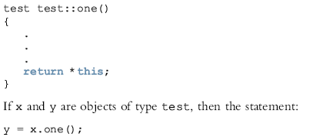

Slide 14
Friend Functions of Classes
A friend function of a class is a nonmember function of the class, but has access to all the members (public or non-public) of the class.
To make a function friend to a class
  The reserved word friend precedes the function prototype in the class definition

Slide 15
Friend Functions of Classes (continued)
The word friend appears only in the function prototype (in the class definition), not in the definition of the friend function
When writing the friend function definition
  The name of the class and the scope resolution operator are not used

Slide 16
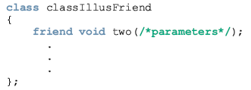
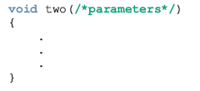

Slide 17
Operator Functions as Member Functions and Nonmember Functions
Most of the operators can be overloaded either as member or nonmember functions
To make an operator function be a member or nonmember function of a class, keep the following in mind:
  1. The function that overloads any of the operators (), [], ->, or = for a class must be declared as a member of the class.

Slide 18
Operator Functions (continued)
  2. Suppose that an operator op is overloaded for a class—say, opOverClass. (Here, op stands for an operator that can be overloaded, such as + or >>.)
    a. If the leftmost operand of op is an object of a different type (that is, not of type opOverClass), the function that overloads the operator op for opOverClass must be a nonmember—that is, a friend of the class opOverClass.
    b. If the operator function that overloads the operator op for the class opOverClass is a member of the class opOverClass, then when applying op on objects of type opOverClass, the leftmost operand of op must be of type opOverClass.

Slide 19
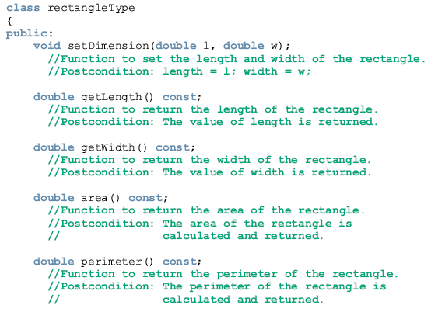

Slide 20
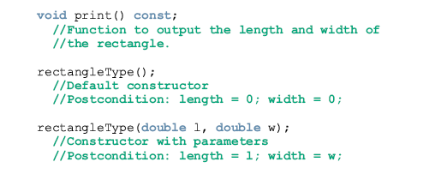


Slide 21
Overloading Binary Operators
Suppose that # represents a binary operator (arithmetic, such as +; or relational, such as ==) that is to be overloaded for the class rectangleType.
This operator can be overloaded as either a member function of the class or as a friend function.

Slide 22

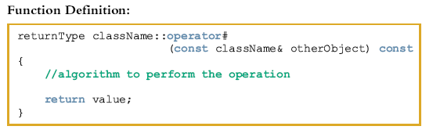

Slide 23
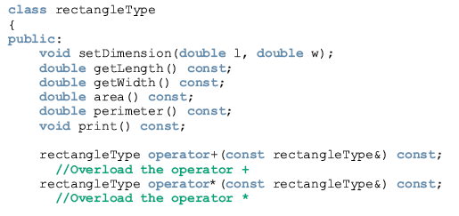
Example 14-4
Let us overload +, *, ==, and != for the class rectangleType. These operators are overloaded as member functions.

Slide 24
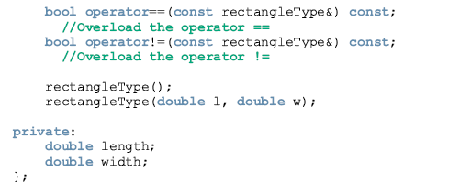

Slide 25
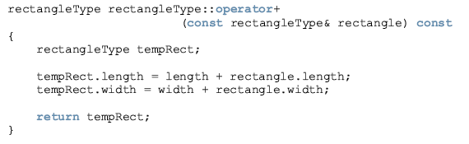
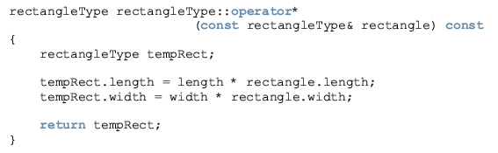

Slide 26
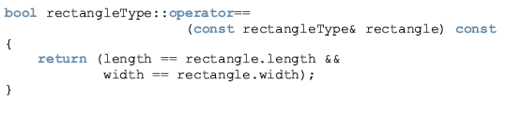
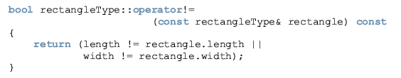

Slide 27
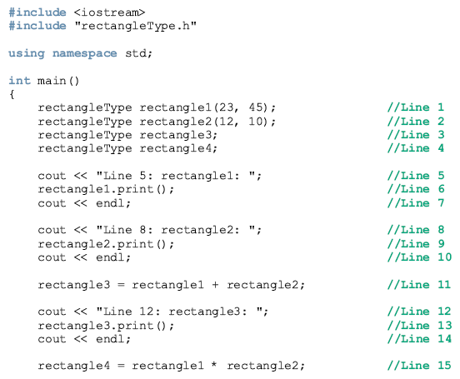

Slide 28
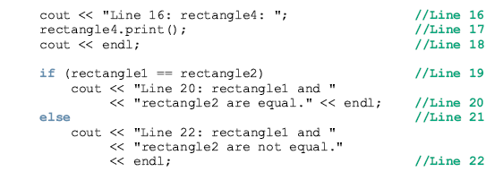
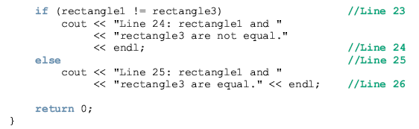

Slide 29
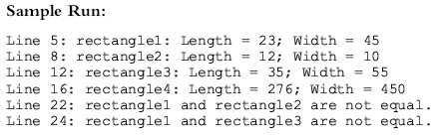

Slide 30

Overloading the Binary Operators (Arithmetic or Relational) as Nonmember Functions

Slide 31
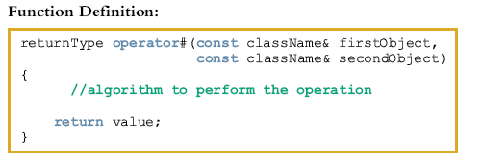
Overloading the Binary Operators (Arithmetic or Relational) as Nonmember Functions (continued)
where # stands for the binary operator to be overloaded, returnType is the type of value returned by the function, and className is the name of the class for which the operator is being overloaded.

Slide 32
Example 14-5
This example illustrates how to overload the operators + and == as nonmember functions of the class rectangleType.
To include the operator function operator+ as a nonmember function of the class rectangleType, its prototype in the definition of rectangleType is:

Slide 33
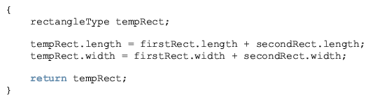
The definition of the function operator+ is as follows:

Slide 34
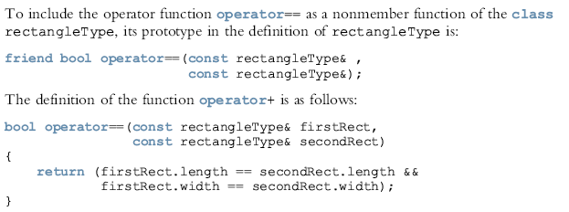

Slide 35

Consider the expression:
cout << myRectangle;
In this expression, the leftmost operand of << (that is, cout) is an ostream object, not an object of type rectangleType. Because the leftmost operand of << is not an object of type rectangleType, the operator function that overloads the insertion operator for rectangleType must be a nonmember function of the class rectangleType.
Similarly, the operator function that overloads the stream extraction operator for rectangleType must be a nonmember function of the class rectangleType.

Slide 36
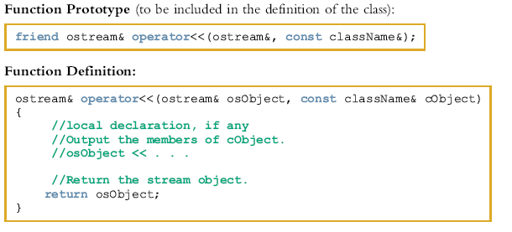

Slide 37
In this function definition:
  Both parameters are reference parameters.
  The first parameter—that is, osObject— is a reference to an ostream object.
  The second parameter is usually a const reference to a particular class, because the most effective way to pass an object as a parameter to a class is by reference. In this case, the formal parameter does not need to copy the member variables of the actual parameter. The word const appears before the class name because we want to print only the member variables of the object. That is, the function should not modify the member variables of the object.
  The function return type is a reference to an ostream object.

Slide 38
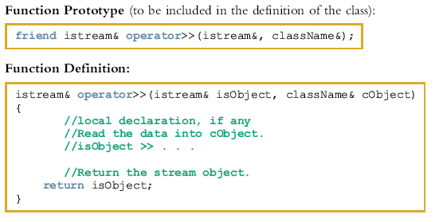

Slide 39
In this function definition:
  Both parameters are reference parameters.
  The first parameter—that is, isObject—is a reference to an istream object.
  The second parameter is usually a reference to a particular class. The data read will be stored in the object.
  The function return type is a reference to an istream object.

Slide 40
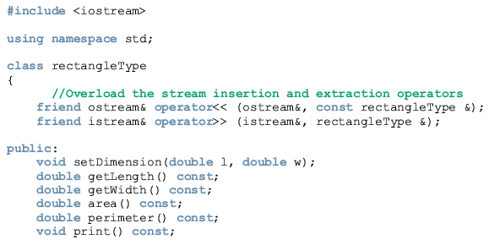
Example 14-6
This example shows how the stream insertion and extraction operators are overloaded for the class rectangleType.

Slide 41
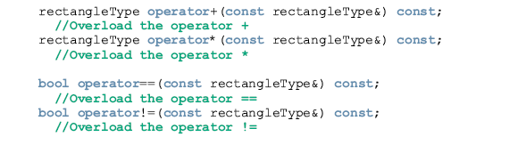
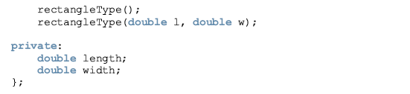

Slide 42
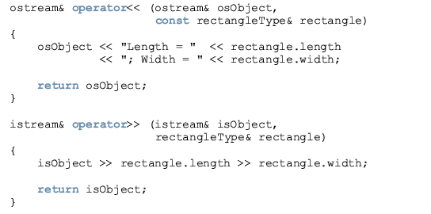

Slide 43
Recall that to overload the assignment operator = for a class, the operator function operator= must be a member of that class.

Slide 44
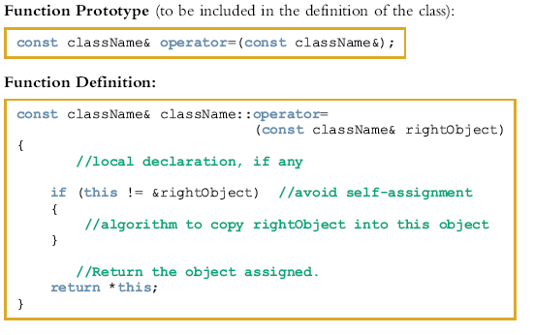

Slide 45
In the definition of the function operator=:
  There is only one formal parameter.
  The formal parameter is usually a const reference to a particular class.
  The function return type is a constant reference to a particular class.

Slide 46

Therefore, to overload a unary operator for a class:
  If the operator function is a member of the class, it has no parameters.
  2. If the operator function is a nonmember—that is, a friend function of the class—it has one parameter.

Slide 47
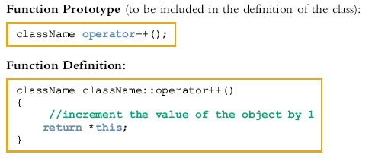

Slide 48
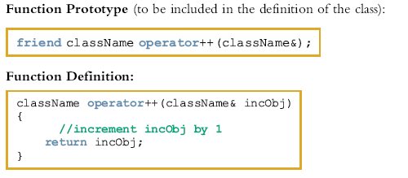
General Syntax to Overload the Pre-Increment Operator ++ as a Nonmember Function

Slide 49
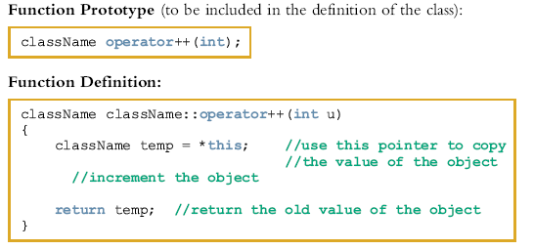
Overloading the Post-Increment Operator as a Member Function

Slide 50
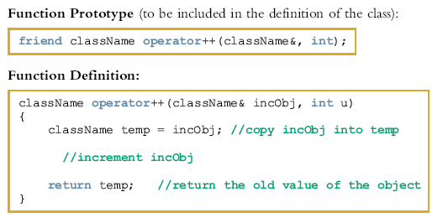
Overloading the Post-Increment Operator as a Nonmember Function

Slide 51
Operator Overloading: Member Versus Nonmember
Certain operators must be overloaded as member functions and some must be overloaded as nonmember (friend) functions
The binary arithmetic operator + can be overloaded either way
Overload + as a member function
  Operator + has direct access to data members of one of the objects
  Need to pass only one object as a parameter

Slide 52
Operator Overloading: Member Versus Nonmember (continued)
Overload + as a nonmember function
  Must pass both objects as parameters
  Could require additional memory and time to make a local copy of the data
For efficiency purposes, overload operators as member functions

Slide 53
Classes and Pointer Data Members
Classes with pointer member variables must:
  Explicitly overload the assignment operator
  Include the copy constructor
  Include the destructor

Slide 54

Overloading the Subscript Operator
The syntax to declare the operator function operator[] as a member of a class for nonconstant arrays is:

Slide 55

Overloading the Subscript Operator (continued)
The syntax to declare the operator function operator[] as a member of a class for constant arrays is:

Slide 56
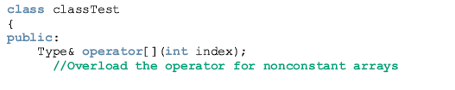
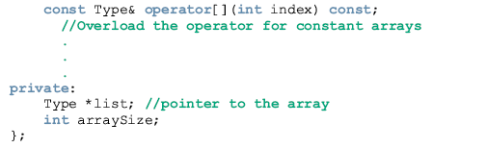

Slide 57
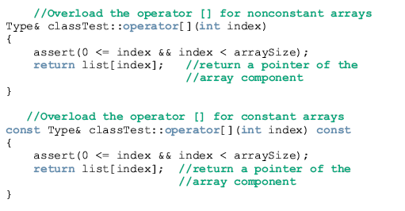

Slide 58
Function Overloading
Overloading a function: several functions with the same name, but different parameters
Parameter types determine which function will execute
Must provide the definition of each function

Slide 59
Templates
Templates: a single code body for a set of related functions (called function template) and related classes (called class template)
The syntax for templates is:
  template <class Type>
  declaration
where Type is the type of the data and declaration is either a function declaration or a class declaration

Slide 60
Templates (continued)
template is a reserved word
The word class in the heading refers to any user-defined type or built-in type
Type is called a formal parameter to the template
Just as variables are parameters to functions
  Data types are parameters to templates

Slide 61
Function Templates
The syntax of the function template is:
  template <class Type>
  function definition
  where Type is called a formal parameter of the template
Type
  Specifies type of parameters to the function
  Specifies return type of the function
  Declares variables within the function

Slide 62
Class Templates
Class templates: a single code segment represents a set of related classes
Syntax:
  template <class Type>
  class declaration
Called parameterized types
  A specific class is made based on the parameter type

Slide 63
Class Templates (continued)
A template instantiation can be created with either a built-in or user-defined type
The function members of a class template are considered function templates

Slide 64
Header File of a Class Template
Passing parameters to a function takes effect at run time
Passing a parameter to a class template takes effect at compile time

Slide 65
Header File of a Class Template (continued)
Cannot compile the implementation file independently of the client code
  Can put class definition and the definitions of the function templates directly in the client code
  Can put class definition and the definitions of the function templates in the same header file

Slide 66
Header File of a Class Template (continued)
Another alternative: put class definition and function definitions in separate files
  However, include directive to implementation file at the end of header file
In either case, function definitions and client code are compiled together
We will put the class definition and the function definitions in the same header file

Slide 67

In Chapter 13, we designed the classes arrayListType, unorderedArrayListType, and orderedArrayListType to process lists in an array.
However, these classes process only those lists whose elements are of type int.
We redesign these classes so that they can be used to process any type of list.

Slide 68
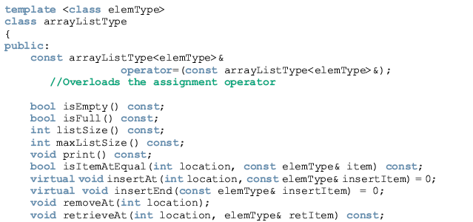

Slide 69
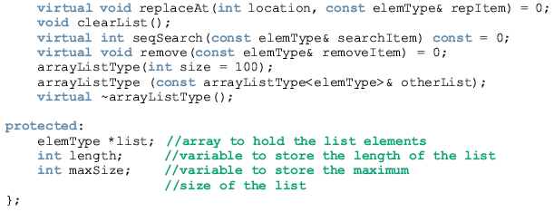

Slide 70
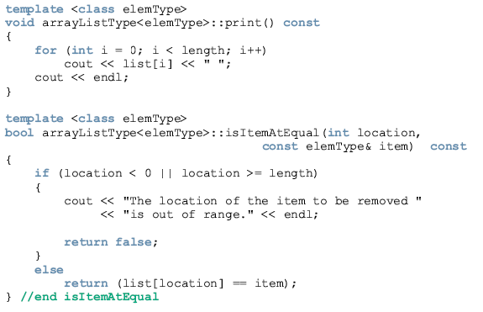

Slide 71
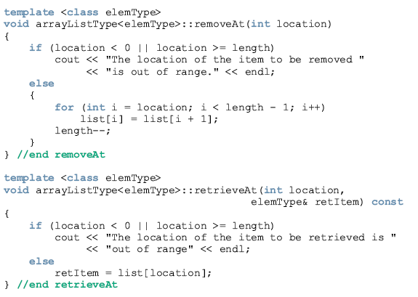

Slide 72
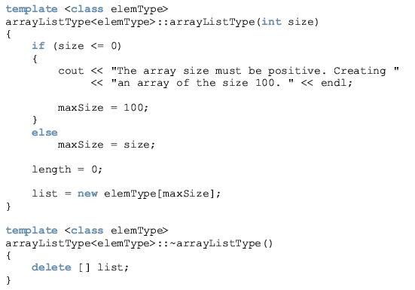

Slide 73
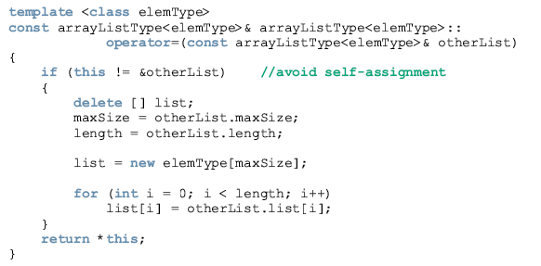

Slide 74
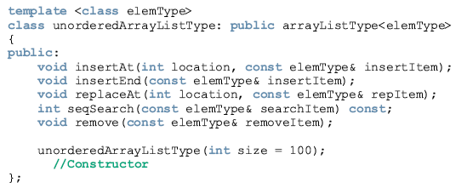

Slide 75
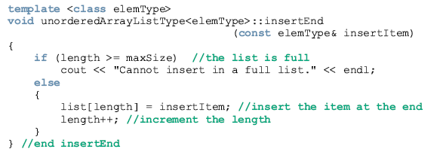

Slide 76
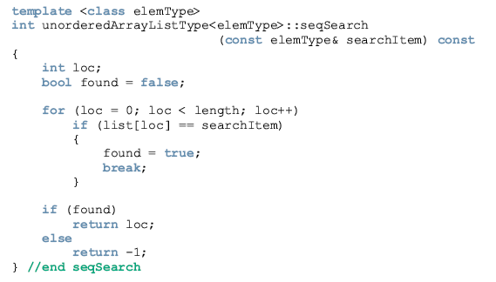

Slide 77
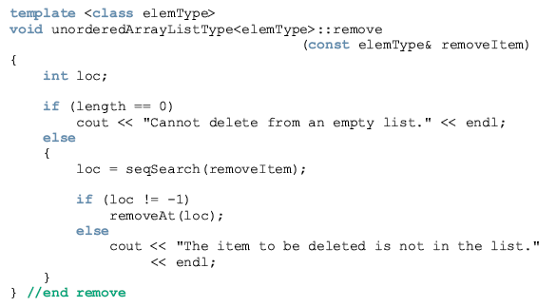

Slide 78
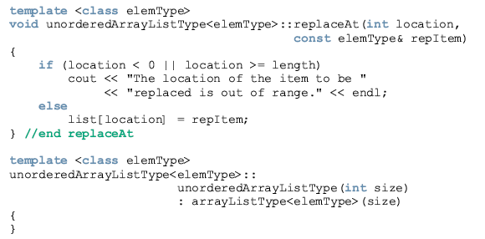

Slide 79
Summary
An operator that has different meanings with different data types is said to be overloaded
Any function that overloads an operator is called an operator function
operator is a reserved word
Operator functions are value-returning
Operator overloading provides the same concise notation for user-defined data types as for built-in data types

Slide 80
Summary (continued)
Only existing operators can be overloaded
The pointer this refers to the object
A friend function is a nonmember of a class
If an operator function is a member of a class
  The leftmost operand of the operator must be a class object (or a reference to a class object) of that operator’s class

Slide 81
Summary (continued)
Every instance of an overloaded function has different sets of parameters
Templates:
  Function template: a single code segment for a set of related functions
  Class template: a single code segment for a set of related classes
Class templates are called parameterized types

