Slide 1
C++ Programming:
Program Design Including
Data Structures, Fourth Edition
Chapter 13: Pointers, Classes, Virtual Functions, and Abstract Classes

Slide 2
Objectives
In this chapter, you will:
Learn about the pointer data type and pointer variables
Explore how to declare and manipulate pointer variables
Learn about the address of operator and the dereference operator [ & * ]
Discover dynamic variables (created at run-time)
C++ Programming: Program Design Including Data Structures, Fourth Edition

Slide 3
Objectives (continued)
Explore how to use the new and delete operators to manipulate dynamic variables
Learn about pointer arithmetic
Discover dynamic arrays
Become aware of the shallow and deep copies of data
Discover the peculiarities of classes with pointer member variables
C++ Programming: Program Design Including Data Structures, Fourth Edition

Slide 4
Objectives (continued)
Learn about virtual functions
Learn about pure virtual functions
Examine the relationship between the address of operator and classes
Become aware of abstract classes
C++ Programming: Program Design Including Data Structures, Fourth Edition

Slide 5
Pointer Data Type and Pointer Variables
Pointer variable:
  content is a memory address
There is no name associated with the pointer data type in C++
  declared using <type> *
C++ Programming: Program Design Including Data Structures, Fourth Edition

Slide 6
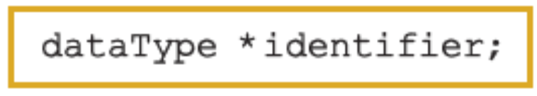
Declaring Pointer Variables
Syntax:
Examples:
  int *p;
  char *ch;
These statements are equivalent:
  int *p;
  int* p;
  int * p;
C++ Programming: Program Design Including Data Structures, Fourth Edition

Slide 7
Declaring Pointer Variables (continued)
In the statement: int* p, q;
  only p is the pointer variable, not q; here q is an int variable
To avoid confusion, attach the character * to the variable name:
int *p, q;
int *p,*q;
C++ Programming: Program Design Including Data Structures, Fourth Edition

Slide 8
Address of Operator (&)
The ampersand, &, is called the address of operator
The address of operator is a unary operator that returns the address of its operand
C++ Programming: Program Design Including Data Structures, Fourth Edition

Slide 9
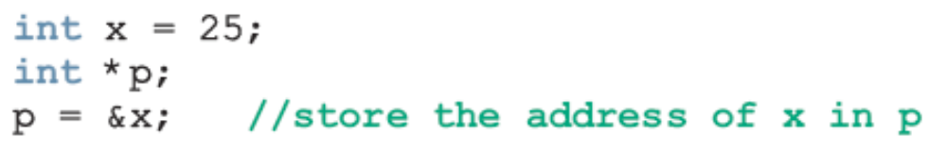


Dereferencing Operator (*)
When used as a unary operator, * is the dereferencing operator or indirection operator
  Refers to object to which its operand points
Example:
  To print the value of x, using p:
  To store a value in x, using p:
C++ Programming: Program Design Including Data Structures, Fourth Edition

Slide 10
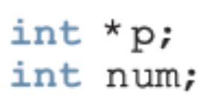
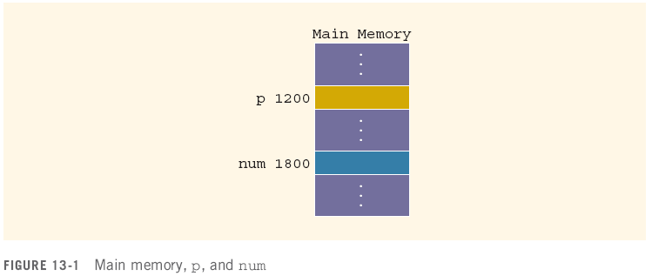

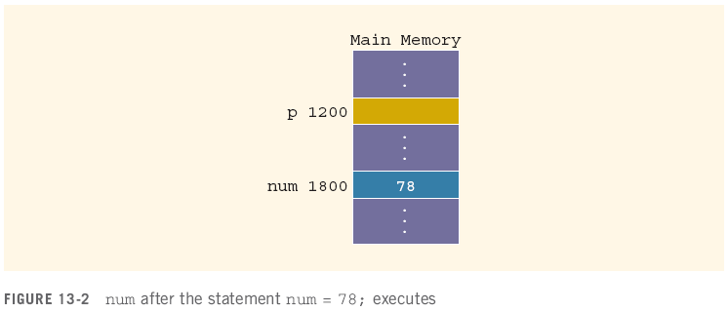

Slide 11

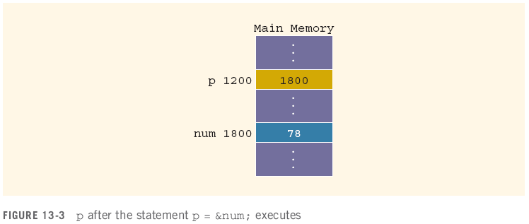

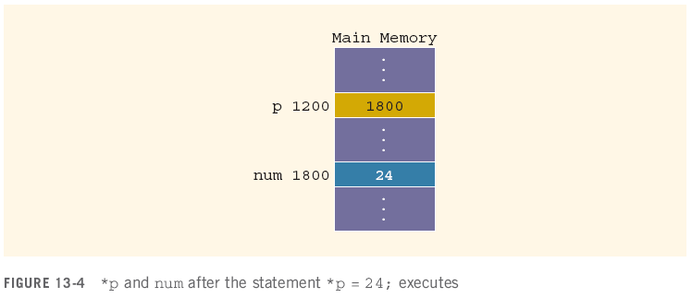

Slide 12
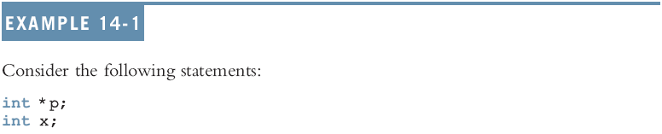

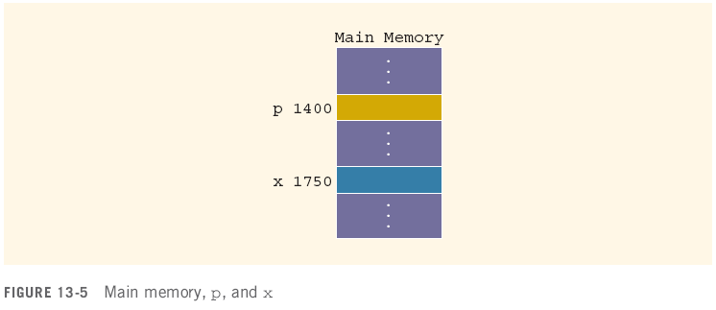
Allocates memory for p only, not for *p

Slide 13
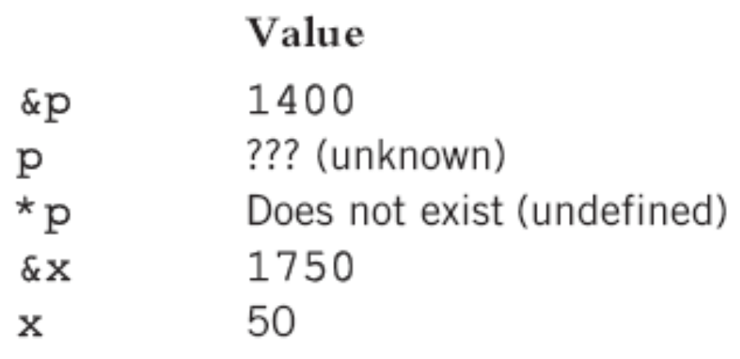
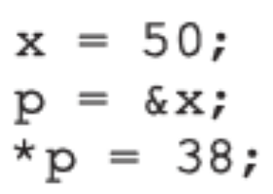
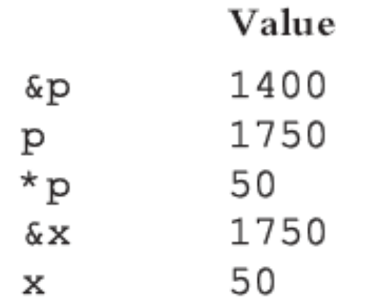
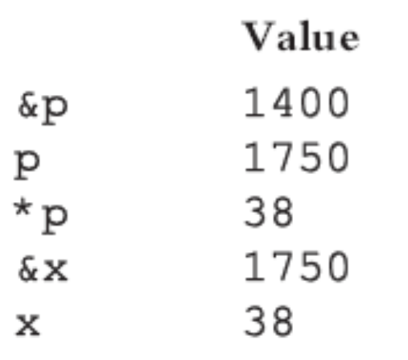
Given these declarations:
int x;
int *p;

Slide 14
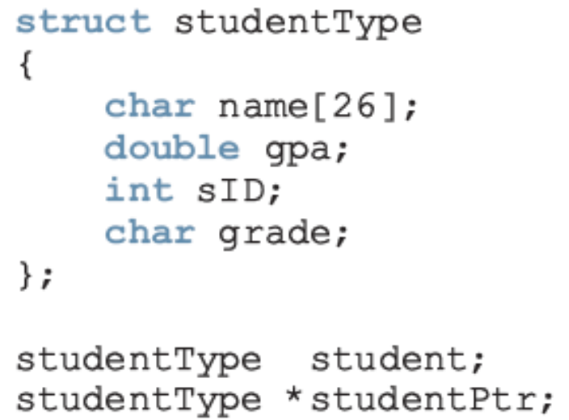
Classes, Structs, and Pointer Variables
You can declare pointers to other data types:
  student is an object of type studentType;
  studentPtr is a pointer variable of type studentType
C++ Programming: Program Design Including Data Structures, Fourth Edition

Slide 15
Classes, Structs, and Pointer Variables (continued)
To store address of student in studentPtr:
  studentPtr = &student;
To store 3.9 in component gpa of student:
  (*studentPtr).gpa = 3.9;
  ( ) used because dot operator has higher
  precedence than dereferencing operator
  Alternative: use member access operator arrow (->) studentPtr -> gpa = 3.9;
C++ Programming: Program Design Including Data Structures, Fourth Edition

Slide 16

Classes, Structs, and Pointer Variables (continued)
The syntax for accessing a class (struct) member using the operator -> is:
Thus,
  (*studentPtr).gpa = 3.9;
  is equivalent to:
  studentPtr->gpa = 3.9;
C++ Programming: Program Design Including Data Structures, Fourth Edition

Slide 17
Initializing Pointer Variables
C++ does not initialize variables of the automatic storage class ( usually local variables ).
Pointer variables must be initialized if you do not want them to contain garbage, you should initialize the variable to NULL or 0.
  Initialized using the constant value 0
    Called the null pointer
    Example: p = 0;
  Or, use NULL named constant: p = NULL;
  The number 0 is the only number that can be directly assigned to a pointer variable
C++ Programming: Program Design Including Data Structures, Fourth Edition

Slide 18
Dynamic Variables
Dynamic variables:
  created during execution
C++ creates dynamic variables using pointers
Operators, new and delete, to create and destroy dynamic variables
  new and delete are reserved words
C++ Programming: Program Design Including Data Structures, Fourth Edition

Slide 19
Operator new
new has two forms:
  where intExp is any expression evaluating to a positive integer
new allocates memory (a variable) of the designated type and returns a pointer to it
  The address of the allocated memory
The allocated memory is uninitialized
C++ Programming: Program Design Including Data Structures, Fourth Edition

Slide 20
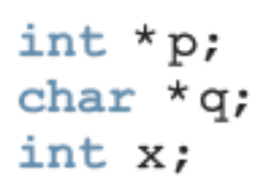
Operator new (continued)
The statement: p = &x;
  Stores address of x in p
    However, no new memory is allocated
The statement: p = new int;
  Creates a variable during program execution somewhere in memory, and stores the address of the allocated memory in p
    To access allocated memory: *p
C++ Programming: Program Design Including Data Structures, Fourth Edition

Slide 21
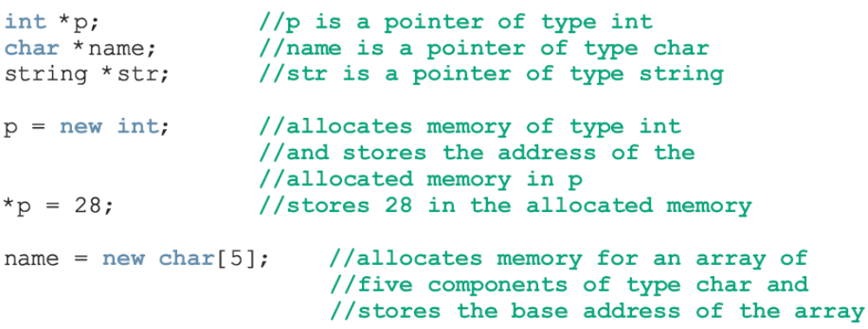
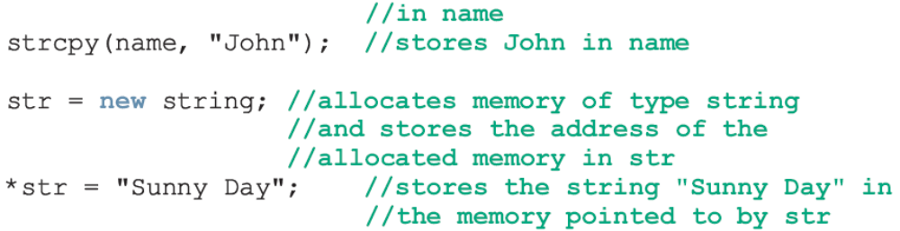

Slide 22
Operator new (continued)
new allocates memory space of a specific type and returns the (starting) address of the allocated memory space
If new is unable to allocate the required memory space, then it throws a bad_alloc exception
  If this exception is not handled, it terminates the program with an error message
C++ Programming: Program Design Including Data Structures, Fourth Edition

Slide 23
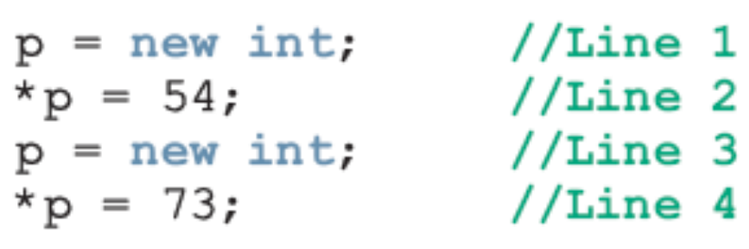
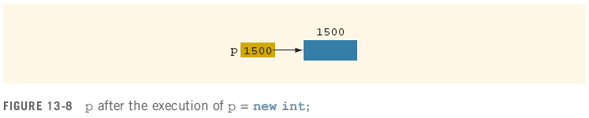

Operator delete
C++ Programming: Program Design Including Data Structures, Fourth Edition

Slide 24
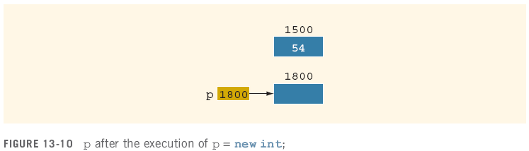
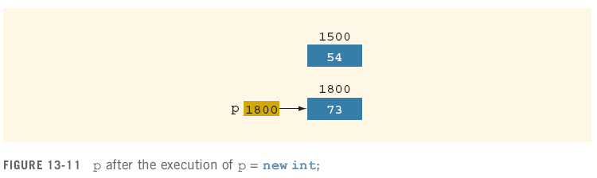
Operator delete (continued)
Memory leak
C++ Programming: Program Design Including Data Structures, Fourth Edition

Slide 25
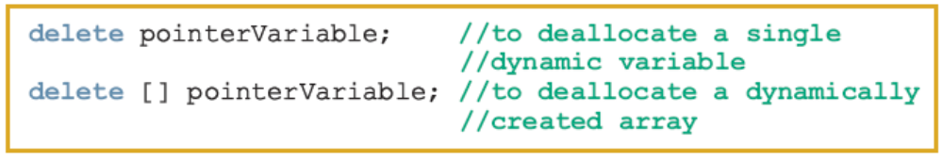
Operator delete (continued)
To avoid memory leak, when a dynamic variable is no longer needed, destroy it
  Deallocate its memory
delete is used to destroy dynamic variables
Syntax:
  Tip: to avoid dangling pointers, set variable to NULL afterwards
C++ Programming: Program Design Including Data Structures, Fourth Edition

Slide 26
Operations on Pointer Variables
Assignment
  value of one pointer variable can be assigned to another pointer of same type
Relational operations
  two pointer variables of same type can be compared for equality, etc.
Some limited arithmetic operations:
  Integer values can be added and subtracted from a pointer variable
  Value of one pointer variable can be subtracted from another pointer variable
C++ Programming: Program Design Including Data Structures, Fourth Edition

Slide 27
Operations on Pointer Variables (continued)
Examples:
  int *p, *q;
  p = q;
  In this case, p == q will evaluate to true, and p != q will evaluate to false
  int *p
  double *q;
  In this case, q++; increments value of q by 8, and p = p + 2; increments value of p by 8
C++ Programming: Program Design Including Data Structures, Fourth Edition

Slide 28
Operations on Pointer Variables (continued)
Pointer arithmetic can be very dangerous
  The program can accidentally access the memory locations of other variables and change their content without warning
    Some systems might terminate the program with an appropriate error message
Always exercise extra care when doing pointer arithmetic
C++ Programming: Program Design Including Data Structures, Fourth Edition

Slide 29
Dynamic Arrays
Dynamic array
  array created during the execution of a program
Example:
  int *p;
  p = new int[10];
  *p = 25;
  p++; //to point to next array component
  *p = 35;
stores 25 into the first memory location
stores 35 into the second memory location
C++ Programming: Program Design Including Data Structures, Fourth Edition

Slide 30
Dynamic Arrays (continued)
C++ allows us to use array notation to access these memory locations
The statements:
p[0] = 25;
p[1] = 35;
stores 25 and 35 into the first and second array components, respectively
C++ Programming: Program Design Including Data Structures, Fourth Edition

Slide 31

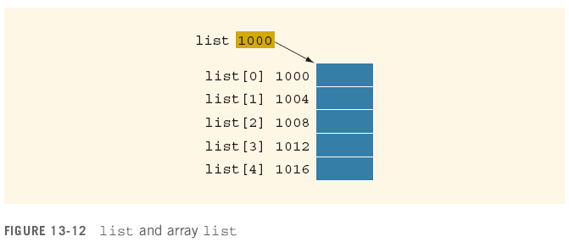

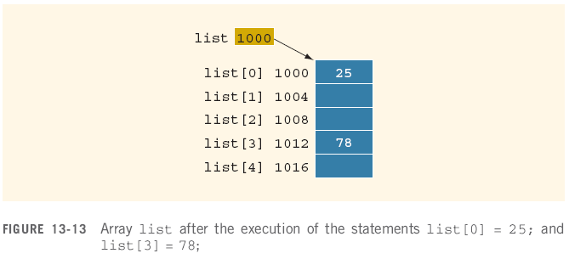

Slide 32
Dynamic Arrays (continued)
The value of list (the address 1000) is constant
  Cannot be altered during program execution
  The increment and decrement operations cannot be applied to list
If p is a pointer variable of type int, then:
p = list;
copies the value of list, the base address of the array, into p
  We can perform ++ and -- operations on p
An array name is a constant pointer
C++ Programming: Program Design Including Data Structures, Fourth Edition

Slide 33
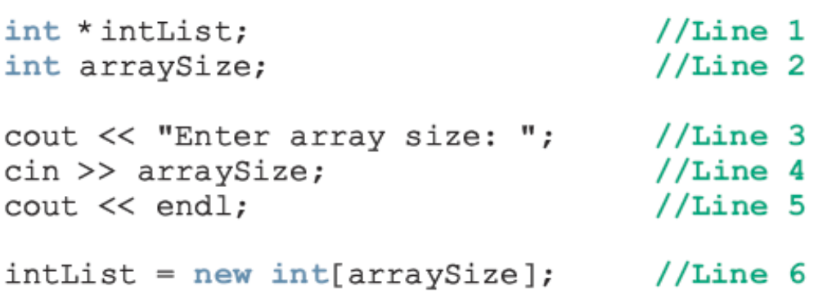
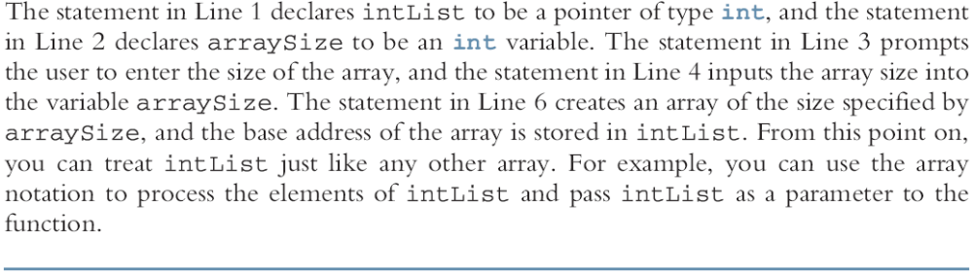

Slide 34
Functions and Pointers
A pointer variable can be passed as a parameter either by value or by reference
To make a pointer a reference parameter in a function heading, use &:
void example(int* &p, double *q)
{
. . .
}
You might want to do this if you needed to change the POINTER variable ( not just the data it points to ).
C++ Programming: Program Design Including Data Structures, Fourth Edition

Slide 35
Pointers and Function Return Values
A function can return a value of type pointer:
int* testExp(...)
{
. . .
}
C++ Programming: Program Design Including Data Structures, Fourth Edition

Slide 36

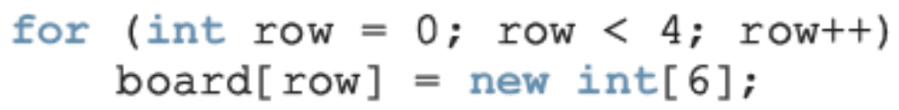

Dynamic Two-Dimensional Arrays
You can create dynamic multidimensional arrays
Examples:
declares board to be an array of four pointers wherein each pointer is of type int
creates the rows of board
declares board to be a pointer to a pointer
C++ Programming: Program Design Including Data Structures, Fourth Edition

Slide 37
Pointers - Addendum
creating a void pointer
  You can create a void pointer in C++. A void pointer may be assigned the value of ANY pointer variable (regardless of type)
  void * ptr; //void pointer
Casting a void pointer
  A void pointer is only useful for temporarily storing other pointers. To be able to use a pointer which has been assigned to a void pointer, you must cast it back to the correct type of pointer and assign it to a pointer variable.
  void * ptr; double x = 23, *xPtr = &x;
  ptr = xPtr; //store double pointer in a void pointer variable
  xPtr = (double *) ptr; //cast as pointer to double and store in xPtr
C++ Programming: Program Design Including Data Structures, Fourth Edition

Slide 38
Pointers – Addendum (continued)
creating a pointer to a function
  Another use of a pointer is to point to a function. The name of a function used alone returns the address of the function in memory (similar to an array name, it is a constant pointer)
  double square ( double ); //prototype for a function
  //below, s is a pointer to a function that has a parameter of type double and
  //which returns a value of type double
  double (*s)(double); //(*s) declares s as a pointer to a function
  s=square; //assign s the address of function square
  cout << "The square of 5 is " << (*s)(5) << endl;
  cout << "address of function square is " << square << endl;
  cout << "value of function pointer s is " << s << endl;
C++ Programming: Program Design Including Data Structures, Fourth Edition

Slide 39

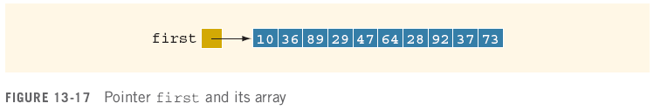
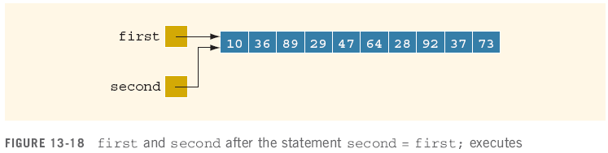
Shallow versus Deep Copy and Pointers
Assume some data is stored in the array:
If we execute:
C++ Programming: Program Design Including Data Structures, Fourth Edition

Slide 40

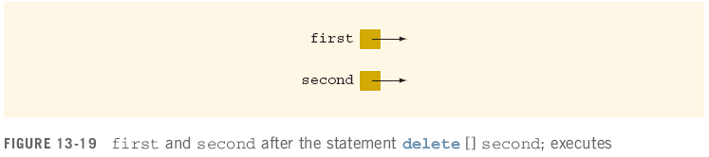
Shallow versus Deep Copy and Pointers (continued)
Shallow copy
  two or more pointers of the same type point to the same memory
  They point to the same data
C++ Programming: Program Design Including Data Structures, Fourth Edition

Slide 41
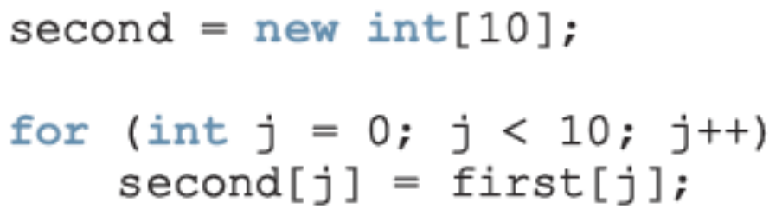
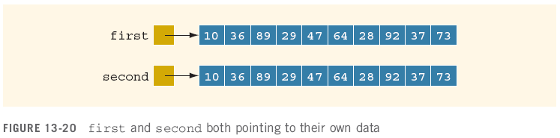
Shallow versus Deep Copy and Pointers (continued)
Deep copy
  two or more pointers have their own data
C++ Programming: Program Design Including Data Structures, Fourth Edition

Slide 42
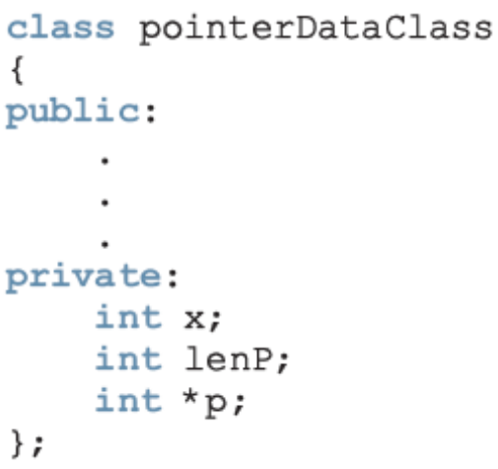

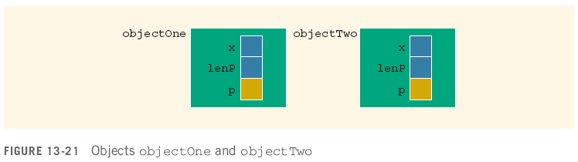
Classes and Pointers: Some Peculiarities
C++ Programming: Program Design Including Data Structures, Fourth Edition

Slide 43
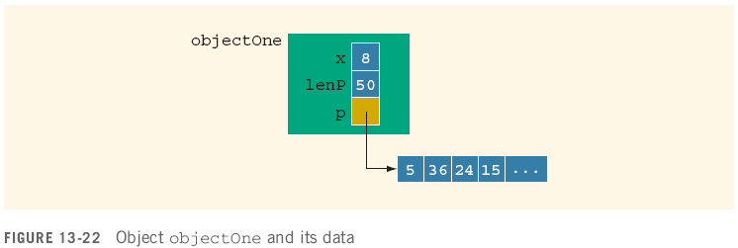
Destructor
If objectOne goes out of scope, the member variables of objectOne are destroyed
  The memory space of the dynamic array would stay marked as allocated, even though it cannot be accessed
C++ Programming: Program Design Including Data Structures, Fourth Edition

Slide 44
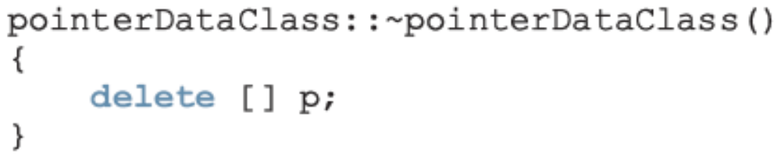
Destructor (continued)
Solution:
  Put the necessary code in the destructor to ensure that when objectOne goes out of scope, the memory of the array is deallocated
C++ Programming: Program Design Including Data Structures, Fourth Edition

Slide 45
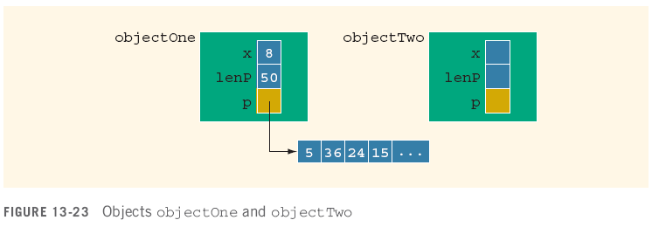

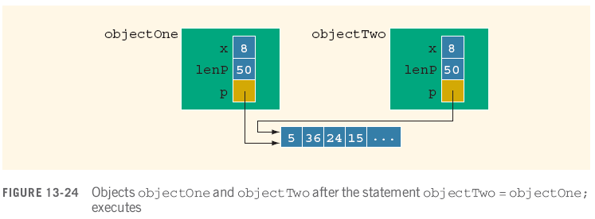
Assignment Operator
C++ Programming: Program Design Including Data Structures, Fourth Edition

Slide 46
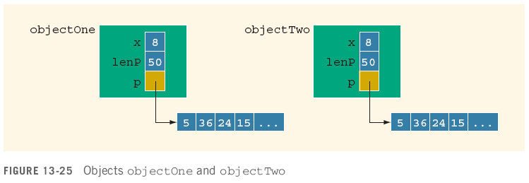
Assignment Operator (continued)
If objectTwo.p deallocates memory space to which it points, objectOne.p becomes invalid
Solution: extend definition of the assignment operator to avoid shallow copying of data
C++ Programming: Program Design Including Data Structures, Fourth Edition

Slide 47
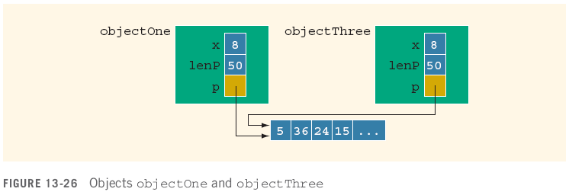
Copy Constructor
This initialization is called the default member-wise initialization
  Initialization due to the constructor, called the copy constructor (provided by the compiler)
C++ Programming: Program Design Including Data Structures, Fourth Edition

Slide 48
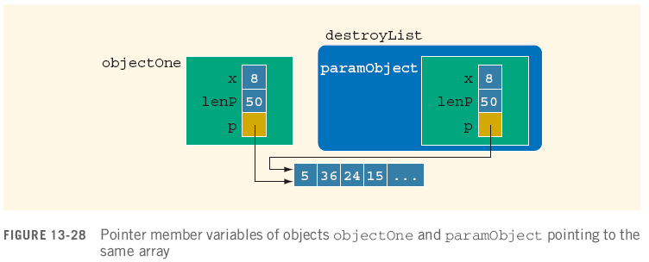
Copy Constructor (continued)
Default initialization leads to shallow copying of data
Similar problem occurs when passing objects by value:
C++ Programming: Program Design Including Data Structures, Fourth Edition

Slide 49
Copy Constructor (continued)
Copy constructor automatically executes in three situations:
  When an object is declared and initialized by using the value of another object
  When, as a parameter, an object is passed by value
  When the return value of a function is an object
C++ Programming: Program Design Including Data Structures, Fourth Edition

Slide 50
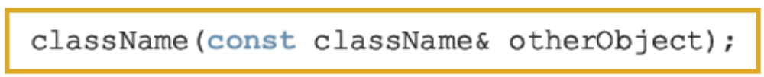
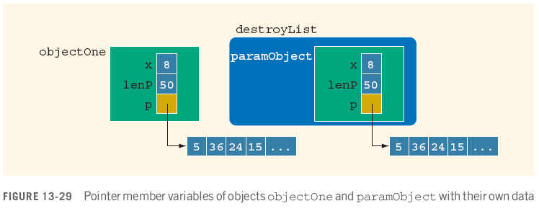
Copy Constructor Definition
Solution: properly define copy constructor
C++ Programming: Program Design Including Data Structures, Fourth Edition

Slide 51
Copy Constructor (continued)
For classes with pointer member variables, three things are normally done:
  Include the destructor in the class definition
  Overload the assignment operator for the class
  Include the copy constructor
C++ Programming: Program Design Including Data Structures, Fourth Edition

Slide 52
Continuation of topics in Chapter 13
Here is where we left off when we initially went through chapter 13 to look at pointers and dynamic variables.
Following topics get into object-oriented design
C++ Programming: Program Design Including Data Structures, Fourth Edition

Slide 53
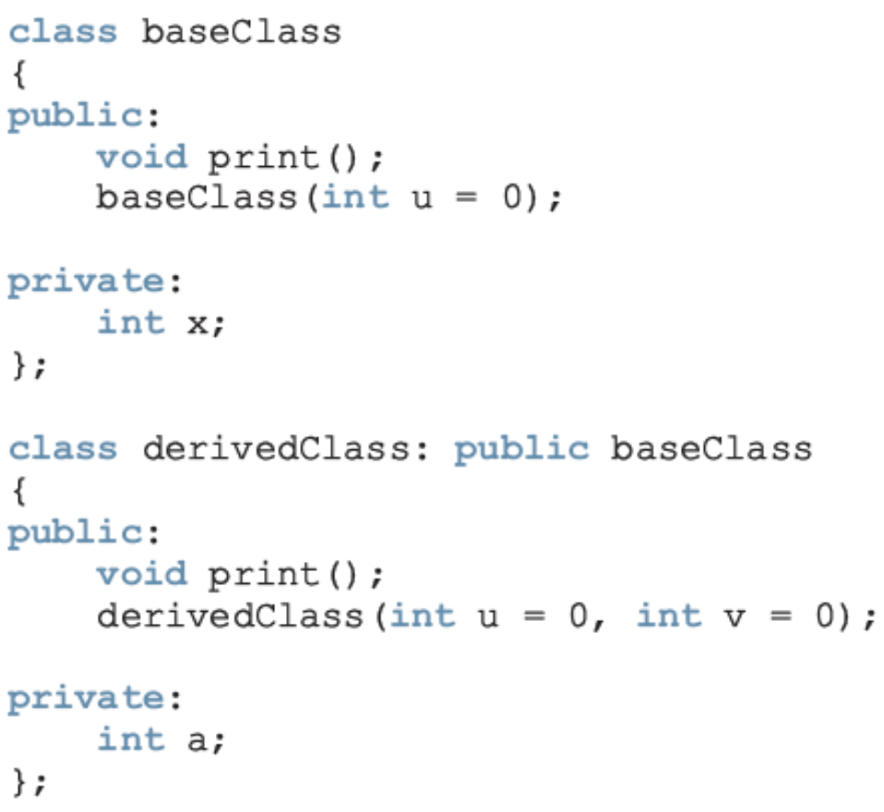
Inheritance, Pointers, and Virtual Functions
You can pass an object of a derived class to a formal parameter of the base class type
C++ Programming: Program Design Including Data Structures, Fourth Edition

Slide 54
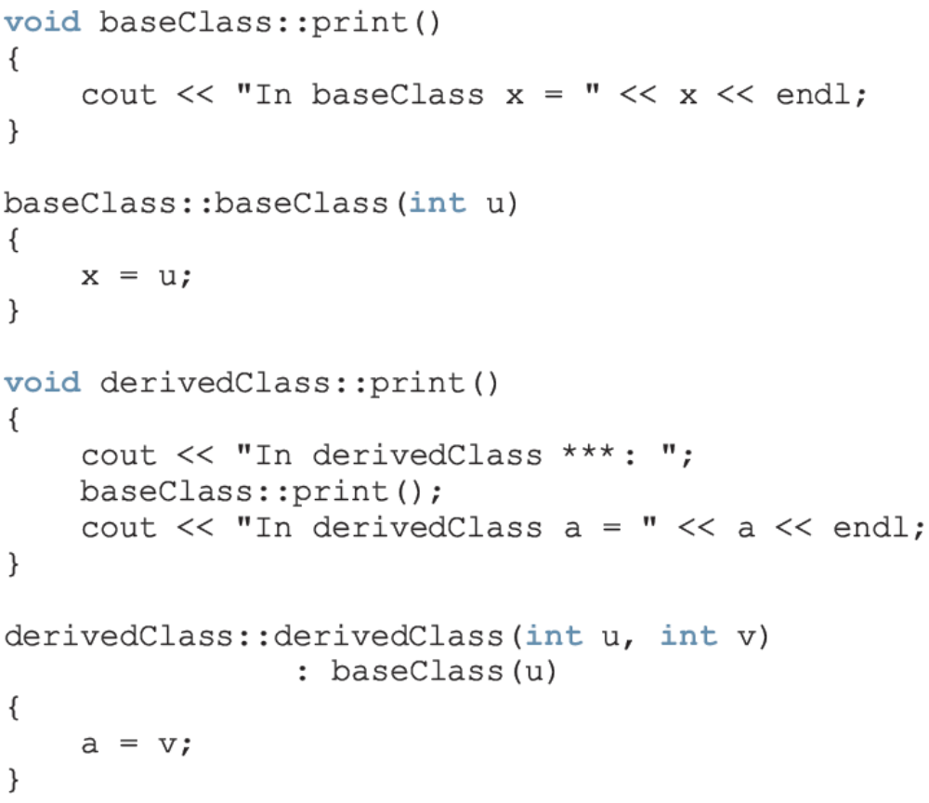

Slide 55
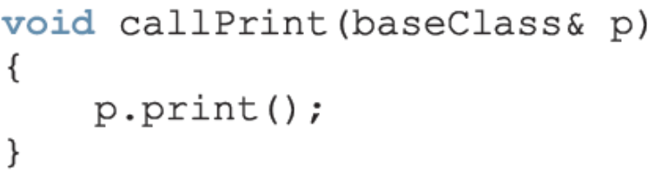
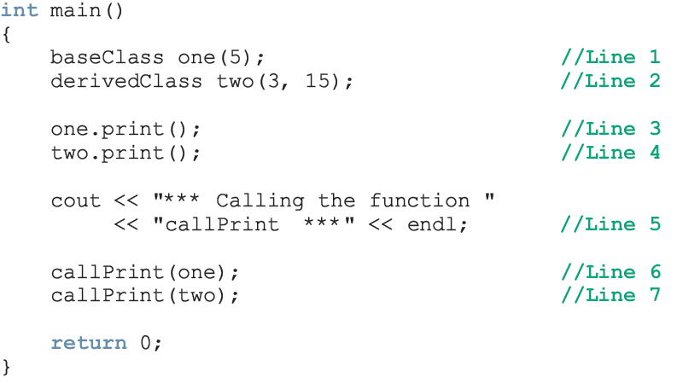
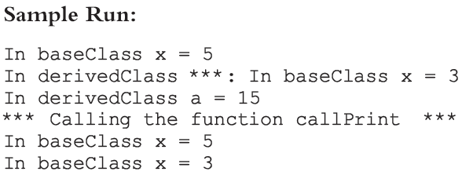

Slide 56
Inheritance, Pointers, and Virtual Functions (continued)
For both statements (Lines 6 and 7), member function print of baseClass was executed
  Because the binding of print, in the body of callPrint, occurred at compile time
Compile-time binding
  the necessary code to call a specific function is generated by the compiler
  Also known as static binding
C++ Programming: Program Design Including Data Structures, Fourth Edition

Slide 57
Inheritance, Pointers, and Virtual Functions (continued)
How can we avoid this problem?
  Virtual functions (reserved word virtual)
Virtual function
binding occurs at program execution time, not at compile time
  This kind of binding is called run-time binding
Run-time binding
  compiler does not generate code to call a specific function; it generates information to enable run-time system to generate specific code for the function call
  Also known as dynamic binding
C++ Programming: Program Design Including Data Structures, Fourth Edition

Slide 58
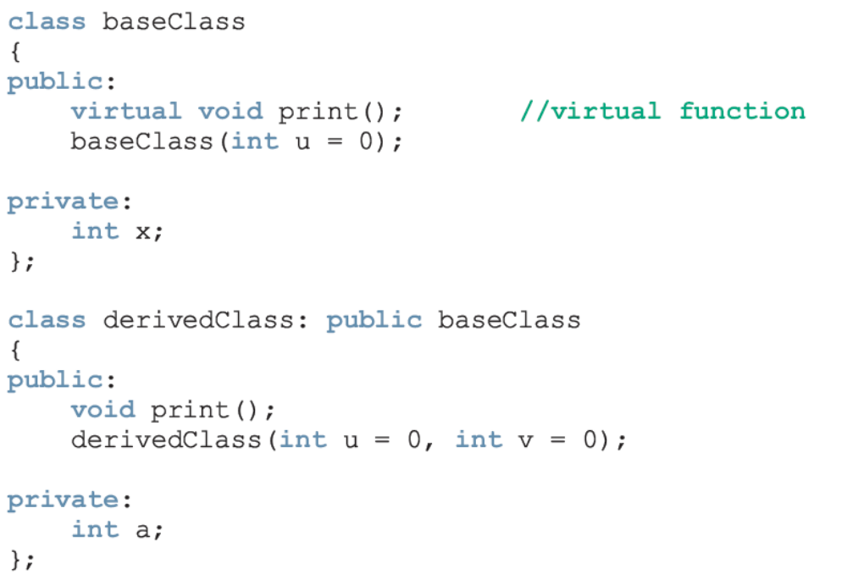
Inheritance, Pointers, and Virtual Functions (continued)
The keyword virtual only needs to be declared in the base class.
C++ Programming: Program Design Including Data Structures, Fourth Edition

Slide 59
Classes and Virtual Destructors
Classes with pointer member variables should have a destructor
  Destructor can be designed to deallocate storage for dynamic objects
If a derived class object is passed to a formal parameter of the base class type, destructor of the base class executes
  Regardless of whether object is passed by reference or by value
Solution: use a virtual destructor (base class)
C++ Programming: Program Design Including Data Structures, Fourth Edition

Slide 60
Classes and Virtual Destructors (continued)
The virtual destructor of a base class automatically makes the destructor of a derived class virtual
  After executing the destructor of the derived class, the destructor of the base class executes
If a base class contains virtual functions, make the destructor of the base class virtual
C++ Programming: Program Design Including Data Structures, Fourth Edition

Slide 61
Abstract Classes and Pure Virtual Functions
Through inheritance we can derive new classes without designing them from scratch
  Derived classes inherit existing members of the base class
  can add their own members
  can redefine or override public and protected member functions
Base class can contain functions that you would want each derived class to implement
    Base class may contain functions that may not have meaningful definitions in the base class
C++ Programming: Program Design Including Data Structures, Fourth Edition

Slide 62
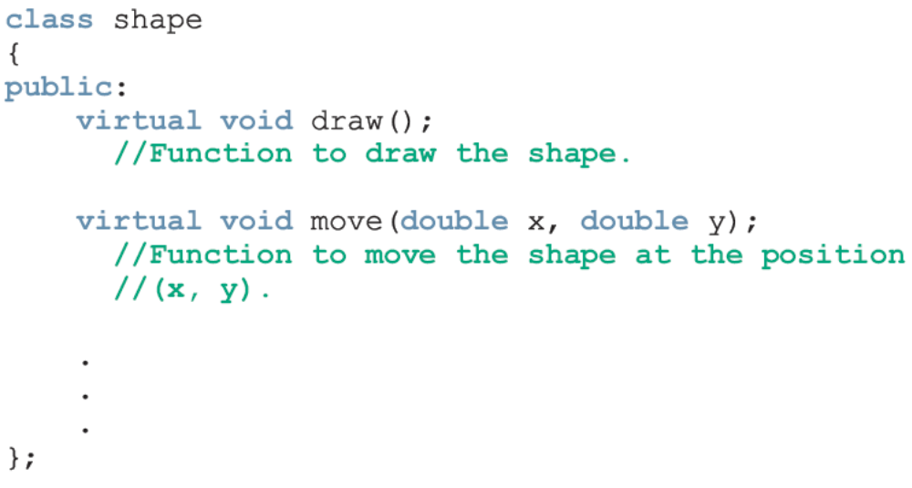

Abstract Classes and Pure Virtual Functions (continued)
To make them pure virtual functions:
C++ Programming: Program Design Including Data Structures, Fourth Edition

Slide 63


Abstract Classes and Pure Virtual Functions (continued)
Abstract class
  contains one or more pure virtual functions
You cannot create objects of an abstract class
C++ Programming: Program Design Including Data Structures, Fourth Edition

Slide 64
Abstract Classes and Pure Virtual Functions (continued)
If we derive rectangle from shape and want to make it a non-abstract class:
  We must provide the definitions of the pure virtual functions of its base class
Note that an abstract class can contain instance variables, constructors, and functions that are not pure virtual
  The class must provide the definitions of constructor/functions that are not pure virtual
C++ Programming: Program Design Including Data Structures, Fourth Edition

Slide 65
Address of Operator and Classes
& operator can create aliases to an object
Consider the following statements:
int x;
int &y = x; //declare an alias for x
x and y refer to the same memory location
y is like a constant pointer variable
y = 25; sets the value of y (and of x) to 25
x = 2 * x + 30; updates the value of x and hence of y
C++ Programming: Program Design Including Data Structures, Fourth Edition

Slide 66
Address of Operator and Classes (continued)
The address of operator can also be used to return the address of a private member variable of a class
  However, if you are not careful:
  this operation can result in serious errors in the program
C++ Programming: Program Design Including Data Structures, Fourth Edition

Slide 67
Summary
Pointer variables contain the addresses of other variables as their values
Declare a pointer variable with an asterisk, *, between the data type and the variable
& is called the address of operator
  Returns the address of its operand
Unary operator * is the dereferencing operator
Member access operator, ->, accesses the object component pointed to by a pointer
C++ Programming: Program Design Including Data Structures, Fourth Edition

Slide 68
Summary (continued)
Dynamic variable
  created during execution
  created using new, deallocated using delete
Shallow copy
  two or more pointers of the same type point to the same memory
Deep copy
  two or more pointers of the same type have their own copies of the data
Can pass an object of a derived class to a formal parameter of the base class type
Binding of virtual functions occurs at execution time (dynamic or run-time binding)
C++ Programming: Program Design Including Data Structures, Fourth Edition

