Slide 1


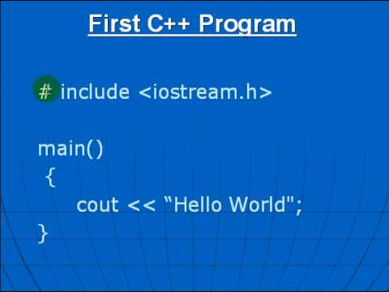
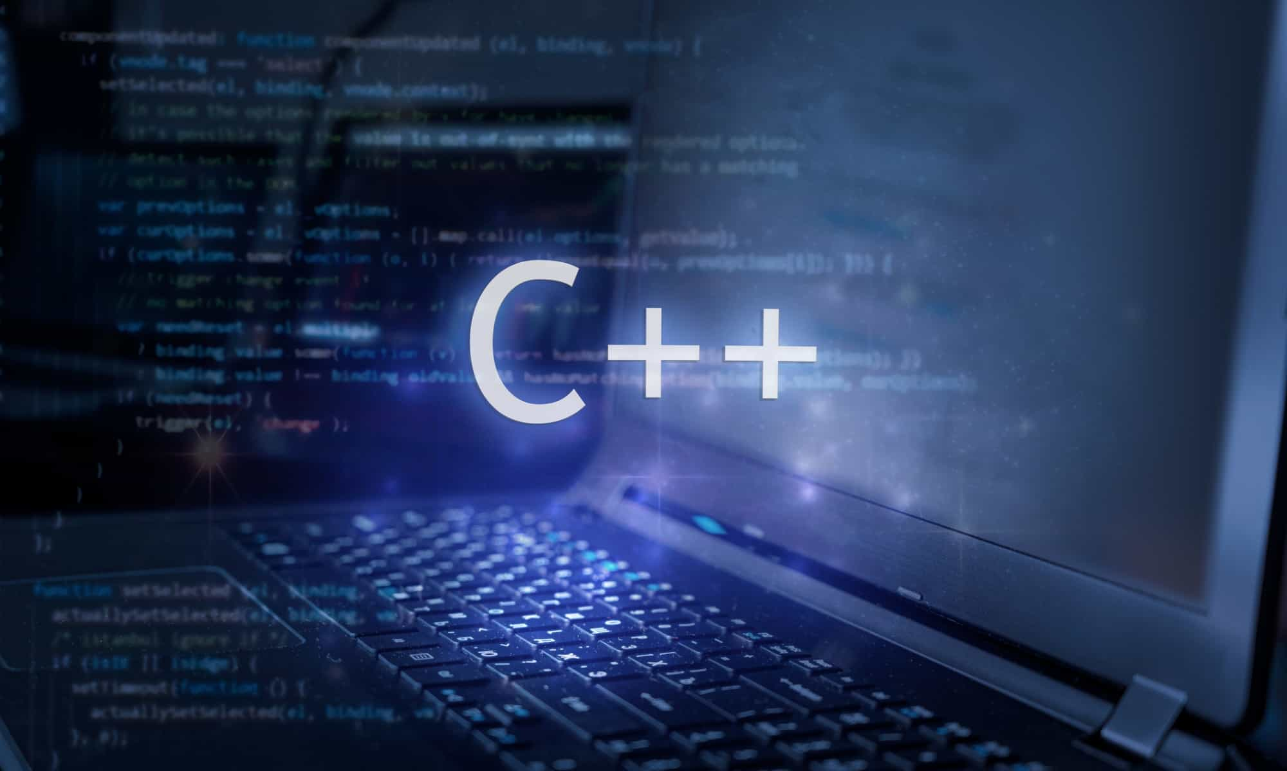
Al-Azhar University
Faculty of Engineering
Systems and Computer Engineering Dept.
Intelligent Systems Engineering Program
ENG 151
Computer Programming I
Prof. Ahmed Youssef

Slide 2
Al-Azhar University
Faculty of Engineering
Systems and Computer Engineering Dept.
Intelligent Systems Engineering Program
ENG 151
Computer Programming I
Function - Recursion

Slide 3
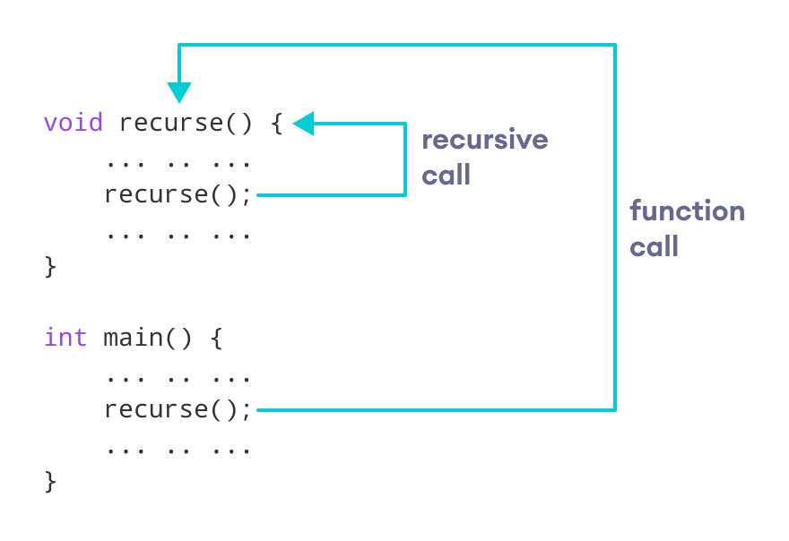
Recursion in C++
A recursive function in C++ is a function that calls itself to solve a problem. Recursion is often used for problems that can be broken down into smaller subproblems of the same type.

Slide 4
Constructing Recursion
    Recursive step
    Base step
General Algorithm
    if (stopping condition) then
  solve simple problem (base)
else
  use recursion to solve smaller problem
  combine solutions from smaller problem

Slide 5
Recursion vs Iteration
Both recursion and iteration are techniques used to repeat a process, but they differ in implementation, efficiency, and usage.
Feature | Recursion | Iteration
Definition | A function calls itself to solve smaller subproblems. | Uses loops (for, while, do-while) to repeat a process.
Termination | Stops when a base case is met. | Stops when a loop condition becomes false.
Memory Usage | Uses extra memory for function call stack | Uses less memory as it operates within a single stack frame.
Performance | Can be slower due to repeated function calls. | Usually faster since it avoids overhead from function calls.

Slide 6
Factorials
The number n factorial, denoted n!, is
n × (n – 1) × … × 3 × 2 × 1
For example:
5! = 5 × 4 × 3 × 2 × 1 = 120.
4! = 4 × 3 × 2 × 1 = 24.
3! = 3 × 2 × 1 = 6.
0! = 1. (by definition!)

Slide 7
Computing Factorials
5! = 5 × 4 × 3 × 2 × 1
5! = 5 × 4!
4! = 4 × 3!
3! = 3 × 2!
2! = 2 × 1!
1! = 1 × 0!
0! = 1
5! = 5 × 4 × 3 × 2 × 1
4!
5! = 5 × 4!

Slide 8
{
Another View of Factorials
1
if n=0 otherwise
n! =
n × (n−1)!

Slide 9
Example : Give an inductive definition of the factorial function F(n) = n!, Then compute F(5).
Solution:
Finding the base step (initial value of factorial function). F(0)=1.
Rule for finding F(n) from F(n - 1) → n! = n (n-1)!
F(n) = (n) F(n - 1)
  F(5) = 5 • F(4)
  = 5 • 4 • F(3)
  = 5 • 4 • 3 • F(2)
  = 5 • 4 • 3 • 2 • F(1)
  = 5 • 4 • 3 • 2 • 1 • F(0) = 5 • 4 • 3 • 2 • 1 • 1=120

Slide 10
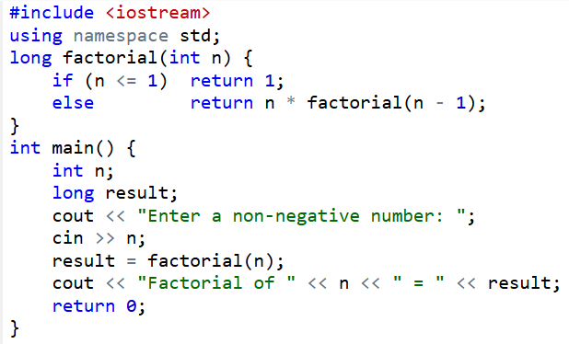
Notes:
#include <iostream>
using namespace std;
long factorial(int n) {
if (n <= 1) return 1;
else return n * factorial(n - 1);
}
int main() {
int n;
long result;
cout << "Enter a non-negative number: ";
cin >> n;
result = factorial(n);
cout << "Factorial of " << n << " = " << result;
return 0;
}

Slide 11
Example : The Sum of the First N Positive Integers
Definition:
  sum(n) = n + (n-1) + (n-2) + … + 1 for any integer n > 0
Recursive relation;
  sum(n) = n + [(n-1) + (n-2) + … + 1]
  = n + sum(n-1)
  Looks so nice, but how about n == 1?
  sum(1) = 1 + sum(0), but the argument to sum( ) must be positive
Final recursive definition:
  sum(n) = 1 if n = 1 (Base case)
  = n + sum(n-1) if n > 1 (Recursive call)

Slide 12
Recursive Definition of sum(n)
int sum(int n)
{
if (n == 1)
return 1;
else
return n + sum(n-1);
}
n = 3
sum(n-1) = ?
return ?

Slide 13
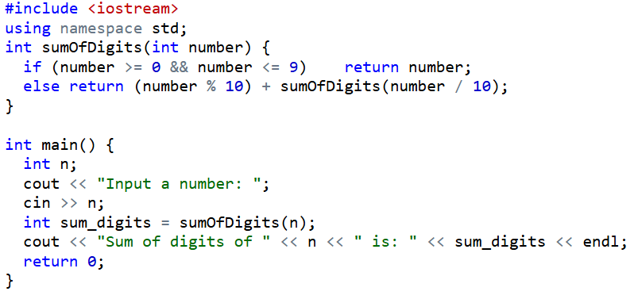
Write a C++ program to implement a recursive function to calculate the sum of digits of a given number.
Notes:
#include <iostream>
using namespace std;
int sumOfDigits(int number) {
if (number >= 0 && number <= 9) return number;
else return (number % 10) + sumOfDigits(number / 10);
}
int main() {
int n;
cout << "Input a number: ";
cin >> n;
int sum_digits = sumOfDigits(n);
cout << "Sum of digits of " << n << " is: " << sum_digits << endl;
return 0;
}

Slide 14
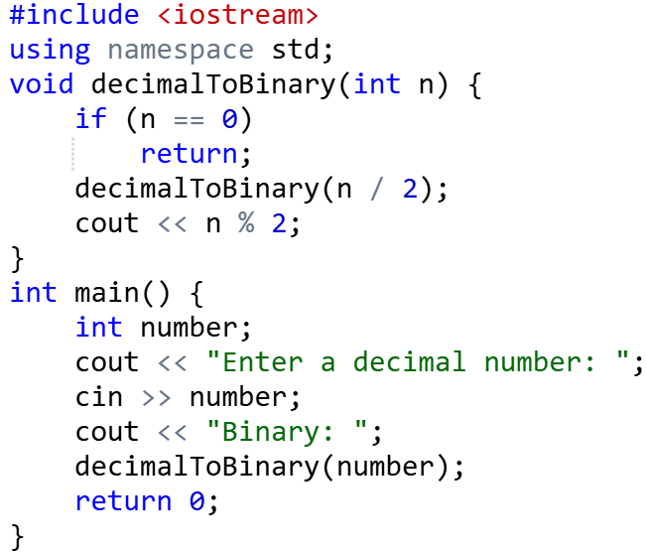
Decimal to binary number using recursion
Notes:
#include <iostream>
using namespace std;
void decimalToBinary(int n) {
if (n == 0)
return;
decimalToBinary(n / 2);
cout << n % 2;
}
int main() {
int number;
cout << "Enter a decimal number: ";
cin >> number;
cout << "Binary: ";
decimalToBinary(number);
return 0;
}

Slide 15
Fibonacci
Fibonacci sequence: each number is the sum of the two preceding ones.
  F(0) = 0, F(1) = 1
  F(n) = F(n - 1) + F(n - 2), for n > 1.
0, 1, 1, 2, 3, 5, 8, 13, 21, 34, 55, 89, 144, ....
Notes:
#include <iostream>
using namespace std;
int fib(int n) {
if((n==1)||(n==0)) {
return(n);
}else {
return(fib(n-1)+fib(n-2));
}
}
int main() {
int x , i=0;
cout << "Enter the number of terms of series : ";
cin >> x;
cout << "\nFibonnaci Series : ";
while(i < x) {
cout << " " << fib(i);
i++;
}
return 0;
}

Slide 16
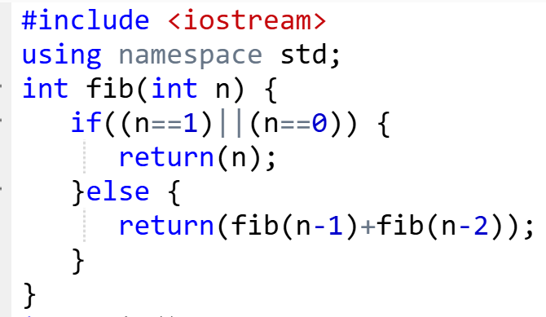
Write a C++ program to implement a recursive function to get the n^{th} Fibonacci number.

Slide 17
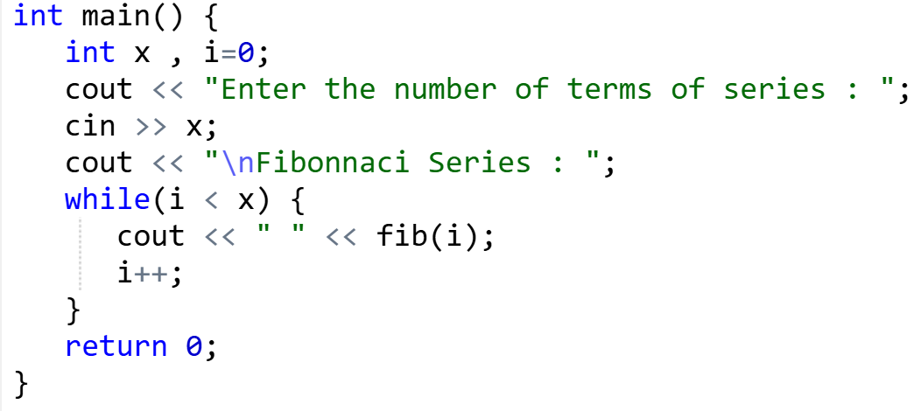

Slide 18
Computing GCD of A and B
  GCD (a, 0) = a (base case)
  GCD (a, b) = GCD (b, a mod b) (recursion)
Recursive method
  gcd(a , b)
  {
  if (b != 0)
  return gcd(b, a % b); // recursion
  return a; // base case
  }

Slide 19
Computing GCD of 33 and 55
  GCD (a, 0) = a (base case)
  GCD (a, b) = GCD (b, a mod b) (recursion)
GCD (33,55) = GCD (55 , 33%55) = GCD (55 , 33)
GCD (55,33) = GCD (33, 55%33) = GCD (33 , 22)
GCD (33,22) = GCD (22, 33%22) = GCD (22 , 11)
GCD (22,11) = GCD (11, 22%11) = GCD (11 , 0)
GCD (11 , 0) = 11
GCD(33,55) = 11

Slide 20
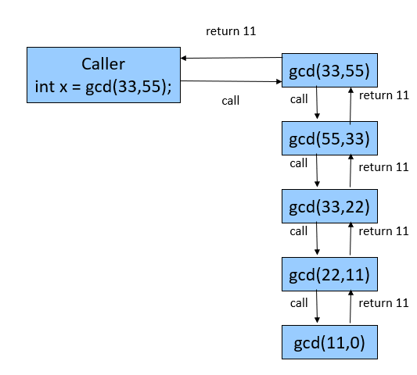
Trace of recursive method
gcd

Slide 21
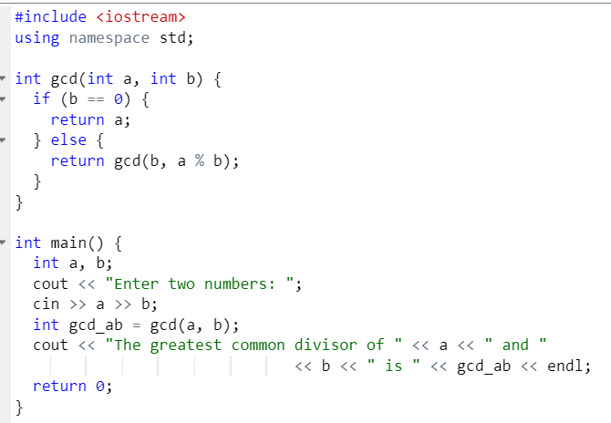

Slide 22
Write a C++ program to implement a recursive function to calculate the power of a number.

Slide 23
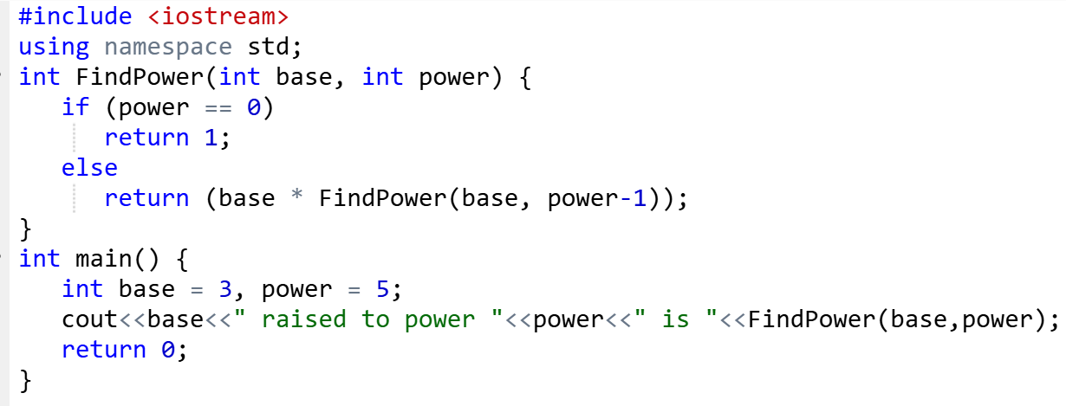

Slide 24
Write a C++ program to implement a recursive function to calculate the product of two numbers without using the multiplication operator.
#include <iostream>
using namespace std;
int multiply(int x, int y) {
if (x == 0 || y == 0)
return 0;
if (y > 0)
return x + multiply(x, y - 1);
else
return -x + multiply(x, y + 1);
}
int main() {
int n1, n2;
cout << "Input the first number: ";
cin >> n1;
cout << "Input the second number: ";
cin >> n2;
int result = multiply(n1, n2);
cout << "Product = " << result << endl;
return 0;
}

