Slide 1
WEB APPLICATIONS ENGINEERING
CSS Foundations & Visual Styling
CSS syntax • selectors • box model • typography • backgrounds
Dr. Mohamed Ryan
LECTURE 3 • CSS
A practical guide from styling basics to responsive interfaces

Slide 2
01 · FOUNDATIONS
Learning Outcomes
Understand CSS
Target elements
Explain how CSS controls presentation while HTML provides structure.
Write selectors and understand which rule wins.
Control spacing
Style content
Use the box model, dimensions, display, and overflow.
Apply colors, typography, units, and backgrounds.
WEB APPLICATIONS ENGINEERING • CSS
02 / 18

Slide 3
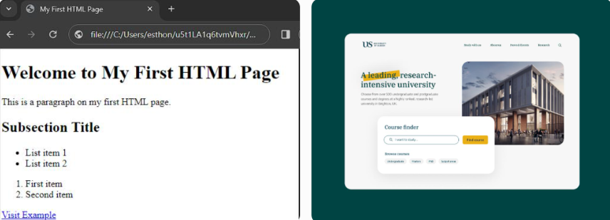
01 · FOUNDATIONS
HTML + CSS: Structure Meets Presentation
THE MENTAL MODEL
HTML + CSS
• HTML describes what content means: headings, paragraphs, links, forms.
• CSS describes how that content looks and is arranged.
• One stylesheet can consistently style many pages.
• Separating structure from presentation improves reuse and maintenance.
<h1 class="page-title">Welcome</h1>
<p class="intro">Learn CSS step by step.</p>
.page-title {
color: #2457a7;
text-align: center;
}
.intro {
line-height: 1.6;
}
WEB APPLICATIONS ENGINEERING • CSS
03 / 18

Slide 4
01 · FOUNDATIONS
Three Ways to Add CSS
Inline
Internal
External · Preferred
<h1 style="color: blue;">Hello</h1>
Quick test only; mixes style with markup.
<style> h1 { color: blue; } </style>
Useful for a single page or demo.
<link rel="stylesheet" href="styles.css">
Reusable, organized, easier to maintain.
WEB APPLICATIONS ENGINEERING • CSS
04 / 18

Slide 5
01 · FOUNDATIONS
CSS Rule Anatomy
READ THE RULE
CSS
• Selector: identifies which elements to target.
• Property: names the aspect to change.
• Value: sets the desired result.
• Each declaration usually ends with a semicolon; declarations sit inside braces (curly brackets).
h1 {
color: #2457a7;
font-size: 2rem;
text-align: center;
}
p {
color: #46546a;
line-height: 1.6;
}
WEB APPLICATIONS ENGINEERING • CSS
05 / 18

Slide 6
01 · SELECTORS
Selectors: Target the Right Elements
COMMON SELECTORS
SELECTOR EXAMPLES
• Element: p targets every paragraph.
• Class: .notice targets every element with class="notice"; reusable.
• ID: #main targets the element with id="main"; use IDs sparingly for styling.
• Universal: * targets all elements.
• Group: h1, h2, p applies one rule to several selectors.
HTML:
<h1 id="main">University Portal</h1>
<p class="notice">Registration is open.</p><p>Explore our programs.</p>
<div class="notice">Admission deadline: June 30.</div>
CSS:
* {box-sizing: border-box;}
h1 {color: navy;}
.notice {background: lightyellow;}
#main {text-align: center;}
h1, p {font-family: Arial, sans-serif;}
WEB APPLICATIONS ENGINEERING • CSS
06 / 18

Slide 7
01 · SELECTORS
Relationships & Attribute Selectors
SELECTOR RELATIONSHIPS
HOW TARGETING DIFFERS
HTML:
<div>
<p>First paragraph</p>
<section>
<p>Second paragraph</p>
</section>
<label for="email">Email</label>
<input type="email" placeholder="Email address">
</div>
<p>Third paragraph</p>
CSS:
div p { color: #c0392b; }
/* Any p inside a div */
div > p { color: #218c74; }
/* p directly inside a div */
input[type="email"] { border: 1px solid #2457a7;}
div, p { color: red;} /* div, p: selects all div elements and all p elements */
• Descendant selector (space): any matching descendant.
• Child selector (>): only direct children.
• Attribute selector: target based on an attribute/value.
• Use commas to group selectors; spaces and commas mean different things.
WEB APPLICATIONS ENGINEERING • CSS
07 / 18

Slide 8
01 · SELECTORS
Specificity & Naming Conventions
PRACTICAL RULES
SPECIFICITY & NAMING
• When declarations conflict, specificity helps determine which applies; source order also matters when specificity ties.
• Typical teaching hierarchy: element < class/attribute/pseudo-class < ID < inline style.
• Prefer reusable, descriptive class names such as .main-header and .user-card.
• Use lowercase and hyphens; avoid spaces in a class selector unless selecting a descendant.
• Avoid relying on IDs and inline styles for routine styling.
HTML:
<p id="notice" class="intro"> Important information</p>
CSS:
/* More specific than p */
p { color: #333; }
.intro { color: #2457a7; }
#notice { color: #c0392b; }
/* Good class names */
.main-header { }
.user-profile { }
*/ Pseudo-class selector */
.btn:hover { background-color: darkblue;}
WEB APPLICATIONS ENGINEERING • CSS
08 / 18

Slide 9
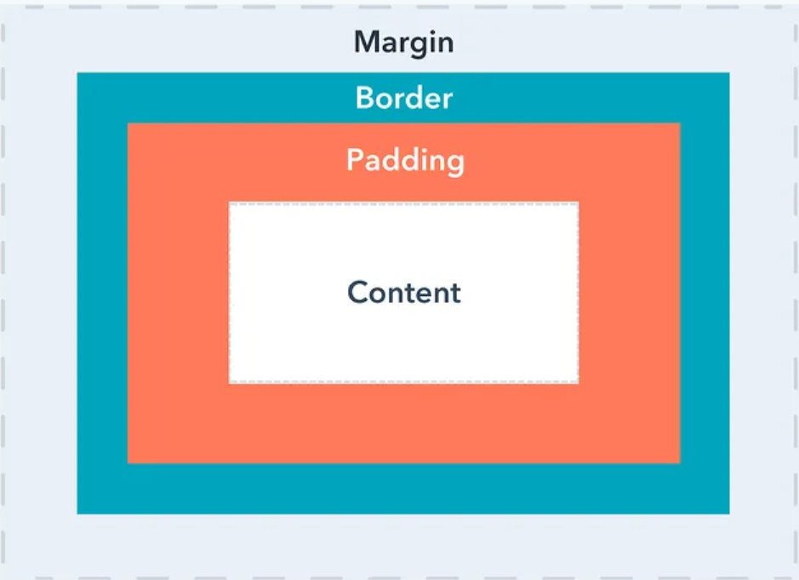
02 · SPACING & DIMENSIONS
The CSS Box Model
Content
Padding + Border
Margin
The text, image, or other content inside the element.
Padding is internal space around content. Border is the visible edge.
External space outside the border; separates an element from neighbors.
WEB APPLICATIONS ENGINEERING • CSS
09 / 18

Slide 10
02 · SPACING & DIMENSIONS
Padding, Margin & Borders
REMEMBER THE DIFFERENCE
BOX SPACING
• Padding creates breathing room inside the border.
• Margin creates space outside the border.
• Border can be styled by width, style, and color; border-radius rounds corners.
• Shorthand values follow top, right, bottom, left when four values are supplied.
• Vertical margins can collapse in some block-flow situations.
.card {
padding: 20px 24px;
margin: 0 auto 24px; /* top=0, L&R: auto, B=24 */
border: 1px solid #d7deea;
border-radius: 12px;
}
/* Four values: top right bottom left */
.box { margin: 10px 15px 20px 25px; }
WEB APPLICATIONS ENGINEERING • CSS
10 / 18

Slide 11
02 · SPACING & DIMENSIONS
Dimensions, Box Sizing & Outlines
CONTROL SIZE SAFELY
DIMENSIONS & FOCUS
• width and height set dimensions; min-/max- constrain them.
• content-box (default) adds padding and border outside the declared width.
• border-box includes padding and border within the declared width; often easier to reason about.
• An outline is drawn outside the border and does not take up layout space.
• Keep a visible focus indicator for keyboard users.
Why is outline useful? When users navigate a webpage with a keyboard, they need to see which control currently has focus.
* { box-sizing: border-box; }
.card {
width: min(100%, 720px);
min-height: 180px;
padding: 24px;
border: 2px solid #2457a7;
}
button:focus-visible {
outline: 3px solid #ef9736;
outline-offset: 3px;
}
Question:
.card { box-sizing: border-box; width: 400px; padding: 24px; border: 2px solid navy;}
Calculate the content width.
WEB APPLICATIONS ENGINEERING • CSS
11 / 18

Slide 12
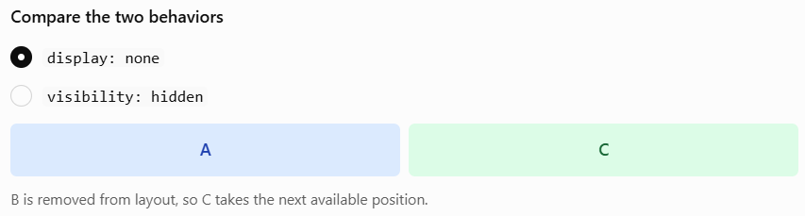
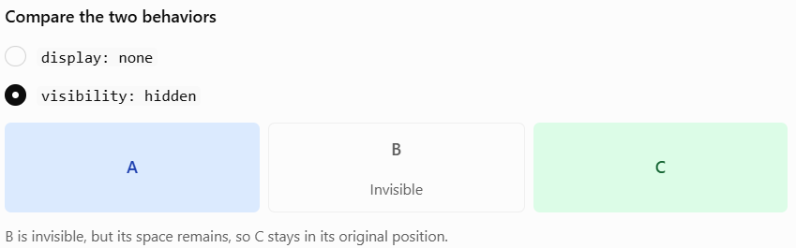
02 · LAYOUT FUNDAMENTALS
Display, Overflow & Visibility
block / inline
inline-block
Block usually starts a new line; inline flows with text and does not accept width/height in the usual way.
.box { display: block; width: 200px; height: 80px;}
.label { display: inline;}
Flows inline while allowing width and height.
.badge { display: inline-block; width: 120px;
height: 40px;}
display vs visibility
overflow
display:none removes layout space; visibility:hidden hides content but preserves its space.
visible, hidden, scroll, or auto controls content that exceeds a box.
<div class="box"> This is a long paragraph that may exceed the available space inside the box.</div>
WEB APPLICATIONS ENGINEERING • CSS
12 / 18

Slide 13
03 · TYPOGRAPHY
Typography: Color, Fonts & Size
BUILD A READABLE TYPE SYSTEM
TYPOGRAPHY
• Text color accepts named, hex, rgb/rgba, and hsl/hsla formats.
• font-family uses a fallback stack ending in a generic family.
• font-size may use px, em, rem, or percentages; rem is often predictable for scalable systems.
• font-weight controls thickness; font-style handles italic/oblique.
• Web fonts can be loaded externally, subject to availability and performance considerations.
body {
color: #253047;
font-family: Arial, Helvetica, sans-serif;
font-size: 1rem;
line-height: 1.6;
}
h1 {
font-size: 2rem;
font-weight: 700;
color: #2457a7;
}
WEB APPLICATIONS ENGINEERING • CSS
13 / 18

Slide 14
03 · TYPOGRAPHY
Text Effects, Alignment & Spacing
PROPERTIES TO RECOGNIZE
TEXT STYLING
• text-align: left, center, right, justify.
• text-decoration: underline, overline, line-through, or none.
• text-transform changes visual case; text-indent indents the first line.
• letter-spacing and word-spacing control spacing; use restraint.
• line-height controls vertical spacing; unitless values such as 1.5 work well for body text.
• text-shadow adds depth; vertical-align is mainly for inline/table-cell alignment.
.article-title {
text-align: center;
letter-spacing: 0.02em;
text-shadow: 1px 2px 3px #0002;
}
.article-body {
line-height: 1.6;
}
a { text-decoration: underline; }
WEB APPLICATIONS ENGINEERING • CSS
14 / 18

Slide 15
03 · TYPOGRAPHY & BACKGROUNDS
CSS Units: Choose with Intent
px
em / rem
A CSS pixel unit; useful for fine details, but fixed sizes alone can limit flexibility.
Relative to font sizing (em often depends on the current element; rem depends on the root size).
% / vw / vh
clamp()
Relative to a containing context or viewport; useful for fluid sizing.
Can define a minimum, preferred fluid value, and maximum for responsive sizing.
WEB APPLICATIONS ENGINEERING • CSS
15 / 18

Slide 16
04 · BACKGROUNDS
Backgrounds: Color, Image & Gradients
COMMON CONTROLS
BACKGROUND EXAMPLE
• background-color accepts the same color formats as text color.
• background-image can use an image URL or a gradient.
• Background images are decorative; use real <img> elements for meaningful content.
• Relative paths are resolved from the stylesheet location.
• Backgrounds repeat by default unless configured otherwise.
.hero {
background-color: #183152;
background-image: linear-gradient(
120deg, #2457a7, #7c5ce6
);
color: white;
}
WEB APPLICATIONS ENGINEERING • CSS
16 / 18

Slide 17
04 · BACKGROUNDS
Background Position, Repeat & Size
MAKE THE IMAGE FIT
HERO BACKGROUND
• background-repeat: repeat, no-repeat, repeat-x, repeat-y.
• background-position controls where the image starts (center, top right, percentages, lengths).
• background-size: cover fills the box and may crop; contain shows the entire image and may leave empty space.
• background-attachment controls scroll behavior; fixed can have mobile/performance caveats.
• Use a semi-transparent overlay when text needs contrast over an image.
.hero {
background-image: url("campus.jpg");
background-repeat: no-repeat;
background-position: center;
background-size: cover;
min-height: 24rem;
}
WEB APPLICATIONS ENGINEERING • CSS
17 / 18

Slide 18
05 · PRACTICE
Lecture 1 — Practice & Recap
TRY THESE TASKS
STARTER CHALLENGE
• Link an external stylesheet and style at least five elements.
• Use element, class, ID, descendant, child, and attribute selectors.
• Create a card using padding, margin, border, border-radius, and border-box.
• Style a hero section with a gradient or image background.
• Adjust typography and test readability at different sizes.
/* Challenge: improve this card */
.card {
max-width: 42rem;
margin: 2rem auto;
padding: 1.5rem;
border: 1px solid #d7deea;
border-radius: 12px;
background: #fff;
}
WEB APPLICATIONS ENGINEERING • CSS
18 / 18

