Slide 1


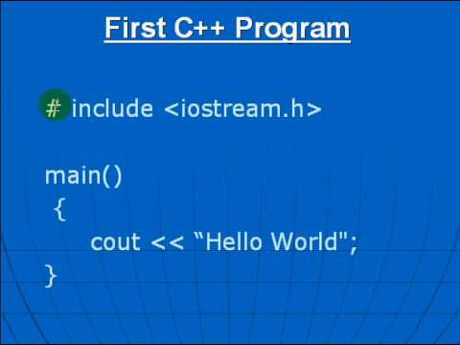
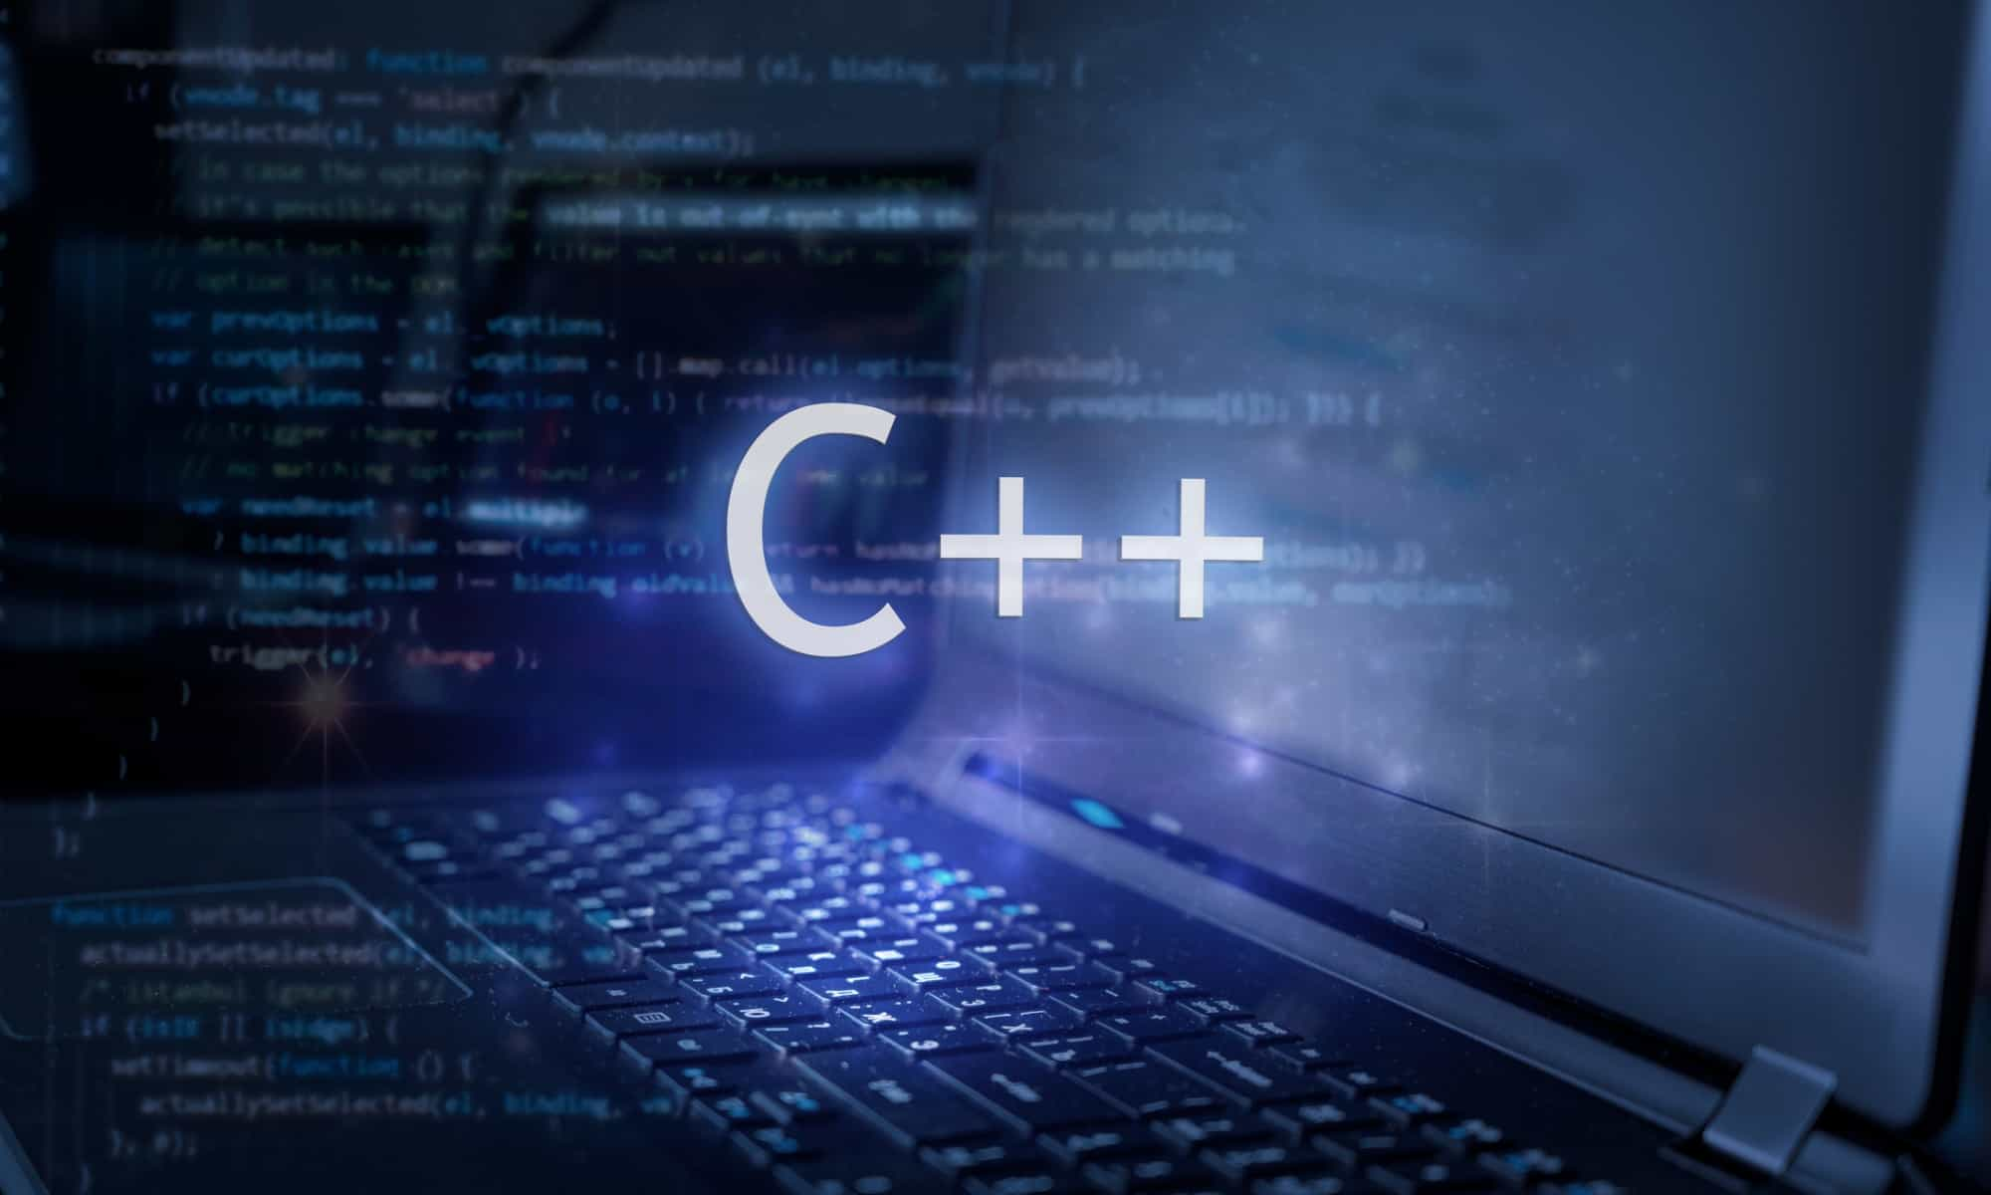
Al-Azhar University
Faculty of Engineering
Systems and Computer Engineering Dept.
Intelligent Systems Engineering Program
ENG 151
Computer Programming I
Prof. Ahmed Youssef

Slide 2
Al-Azhar University
Faculty of Engineering
Systems and Computer Engineering Dept.
Intelligent Systems Engineering Program
ENG 151
Computer Programming I
Arrays

Slide 3
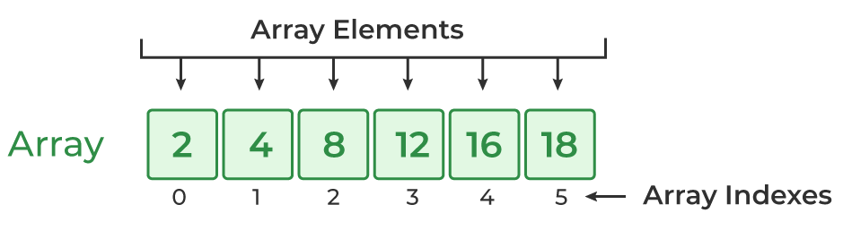
Introduction
An array in C++ is a data structure that stores a collection of elements of the same type.

Slide 4
Properties of Arrays in C++
Indexing of an array starts from 0. It means the first element is stored at the 0th index, the second at 1st, and so on.
Elements of an array can be accessed using their indices.
Once an array is declared its size remains constant throughout the program.
An array can have multiple dimensions.
The number of elements in an array can be determined using the sizeof operator.

Slide 5
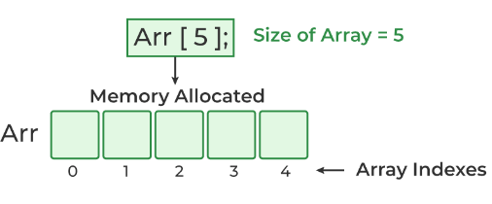
Array Declaration in C++
data_type array_name[size_of_array];
Example:
int Arr[5];
int → data_type
Arr → array_name
5 → size_of_array
Notes:
data_type array_name[Size_of_array];

Slide 6
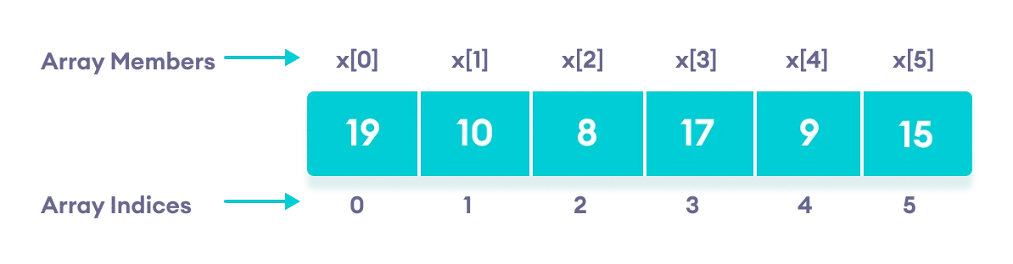
C++ Array Initialization
// declare and initialize an array
int x[6] = {19, 10, 8, 17, 9, 15};
int x[ ] = {19, 10, 8, 17, 9, 15};

Slide 7
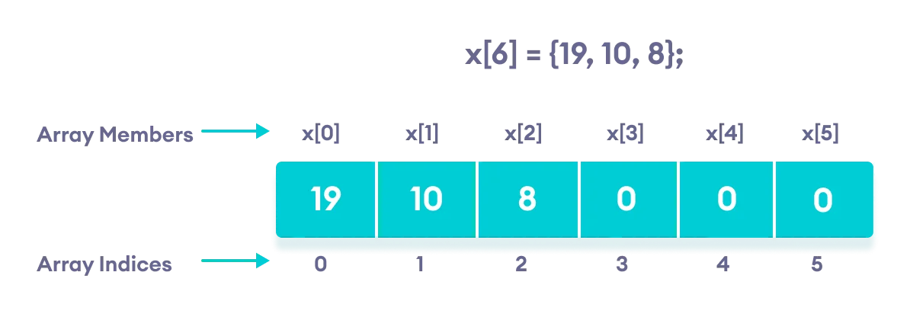
C++ Array With Empty Members

Slide 8
Array Initialization
int X[5] = {6, 12, 14, 17, 8};
int X[5] = { };
int X[5] = {6, 12};
int X[ ] = {6, 12, 14, 17, 8};
6 | 12 | 14 | 17 | 8
0 | 0 | 0 | 0 | 0
6 | 12 | 0 | 0 | 0
6 | 12 | 14 | 17 | 8

Slide 9
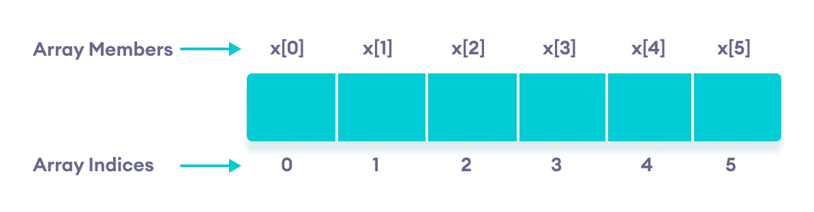
Access Elements in C++ Array
// int X[6] = {6, 12, 14, 17, 8, 2};
X[0] = 6 X[1] = 12 X[2] = 14 X[3] = 17 X[4] = 8 X[5] = 2

Slide 10
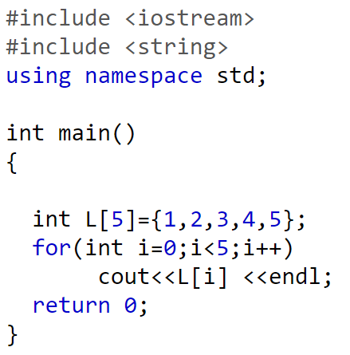
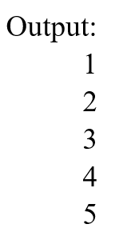
Displaying Array Elements

Slide 11
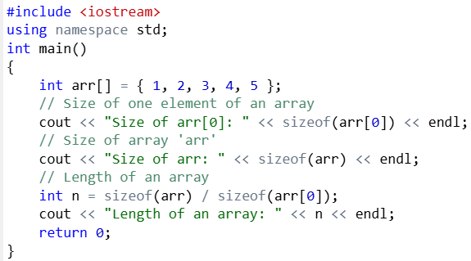

Find the Size of an Array
Notes:
#include <iostream>
using namespace std;
int main()
{
int arr[] = { 1, 2, 3, 4, 5 };
// Size of one element of an array
cout << "Size of arr[0]: " << sizeof(arr[0]) << endl;
// Size of array 'arr'
cout << "Size of arr: " << sizeof(arr) << endl;
// Length of an array
int n = sizeof(arr) / sizeof(arr[0]);
cout << "Length of an array: " << n << endl;
return 0;
}

Slide 12
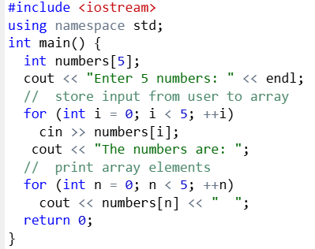
Take Inputs from User and Store values in Array
Notes:
#include <iostream>
using namespace std;
int main() {
int numbers[5];
cout << "Enter 5 numbers: " << endl;
// store input from user to array
for (int i = 0; i < 5; ++i)
cin >> numbers[i];
cout << "The numbers are: ";
// print array elements
for (int n = 0; n < 5; ++n)
cout << numbers[n] << " ";
return 0;
}

Slide 13
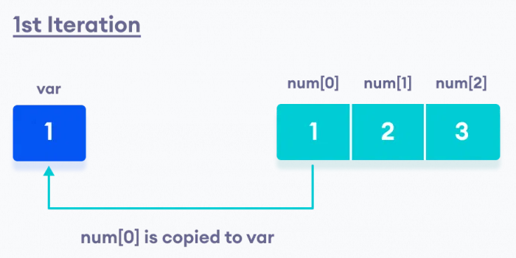
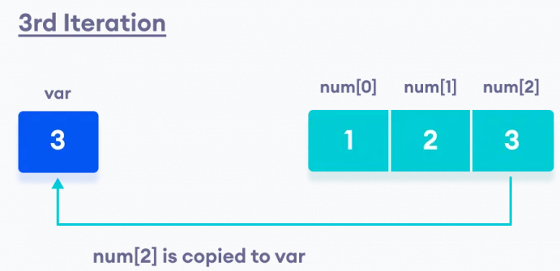
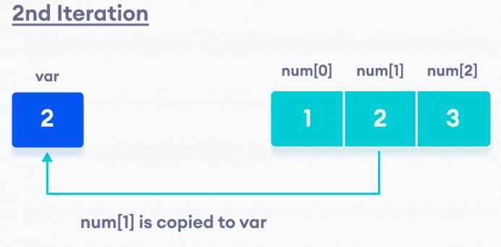
C++ Ranged for Loop
// initialize an int array
int num[3] = {1, 2, 3};
// use of ranged for loop
for (int var : num) {
// code
}
The ranged for loop iterates the array num from beginning to end. The int variable var stores the value of the array element in each iteration.
Notes:
C++ Array Out of Bounds

Slide 14
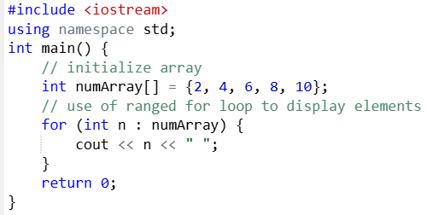
Ranged for Loop to Display Array

Slide 15
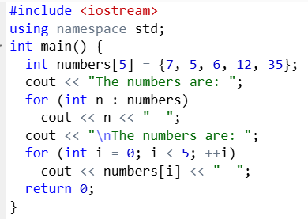
Displaying Array Elements
Notes:
#include <iostream>
using namespace std;
int main() {
int numbers[5] = {7, 5, 6, 12, 35};
cout << "The numbers are: ";
for (int n : numbers)
cout << n << " ";
cout << "\nThe numbers are: ";
for (int i = 0; i < 5; ++i)
cout << numbers[i] << " ";
return 0;
}

Slide 16
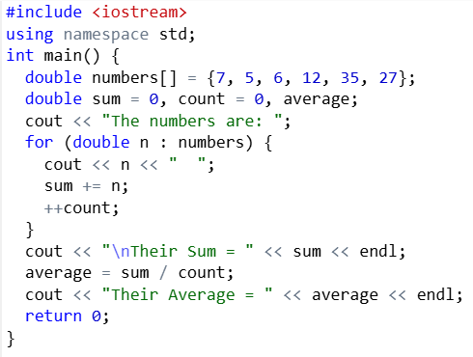
Display Sum and Average of Array Elements
Notes:
#include <iostream>
using namespace std;
int main() {
double numbers[] = {7, 5, 6, 12, 35, 27};
double sum = 0, count = 0, average;
cout << "The numbers are: ";
for (double n : numbers) {
cout << n << " ";
sum += n;
++count;
}
cout << "\nTheir Sum = " << sum << endl;
average = sum / count;
cout << "Their Average = " << average << endl;
return 0;
}

Slide 17
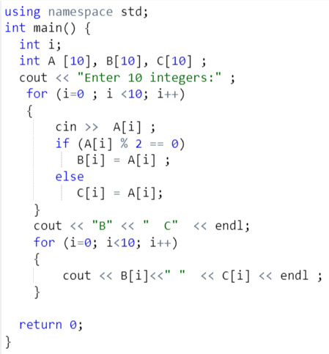
Example
Write a C++ program to read 10 integers and store them in array A. Then it finds the even numbers to store them in array B and the odd numbers to store them in array C.

Slide 18
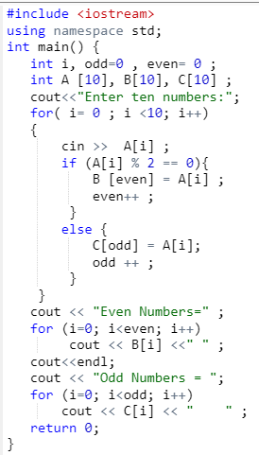
Example
Modify the program of previous example so that the data are stored in consecutive locations
Notes:
#include <iostream>
using namespace std;
int main() {
int i, odd=0 , even= 0 ;
int A [10], B[10], C[10] ;
cout<<"Enter ten numbers:";
for( i= 0 ; i <10; i++)
{
cin >> A[i] ;
if (A[i] % 2 == 0){
B [even] = A[i] ;
even++ ;
}
else {
C[odd] = A[i];
odd ++ ;
}
}
cout << "Even Numbers=" ;
for (i=0; i<even; i++)
cout << B[i] <<" " ;
cout<<endl;
cout << "Odd Numbers = ";
for (i=0; i<odd; i++)
cout << C[i] << " " ;
return 0;
}

Slide 19
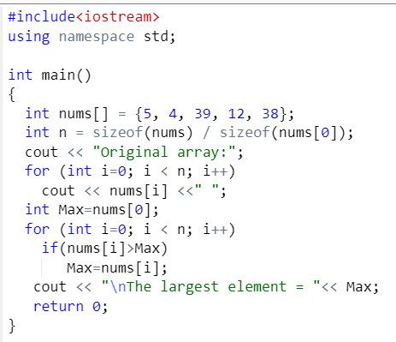
Example
Write a C++ program to find the largest element of a given array of integers.

Slide 20
C++ Passing Array to Function

Slide 21
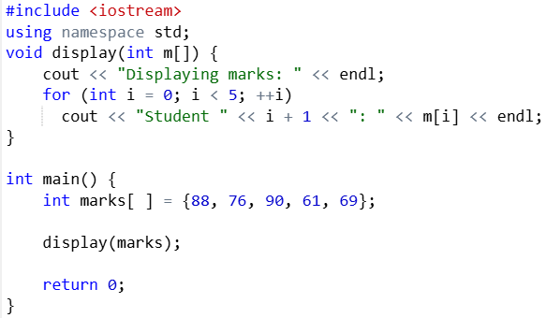
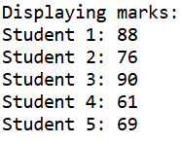
// C++ Program to display marks of 5 students
Notes:
#include <iostream>
using namespace std;
void display(int m[]) {
cout << "Displaying marks: " << endl;
for (int i = 0; i < 5; ++i)
cout << "Student " << i + 1 << ": " << m[i] << endl;
}
int main() {
int marks[ ] = {88, 76, 90, 61, 69};
display(marks);
return 0;
}

Slide 22
Example
Write a C++ program to find the largest three elements in an array.

Slide 23
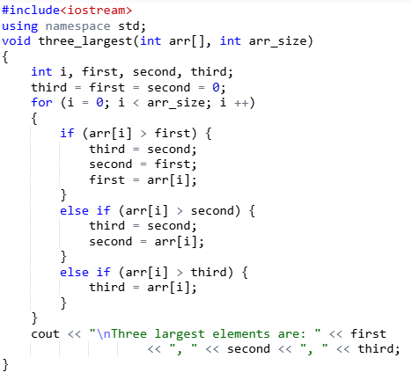

Slide 24
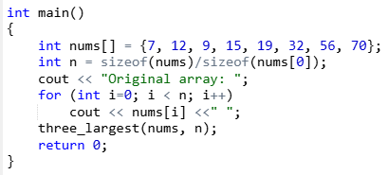

Slide 25
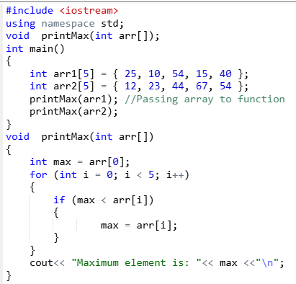
Print maximum number

Slide 26
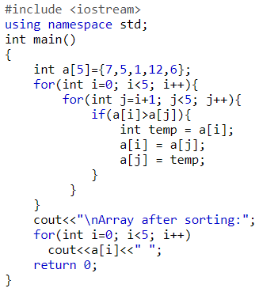
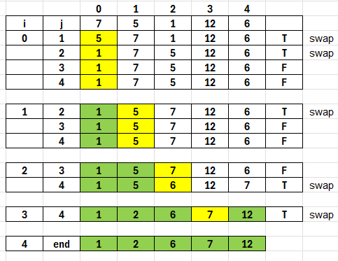
Sorting in Arrays
Notes:
#include <iostream>
using namespace std;
int main()
{
int a[5]={7,5,1,12,6};
for(int i=0; i<5; i++)
{
for(int j=i+1; j<5; j++)
{
if(a[i]>a[j])
{
int temp = a[i];
a[i] = a[j];
a[j] = temp;
}
}
}
cout<<"\nArray after sorting:";
for(int i=0; i<5; i++)
cout<<a[i]<<" ";
return 0;
}

Slide 27
2D Arrays

Slide 28
Multidimensional Array
C++ multidimensional array is an array that has more than one dimension and allows you to store data in a grid-like structure
A two-dimensional array in C++ is the simplest form of a multi-dimensional array.
A two-dimensional array is also called a matrix.

Slide 29
Syntax of Two-Dimensional Array in C++
data_type array_name[row_size][column_size];
int x[2][3];
Initialization of 2D Array:
int x[2][3] = {2, 4, 5, 9, 0, 19};
int test[2][3] = { {2, 4, 5}, {9, 0, 19}};
X[0][0] | X[0][1] | X[0][2]
X[1][0] | X[1][1] | X[1][2]
2 | 4 | 5
9 | 0 | 19

Slide 30
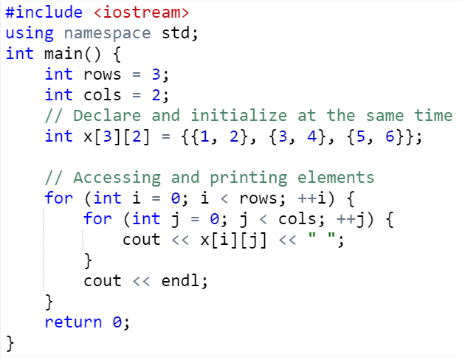
Example
X[0][0] | X[0][1]
X[1][0] | X[1][1]
X[2][0] | X[2][1]
1 | 2
3 | 4
5 | 6
Notes:
#include <iostream>
using namespace std;
int main() {
int rows = 3;
int cols = 2;
// Declare and initialize at the same time
int x[3][2] = {{1, 2}, {3, 4}, {5, 6}};
// Accessing and printing elements
for (int i = 0; i < rows; ++i) {
for (int j = 0; j < cols; ++j) {
cout << x[i][j] << " ";
}
cout << endl;
}
return 0;
}

Slide 31
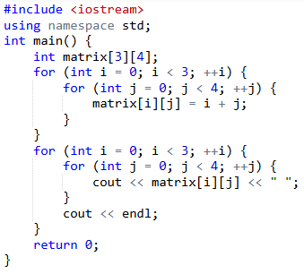
Example
0 1 2 3
1 2 3 4
2 3 4 5
Notes:
#include <iostream>
using namespace std;
int main() {
int matrix[3][4];
for (int i = 0; i < 3; ++i) {
for (int j = 0; j < 4; ++j) {
matrix[i][j] = i + j;
}
}
for (int i = 0; i < rows; ++i) {
for (int j = 0; j < cols; ++j) {
cout << matrix[i][j] << " ";
}
cout << endl;
}
return 0;
}

Slide 32
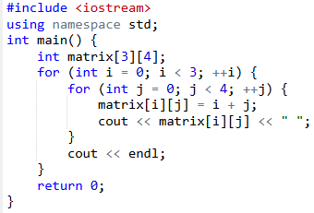
Example
0 1 2 3
1 2 3 4
2 3 4 5
Notes:
#include <iostream>
using namespace std;
int main() {
int matrix[3][4];
for (int i = 0; i < 3; ++i) {
for (int j = 0; j < 4; ++j) {
matrix[i][j] = i + j;
}
}
for (int i = 0; i < rows; ++i) {
for (int j = 0; j < cols; ++j) {
cout << matrix[i][j] << " ";
}
cout << endl;
}
return 0;
}

Slide 33
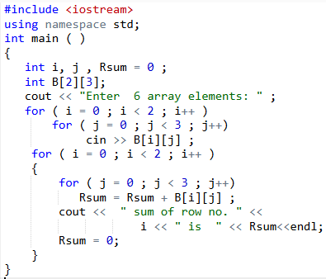
Example
Write C++ program that reads array A of size (2 x 3) and finds the sum of the elements in each row.
Notes:
#include <iostream>
using namespace std;
int main ( )
{
int i, j , Rsum = 0 ;
int B[2][3];
cout << "Enter 6 array elements: " ;
for ( i = 0 ; i < 2 ; i++ )
for ( j = 0 ; j < 3 ; j++)
cin >> B[i][j] ;
for ( i = 0 ; i < 2 ; i++ )
{
for ( j = 0 ; j < 3 ; j++)
Rsum = Rsum + B[i][j] ;
cout << " sum of row no. " <<
i << " is " << Rsum<<endl;
Rsum = 0;
}
}

Slide 34
Example
Write a C++ program that reads an array of size (3 x 3) and finds the product of the diagonal elements.

Slide 35
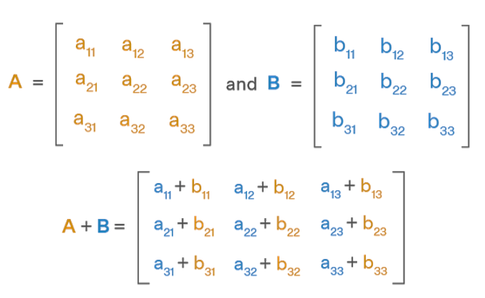
Matrix Addition using 2D Arrays in C++

Slide 36
Matrix Addition using 2D Arrays in C++
#include<iostream>
using namespace std;
int main()
{
int m1[5][5], m2[5][5], m3[5][5];
int i, j, row, col;
cout<<"Enter no. of rows of the matrices to be added(max 5):";
cin>>row;
cout<<"Enter no. of columns of the matrices to be added(max 5):";
cin>>col;
Notes:
#include<iostream>
using namespace std;
int main()
{
int m1[5][5], m2[5][5], m3[5][5];
int i, j, row, col;
cout<<"Enter the no.of rows of the matrices to be added(max 5):";
cin>>row;
cout<<"Enter the no.of columns of the matrices to be added(max 5):";
cin>>col;
cout<<"\n1st Matrix Input:\n";
for(i=0;i<row;i++)
{
for(j=0;j<col;j++)
{
cout<<"\nmatrix1["<<i<<"]["<<j<<"]= ";
cin>>m1[i][j];
}
}
cout<<"\n2nd Matrix Input:\n";
for(i=0;i<row;i++)
{
for(j=0;j<col;j++)
{
cout<<"\nmatrix2["<<i<<"]["<<j<<"]= ";
cin>>m2[i][j];
}
}
cout<<"\nAdding Matrices...\n";
for(i=0;i<row;i++)
{
for(j=0;j<col;j++)
{
m3[i][j]=m1[i][j]+m2[i][j];
}
}
cout<<"\nThe resultant Matrix is:\n";
for(i=0;i<row;i++)
{
for(j=0;j<col;j++)
cout<<"\t"<<m3[i][j];
cout<<endl;
}
}

Slide 37
Input: First Matrix
cout<<"\n First Matrix Input:\n";
for(i=0;i<row;i++)
{
for(j=0;j<col;j++)
{
cout<<"\nmatrix1["<<i<<"]["<<j<<"]= ";
cin>>m1[i][j];
}
}

Slide 38
Input: Second Matrix
cout<<"\n Second Matrix Input:\n";
for(i=0;i<row;i++)
{
for(j=0;j<col;j++)
{
cout<<"\nmatrix2["<<i<<"]["<<j<<"]= ";
cin>>m2[i][j];
}
}

Slide 39
Adding Matrices
cout<<"\nAdding Matrices...\n";
for(i=0;i<row;i++)
{
for(j=0;j<col;j++)
{
m3[i][j]=m1[i][j]+m2[i][j];
}
}

Slide 40
The Resultant Matrix
cout<<"\nThe resultant Matrix is:\n";
for(i=0;i<row;i++)
{
for(j=0;j<col;j++)
{
cout<<"\t"<<m3[i][j];
}
cout<<endl;
}
return 0;
}

