Slide 1


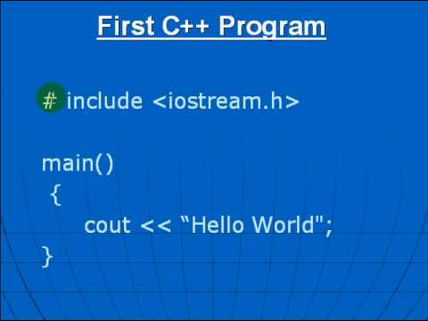
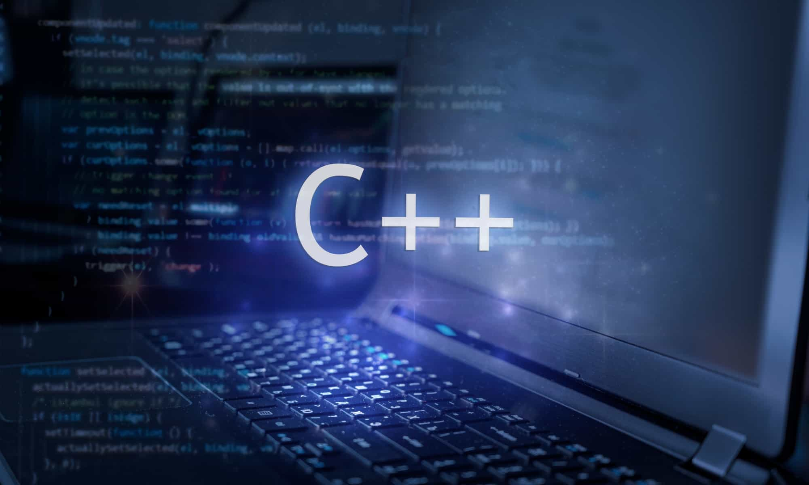
Al-Azhar University
Faculty of Engineering
Systems and Computer Engineering Dept.
Intelligent Systems Engineering Program
ENG 151
Computer Programming I
Prof. Ahmed Youssef

Slide 2
Al-Azhar University
Faculty of Engineering
Systems and Computer Engineering Dept.
Intelligent Systems Engineering Program
ENG 151
Computer Programming I
Strings

Slide 3
Strings
In C++, strings are sequences of characters used to store and manipulate text. They can be implemented using C-style strings or the std::string class from the Standard Template Library (STL).
C-Style Strings
  Represented as arrays of characters terminated by a null character (\0).
  Fixed size.
std::string class
  A flexible and dynamic way to handle strings.

Slide 4
Strings
C-style strings
std::string class
#include <iostream>
using namespace std;
int main() {
char str[] = " Hello, World!";
cout << "String: " << str << endl;
return 0;
}
#include <iostream>
#include <string>
using namespace std;
int main() {
string str = "Hello, World!";
cout << "String: " << str << endl;
return 0;
}

Slide 5
Strings (Continued)
There is a difference between 'A' and "A"
  'A' is the character A
  "A" is the string A
Because strings are null terminated, "A" represents two characters, 'A' and '\0‘
Similarly, "Hello" contains six characters, 'H', 'e', 'l', 'l', 'o', and '\0'
5

Slide 6
String Length
To get the length of a string:
string txt = "ABCDEFGHIJKLMNOPQRSTUVWXYZ";
use the length() function:
cout << "The length of string is: " << txt.length();
OR
use the size()function:
cout << "The length of string is: " << txt.size();

Slide 7
User Input Strings
It is possible to use cin >> to store a string entered by a user.
However, cin considers a space (whitespace, tabs, etc) as a terminating character, which means that it can only store a single word.
    string firstName;
    cout << "Type your first name: ";
    cin >> firstName;
    cout << "Your name is: " << firstName;

Slide 8
User Input Strings
We use the getline() function to read a line of text.
string fullName;
cout << "Type your full name: ";
getline (cin, fullName);
cout << "Your name is: " << fullName;

Slide 9
Operations on Strings
Concatenation:
The + operator can be used between strings to add them together to make a new string.
string first = "Hello";
string second = "World";
string result = first + " " + second;
cout << result; // Output: Hello World

Slide 10
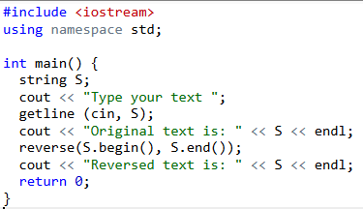
Reverse String
Notes:
#include <iostream>
using namespace std;
int main() {
string S;
cout << "Type your text ";
getline (cin, S);
cout << "Original text is: " << S << endl;
reverse(S.begin(), S.end());
cout << "reversed text is: " << S << endl;
return 0;
}

Slide 11
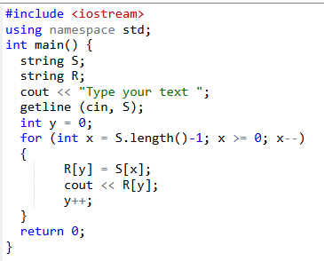
Notes:
#include <iostream>
using namespace std;
int main() {
string S;
string R;
cout << "Type your text ";
getline (cin, S);
int y = 0;
for (int x = S.length()-1; x >= 0; x--)
{
R[y] = S[x];
cout << R[y];
y++;
}
return 0;
}

Slide 12
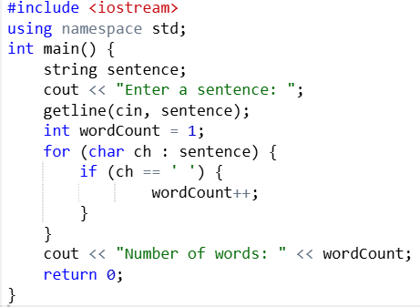
Count the number of words in a sentence
Notes:
#include <iostream>
using namespace std;
int main() {
string sentence;
cout << "Enter a sentence: ";
getline(cin, sentence);
int wordCount = 0;
bool inWord = false;
for (char ch : sentence) {
if (ch != ' ') {
if (!inWord) {
wordCount++;
inWord = true;
}
} else {
inWord = false;
}
}
cout << "Number of words: " << wordCount;
return 0;
}

Slide 13
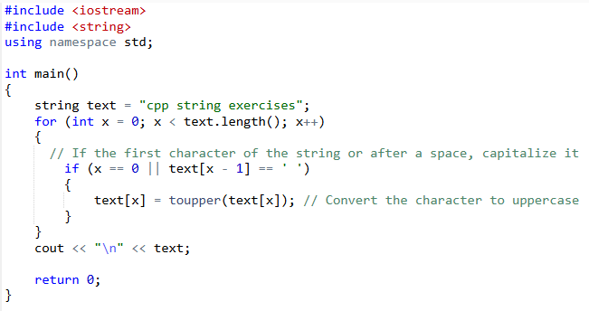
Write a C++ program to capitalize the first letter of each word in a given string.
Notes:
#include <iostream>
#include <string>
using namespace std;
int main()
{
string text = "cpp string exercises";
for (int x = 0; x < text.length(); x++)
{
// If the first character of the string or after a space, capitalize it
if (x == 0 || text[x - 1] == ' ')
{
text[x] = toupper(text[x]); // Convert the character to uppercase
}
}
cout << "\n" << text;
return 0;
}

Slide 14
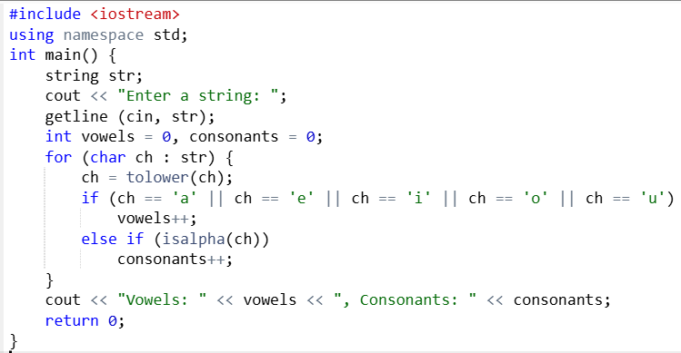
Count the number of vowels and consonants in a string
Notes:
#include <iostream>
using namespace std;
int main() {
string str;
cout << "Enter a string: ";
getline (cin, str);
int vowels = 0, consonants = 0;
for (char ch : str) {
ch = tolower(ch);
if (ch == 'a' || ch == 'e' || ch == 'i' || ch == 'o' || ch == 'u')
vowels++;
else if (isalpha(ch))
consonants++;
}
cout << "Vowels: " << vowels << ", Consonants: " << consonants;
return 0;
}

Slide 15
Exercises
Write a program that takes a string as input and prints it in reverse order.
Write a program to change (lower to upper and upper to lower cases) for each character in a given string.
Write a program that removes all spaces from a string.
Write a program to find the longest word in a given sentence.

