Slide 1


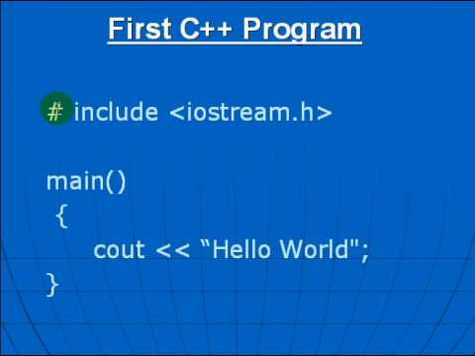
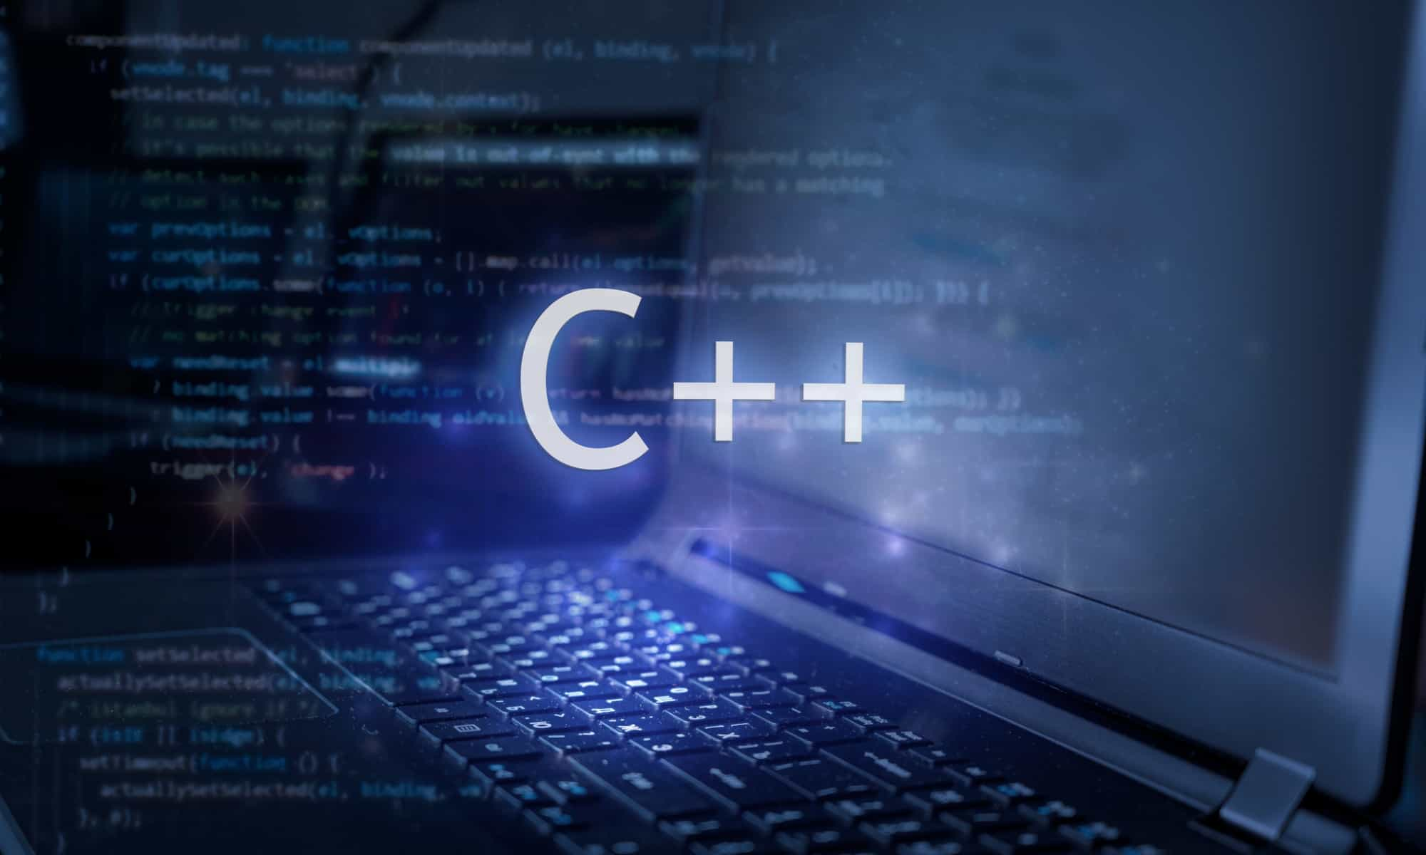
Al-Azhar University
Faculty of Engineering
Systems and Computer Engineering Dept.
Intelligent Systems Engineering Program
ENG 151
Computer Programming I
Prof. Ahmed Youssef

Slide 2
Al-Azhar University
Faculty of Engineering
Systems and Computer Engineering Dept.
Intelligent Systems Engineering Program
ENG 151
Computer Programming I
Structure

Slide 3
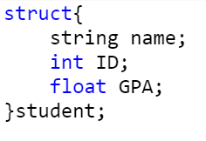
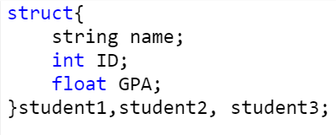
Structure
Structure is a collection of variables of different data types under a single name.
Notes:
struct Person { char name[50]; int age; float salary; };

Slide 4
Example
#include <iostream>
#include <string>
using namespace std;
int main( ) {
struct {
string name;
int ID;
float GPA;
} student1,student2;
// Put data into the first structure
student1.name = "Ayman";
student1.ID = 20240014;
student1.GPA = 3.2;
// Put data into the second structure
student2.name = "Amal";
student2.ID = 20240020;
student2.GPA = 3.8;
// Print the structure members
cout<<student1.name<<" "<< student1.ID <<" "<< student1.GPA <<"\n";
cout<<student2.name<<" "<< student2.ID <<" "<< student2.GPA <<"\n";
return 0;
}
Notes:
#include <iostream>
#include <string>
using namespace std;
int main() {
struct {
string name;
int ID;
float GPA;
} student1,student2;
// Put data into the first structure
student1.name = "Ayman";
student1.ID = 20240014;
student1.GPA = 3.2;
// Put data into the second structure
student2.name = "Amal";
student2.ID = 20240020;
student2.GPA = 3.8;
// Print the structure members
cout<<student1.name<<" "<< student1.ID <<" "<< student1.GPA <<"\n";
cout<<student2.name<<" "<< student2.ID <<" "<< student2.GPA <<"\n";
return 0;
}

Slide 5
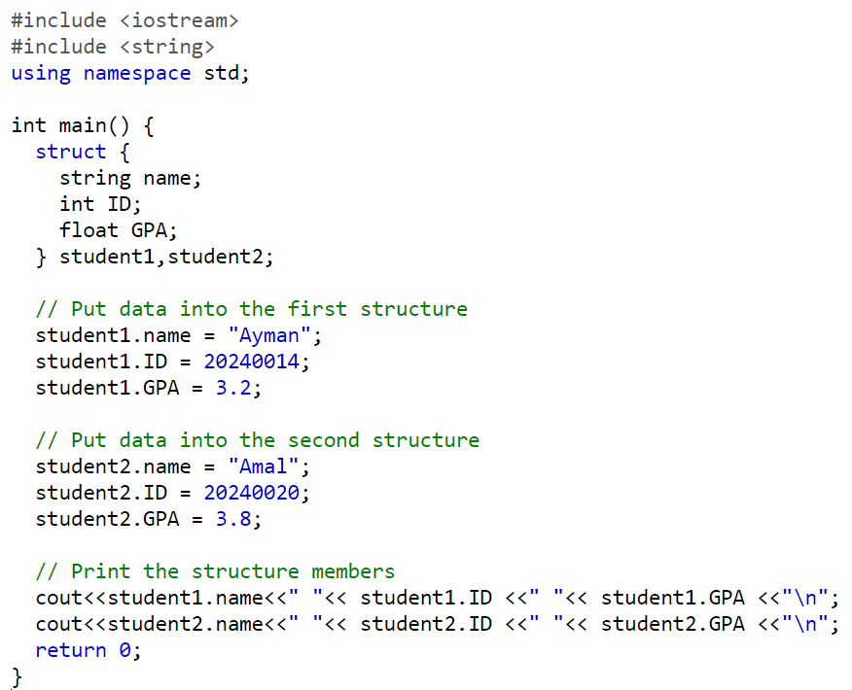

Slide 6
Array of Structure
1. Defining the Structure:
2. Declaring an Array of Structures:
struct student {
int id;
string name;
double gpa;
};
student students[10];
// An array of 10 Student structures
Notes:
Student students[10]; // An array of 10 Student structures

Slide 7
Array of Structure
3.Initialize of an array of structures
4. Display information of students
struct student students[3] = {
{ 1, "Ahmed", 3.1 },
{ 2, "Akram", 3.9 },
{ 3, "Zeyad", 3.8 }
};
for (int i = 0; i < 3; i++) {
cout<<"ID number:"<<students[i].id<<endl;
cout<< "Name:" <<students[i].name<<endl;
cout<<"GPA :"<<students[i].gpa<<endl;
}

Slide 8
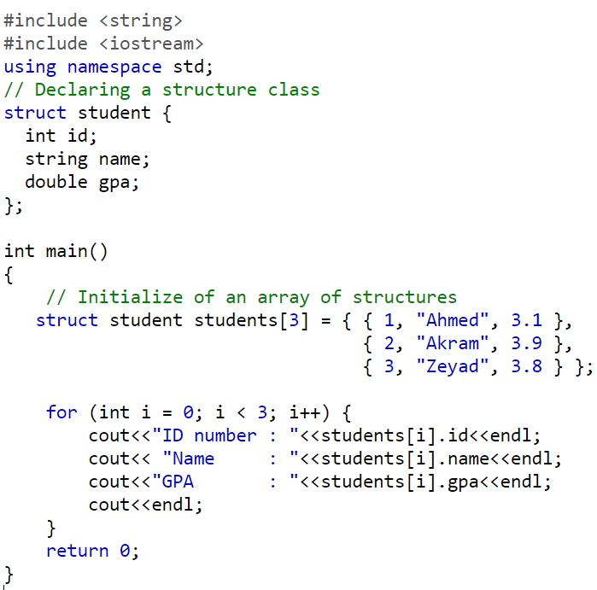
Notes:
#include <string>
#include <iostream>
using namespace std;
// Declaring a structure class
struct student {
int id;
string name;
double gpa;
};
int main()
{
// Initialize of an array of structures
struct student students[3] = { { 1, "Ahmed", 3.1 },
{ 2, "Akram", 3.9 },
{ 3, "Zeyad", 3.8 } };
for (int i = 0; i < 3; i++) {
cout<<"ID number : "<<students[i].id<<endl;
cout<< "Name : "<<students[i].name<<endl;
cout<<"GPA : "<<students[i].gpa<<endl;
cout<<endl;
}
return 0;
}

Slide 9
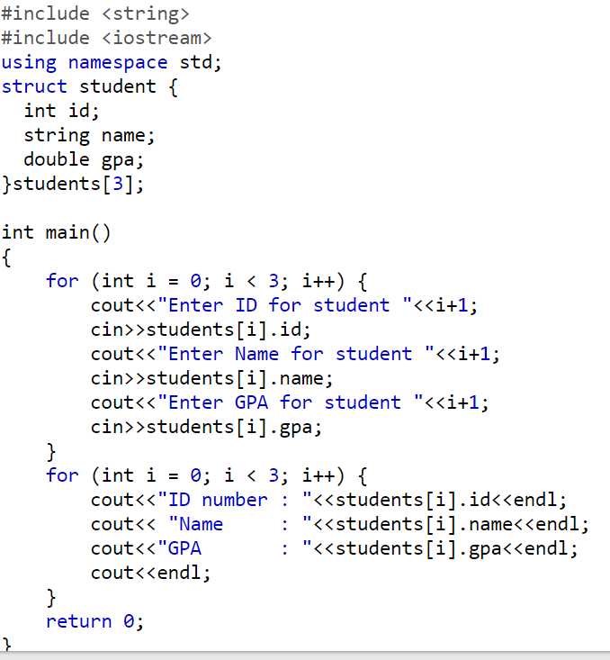
Notes:
#include <string>
#include <iostream>
using namespace std;
struct student {
int id;
string name;
double gpa;
}students[3];
int main()
{
for (int i = 0; i < 3; i++) {
cout<<"Enter ID for student "<<i+1;
cin>>students[i].id;
cout<<"Enter Name for student "<<i+1;
cin>>students[i].name;
cout<<"Enter GPA for student "<<i+1;
cin>>students[i].gpa;
}
for (int i = 0; i < 3; i++) {
cout<<"ID number : "<<students[i].id<<endl;
cout<< "Name : "<<students[i].name<<endl;
cout<<"GPA : "<<students[i].gpa<<endl;
cout<<endl;
}
return 0;
}

Slide 10
Example
Write a C++ program to calculate the GPA for multiple students, where all students are enrolled in the same set of courses.
Define a structure to represent a student (e.g., name, ID, and grades).
Define a structure to represent a course (e.g., course name and credit hours).
Accept input for each student’s information.
Accept input for each student’s grades in the common courses.
Calculate each student’s GPA based on their grades and the credit hours of the courses.
Display each student’s name, ID, and GPA.

Slide 11

$$GPA= \frac{\sum{\left(Grade Point∗Credit Hours\right)}}{\sum{Credit Hours}}$$
Grade | Grade Point
90–100 | 4.0
80–89 | 3.3
70–79 | 2.3
60–69 | 1.7
Below 60 | 0.0

Slide 12
#include <iostream>
#include <string>
using namespace std;
int numCourses = 3;
// Struct to store course info (common for all)
struct Course {
string courseName;
int creditHours;
};
// Struct to store student info
struct Student {
string name;
int id;
double grades[numCourses];
};
Notes:
#include <iostream>
#include <string>
using namespace std;
int numCourses = 3;
// Struct to store course info (common for all)
struct Course {
string courseName;
int creditHours;
};
// Struct to store student info
struct Student {
string name;
int id;
double grades[numCourses]; // Only grades needed
};
// Function to calculate GPA for a student
double calculateGPA(Student s, Course courses[]) {
double totalPoints = 0;
int totalCredits = 0;
double gradePoint;
for (int i = 0; i < numCourses; i++) {
if (s.grades[i] >= 90)
gradePoint = 4.0;
else if (s.grades[i] >= 80)
gradePoint = 3.0;
else if (s.grades[i] >= 70)
gradePoint = 2.0;
else if (s.grades[i] >= 60)
gradePoint = 1.0;
else
gradePoint = 0.0;
totalPoints += gradePoint * courses[i].creditHours;
totalCredits += courses[i].creditHours;
}
if (totalCredits == 0) return 0.0;
return totalPoints / totalCredits;
}
int main() {
// Define common courses
Course courses[numCourses] = {
{"Math", 3},
{"Physics", 4},
{"Computer Science", 3}
};
const int numStudents = 2;
Student students[numStudents];
// Input student data
for (int i = 0; i < numStudents; i++) {
cout << "Enter name of student " << i + 1 << ": ";
getline(cin, students[i].name);
cout << "Enter ID of student " << i + 1 << ": ";
cin >> students[i].id;
for (int j = 0; j < numCourses; j++) {
cout << " Enter grade for " << courses[j].courseName << ": ";
cin >> students[i].grades[j];
}
cin.ignore(); // Clear input buffer
cout << endl;
}
// Display GPA
for (int i = 0; i < numStudents; i++) {
cout << "Student: " << students[i].name << endl;
cout << "GPA: " << calculateGPA(students[i], courses) << endl;
cout << "------------------------" << endl;
}
return 0;
}

Slide 13
// Function to calculate GPA for a student
double calculateGPA(Student s, Course courses[]) {
double totalPoints = 0;
int totalCredits = 0;
double gradePoint;
for (int i = 0; i < numCourses; i++) {
if (s.grades[i] >= 90) gradePoint = 4.0;
else if (s.grades[i] >= 80) gradePoint = 3.0;
else if (s.grades[i] >= 70) gradePoint = 2.0;
else if (s.grades[i] >= 60) gradePoint = 1.0;
else gradePoint = 0.0;
totalPoints += gradePoint * courses[i].creditHours;
totalCredits += courses[i].creditHours;
}
if (totalCredits == 0) return 0.0;
return totalPoints / totalCredits;
}

Slide 14
int main() {
// Define common courses
Course courses[numCourses] = {
{"Math", 3},
{"Physics", 4},
{"Computer Programming", 3}
};
int numStudents = 2;
Student students[numStudents];

Slide 15
// Input student data
for (int i = 0; i < numStudents; i++) {
cout << "Enter name of student " << i + 1 << ": ";
getline(cin, students[i].name);
cout << "Enter ID of student " << i + 1 << ": ";
cin >> students[i].id;
for (int j = 0; j < numCourses; j++) {
cout << "Enter grade for " << courses[j].courseName << ": ";
cin >> students[i].grades[j];
}
cin.ignore(); // Clear input buffer
cout << endl;
}

Slide 16
// Display GPA
for (int i = 0; i < numStudents; i++) {
cout << "Student: " << students[i].name << endl;
cout << "GPA: " << calculateGPA(students[i], courses) << endl;
cout << "------------------------" << endl;
}
return 0;
}

Slide 17
Exercise
Define a structure named Employee with the following members: name (string), age (int), and salary (float).
Write a program that asks the user to input the details of an employee (name, age, and salary).
Create an array of Employee structures to store the details of 3 employees.
Write a loop to input the details of each employee.
Use another loop to display the details of all employees.

