Slide 1


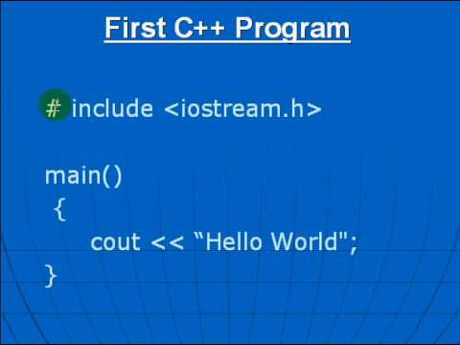
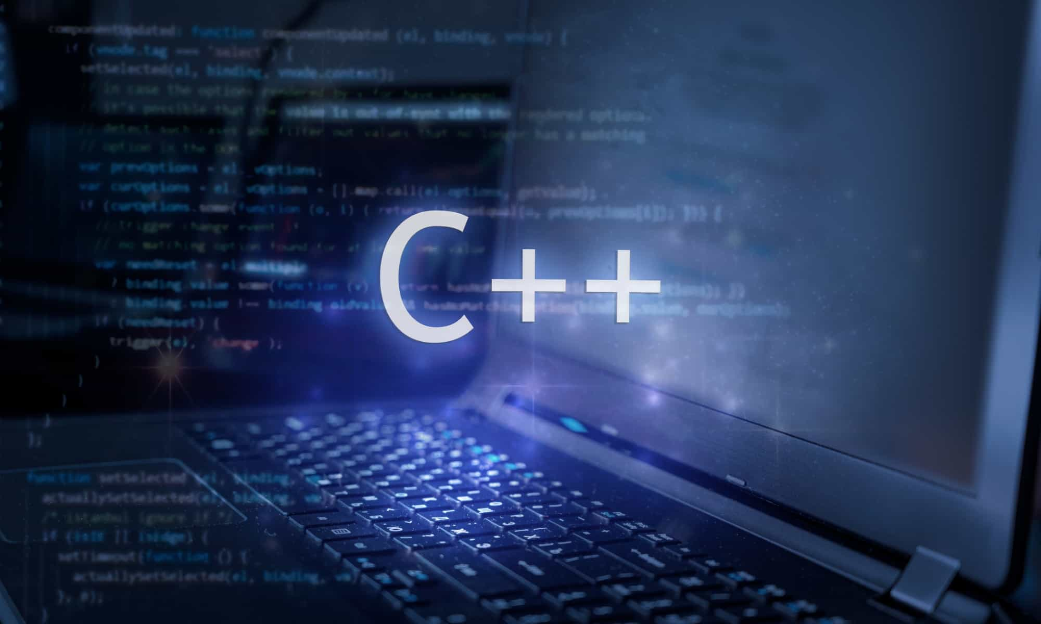
Al-Azhar University
Faculty of Engineering
Systems and Computer Engineering Dept.
Intelligent Systems Engineering Program
ENG 151
Computer Programming I
Prof. Ahmed Youssef

Slide 2
Al-Azhar University
Faculty of Engineering
Systems and Computer Engineering Dept.
Intelligent Systems Engineering Program
ENG 151
Computer Programming I
Pointer

Slide 3
Introduction
In C++, pointers are variables that store the memory addresses of other variables.
int* x; // a pointer to integer
double * x; // a pointer to double
float *x; // a pointer to float
char* ch // a pointer to a character

Slide 4
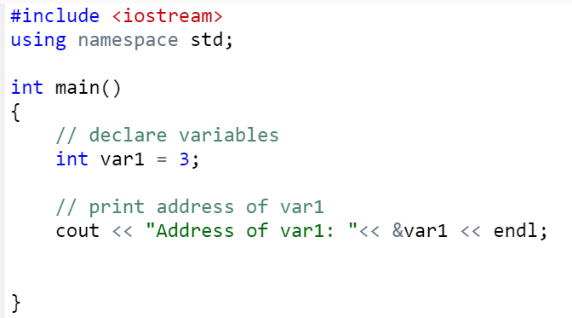
Printing Variable Addresses in C++
Address of var1: 0x50528c
Notes:
#include <iostream>
using namespace std;
int main() {
int var = 5;
int* pointVar = &var; // store address of var
cout << "var = " << var << endl; // print var
// print *pointVar
cout << "*pointVar = " << *pointVar << endl << endl;
cout << "Changing value of var to 7:" << endl;
var = 7;
cout << "var = " << var << endl; // print var
// print *pointVar
cout << "*pointVar = " << *pointVar << endl << endl;
cout << "Changing value of *pointVar to 16:" << endl;
*pointVar = 16;
cout << "var = " << var << endl; // print var
// print *pointVar
cout << "*pointVar = " << *pointVar << endl;
return 0;
}

Slide 5
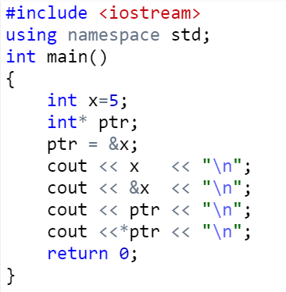
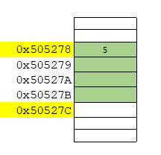
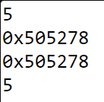
Example
Notes:
#include <iostream>
using namespace std;
int main()
{
int x=5;
int* ptr;
ptr = &x;
cout << x << "\n";
cout << &x << "\n";
cout << ptr << "\n";
cout <<*ptr << "\n";
return 0;
}

Slide 6
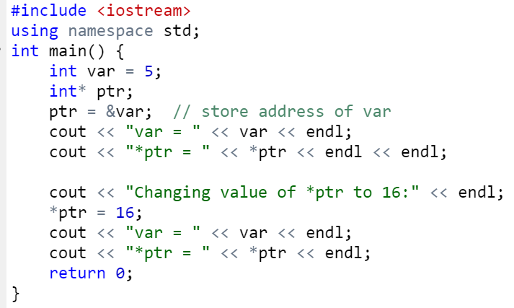
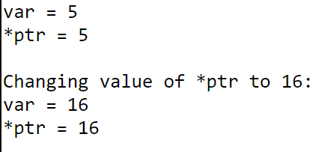
Changing Value Pointed by Pointers
Notes:
#include <iostream>
using namespace std;
int main() {
int var = 5;
int* ptr;
ptr = &var; // store address of var
cout << "var = " << var << endl;
cout << "*ptr = " << *ptr << endl << endl;
cout << "Changing value of *ptr to 16:" << endl;
*ptr = 16;
cout << "var = " << var << endl;
cout << "*ptr = " << *ptr << endl;
return 0;
}

Slide 7
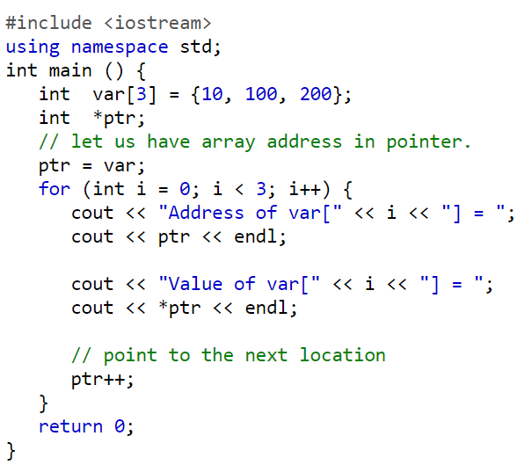
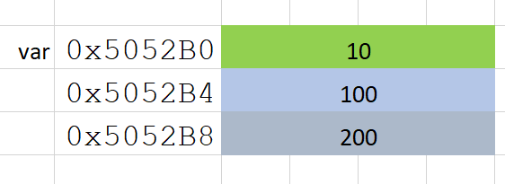
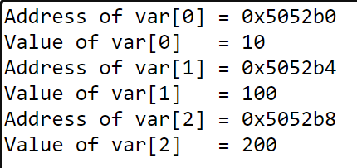
Pointer and Arrays
Notes:
#include <iostream>
using namespace std;
int main () {
int var[3] = {10, 100, 200};
int *ptr;
// let us have array address in pointer.
ptr = var;
for (int i = 0; i < 3; i++) {
cout << "Address of var[" << i << "] = ";
cout << ptr << endl;
cout << "Value of var[" << i << "] = ";
cout << *ptr << endl;
// point to the next location
ptr++;
}
return 0;
}

Slide 8
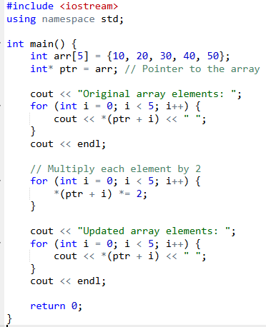

What is the output of this program?
Notes:
#include <iostream>
using namespace std;
int main() {
// Step 1: Create an array
int arr[5] = {10, 20, 30, 40, 50};
int* ptr = arr; // Pointer to the array
// Step 2: Use pointer to iterate and print the array elements
cout << "Original array elements: ";
for (int i = 0; i < 5; i++) {
cout << *(ptr + i) << " "; // Access elements using pointer arithmetic
}
cout << endl;
// Step 3: Modify each element using the pointer
for (int i = 0; i < 5; i++) {
*(ptr + i) *= 2; // Multiply each element by 2
}
// Step 4: Print the updated array
cout << "Updated array elements: ";
for (int i = 0; i < 5; i++) {
cout << *(ptr + i) << " ";
}
cout << endl;
return 0;
}

