Slide 1
Lecture 5
Boolean Algebra

Slide 2
Introduction
The Boolean algebra we present is an algebra dealing with binary variables and logic operations.
The variables are designated by letters of the alphabet, and the three basic logic operations are AND, OR, and NOT.
A Boolean expression is an algebraic expression formed by using binary variables, the constants 0 and 1, the logic operation symbols, and parentheses.
Boolean algebra is applied to reduce an expression for the purpose of obtaining a simpler circuit.
A Boolean function can be described by a Boolean equation consisting of a binary variable identifying the function followed by an equals sign and a Boolean expression.

Slide 3

Example
Consider an example Boolean equation:
Where, this Boolean equation representing electrical or electronic logic for control of the lowering of the driver’s power window in a car.
The function L means that the window motor is powered up to turn in the direction that lowers the window.
D is an output produced by pushing a panel switch on the inside of the driver’s door.
X is the output of a mechanical limit switch.

Slide 4
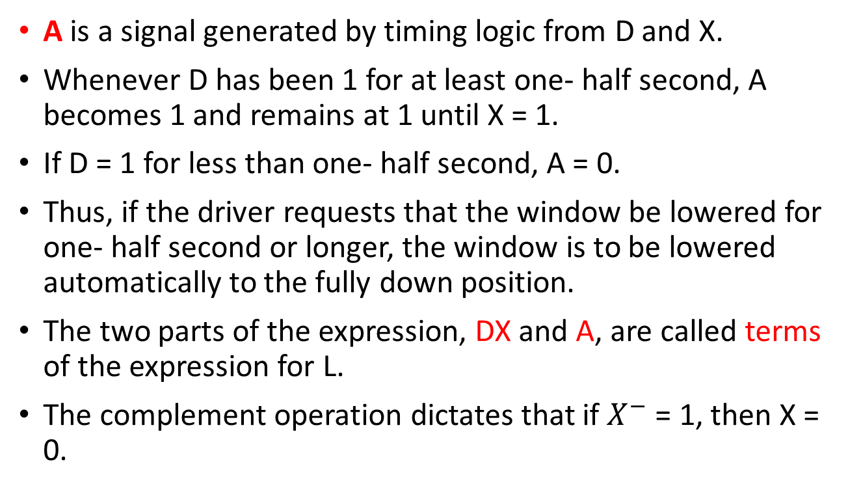
Cont.,
A is a signal generated by timing logic from D and X.
Whenever D has been 1 for at least one- half second, A becomes 1 and remains at 1 until X = 1.
If D = 1 for less than one- half second, A = 0.
Thus, if the driver requests that the window be lowered for one- half second or longer, the window is to be lowered automatically to the fully down position.
The two parts of the expression, DX and A, are called terms of the expression for L.
The complement operation dictates that if $X^{−}$ = 1, then X = 0.

Slide 5
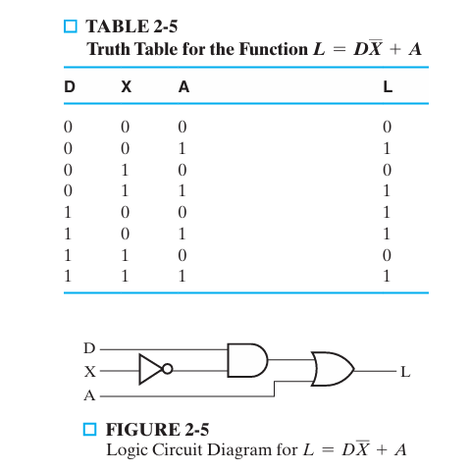

Slide 6
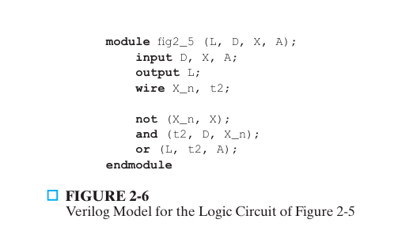
HDL Implementation

Slide 7
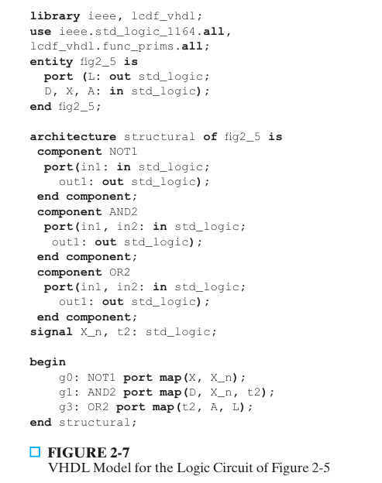

Slide 8
Logic Circuits
Combinational Logic Circuits.
Logic circuits of this type are called combinational logic circuits, since the variables are “combined” by the logical operations.
Sequential Logic circuits.
This is in contrast to the sequential logic, in which variables are stored over time as well as being combined.

Slide 9
Basic Identities of Boolean Algebra
By manipulating a Boolean expression according to Boolean algebraic rules, it is often possible to obtain a simpler expression for the same function.
This simpler expression reduces both the number of gates in the circuit and the numbers of inputs to the gates.
To see how this is done, we must first study the basic rules of Boolean algebra.
Table 2-6 lists the most basic identities of Boolean algebra.

Slide 10
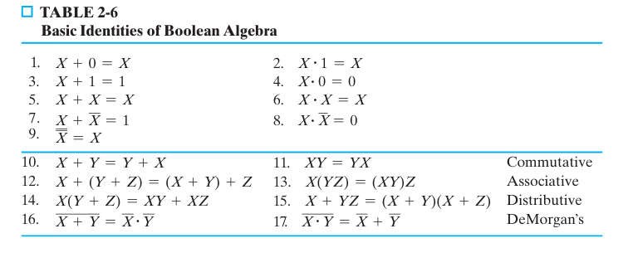

Slide 11
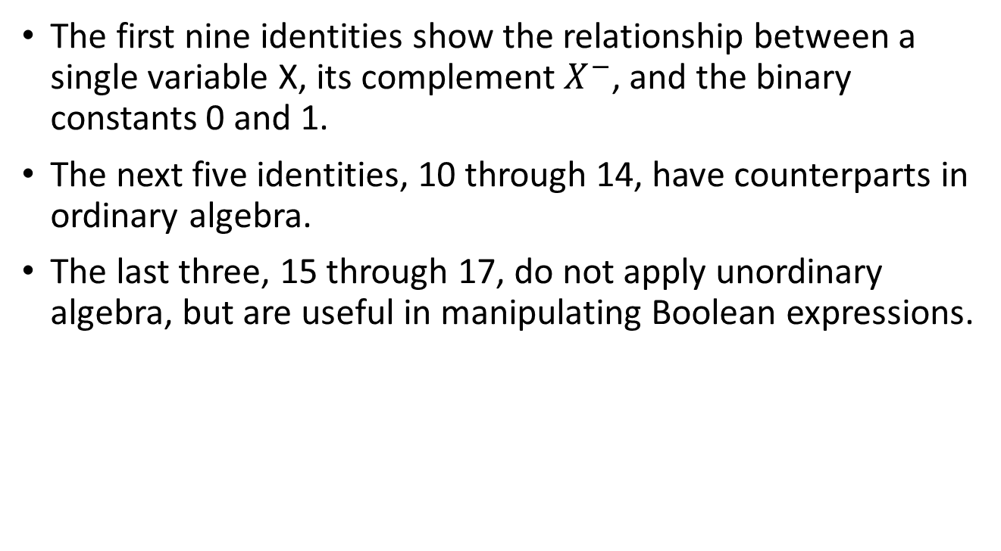
Note:
The first nine identities show the relationship between a single variable X, its complement $X^{−}$, and the binary constants 0 and 1.
The next five identities, 10 through 14, have counterparts in ordinary algebra.
The last three, 15 through 17, do not apply unordinary algebra, but are useful in manipulating Boolean expressions.

Slide 12
Duality of Boolean Algebra
The dual of an algebraic expression is obtained by interchanging OR and AND operations and replacing 1s by 0s and 0s by 1s.
An equation in one column of table 2.6, can be obtained from the corresponding equation in the other column by taking the dual of the expressions on both sides of the equals sign.
For example, relation 2 is the dual of relation 1 because the OR has been replaced by an AND and the 0 by 1.
It is important to note that most of the time the dual of an expression is not equal to the original expression, so that an expression usually cannot be replaced by its dual.

Slide 13
Precedence of Operations
Parenthesis ( )
NOT
AND,
OR

Slide 14

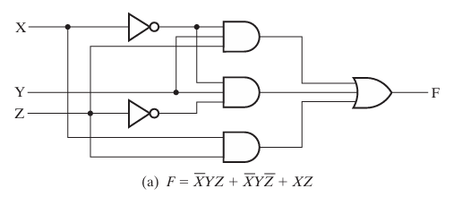
Algebraic Manipulation
Boolean algebra is a useful tool for simplifying digital circuits.
Consider, for example, the Boolean function represented by:
The gate implementation without simplification:

Slide 15
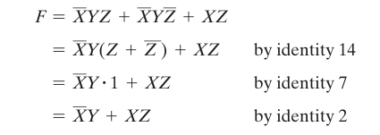
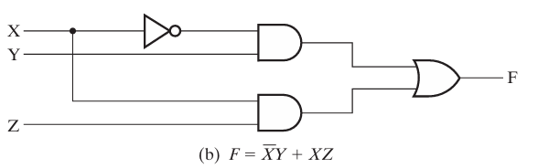
Cont.,
Now consider a simplification of the expression for F by applying some of the identities listed in Table 2-6:
The gate implementation with simplification:

Slide 16
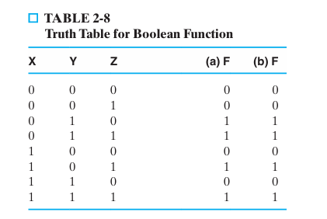

Slide 17
Note:
When a Boolean equation is implemented with logic gates, each term requires a gate, and each variable within the term designates an input to the gate.
We define a literal as a single variable within a term that may or may not be complemented.
The expression for the function in Figure 2-8(a) has three terms and eight literals; the one in Figure 2-8(b) has two terms and four literals.
By reducing the number of terms, the number of literals, or both in a Boolean expression, it is often possible to obtain a simpler circuit.

Slide 18


Examples
The following examples use identities from Table 2-6 to illustrate a few of the possibilities:

Slide 19


Assignment
Proof the following Boolean expression (consensus theorem ) by using Identities ():
Also, Proof the dual of the consensus theorem:

Slide 20
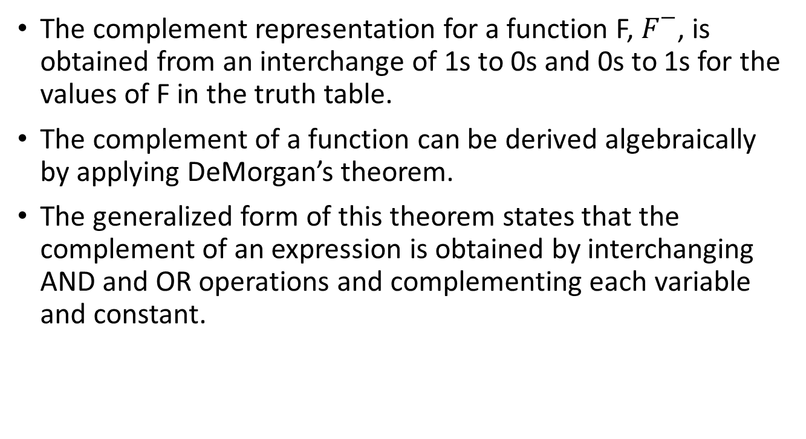
Complementing Function By Using DeMorgan’s theorem
The complement representation for a function F, $F^{−}$, is obtained from an interchange of 1s to 0s and 0s to 1s for the values of F in the truth table.
The complement of a function can be derived algebraically by applying DeMorgan’s theorem.
The generalized form of this theorem states that the complement of an expression is obtained by interchanging AND and OR operations and complementing each variable and constant.

Slide 21
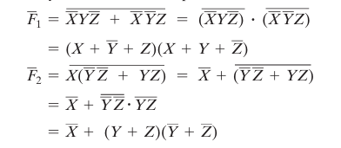
Example
Find the complement of each of the functions represented by the equations:
Solution:
By applying DeMorgan’s theorem:

Slide 22
Complementing Functions by using Duals
A simpler method for deriving the complement of a function is to take the dual of the function equation and complement each literal.
This method follows from the generalization of DeMorgan’s theorem.
Remember that the dual of an expression is obtained by interchanging AND and OR operations and 1s and 0s.
To avoid confusion in handling complex functions, adding parentheses around terms before taking the dual is helpful, as illustrated in the next example.

Slide 23
Example
Find the complements of the functions in the above Example by taking the duals of their equations and complementing each literal.
Solution:

Slide 24
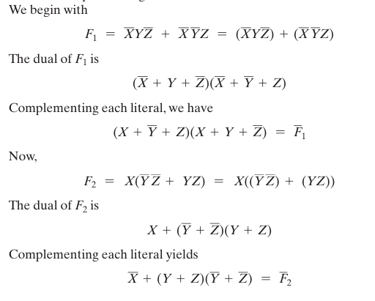

Slide 25
Home Work
Sheet 2, PP . 102 at text book

