Slide 1
House Price Prediction
Using Machine Learning and Streamlit Web App
Presented by:
Moaz Mohamed
Mai Mahmoud

Slide 2
Project Overview
Predict house sale prices.
Use regression techniques with structured data.
Build a web app using Streamlit.

Slide 3
Dataset Introduction
Source: Kaggle - House Prices.
79 explanatory variables.
Target: SalePrice.

Slide 4
Tools and Libraries
Pandas
NumPy
Matplotlib, Seaborn
Random Forest Regressor
Joblib
Streamlit

Slide 5
Data Preprocessing
Handling missing values
Encode categorical features
Scale numerical features
Feature engineering

Slide 6
Exploratory Data Analysis
Correlation with SalePrice
Identify key features (e.g., OverallQual, GrLivArea)

Slide 7
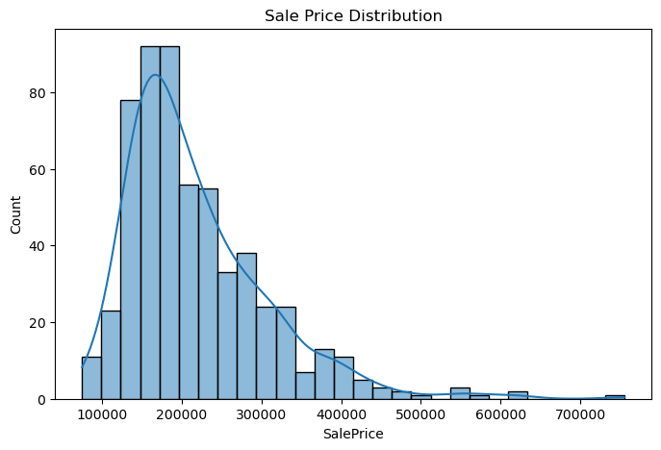
Target Variable Distribution
Visualized SalePrice.
Log transformation reduced skewness.

Slide 8
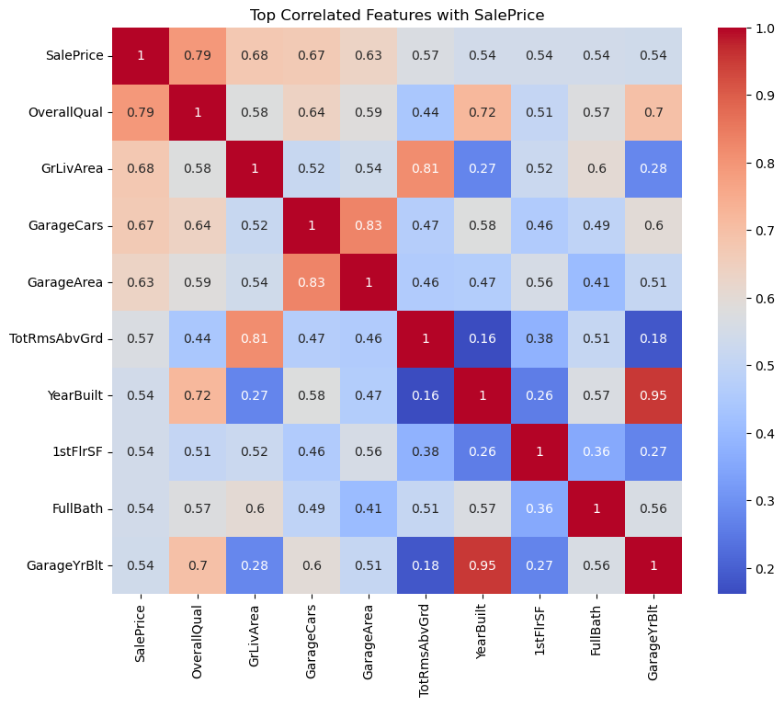
Correlation Matrix
Heatmap of feature correlation with SalePrice.

Slide 9
Handling Categorical Data
One-hot encoding
Label encoding for ordered categories

Slide 10
Model Selection
Linear, RF
Best: [Random Forest Regressor]

Slide 11
Model Evaluation Metrics
R² Score
RMSE

Slide 12
Final Model Performance
R²: 77%
RMSE: $46000 (approx.)

Slide 13
Saving the Model
Used joblib to save:
Trained model (pkl)
Feature columns

Slide 14
Streamlit App Overview
Users input key features
Click 'Predict' to estimate price

Slide 15
App Interface
Number inputs for features
Predict button returns price

Slide 16
Sample Prediction
GrLivArea: 1500
OverallQual: 7
GarageCars: 2
Predicted Price: $245,000

Slide 17
Model Limitations
Limited to the houses that are in the same location to the houses in the dataset
Sensitive to feature selection
Requires clean input

Slide 18
Future Improvements
Add geo features
Cloud deployment

Slide 19
Thank You

