Slide 1
Data Mining
Department of Computer Sciences
Quaid-i-Azam University
Lecture#5
Readngs: Han and Kamber Section 2.2-2.4
Adapted from data mining books by Han and Kamber, Pang Ning et al. and Leskovic et al.

Slide 2
Learning Objectives
To understand measures of central tendency and basic graphical displays

Slide 3
Knowing the Data
Basic Statistical Descriptions
Motivation
To better understand the data distribution, get an overall picture, and identify typical properties

Slide 4
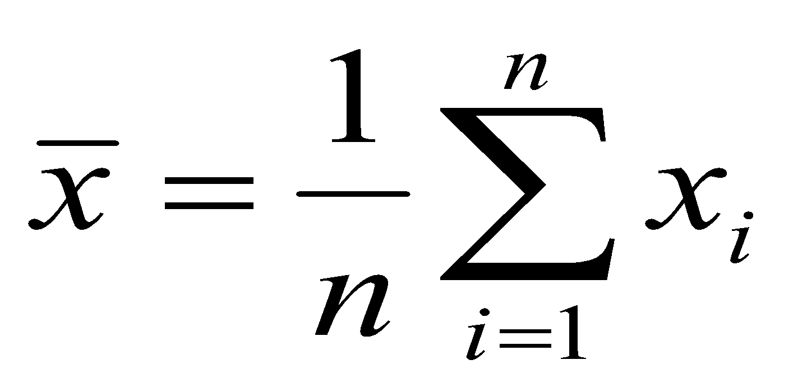
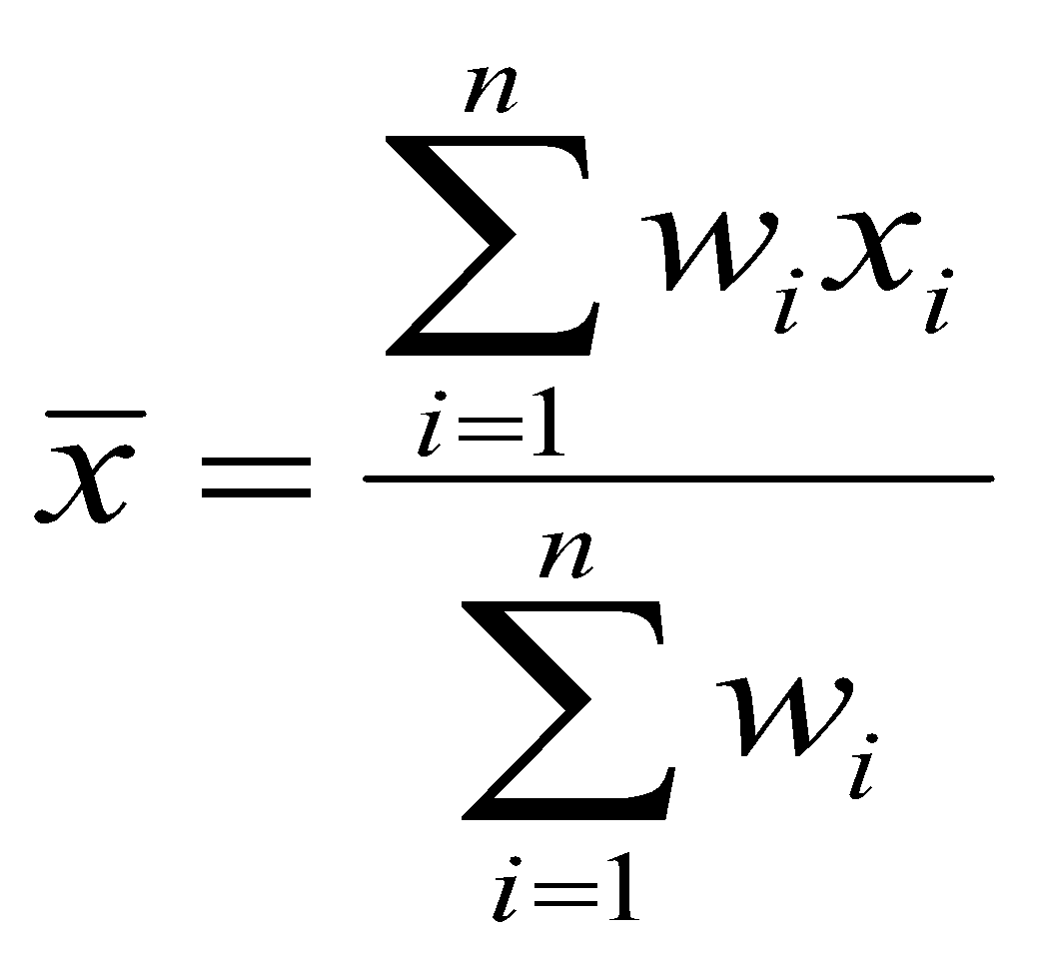
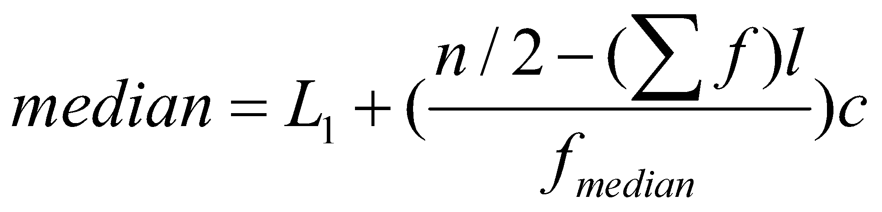
Measuring the Central Tendency
Mean
Weighted arithmetic mean
Trimmed mean
mean is sensitive to extreme/outlier values
chopping extreme values
Median
Better measure for skewed data
Holistic measure
Can only be computed on the entire data set
Middle value if odd number of values, or average of the middle two values otherwise
Estimated by interpolation (for grouped data)

Slide 5
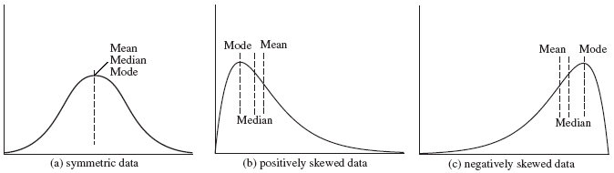
Measuring the Central Tendency (contd…)
Mode
Value that occurs most frequently in the data
Unimodal, bimodal, trimodal
Empirical formula
For unimodal frequency curves that are moderately skewed

Slide 6
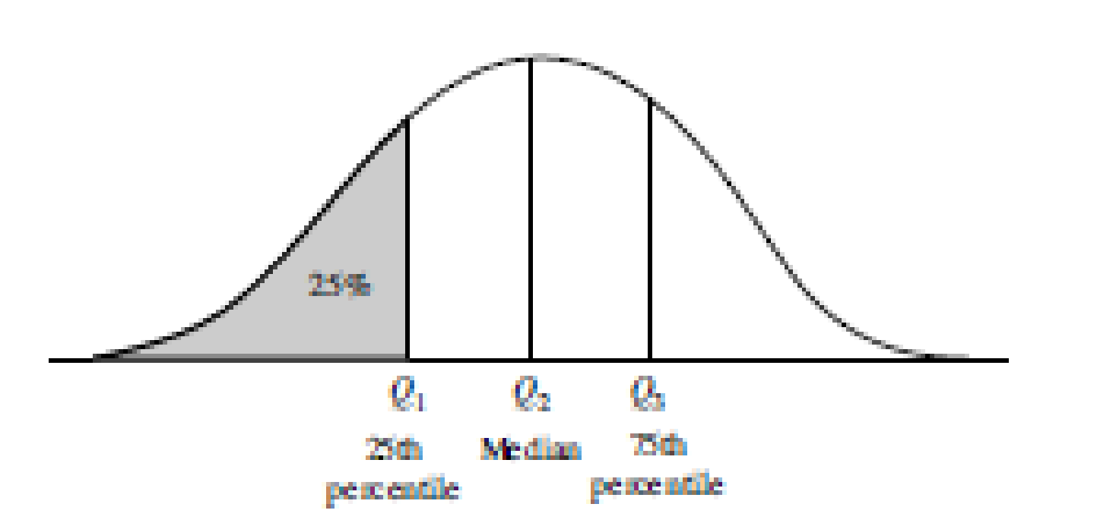
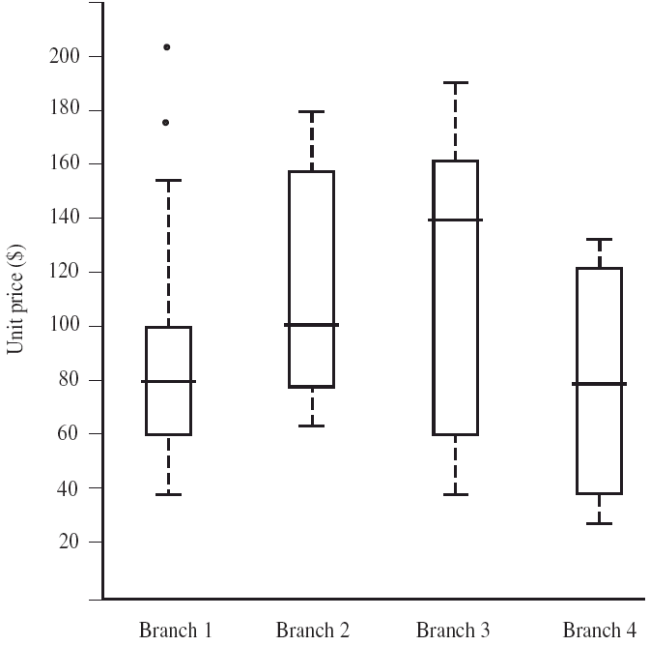
Measuring the Dispersion of Data
Degree to which numerical data tend to spread
Range, Quartiles, outliers and boxplots
Range: Difference between largest and smallest value
Quartiles: Q1 (25th percentile), Q3 (75th percentile)
Inter-quartile range: IQR = Q3 – Q1
Outlier: usually, a value higher/lower than 1.5 x IQR
Five number summary: min, Q1, M, Q3, max
Boxplot: ends of the box are the quartiles, median is marked, whiskers, and plot outlier individually

Slide 7
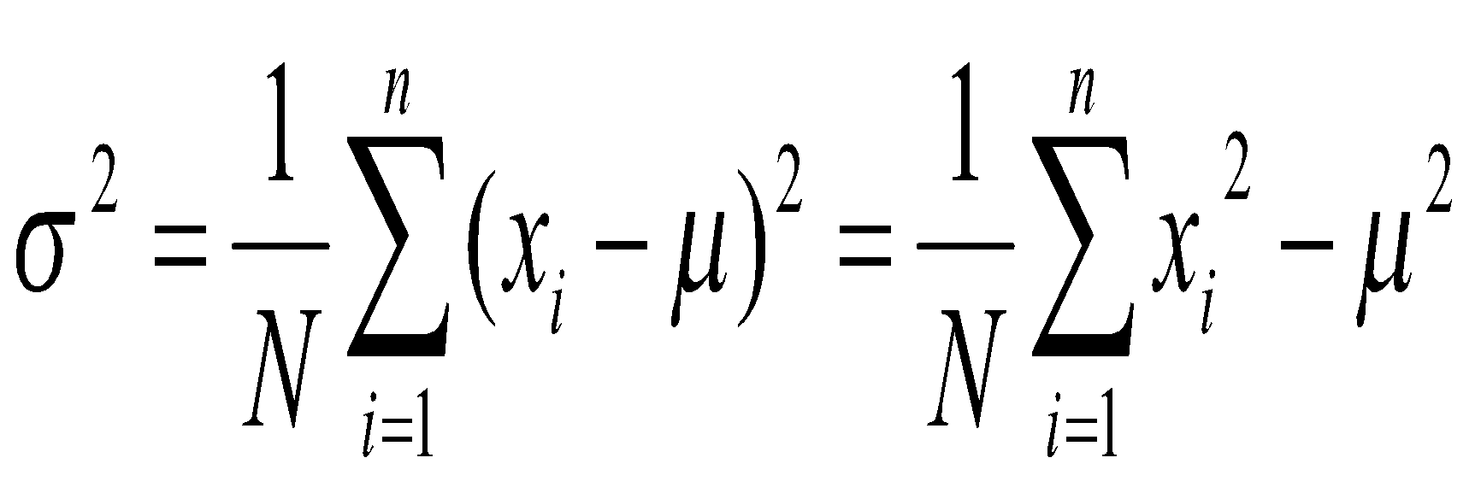
Measuring the Dispersion of Data (contd…)
Variance and standard deviation (sample: s, population: σ)
Variance: (algebraic, scalable computation)
Standard deviation s (or σ) is the square root of variance s² ⁽or σ²⁾

Slide 8
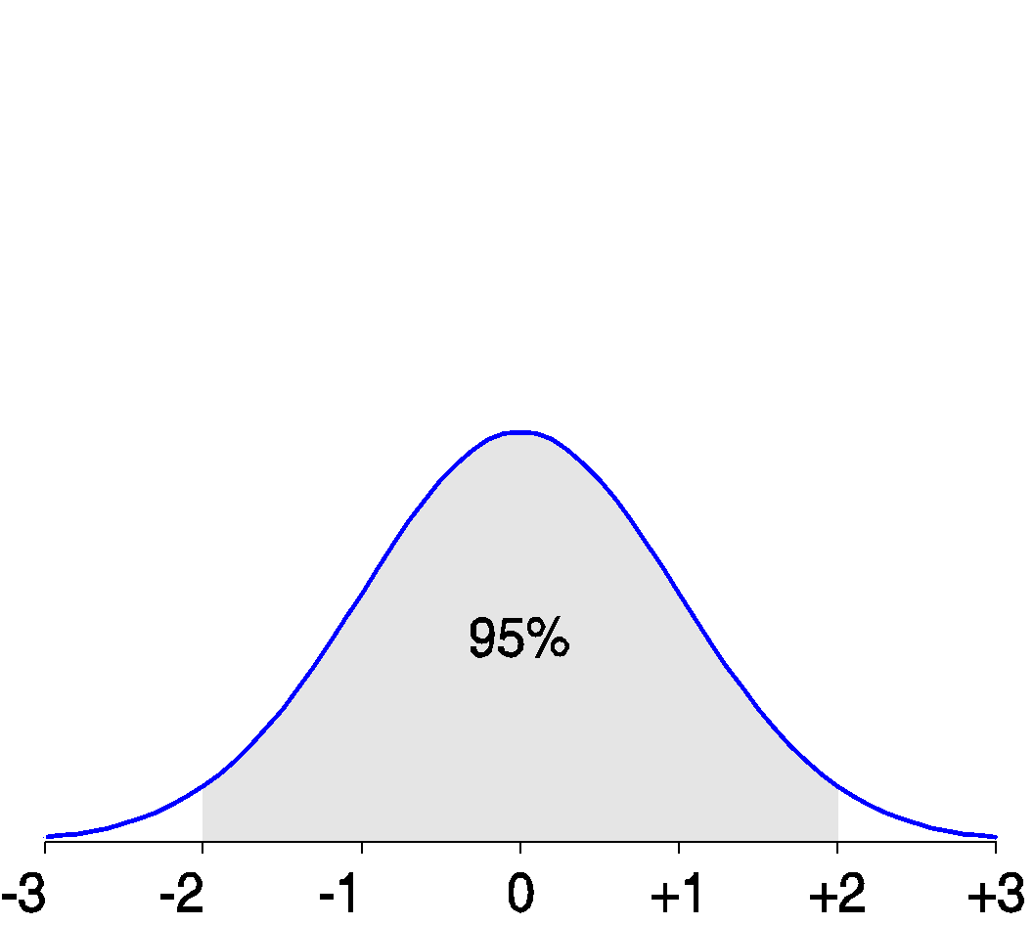
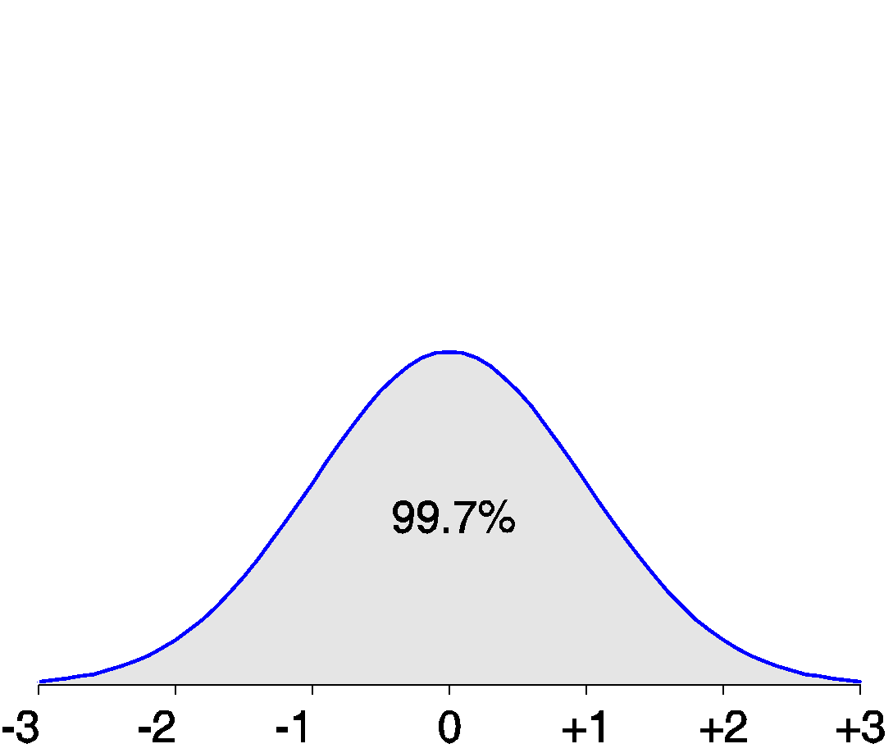
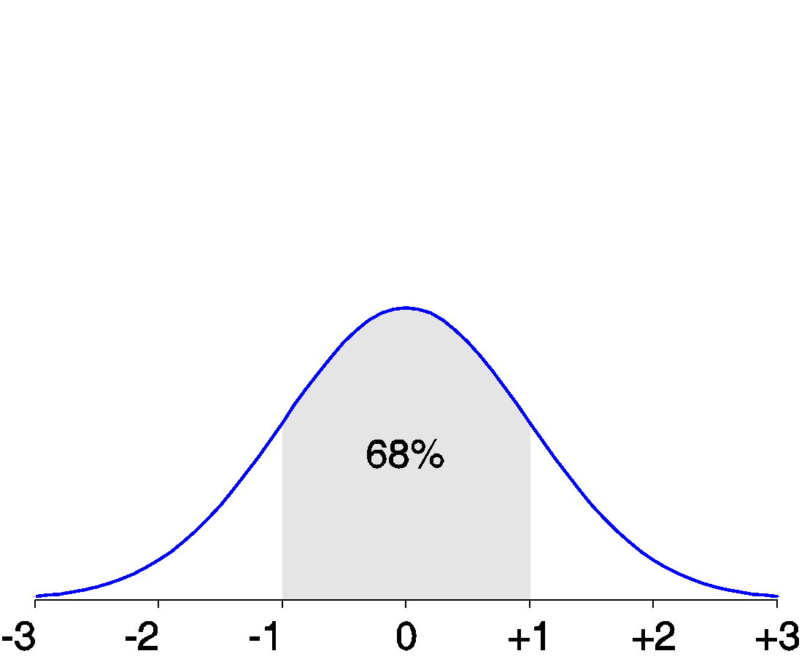
Properties of Normal Distribution Curve
The normal (distribution) curve
From μ–σ to μ+σ: contains about 68% of the measurements (μ: mean, σ: standard deviation)
From μ–2σ to μ+2σ: contains about 95% of it
From μ–3σ to μ+3σ: contains about 99.7% of it

Slide 9
Graphic Displays of Basic Statistical Descriptions
Motivation
To better understand the data, get an overall picture, and identify typical properties

Slide 10

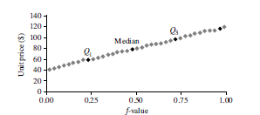
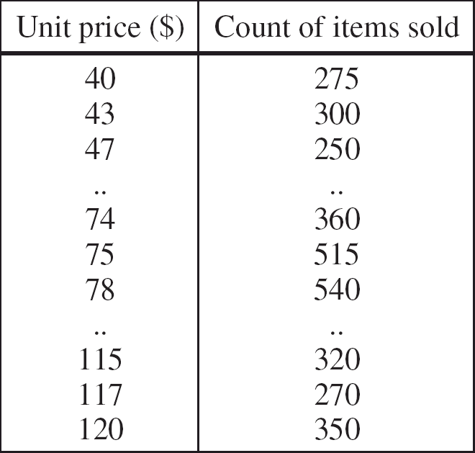
Quantile Plot
Displays all of the data (allowing the user to assess both the overall behavior and unusual occurrences)
Plots quantile information
For a data x_{i} data sorted in increasing order, f_{i} indicates that approximately 100 f_{i}% of the data are below or equal to the value x_{i}

Slide 11
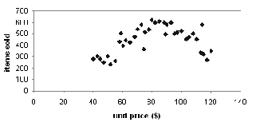
Scatter plot
Provides a first look at bivariate data to see clusters of points, outliers, etc
Each pair of values is treated as a pair of coordinates and plotted as points in the plane

Slide 12
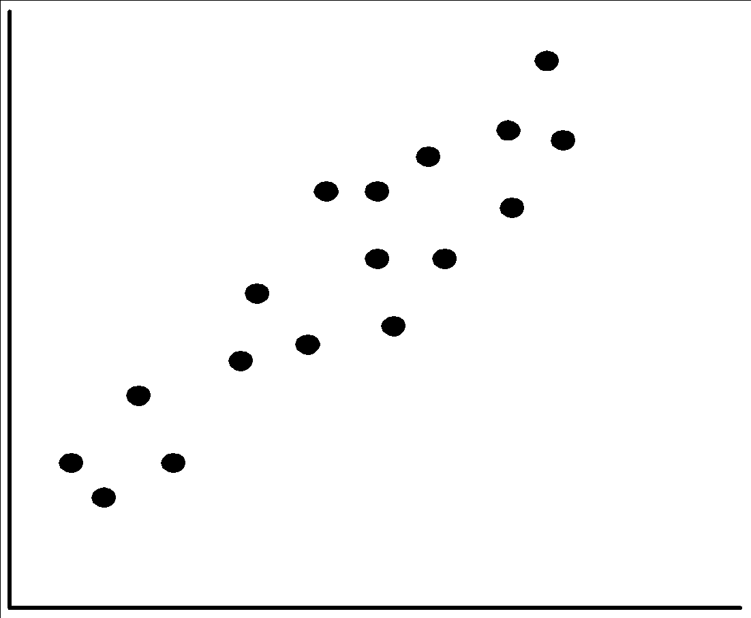
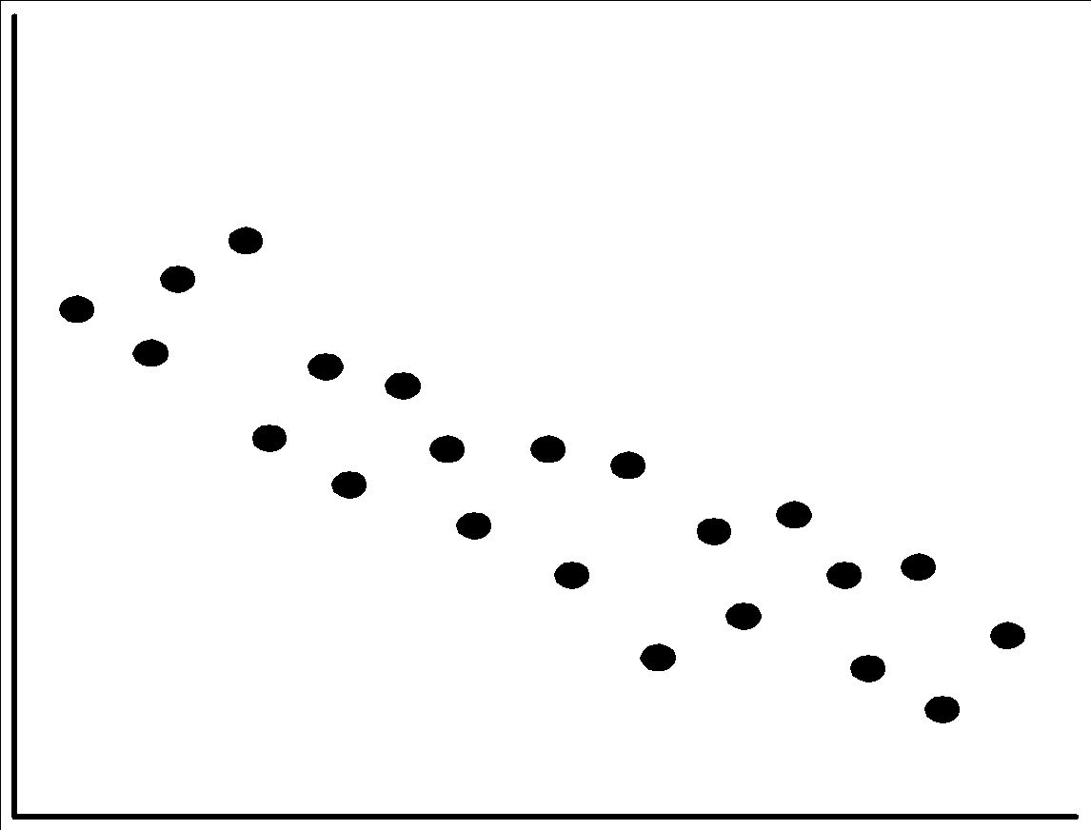
Positively and Negatively Correlated Data

Slide 13
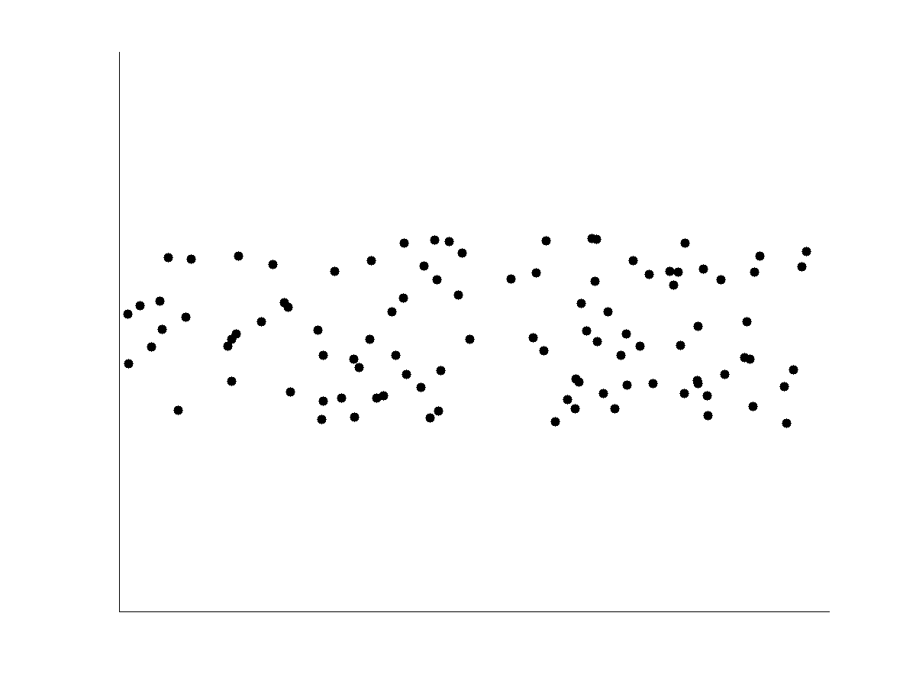
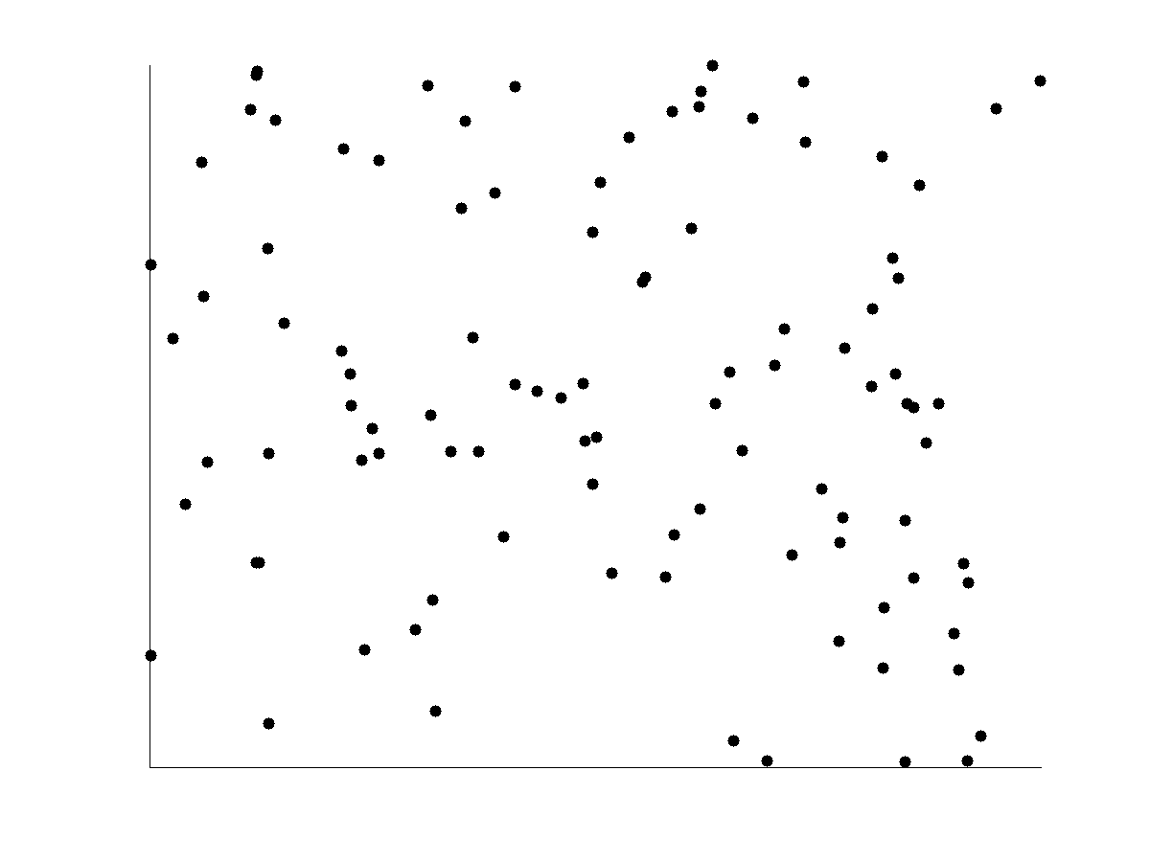
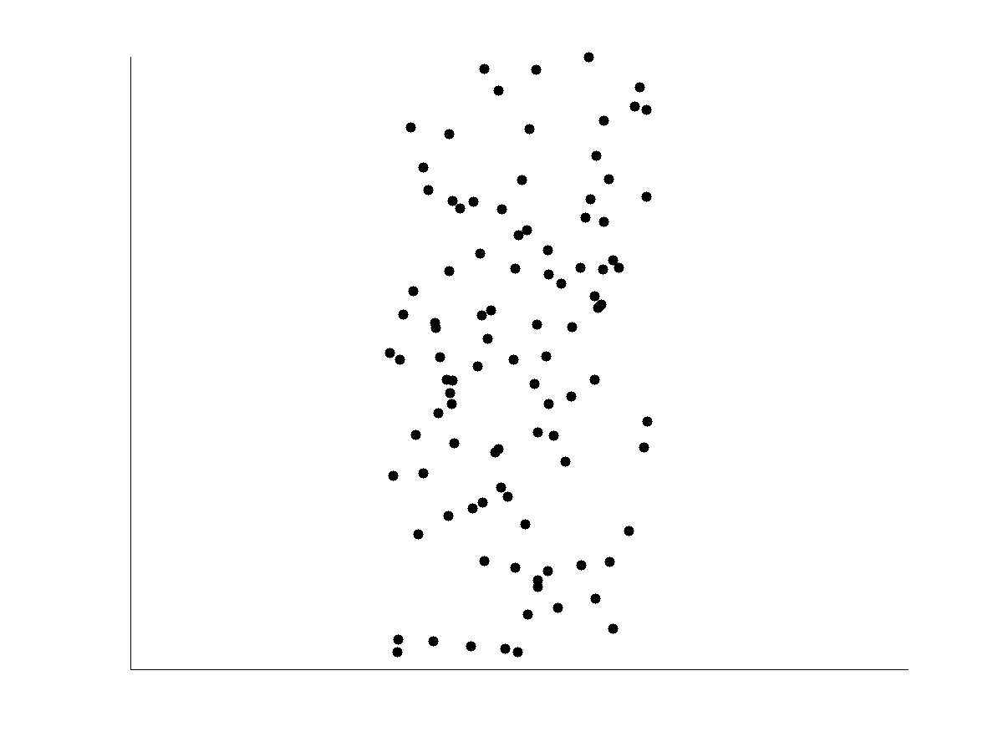
Not Correlated Data

Slide 14
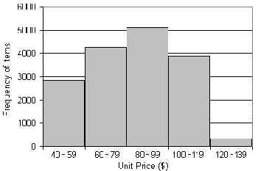
Histogram Analysis
Graph displays of basic statistical class descriptions
Frequency histograms
A univariate graphical method
Consists of a set of rectangles that reflect the counts or frequencies of the classes present in the given data

Slide 15
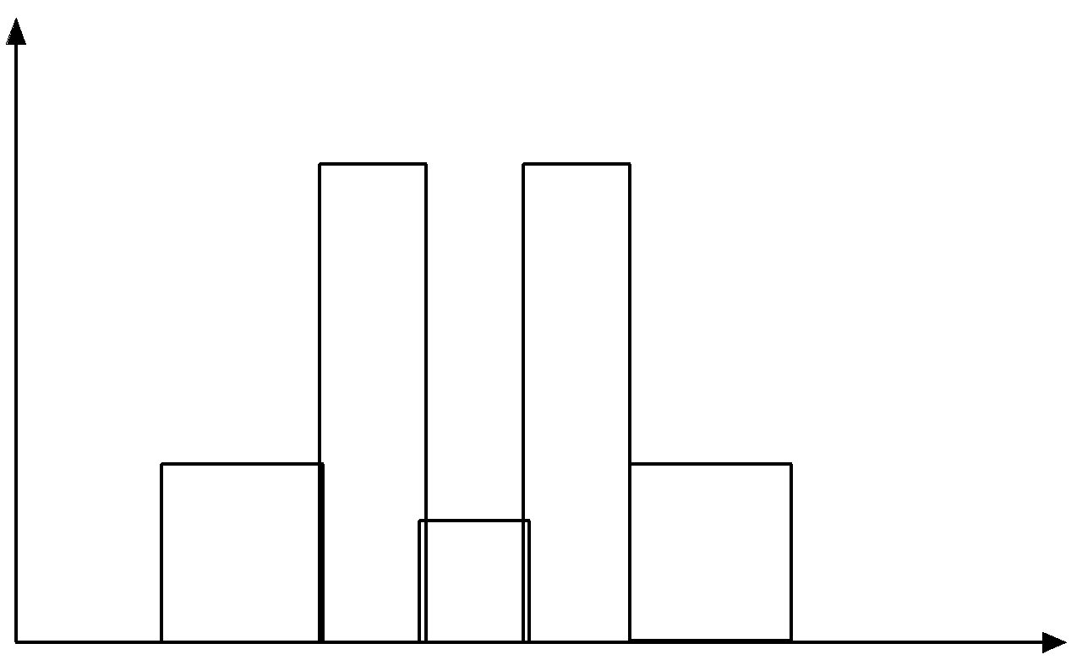
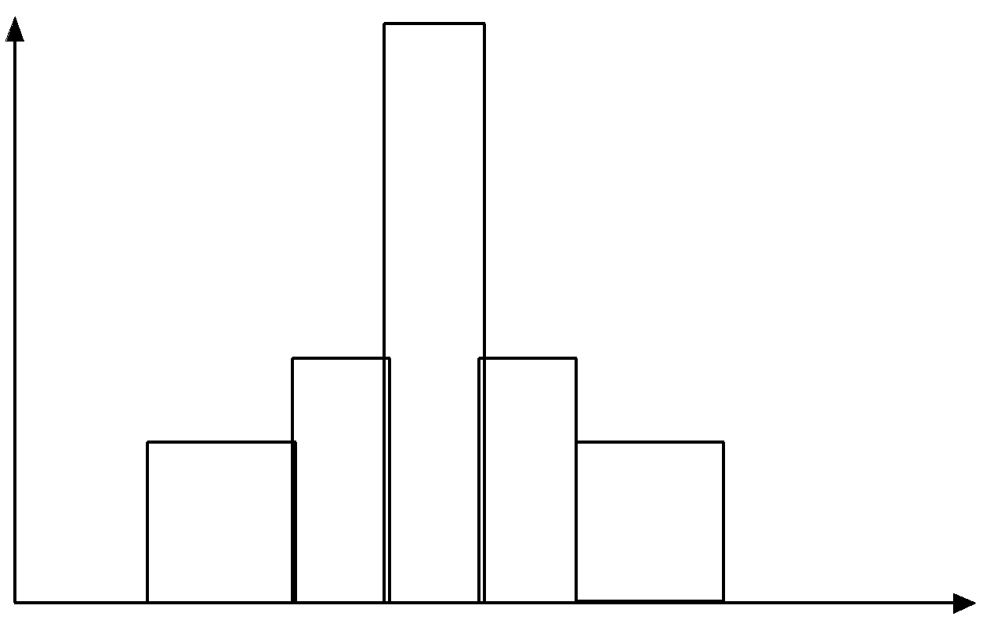
Histograms Often Tell More than Boxplots
The two histograms shown in the left may have the same boxplot representation
The same values for: min, Q1, median, Q3, max
But they have rather different data distributions

Slide 16
Similarity and Dissimilarity
Similarity
Numerical measure of how alike two data objects are
Value is higher when objects are more alike
Often falls in the range [0,1]
Dissimilarity (e.g., distance)
Numerical measure of how different two data objects are
Lower when objects are more alike
Minimum dissimilarity is often 0
Upper limit varies
Proximity refers to a similarity or dissimilarity

Slide 17
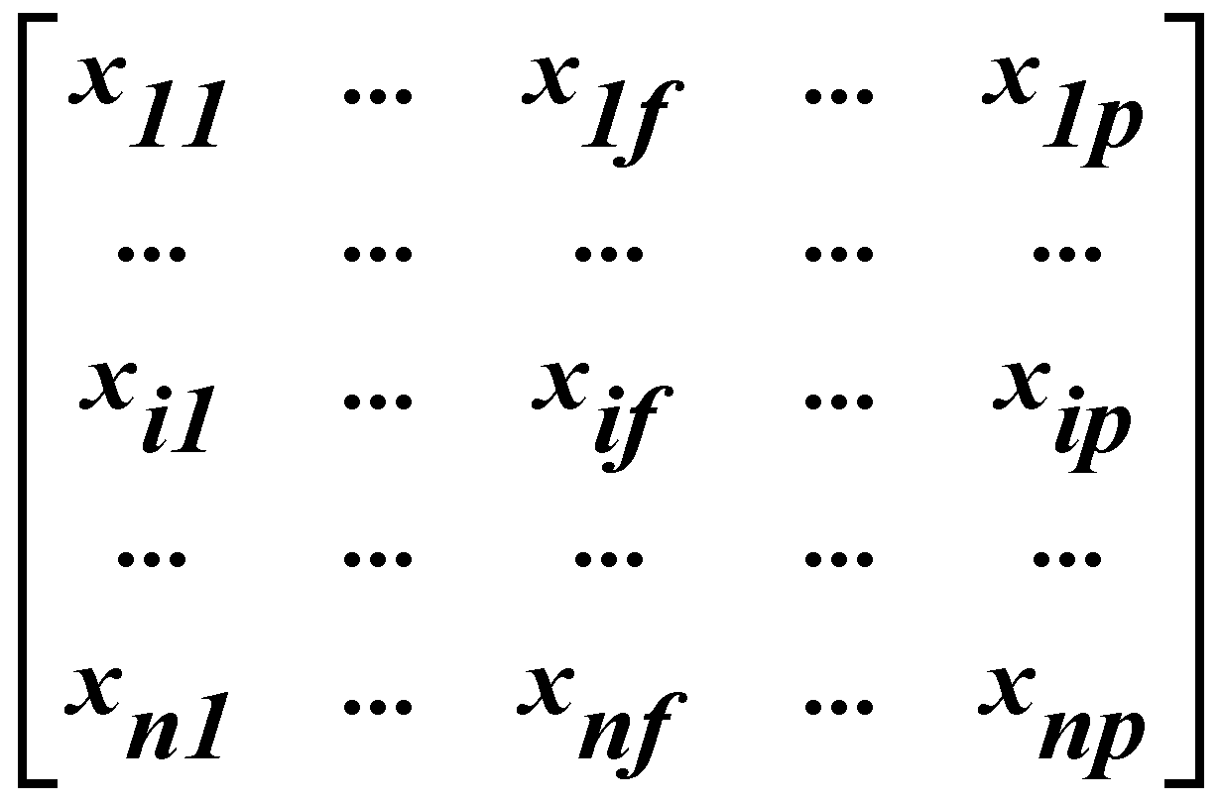
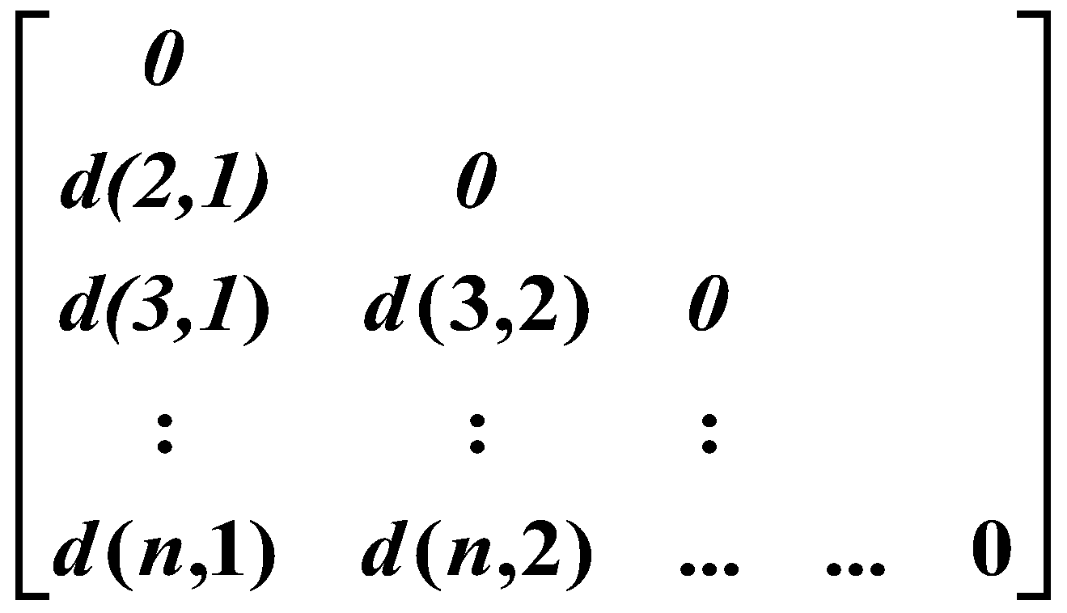
Data Matrix and Dissimilarity Matrix
Data matrix
n data points with p dimensions
Two modes
Dissimilarity matrix
n data points, but registers only the distance
A triangular matrix
Single mode

Slide 18
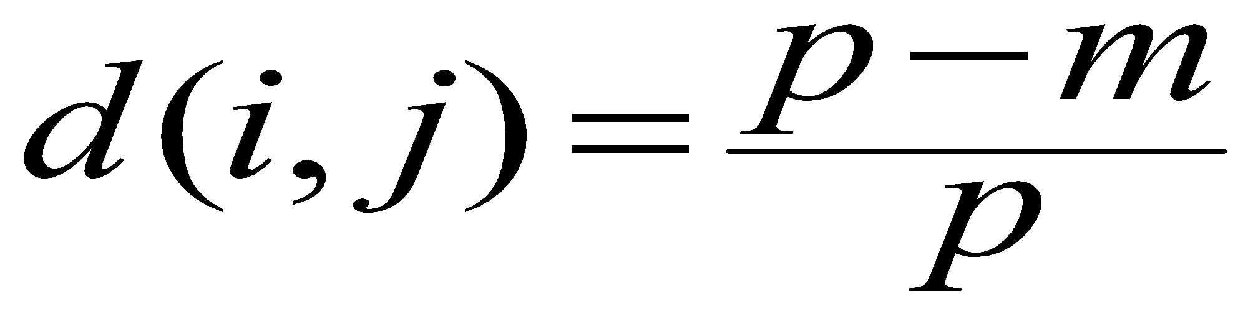
Proximity Measure for Nominal Attributes
Can take 2 or more states, e.g., red, yellow, blue, green (generalization of a binary attribute)
Method 1: Simple matching
m: # of matches, p: total # of variables
Method 2: Use a large number of binary attributes
creating a new binary attribute for each of the M nominal states

Slide 19
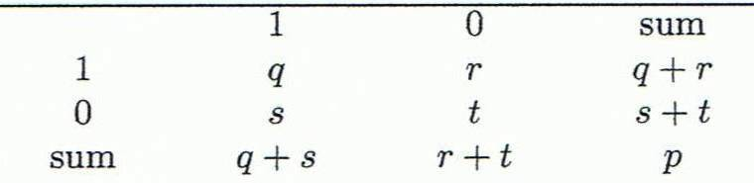
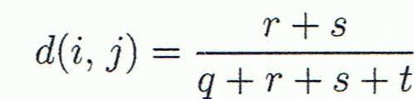
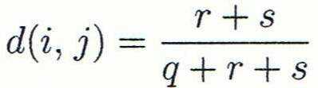

Proximity Measure for Binary Attributes
Object j
A contingency table for binary data
Distance measure for symmetric binary variables:
Distance measure for asymmetric binary variables:
Jaccard coefficient (similarity measure for asymmetric binary variables):
Object i
Note: Jaccard coefficient is the same as “coherence”:

Slide 20
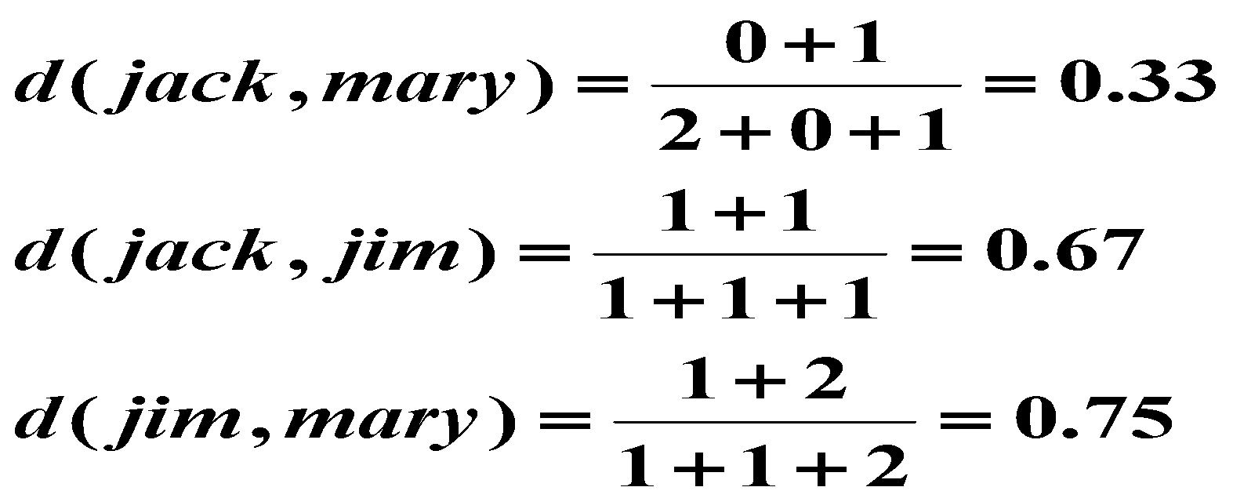
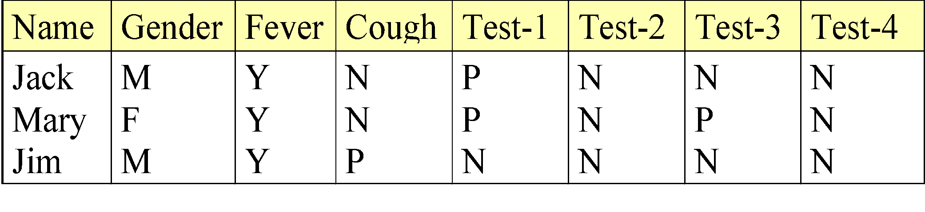
Dissimilarity between Binary Variables
Example
Gender is a symmetric attribute
The remaining attributes are asymmetric binary
Let the values Y and P be 1, and the value N 0

Slide 21
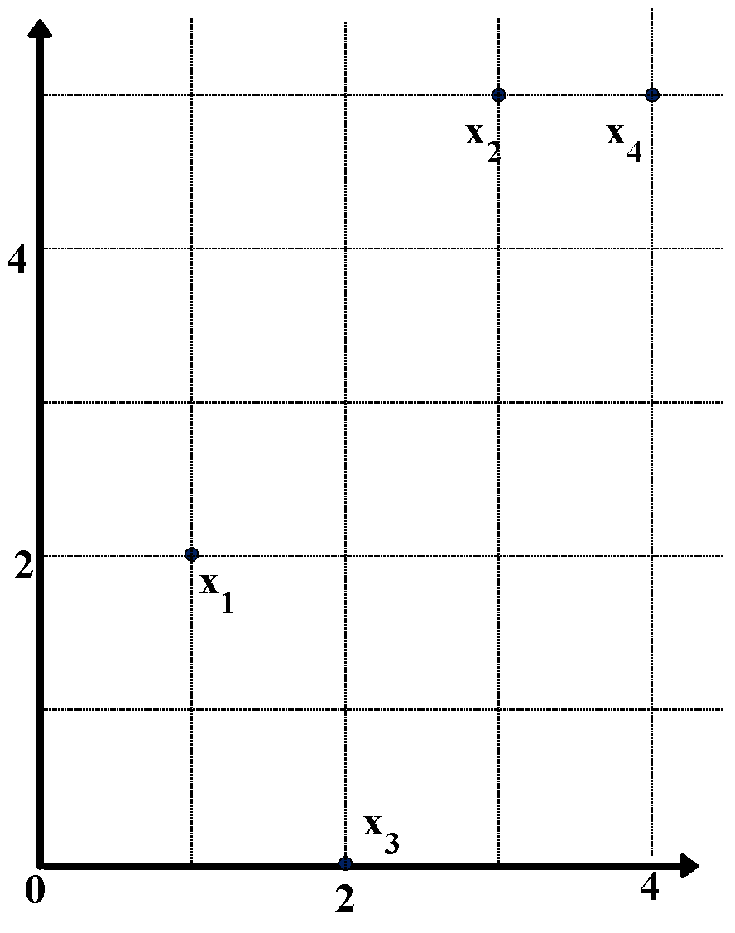
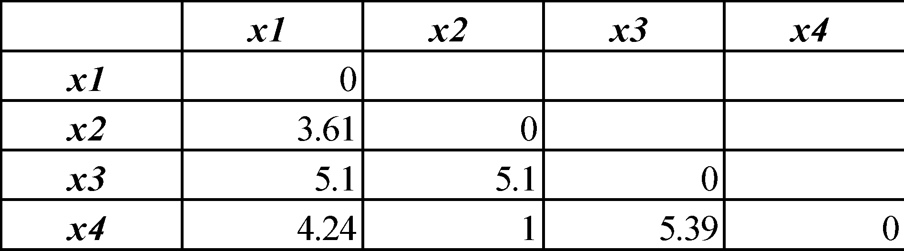
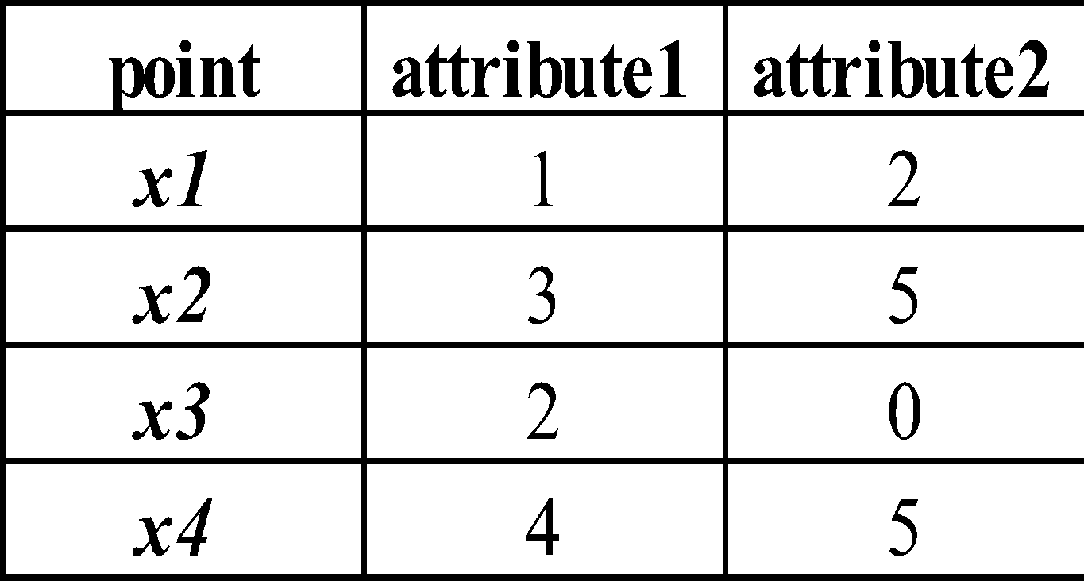
Example: Data Matrix and Dissimilarity Matrix
Data Matrix
Dissimilarity Matrix
(with Euclidean Distance)

Slide 22
Distance on Numeric Data: Minkowski Distance
Minkowski distance: A popular distance measure
where i = (x_{i1}, x_{i2}, …, x_{ip}) and j = (x_{j1}, x_{j2}, …, x_{jp}) are two p-dimensional data objects, and h is the order (the distance so defined is also called L-h norm)
Properties
d(i, j) > 0 if i ≠ j, and d(i, i) = 0 (Positive definiteness)
d(i, j) = d(j, i) (Symmetry)
d(i, j) ≤ d(i, k) + d(k, j) (Triangle Inequality)
A distance that satisfies these properties is a metric

Slide 23
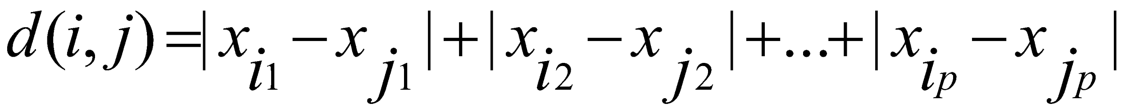
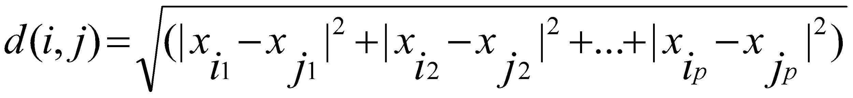
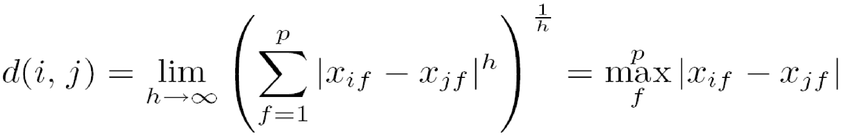
Special Cases of Minkowski Distance
h = 1: Manhattan (city block, L₁ norm) distance
E.g., the Hamming distance: the number of bits that are different between two binary vectors
h = 2: (L₂ norm) Euclidean distance
h → ∞. “supremum” (L_{max} norm, L∞ norm) distance.
This is the maximum difference between any component (attribute) of the vectors

Slide 24
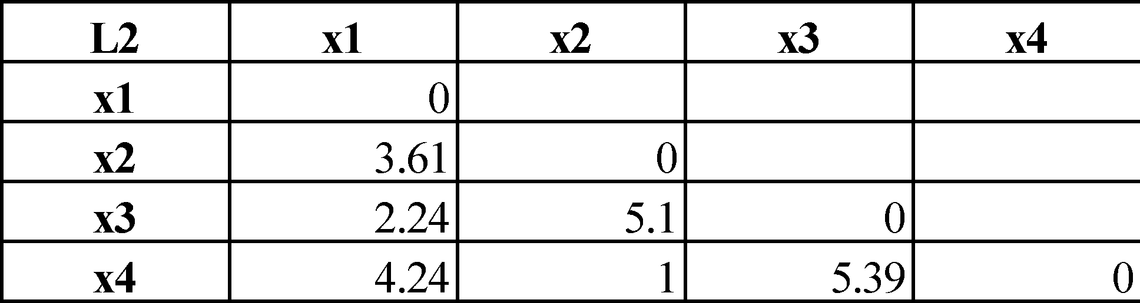
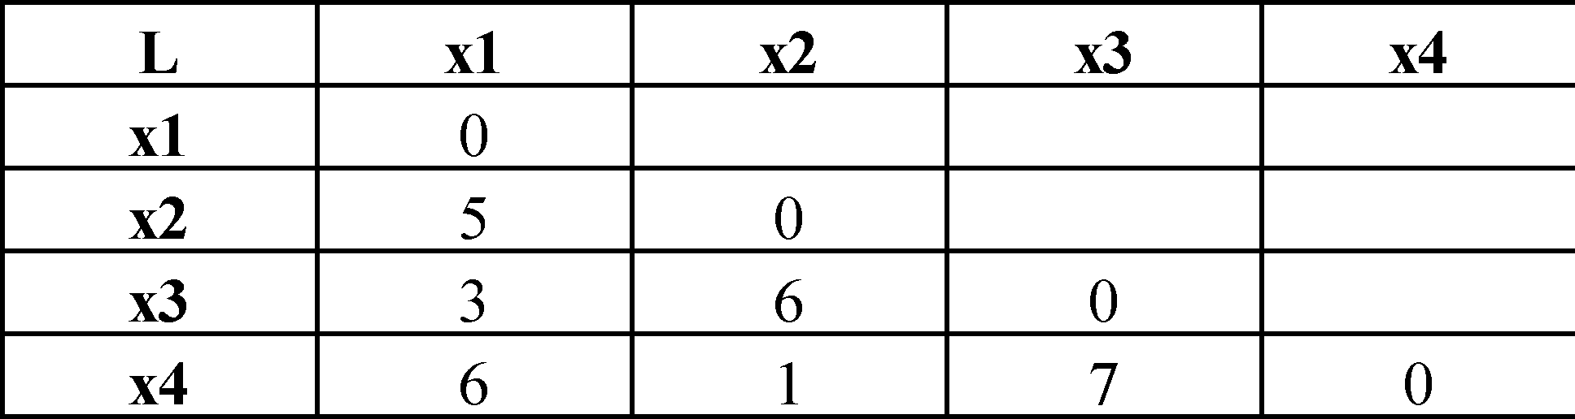
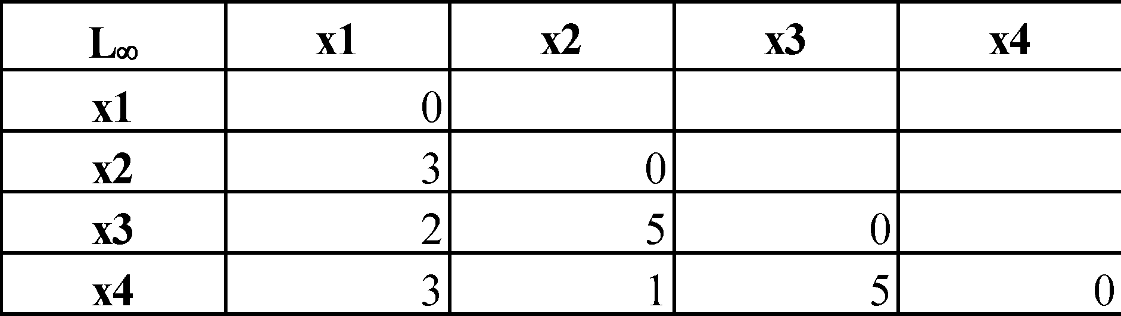
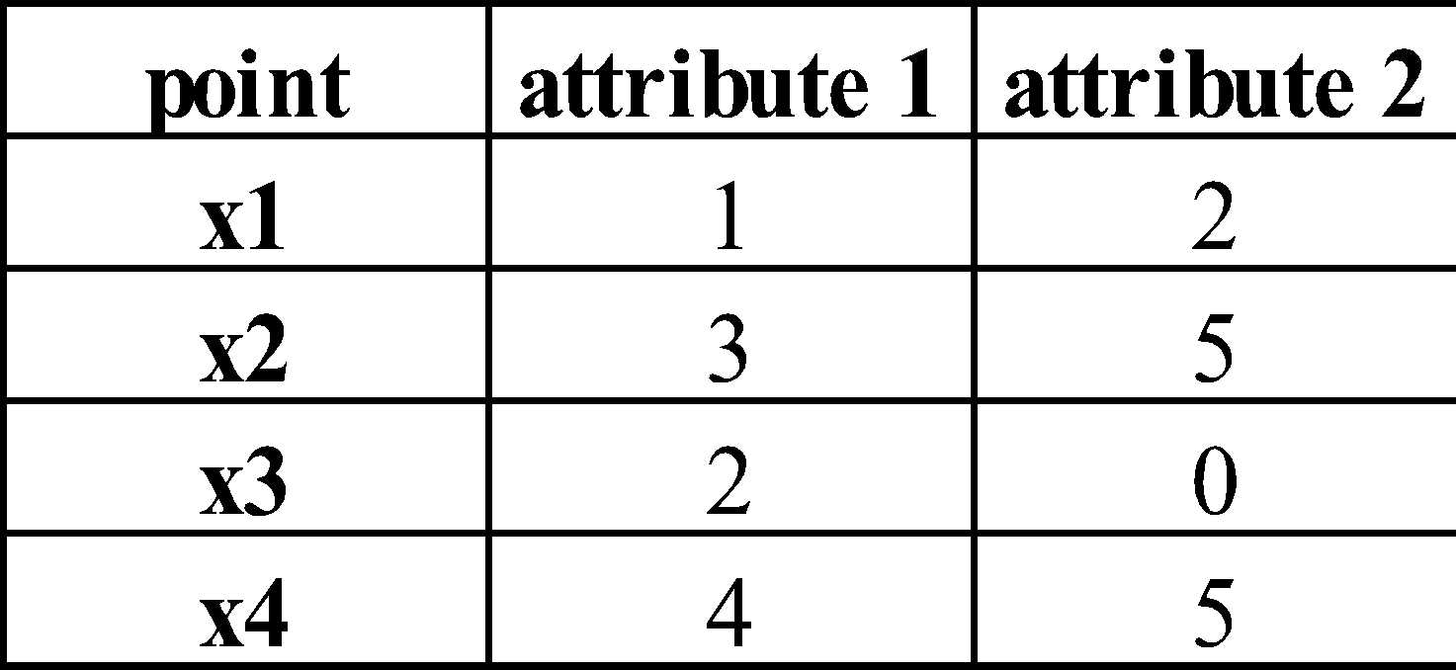
Example: Minkowski Distance
Dissimilarity Matrices
Manhattan (L₁)
Euclidean (L₂)
Supremum

Slide 25
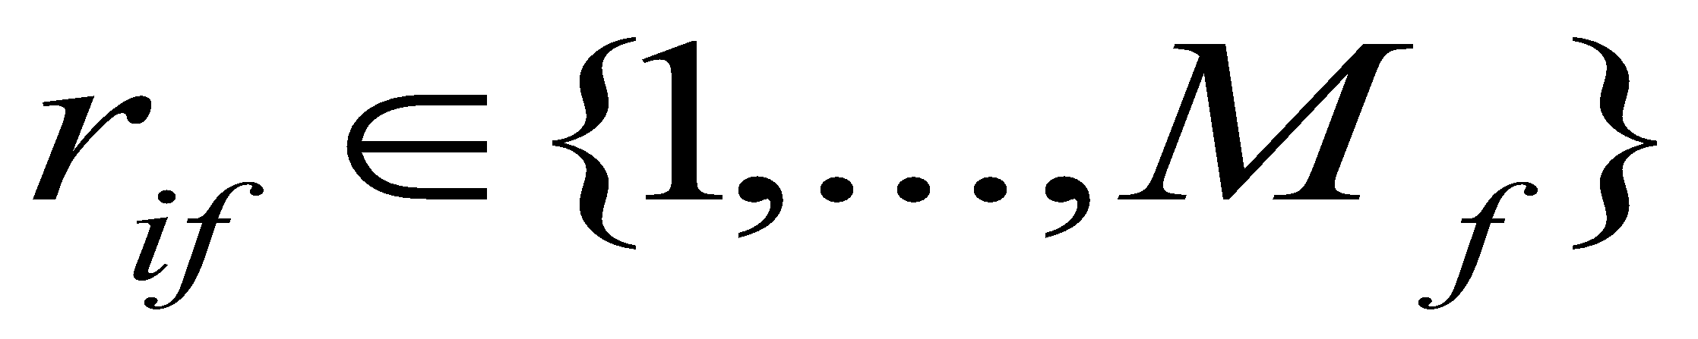
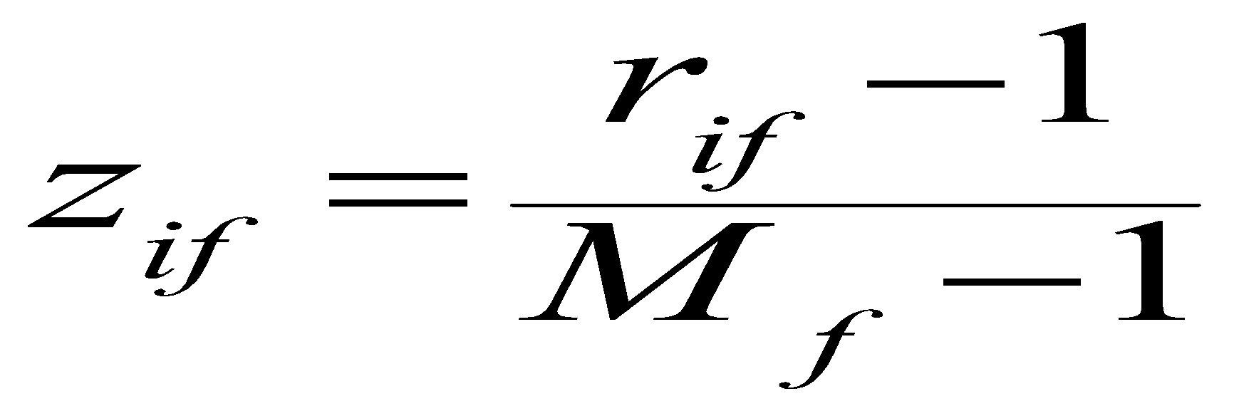
Ordinal Variables
An ordinal variable can be discrete or continuous
Order is important, e.g., rank
Can be treated like interval-scaled
replace x_{if} by their rank
map the range of each variable onto [0, 1] by replacing i-th object in the f-th variable by
compute the dissimilarity using methods for interval-scaled variables

Slide 26
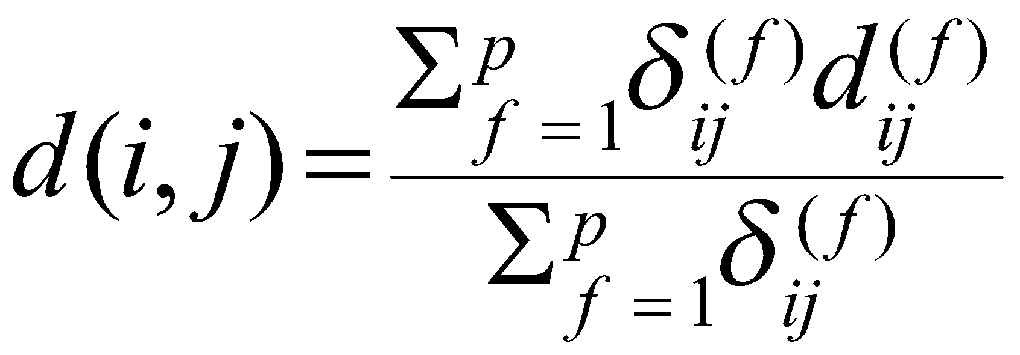
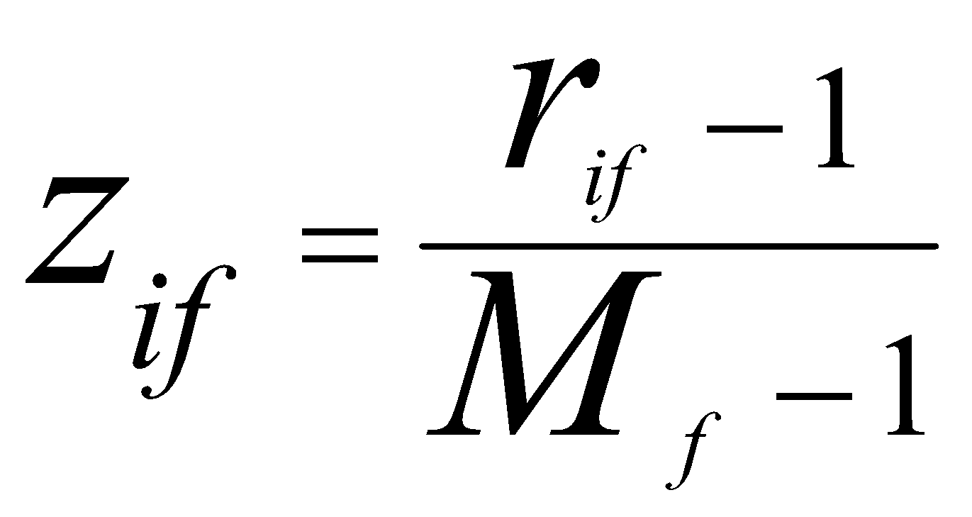
Attributes of Mixed Type
A database may contain all attribute types
Nominal, symmetric binary, asymmetric binary, numeric, ordinal
One may use a weighted formula to combine their effects
f is binary or nominal:
d_{ij}^{(f)} = 0 if x_{if} = x_{jf} , or d_{ij}^{(f)} = 1 otherwise
f is numeric: use the normalized distance
f is ordinal
Compute ranks r_{if} and
Treat z_{if} as interval-scaled

Slide 27
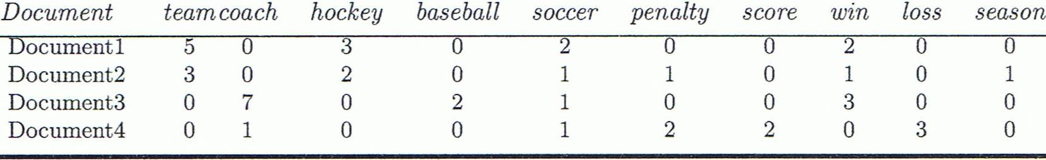
Cosine Similarity
A document can be represented by thousands of attributes, each recording the frequency of a particular word (such as keywords) or phrase in the document.
Other vector objects: gene features in micro-arrays, …
Applications: information retrieval, biologic taxonomy, gene feature mapping, ...
Cosine measure: If d₁ and d₂ are two vectors (e.g., term-frequency vectors), then
cos(d₁, d₂) = (d₁ ∙ d₂) /||d₁|| ||d₂|| ,
where ∙ indicates vector dot product, ||d||: the length of vector d

Slide 28
Example: Cosine Similarity
cos(d₁, d₂) = (d₁ ∙ d₂) /||d₁|| ||d₂|| ,
where ∙ indicates vector dot product, ||d|: the length of vector d
Ex: Find the similarity between documents 1 and 2.
d₁ = (5, 0, 3, 0, 2, 0, 0, 2, 0, 0)
d₂ = (3, 0, 2, 0, 1, 1, 0, 1, 0, 1)
d₁∙d₂ = 5*3+0*0+3*2+0*0+2*1+0*1+0*1+2*1+0*0+0*1 = 25
||d₁||= (5*5+0*0+3*3+0*0+2*2+0*0+0*0+2*2+0*0+0*0)^{0.5}=(42)^{0.5} = 6.481
||d₂||= (3*3+0*0+2*2+0*0+1*1+1*1+0*0+1*1+0*0+1*1)^{0.5}=(17)^{0.5} = 4.12
cos(d₁, d₂ ) = 0.94

