Slide 1
Data Mining
Department of Computer Sciences
Quaid-i-Azam University
Spring 2023 Semester
CS 458: Introduction to Data Mining
Course Instructor: Onaiza Maqbool
Adapted from data mining books by Han and Kamber, Pang Ning et al. and Leskovic et al.

Slide 2
Learning objectives
To understand data and its importance
To appreciate the amount of data and its sources
To understand the importance of data mining

Slide 3
Data Mining
Data mining is the process of discovering interesting patterns and knowledge from large amounts of data
Knowledge discovery from data

Slide 4
The Information Hierarchy
Data
Facts or figures that can be measured, collected, reported or analyzed
Data must be put into context
Information
Essentially data, converted and organized into a more functional form
Recognizes and presents the relationship between data after analysis
Knowledge
What you observe after organizing data into useful & valuable information
https://techwithtech.com/data-vs-information-vs-knowledge-vs-wisdom/

Slide 5
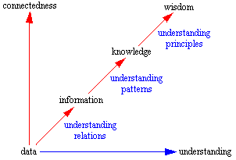
The Information Hierarchy
https://theeconomyofmeaning.com/2018/06/29/the-difference-between-data-information-knowledge-and-wisdom/

Slide 6
The Information Hierarchy
Wisdom
The “ability to think and act using knowledge, experience, common sense, and insight”
Wisdom is influenced by knowledge
Knowledge is knowing what to say - Wisdom is knowing when to say it
Data + Context = Information
Information + Analysis = Knowledge
Knowledge + Discernment = Wisdom
They have one thing in common: all are required to gain insight

Slide 7
WISDOM
Decision Support Systems
Data Mining
OLAP
Knowledge
Information Systems
Information
Transaction Systems
DATA

Slide 8
How large is large
Binary |  |  | Decimal
Name | Symbol | Value (base 2) | Name | Symbol | Value (base 10)
kibibyte | KiB | 2¹⁰ | kilobyte | KB | 10³
mebibyte | MiB | 2²⁰ | megabyte | MB | 10⁶
gibibyte | GiB | 2³⁰ | gigabyte | GB | 10⁹
tebibyte | TiB | 2⁴⁰ | terabyte | TB | 10¹²
pebibyte | PiB | 2⁵⁰ | petabyte | PB | 10¹⁵
exbibyte | EiB | 2⁶⁰ | exabyte | EB | 10¹⁸
www.ibm.com

Slide 9
How large is large
Zettabyte = 1000 Exabytes (10²¹)
Yottabytes = 1000 Zettabytes
Brontobyte = 1000 Yottabytes (not standardized yet)
If we were to put Yottabytess of data in DVDs, a yottabyte would require 250 trillion DVDs
Yottabyte is still a theoretical measure that might be possible in the future. No storage capacity today compares to it, really
To put things in perspective 1 Yottabyte would be written in decimal system as 1,208,925,819,614,629,174,706,176

Slide 10
Amount of Data in the World
3.5 quintillion bytes (exabytes) of data created every day
The amount of data in the world - 64 zettabytes Data Statistics - How much data is there in the world?
By 2025, amount of data each day to reach 463 exabytes globally
By 2025, there will be 175 zettabytes of data in the global datasphere
In 2020, roughly 333,2 billion emails were sent and received each day
Almost 5 billion videos on Youtube are watched every day
Four PB is the amount of new data being generated by Facebook daily
Every 24 hours, 500 million tweets are published on Twitter
18.7 billion text messages are sent every day worldwide
By 2025, there will be 75 billion IoT devices
How Much Data Is Created Every Day? [27 Powerful Stats] (seedscientific.com)

Slide 11

Data - Importance
Data is the new oil
Knowing the amount of data created every day means nothing
We should know how to use it strategically
Like oil, data itself has little intrinsic value
What really matters - actionable insights
Need to harness it correctly

Slide 12
Unlike Oil….
Data is limitless in its volume, quantity, and availability
It grows even when you don't want it to grow
Data is easy to generate and cheap to transport
Data can be reused, repurposed, and new insights can continue to be gleaned from old data
Data is both the inputs and the outputs of our technology organism
Like oil, data can be dirty - unlike oil, it can be cleansed with more data
www.Forbes.com

Slide 13
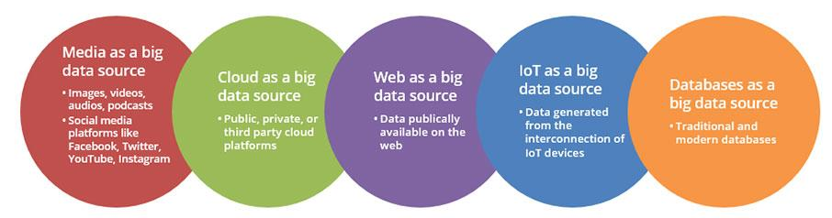
Data Mining - Motivation
Explosive Growth of Data
Data collection and data availability
Major sources of abundant data
Business: Web, e-commerce
Science: Remote sensing, bioinformatics
Society and everyone: news, digital cameras
Top 5 sources of big data | Artificial Intelligence | Data Science | (allerin.com)

Slide 14
Data Mining - Motivation
Traditional data analysis techniques cannot be used due to massive data size
Data has a non-traditional nature - traditional approaches cannot be applied
The questions cannot be addressed using existing data analysis techniques
Scalability
High dimensionality
Heterogenous and complex data
Data ownership and distribution
Non-traditional analysis
Not all information discovery tasks are considered to be data mining

Slide 15
Data Mining - Motivation
Although we say we are living in the information age, it may be more appropriate to say that we are living in the data age.
Terabytes or petabytes of data pour into our networks, WWW and storage devices
Data collected in repositories becomes a data tomb
Data mining tools can turn data tombs into “golden nuggets” of knowledge

Slide 16
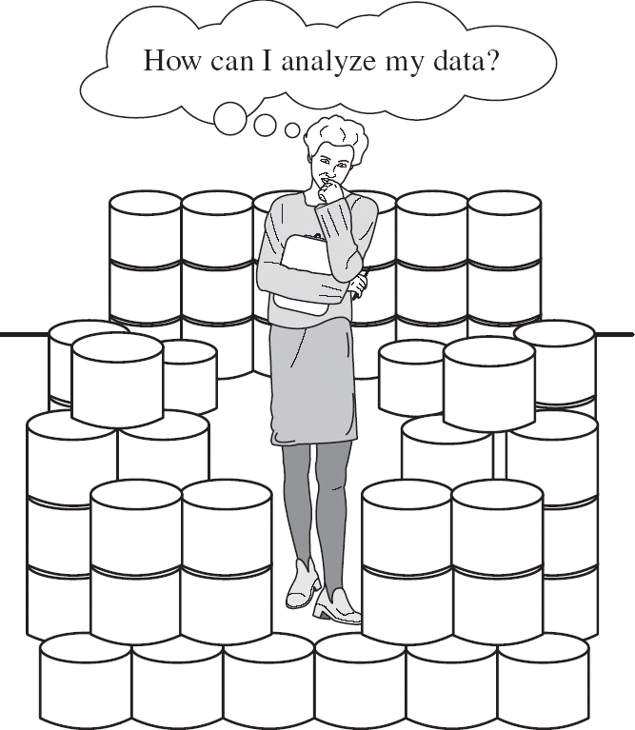
Motivation (contd…)
We are data rich, but information poor!
We are drowning in data, but starving for knowledge!
Need to turn data into useful information and knowledge

Slide 17
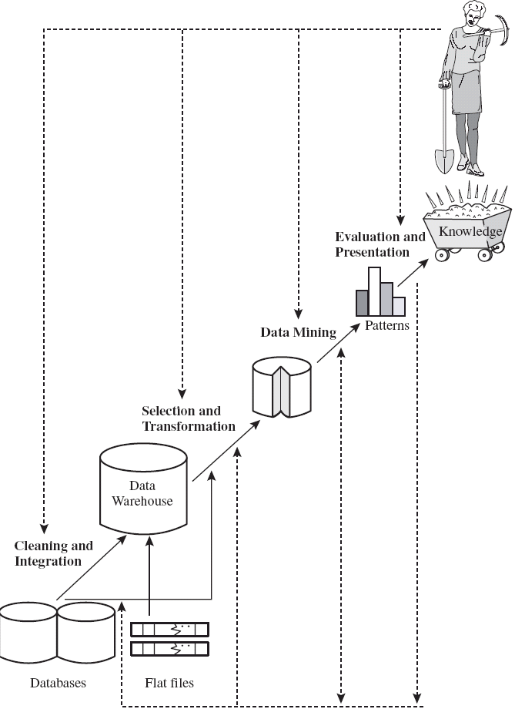
Motivation (contd…)
“Necessity is the mother of invention”
Data mining—Automated analysis of massive data sets
Data mining (knowledge discovery from data)
Extraction of interesting (non-trivial, implicit, previously unknown and potentially useful) patterns or knowledge from huge amount of data
Data mining: a misnomer?
Alternative names
Knowledge discovery (mining) in databases (KDD), knowledge extraction, data/pattern analysis, data archeology, data dredging, information harvesting, business intelligence
Watch out: Is everything “data mining”?
Simple search and query processing

