Slide 1
Git Tutorial
Tolu Oyeniyi
CS 124
Stanford
Winter 2023

Slide 2
What is Version Control?
A system that keeps records of your changes.
Users keep entire code and history on their local machines.
Allows for collaborative development.
Allows you to know who made what changes and when.
Allows you to revert any changes and go back to a previous state.

Slide 3

What is Git?
A tool which allows you to manage and track changes to files over time.
When you create a repository you will see a .git directory.
It keeps track of a file’s history – its tracks changes and who made those changes.
Each version of a file is called a commit.

Slide 4
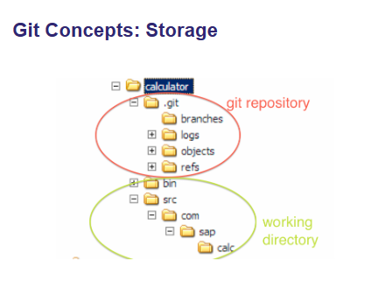

Slide 5

What is a Repository? (Repo)
A collection of all the files and the
history of those files.
which consist of all your commits.
A place where all your hard work is stored.

Slide 6
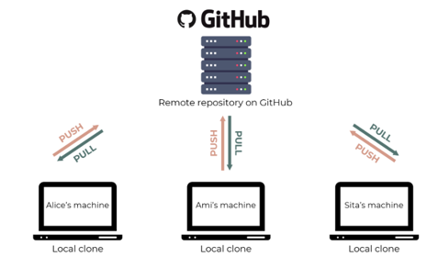
What is GitHub?
A remote repository in which you can host your local repository.
And a place to collaborate with others.

