Slide 1

GIT
&
GITHUB

Slide 2
Agenda
Introduction to GIT
Why do we need GIT & GITHUB
What is GIT & GITHUB
Introduction to Basic Unix Commands
Tracking our first Project using GIT
Git Workflow
Connecting Git to Github

Slide 3
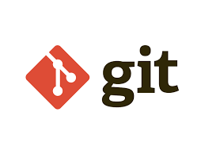
Why do we need GIT

Slide 4

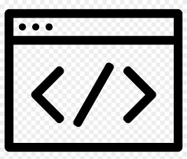



Case Study 1
Performs + , - operations
Calculator Code
Performs + , - ,*, /
operations
Calculator
Code
Sorry john i edited the code now it isn't working
I will have to rewrite my all code
Performs + , - ,*, /,sqrt, %
operations
Calculator Code

Slide 5
Old Tedious Solution
Making copies and editing them
Performs + , - operations
Calculator Code 1
Code
Performs + , - ,*, /
operations
Copy
Calculator Code 2
Performs + , - ,*, /,sqrt, %
operations
Calculator Code 3
Copy

Slide 6
What is a version?
Solution : Version Control Tool
This code performs + and - of numbers
Version 1
This code performs + , -, / and * of numbers
Version 2

Slide 7

Git
GIT is a version control tool that help us keep track of all the versions of our code
Local Repository
Data is stored and managed locally
Locker Room
Codes

Slide 8
Version
Control System
Different Versions of Code
Each version is saved with a message , date & time and the author signature
GIT
Message:This code is for +, -
date:12/3/2020
Time:15:00
Author:syntax technologies
Performs + , - operations
Code
Version 1
Performs + , - ,*, /
operations
Message:This code is for +, -,*,/
date:12/3/2020
Time:15:00
Author:syntax technologies
Code
Version 2
Performs + , - ,*, /,sqrt, %
operations
Code

Slide 9
Version Control System
Different Versions Of Code
GIT
This code is for +, -
This code is for +, -,*,/
Version 1
Version 2
Hey Git ! Give me version 2 of my code
This code is for +, -,*,/
Version 2

Slide 10
Advantages of GIT
We don't have to manage versions , git take cares of it automatically
The storage technique used is very optimized hence it takes very less memory to save all the different version

Slide 11

Why do we need GITHUB

Slide 12
What if your laptop fails?
No Problem! We got our backup on GITHUB!!!

Slide 13

Github
GIT
GITHUB
This code is for +, -
This code is for +, -
Version 1
Version 1
This code is for +, -,*,/
This code is for +, -,*,/
Version 2
Version 2
Remote Repository
Remote Repository is a central location in which data is stored and managed on the internet

Slide 14
Case Study 4
GITHUB makes it easy to collaborate and work on the same project
Task 1
Big User Story
Task 2
Task 3

Slide 15
Case Study 4
Task 1
Task 1 is complete
Task 1
Few remaining issues are being resolved
Task 2
Task 2
Task 3 is completed
Task 3
Task 3

Slide 16
Git & Github
GIT
GITHUB
Local
Storage
On computer
Remote storage
On the
Internet

Slide 17
What do we need to use GIT
GIT software is designed to understand UNIX styles commands
UNIX is an operating system just like WINDOWS and MAC-OS
In order to use these commands we need
Windows→ GITBASH
MAC→Terminal

Slide 18
Understanding the Basic Unix Commands
These commands help us to navigate to the correct folder where we want to create our GIT repository

Slide 19
Basic UNIX Commands
pwd→ Print working Directory
ls→ list all the contents of the directory
cd→ change directory
cd.. → move one step back
Cd~ → move to the home directory

Slide 20


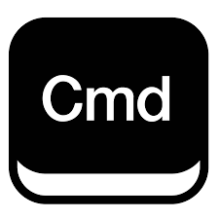



Commands
Human to Computer interaction
Command Prompt
Windows
MAC Terminal
MAC

Slide 21

GIT BASH
GIT BASH
Windows OS
MAC Terminal
MAC
Git is a set of command line utility programs that are designed to execute on a Linux style command-line environment
Git Bash allows us to use Linux style commands in windows

Slide 22
Three Stage Architecture
code
code
Staging
Working Directory
Git add .
Git commit
Repo

Slide 23
Three Stage Architecture
Repo
A
Working Directory
A
Working Directory
A
A
A
A
B
C
A
B
B
B
B
C
C
C
C
Staging
B
Staging
B
C
C
Git commit
Git add .
Git commit
Working Directory
A
A
Repo
A
B
B
A
B
B
C
Staging
Git add .
Git commit

Slide 24
Local Version Control System
Local Computer
Code
V3
V2
V1
Every version is stored locally on the machine
In case of failure of machine no backup of Data Available

Slide 25
Centralized
Version
Control
System
Push
V5
V5
Pull
User 1
V4
Push
V3
V4
V2
Pull
User 2
V1
Push
V1
Pull
User 3
All versions are kept on repository
Each user pulls the required version only
Incase of loss of server no backup is available

Slide 26
Distributed Version Control System
Pull
V5
V4
Push
V3
V5
V2
V5
V1
User 1
V4
V5
Push
V4
V4
V3
V3
Pull
V2
V2
V1
User 2
V1
Push
V5
V1
V4
Pull
V3
V2
V1
User 3
Each user pulls the whole repository
Incase of loss of server backup is available in local

Slide 27
Stashing
Stash 0
Changes in code
Working Directory
Changes in code
Stash 1
Changes in code
Stash 2
Every time we make a change and use stash
It creates a new stash for that particular change

Slide 28
Stashing
Staging
Repo
Working Directory
code
Changes in code
Changes in code
stash
Git stash Apply
Git stash saves the changes to stashing area
The code in our last commit is returned to the directory
Git stash apply reverts our changes to the stash last applied

Slide 29

Branching and Merging
Branching
and
Merging
Branching
Merging

Slide 30


Branching
and Merging
New feature
C1
C2
C3
Looks perfect lets merge it to main branch
Main
C1
C2
C3
C4
C5
C6
C7
C8
C9
Please test the idea in a new branch
I have an amazing idea lets add it in our project
Lets test it first and then we can add it
Main
Main
New Feature
Code
Code
Code
Tony
Mike
John

Slide 31
Branching Workflow
Work Flow Branching
Long Running Branches
Topic Branches
Proposed Update
Develop
Master
Any new topic

Slide 32
Fast Forward Merge
Issue
Sun
C1
IssueSun
C1
Sun
C1
Sun
C1
Fast Forward Merge
Main
C1
C2
Main
C1
C2
1
2
Sun
C1
C1
C1
C1
Main
C1
C2
Fast Forward Merge
Main
C1
C2
3
4

Slide 33
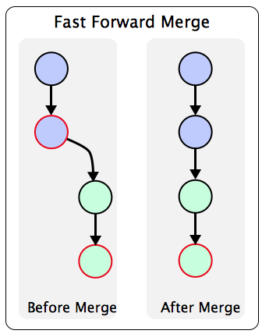
Fast Forward Merge

Slide 34
Merge
Conflict
C1
Fearo
C1
Fast Forward Merge
Main
Main
C1
C1
C1
C1
C1
C1
C1
C1
Omaro
C1
Omaro
C1
1
2
C1
Main
C1
C1
C1
C1
C1
C Merged
C1
3
Fearo
C1
Merge Conflict
Resolved
Conflict
Main
C1
C1
C1
C1
C1
4
C Merged

Slide 35
Merge
Conflict
File A
Base
File B
Line 10: The Human Brain named itself
Line 10: The subconscious part of Brain is more powerful than the conscious
Line 10: Tap into your subconscious brain
CONFLICT

