Slide 1
Data
Computer
Output
Program
Data
Computer
Program
Output

Slide 2
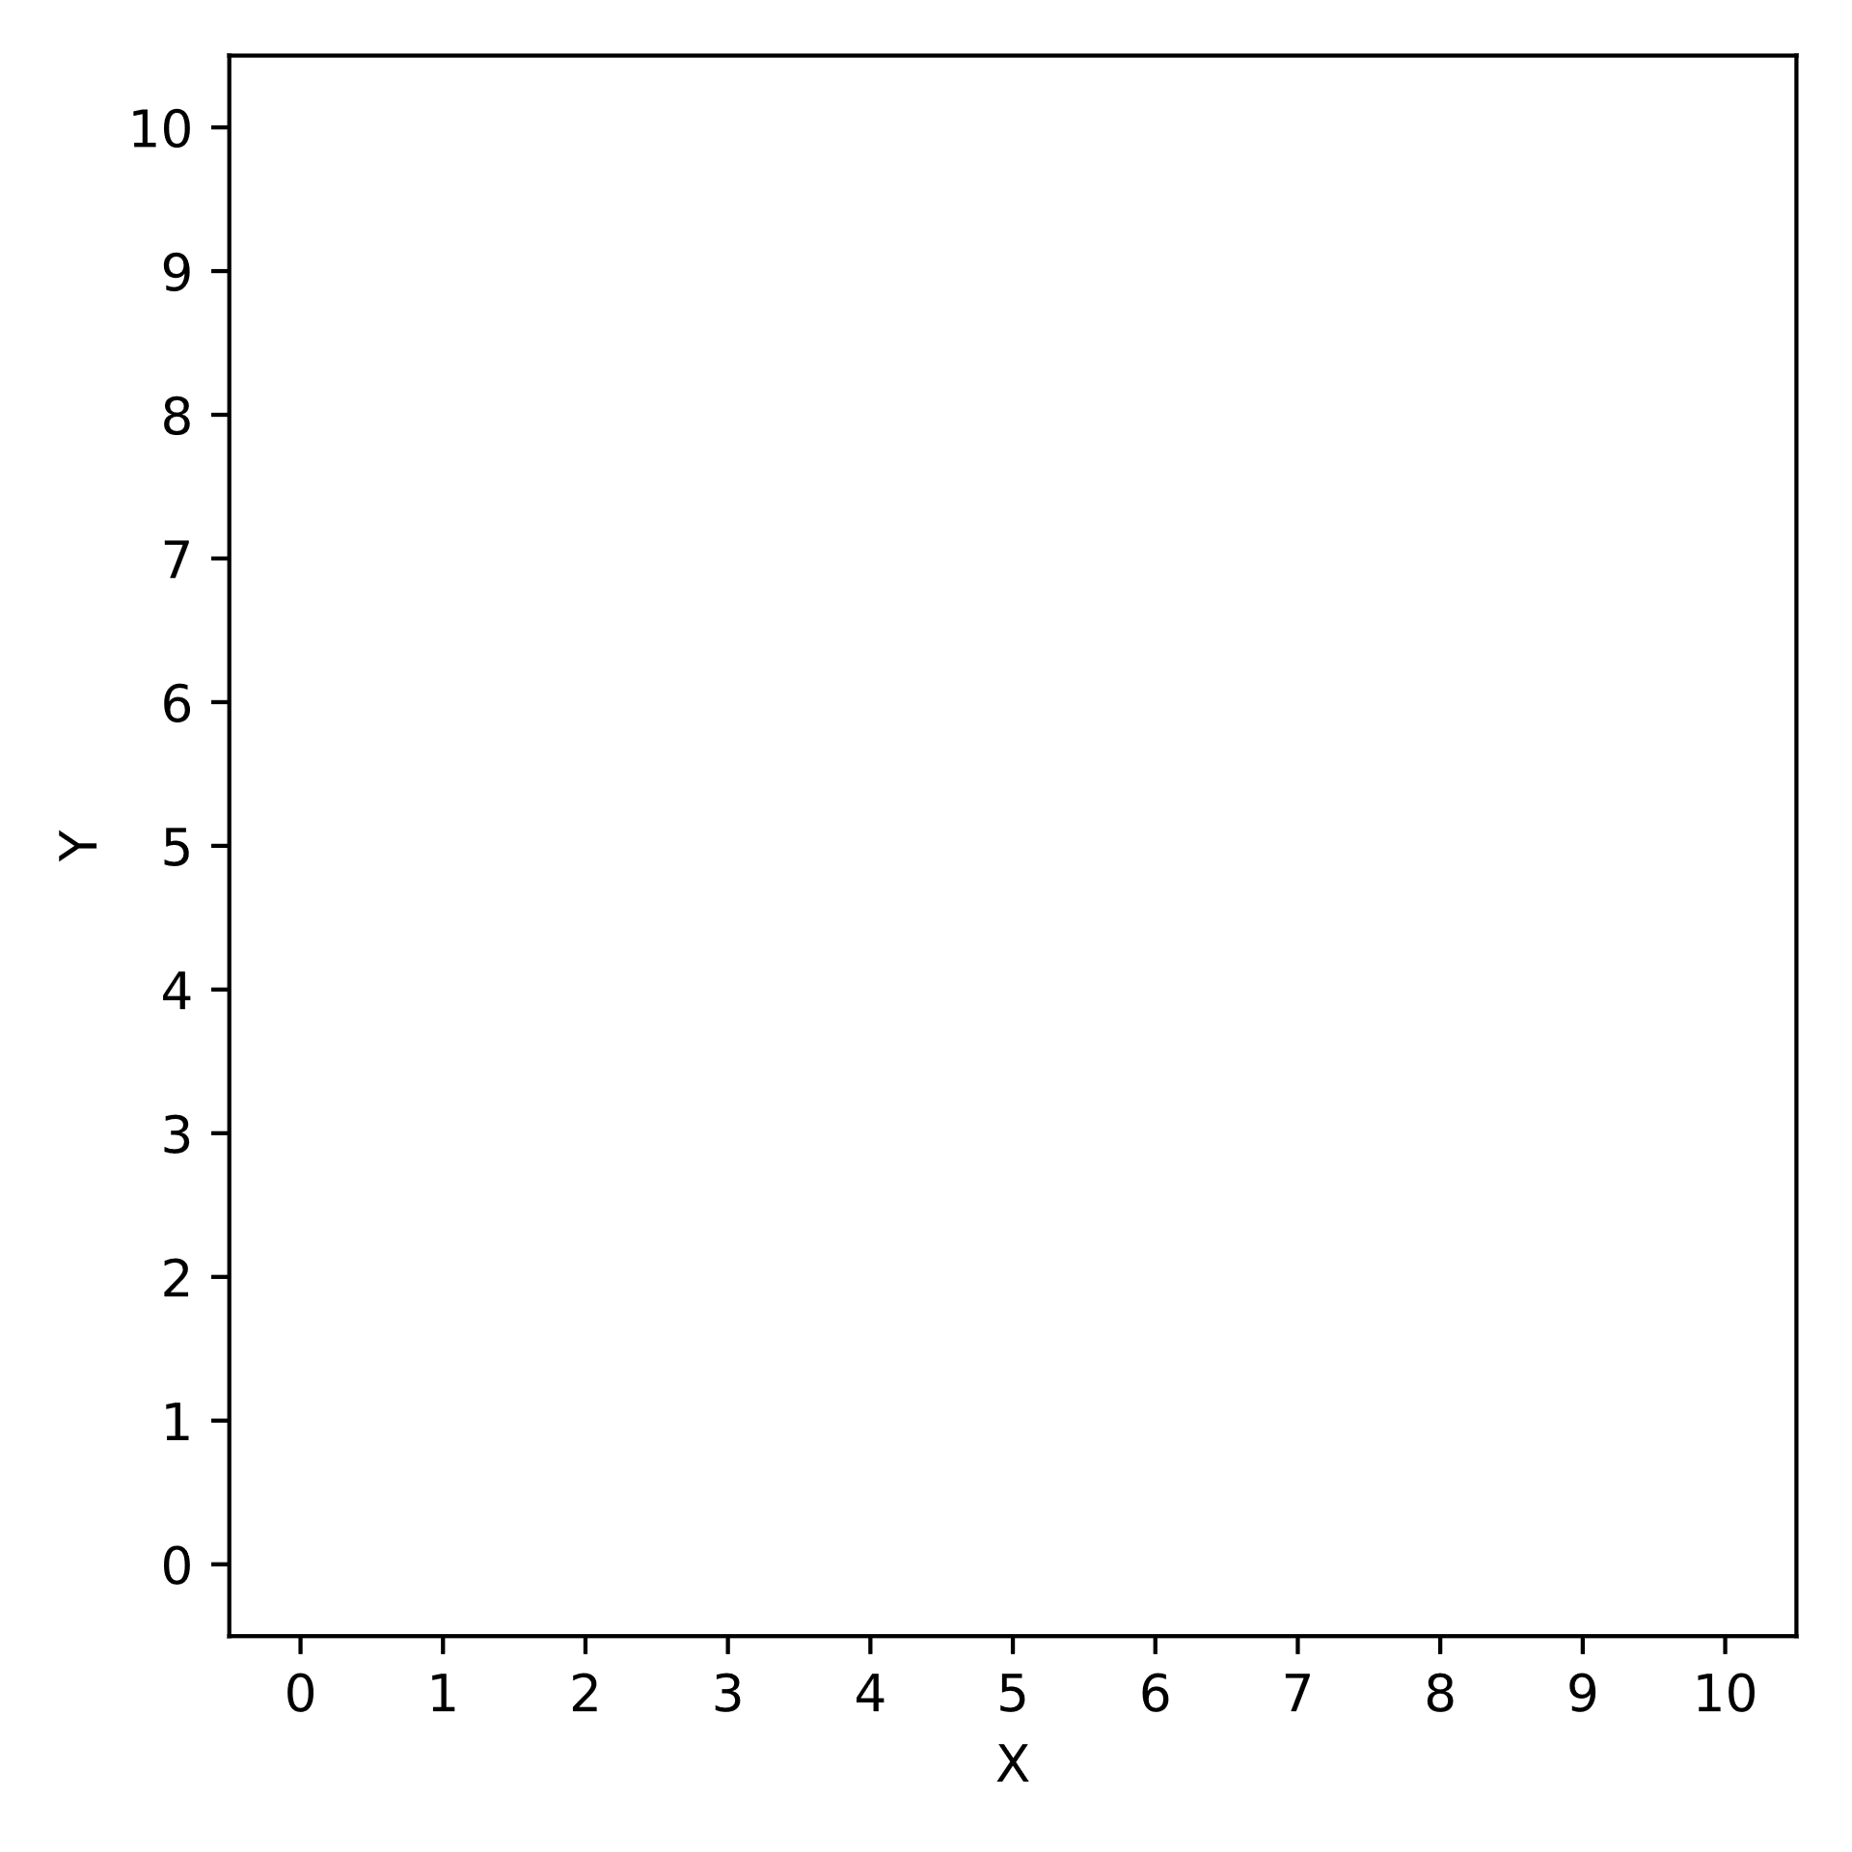
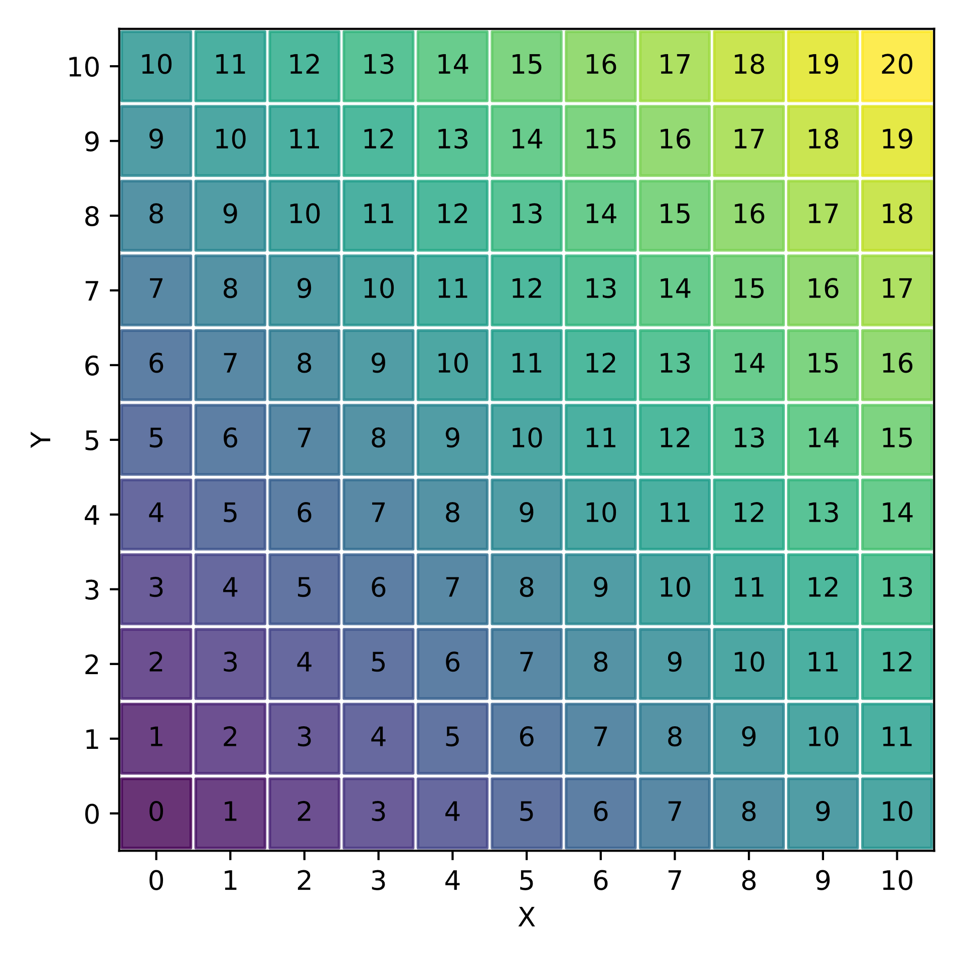
Data
[ (x=0, y=0),
(x=1, y=0),
(x=0, y=1),
...
]
Output
Computer
Program (python)
def sum(x, y):
return x + y

Slide 3

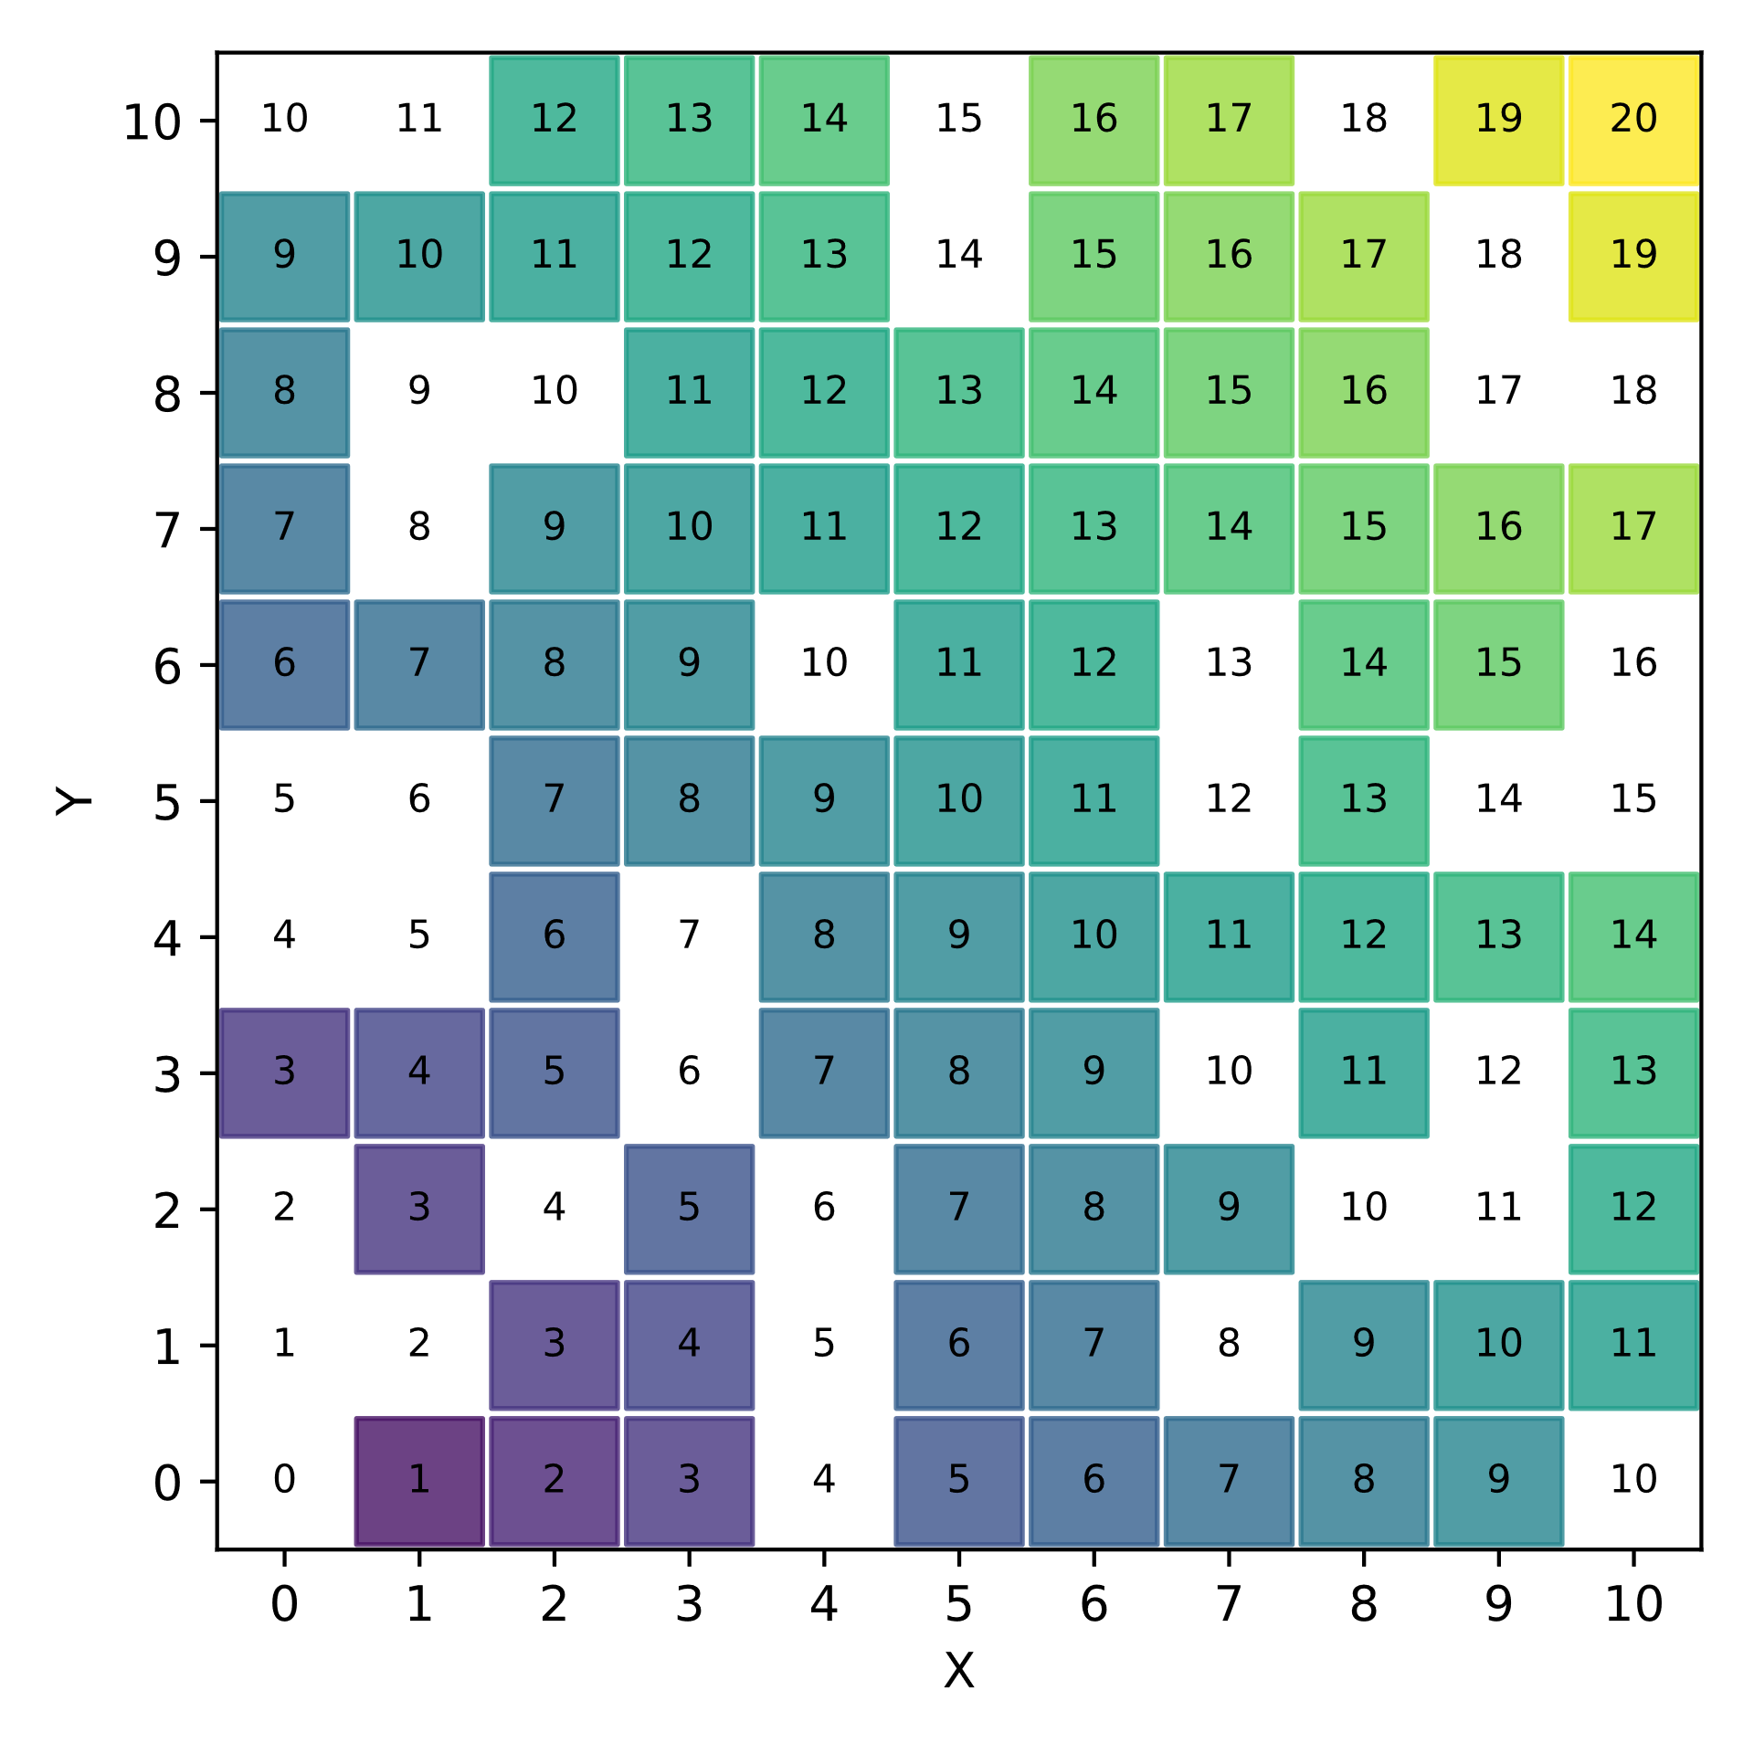
Data (training data)
[ (x=0, y=0),
(x=1, y=0),
(x=0, y=1),
...
]
Program
Computer
Output (labels = ground truth)
ML
model

Slide 4
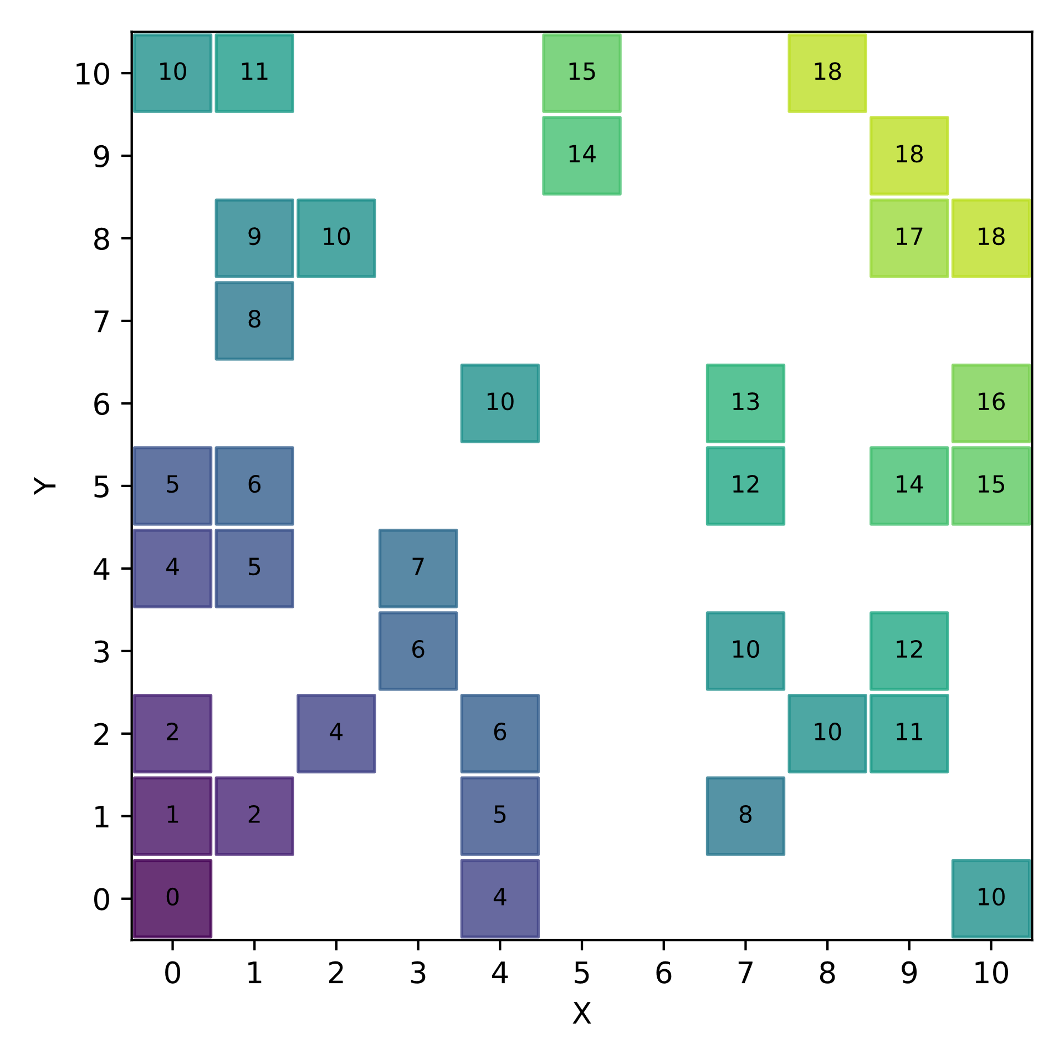
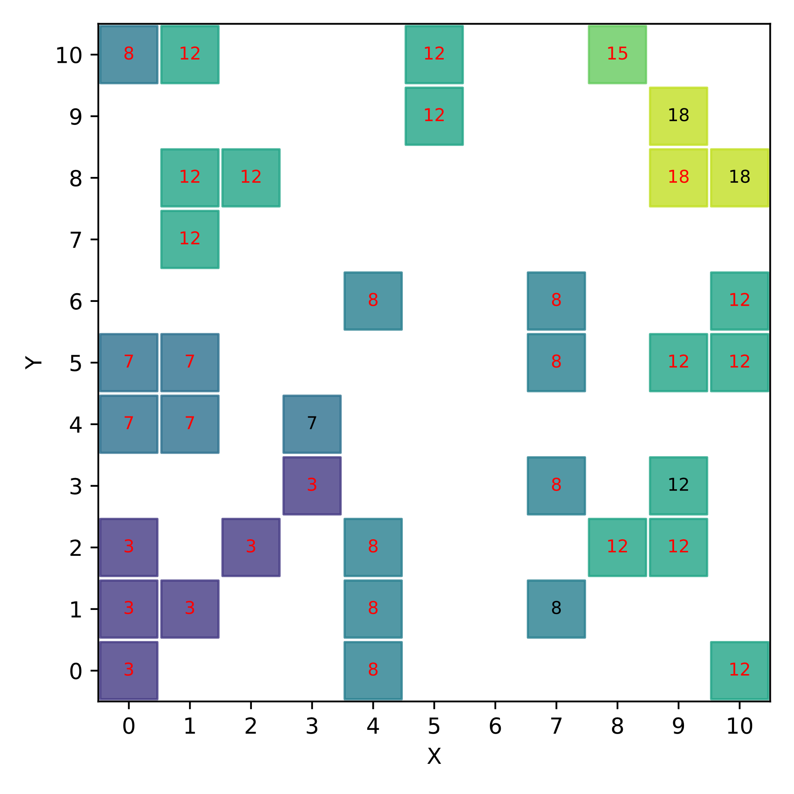
Data (test data)
Data (training data)
[ (x=1, y=0),
(x=2, y=0),
...
]
Predictions (in red the wrong ones)
Program
Computer
Output (labels = ground truth)
ML
model

Slide 5
Decision Tree
X+Y=3 if x < 3.5 and y < 3.5
X+Y=12 if x >= 7.5 and y < 7.5

