Slide 1


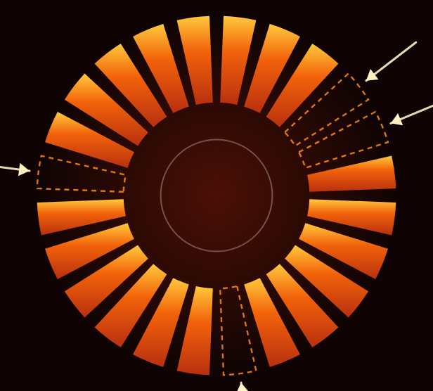
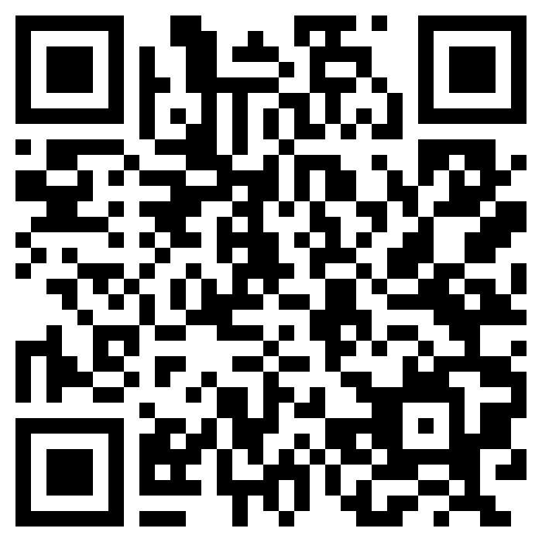
FOR THE PERSON WHO SIGNS IT OFF
LEVEL-4 CAPSTONE 2026
EVERY ANSWER
ARRIVES WITH
ITS P
AGE.
Construction documents are contractual. Slabs specified at one concrete strength, piles at another, both buried in a ninety-page specification. An assistant that confuses the two does not look wrong — it looks certain. Then the floor comes out and the claim comes in.
LIT
the evidence exists, and you are shown it
DIMMED
less certain — and told to you as less certain
DARK
nothing in the record, so nothing is claimed
01 — WHAT YOU ASK
Every answer shows its page.
Ask about the response period, the concrete schedule, the latest stamped revision. Back comes the answer with the document, the page, and how sure it is — one click from seeing it yourself. Tables, drawings and stamps are found, not just typed paragraphs.
When the documents do not settle it, it says so — then names what it does hold.
02 — WHAT YOU TELL IT
Blanks get a question, not a guess.
Say what you want made — a project, a task, a person, a cost, an order. It works out what is mandatory, asks for each missing piece one question at a time, and keeps what you have already told it. The form opens once, complete.
A person, trade or category that does not exist is never accepted, and never quietly corrected.
03 — WHO IS IN CHARGE
Nothing moves without your say-so.
A programme or cost plan becomes a reviewable draft of projects, tasks and costs — nothing is committed until you confirm it. Schedule and cost health read off the live programme, flagging the slip early. Mail, diary and files act only on your word.
0
answers given without a page you can open and check
0
blanks filled with a guess — it asks you instead
Every company's records sit apart by structure, not by a setting someone can switch off.
1
click from any answer to the page, table or stamp behind it
11
kinds of record raised from one plain sentence
591
automated checks it must pass before anyone on site relies on it
Fluency is cheap. On a contract, only the page counts.
Md. Mobasharul Islam · [Team member 2] · [Team member 3]
Level-4 Capstone Project
Dhaka · 2026
Supervised by [Supervisor name] · Department of Computer Science & Engineering, Bangladesh University of Engineering & Technology

