Slide 1
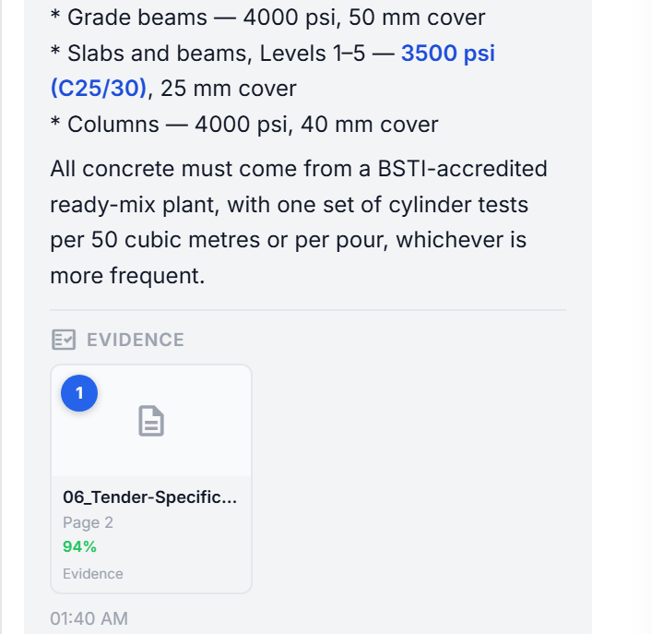
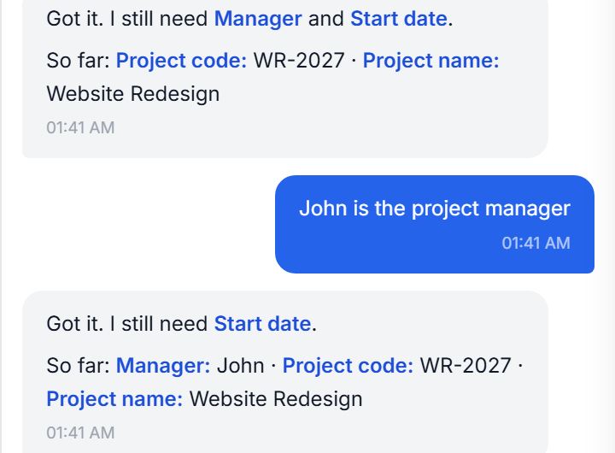
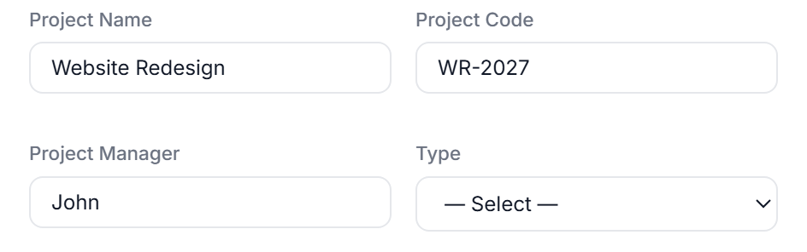
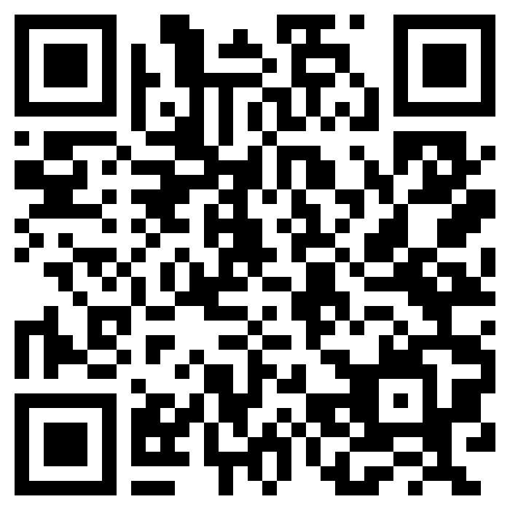
BANGLADESH UNIVERSITY OF ENGINEERING & TECHNOLOGY · DEPT. OF CSE · LEVEL-4 CAPSTONE 2026
BuildMarshalAI
Construction document intelligence that refuses to guess. Every answer points at the page it came from; every field it cannot read, it asks for.
ColPali v1.2 · MaxSim
ChromaDB · FastAPI
Gemini via CLIProxyAPI
1 × RTX 3070 · on-premises
Md. Mobasharul Islam (2105076) · [Team member 2] · [Team member 3] | Supervised by [Supervisor name], Department of Computer Science & Engineering
A construction contract is a legal document. Slabs are specified at 3500 psi and piles at 4000 psi — an assistant that confuses the two has not made a typo, it has created a liability.
Site engineers still answer such questions by hand-searching hundreds of pages of specifications and drawings. A general-purpose assistant answers fluently and wrongly, with nothing to check it against — and will invent a project, a date or a person to finish filling a form.
GUARANTEE 01 — READING
Every answer points at the page it came from.
Retrieval runs over rendered page images, not extracted text. A ColPali v1.2 vision–language encoder embeds each page as a grid of patch vectors and MaxSim scores the question against them — so a table, a stamped revision or a floor plan is searchable on the same footing as a paragraph.
The citation is part of the answer. Document, page and MaxSim score travel with every reply; one click opens that exact page image. Scanned drawings and dense tender tables — where a text-chunk pipeline returns nothing usable — are retrieved the same way.
Nothing found means nothing said. With no passage above threshold it says so and names what the workspace holds, rather than composing something plausible.
The answer alongside is checkable in one click: 06_Tender-Specification.pdf, page 2, 94% MaxSim — the page that actually carries the concrete schedule.
A live answer and its evidence card — grades differ by location.
GUARANTEE 02 — WRITING
Every field it cannot read, it asks for.
Chat creates eleven kinds of record — projects, tasks, users, roles, costs, procurement, catalogues. What each one mandates is derived from the application's own constructors and validators, so the assistant and the API can never disagree about what is required.
A reference must exist. A project type, trade or assignee is accepted only when it names a record already in the workspace; an unmatched value is dropped and asked about, never corrected to the nearest guess.
It collects across turns. Values given one message at a time accumulate; it asks only for what is outstanding and never re-asks.
Mid-collection: each reply names only what is still missing.
The form opens once, at the end. Complete and prefilled for review — then the record is written by the POST route that already owns the permission check and the validator.
Interpretation creates nothing. 529 tests / 591 cases hold the line — including that an unreadable date is asked for again rather than filled in.
Then the dialog opens once, prefilled, for review.
HOW IT WORKS — TWO PATHS, ONE GUARANTEE EACH
READING · A QUESTION
Documents
Page images
ColPali v1.2
ChromaDB
MaxSim
Answer + evidence
PDF · XLSX · drawings
rendered, not parsed
patch embeddings
per-account index
top-k pages + score
Gemini · CLIProxyAPI
the cited page travels with the answer
WRITING · A COMMAND
A sentence
entity_schema
What is missing?
Prefilled form
POST /api/…
Record
“create a project…”
mandatory fields
references checked
reviewed by a person
permission + validator
written once
ask in chat · keep what is settled · loop until nothing mandatory is missing
Each account holds its own documents, index and settings — isolation is structural, not a filter. · Retrieval runs locally; pages are never uploaded to search them.
THE REST OF THE PLATFORM
BUILT AND TESTED
Document onboarding
Earned value & flow
591
112
11
A programme or cost plan becomes a reviewable draft — you confirm before anything is committed.
SPI, CPI and the 50/50 rule computed from the live programme, with rule-based risk flags.
test cases passing,
from 529 test functions
API routes across
23 backend modules
record types creatable
from a sentence
Google & Microsoft 365
Generated reports
Drive indexing, mail drafting, calendar and Meet — every booking behind an explicit confirm.
Phase-by-phase project reports rendered to PDF from the same cited evidence.
26k
0
1
Structural multi-tenancy
Evidence viewer
lines of Python
and JavaScript
invented references
accepted, by design
consumer GPU —
runs fully on-premises
Each account keeps its own documents, index, projects and settings — nothing is shared by default.
Open the cited page itself, at the region that matched, without leaving the answer.
BuildMarshalAI — evidence-cited retrieval and schema-bound record creation for construction project management.
Level-4 Capstone Project
Dept. of CSE, BUET · 2026
github.com/Mobasharul-Islam/BuildMarshalAI_capstone · FastAPI · ColPali v1.2 · ChromaDB · Gemini via CLIProxyAPI · vanilla JS

