Slide 1
Portfolio
Name: Mobassira Atika
ID: UG02-41-16-010

Slide 2
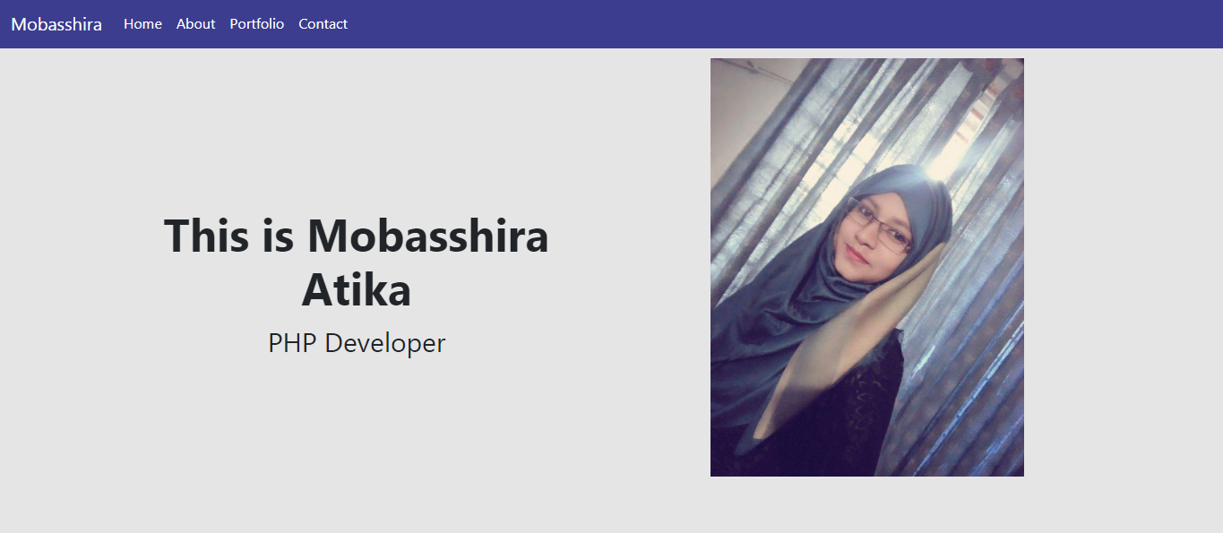

Slide 3


Slide 4
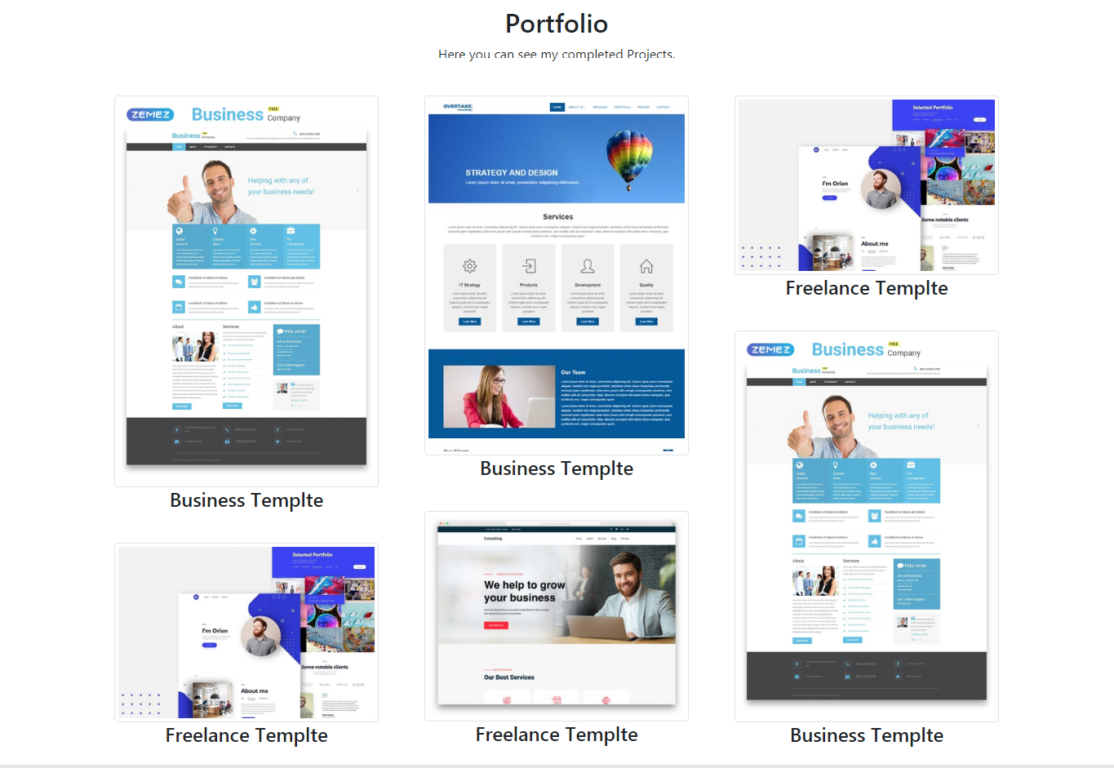

Slide 5
