Slide 1
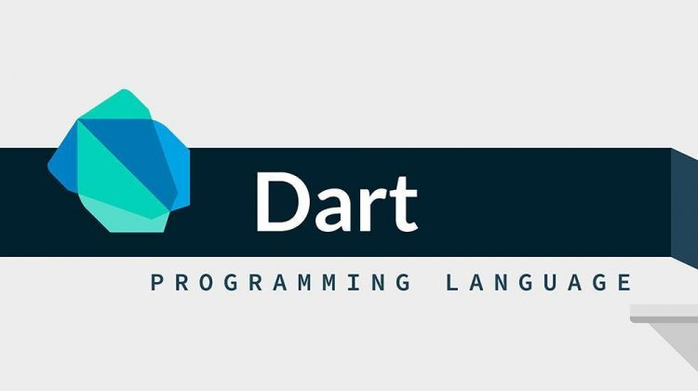

Basics of Dart
(Tiigsi) Mobile AppDev Course

Slide 2

What is Dart
Dart is a new language using C-style which is developed by Google. It appeared first time in 2007 and the first stable release was in Oct 2011. Dart is used for developing web, server, mobile applications and some IoT devices.
It is open-source object-oriented, staticly typed, and easy to learn programming language.

Slide 3
CONTENTS
# |  | #
1 | Variables | 2 | Data Types
3 | Comments | 4 | Operators
5 | Control Flows | 6 | Functions
7 | Classes & Objects

Slide 4
Functions
Variables
A variable is "a named space in the memory" that stores values.
In other words, it acts a container for values in a program. Variable names are called identifiers. These are the naming rules for an identifier:
1. Identifiers cannot be keywords.
2. Identifiers can contain alphabets and numbers.
3. Identifiers cannot contain spaces and special characters, except the underscore (_) and the dollar ($) sign.
4. Variable names cannot begin with a number.

Slide 5

Functions
Data Types
Like other languages (C, C++, Java), whenever a variable is created, each variable has an associated data type. These are the data type :
Data Type | Keyword | Description
Numbers | int, double | Represents numeric literals
Strings | String | Represents a sequence of characters
Booleans | bool | Represents Boolean values true and false
Lists | List | An ordered group of objects
Maps | Map | Represents a set of values as key-value pairs

Slide 6
Functions
Comments
In every programming language comments play an important role for a better understanding of the code. Comments are a set of statements that are not meant to be executed by the compiler.
Types of Dart Comments:
Dart Single line Comment.
// This is a single line comment.
2. Dart Multiline Comment.
/*
These are multiple line
of comments
*/

Slide 7

Functions
Operators
The operators are special symbols that are used to carry out certain operations on the operands.
These are the main dart operators:
Arithmetic Operators
Relational Operators
Assignment Operators
Logical Operators
Conditional Operator

Slide 8
Functions
1. Arithmetic Operators
This class of operators contain those operators which are used to perform arithmetic operation on the operands. They are binary operators i.e they act on two operands. They go like this:
Symbol | Operator Name | Description
+ | Addition | Use to add two operands
_ | Subtraction | Use to subtract two operands
* | Multiplication | It is Use to reverse the sign of the expression
/ | Divition | An ordered group of objects
% | Modulus | Use to give remainder of two operands

Slide 9
Functions
2. Relational Operators
This class of operators contain those operators which are used to perform arithmetic operation on the operands. They are binary operators i.e they act on two operands. They go like this:
Symbol | Operator Name | Description
> | Greater than | Check which operand is bigger and give result as boolean.
< | Less than | Check which operand is smaller and give result as boolean.
>= | Greater than/Equal to | Check which operand is greater or equal to each other.
<= | Less than/Equal to | Check which operand is less than or equal to each other.
== | Equal to | Check whether the operand are equal to each other or not.
!= | Not Equal to | Check whether the operand are not equal to each other or not.

Slide 10
Functions
3. Assignment Operators
This class of operators contain those operators which are used to assign value to the operands. It goes like this:
Symbol | Operator Name | Description
= | Equal to | Check which operand is bigger and give result as boolean.
??= | Assignment Operator | Assign the value only if it is null

Slide 11
Functions
4. Logical Operators
This class of operators contain those operators which are used to assign value to the operands. It goes like this:
Symbol | Operator Name | Description
&& | And Operator | Use to add two conditions and if both are true than it will return true.
|| | Or Operator | Use to add two conditions and if even one of them is true than it will return true.
! | Not Operator | It is use to reverse the result.

Slide 12
Functions
5. Conditional Operators
This class of operators contain those operators which are used to assign value to the operands. It goes like this:
Symbol | Operator Name | Description
condition ? expersion1 : expersion2 | Ternary Operator | It is a simple version of if-else statement. If the condition is true than expersion1 is executed else expersion2 is executed.
expersion1 ?? expersion2 | Null Check Operator | If expersion1 is non-null returns its value else returns expression2 value.

Slide 13
Functions
Control Flow
The control statements or flow of control statements are used to control the flow of Dart program. These statements are very important in any programming languages to decide whether other statement will be executed or not
These are the main dart Control Flow statements:
If -Else statement
Switch-case statement
Loops

Slide 14
Functions
If-else Statement
This type of statements simply checks the condition and if it is true the statements within it is executed but if it in is not then the statements are simply ignored in the code.
Syntax:
if ( condition ) {
// body of if
}
Example:
int age = 10;
if (age > 3) {
print("Condition is true");
}

Slide 15
Functions
Switch Statement
In Dart, switch-case statements are a simplified version of the nested if-else statements. Its approach is the same as that in Java.
Example:
String daytime = “Morning”;
switch (daytime) {
case “Morning” : {
print("It is morning");
} break;
case “Evening”: {
print("It is evening");
}
}

Slide 16
Functions
Loops
A looping statement in Dart or any other programming language is used to repeat a particular set of commands until certain conditions are not completed. There are different ways to do so.
Loops types are as below:
for loop
for… in loop
for each loop
while loop
do-while loop

Slide 17
Functions
Functions
Function is a set of statements that take inputs, do some specific computation and produces output. Functions are created when certain statements are repeatedly occurring in the program and a function is created to replace them. Functions make it easy to divide the complex program into smaller sub-groups and increase the code reusability of the program.
Function Syntax
return_type function_name ( parameters ) {
// Body of function
return value;
}

Slide 18
Functions
Classes & Objects
Dart is an object-oriented programming language, so it supports the concept of class, object … etc. In Dart, we can define classes and objects of our own. We use the class keyword to do so.
Sytanx of Class Declaration
class class_name {
// Body of class
}
Sytanx of Object Declaration
var object_name = class_name();

Slide 19

THANKS
Cabdifataax Cabdilaahi

