Slide 1
Learn-Once Write-Anywhere
Ein Gyin Aung

Slide 2
Learn-Once Write-Anywhere
It is not aiming to be a cross platform, write-once run-anywhere, tool.
It is aiming to be learn-once write-anywhere.

Slide 3
What is React Native
It is a JavaScript FrameWork for writing real, natively rendering mobile
applications for iOS and Android.
It’s based on React Facebook’s JavaScript library for
building user interfaces, but instead of targeting the browser, it targets mobile
platforms
React Native applications are written using a mixture of
JavaScript and XML-esque markup, known as JSX.

Slide 4
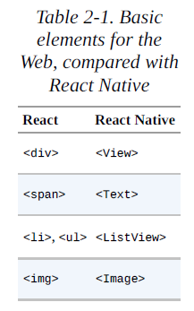
What is React Native
In React for the Web, you render normal HTML elements (<div>, <p>,
<span>, <a>, etc.).
With React Native, all of these elements are replaced by platform specific
React components ( See Table 2-1)

Slide 5
What is React Native
There is no DOM on Mobile.
In the native would text can’t be directly in a “<View/>”.
For that we need to insert a “<Text/>” component.

Slide 6
What is React Native
React Native is like React
It uses native components instead of web components
Need to understand some of the basic React concepts
RN doesn’t use CSS.
To build your JS code, RN uses Node.js, a JavaScript Runtime.

Slide 7
ECMAScript (ES6)
iOS 9 doesn’t fully support ES6
React Nativ euses “Babel” tool to automatically translate Modern JavaScript into
Compatible legacy JavaScript where necessary.
Classes were introduced in ES6.
[Reference]
https://facebook.github.io/react-native/docs/javascript-environment.html

Slide 8
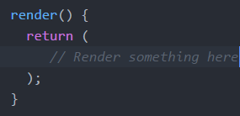
Single Rendering Entry Point
React component has a “render” function.
In fact, React throws an error if there is no render function defined inside the component

Slide 9
AppRegistry
It defines the entry point to the app and provides the root component
AppRegistry.registerComponent('SignIn_Demo', () => SignIn_Demo);

Slide 10
Navigator
It uses to switch between Screens.
< Navigator
renderScene= handler implementation, mapping a route to a screen
/>
[ Reference ]
https://facebook.github.io/react-native/docs/navigator.html

Slide 11
“use strict”
Enable Strict Mode
It makes JavaScript better.

Slide 12
React Native for Web
If we want to see RN example on Web, we need to install
react-native-web
https://www.npmjs.com/package/react-native-web#quick-start

Slide 13
React Native Plugin
..\..\..>npm install [plugin-name] –save
[Reference]
https://www.npmjs.com/search?q=react+native
https://www.versioneye.com/keywords/react-native?language=&page=39

Slide 14
Reference Link
https://facebook.github.io/react-native/docs/getting-started.html#content
https://www.toptal.com/ios/cold-dive-into-react-native-a-beginners-tutorial
https://github.com/MobileAppEmpire/E-Book/tree/master/ReactNative

