Slide 1

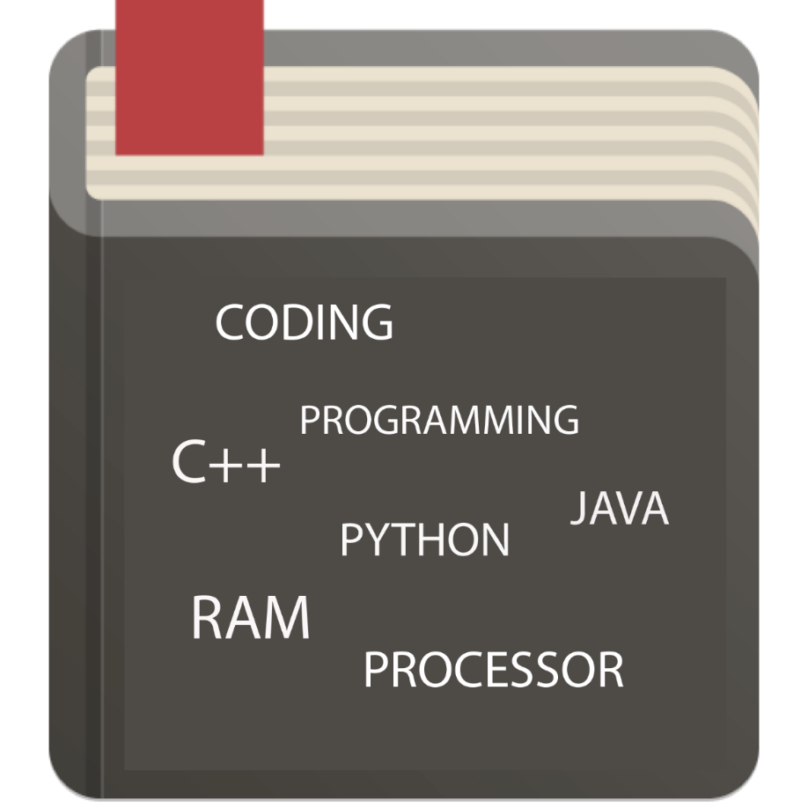
Dictionary
戴佳德-12304101
阿里-12304103
Vincent-12304007

Slide 2
Summary
Purpose
Audience
Use Case
Design
Implementations

Slide 3
Purpose
The dictionary is an APP that explains a word that you are looking for, anytime, anywhere.
It can be used to:
  Check spelling.
  Checking the pronunciation of a word.
  Searching for definition and usage, such as noun, verb, adjective.

Slide 4


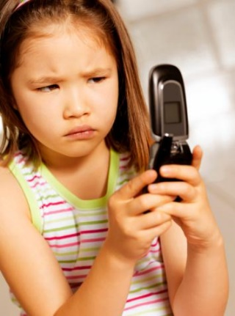

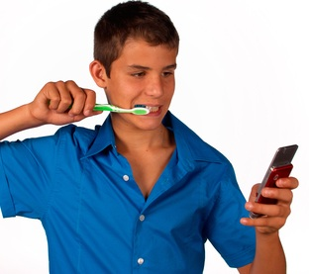

Audience

Slide 5
Use Case: Definition of a word
Precondition: LISTVIEW contains a link to the word definition
Description:
After a click on a word, a new fragment is displayed, showing
the word definition, all about it and the usage (noun, verb, adjective, etc...).
the screen also show others button as a pronunciation button.
Exception:
if the user is not satisfied with the dictionary's explanation, he/she can use the GOOGLE or WIKIPEDIA icon to search for more information

Slide 6
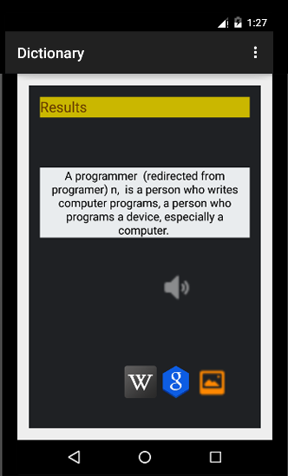
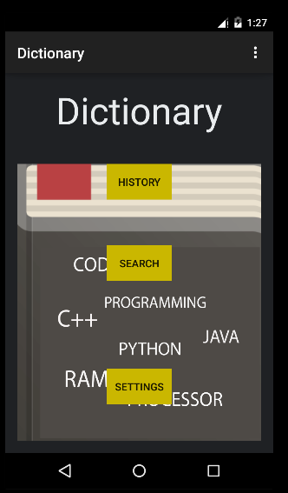
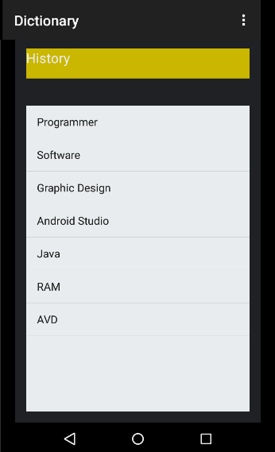
Designs

Slide 7
Implementations
Implement the dictionary by adding a picture for each word so the user can have more understanding on it.
Provide setting menu for customize the apps (ex. changing the color, text size, etc)
Provide a help tab to help users to understand how the app works

