Slide 1

Delicacy Designer
食星球
Team member:
Ruonan Chen,Guang Yang, Mengbang Zhu

Slide 2
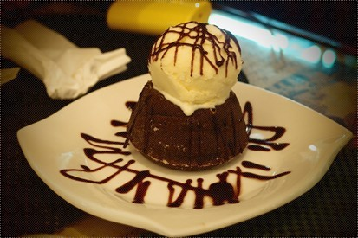
Overview
Purpose
Audience
  User Scenarios
Design

Slide 3


Purpose

Slide 4

Purpose
Recipe for cook lovers----you can not only read recipe here but also put your own recipe on it to help others
Market is also provided for people who wants to buy the related material while reading one recipe
Recommendation for eating---to help the people who is wavering in choosing what to eat, this app can recommend the recipe or the restaurants nearby
SNS for delicious food----anything about food you can post to this social platform, you can find lots of food lovers as you here

Slide 5


Audience

Slide 6





Audience
Cook lovers
Food lovers
Search recipe,share recipe
and buy materials
People who loves food and
like sharing on internet,
especially the young people.
people who don’t
know what to eat
To be a Delicacy Designer !
People who always feel difficult
to find where or what to eat

Slide 7


  User Scenarios

Slide 8

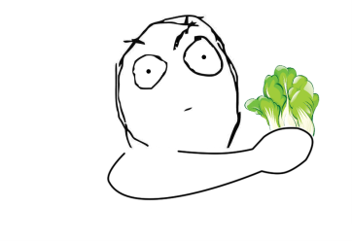
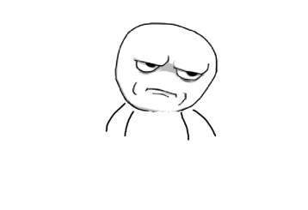
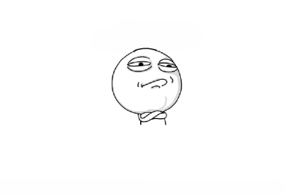
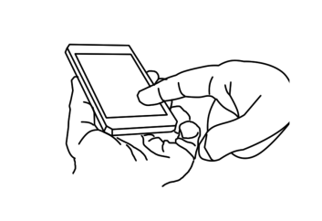
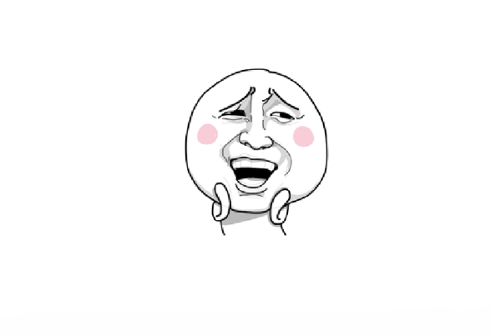
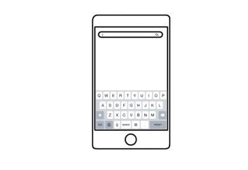
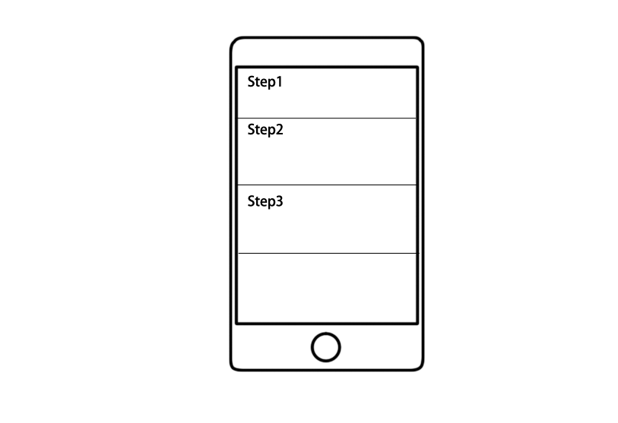
  A. Cooking learning
I want to cook!
Aha! Delicacy
Designer!
Connect network
But how ?
Success!
Type in the
recipe name
App shows the steps~

Slide 9
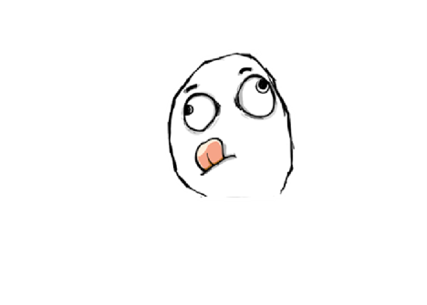
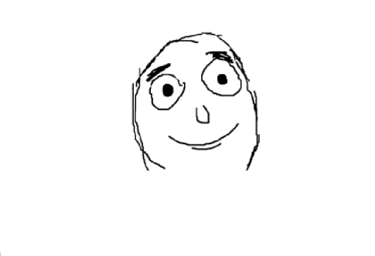
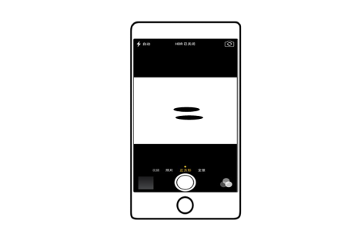
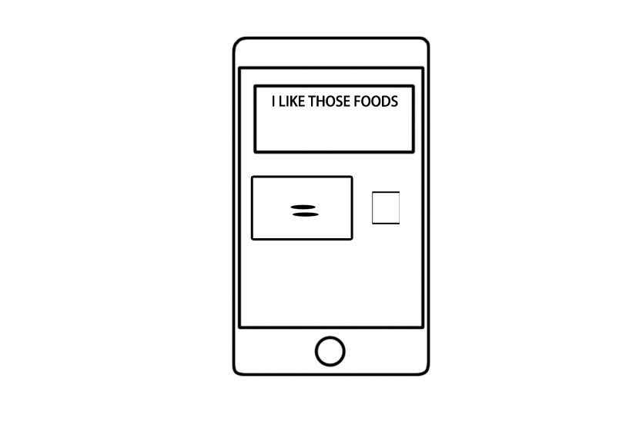
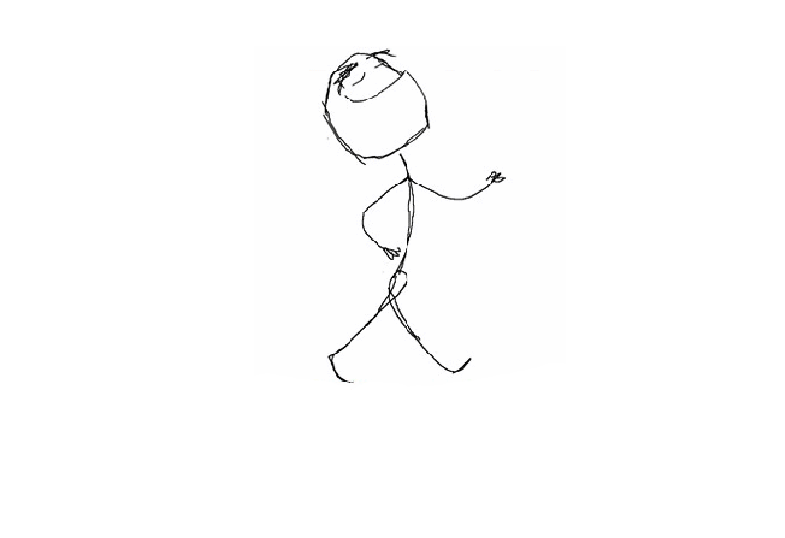
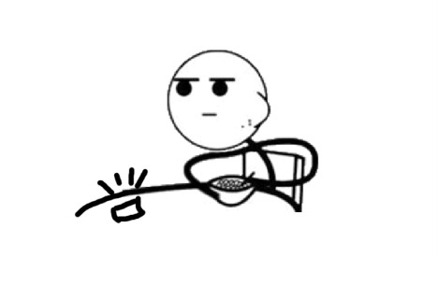
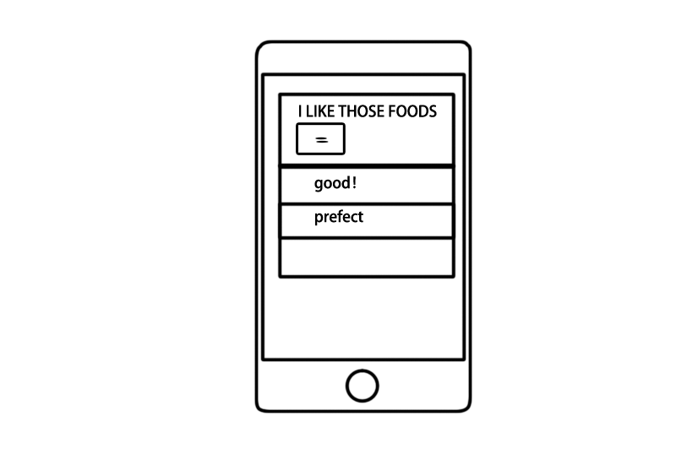
  B. Share
Lilei is eating some
delicious foods
He wants to show
to his friends~
Edit and Post !
Take photo!
One fine day!
Duang~
Wow! Looks delicious!

Slide 10


  Design

Slide 11

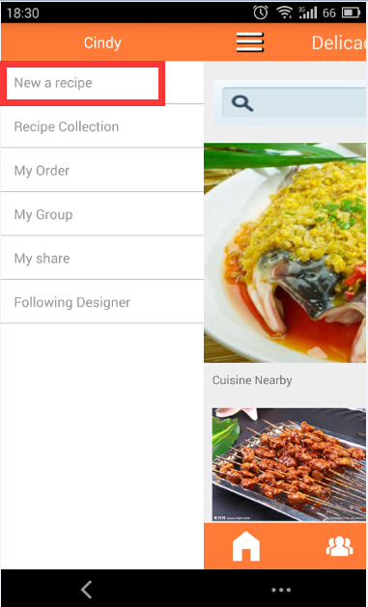
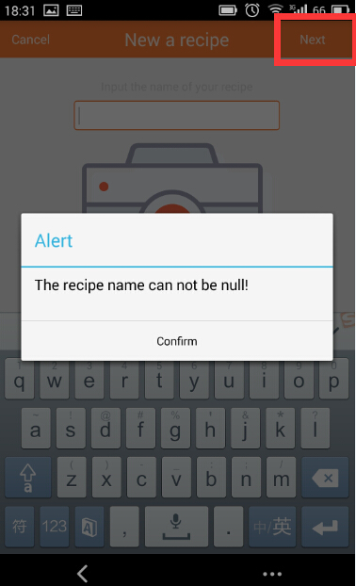
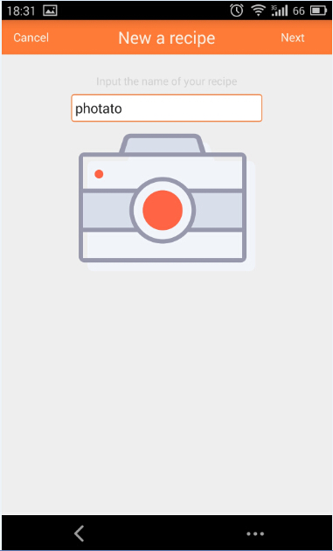
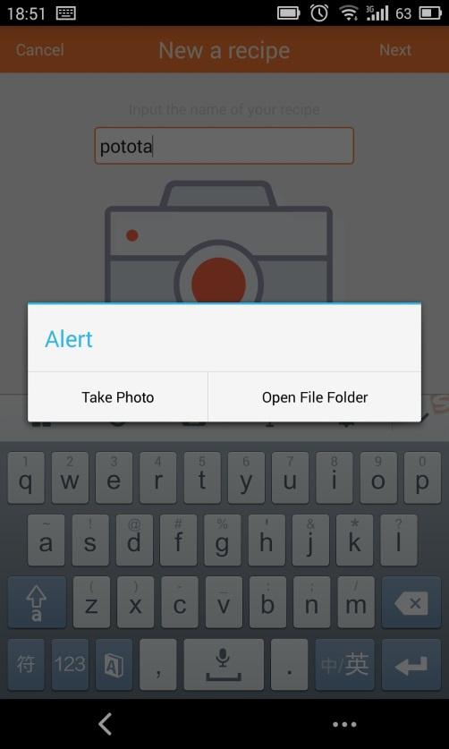
  A. Use case-create recipe

Slide 12
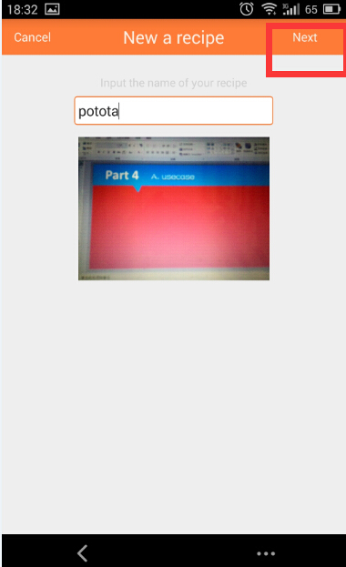
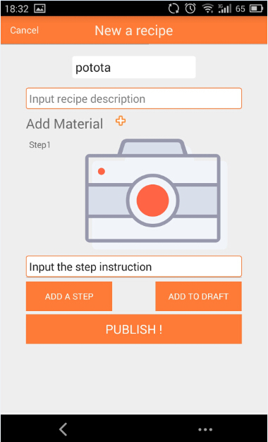
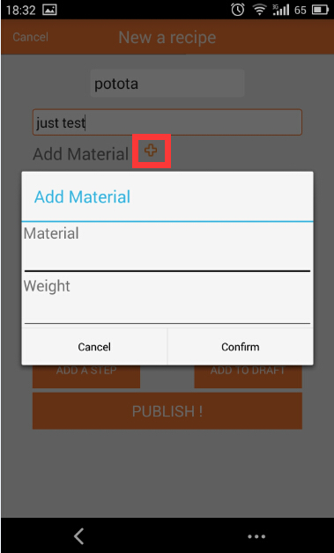
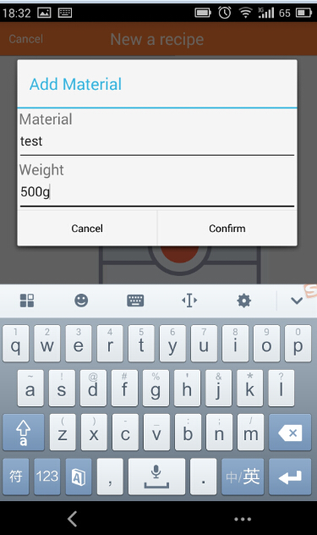
  A. Use case-create recipe

Slide 13
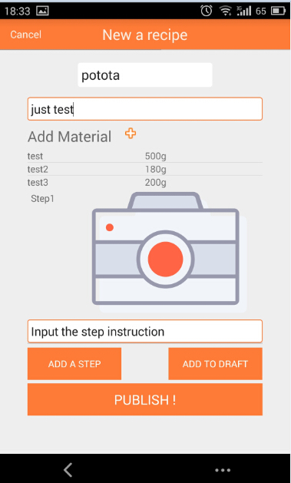
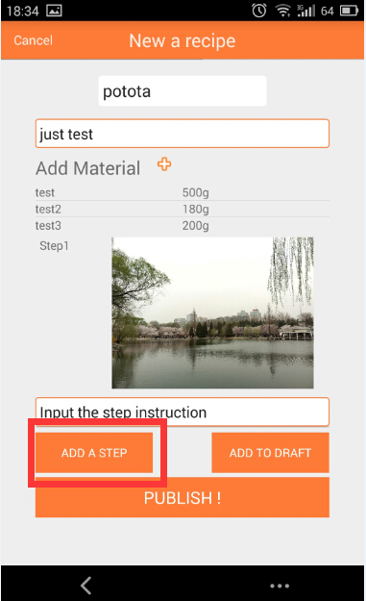
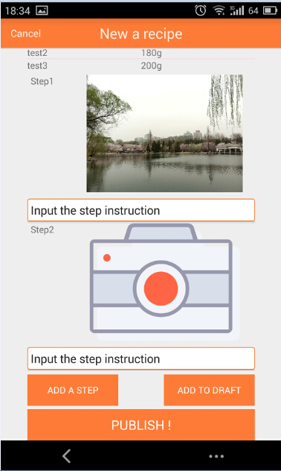
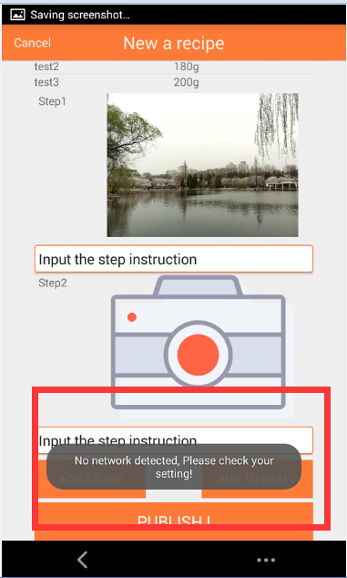
  A. Use case-create recipe

Slide 14
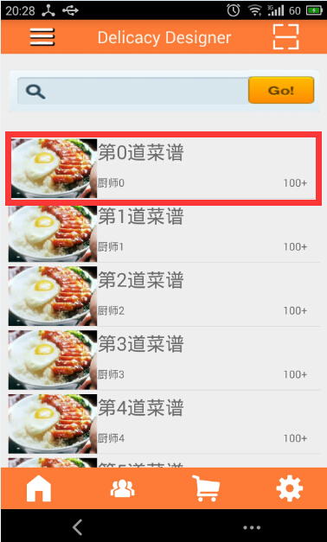
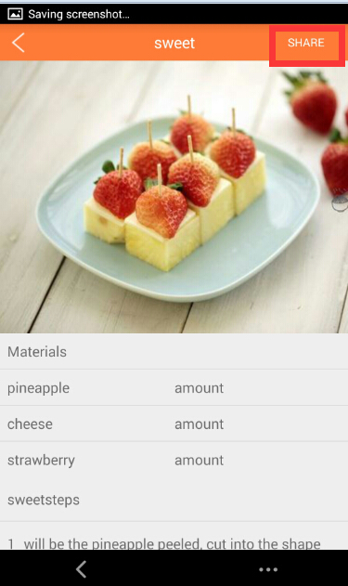
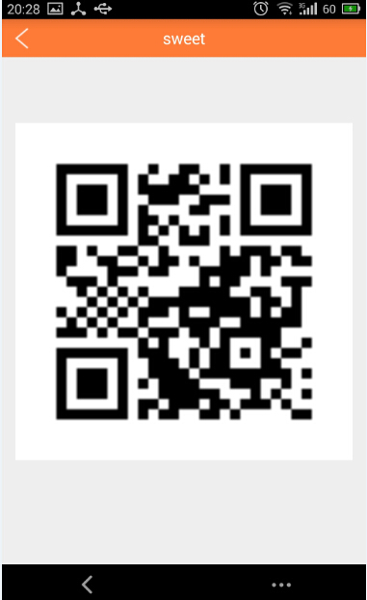
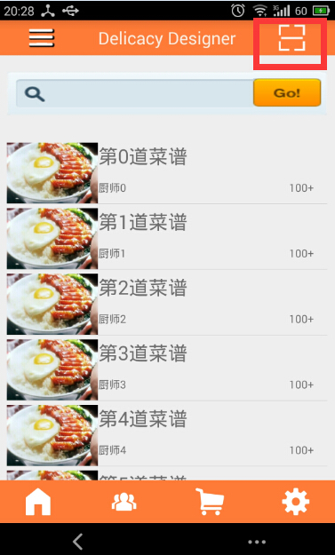
  A. Use case-search recipe

Slide 15
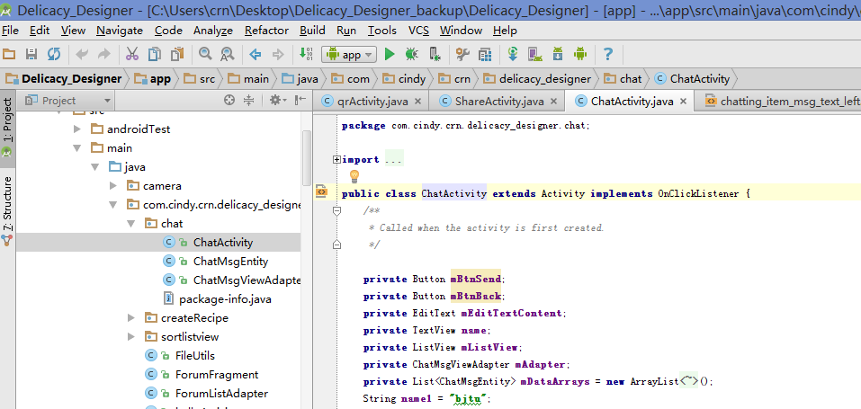
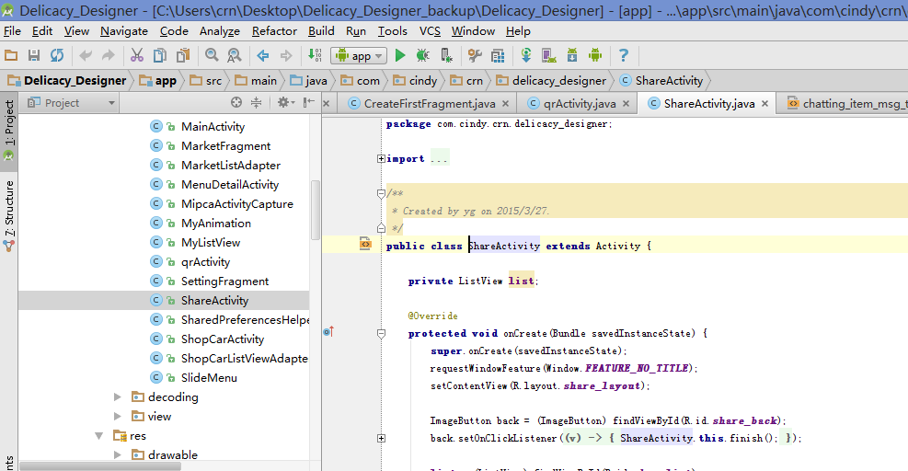
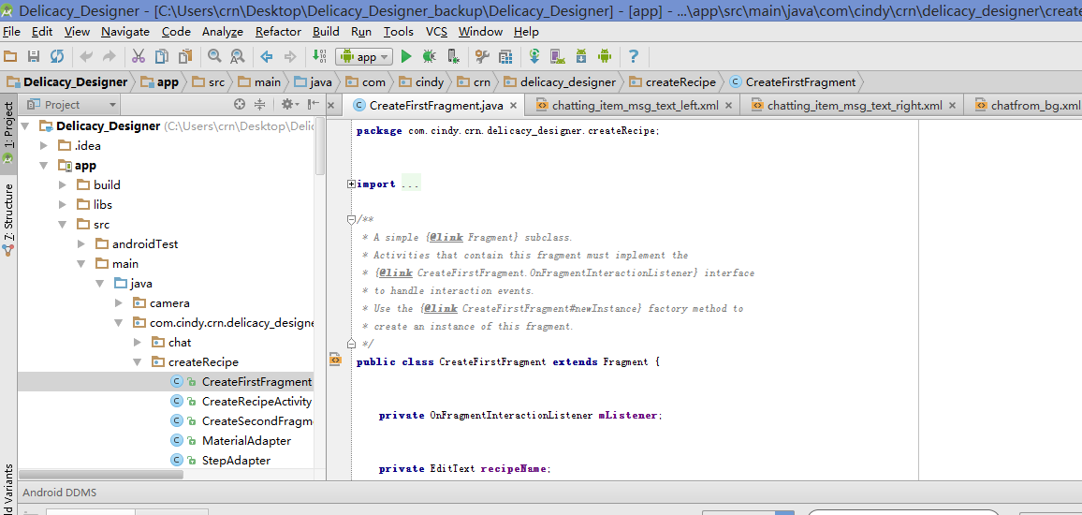
  B. code sample
And so on~
Follower chat
share
Create

Slide 16
  C. Future development
Implement the whole function for the android client
Develop a server for the app
Do some testing
Make it available for downloading
Do some promotion for this app

Slide 17
Delicacy Designer

