Slide 1


OTR
On The Road
Team：9
Date：2015/4/2

Slide 2
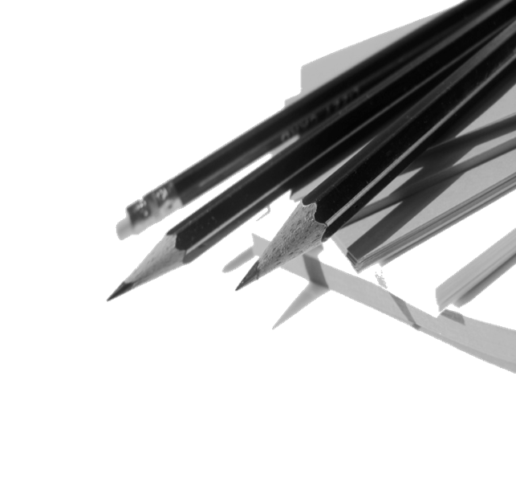

Overview
1
Purpose & Audience
2
Our prototype
3
Usecases
4
Future development

Slide 3
1
Purpose & Audience
o(*￣︶￣*)o

Slide 4
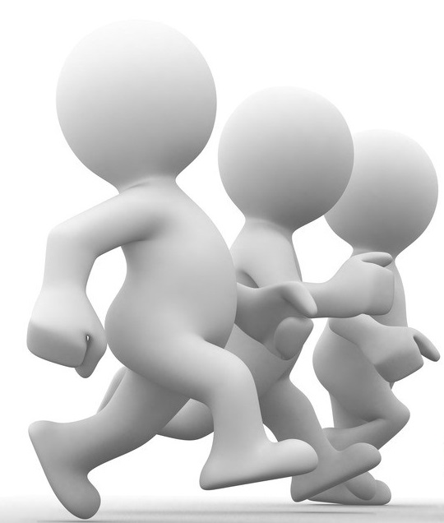
I enjoy sports
OTR give me a more fresh lifestyle

Slide 5

I am an environmentalist
OTR supports me to choose walking instead of driving

Slide 6
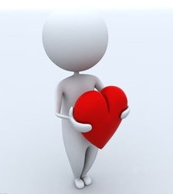
I am just a warm-heart person
OTR provide me a real and effective way to help poor people with my own efforts.

Slide 7

Account steps !
Trees drawing !
Do charity !
OTR

Slide 8
2
Our prototype
(๑•̀ㅂ•́)و✧

Slide 9
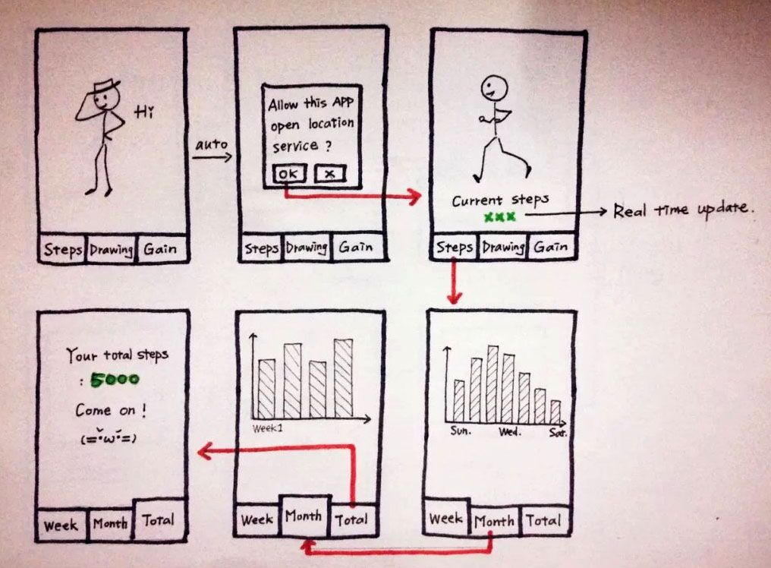
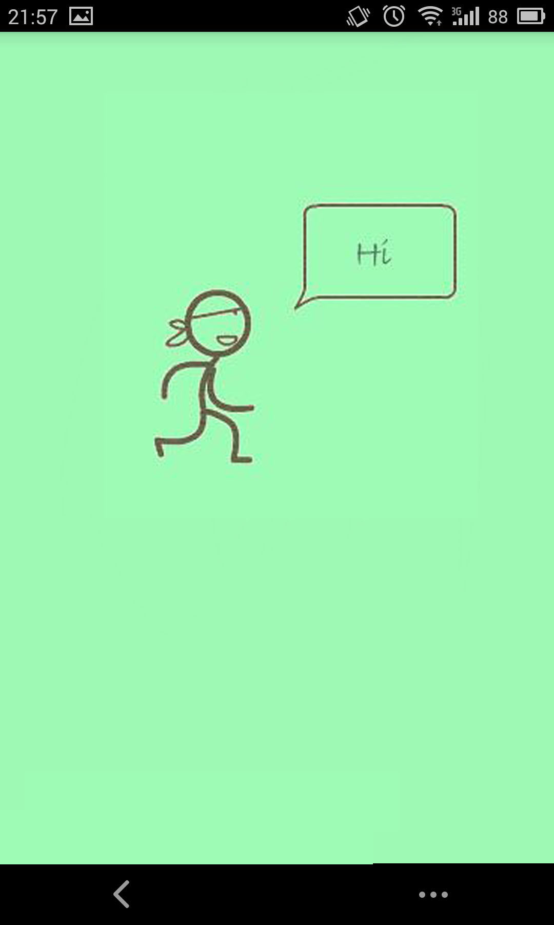
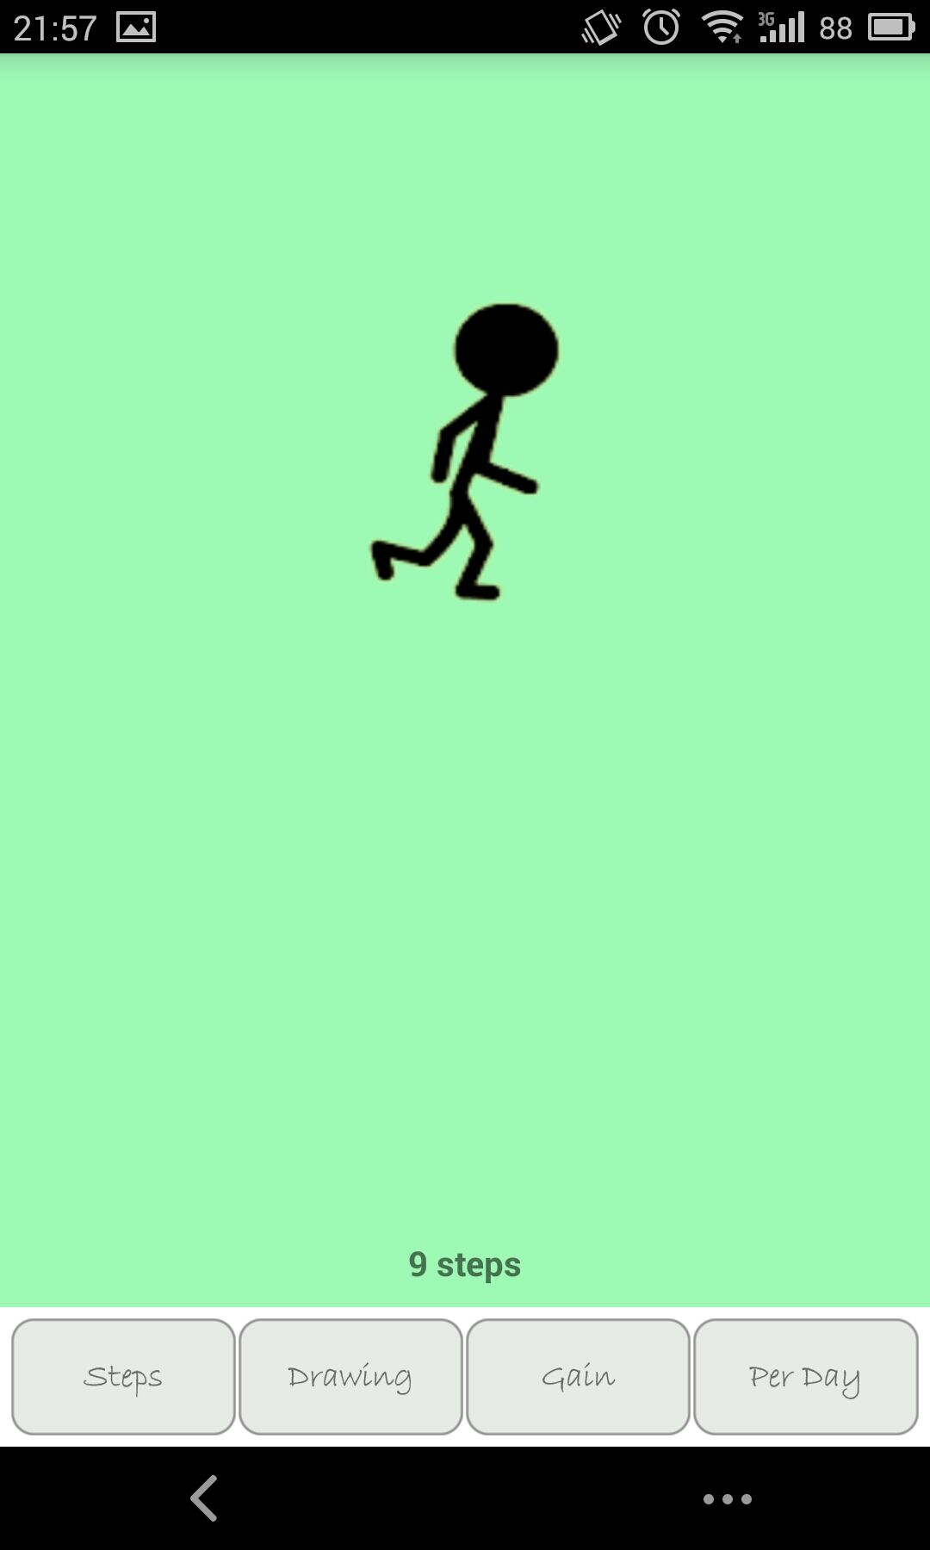
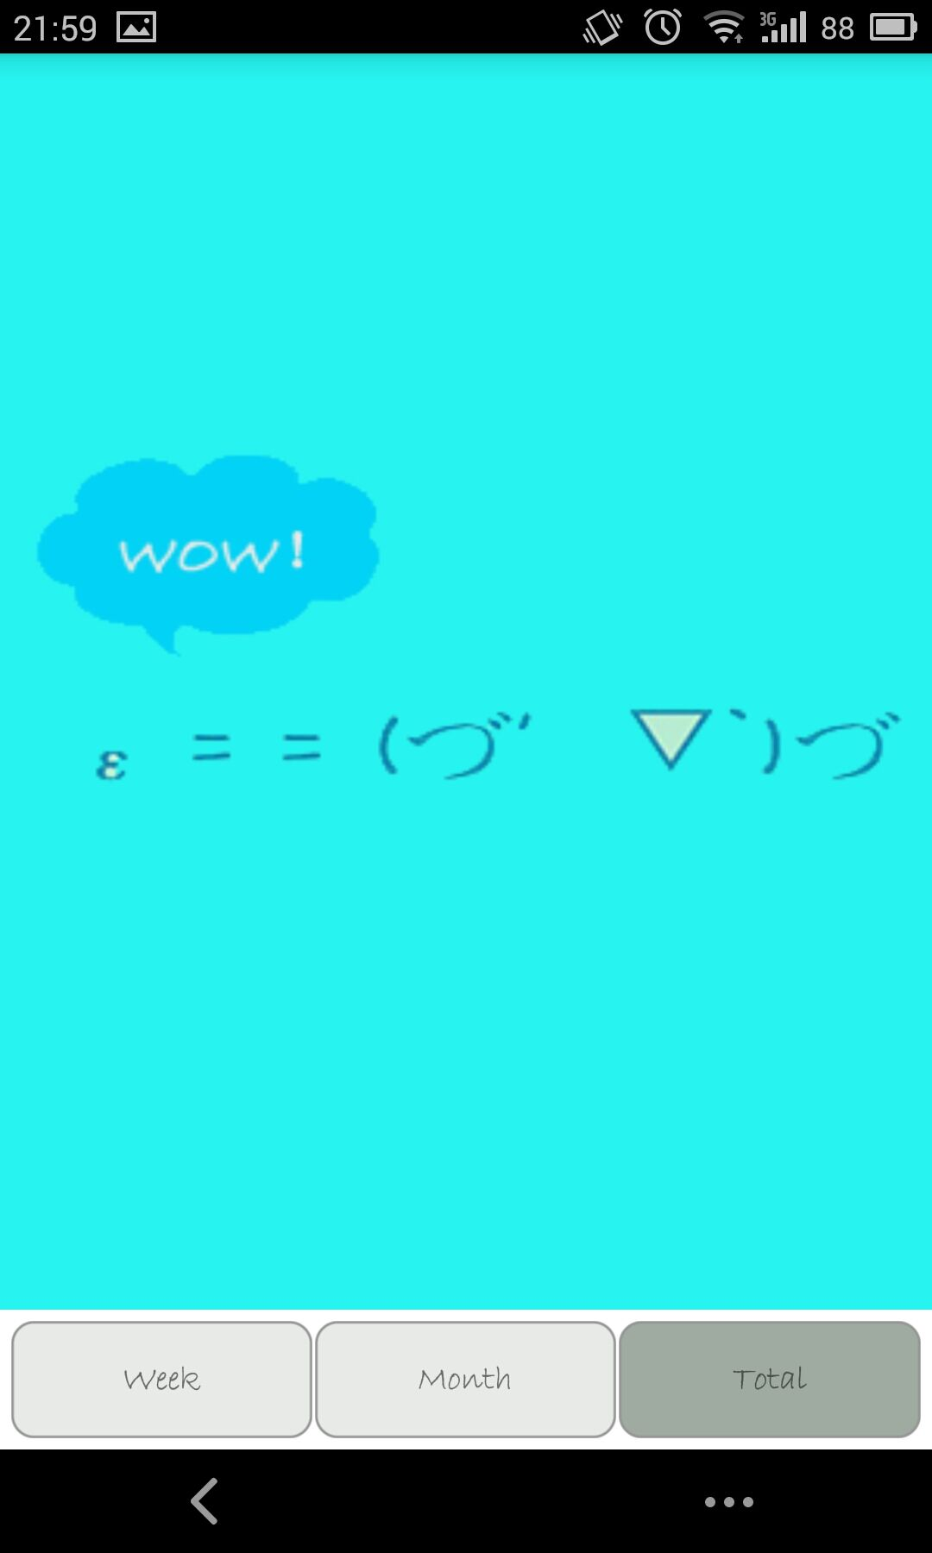
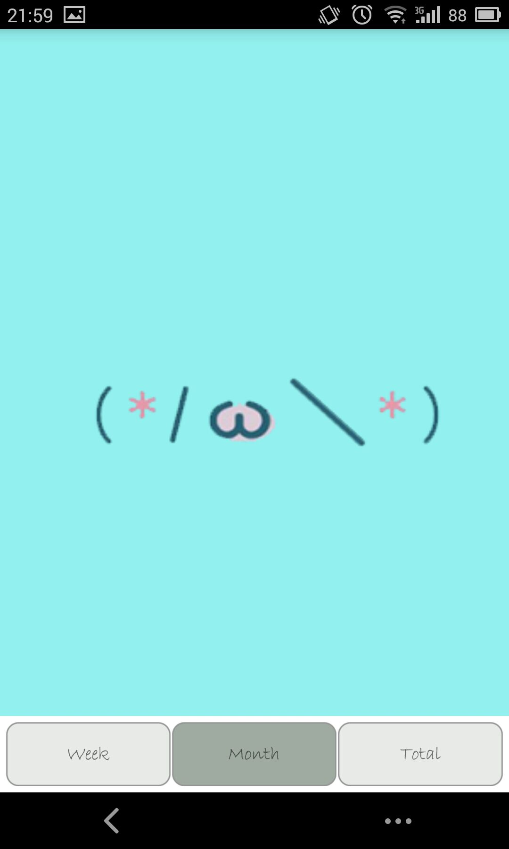
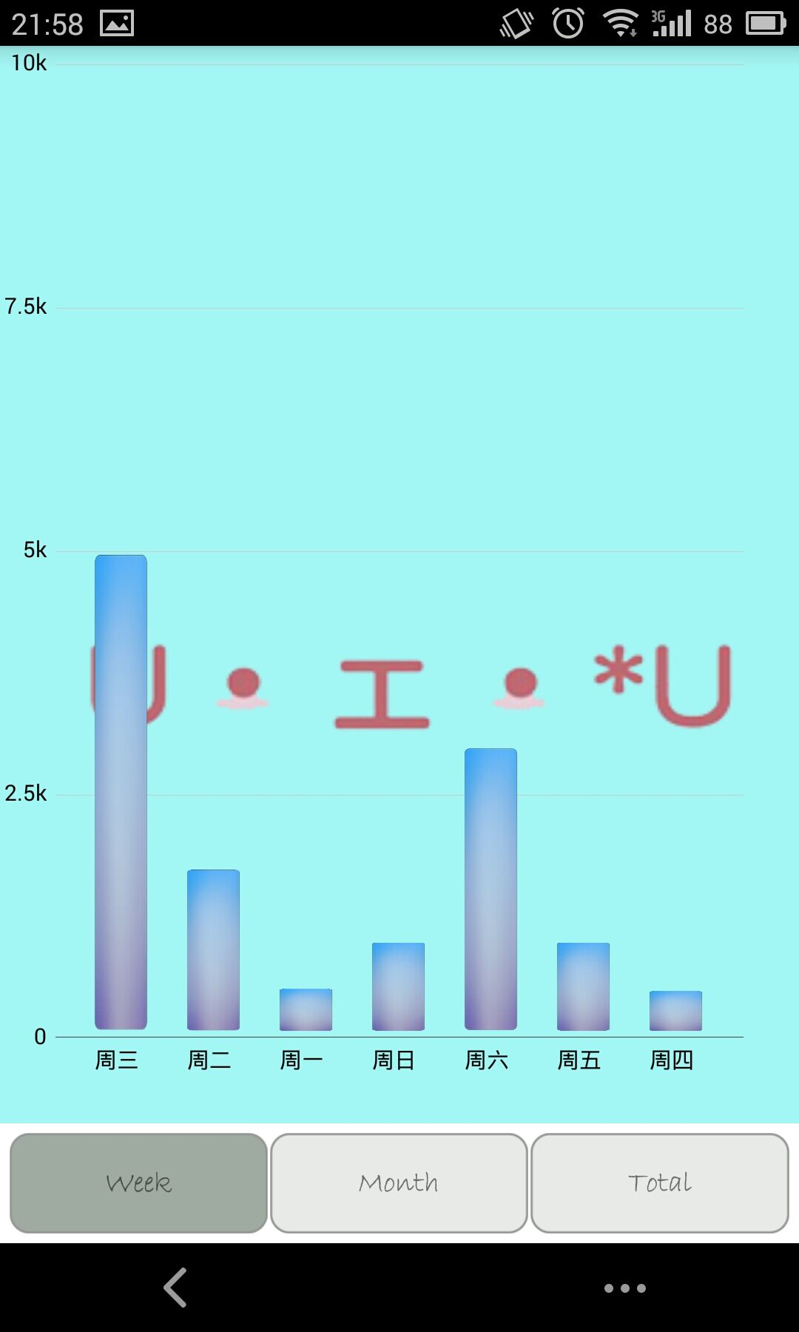
Sketch 1 ： Steps accounting & Data statistics

Slide 10
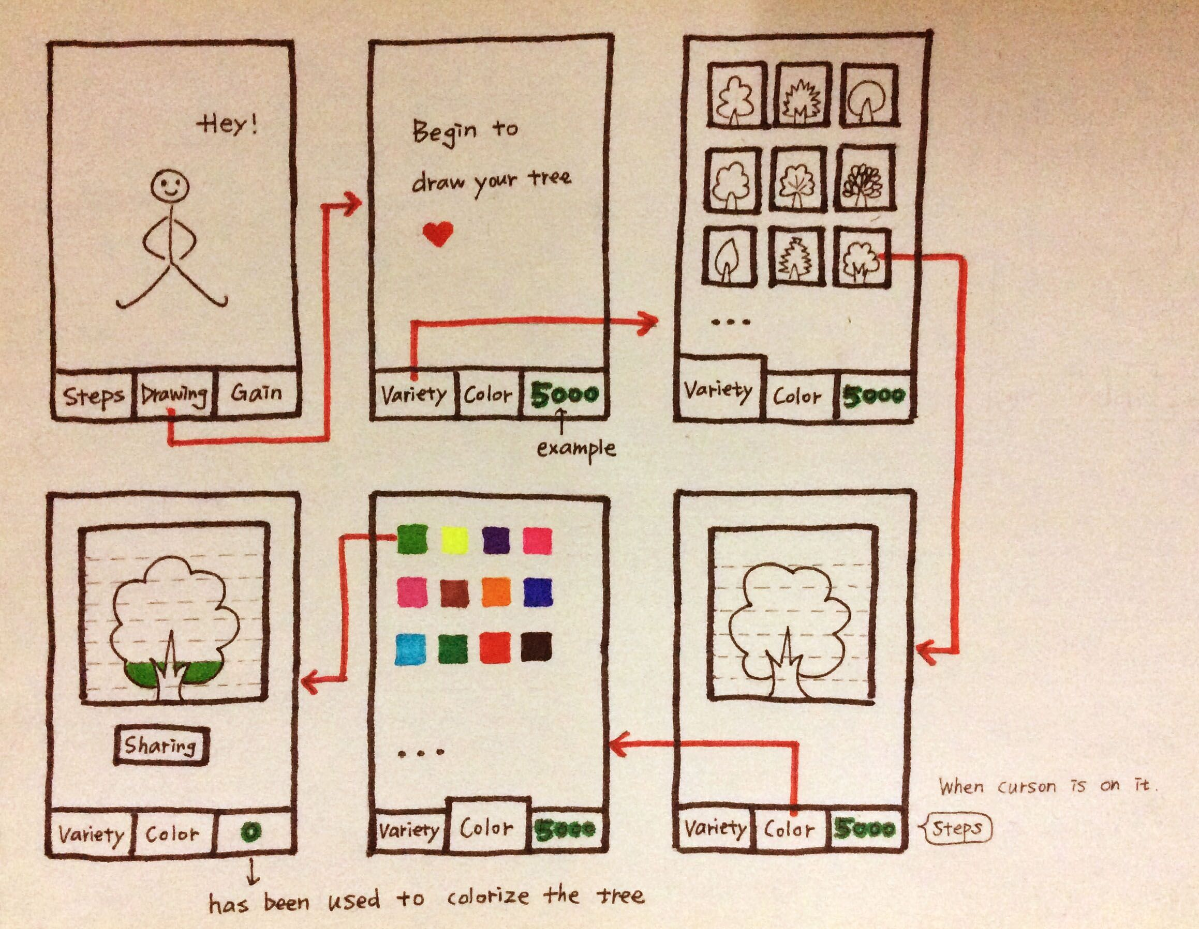
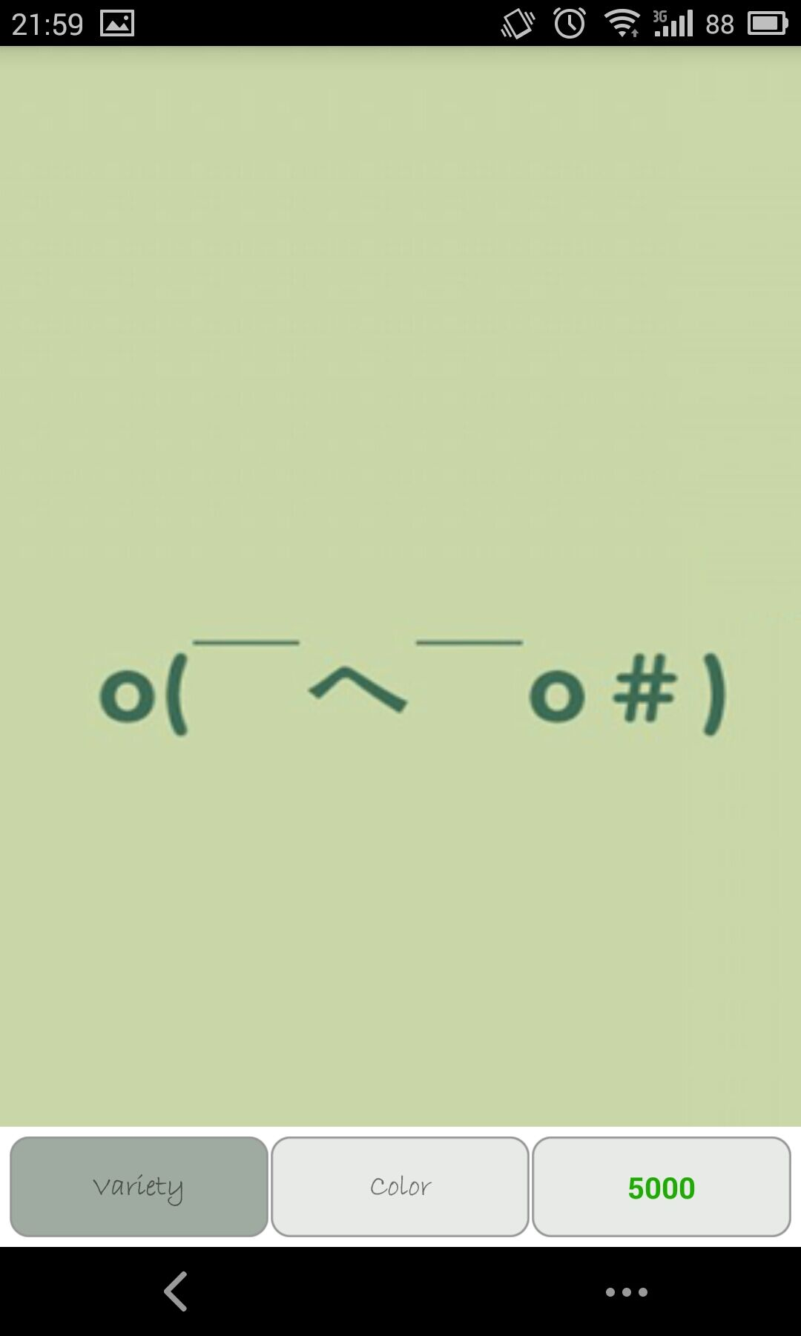
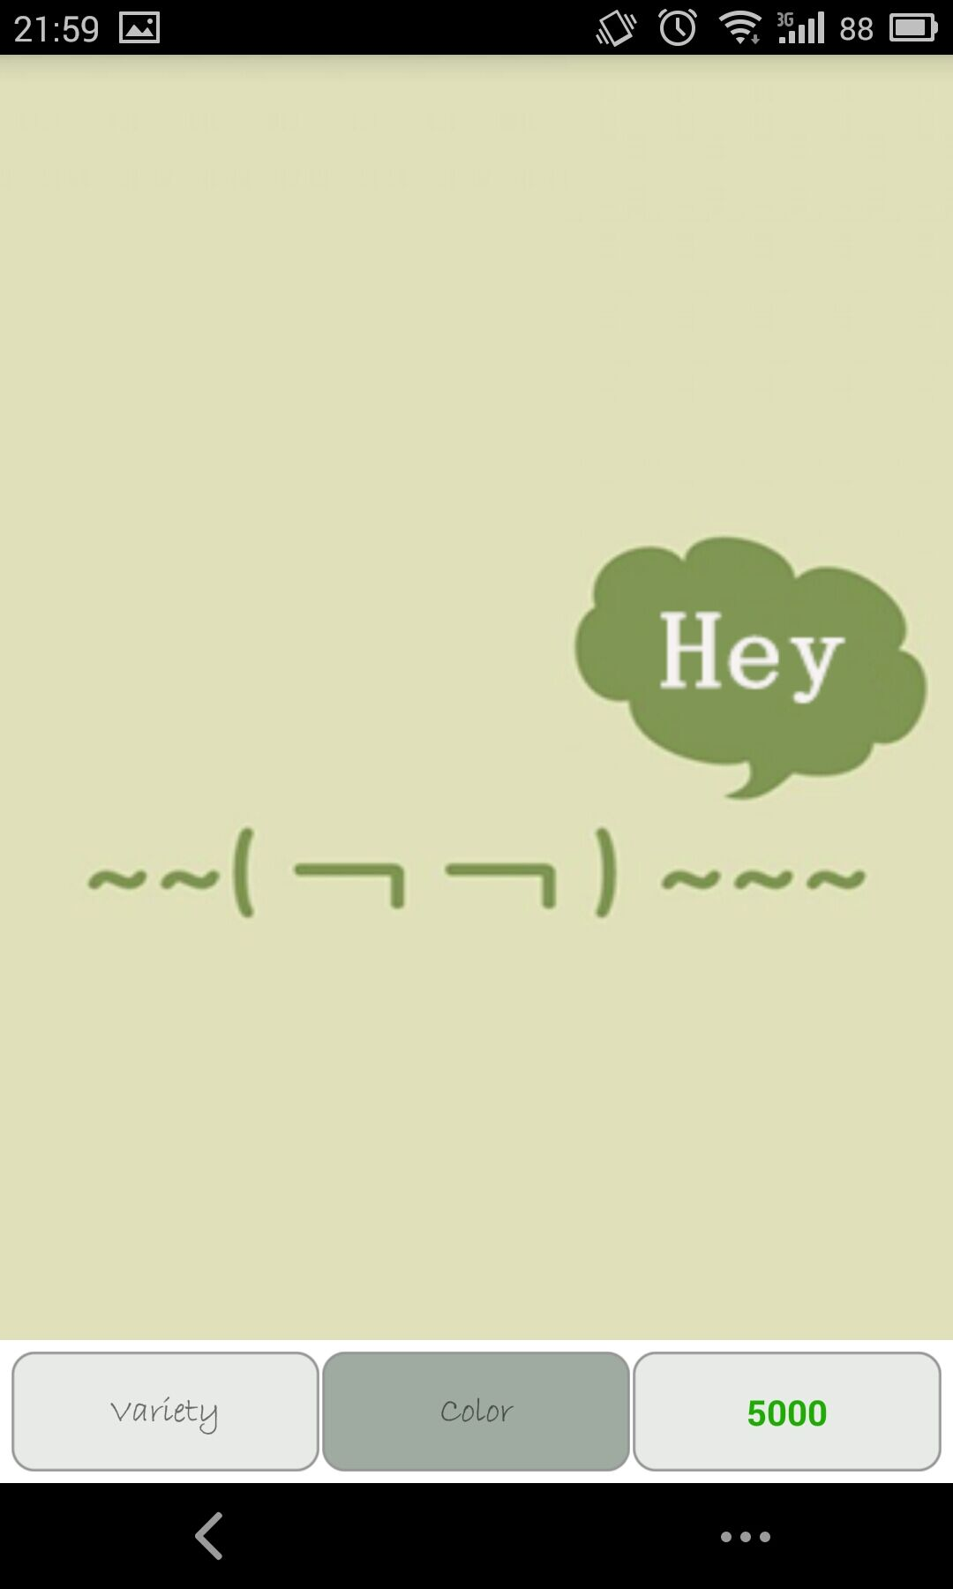
Sketch 2 ： Trees drawing

Slide 11
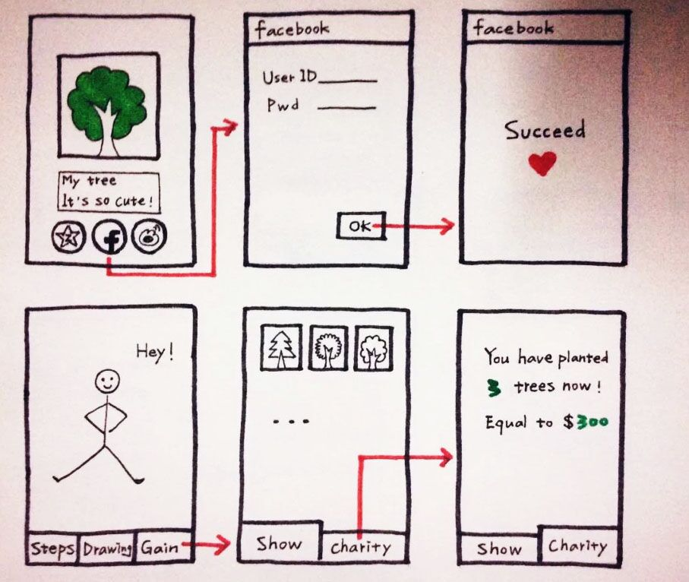

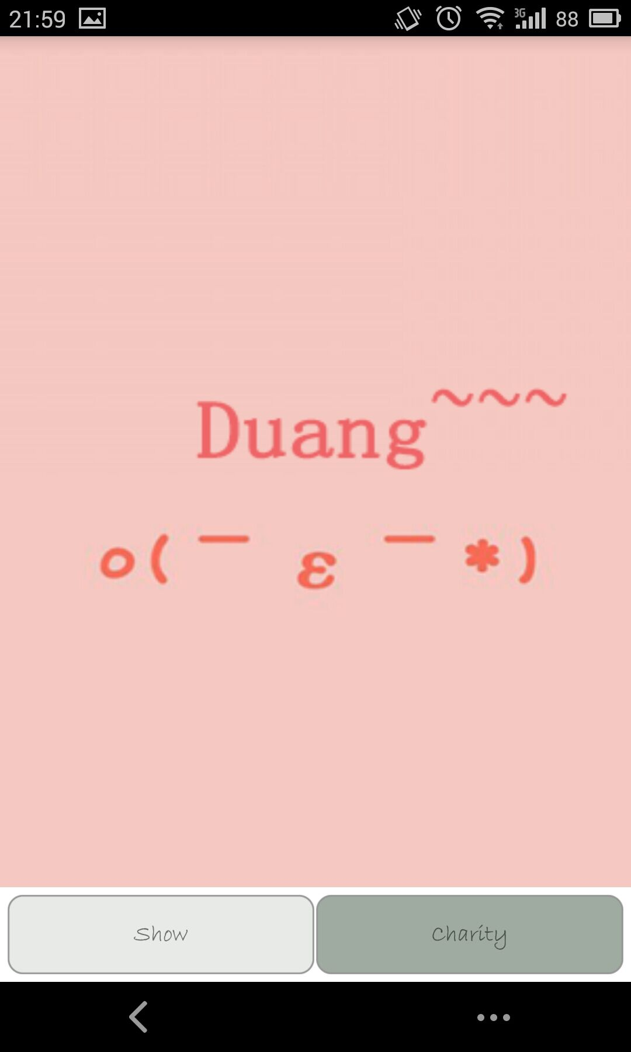
Sketch 3 ： Sharing & Charity

Slide 12
3
Usecases
(☆▽☆)

Slide 13
Welcome Screen
Steps Accounting

Slide 14





Slide 15
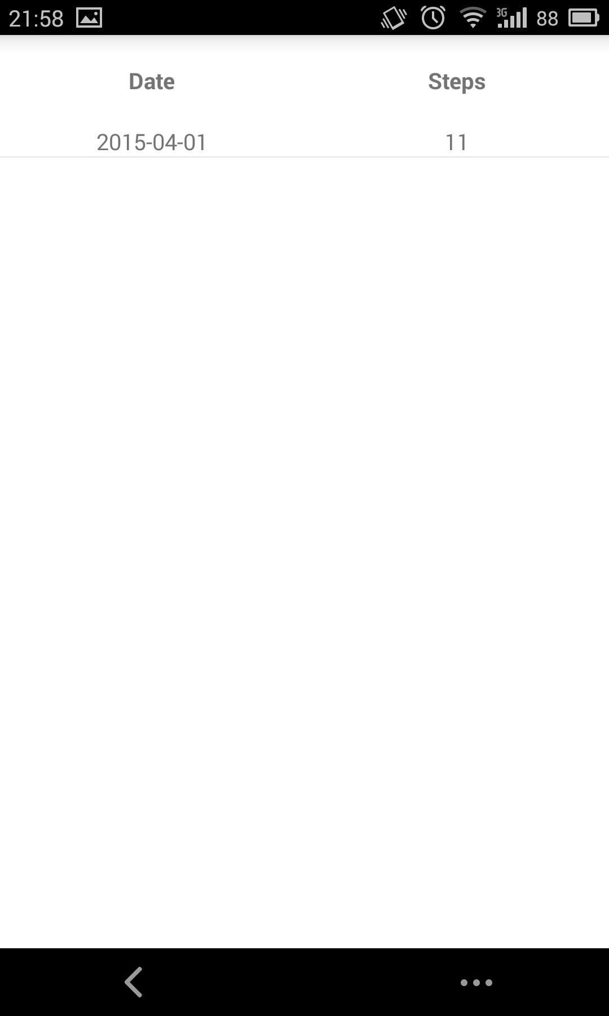
Data Statistics
Steps Per Day

Slide 16
4
Future Development
~\(≧▽≦)/~[Go!]

Slide 17

Charity
3
3.1 Contact with charity institution
3.2 Or get sponsorship from advertisers
说明
4
More…
4.1 Improve the UI constantly
4.2 Improve from User feedback
说明

Slide 18
Functions
1
1.1 Improve the residual function
："Drawing" & "Gain"
2
Database
2.1 Create database
2.2 Connect database

Slide 19

Thank You ~

