Slide 1

Android
My-diary
SPRING 2015
TEAM 29

Slide 2

WHAT
ABOUT US ?

Slide 3


R
N
U
A
O
M
Y
E
金松奎
尹琦云
12301154-jinsongkui
12301169-yinqiyun
MY TEAM
胡嘉星
戴鸿超
12301151-hujiaxing
12301146-daihongchao

Slide 4
INTRODUCTION
PURPOSE
AUDIENCE
USER SCENARIOS
OVERALL DESIGN
DEMO
FUTURE DEVELOPMENT

Slide 5
PURPOSE
It helps someone who in a diary completed their own electronic diaries.let them keep a good mood in writing process.
He solved writing places limited, time limitation problem in the original diary. It overcomes the problems including depreciation、damage、 lost、 difficulties in retrieval at the same time.

Slide 6
AUDIENCE
The people who keep a habit of writing diary and always review their own diary.They don’t have a way to remove the problems of traditional diaries. At the same time they want to change the way of writing into a electronic means.

Slide 7
USER SCENARIOS
A middle school students staying at home with completing his homework.
A white-collar already be workers, he abandoned in the company today.Since he is still single,there is no effective way to vent his emotions.

Slide 8
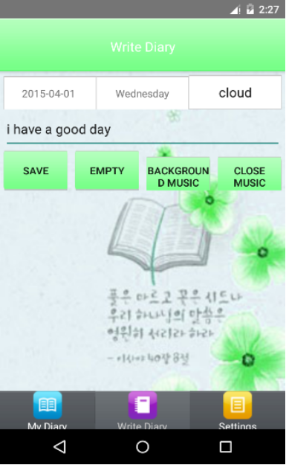
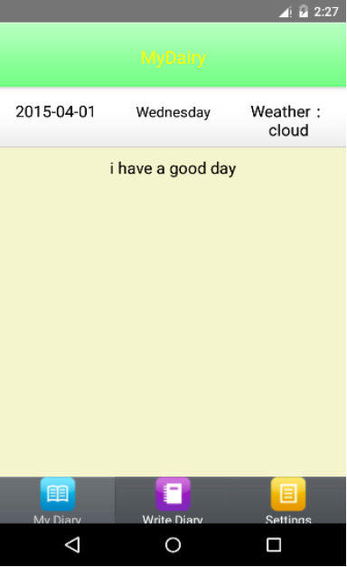
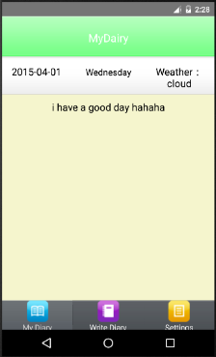
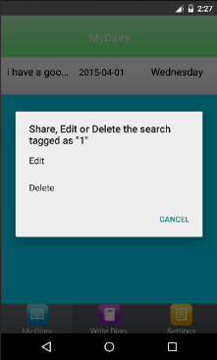
OVERALL DESIGN

Slide 9
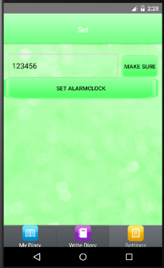
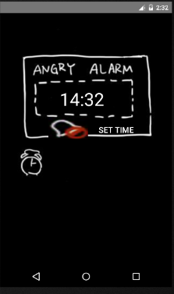
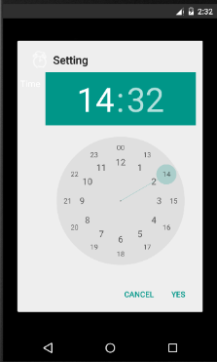
OVERALL DESIGN

Slide 10

The people who
keep a habit of
writing diary and always
review their own diary.
They don’t have a way
to remove the problems of
traditional diaries.
Who…

Slide 11

This is a good records of
their lives. Our app is
convenient to use.
Even people don’t take
a pen around them.
They can still write
diary everywhere on their
mobile phone.
Why…

Slide 12
original diary
lost
problem
damage
solve
depreciation
waste time
waste resource

Slide 13
1
Children login
2
Children write
diary
Scene1
Scene1
use case
3
Children mangment
diary

Slide 14
1
Human Read
Scene2
Scene2
use case
2
Human Background
Music
3
Human save diary

Slide 15
FUTURE
DEVELOPMENT

Slide 16
THANK YOU …

