Slide 1

One Topic One Day
——An application for debate
Notes:
1-3 介绍 韩春雨
4 用户 杨梦月
5-8 用例 蒋圣
9-10 计划 石临成

Slide 2
并不是所有道理都黑键白键般的分明
Not all things can be divided into tow colors like piano keyboard
——《黑键》
—— Black Key

Slide 3
Introduction
Social
Debate
Impressive
Notes:
The App named One Topic One Day publishes a topic that is controversial to users. Users can show their own view about the topic. The topic may be a motion used in debate game ,an international event and so on. It can help people share their different view about the topic and it aimed at open people's horizon and use dialectical thinking. It will be the biggest platform for people to debate.
One Topic One Day is an interesting social application focusing on debate. Every day, it publishes a topic that is controversial to users.

Slide 4
Audience
Ordinary
Amateur
Debater
Notes:
Our app is for people who are interested in debate ,such as debater and other amateur . Mainly about 3 kind of people. The ordinary is different with the amateur because they may just interested the topic but not the debate. Though our app is an app of the debate , it doesn’t obey the process of the real debate.it is like a discuss about a topic. our app is easy to understand and easy to use for these three kind of people. So the people who are not debater they are just feel interested about topic the can join the discuss.

Slide 5
User Case
Browse
Comment
Favorite
Profile
……

Slide 6
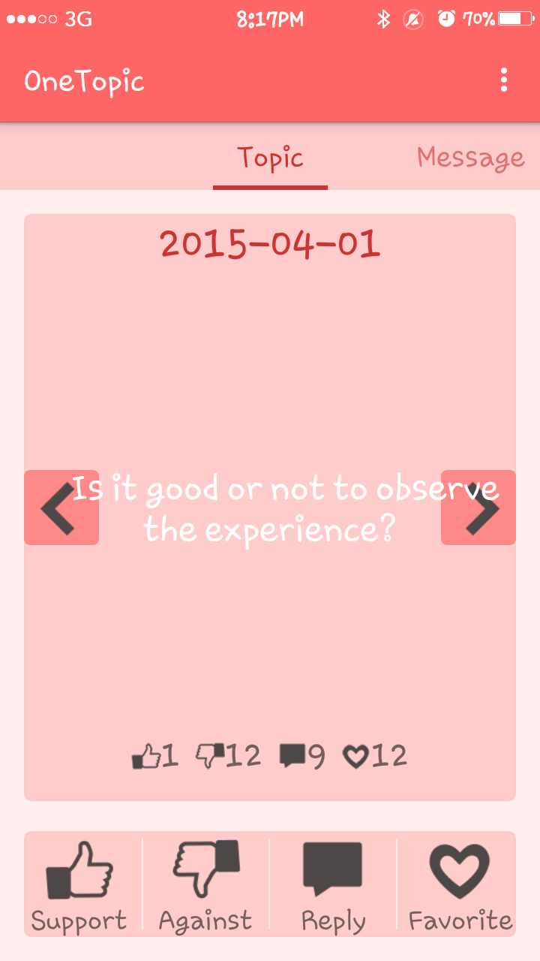
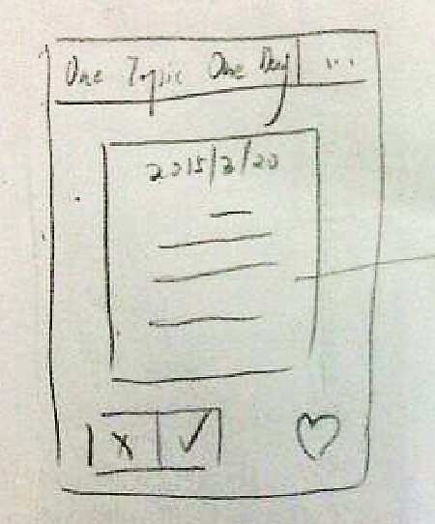
Browse topics
Notes:
It display today topic, you can see the date, topic and statistic number.
I can change to another day’s topic by click the navigation button
There is for button On the bottom, you can choice you side. support, against and the reply and favorite.
When you touch the button ,I will become red to indicate you have done this

Slide 7
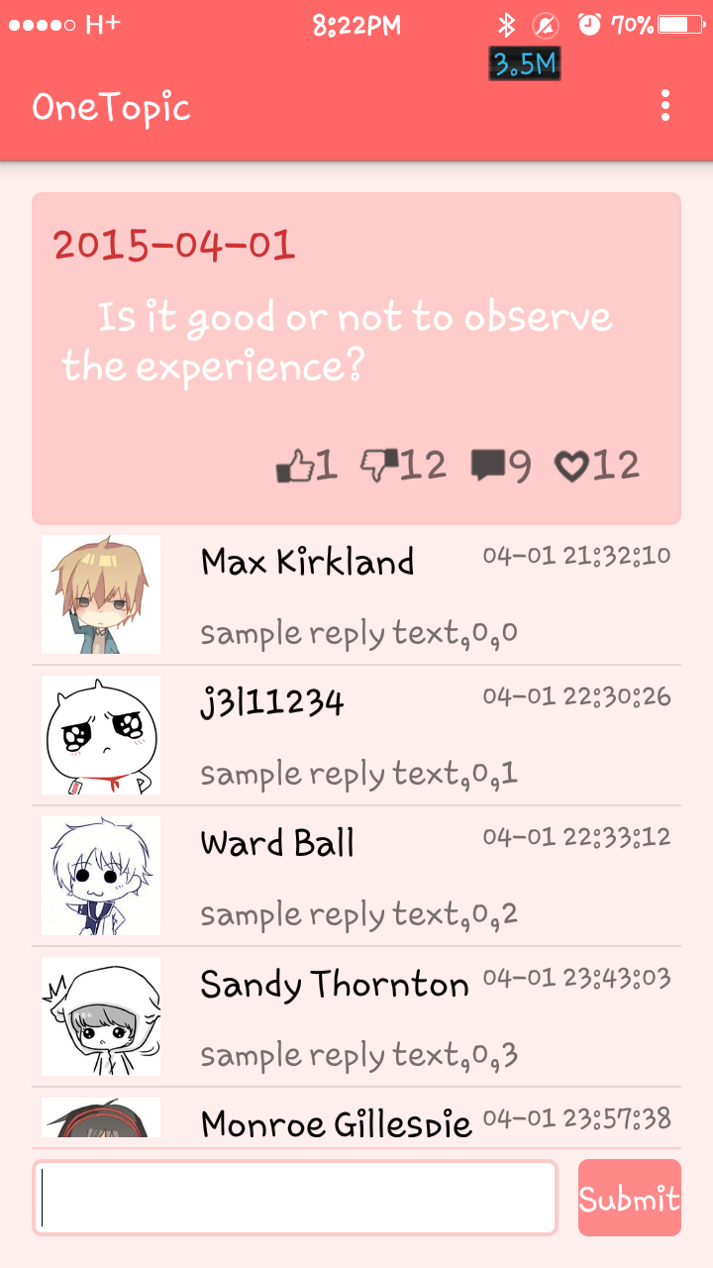
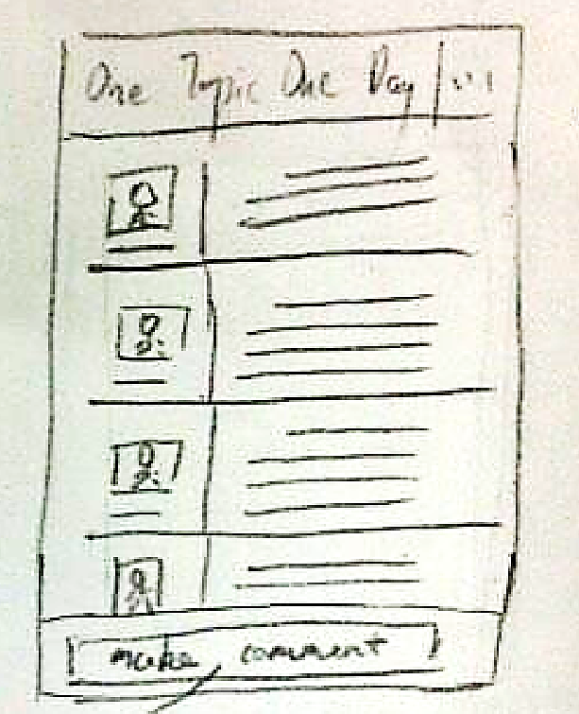
View/Submit comment
Notes:
It is the comment list of one tipic.
There is fake data
Here you cae see the comments , they are sorted by the time,
The list can be swipe
You can also submit you opinion.

Slide 8
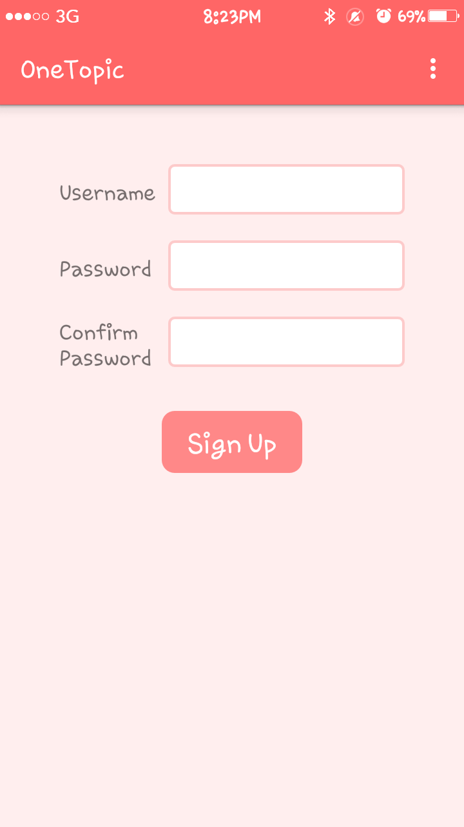
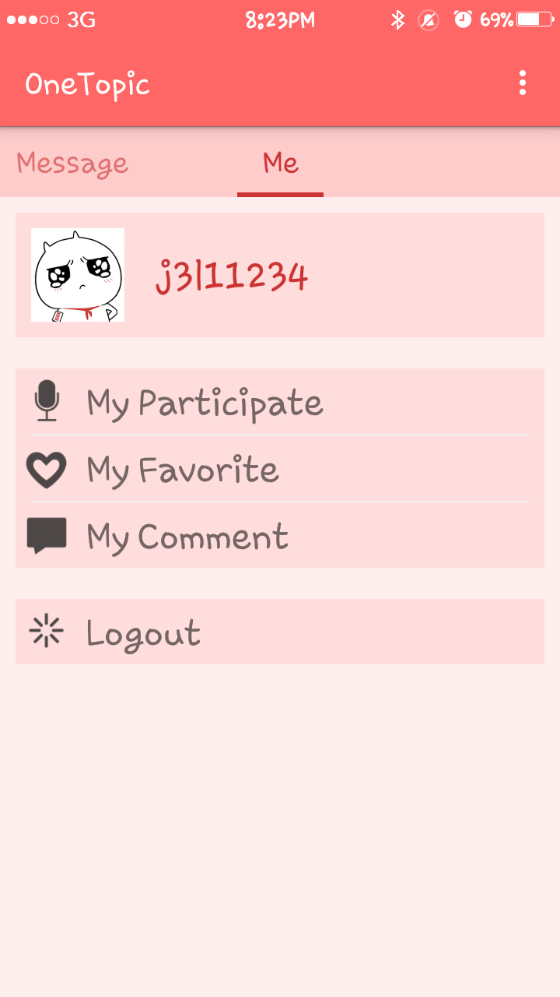
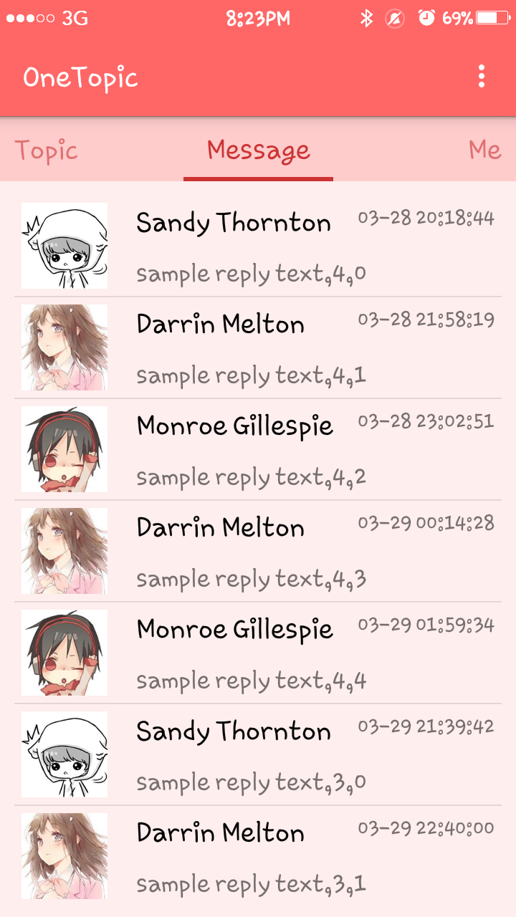
More
Notes:
Thiere are other screenshot
Login/profile/message

Slide 9
To Do
Design database
Develop back-end
Advertise & Popularize
……

Slide 10
Thanks!

