Slide 1
SearchYou

Slide 2
Purpose
1.Make the employment more convenient
2.Connect between the employer and employee

Slide 3
Audiences：
1.Students(employee)
2.Companies(employer)

Slide 4
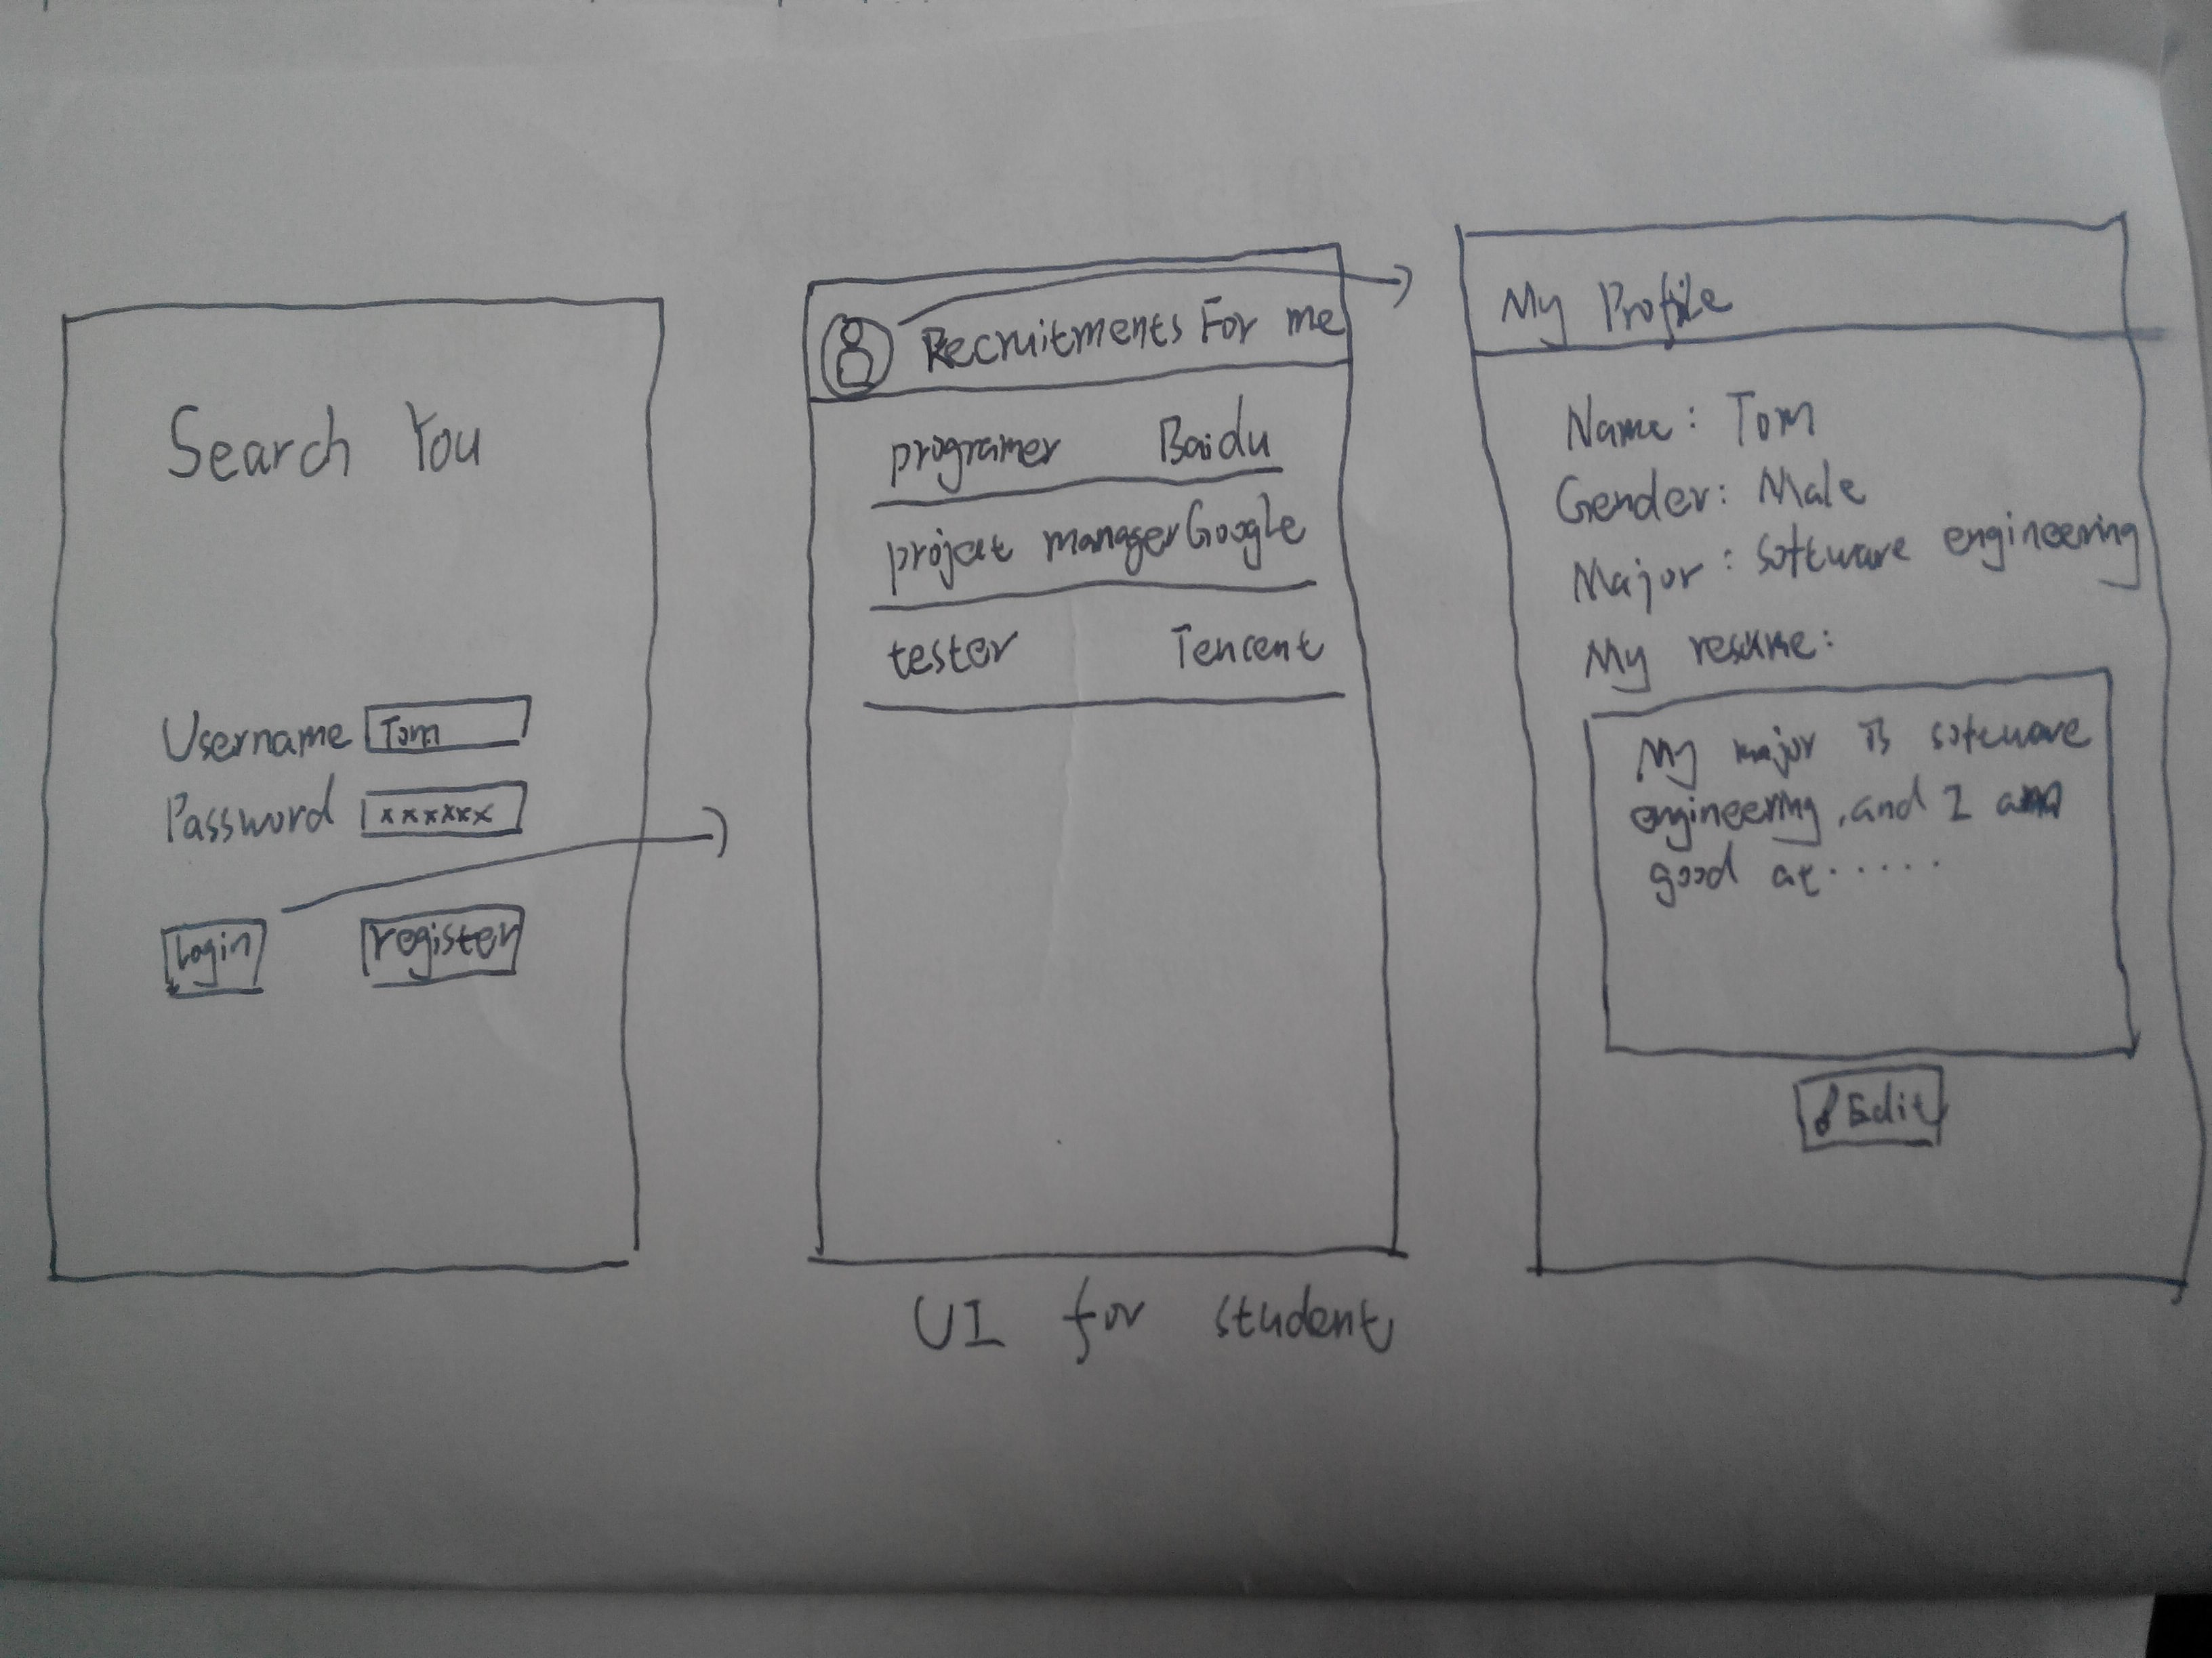

Slide 5
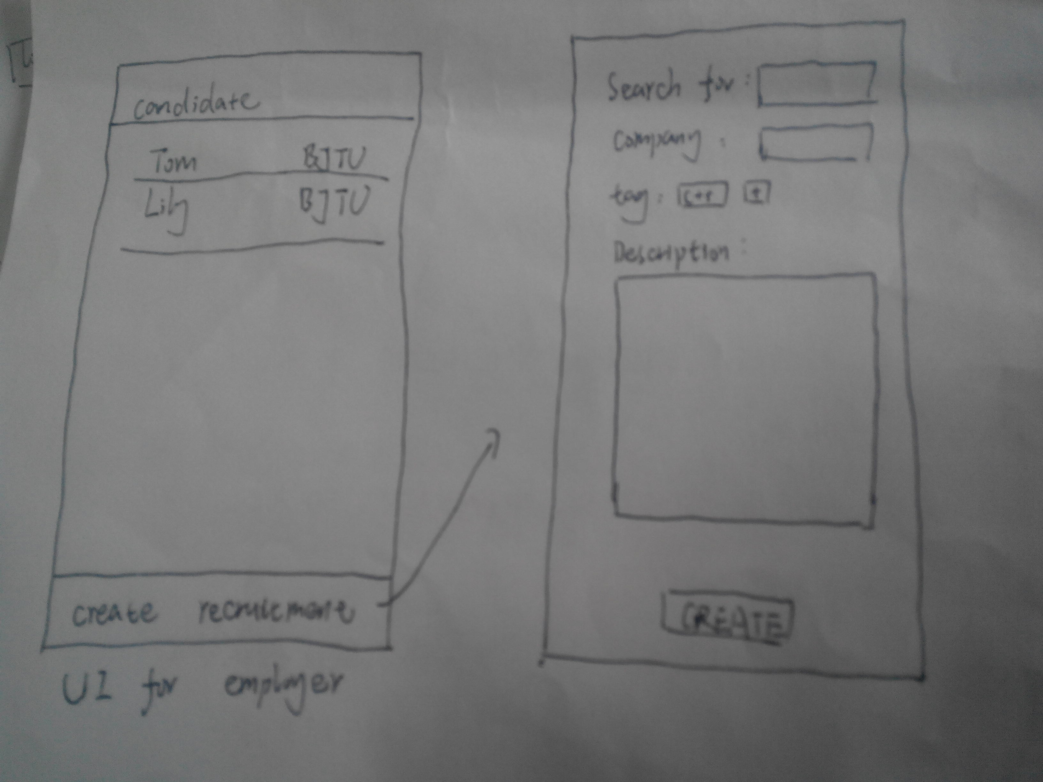

Slide 6
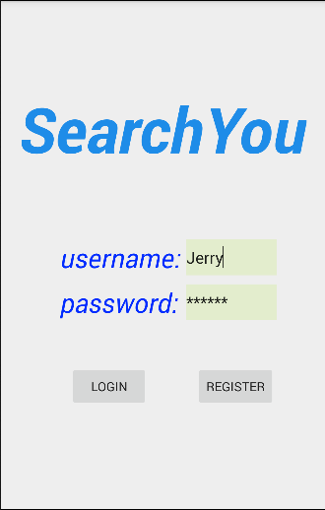
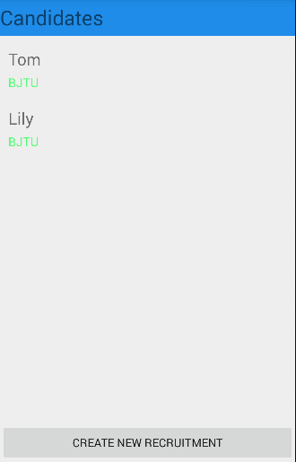
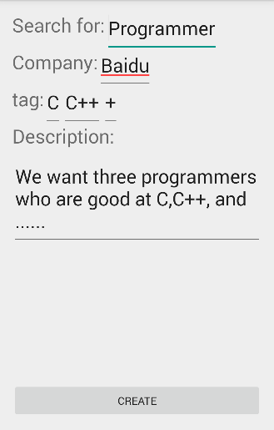

Slide 7
