Slide 1
Search You

Slide 2
Purpose
1.Make the employment more convenient 2.Connect between the employer and employee

Slide 3
Audiences
1.Students(employee)
2.Companies(employer)

Slide 4
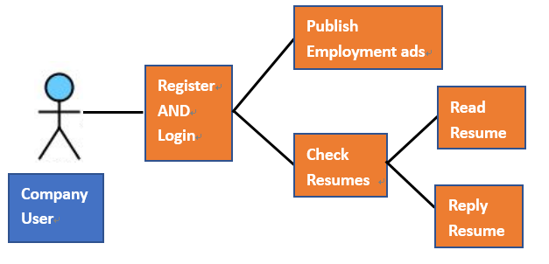
Use Case Overview

Slide 5
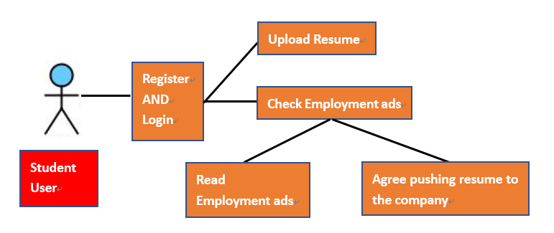
Use Case Overview

Slide 6
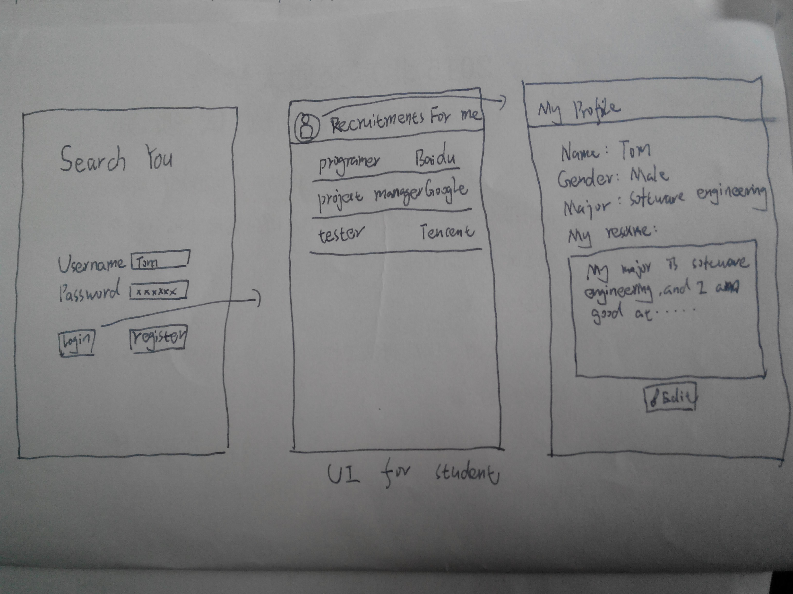

Slide 7
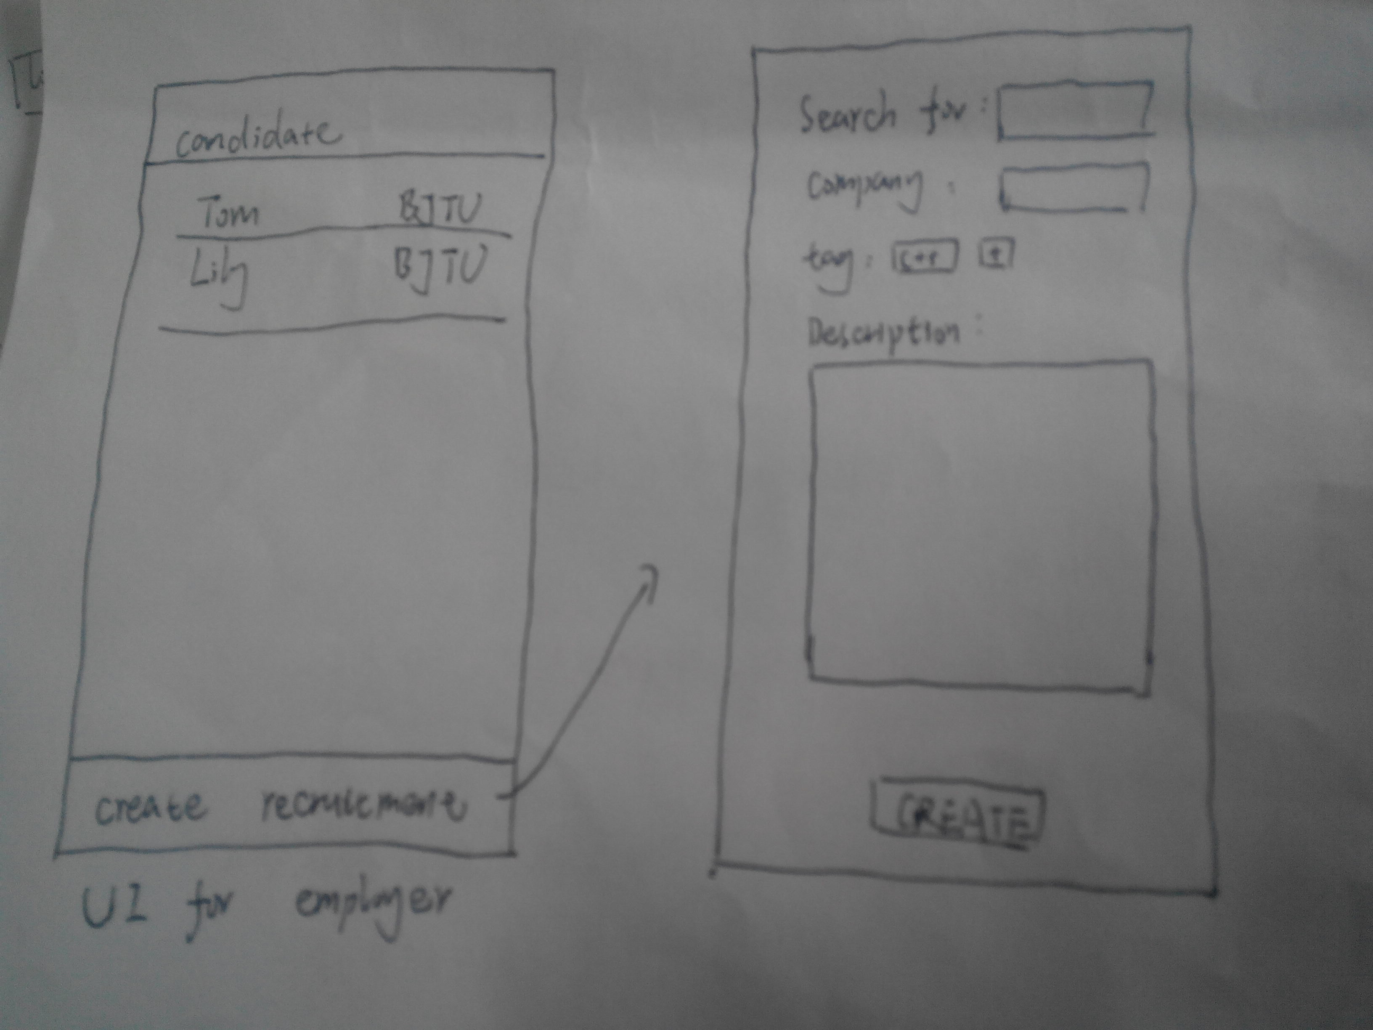

Slide 8
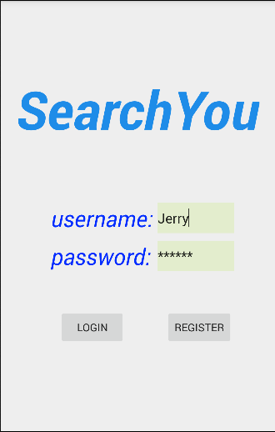
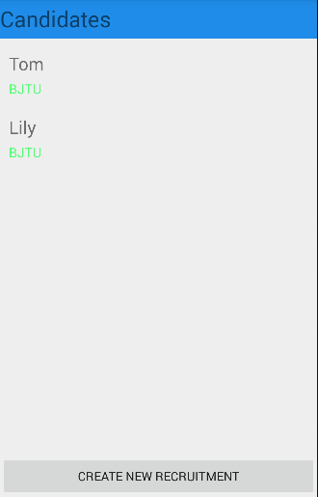
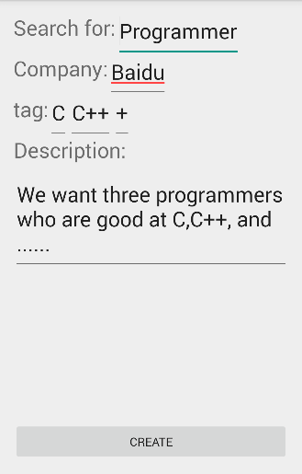

Slide 9
