Slide 1


Shan Pai

Slide 2


Menu
Purpose & Audience
Demo
User Case Overview
Sketches

Slide 3

Introduction
Nowadays, more and more people like to take photos
via their smart phones. And some of the pictures are really
of high quality. Besides, people are also eager to share their
experience with others. Therefore, our project is a picture social application. It can not only take and upload photos, but also earn money by selling photos. That is to say, it is a mixture of social network and e-commerce system.

Slide 4

Introduction
“Shan” “善” means
being good at &
charity
“Pai” “拍” means
taking photos &
auction
Shan Pai
善拍

Slide 5

Purpose & Audience
Purpose:
Provide a platform to share
original pictures and earn
money by selling them
Instagram
Nice
Audience:
啪啪
逗萌
people who have a smart
phone, like taking photos,
and are willing to help others
Image Social network

Slide 6

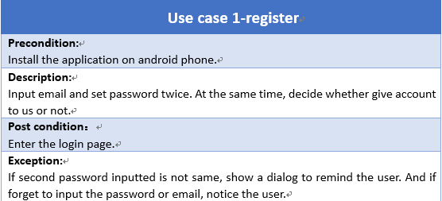
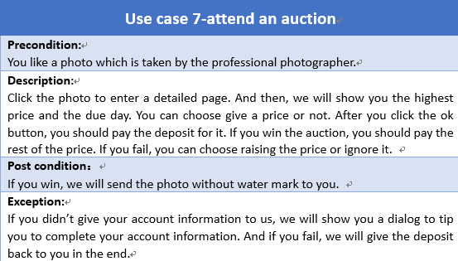
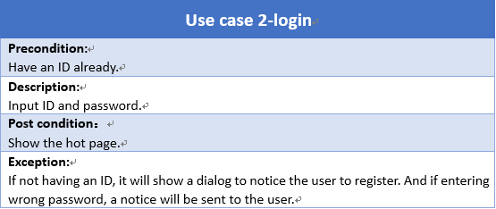
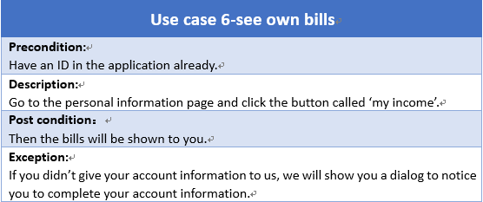
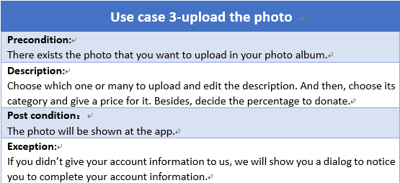
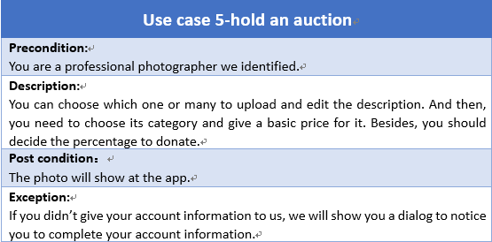
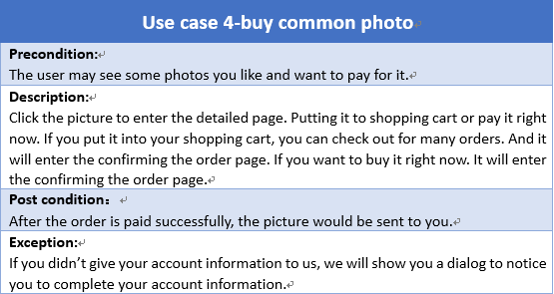
Use Case Overview

Slide 7
Use Case Overview

Slide 8
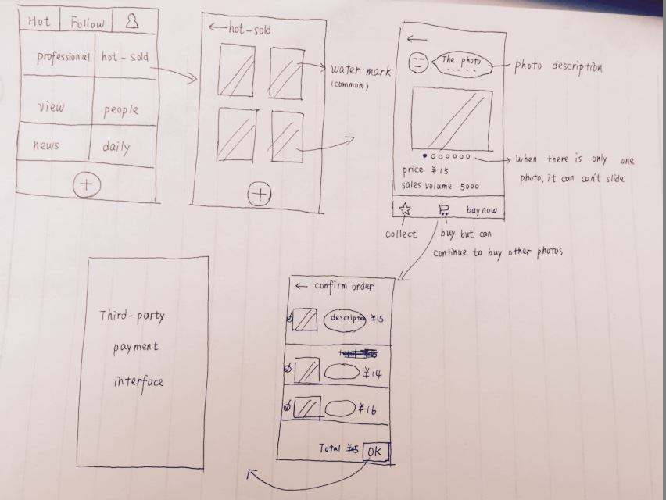
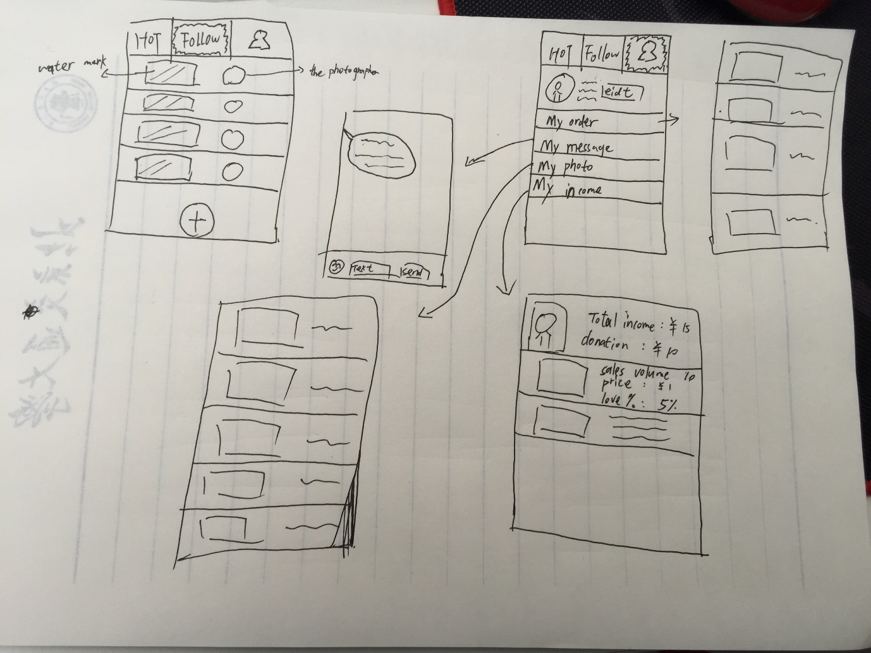
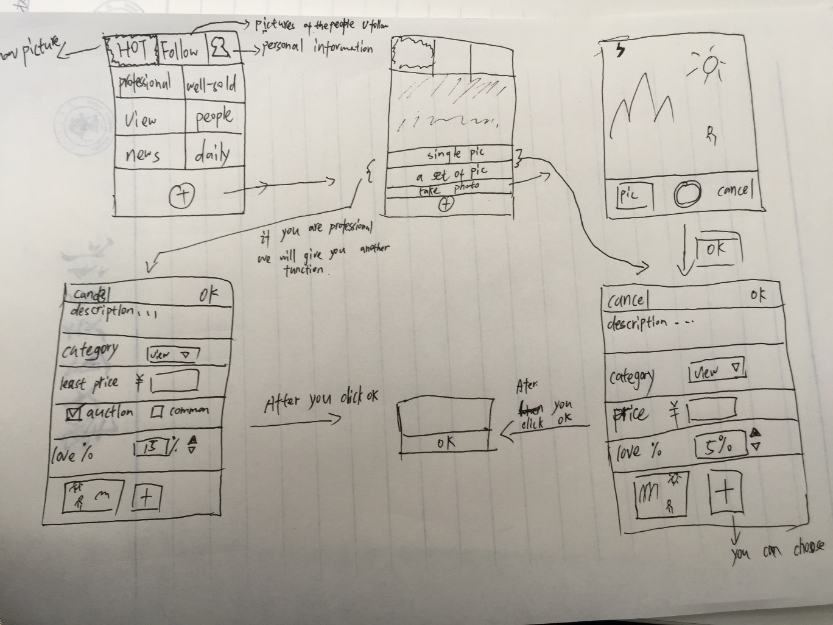
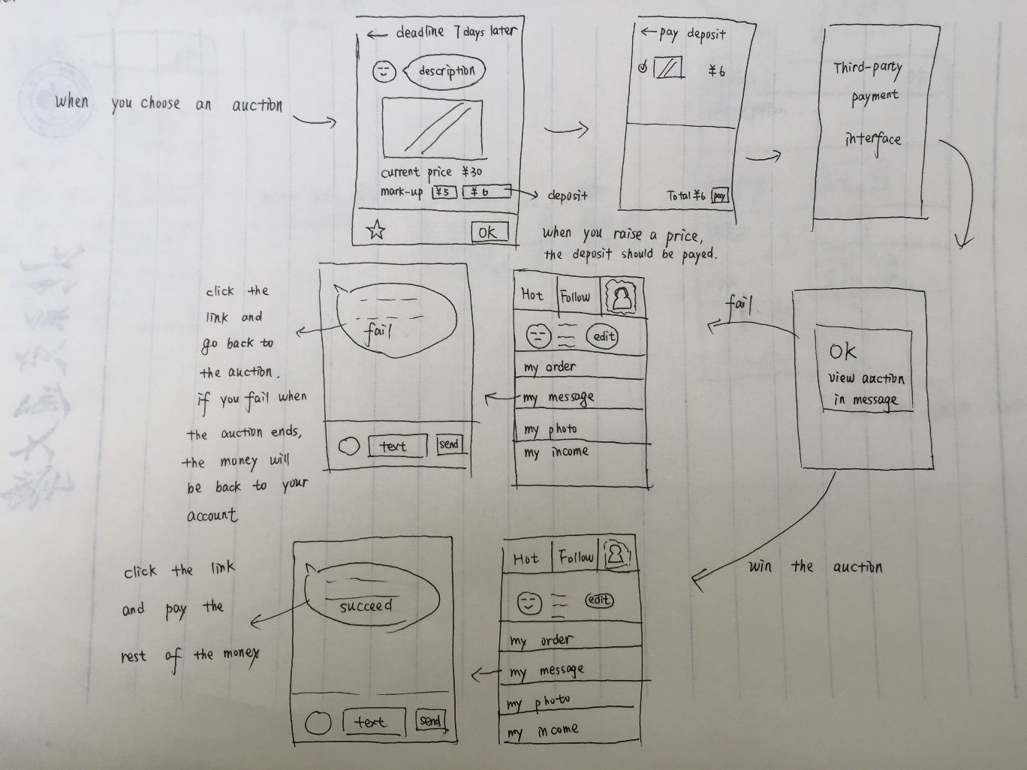
Sketches

Slide 9
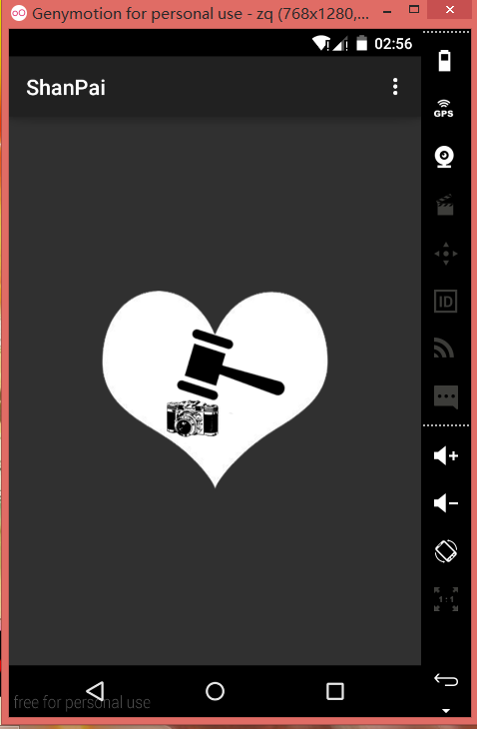
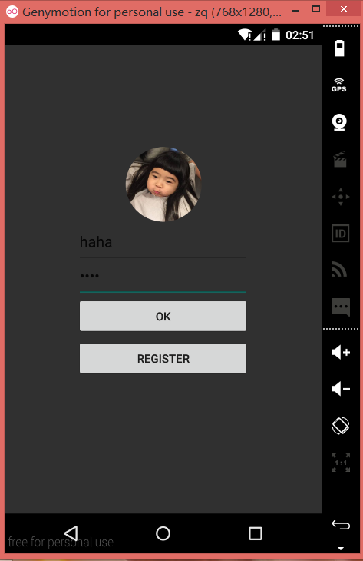
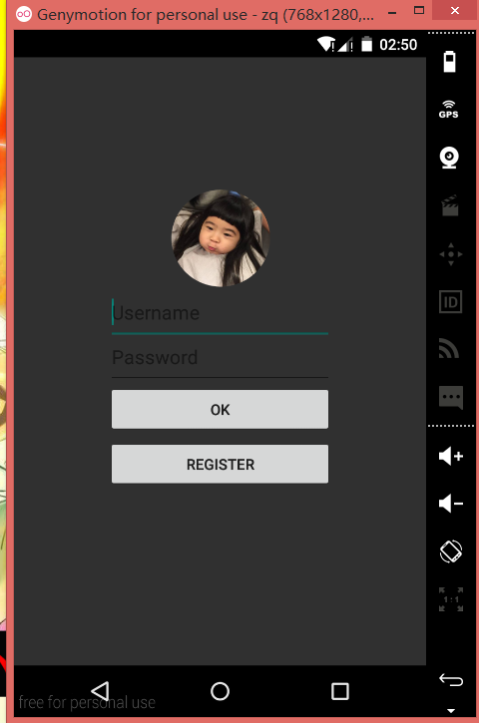
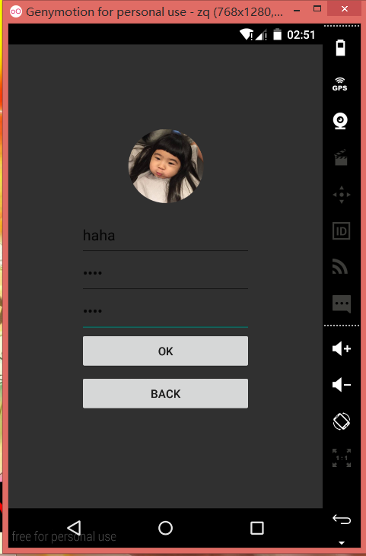
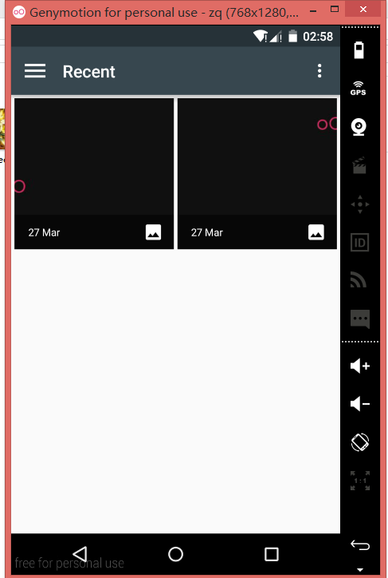
Screen Shots

Slide 10
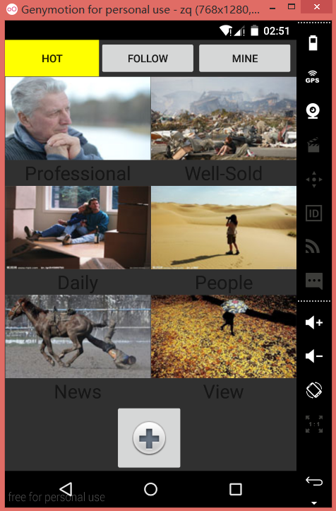
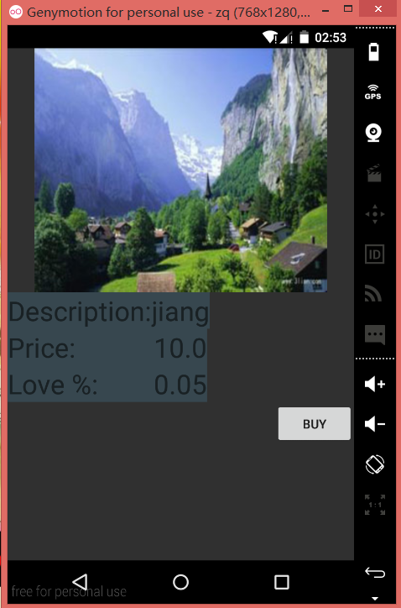
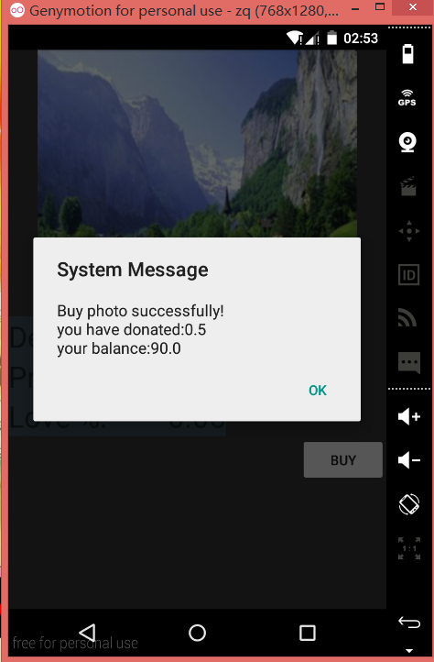
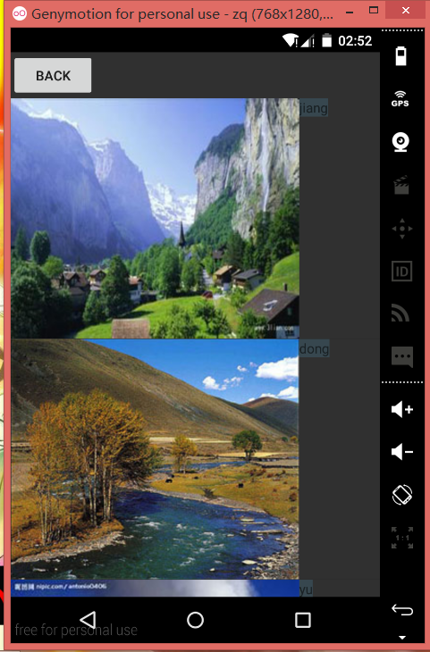
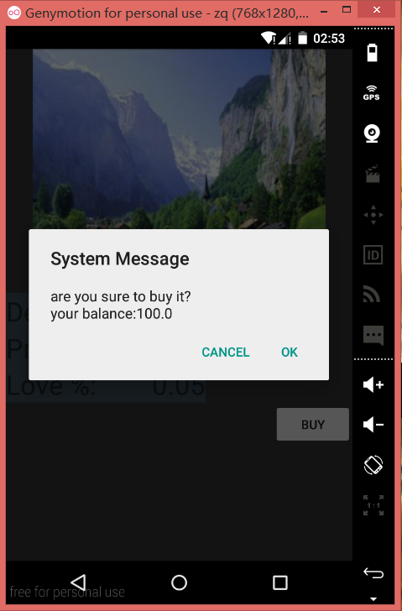
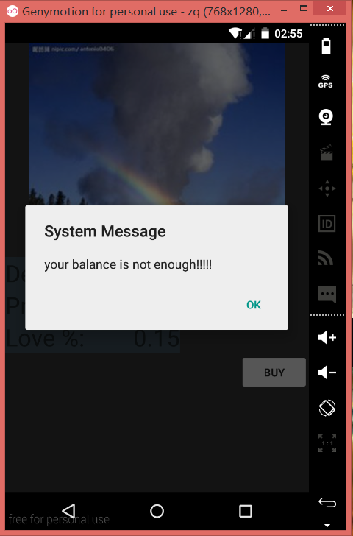
Screen Shots

Slide 11
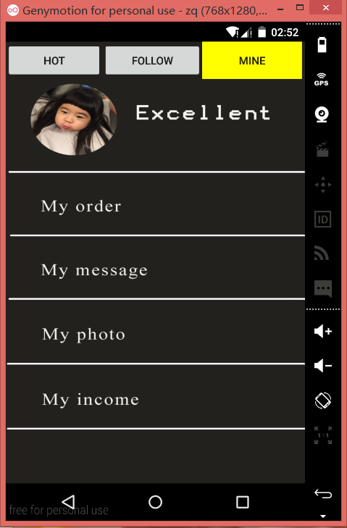
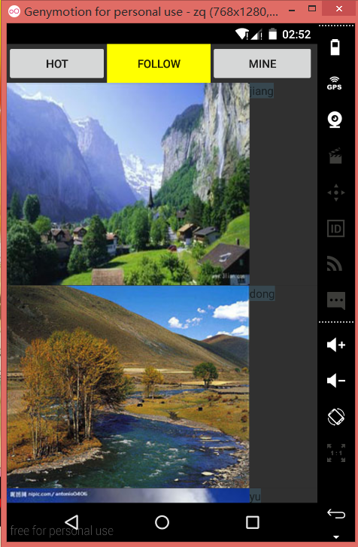
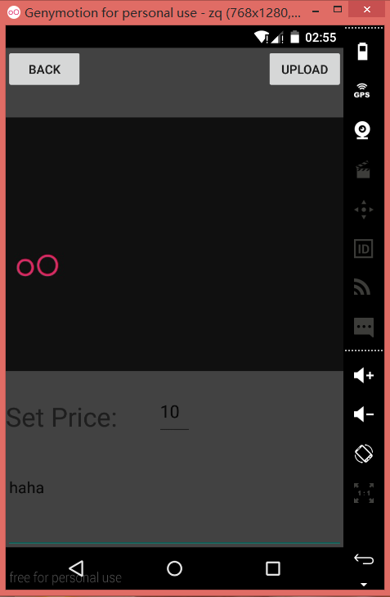
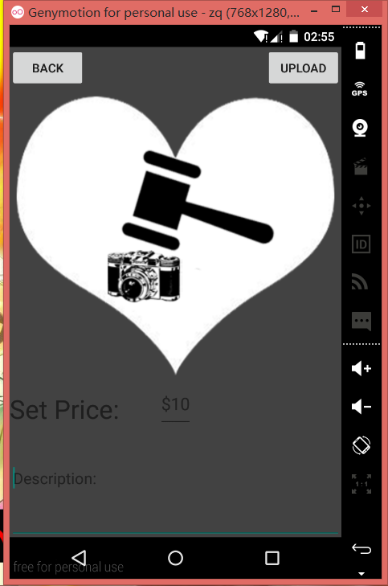
Screen Shots

Slide 12

Future Development
Beautify the interface
Implement the auction, uploading album, seeing messages, seeing bills, modifying personal information and paying with AliPay
Add user tutorial
Fault tolerance

