Slide 1

Ringing-Calendar
--Team 11

Slide 2
Purpose
With the peace of life increasing, everybody have a lot of things to do which would make us forget something. Our app memorandum which is put in a calendar is just a useful tool to solve the problem

Slide 3


I haven prepared for…But it must be…
So many things to do
I should do A first, but B could not be delayed…..
Fast peace of life
Oh, no!!! I forgot to……

Slide 4

Memorandum
+
Calendar

Slide 5
Audience
B
C
A
D
EVERYBODY

Slide 6
Use Case
No.1 Add an event in the calendar
No.2 Search events in the calendar

Slide 7
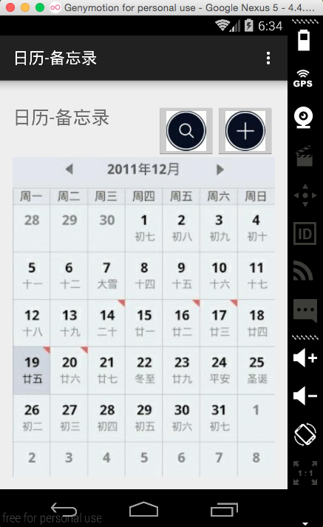
App main screen

Slide 8
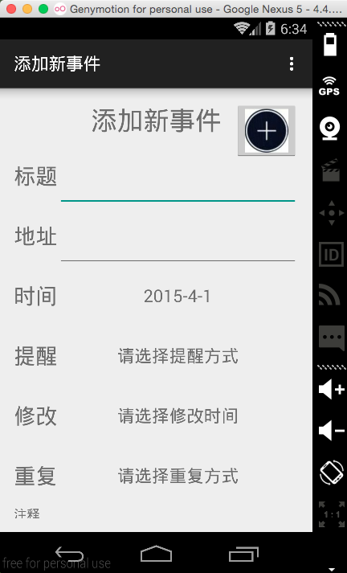
ADD
Add an Event

Slide 9
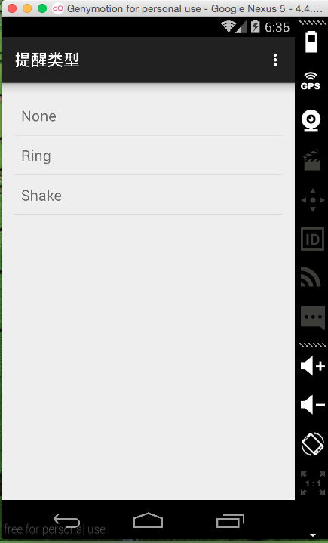
ADD
Set Remind

Slide 10
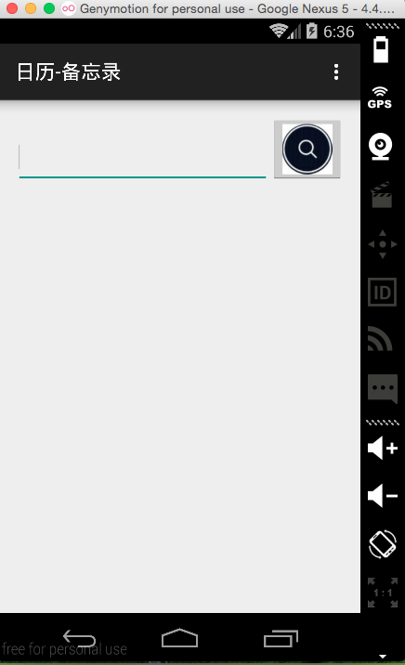
SEARCH
Find Notes
Update Notes
Delete Notes

Slide 11
Future
Complete the calendar
Add account and connect to the database
Add sharing part with friends

Slide 12
Thank You ^_^

