Slide 1
BuDu RoadCondition
Team Leader：Chen Junjun
Team Members：Li Yifeng,Hu Teng,Ni Yao

Slide 2
1
App Introduce
2
Some Use Case
3
Demonstrate
4
Development
5
Summary

Slide 3
1
App Introduce

Slide 4
1
App Introduce
Brief description
Audience description
Nowadays, traffic condition is getting worse and worse, like Beijing. Bad traffic condition has caused a lot of troubles to people. People always complain about this, but they totally have no idea about how to change that. So our app BuDu Road Condition is dedicated to helping people to avoid the inconvenience of traffic jams. Here is the functions: Show you the road condition that around you; query road condition; route navigation; Commonly used road collection; uploading your own road condition. And most important is that BuDu can provide you real-time traffic information. We do believe that BuDu can improve your life, and benefit you.
Our customers are people that have their owe cars. Some of them are young working people, for them more accurate road condition information are required, especially on the way to work. They need real-time traffic information to avoid the losses caused by the traffic jam; Some of them are people that go for a travel, road condition will influence their travel plan on some degree; And also some of them are business man, good road condition will improve their working efficiency....

Slide 5
2
Some Use Case

Slide 6
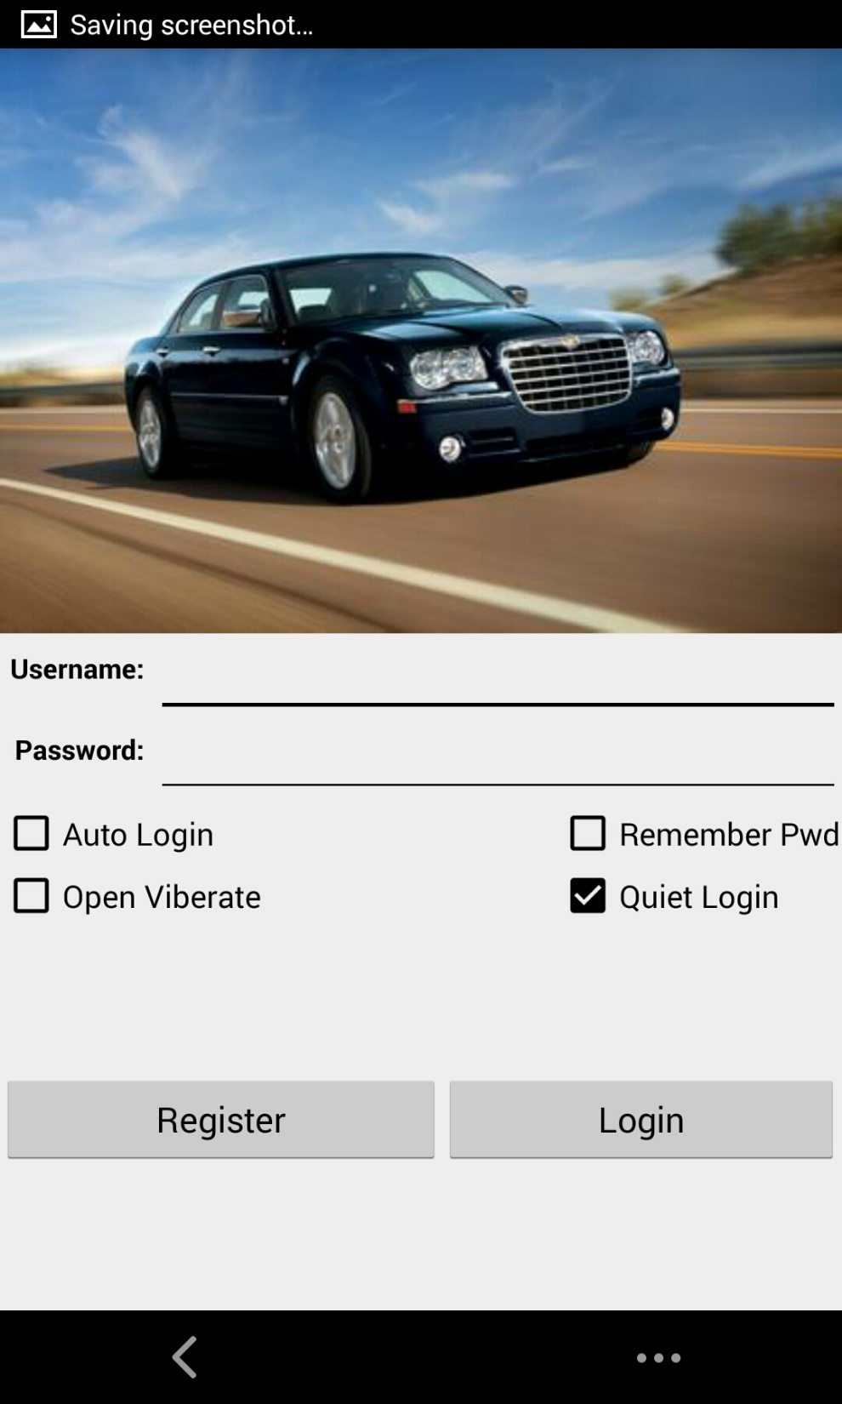
2
Login Use Case
Precondition: connect to the internet
Description: User enter the username and password, click the register/login button.
Postcondition: according to the locate user login in, app will show user the road traffic information in the list near the user.
Exception: username has been registered/the password is wrong, it will show a dialog said “duplicate username”/”wrong password”.

Slide 7
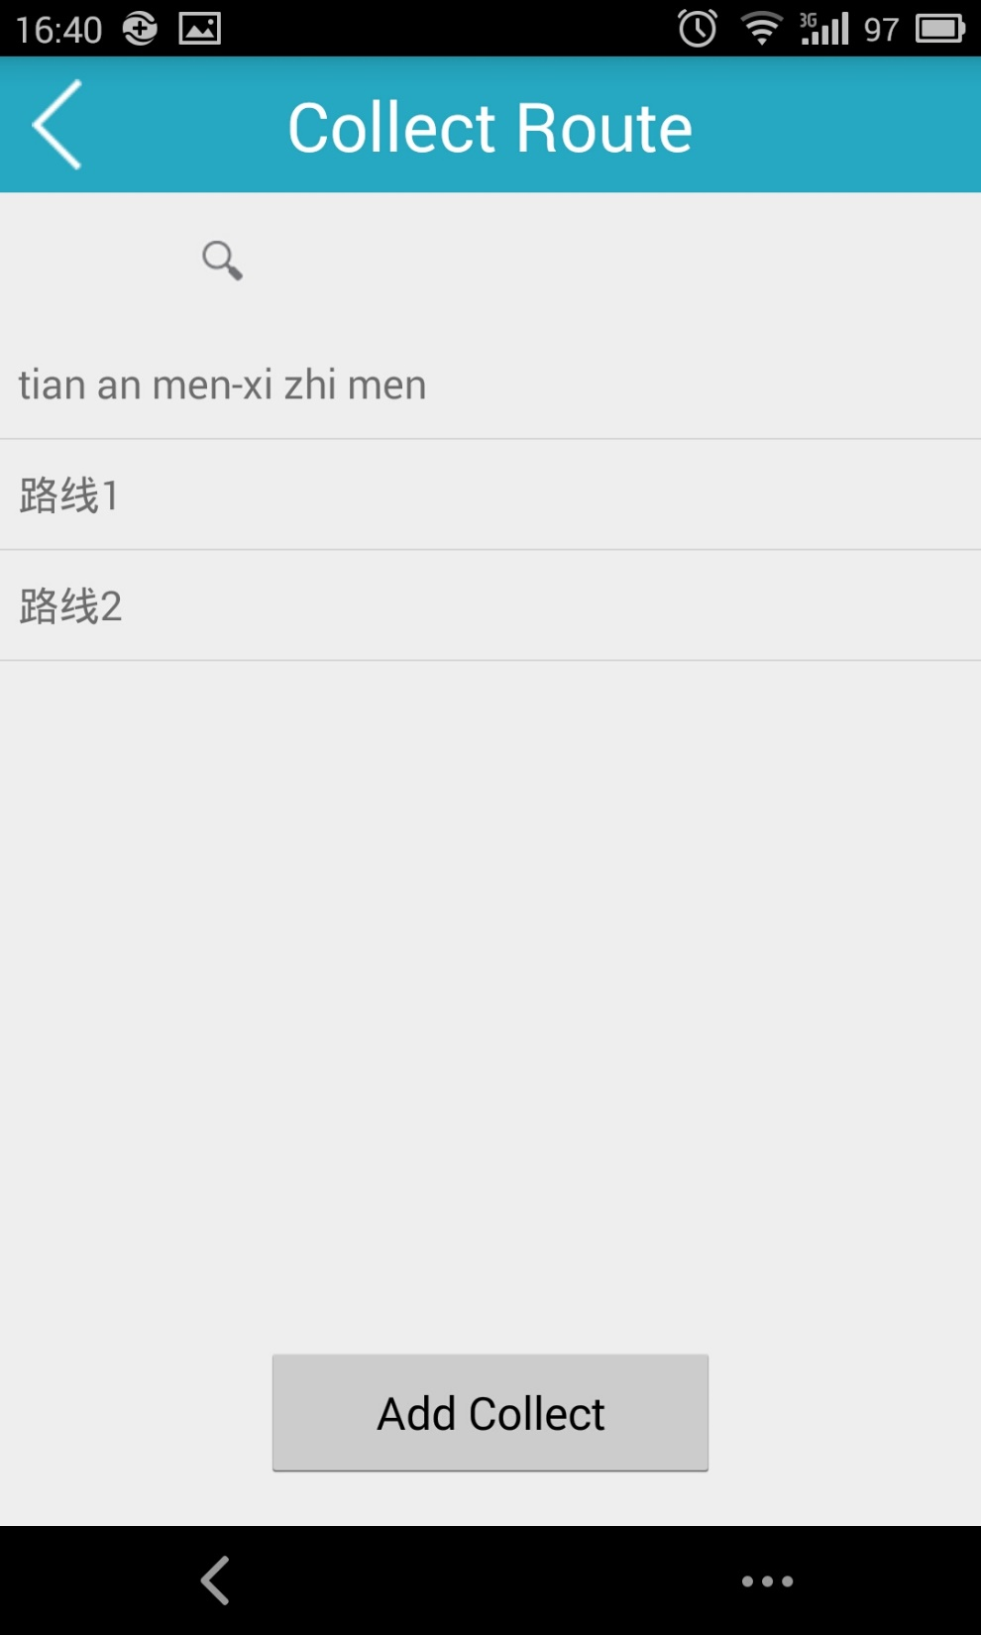
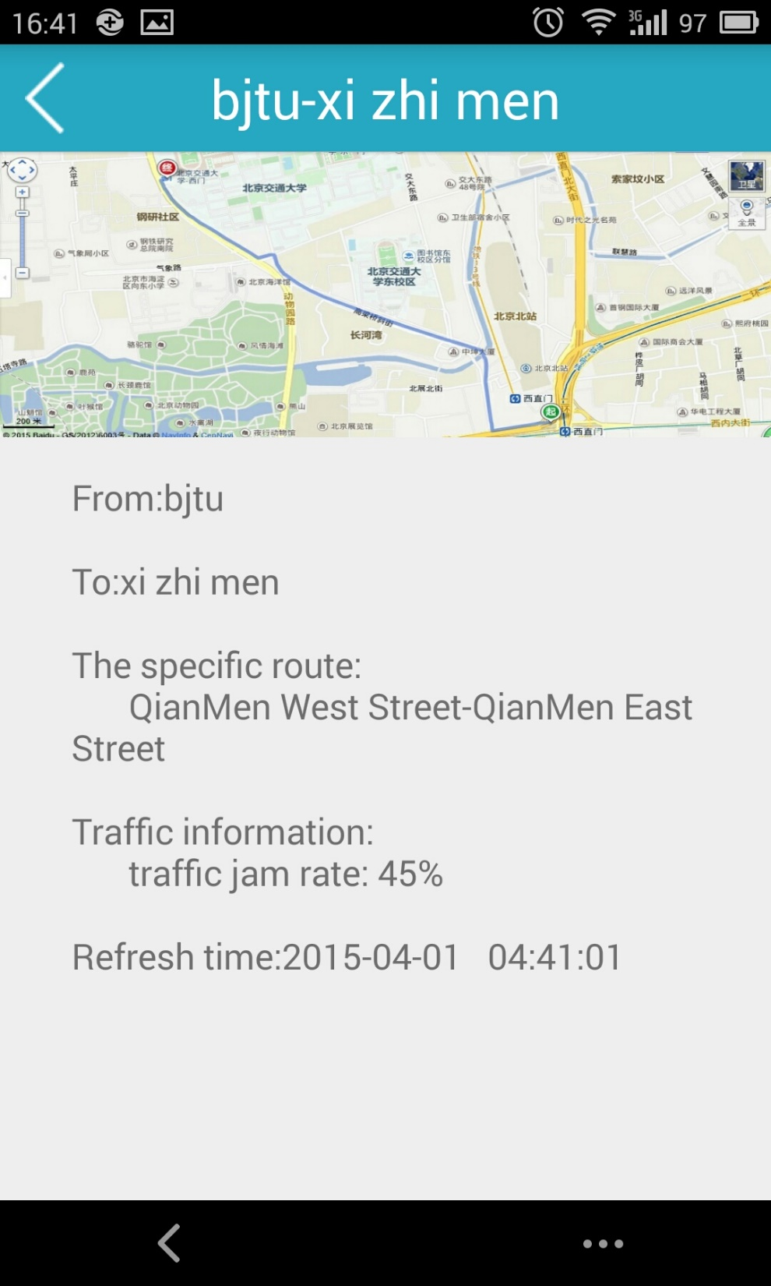
2
Collect Use Case
Precondition: collect route has been saved
Description: When the app layout is refreshed, all saved routes appear in the route list.
Postcondition: all saved routes will show in the list.
Exception:none

Slide 8
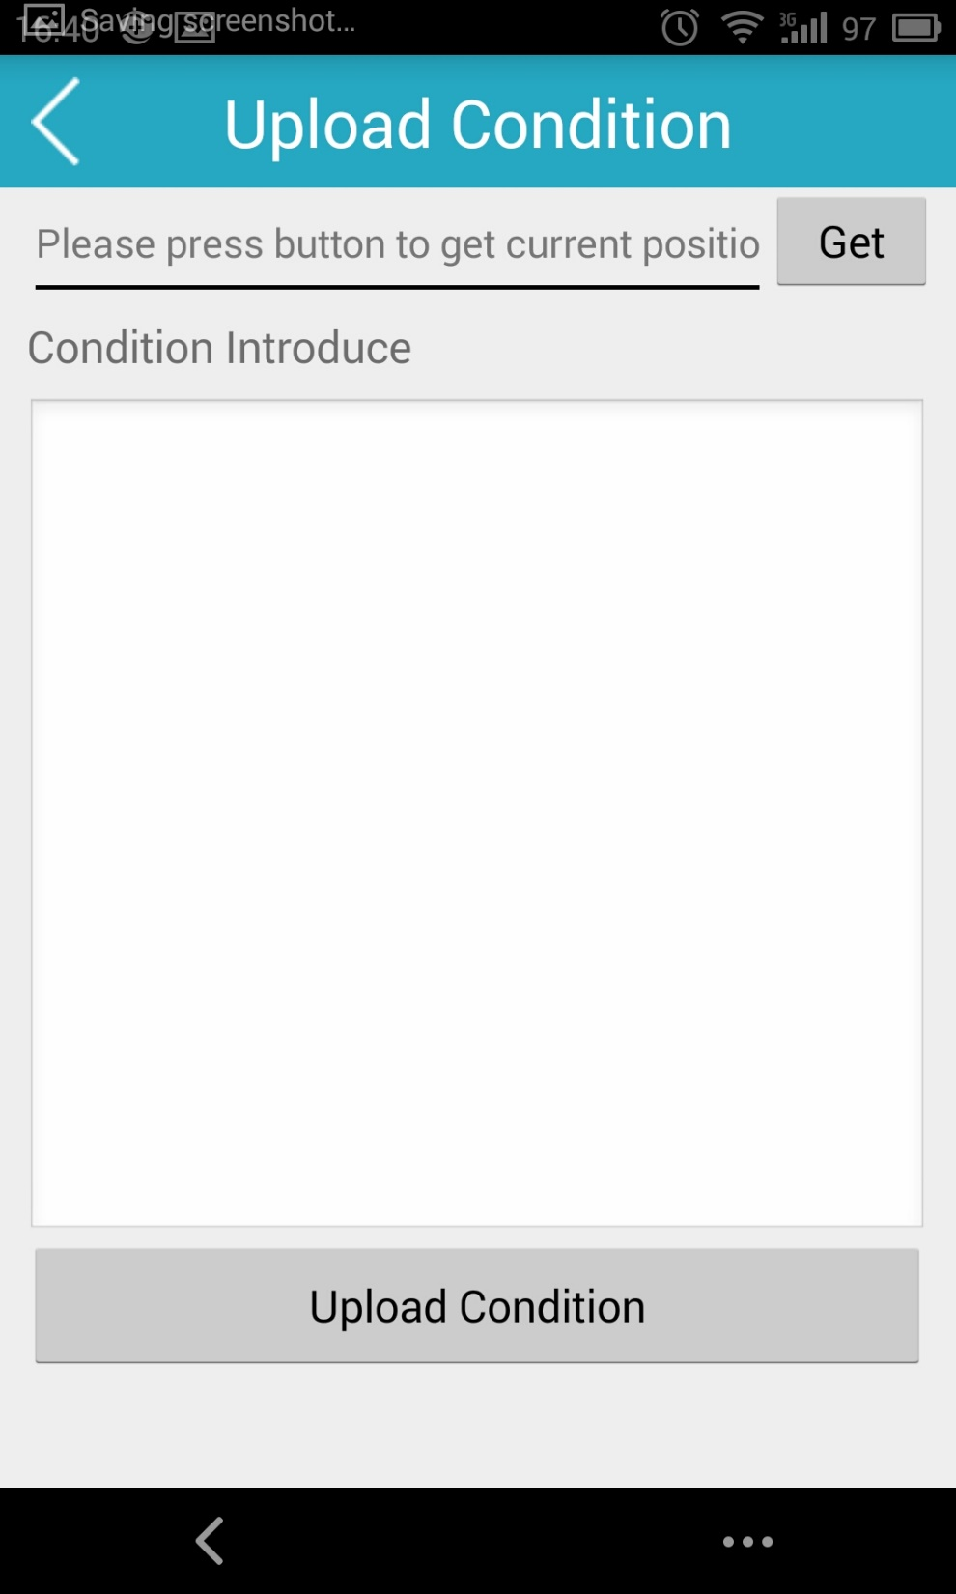
2
Update Use Case
Precondition: the user has logined in and locate the place
Description: The place textview shows the place the user in, user enters the road traffic information and click the submit button. The layout will show a dialog box said “commit successful”.
Postcondition: The road condition will be sent to the server, and the road condition will refresh.
Exception: the road traffic information is empty it will show a dialog said “please enter the road traffic information”.

Slide 9
3
Demonstrate

Slide 10
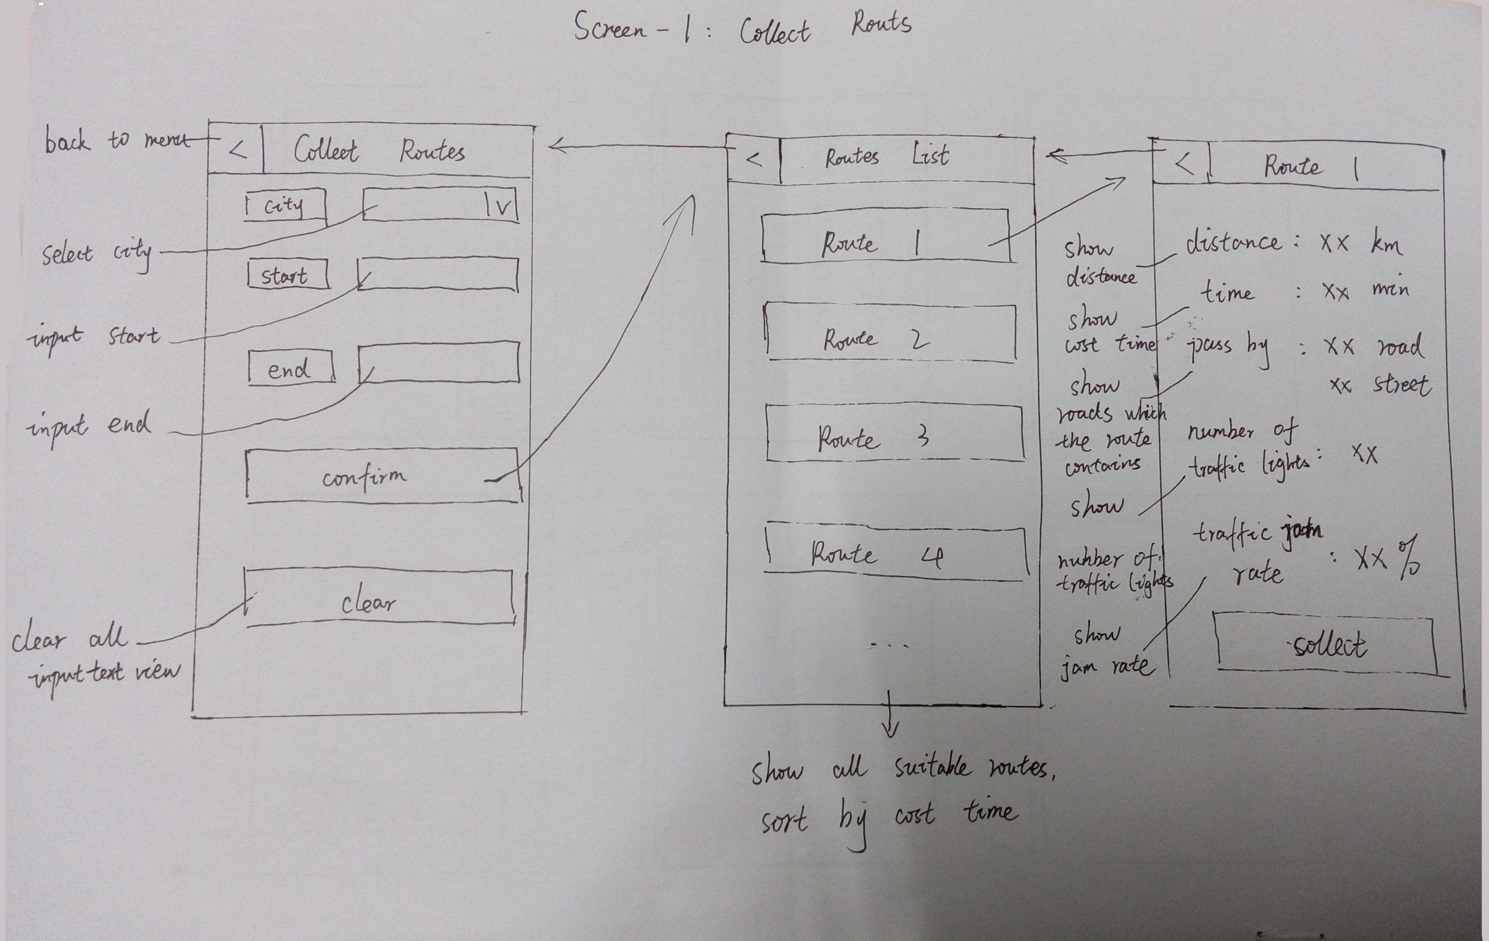
3
Collect Route Sketches

Slide 11
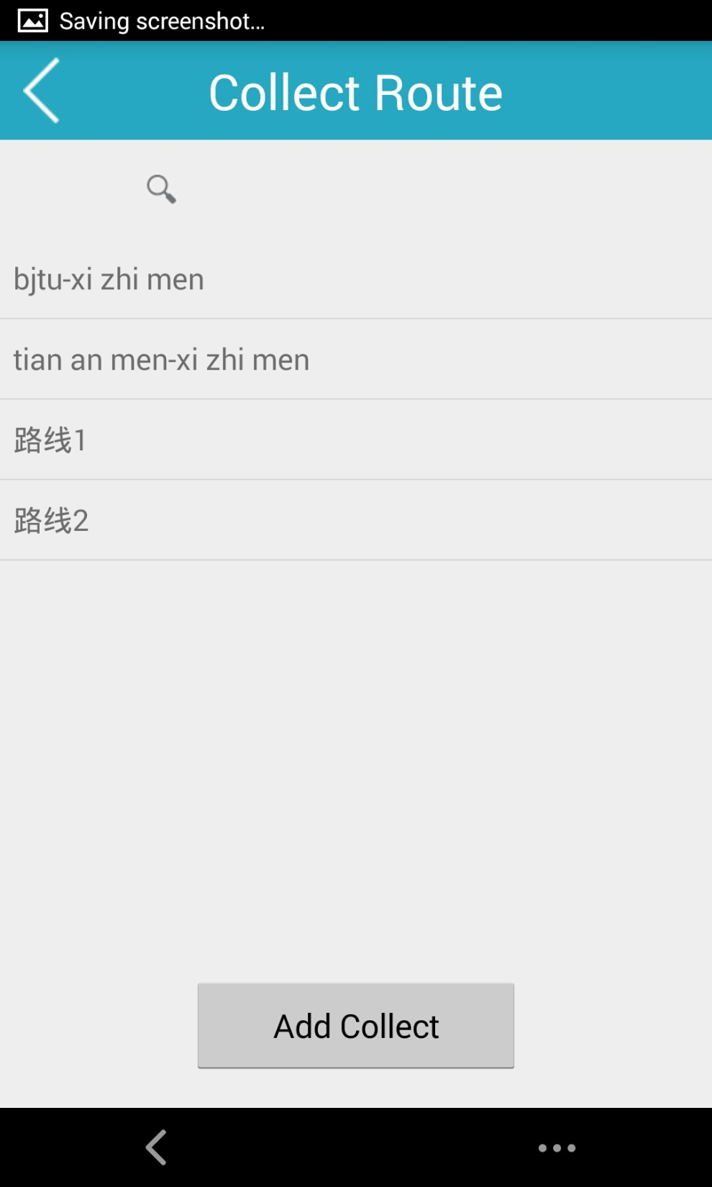
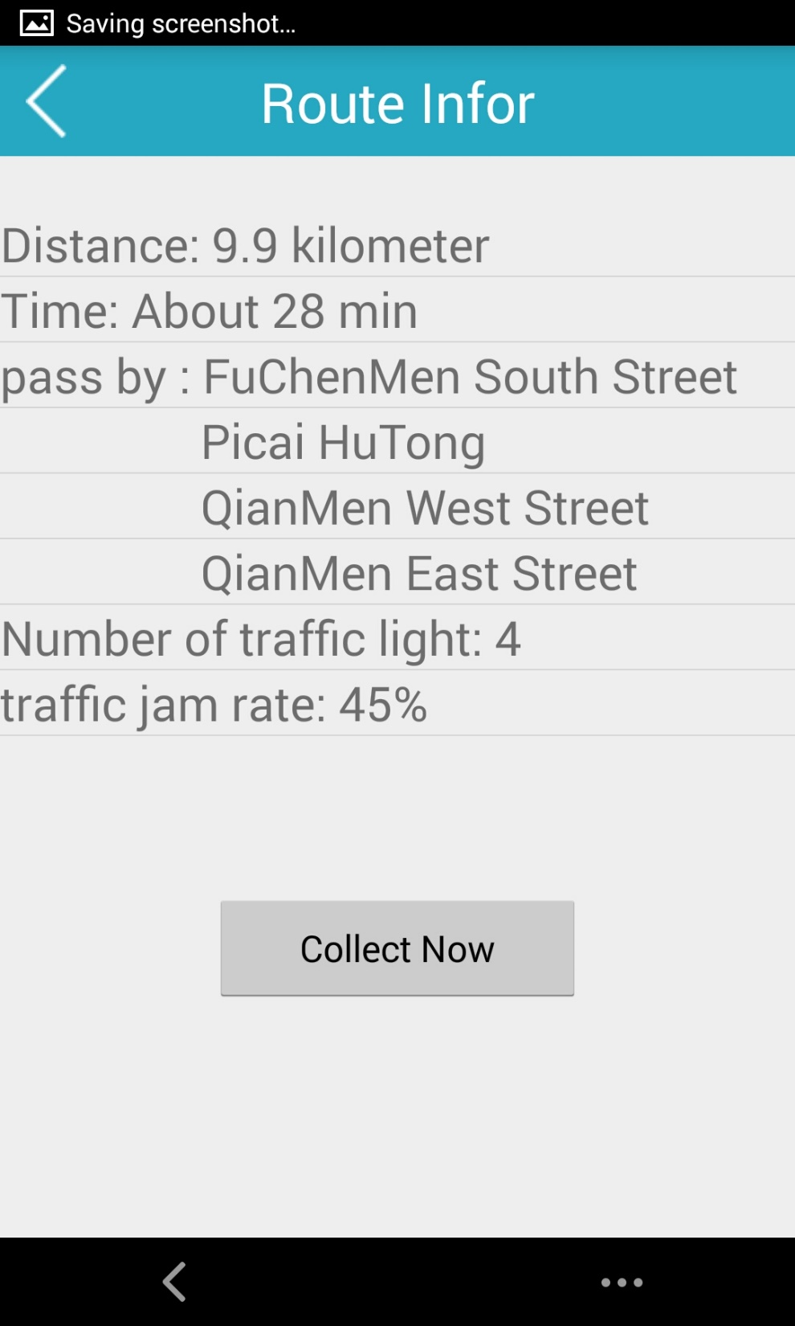
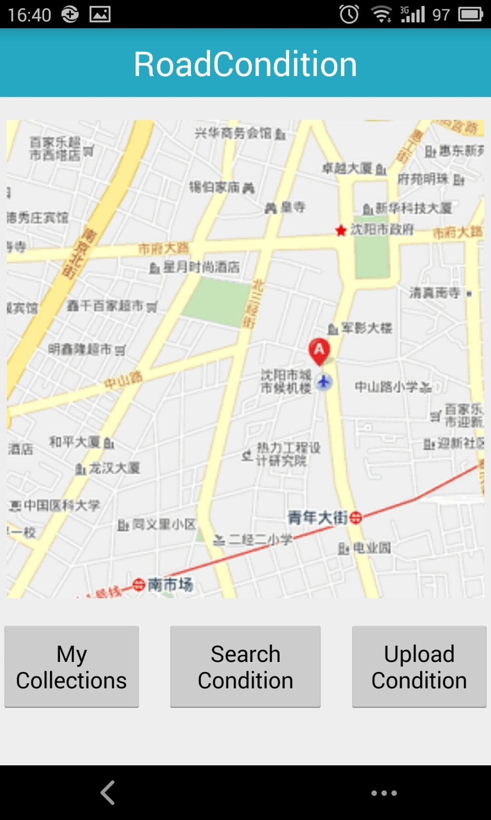
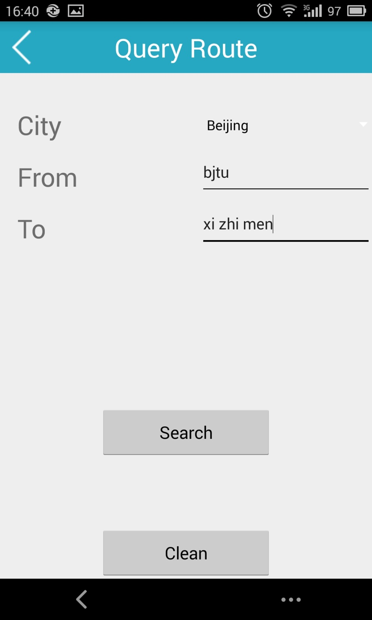
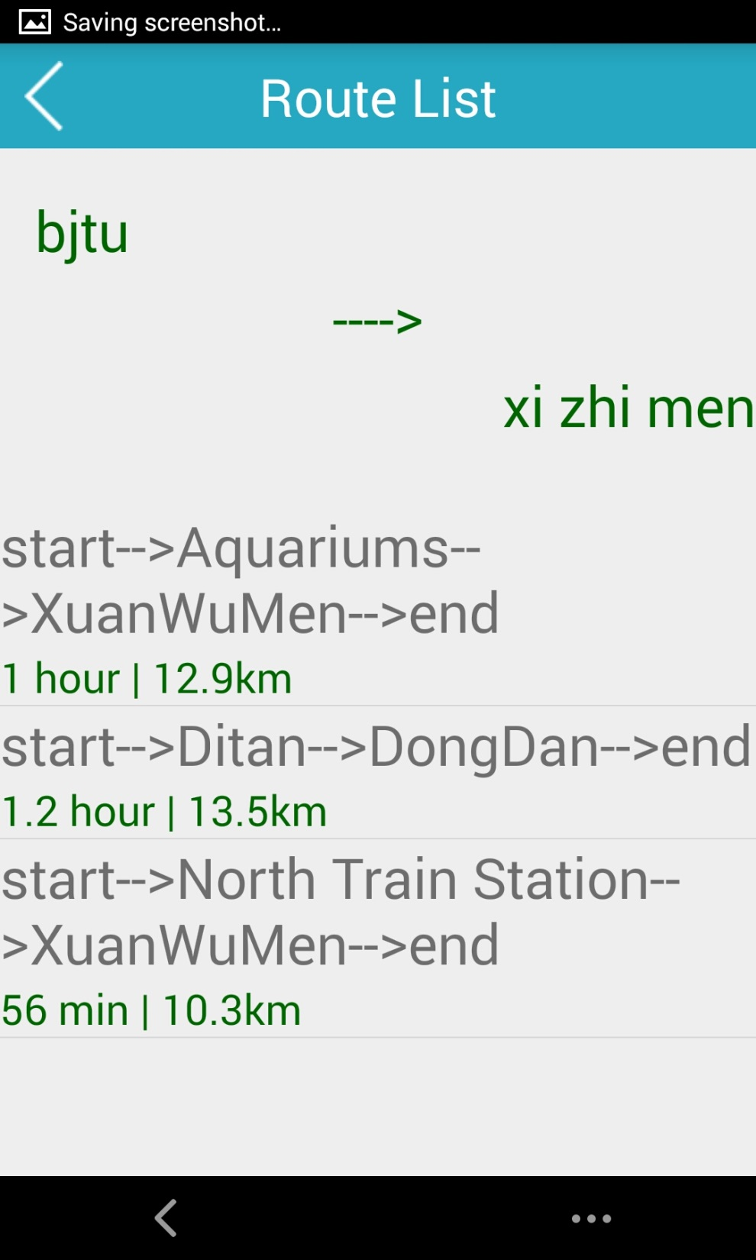
3
Collect Route Flow
My Collections
Show Details and Add
Collect
Search
Collections
First,click “My Collections”to the Collections Route list,we can see our collections in the past.
Finally , we click the collect now to get the route into the collect list.
Next,click “Add Collect”to search new route before adding it into the list.
After enter start and end,click “Search”to search a new route.
Then,we can see the route list about what we want to search.

Slide 12
4
Development

Slide 13
4
Development
UI Design
Baidu API
current situation:
So……ugly.
Target:
More beautiful,
More practical.
Current Situation:
Some errors for baidu map.
Target:
Realize baidu map location and more baidu api function.
Server
Current Situation:
No server,
No share.
Target:
Create a server for users to share and get road conditions.

Slide 14
5
Summary

Slide 15
5
Summary
Through this project , we have a further understand about how activity and fragment create and skip.
Besides, we get many experience about the adapter.
However , we also find many problems.
The UI design, our team member is poorly in it. We all lack art gene.
Some problems about the UI fix. When we change the language, the word will not fit will.
Naming conventions. Every team member has his own habit. And its id is hard to recognize.

Slide 16
Thank You!

