Slide 1
BuDu RoadCondition
Team Leader：Chen Junjun
Team Members：Li Yifeng,Hu Teng,Ni Yao

Slide 2
1
App Introduce
2
Main Use Case
3
Development
4
Summary

Slide 3
1
App Introduce

Slide 4
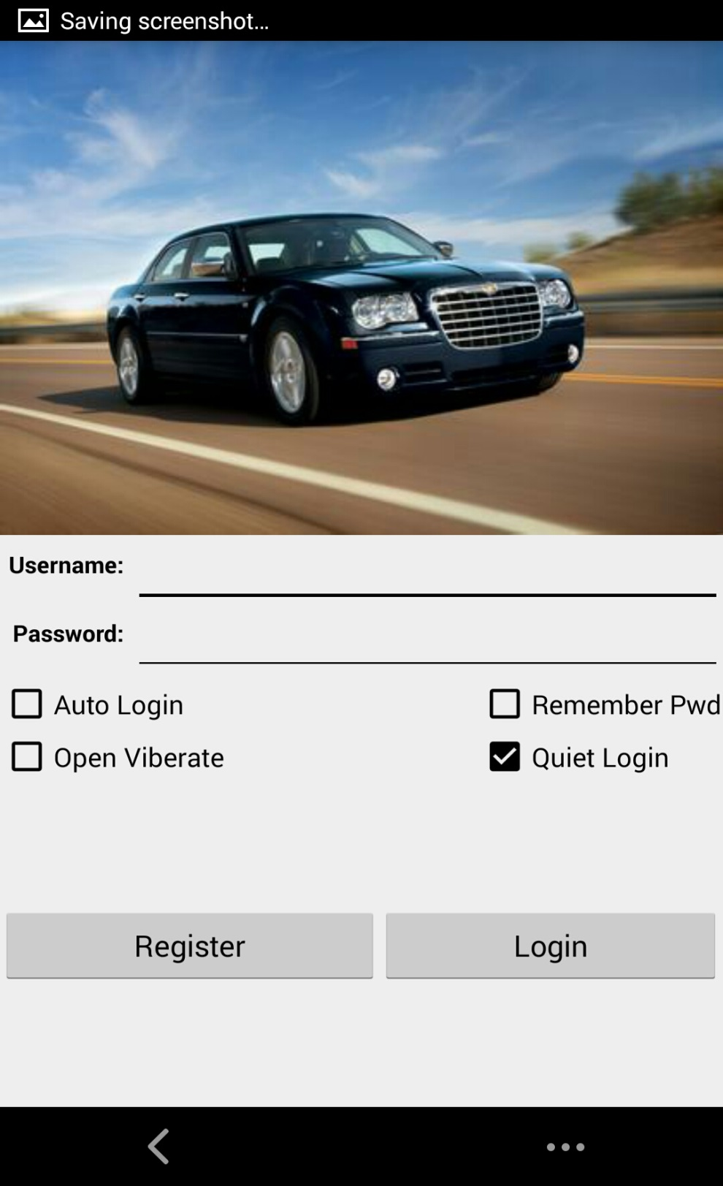
1
App Introduce
App Introduce
BuDu RoadCondition is an mobile application which is designed for people who drives to work every day,it can provide service that includes upload and collect road conditions,and tells you how to go to the destination most quickly.

Slide 5
2
Main Use Case

Slide 6
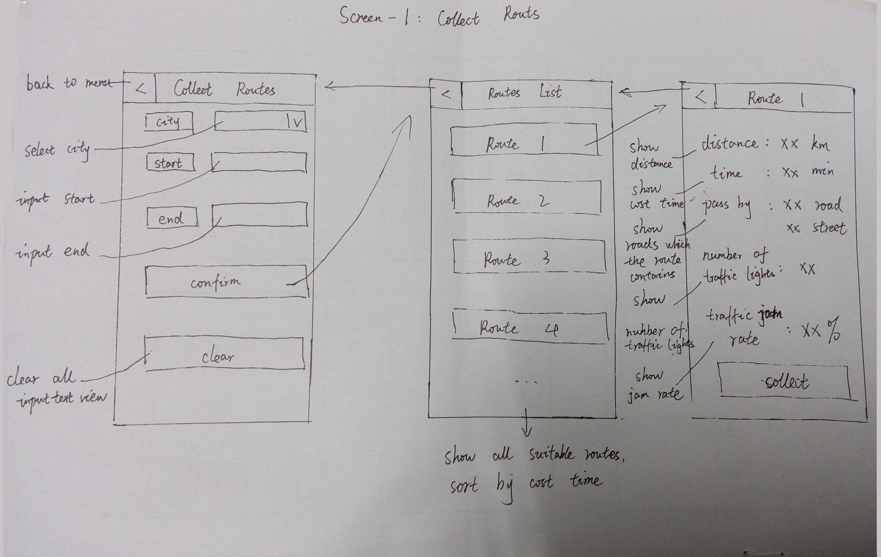
2
Collect Route Sketches

Slide 7
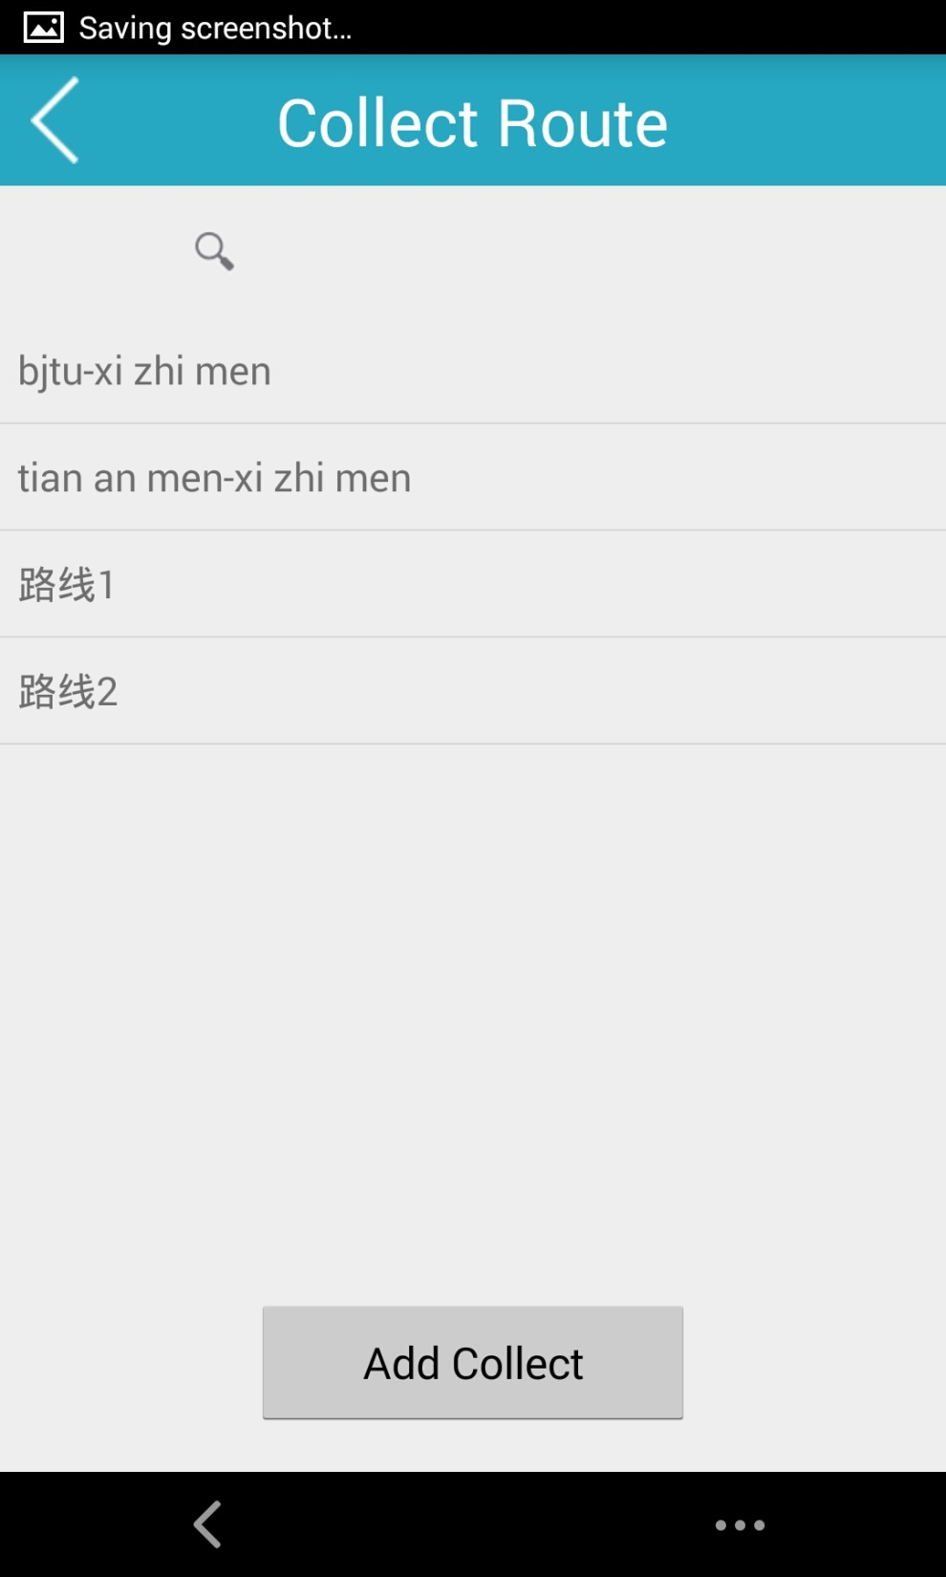
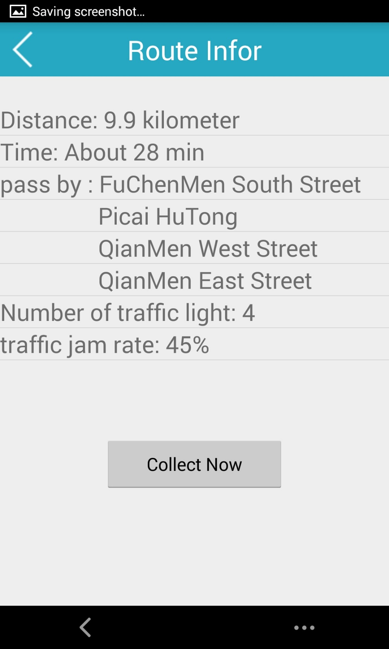
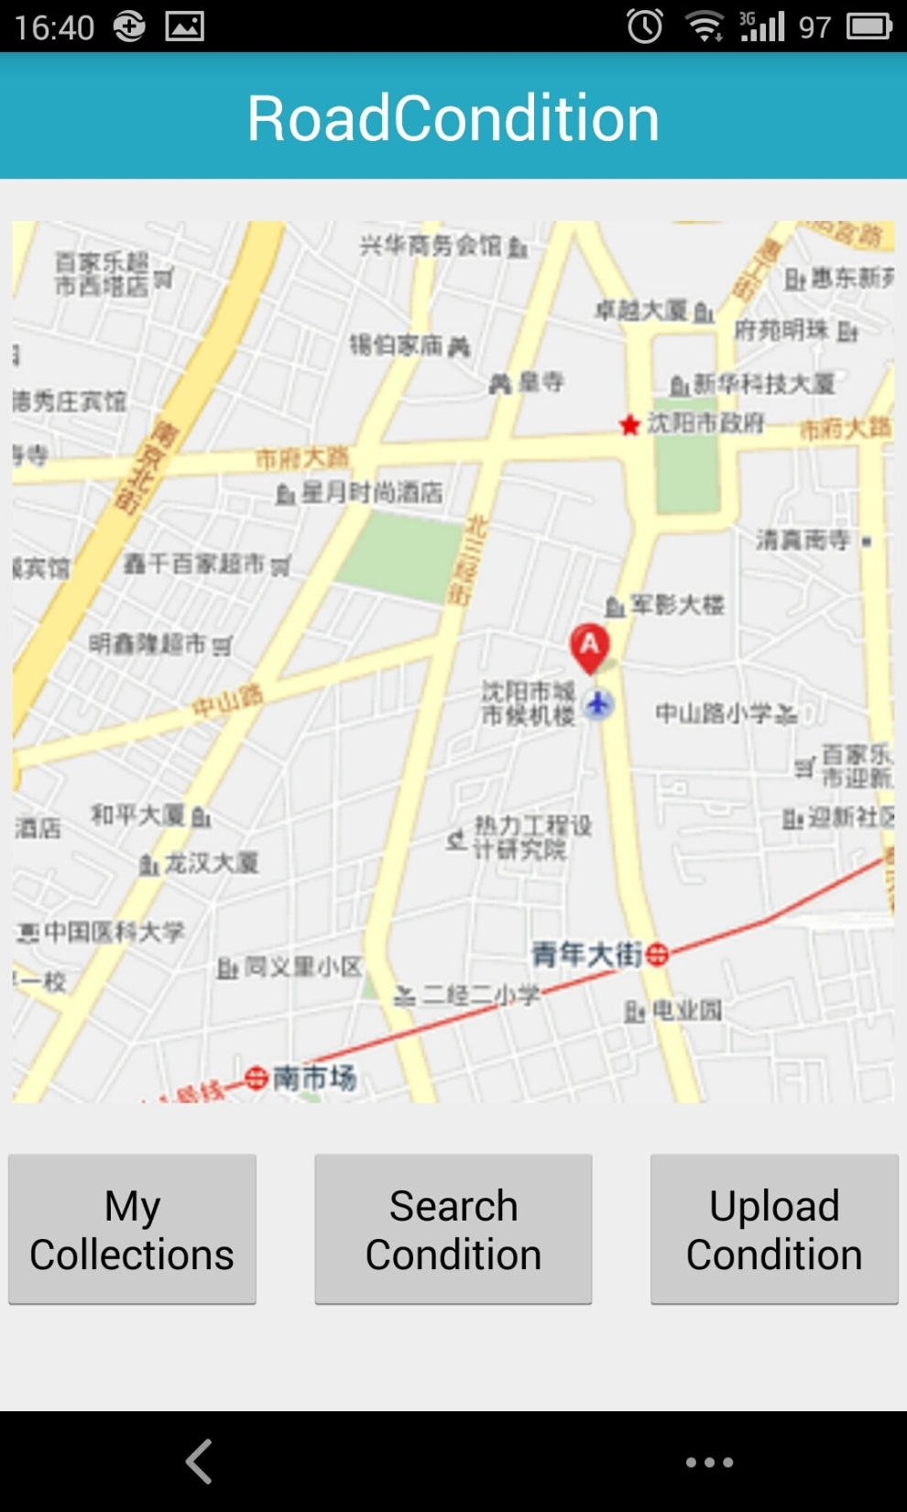
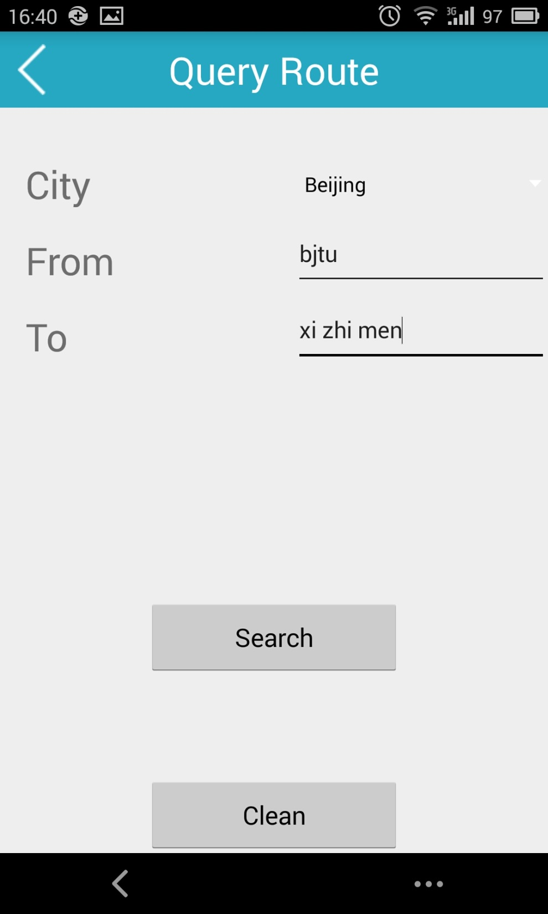
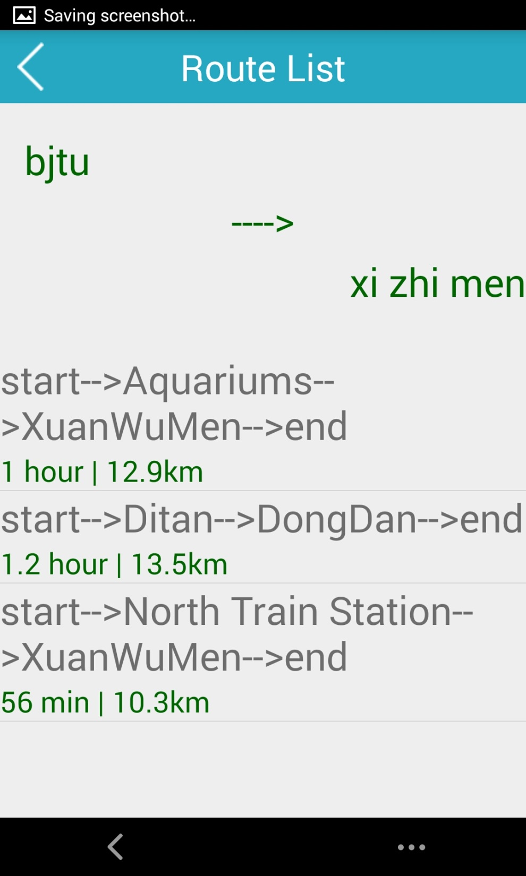
2
Collect Route Flow
My Collections
Show Details and Add
Collect
Search
Collections
First,click “My Collections”to the Collections Route list,we can see our collections in the past.
Finally , we click the collect now to get the route into the collect list.
Next,click “Add Collect”to search new route before adding it into the list.
After enter start and end,click “Search”to search a new route.
Then,we can see the route list about what we want to search.

Slide 8
3
Development

Slide 9
3
Development
UI Design
Baidu API
current situation:
So……ugly.
Target:
More beautiful,
More practical.
Current Situation:
Some errors for baidu map.
Target:
Realize baidu map location and more baidu api function.
Server
Current Situation:
No server,
No share.
Target:
Create a server for users to share and get road conditions.

Slide 10
4
Summary

Slide 11
4
Summary
Through this project , we have a further understand about how activity and fragment create and skip.
Besides, we get many experience about the adapter.
However , we also find many problems.
The UI design, our team member is poorly in it. We all lack art gene.
Some problems about the UI fix. When we change the language, the word will not fit will.
Naming conventions. Every team member has his own habit. And its id is hard to recognize.

Slide 12
Thank You!

