Slide 1


VentHub

Slide 2
Purpose
You can share your experience to the public, therefore, other people could get lesson from your experience.
Or you could also lay bare the truth about some department, or some matters.
Or you maybe want to put your experience on a popular position thus everyone could see it and give pressure to related departments, and appeal to solve the problems. Now.. you have VentHub, which provide a way to you to express your feelings to the public!

Slide 3
Audience
This application is oriented to the students, teachers and staffs in BJTU, who want to vent via internet.
Age: 16-50
Needs: Someone who wants to express inner dissatisfaction, and remind related departments of some matters.

Slide 4
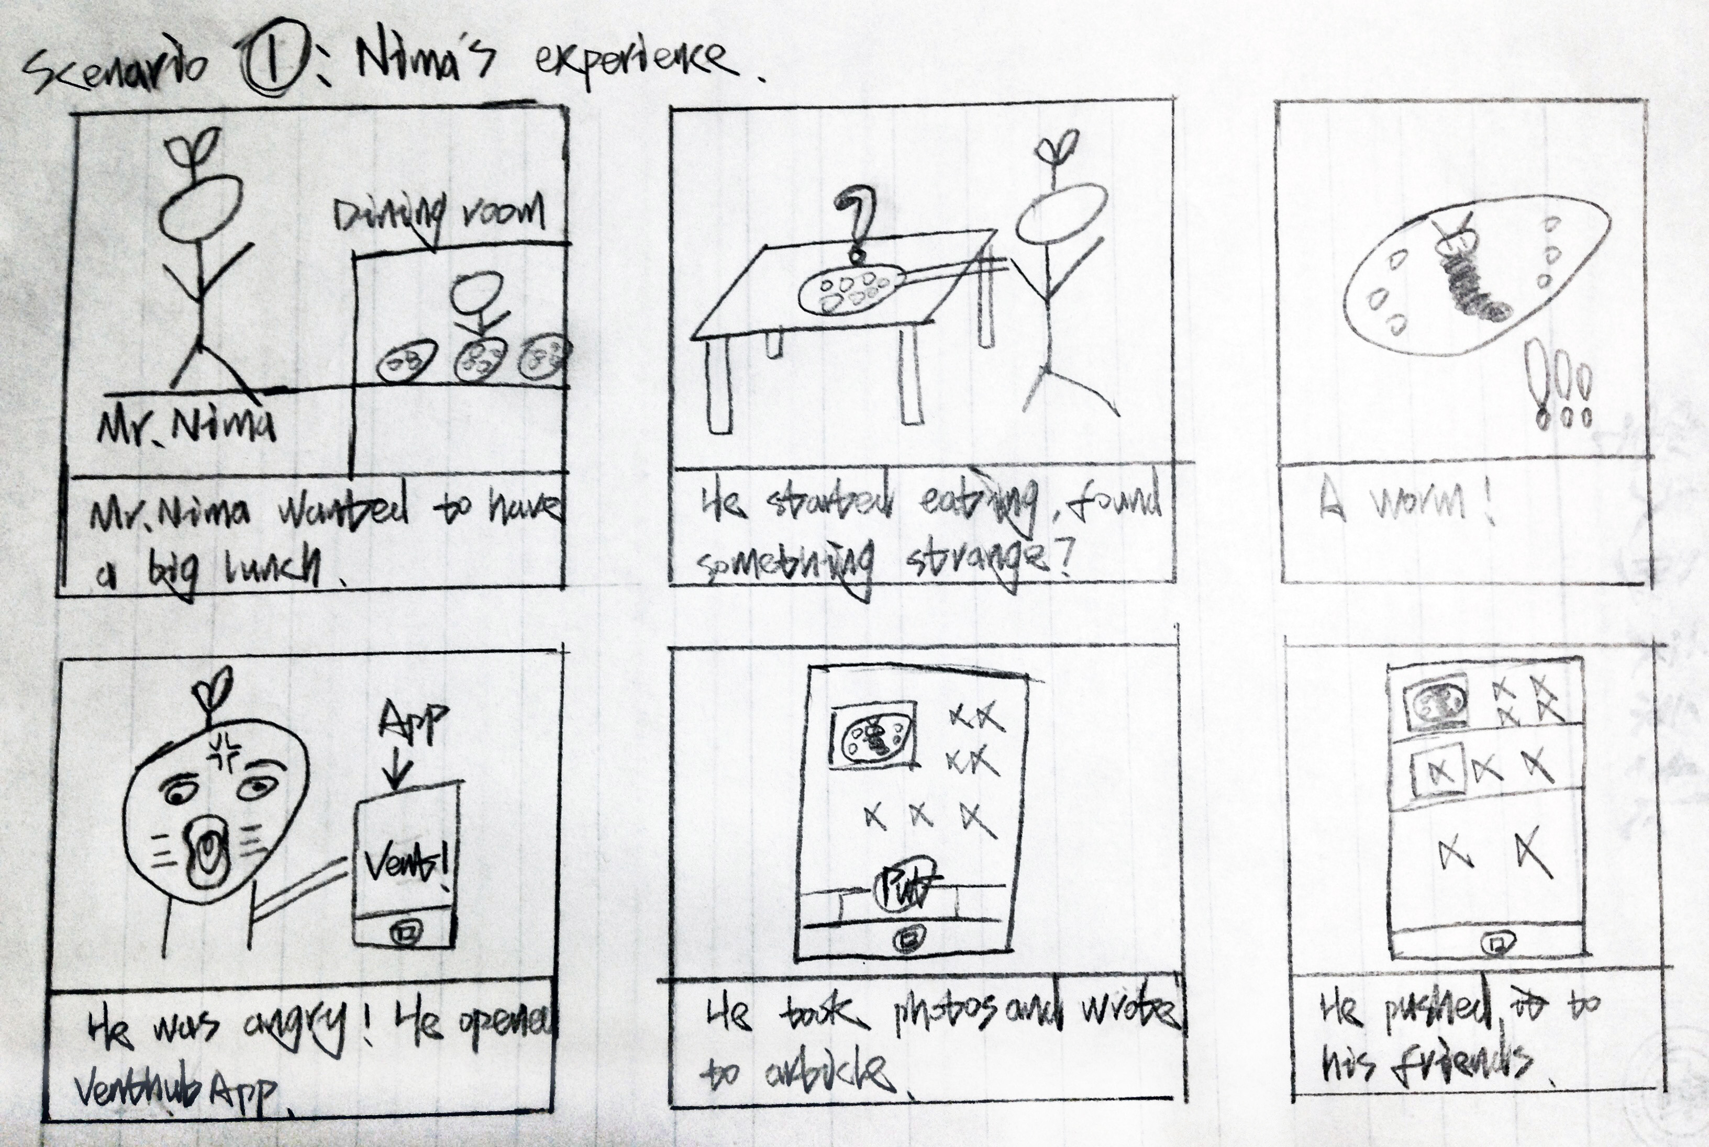
User scenario

Slide 5
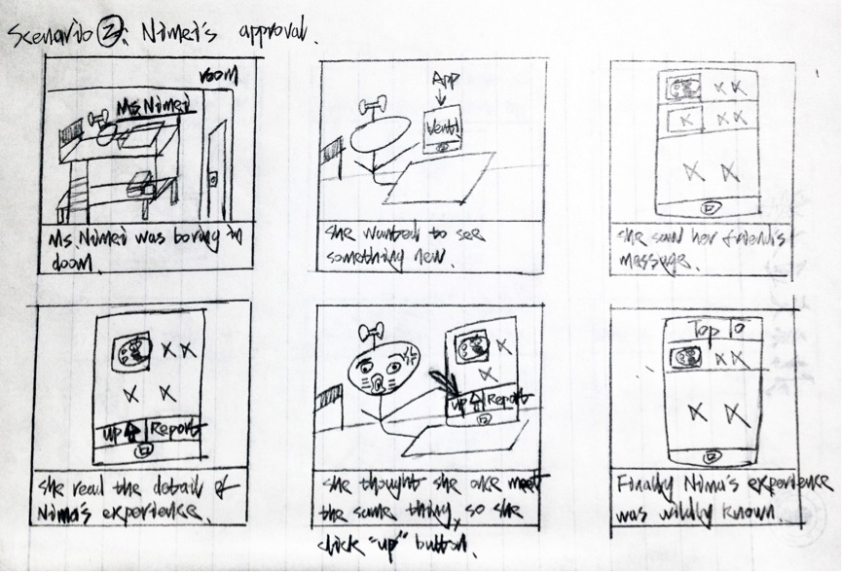
User scenario

Slide 6
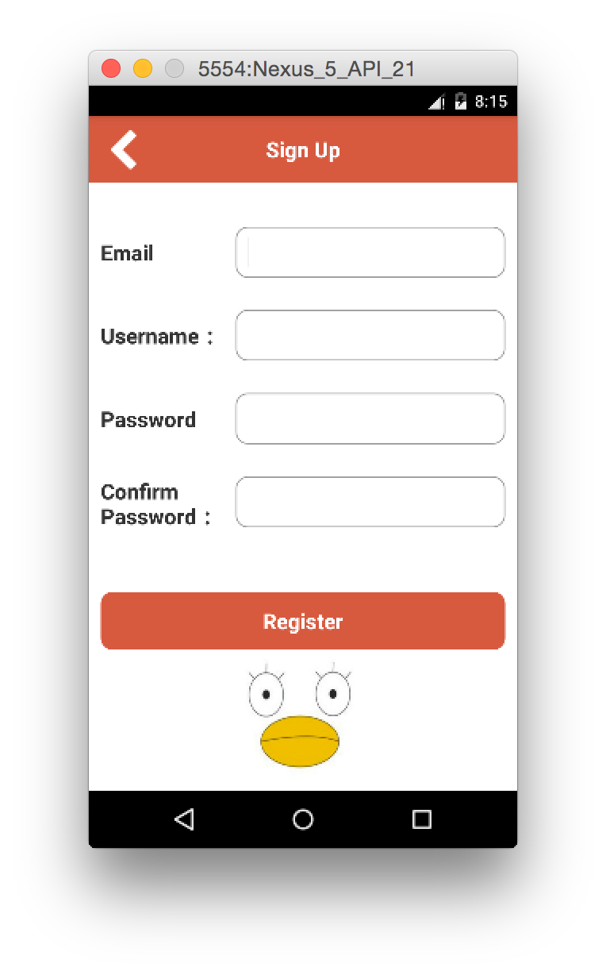
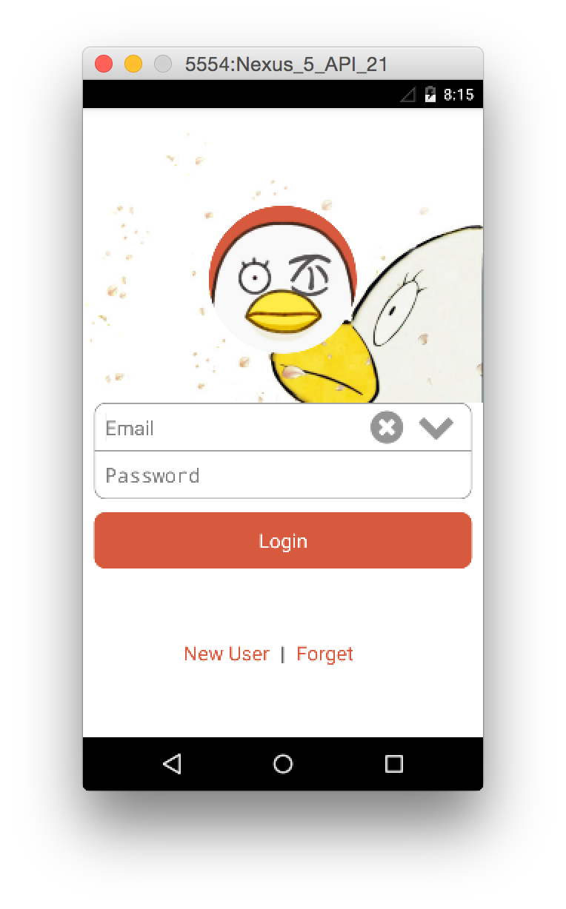
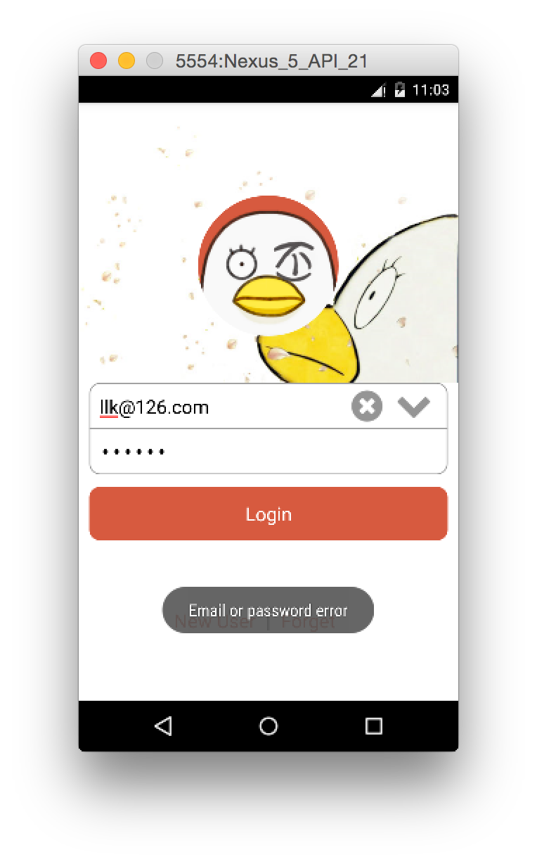
Screens

Slide 7
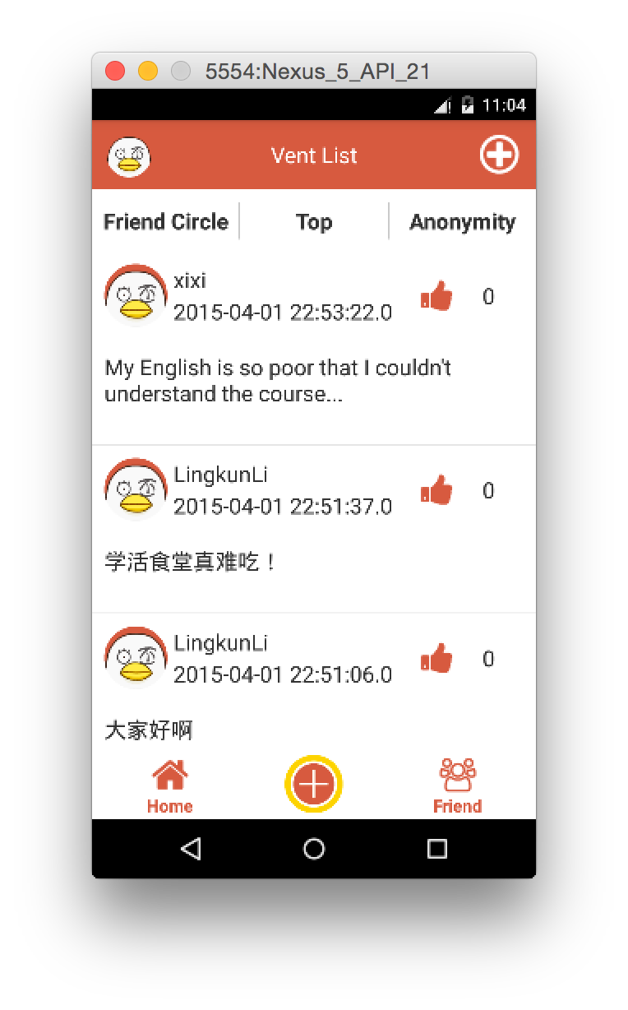
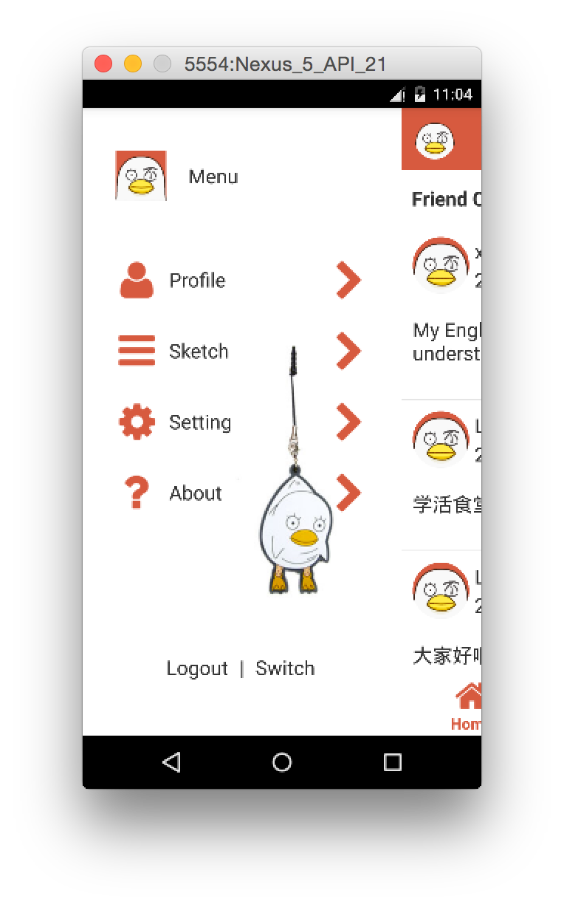
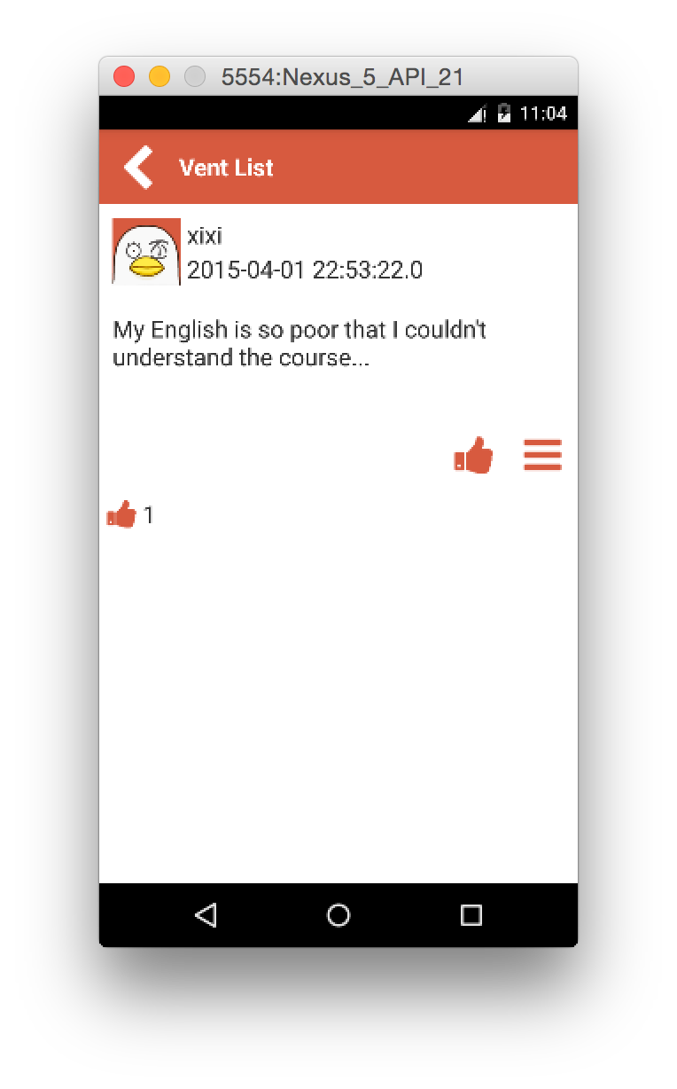
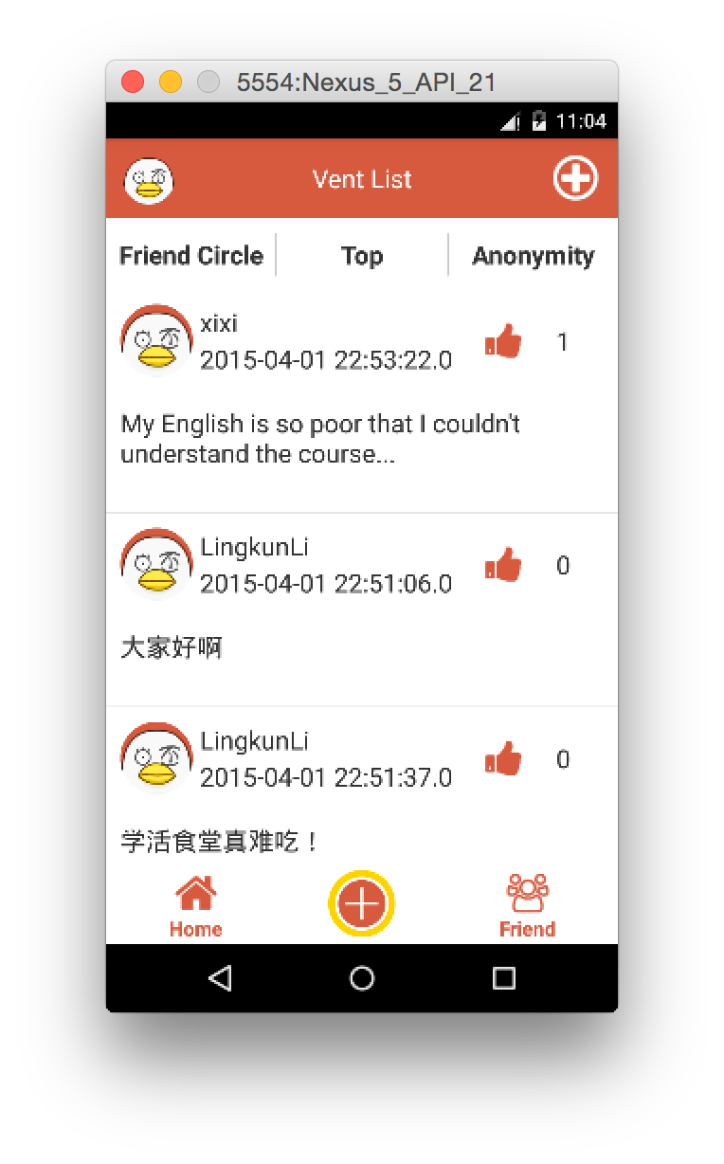
Screens

Slide 8
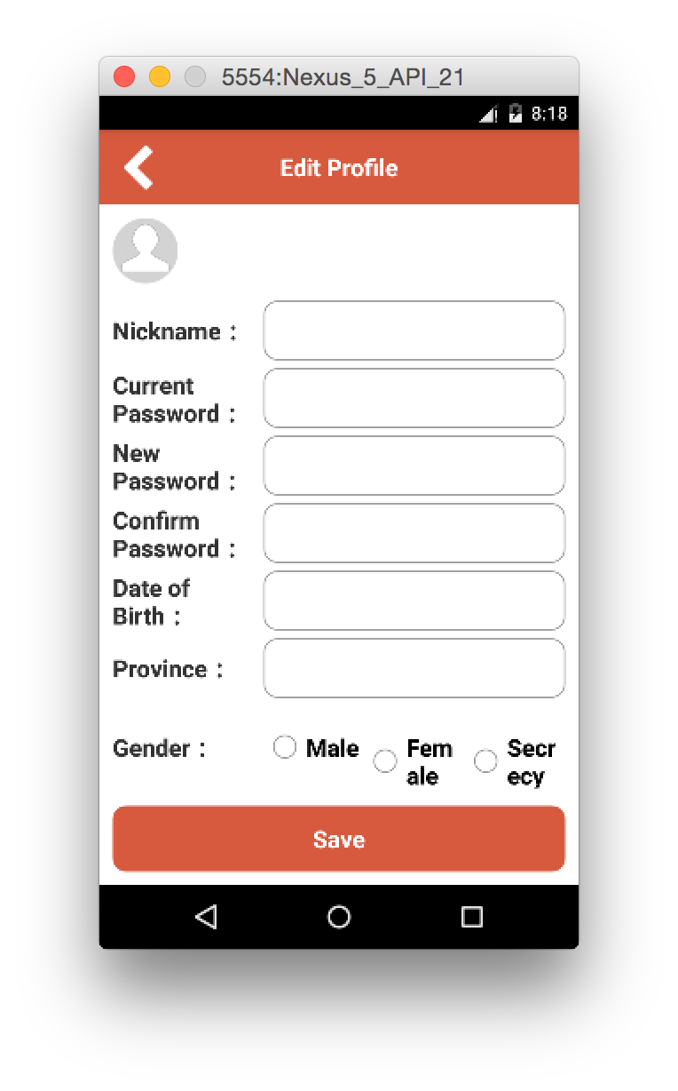
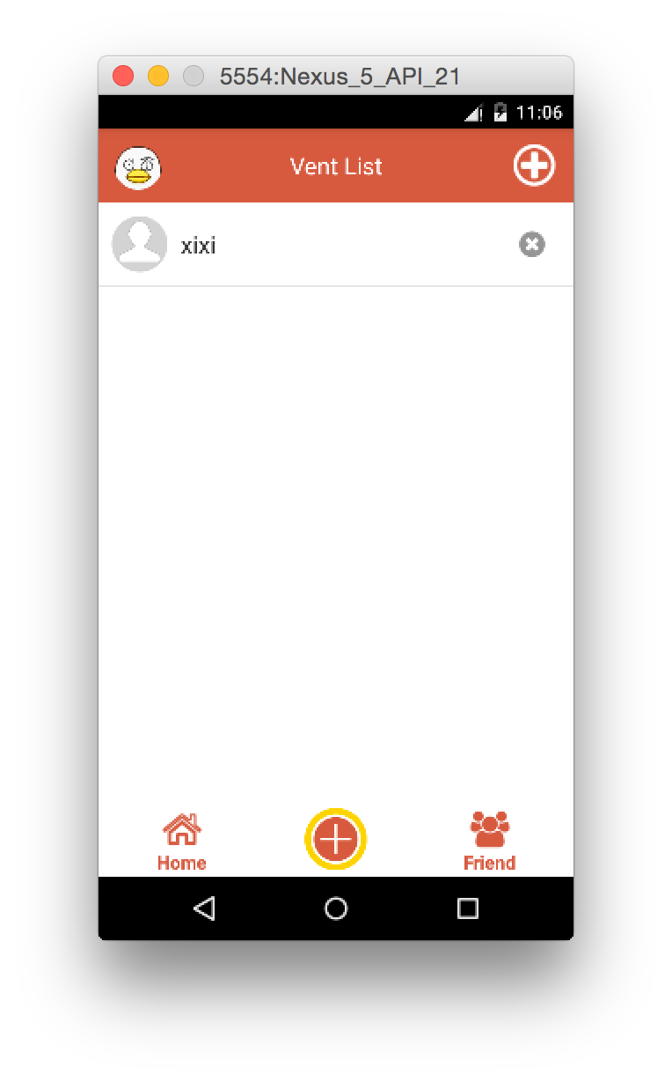
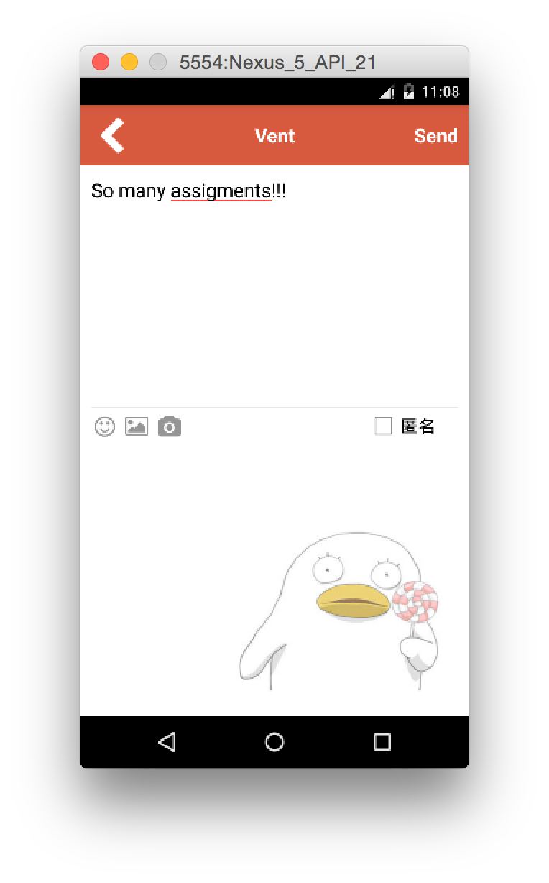
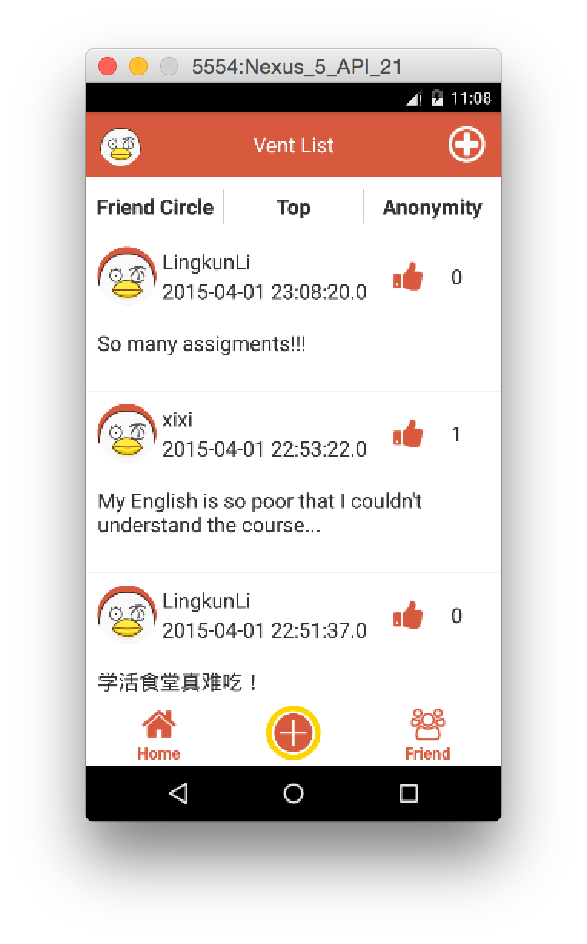
Screens

Slide 9
Next Step
Implement other functionalities in the menu bar
Make it better in detail
Release to the public

Slide 10
VentHub

