Slide 1
Objective-C Runtime
Pavel Kravchenko,
Videal
Notes:
Dynamic language
Late binding
Message sending instean function call
Сообщения
Метаинформация
протоколы
Objective-C, известный также как Objective C, ObjC или Obj-C — компилируемый объектно-ориентированный язык программирования корпорации Apple, построенный на основе языка Си и парадигм Smalltalk.
В отличие от C++, язык Objective-C полностью совместим с Си (язык Objective-C является надмножеством языка Си) и код на Си компилируется. Объектная модель построена в стиле Smalltalk, то есть объектам посылаются сообщения.

Slide 2
What is it?
The runtime system acts as a kind of operating system for the Objective-C language, and we can interact with it:
1. through Objective-C source code
2. through NSObject methods
3. through direct calls
Notes:
Another

Slide 3
Interacting with runtime
NSObject methods
class
IsKindOfClass:
IsMemberOfClass:
RespondsToSelector:
ConformsToProtocol:
MethodForSelector:
Runtime methods
object_getClass
class_addMethod
class_replaceMethod
objc_msgSend
class_addIvar

Slide 4
Basic Types
typedef struct objc_selector *SEL; (unique identifier of the method name)
typedef struct objc_class *Class;
typedef struct objc_object {
Class isa;
} *id
struct objc_class {
Class isa;
Class super_class;
}
struct objc_method {
SEL method_name;
char *method_types;
IMP method_imp;
}

Slide 5
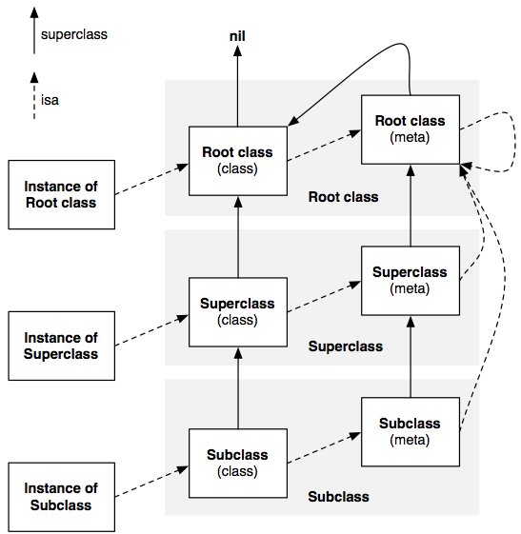
Classes and metaclasses

Slide 6
Messaging
2011-03-26 07:32:26.268 First[48403:207] *** Terminating app due to uncaught exception 'NSInvalidArgumentException', reason: '-[NSCFString setObject:forKey:]: unrecognized selector sent to instance 0x4e0cc70'
*** Call stack at first throw:
(
0 CoreFoundation 0x00db4be9 __exceptionPreprocess + 185
1 libobjc.A.dylib 0x00f095c2 objc_exception_throw + 47
2 CoreFoundation 0x00db66fb -[NSObject(NSObject) doesNotRecognizeSelector:] + 187
3 CoreFoundation 0x00d26366 ___forwarding___ + 966
4 CoreFoundation 0x00d25f22 _CF_forwarding_prep_0 + 50
5 First 0x00002616 -[My1 newM] + 101
6 First 0x00001f00 -[My1 mySelector] + 50

Slide 7
Messaging
1. objC_msgSend(id, SEL, arg1, ...)
2. resolveInstanceMethod:(SEL) aSEL
3. forwardingTargetForSelector:(SEL) aSel
4. forwardInvocation:(NSInvocation *) inv
4.1 methodSignatureForSelector:(SEL) aSel
  4.2 invokeWithTarget:(id) someObject
5. doesNotRecognizeSelector:(SEL) aSel

Slide 8
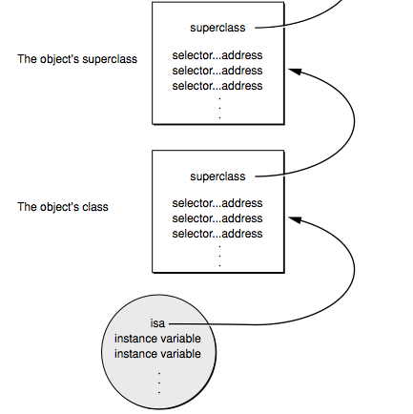
Messaging
Notes:
When isa is initialized?
Class object also has isa
Print of object
Class about superclass
typedef struct objc_class *Class;
typedef struct objc_object {
Class isa;
} *id;

Slide 9
Messaging
1. [target someMethod:arg1 :arg2];
2. SEL selector = @selector(someMethod::);
3. objc_msgSend(target, selector, arg1, arg2)
4. methodForSelector:
5. call function
Notes:
Два метода с одинаковым именем соответсвуют одному селектору ? Динамик тайпинг не работает, если тип обьекта определен программистом
If there were one selector per method implementation, a message would be no different than a function call.

Slide 10
Dynamic Method Resolution
void dynamicMethodIMP(id self, SEL _cmd) {
// implementation ....
}
+ (BOOL) resolveInstanceMethod:(SEL) aSEL {
if (aSEL == @selector(resolveThisMethodDynamically)) {
class_addMethod([self class], aSEL, (IMP) dynamicMethodIMP, "v@:");
return YES;
}
return [super resolveInstanceMethod:aSEL];
}
Notes:
C function is method of class?

Slide 11
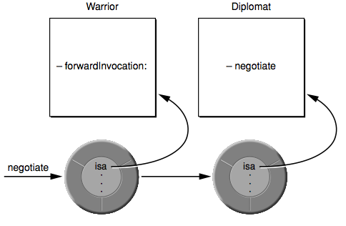
Message Forwarding
Notes:
Реализация прокси

Slide 12
Message Forwarding
-(void)forwardInvocation:(NSInvocation *)inv {
if ([someObj respondsToSelector:[inv selector]]){
[anInvocation invokeWithTarget:someObj];
}
else {
[super forwardInvocation:inv];
}
}

Slide 13
Message Forwarding
@implementation NSObject (NoCrash)
- (NSMethodSignature *)methodSignatureForSelector:(SEL)aSelector
{
NSMethodSignature *methodSignature = [NSMethodSignature signatureWithObjCTypes:"v@:"];
return methodSignature;
}
- (void) forwardInvocation:(NSInvocation *)anInvocation
{
}

Slide 14
KVO
Automatic key-value observing is implemented using a technique called isa-swizzling.
What KVO does when you request to observe some property:
Gets the class of the object
Creates a new subclass of the object's class
Overrides the -class method with one that returns the Class of the original class
Overrides the desired setter methods in the original class
Sets the isa variable of the object to the new subclass
Notes:
Automatic key-value observing is implemented using a technique called isa-swizzling.
The isa pointer, as the name suggests, points to the object's class which maintains a dispatch table. This dispatch table essentially contains pointers to the methods the class implements, among other data.
When an observer is registered for an attribute of an object the isa pointer of the observed object is modified, pointing to an intermediate class rather than at the true class. As a result the value of the isa pointer does not necessarily reflect the actual class of the instance.
Instead of relying on the isa pointer your application should use the class method to determine the class of an object instance.

Slide 15
Method swizzling
DataObject * dataObject = [[DataObject alloc] init];
[dataObject addObserver:self forKeyPath:@"dataValue" options:0 context:NULL];
NSLog(@"%@", [dataObject class]); //logs "DataObject"
NSLog(@"%@", object_getClass(dataObject)); //logs "NSKVONotifying_DataObject"

Slide 16
Tricks
id classObj = objc_getClass("SomeClass");
unsigned int outCount, i;
objc_property_t *properties = class_copyPropertyList(classObj, &outCount);
for (i = 0; i < outCount; i++) {
objc_property_t property = properties[i];
NSString *selector = [NSString stringWithCString:property_getName(property)];
SEL selForProperty = NSSelectorFromString(selector);
NSLog(@"%@", [self performSelector:selForProperty]);
}

Slide 17
Links
http://touchdev.ru/documents/958
http://www.sealiesoftware.com/blog/archive/2009/04/14/objc_explain_Classes_and_metaclasses.html
http://cocoawithlove.com/2010/01/what-is-meta-class-in-objective-c.html
http://cocoasamurai.blogspot.com/2010/01/understanding-objective-c-runtime.html
Objective C Runtime Programming Guide
Objective C Runtime Reference

Slide 18

About me
Pavel Kravchenko
skype: ideateam_macuser
email:
kravchenkopo@gmail.com

