Slide 1
MHS
MOBILE HARDWARE SAMPLER

Slide 2
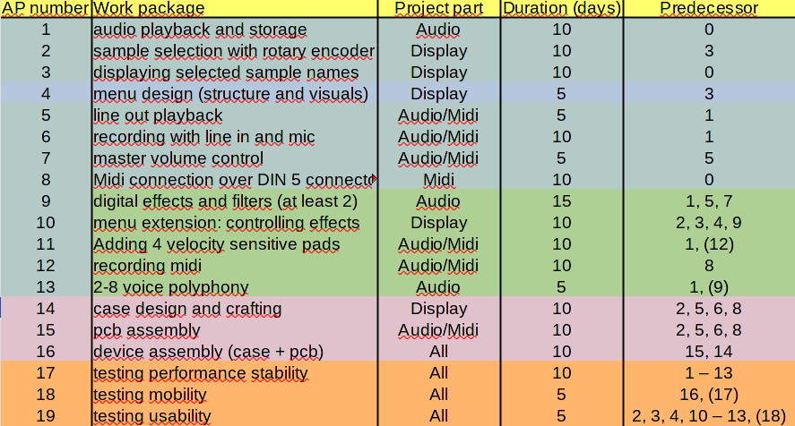
STAGE 1
Stage 2
Stage 3
Testing and troubleshooting

Slide 3
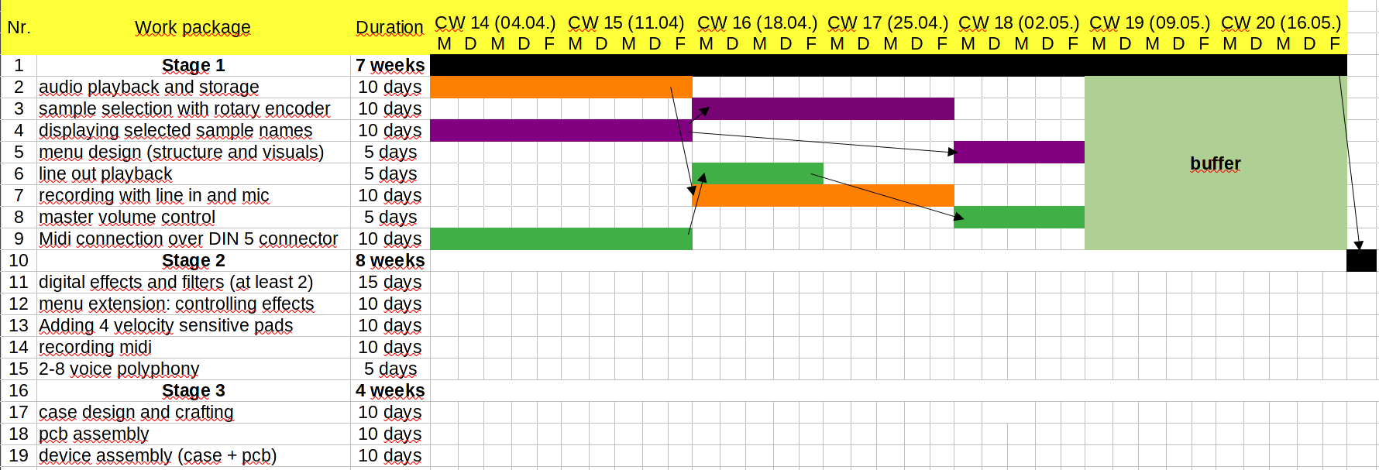
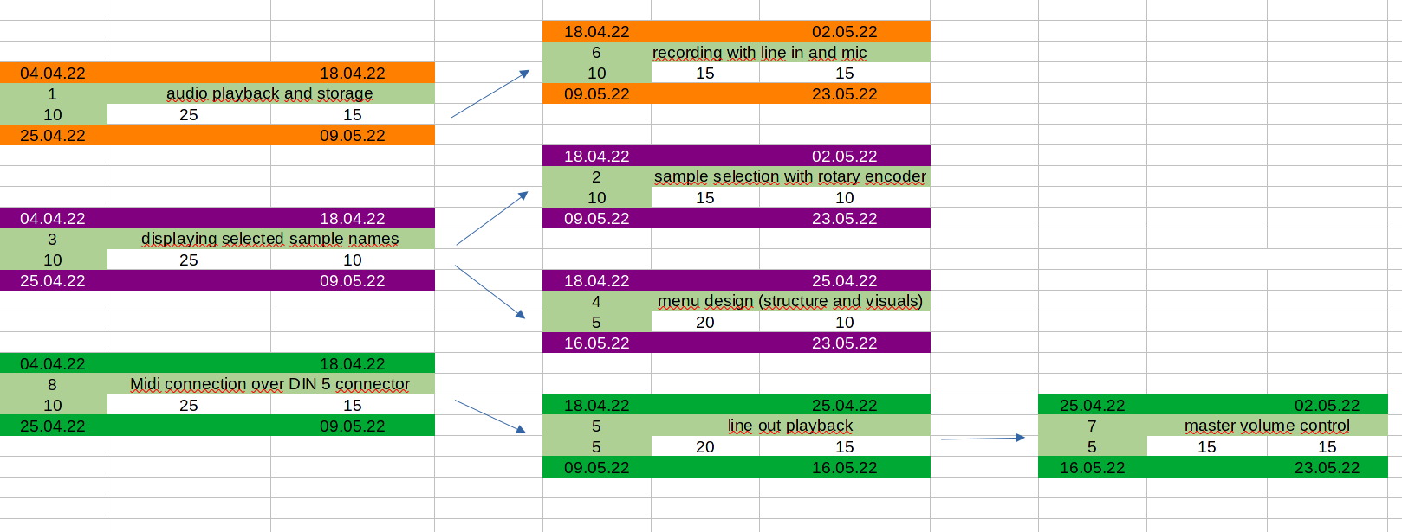

Slide 4
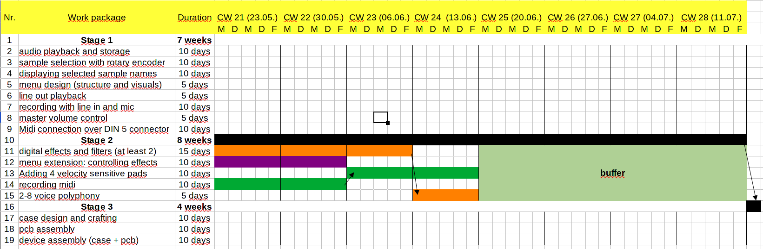
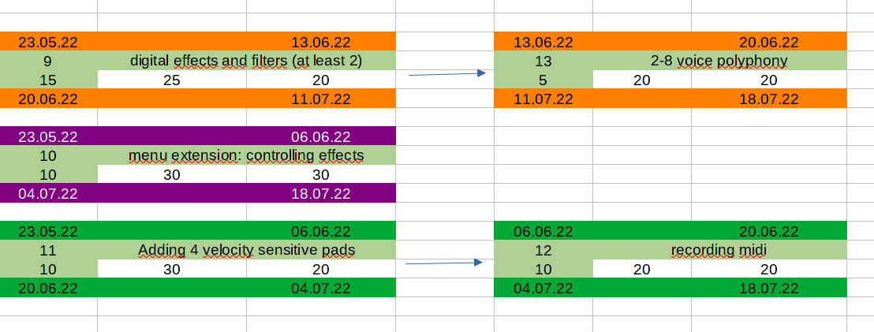

Slide 5
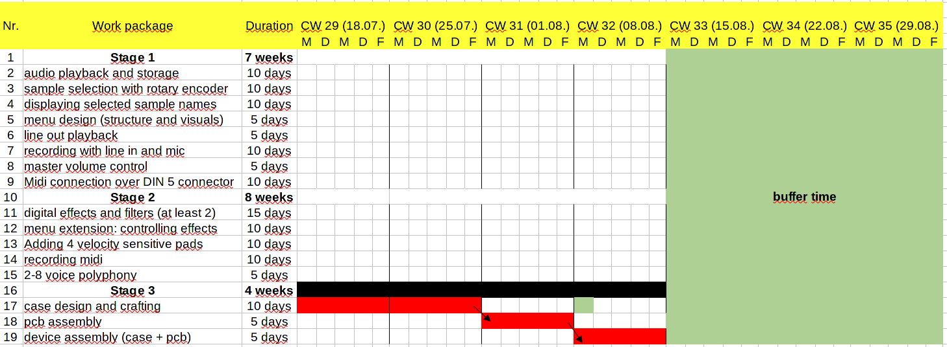

Slide 6
Quality Control
1
2
3
4
5
Real Time
DSP
Clear User
Control
Sample Polyphony
Modern
looking
Connectivity

Slide 7
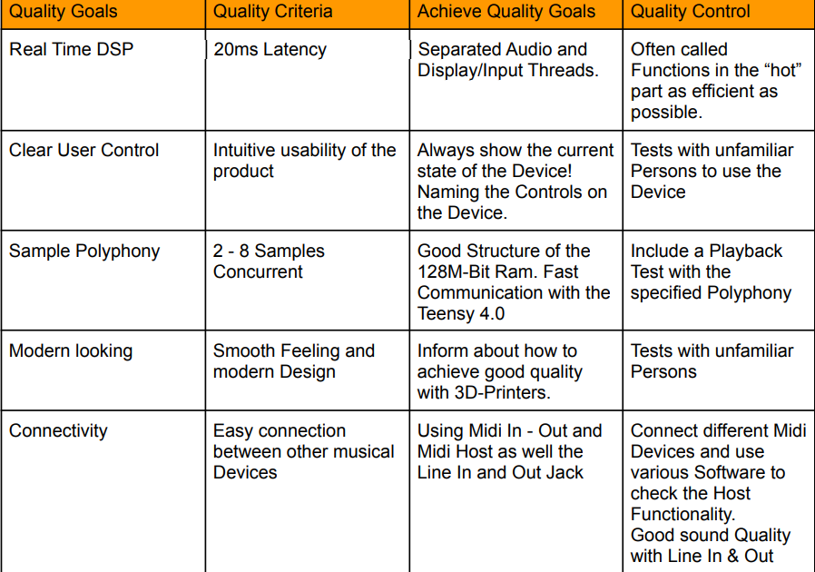
Quality Control
1
2
3
4
5

Slide 8

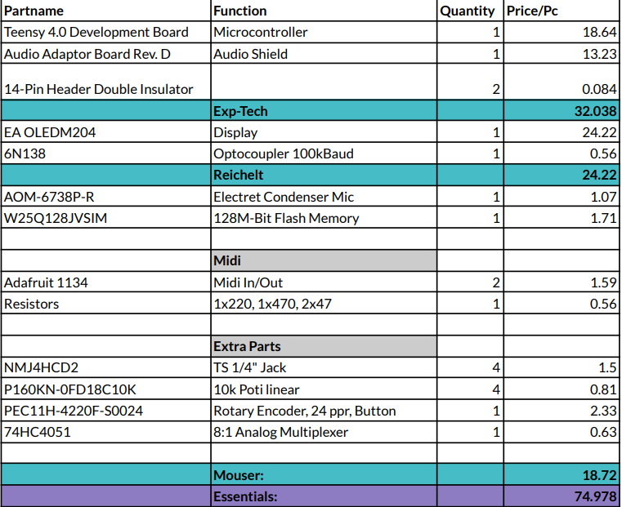
Hardware Cost

Slide 9
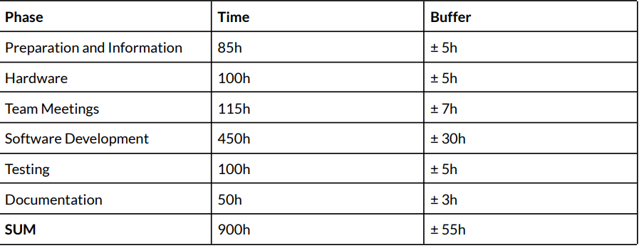
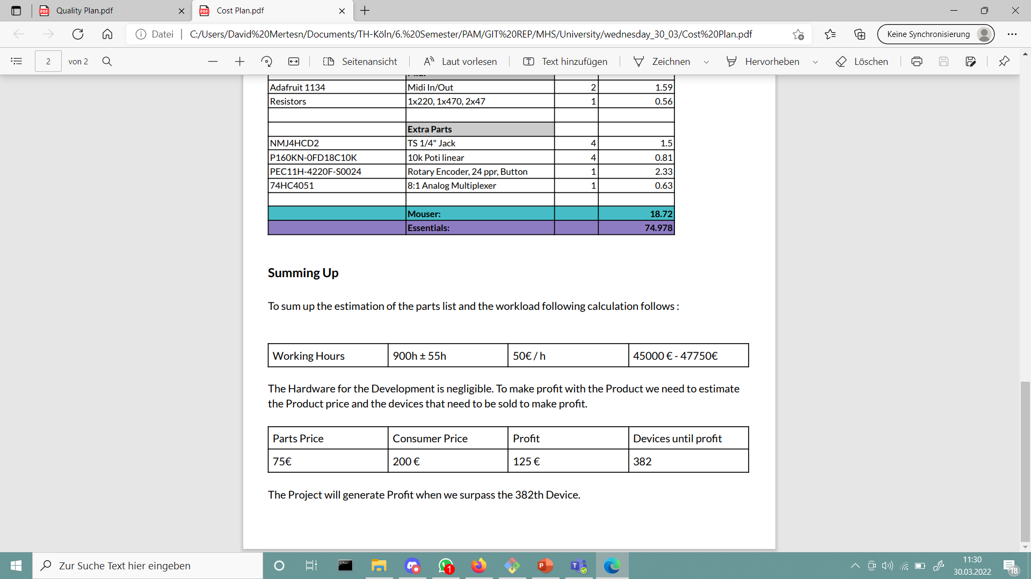
Time Expense

Slide 10

Profit margin

Slide 11
Capacity
What do we need?
Restrictions?
6x Teensy 4.0 microcontroller
6x Teensy audio shields
6x Displays
12x Midi Ports
6x Electret Condenser Microphones
6x 128M-Bit Flash Memories
24 x TS ¼” Jacks
24 x 10k linear Potis
6 x Rotary Encoders
6x 8:1 Analog Multiplexer
5x Media technology students/ engineers
Tools for communication and data exchange
We are planning to order the parts
this week (29.03- 03.04.)
One Student is missing for two weeks
(31.3 -16.4)
Tools are implementet and ready to use

