Slide 1


An R package to estimate the population using mobile phone data INE Spain and INS Romania
Implementation of the population estimation methodology

Slide 2
Content of the presentation
Introduction
The underlaying model
pestim structure
The process of computing population estimation
Population estimation at a time instant
Population estimates for several cells
Population estimates along a sequence of time

Slide 3
Introduction
We created a github account to disseminate the results of the WP5 – Mobile Phone data : https://github.com/MobilePhoneESSnetBigData
It is not meant to replace the wiki page of the project but mainly to make available the software tools developed during SGA2;
Currently it contains 2 R packages:
pestim - provides population estimations;
mobloc - provides mobile location algorithms and tools;
The hierarchical methodology developed for population estimation was implemented in an R package “pestim” which is freely available under the GPL3 and EUPL licenses at the following address:
https://github.com/MobilePhoneESSnetBigData/pestim

Slide 4
Introduction
At this moment, we recommend to install it from sources (requires compilation)
For Windows users, Rtools should be installed;
For Linux and Mac OS X a proper C++ compiler should be available (gcc or LLVM);
Installing the package is simple:
library(devtools)
install_github("MobilePhoneESSnetBigData/pestim", build_vignettes=TRUE)
We also provide binaries for Windows and Mac OS X :
for Windows : https://github.com/MobilePhoneESSnetBigData/Estimation_Population/blob/master/pestim_0.1.0.zip
for Mac OS X : https://github.com/MobilePhoneESSnetBigData/Estimation_Population/blob/master/pestim_0.1.0.tgz

Slide 5
Introduction
The functions included in pestim package are computationally intensive and we recommend to be installed on a high performance workstation;
Some minimal hardware requirements (to run some example simulations):
a computer with at least 8GB of RAM memory and an Intel I7 processor with 4 physical cores (although Intel I5 with 2 cores works, but with the corresponding increase in the running time);
Documentation of the package is available as:
A package vignette;
A Reference Manual, available at: pestim/doc/pestim_Reference_Manual.pdf
Usual R Help for each function included in this package callable from R console with:
?help(pestim)
?function_name

Slide 6
The underlaying model
The model implemented in pestim package is based on two prior assumptions:
Given that mobile phone data and official data operate at different time scales, we assume that there is an initial time instant in which we can equate population figures from both sources;
The mobility patterns of individuals do not depend on the mobile network operator which they are subscribed to;
pestim package provides two types of estimations:
at the initial time instant t₀, it makes inferences for the actual population counts in each cell using mobile phone data and administrative data;
the spatial and time evolution at later moments, t₁,t₂, … t_{n}, are produced using the transition matrices of individuals from cell to cell inferred from mobile phone microdata;

Slide 7
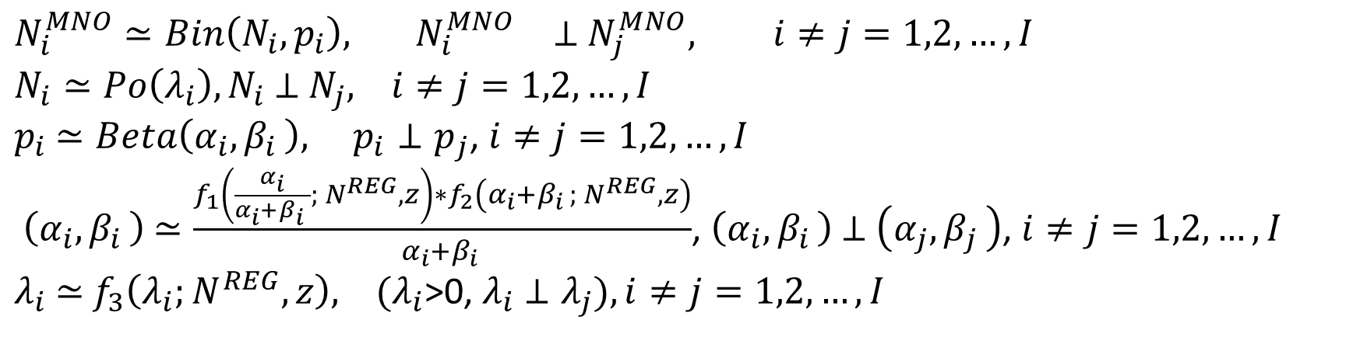
The underlaying model
The model for population estimation at a time instant can be summarized as follows:
$$N_{i}^{MNO}≃Bin\left(N_{i}, p_{i}\right), { N}_{i}^{MNO}⊥{ N}_{j}^{MNO}, i≠j=1,2,…,I$$
$N_{i}≃Po\left(λ_{i}\right),N_{i}$ $⊥$ $N_{j}, i≠j=1,2,…,I$
$p_{i}$ $≃Beta\left(α_{i},β_{i }\right), p_{i}⊥p_{j}$, $i≠j=1,2,…,I$
$\left(α_{i},β_{i }\right)$ $≃\frac{f_{1}\left(\frac{α_{i}}{α_{i}+β_{i }}; N^{REG}, z\right)∗f_{2}\left(α_{i}+β_{i }; N^{REG}, z\right)}{α_{i}+β_{i }}$, $\left(α_{i},β_{i }\right)$ $⊥$ $\left(α_{j},β_{j }\right)$, $i≠j=1,2,…,I$
$λ_{i}$ $≃$ $f_{3}\left(λ_{i};N^{REG}, z\right), (λ_{i}$>0, $λ_{i}$ $⊥λ_{j}), i≠j=1,2,…,I$

Slide 8
pestim structure
pestim software package contains basically three types of functions:
Auxiliary functions
Computations of mathematical functions, e.g: the confluent hypergeometric function, the ratio of two beta functions, an optimization routine for a concrete probability distribution, etc. Examples: kummer, Phi, ratioBeta, modeLambda;
Distribution-related functions
Generation of random values according to different probability distributions for priors, posteriors, and the generation of parameter specifications for these distributions. Examples: d-p-q-rtriang, d-rlambda, rmatProb, rN0, rNt, rNtcondN0, alphaPrior, genAlpha, genUV.
Estimation-related functions
Estimates based upon the populations generated with the preceding functions. Examples: postN0, postNt, postNtcondN0

Slide 9
The process of computing population estimation
The process diagram of computing population estimation using mobile phone and official population data is depicted below:
(N₁^{MNO}, N₁^{REG}) … (N_{I}^{MNO}, N_{I}^{REG}) are the population counts reported by the MNO in territorial cells and P(N|N^{MNO}; N^{REG}) is the posterior probability distribution that can be used to assess the uncertainty in the output estimates;
N₂^{MNO}, N₂^{REG}
N₁^{MNO}, N₁^{REG}
N_{I}^{MNO}, N_{I}^{REG}
P(N|N^{MNO}; N^{REG})

Slide 10
Population estimation at a time instant
1. Set the values for N^{MNO} and N^{REG}
2. Generate values using the prior distributions for the hyperparameters
3. Estimate the population counts using a predefined number of simulations
4. Compute some statistics (mean, median, mode) of the estimated population counts
5. Visualize the results
We will show how to use pestim package to compute population estimations at the initial time instant t₀ for a single cell;

Slide 11
Population estimation at a time instant
Step 1: we’ll assume:
A true population N₀=100;
The population count given by some administrative register N^{REG}=97 (a 3% error);
The population given by the MNO N^{MNO}=19 (around 20% proportion of detected population);
Step2: generate data for the prior distributions of the hyperparameters;
Currently, pestim package supports the following distributions:
Uniform distribution;
Triangular distribution;
Gamma distribution;
Degenerate distribution;

Slide 12
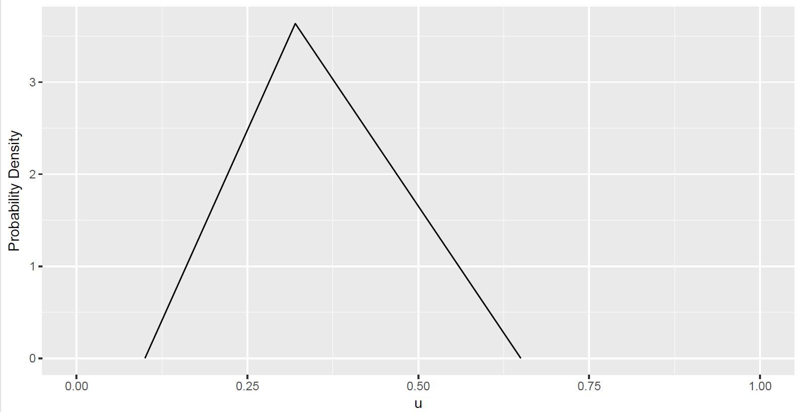
Population estimation at a time instant
An example of using the triangular distribution:
library(ggplot2)
library(pestim)
x <- seq(0.10, 0.65, by = 0.01)
y <- dtriang(x, xMin = 0.10, xMax = 0.65, xMode = 0.32)
df <- data.frame(x = x, y = y)
ggplot(df, aes(x, y)) + geom_line() + scale_x_continuous(limits = c(0, 1)) + xlab('u') + ylab('Probability Density’)

Slide 13
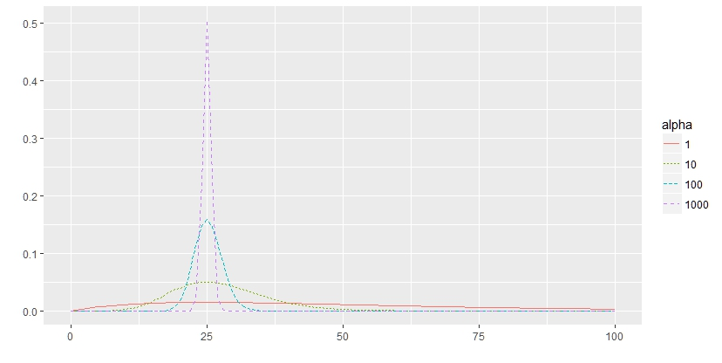
Population estimation at a time instant
The gamma distribution is another choice for modelling the cell size v and the hyperparameter λ;
alphas <- c(1, 10, 100, 1000)
mode <- 25
#generate points
df <- lapply(alphas, function(alpha){
x <- 0:100
y <- dgamma(x, shape=alpha+1,scale=mode/alpha)
z <- as.character(alpha)
output <- data.frame(x = x, y = y, alpha = z)
return(output)
})
#visualize de result
df <- Reduce(rbind, df)
ggplot(df, aes(x, y, col = alpha, group = alpha)) + geom_line(aes(linetype = alpha)) + scale_x_continuous(limits = c(0, 100)) + xlab('') + ylab('')

Slide 14
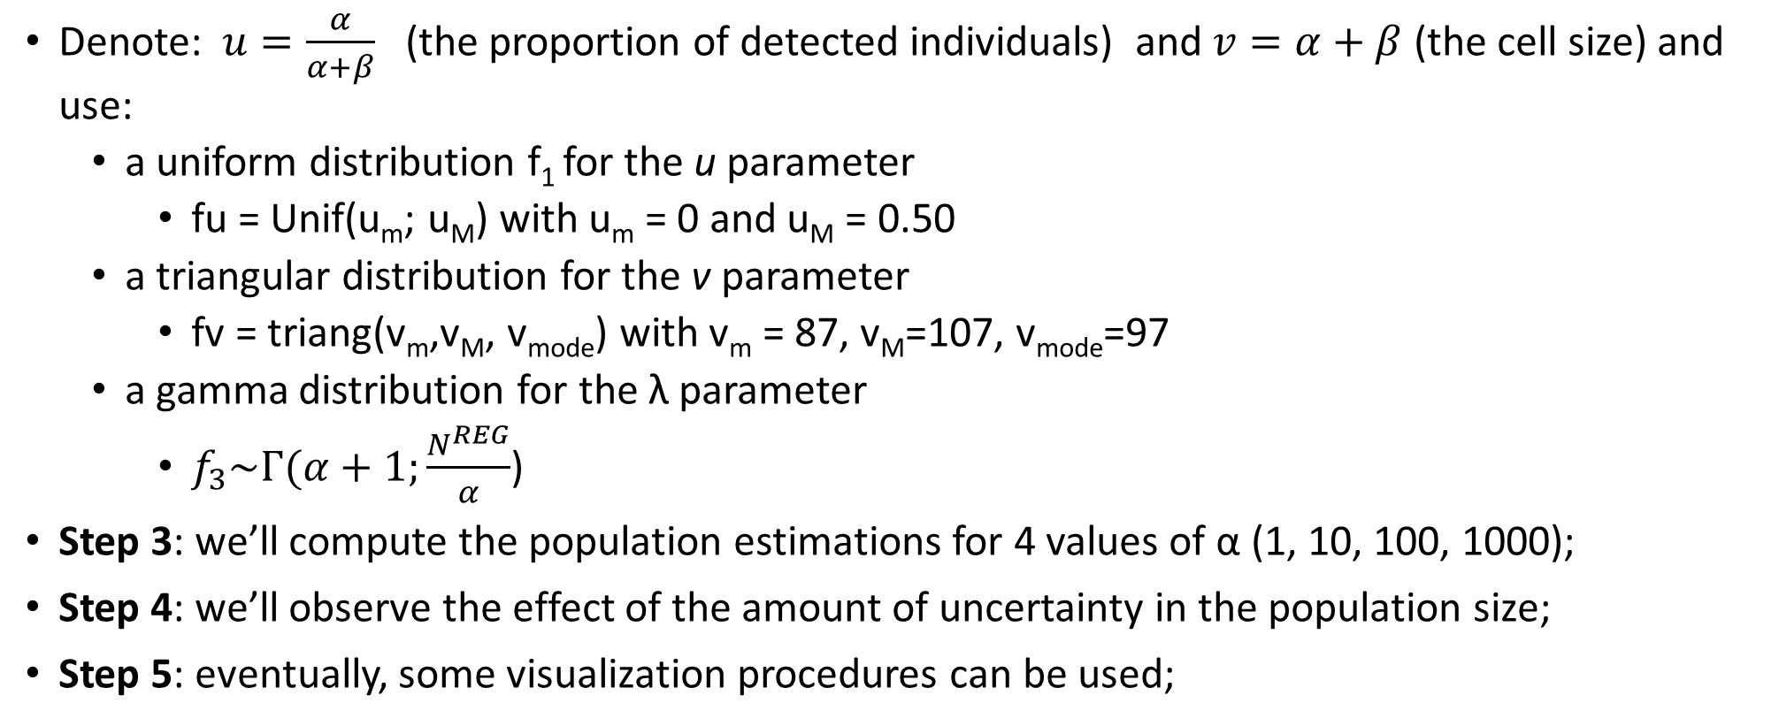
Population estimation at a time instant
Denote: $u=\frac{α}{α+β}$ (the proportion of detected individuals) and $v=α+β$ (the cell size) and use:
a uniform distribution f₁ for the u parameter
fu = Unif(u_{m}; u_{M}) with u_{m} = 0 and u_{M} = 0.50
a triangular distribution for the v parameter
fv = triang(v_{m},v_{M}, v_{mode}) with v_{m} = 87, v_{M}=107, v_{mode}=97
a gamma distribution for the λ parameter
$f_{3}\sim Γ(α+1;\frac{N^{REG}}{α}$)
Step 3: we’ll compute the population estimations for 4 values of α (1, 10, 100, 1000);
Step 4: we’ll observe the effect of the amount of uncertainty in the population size;
Step 5: eventually, some visualization procedures can be used;

Slide 15
# load the required libraries
library(pestim)
library(data.table)
library(ggplot2)
# set de values for nREG, nMNO, and prior distributions
nReg <- 97
nMNO <- 19
fu <- list('unif', xMin = 0, xMax = 0.50)
fv <- list('triang', xMin = 87, xMax = 107, xMode = 97)
alphaSeq <- c(1, 10, 100, 1000)
flambdaList <- list()
for (alpha in alphaSeq){
flambdaList[[as.character(alpha)]] <-list('gamma', shape = 1 + alpha, scale = nReg / alpha)
}
#set the number of simulations
nSim <- 100
#generate nSim estimations for each value of alpha
results <- lapply(alphaSeq, function(alpha){
flambda <- flambdaList[[as.character(alpha)]]
output <- replicate(nSim, postN0(nMNO, nReg, fu, fv, flambda))
output <- as.data.table(t(matrix(unlist(output), nrow = 3)))
setnames(output, c('postMean', 'postMedian', 'postMode'))
output[, sim := 1:nSim]
output <- melt(output, id.vars = 'sim')
output[, 'alpha' := alpha]
return(output)
})
names(results) <- alphaSeq
results <- rbindlist(results)
# plot the results
ggplot(results, aes(x = variable, y = value)) + geom_boxplot() + facet_grid(. ~ alpha) + xlab('') + ylab('') + geom_hline(yintercept = nReg) + theme(axis.text.x = element_text(angle = 90, hjust = 1, vjust = .5))

Slide 16
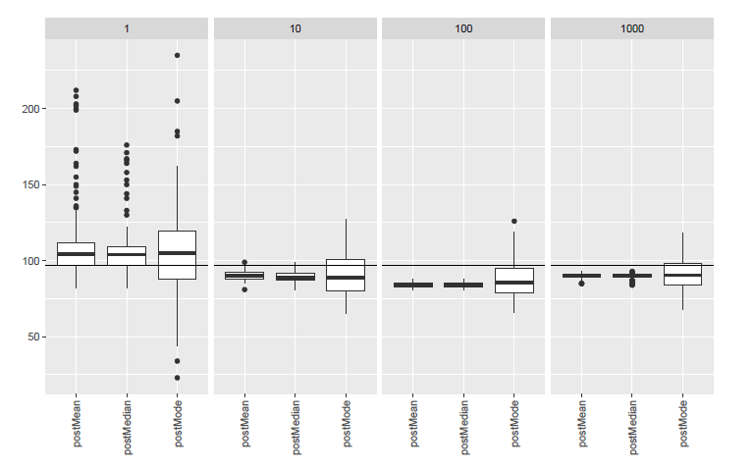

Slide 17
Population estimates for several cells
Estimation for several cells is straightforward since the estimation in each cell is independent of each other;
The same function postN0() should be used, sending it the corresponding parameters for each cell;

Slide 18
Population estimates along a sequence of time
The process of generating population estimates along a sequence of time is depicted below
N^{MNO}(t₀,t_{n}),
N^{REG}(t₀)
N_{1.}^{MNO}(t₀)
N_{1j}^{MNO}(t_{0,} t_{n})
N₁^{REG}(t₀)
pestim
P(N(t₀)|N^{MNO}(t₀),N^{REG}(t₀))
P(N(t_{n})|N^{MNO}(t_{0,} t_{n}),N^{REG}(t₀))
N_{2.}^{MNO}(t₀)
N_{2j}^{MNO}(t_{0,} t_{n})
N₂^{REG}(t₀)
…….

Slide 19
Population estimates along a sequence of time
As the input data we used the number of individuals N^{MNO}_{ij} (t₀, t_{n}) moving from cell i to cell j in the time interval (t₀, t_{n}) according to the MNO data;
These data will be combined with official data and to provide the following outputs:
the probability distribution of actual individuals in each territorial cell i at the initial time t₀;
the probability distribution of actual individuals at the time instants t_{n} for n = 1, 2, …
The computations are based on the following assumptions:
we assume that at a given time instant t₀ both population figures in each territorial cell can be equated to some extent. We will take N_{i}^{Reg} as a fixed quantity without a prior distribution;
the movements of individuals from one cell to another cell is assumed to be independent of being subscribers of a given MNO or another;

Slide 20
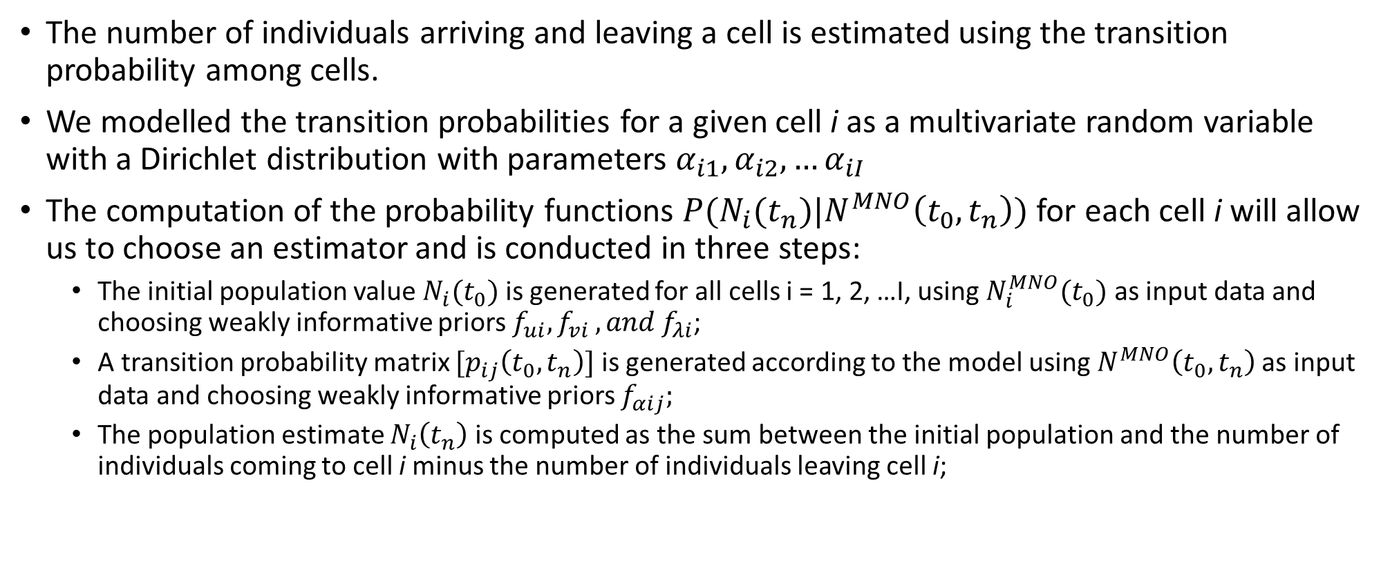
Population estimates along a sequence of time
The number of individuals arriving and leaving a cell is estimated using the transition probability among cells.
We modelled the transition probabilities for a given cell i as a multivariate random variable with a Dirichlet distribution with parameters $α_{i1},α_{i2}, …α_{iI}$
The computation of the probability functions $P(N_{i}(t_{n})|N^{MNO}\left(t_{0},t_{n}\right))$ for each cell i will allow us to choose an estimator and is conducted in three steps:
The initial population value $N_{i}(t_{0})$ is generated for all cells i = 1, 2, …I, using $N_{i}^{MNO}(t_{0})$ as input data and choosing weakly informative priors $f_{ui}, f_{vi }, and f_{λi}$;
A transition probability matrix $[p_{ij}\left(t_{0}, t_{n}\right)]$ is generated according to the model using $N^{MNO}\left(t_{0},t_{n}\right)$as input data and choosing weakly informative priors $f_{αij};$
The population estimate $N_{i}\left(t_{n}\right)$ is computed as the sum between the initial population and the number of individuals coming to cell i minus the number of individuals leaving cell i;

Slide 21
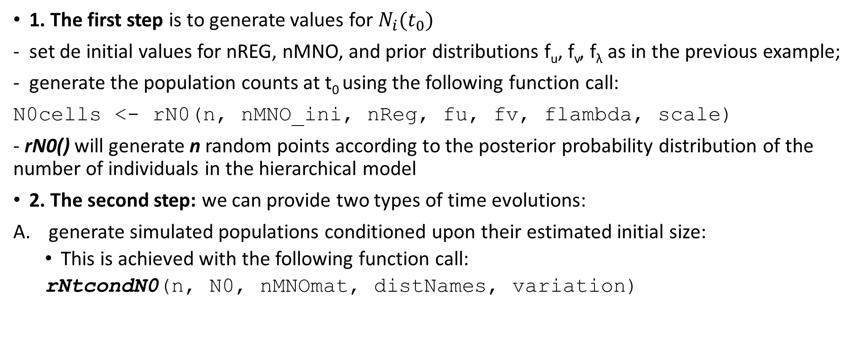
Population estimates along a sequence of time
1. The first step is to generate values for $N_{i}(t_{0})$
set de initial values for nREG, nMNO, and prior distributions f_{u}, f_{v}, f_{λ} as in the previous example;
generate the population counts at t₀ using the following function call:
N0cells <- rN0(n, nMNO_ini, nReg, fu, fv, flambda, scale)
- rN0() will generate n random points according to the posterior probability distribution of the number of individuals in the hierarchical model
2. The second step: we can provide two types of time evolutions:
generate simulated populations conditioned upon their estimated initial size:
This is achieved with the following function call:
rNtcondN0(n, N0, nMNOmat, distNames, variation)

Slide 22
Population estimates along a sequence of time
B. We can also produce estimates unconditioned on the initial estimate of the population in each cell;
The uncertainty in the estimation of the initial population of each cell is incorporated into the estimation process for later time periods
A simple example how to produce these estimates is presented in the next slide using 3 consecutive time instants;

Slide 23
# The number of generated values
n <- 1e6
#The transition matrix of individuals detected by the MNO
nMNOmat <- rbind(c(9, 2, 5), c(4, 19, 9), c(2, 6, 15))
# Population at the initial time of each cell according to the
# population register
nReg <- c(125, 95, 121)
# List of priors for u and v and lambda
u0 <- rowSums(nMNOmat) / nReg
cv_u0 <- 0.1
fu <- lapply(u0, function(u) {
umin <- max(0, u - cv_u0 * u)
umax <- min(1, u + cv_u0 * u)
output <- list('unif', xMin = umin, xMax = umax)
return(output)
})
v0 <- nReg
cv_v0 <- 0.10
fv <- lapply(v0, function(u){
umin <- max(0, u - cv_v0 * u)
umax <- u + cv_v0 * u
output <- list('unif', xMin = umin, xMax = umax)
return(output)
})
cv_lambda <- 0.5
alpha <- 1 / cv_lambda^2 - 1
flambda <- lapply(v0, function(v){
list('gamma', shape = 1 + alpha, scale = v / alpha)
})
# Names and parameters of priors for the transition
# probabilities
distNames <- rep('unif', 3)
variation <- rep(list(list(cv = 0.20)), 3)
# The population estimations
Nt <- rNt(n, nMNOmat, nReg, fu, fv, flambda, distNames, variation)$N

