Slide 1

INTERNET PROGRAMMING AND MOBILE PROGRAMMING

Slide 2
Market Management System

Slide 3
Table of content
introduction
I-Identification of the database element
1-Review on class diagram
2-ER diagram
3-Choose of the DBMS
II-Creation and population
1-Creation of the database
2-population
III-testing

Slide 4
Introduction
Implementing a database for a project involves several steps that are essential in ensuring that the database performs optimally and meets the project requirements. the implementation of a database for a project involves identifying the scope of the database, selecting a suitable DBMS, designing the database schema, creating and populating the database, testing and optimizing the database for performance, and implementing security measures to ensure data security

Slide 5
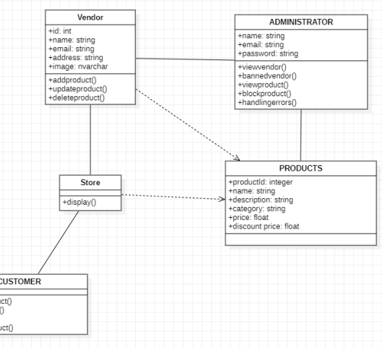
I-IDENTIFICATION OF THE DATABASE ELEMENT
1-REVIEW ON CLASS DIAGRAM
In this class diagram, the element that have to be stored are: vendor, product and administrator. With a focus on the mobile app development, we will not consider the administrator class. We will be left two class Vendor and Products class which share a many to many relationship.

Slide 6
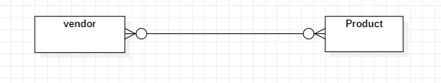
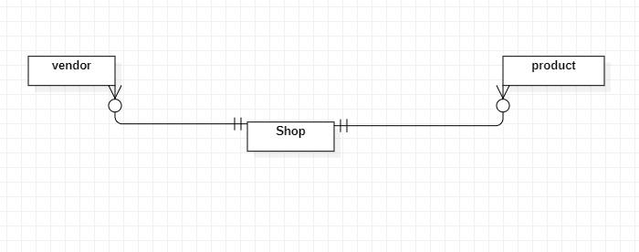
I-IDENTIFICATION OF THE DATABASE ELEMENT
2-ER diagram

Slide 7

I-IDENTIFICATION OF THE DATABASE ELEMENT
3-Choose of the DBMS
For this project we have chosen MySQL as DBMS because the system has a simple to moderate complexity and stores relatively small amounts of data, which make MySQL an appropriate choice.

Slide 8
II-CREATION AND POPULATION
1-CREATION OF THE DATABASE
vendor
CREATE TABLE Vendor ( vendor_id INT PRIMARY KEY, vendor_name VARCHAR(255), vendor_city VARCHAR(255), vendor_phone VARCHAR(50), vendor_email VARCHAR(255) );
Shop
CREATE TABLE Shop ( vendor_id INT, product_id INT, PRIMARY KEY (vendor_id, product_id), FOREIGN KEY (vendor_id) REFERENCES Vendor(vendor_id), FOREIGN KEY (product_id) REFERENCES Product(product_id));
Product
CREATE TABLE Product ( product_id INT PRIMARY KEY, product_name VARCHAR(255), product_price DECIMAL(10,2), vendor_id INT, FOREIGN KEY (vendor_id) REFERENCES Vendor(vendor_id) );

Slide 9
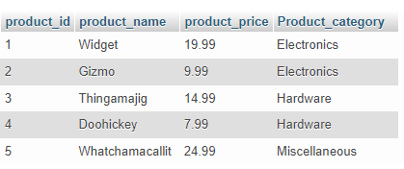
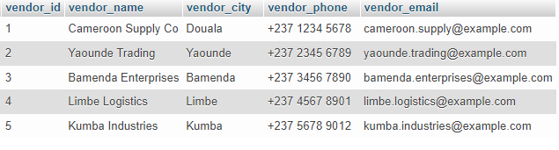
II-CREATION AND POPULATION
2-population

Slide 10
II-CREATION AND POPULATION
2-population
INSERT INTO Product (product_id, product_name, product_price, product_category)
VALUES (1, 'Widget', 19.99, 'Electronics');
INSERT INTO Product (product_id, product_name, product_price, product_category)
VALUES (2, 'Gizmo', 9.99, 'Electronics');
INSERT INTO Product (product_id, product_name, product_price, product_category)
VALUES (3, 'Thingamajig', 14.99, 'Hardware');
INSERT INTO Product (product_id, product_name, product_price, product_category)
VALUES (4, 'Doohickey', 7.99, 'Hardware');
INSERT INTO Product (product_id, product_name, product_price, product_category)
VALUES (5, 'Whatchamacallit', 24.99, 'Miscellaneous');

Slide 11
II-CREATION AND POPULATION
2-population
INSERT INTO Vendor (vendor_id, vendor_name, vendor_city, vendor_phone, vendor_email)
VALUES (1, 'Cameroon Supply Co', 'Douala', '+237 1234 5678', 'cameroon.supply@example.com');
INSERT INTO Vendor (vendor_id, vendor_name, vendor_city, vendor_phone, vendor_email)
VALUES (2, 'Yaounde Trading', 'Yaounde', '+237 2345 6789', 'yaounde.trading@example.com');
INSERT INTO Vendor (vendor_id, vendor_name, vendor_city, vendor_phone, vendor_email)
VALUES (3, 'Bamenda Enterprises', 'Bamenda', '+237 3456 7890', 'bamenda.enterprises@example.com');
NSERT INTO Vendor (vendor_id, vendor_name, vendor_city, vendor_phone, vendor_email)
VALUES (4, 'Limbe Logistics', 'Limbe', '+237 4567 8901', 'limbe.logistics@example.com');
INSERT INTO Vendor (vendor_id, vendor_name, vendor_city, vendor_phone, vendor_email)
VALUES (5, 'Kumba Industries', 'Kumba', '+237 5678 9012', 'kumba.industries@example.com');

Slide 12


IIII- Testing
1- code
The coding part of the back end have been done with php and for now a vendor can login, register a product and view them.
2- Testing
The testing part is done with postman

Slide 13

Thank you!

