Slide 1

INTERNET PROGRAMMING AND MOBILE PROGRAMMING

Slide 2

Market Management System

Slide 3
Table of contents
Introduction
Project Description I- Data Flow Diagram II- Use Case Diagram III-Sequence Diagram IV- Class Diagram V- Activity Diagram

Slide 4

Introduction
UML is a visual modeling language for software components and system designs that simplifies communication of complex information. This report presents a UML diagram for our software system, including components, relationships and interactions. The report is divided into Class, Use Case, Sequence, Activity, and Data flow diagrams, each with detailed descriptions of how they were created and key design decisions. The report highlights the value of UML as a tool for documentation and communication, aiming to present a clear, concise and accurate representation of the system's design to developers, stakeholders, and the project team.

Slide 5


Project Description
The Local Product Pricing and Vendor Management System is a mobile app that lets customers view local and regional product prices in Cameroon, and allows vendors to upload their catalogue. Vendors need to create an account to manage their product listings, and customers can compare prices to make informed purchases. Features include vendor management, search and filtering, notifications, and feedback. This app benefits small and medium businesses, customers seeking competitively-priced products and is also moderated to ensure legal products are presented.

Slide 6

I-Data flow diagram

Slide 7
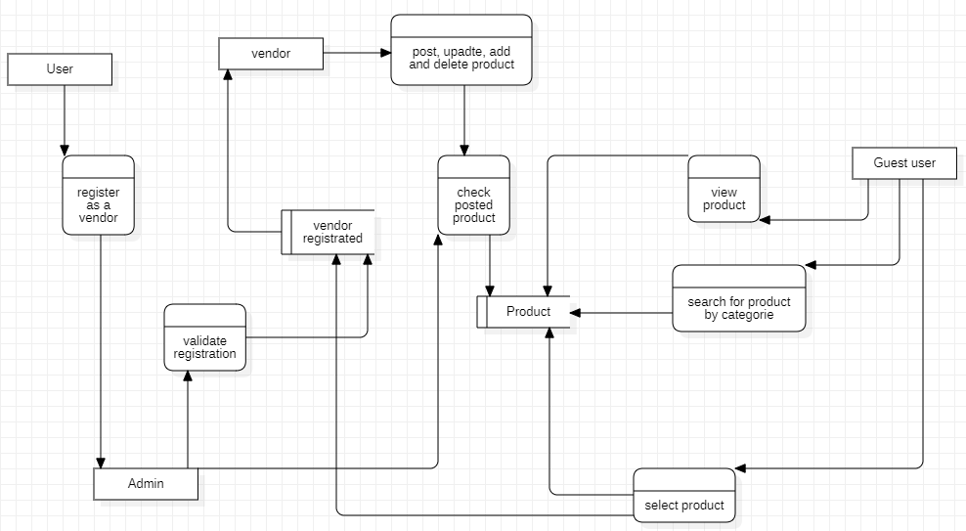
I- Data Flow Diagram
1- presentation

Slide 8
Data flow Diagram
Description
External entity:
Guest user: the guest user here represents the customer that will come and view the various product and details about it (vendor location, vendor contact, price of the product). As the customer doesn’t need to sign in, he is considered as guest user
User: the user here is a person willing to be a vendor. So, he will have to register before he can be a vendor
Vendor: the vendor is the main user of the system. He is the one in charge of posting product and their price on the system.
Admin: the Admin in in charge of controlling the action of a vendor and he is the one validating the user registration for him to be a vendor.

Slide 9
Data flow Diagram
Description
Process:
Register as vendor: this happens when a user fills in the form for him to be a vendor. The input comes from the user, and the output (user information) is sent to the admin
Validate registration: it happens when the admin has received the information of the user and processed it. He will send the information to the database.
Post, update, add and delete product: this represents all the action that a vendor can do. It receives as input the information about the product and sends it to the next process.
Check posted product: this operation is done by the admin on the product sent by the vendor. His input is the information send by the vendor and the authorization of the admin. It will store the information in the database if everything is ok.

Slide 10
Data flow Diagram
Description
Process:
View product: this operation permits the guest user to view the product according to his locality. It will sort the product by nearest location.
Search for product by category: it permits the guest user to sort product by category.
Select product: it permits to guest user to see information about the product (price, product name, vendor location, vendor contact etc...)

Slide 11
Data flow Diagram
Description
Data store:
Product: it is the representation of the table product in the database.
Registrated vendor: it is the representation of the table vendor in the database

Slide 12
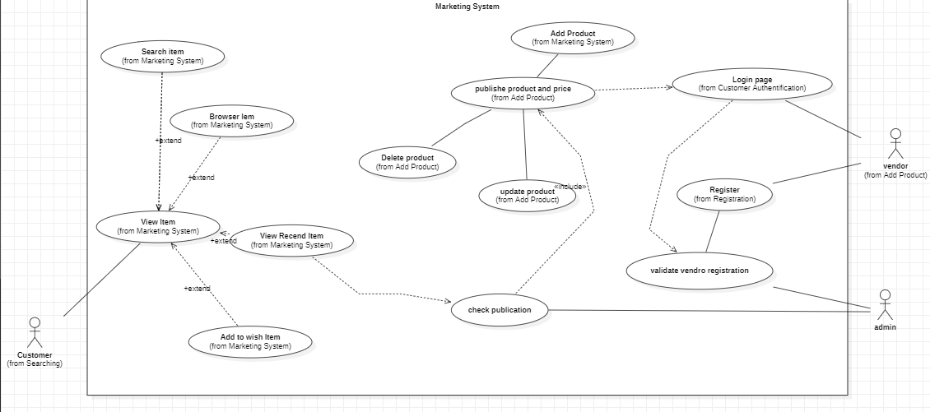
II- Use case diagram

Slide 13
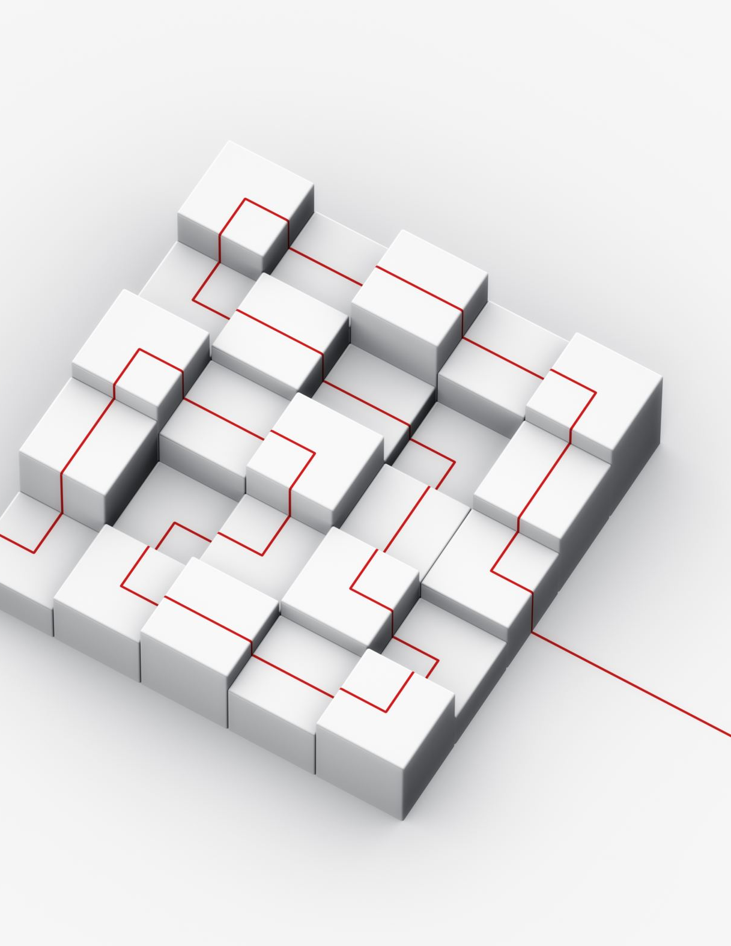
Use case Diagram
Description
Our use case diagram clearly present the interaction between actor in the system. We have 3 actors ( vendor, customer and admin).

Slide 14

III- sequence diagram

Slide 15
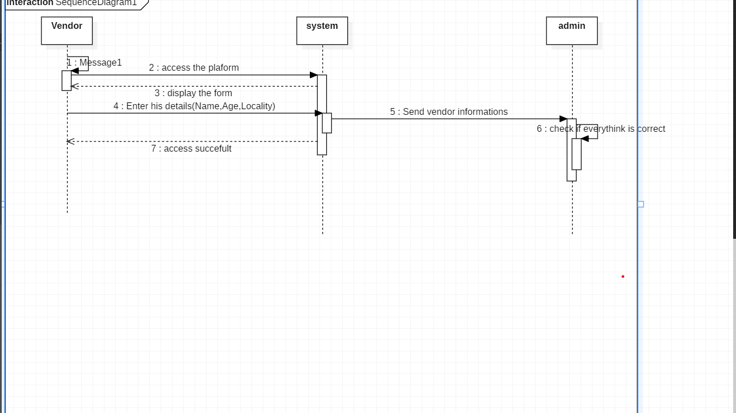
1- Registration

Slide 16
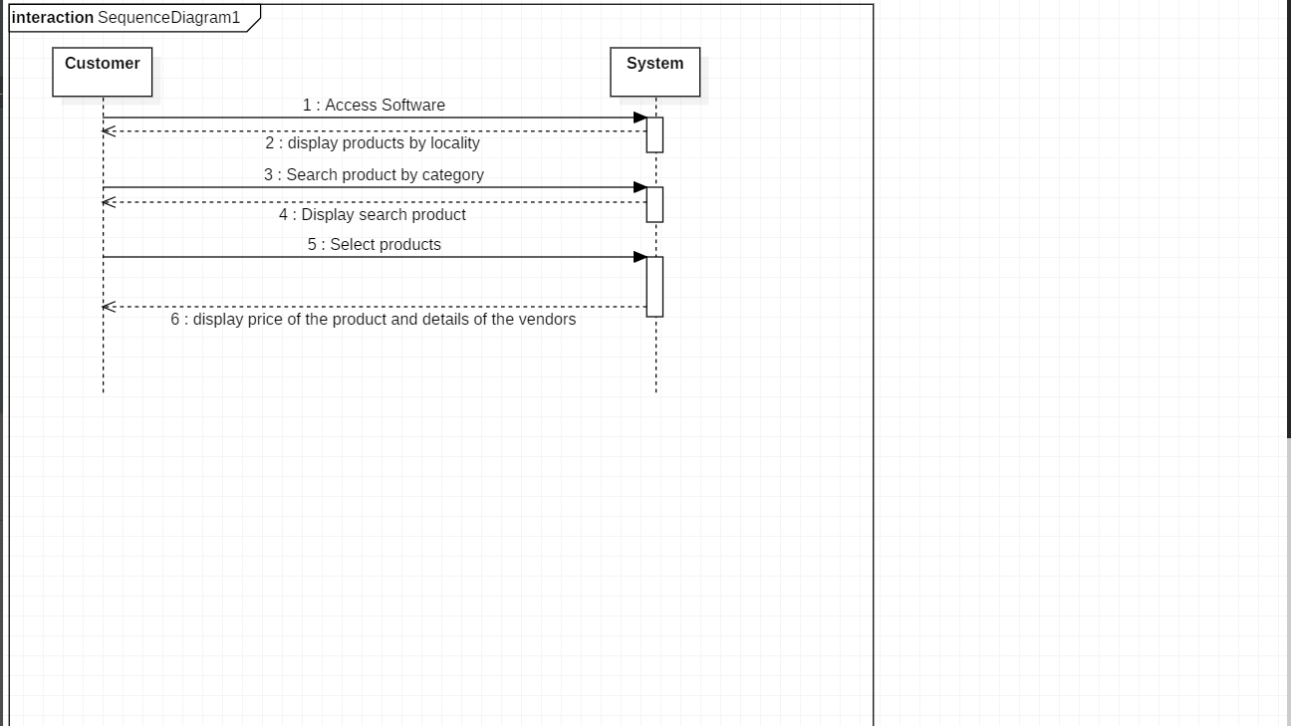
2-Customer

Slide 17
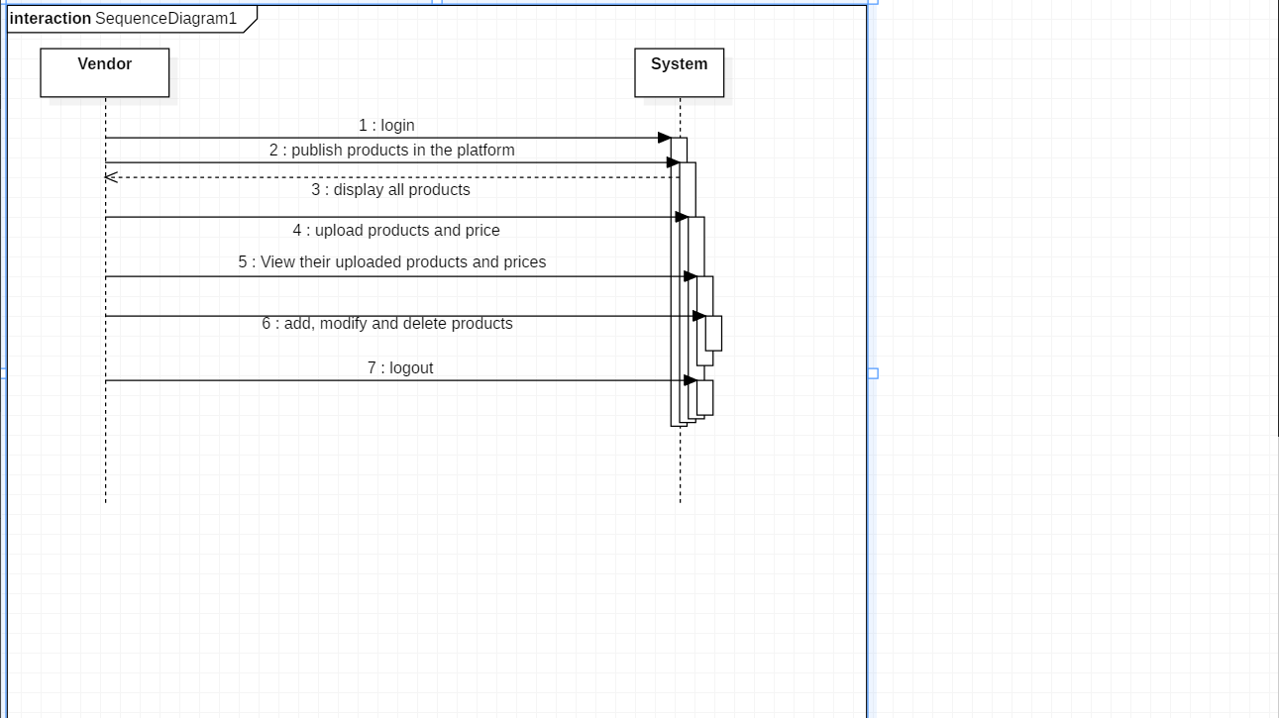
3- Vendor

Slide 18

IV-Class diagram

Slide 19
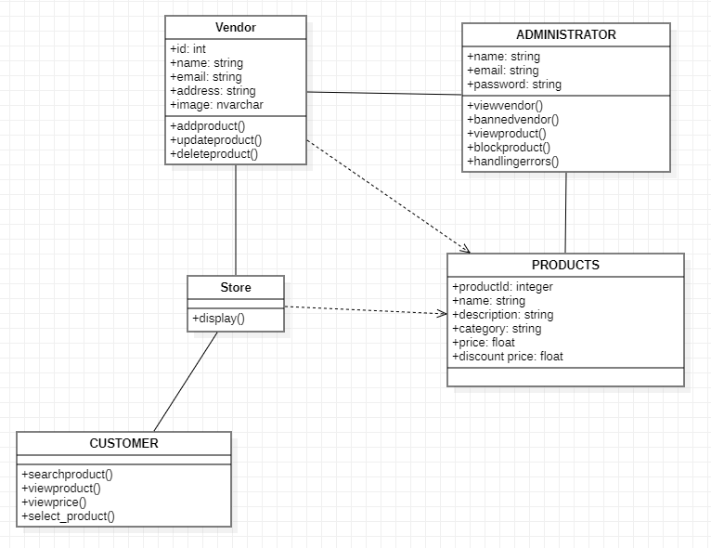
IV- Class Diagram

Slide 20

Class diagram
Description
Customer: in our application, the customer is considered as a guest user because he doesn’t create an account and can freely use the application to look for a product.
Vendor: he is the one in charge of posting the product and price, he needs to sign in to be able to create, add, update or delete product and price
Admin: he is in charge of the management system of the application. He supervises all the action done by vendor (validating registration, checking the conformity of a product and the vendor account)

Slide 21
Class diagram
Description
Products: they are all the articles sold by a vendor
Store: this is the collection of all the products of a vendor. It

Slide 22

V- Activity diagram

Slide 23
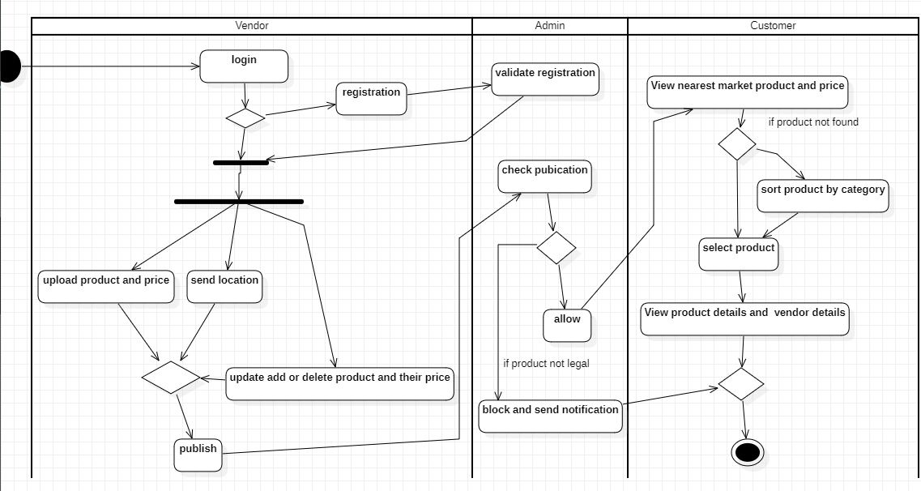
V- Activity diagram

Slide 24

Thank you.

