Slide 1

INTERNET PROGRAMMING AND MOBILE PROGRAMMING

Slide 2

Online pricing system

Slide 3
Table of content
I- PURPOSE AND BENEFIT
II- KEY FEATURES
III- TECHNICAL REQUIREMENTS
IV- USER INTERFACE
V- SECURITY
VI- SUPPORT AND MAINTENANCE

Slide 4
I- PURPOSE AND BENEFIT
Consistency
I- PURPOSe
the main purpose of this project was to provide buyers with various price of various product on their market. This for them to save time and be more precis in their decision
Real-time updates
Customer convenience

Slide 5
I- PURPOSE AND BENEFIT
Competitive Advantage Experience
I- Benefit
Improved Accuracy
By automating the pricing process, businesses can save money on labor costs and reduce pricing errors that can result in lost revenue.
Business that offer transparent and fair prices through an online pricing system can provide customers with a better experience, improving customer satisfaction and loyalty.
Increased Efficiency
By being able to quickly respond to changes in the market, businesses can gain a competitive edge over their competitors who may still be using manual pricing methods.
Online pricing systems use algorithms and data analysis to recommend or set prices, which can lead to more accurate pricing decisions.
An online pricing system can streamline the pricing process and reduce the amount of time and resources required to set and manage prices for products or services.
Cost Savings
Better Customer Experience

Slide 6
Key features
Our application is capable of letting vendors to upload their product with their respective price and location.
It also permits vendors to enlarge their market.
It permits customers to view and know the location where their goods are located.
The customer can also search and compare prices and has the ability to get in direct contact with the vendor.
Customer has the ability to rate vendors

Slide 7
TECHNICAL REQUIREMENTS
The following technical requirements are needed in the system as we want the application to have access to the camera, gallery, and location:
- The system should be developed using technologies such as Flutter and PHP
- The database should be MySQL or PostgreSQL
- The system should run on Android an IOS devices
- The system should have adequate security measures in place such as two-factor authentication and data encryption.

Slide 8
FUNCTIONAL REQUIREMENTS
Vendor Management
1. The system should have the ability to add, modify, and delete vendors.
2. The system should allow vendors to upload their products and prices.
3. The system should allow vendors to view their uploaded products and prices

Slide 9
FUNCTIONAL REQUIREMENTS
User Management
1. The system should allow users to search for products in their locality.
2. The system should enable users to view the prices of products in different markets.
3. The system should allow users to filter the search results based on specific criteria.

Slide 10
FUNCTIONAL REQUIREMENTS
Authentication
1. The system should require vendors to login to perform operations and ensure that they are authorized to perform the operation they want to execute.

Slide 11
FUNCTIONAL REQUIREMENTS
Product Management
1. The system should enable users to search for products based on product category.
2. The system should allow users to sort search results based on price, location of market or vendor

Slide 12
NON-FUNCTIONAL REQUIREMENTS
Performance
1. The system should have an average response time of fewer than 2 seconds.
2. The system should be able to handle a maximum of 1000 concurrent users.
3. The system should be available for use 24/7, with scheduled maintenance windows

Slide 13
NON-FUNCTIONAL REQUIREMENTS
Security
1. The system should be secure, utilizing techniques like authentication and encryption to protect data privacy and prevent unauthorized access.

Slide 14
USER INTERFACE
Here we will show a simple representation of how our application function

Slide 15
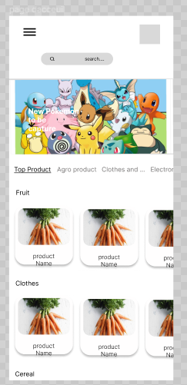
USER INTERFACE
Here the Customer views all the products which are already in category

Slide 16
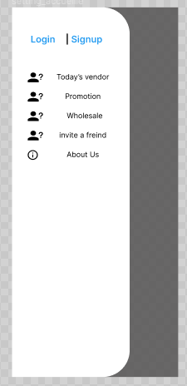
USER INTERFACE
Here the Vendor has the choice to login if he already has an account or sign-up so as to create an account

Slide 17
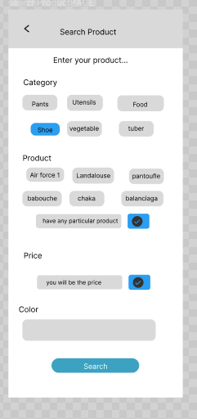
USER INTERFACE
The Customer is able to search a product based on the category

Slide 18
USER INTERFACE
Below we can see that there is a first part concerning the preview where the customer can view a product and products similar to it, also he is able to view details about the product like Vendor, prices and quantity, location and product name.

Slide 19
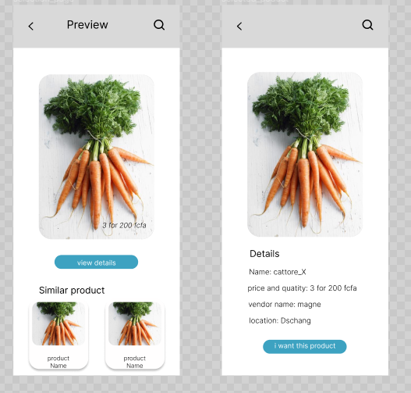
USER INTERFACE

Slide 20
USER INTERFACE

Slide 21
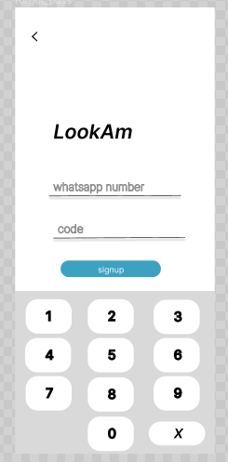
USER INTERFACE

Slide 22
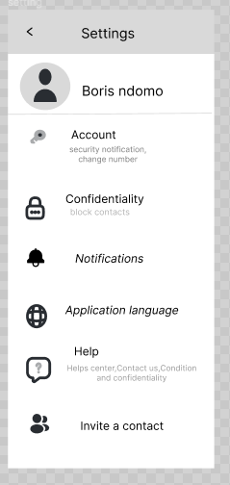
USER INTERFACE

Slide 23
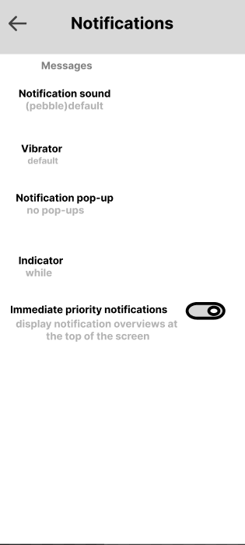
USER INTERFACE

Slide 24
SECURITY
In order to ensure a certain security to permit vendor’s information to be well kept, we use hashing encryption

Slide 25
SUPPORT AND MAINTENANCE
Support and maintenance are critical aspects of ensuring the ongoing success of an online management system. Here are some key considerations for supporting and maintaining an online management system
Provide user support: To ensure that users can effectively use the system
Monitor system performance: To ensure that the system is performing optimally
Conduct regular updates: To ensure that the system is up-to-date
Perform backups: To ensure that data is not lost in the event of a system failure
Stay up-to-date with industry trends: To ensure that the system remains competitive

Slide 26
Pricing
Our system works with bundled subscriptions offers vendors a cost-effective way to access multiple features and services. Pricing varies depending on the provider and plan chosen, with some providers offering multiple tiers of subscriptions. When considering a bundled subscription, it's important to review the features, pricing structure, and payment options to ensure it fits your business needs and budget. Flexible payment options, such as monthly or yearly billing, are often available. Choose a subscription that meets your needs and budget for the best value.

Slide 27
END
Thank you

