Slide 1
INTERNET PROGRAMMING AND MOBILE PROGRAMMING

Slide 2
COLLECTION OF REQUIREMENT AND ANALYSIS OF REQUIREEMENT

Slide 3
Table of contents
Introduction
I- Presentation of requirements
1. Functional requirement
2. Non-functional requirement
II- Analysis and modeling of requirements
Requirement diagram Use case diagram Class diagram Activity diagram Sequence diagram
III- Cost Evalution of the project

Slide 4
Introduction
In certain situations, we may have an urgent need to purchase a certain item, but not only do we struggle to locate it, we are also unsure if it falls within our budget. Similarly, as sellers, we may possess competitive pricing for our offerings, yet remain relatively unkwown to potential customers. Therefore, our objective of this project is to develop an application that caters to both buyers and sellers, allowing them to conviniently search for items at a price point that suits them. Through this platform, vendors can connect with customers who meet their expectations and preferences.

Slide 5
REQUIREMENTS
FUNCTIONAL REQUIREMENTS
Vendor Management
User Management
Authentication
Product Management
NON-FUNCTIONAL REQUIREMENTS
Performance
Security

Slide 6
FUNCTIONAL REQUIREMENTS
Vendor Management
1. The system should have the ability to add, modify, and delete vendors.
2. The system should allow vendors to upload their products and prices.
3. The system should allow vendors to view their uploaded products and prices

Slide 7
FUNCTIONAL REQUIREMENTS
User Management
1. The system should allow users to search for products in their locality.
2. The system should enable users to view the prices of products in different markets.
3. The system should allow users to filter the search results based on specific criteria.

Slide 8
FUNCTIONAL REQUIREMENTS
Authentication
1. The system should require vendors to login to perform operations and ensure that they are authorized to perform the operation they want to execute.

Slide 9
FUNCTIONAL REQUIREMENTS
Product Management
1. The system should enable users to search for products based on product category.
2. The system should allow users to sort search results based on price, location of market or vendor.

Slide 10
NON-FUNCTIONAL REQUIREMENTS
Performance
1. The system should have an average response time of fewer than 2 seconds.
2. The system should be able to handle a maximum of 1000 concurrent users.
3. The system should be available for use 24/7, with scheduled maintenance windows

Slide 11
NON-FUNCTIONAL REQUIREMENTS
Security
1. The system should be secure, utilizing techniques like authentication and encryption to protect data privacy and prevent unauthorized access.

Slide 12
ANALYSIS AND MODELING OF REQUIREMENTS
To gain more comprehensive understanding of the project, we conducted an analysis of various requirements and generated a set of diagrams to outline a blueprint of the system’s intended functionality. Our aim was to ensure a clear and thorough view of the project.

Slide 13
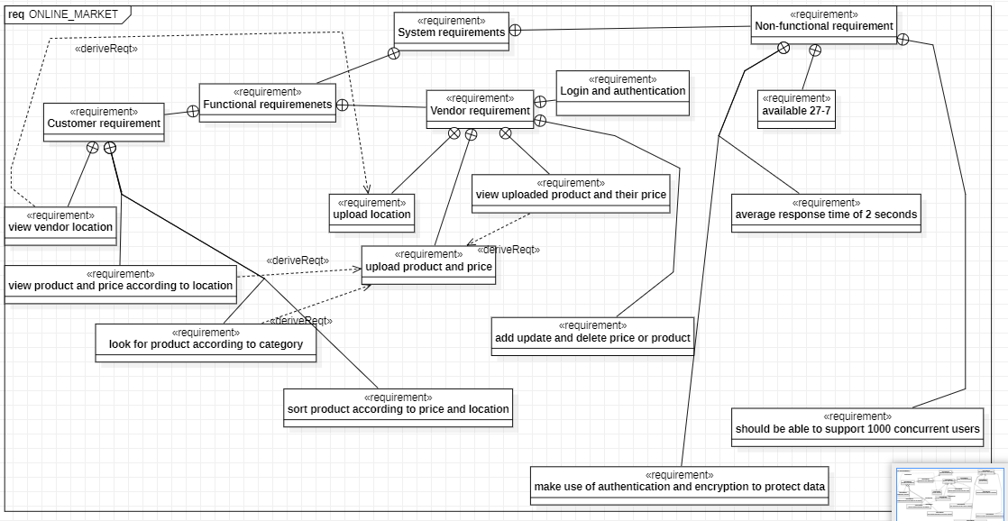
ANALYSIS AND MODELING OF REQUIREMENTS
1 Requirement diagram

Slide 14
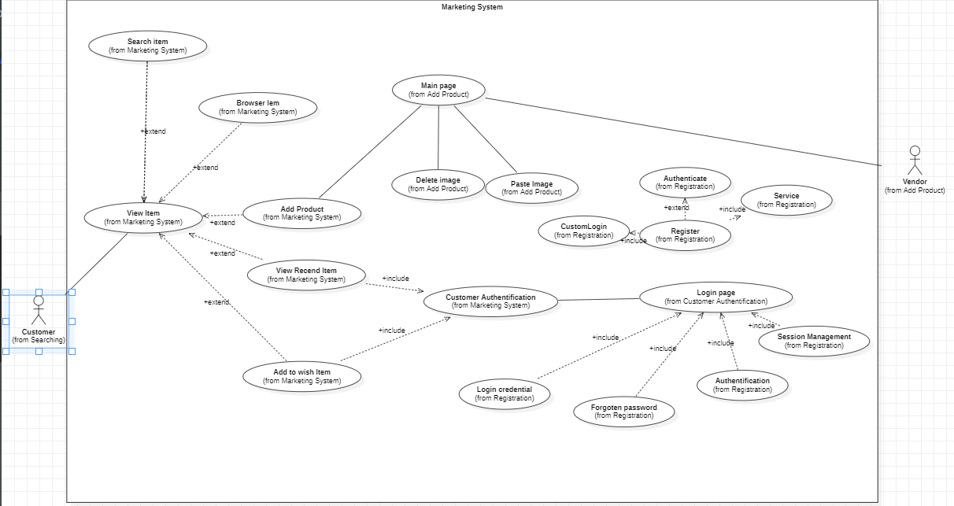
ANALYSIS AND MODELING OF REQUIREMENTS
2 Use case diagram

Slide 15
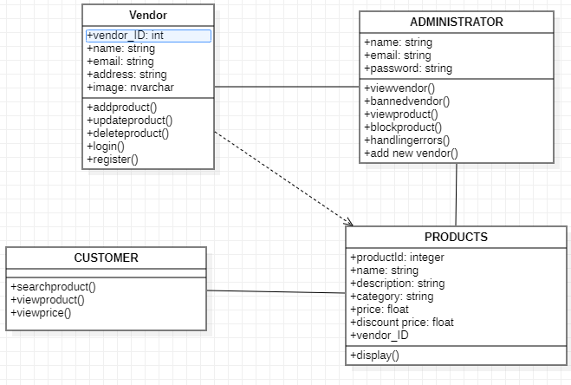
ANALYSIS AND MODELING OF REQUIREMENTS
2-Class diagram

Slide 16
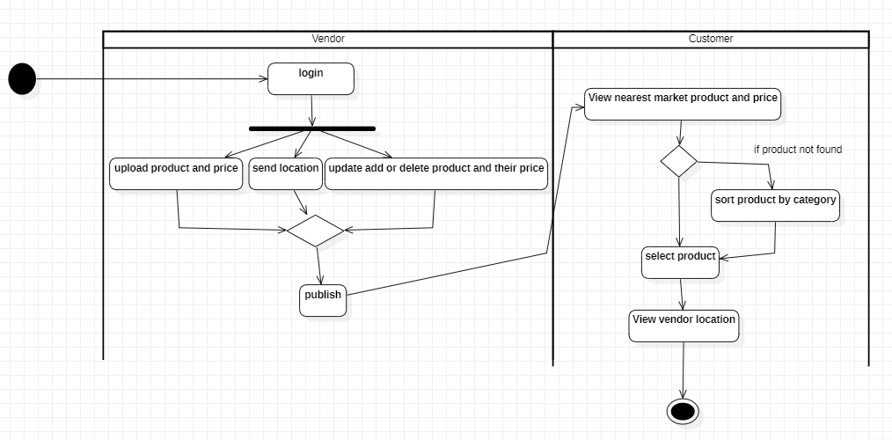
ANALYSIS AND MODELING OF REQUIREMENTS
3-Activity diagram

Slide 17
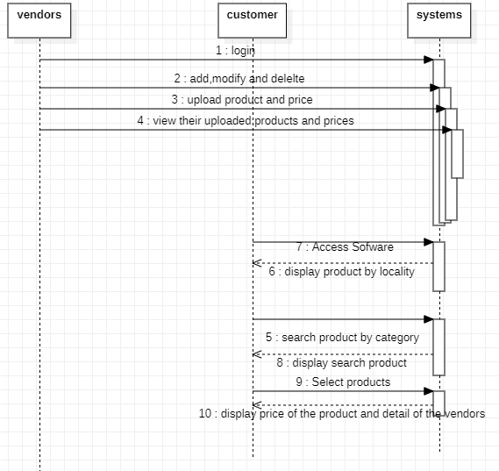
ANALYSIS AND MODELING OF REQUIREMENTS
3-Sequence diagram

Slide 18
III-Cost Evaluation of the project
High level module map
Technology use for the project
Billing

Slide 19
High level module map
User Authentication Module
- Responsible for user login and registration
- Ensures secure access to the system

Slide 20
High level module map
Vendor Module
- Allows vendors to upload and update product information including name, description, quantity, and price.
- Enables vendors to set their location

Slide 21
High level module map
Product Information Module
- Provides users with a search feature to find products and up-to-date prices in their locality.
- Allows users to filter by product, location or price range.
- Provides users with product information and price in different markets in Cameroon.

Slide 22
High level module map
Reporting and Analytics Module
- Provides data visualization to help users understand trends and patterns.

Slide 23

Technology use for the project
-For front-end development:
We plan to build the software in a short period of time and for both Android and iOS devices. So, we have choosing FLUTTER for the front-end development because of his cross-platform advantage that will permit us to save time by editing code for Android and iOS device, his level of difficulty in terms of learning which is very low which make it easy to learn and the size of his community.

Slide 24

Technology use for the project
For back-end development:
the level of security offer by PHP is appropriate for this project. Also, is scalability, flexibility make it the best choose for our project.

Slide 25

Technology use for the project
For UI/UX design:
For the design of the application, we plan on using FIGMA.

Slide 26
BILLING
Source of cost | Amount (in Franc CFA)
Infrastructure (server) | 5 000 – 30 000
Development team
Front-end development | 150 000 – 500 000 per page
Back-end development | 7000 – 40 000 per hour
UI/UX design | 10 000 - 40 000 per hour

