Slide 1

IOT Workshop #2: Grove Kit Demo
Mitch “Rez” Muenster
@MobileRez
mobilerez.tumbler.com
Xamarin Certified Developer
Maker
Grinder / Biohacker

Slide 2
Review From Last Week

Slide 3
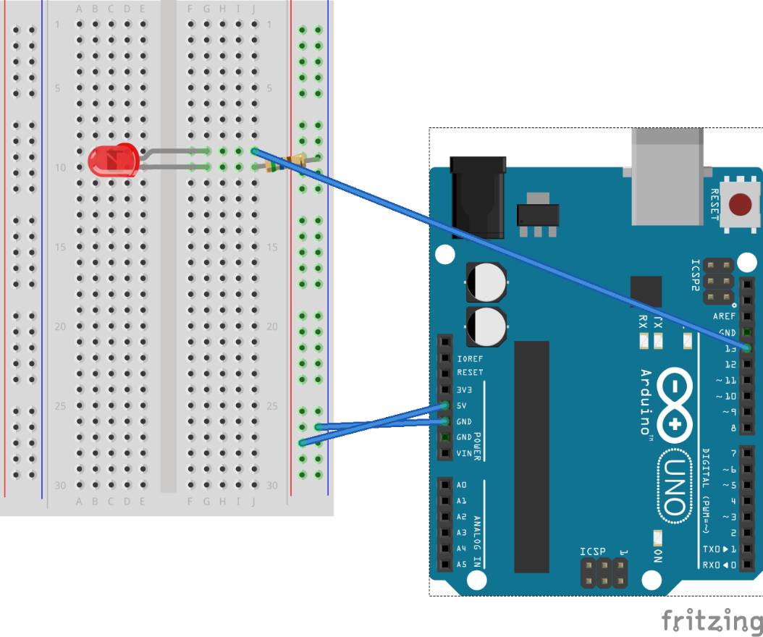
LED Arduino Demo

Slide 4
Electronic Definitions
Circuit: A complete and closed path around which a circulating electric current can flow.
Resistor: A device used to store an electric charge, consisting of one or more pairs of conductors separated by an insulator
Relay: Used to controlling and switching currents
Transistor: A transistor uses a small current to switch or amplify a much larger current.
Capacitor: A device used to store an electric charge, consisting of one or more pairs of conductors separated by an insulator

Slide 5
Electronic Definitions Cont.
Current: A flow of electricity which results from the ordered directional movement of electrically charged particles.
Volts: Voltage (volts) measures the pressure, or FORCE, of electricity.
Wats: Electrical power is the product of voltage and current, and it's measured in watts.
Ohms: Unit of resistance offered to current flow by a conductor.

Slide 6
What made our demo work?
Notes:
Demo with multi meter and resistor.

Slide 7
Grove Kit Demo
LED Screen Text

Slide 8
Initial Setup
Download & Install Seedstudio Driver http://seeedstudio.com/wiki/Download_Arduino_and_install_Arduino_driver
Download the Grove Library fo​r the Grove starter kit https://github.com/Seeed-Studio/Sketchbook_Starter_Kit_V2.0

Slide 9
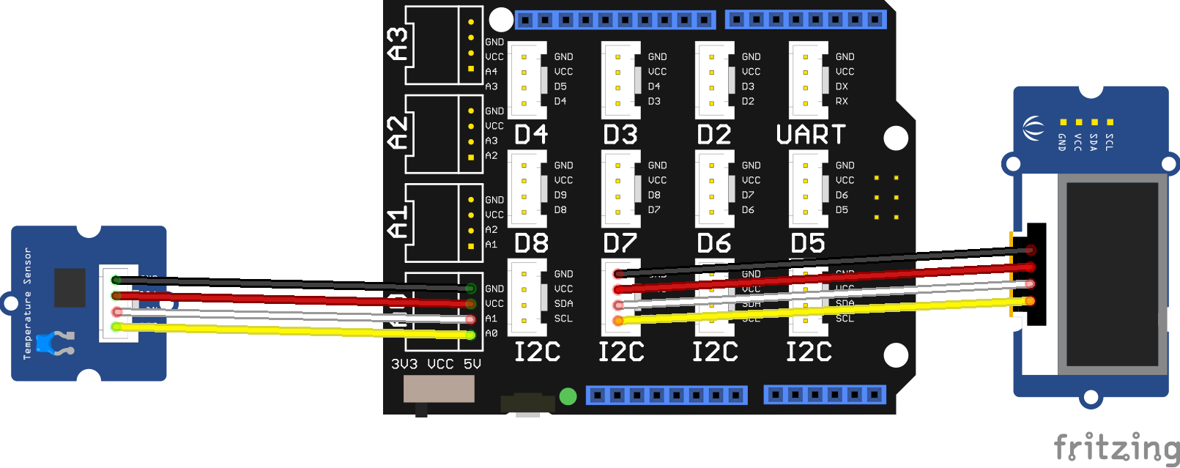
Grove Kit RGB Backlight LCD & Temperature Display Demo

Slide 10
#include <Wire.h>
#include "rgb_lcd.h“
rgb_lcd lcd;
int colorR = 255;
int colorG = 0;
int colorB = 0;
void setup()
{
lcd.begin(16, 2); // set up the LCD's number of columns and rows
lcd.setRGB(colorR, colorG, colorB);
lcd.print("hello, world!"); // Print a message to the LCD.
delay(1000);
}
void loop()
{
lcd.setCursor(0, 1); // set the cursor to column 0, line 1
lcd.print(millis()/1000); // print the number of seconds since reset:
delay(100);
}

Slide 11
int pinTemp = A0; //Define the pin to which the temperature sensor is connected.
int B = 3975; //Define the B value which is used to convert form the analog value to a temperature value
void setup()
{
//Configure the serial communication line at 9600 baud (bits per second.)
Serial.begin(9600);
}
void loop()
{
int val = analogRead(pinTemp); // Get the (raw) value of the temperature sensor.
//Determine the current resistance of the thermistor based on the sensor value.
float resistance = (float)(1023-val)*10000/val;
//Calculate the temperature based on the resistance value.
float temperature = 1/(log(resistance/10000)/B+1/298.15)-273.15;
Serial.println(temperature); //Print the temperature to the serial console.
delay(1000); //Wait one second between measurements.
}

Slide 12
Lets Merge the two code samples to make our Temperature display on the LCD
Notes:
Demo with multi meter and resistor.

