Slide 1


MobilityAPI
An OGC API – Moving Features server over MobilityDB
A thin compiled tier over MobilityDB · canonical Danish AIS example
net/http + pgxpool · single static binary · no MEOS in the tier
1
Notes:
MobilityAPI is an OGC API – Moving Features server over MobilityDB: a thin compiled tier that keeps every temporal computation in the database and ships as a single static binary. This deck walks the implemented surface against a day of Danish AIS ship-trajectory data.

Slide 2
WHAT IT IS
A Thin Tier over MobilityDB, Fat Database
▸ OGC-compliant: implements OGC API – Moving Features – Part 1: Core (collections, items, temporal geometry, derived queries, temporal properties)
▸ Thin compiled tier: net/http and a pgx connection pool; a single static binary, no cgo and no MEOS in the process
▸ Fat database: every temporal computation stays in MobilityDB; the tier never parses or transforms a trajectory in memory
▸ REST for any client: browsers, mobile, microservices and ETL consume mobility data without SQL or the PostgreSQL wire protocol
▸ Bounded as data grows: streaming responses, keyset pagination and index-using filters keep memory and paging bounded as collections grow
REQUEST FLOW
Browser
Mobile
ETL / lake
▼ HTTP
OGC API – Moving Features · MF-JSON
MobilityAPI (Go)
net/http + pgxpool
▼ SQL
PostgreSQL wire · pgx
MobilityDB / PostgreSQL
tgeompoint · STBOX · TSTZSPAN
MobilityAPI · OGC API – Moving Features
02
Notes:
Positioning: a thin HTTP/OGC facade in front of MobilityDB. Reads stream asMFJSON assembled in SQL; writes call tgeompointFromMFJSON. The only application logic is a small crs and interpolation adapter.

Slide 3
ARCHITECTURE
Where the Work Happens
In the tier (Go)
In the database (MobilityDB)
▸ Routing: net/http with the Go 1.22 pattern mux; one handler per OGC resource
▸ Pooling: a pgx pool multiplexes requests onto a bounded set of database connections
▸ Adapter: crs URN to EPSG and interpolation Stepwise to Step, roughly fifty lines
▸ Streaming: responses are written row by row from a server-side cursor
▸ Reads: asMFJSON assembles MovingFeaturesJSON in SQL; the tier streams the text
▸ Writes: tgeompointFromMFJSON parses the payload into a tgeompoint
▸ Filters: bbox and datetime push to the GiST index; atTime clips
▸ Measures: speed, cumulativeLength and azimuth compute the derived properties
No MEOS in the tier
▸ The trajectory is never materialised or parsed in the tier
▸ It travels as MF-JSON text on the way out, MovingFeaturesJSON on the way in
▸ MobilityDB does the parsing, the geometry algebra and the temporal computations
▸ A single static binary, no cgo dependency
MobilityAPI · OGC API – Moving Features
03
Notes:
The division of labour: the tier routes, pools and streams; MobilityDB does all temporal work and (de)serialization. No MEOS runs in the tier.

Slide 4
SAME DATA, TWO INTERFACES
MobilityDB SQL vs MobilityAPI REST
PostgreSQL / MobilityDB
MobilityAPI
INSERT INTO ships (id, mmsi, name, trip)
VALUES (205106000, 205106000, 'MARCUS',
tgeompoint '[
Point(645829 6058110)@2026-02-26 06:00+00,
Point(651280 6058390)@2026-02-26 06:25+00,
Point(656731 6058670)@2026-02-26 06:50+00]'
);
POST /collections/ships/items
Content-Type: application/json
{
"type": "Feature",
"id": "205106000",
"properties": { "name": "MARCUS" },
"temporalGeometry": {
"type": "MovingPoint",
"datetimes": ["2026-02-26T06:00:00+00", ...],
"coordinates": [[645829, 6058110], ...],
"interpolation": "Linear"
}
}
MobilityAPI · OGC API – Moving Features
04

Slide 5
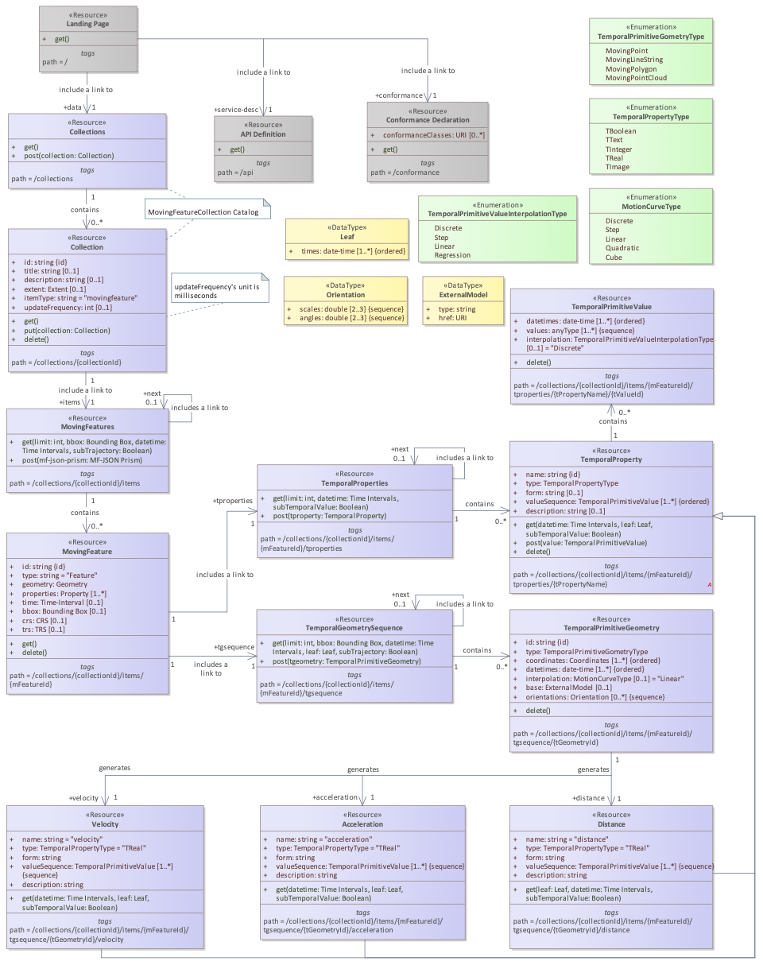
STANDARD
OGC API – Moving Features Data Model
▸ Collection: a named group of moving features (itemType movingfeature)
▸ MovingFeature: an item with id, properties, crs and trs
▸ TemporalGeometry: a MovingPoint with parallel coordinates and datetimes plus interpolation
▸ Derived queries: distance and velocity over a temporal geometry
▸ TemporalProperties: time-varying attributes derived from the trajectory
Class diagram — OGC API – Moving Features – Part 1: Core (fig. 1)
MobilityAPI · OGC API – Moving Features
05
Notes:
The OGC data model maps one to one onto MobilityAPI's REST resources.

Slide 6
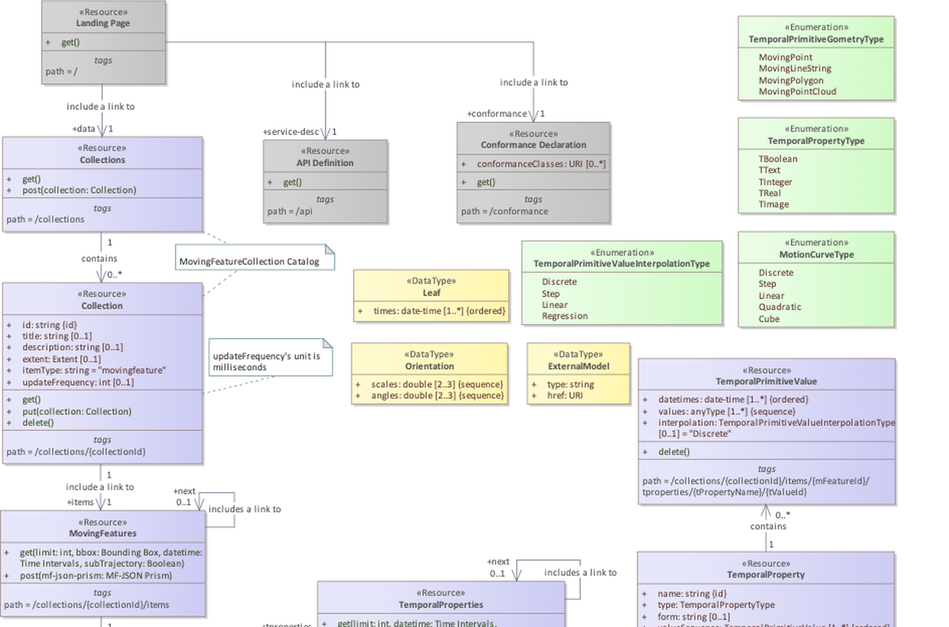
OGC DATA MODEL · DETAIL
upper half · 1 / 2
MobilityAPI · OGC API – Moving Features
06
Notes:
Zoomed view of the OGC API – Moving Features class diagram for class-level detail.

Slide 7
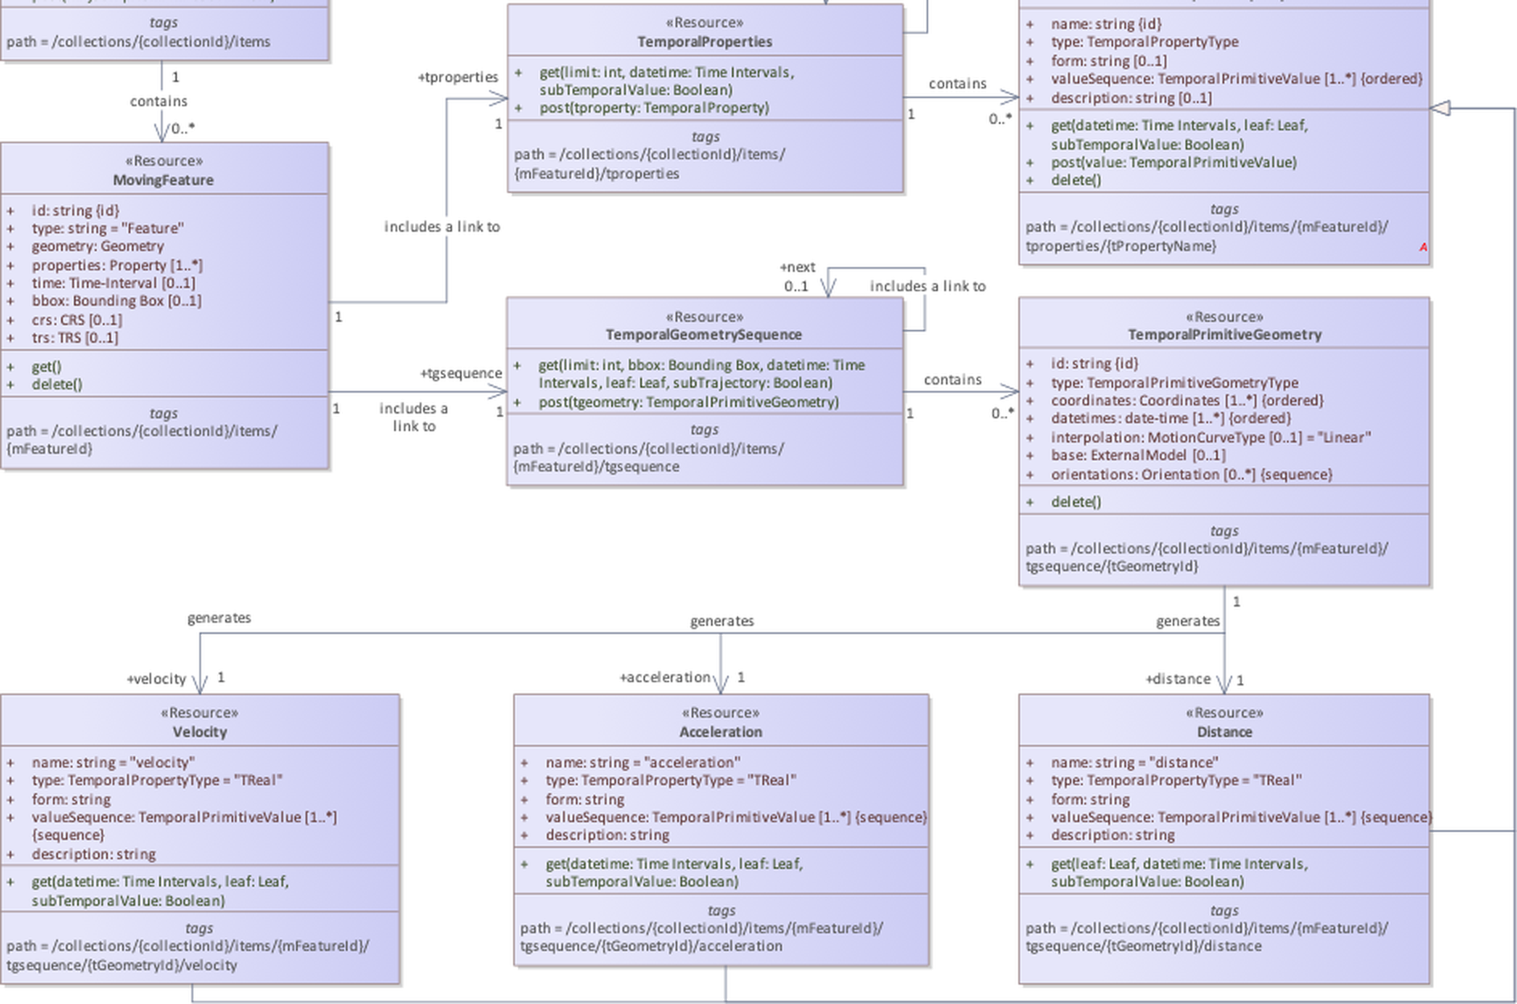
OGC DATA MODEL · DETAIL
lower half · 2 / 2
MobilityAPI · OGC API – Moving Features
07
Notes:
Zoomed view of the OGC API – Moving Features class diagram for class-level detail.

Slide 8
UNDER THE HOOD
How MobilityAPI Persists Moving Features
STORED COLUMNS
STANDARD FIELDS SERVED
collections
Collection
PK id TEXT
title TEXT
description TEXT
itemType TEXT
crs INTEGER
▸ Stored: id, title, description, itemType, crs
▸ Derived: extent (spatial bbox and time interval)
▸ Generated: links
MovingFeature
▸ Stored: id, properties (mmsi, name)
▸ Derived from trip: temporalGeometry, bbox, time, geometry
▸ From the registry: crs
▸ Constant: trs
▸ Generated: links
ships
PK id INTEGER
mmsi BIGINT
name TEXT
trip tgeompoint
How fields are provided
one feature table per collection
▸ Derived fields come O(1) from the tgeompoint and its inline STBOX
▸ Links are generated per request
MobilityAPI · OGC API – Moving Features
08
Notes:
Stored versus served: the two tables hold the columns; every other OGC field (the collection extent, and the feature bbox, time, geometry, crs, trs and links) is derived O(1) from the tgeompoint and its inline STBOX, or generated per request.

Slide 9
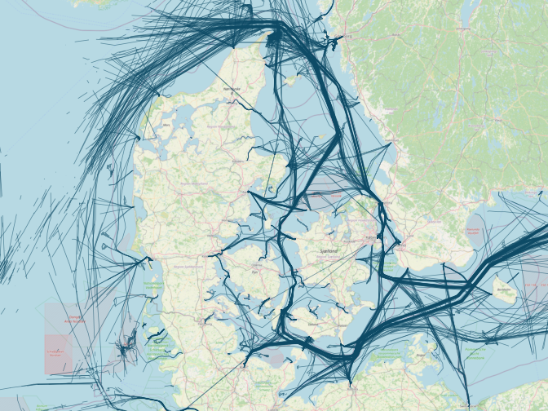
CANONICAL EXAMPLE
A Day of Danish AIS Ship Traffic
▸ Source: Danish Maritime Authority AIS feed (aisdata.ais.dk)
▸ Window: 2026-02-26 to 2026-02-27
▸ 2,833 trajectories: 1,878 distinct vessels (MMSI), each a MovingPoint
▸ 6.2 million instants: observed position across the collection
▸ CRS: EPSG:25832 (ETRS89 / UTM 32N, metres)
Danish AIS vessel trajectories, 2026-02-26
MobilityAPI · OGC API – Moving Features
09
Notes:
The loaded ships collection: 2,833 vessel trajectories from 1,878 MMSI over one day, 6.2 million observed instants, in EPSG:25832.

Slide 10
REFERENCE
The OGC Endpoint Surface
GET
POST
/collections
GET
/collections/{collectionId}
GET
POST
/collections/{collectionId}/items
GET
DELETE
/collections/{collectionId}/items/{mFeatureId}
GET
POST
/collections/{collectionId}/items/{mFeatureId}/tgsequence
GET
/collections/{collectionId}/items/{mFeatureId}/tgsequence/{tGeometryId}/distance
GET
/collections/{collectionId}/items/{mFeatureId}/tgsequence/{tGeometryId}/velocity
GET
/collections/{collectionId}/items/{mFeatureId}/tproperties
GET
/collections/{collectionId}/items/{mFeatureId}/tproperties/{tPropertyName}
GET
/ · /api · /conformance
Notes
▸ Every path above is OGC API – Moving Features – Part 1: Core; acceleration returns 501 (not derivable)
▸ Items query parameters: bbox, datetime, subtrajectory, leaf, limit, page cursor
MobilityAPI · OGC API – Moving Features
10
Notes:
The standard endpoint surface, full paths. Beyond-standard features (the lakehouse export and in-place replace) are on the Additional features slide.

Slide 11
WALKTHROUGH
The Ships Collection, End to End
List → filter → retrieve → derive → write, all over HTTP
11
Notes:
Section divider: the live walkthrough against the ships collection.

Slide 12
COLLECTIONS
List Collections · Retrieve One
GET
/collections
GET
/collections/ships
200 OK
200 OK
{
"collections": [
{
"id": "ships",
"title": "ships",
"itemType": "movingfeature",
"description": "Danish AIS vessel trajectories",
"links": [
{ "rel": "items",
"href": "/collections/ships/items" },
{ "rel": "enclosure",
"href": "/collections/ships/export",
"type": "application/x-ndjson" }
]
}
]
}
{
"id": "ships", "title": "ships",
"itemType": "movingfeature",
"description": "Danish AIS vessel trajectories",
"crs": [".../def/crs/EPSG/0/25832"],
"extent": {
"spatial": { "bbox": [[152625, 5942006,
1020003, 6545239]] },
"temporal": { "interval": [["2026-02-26 ...",
"2026-02-27 ..."]] } },
"links": [ { "rel": "self" },
{ "rel": "items" },
{ "rel": "enclosure" } ]
}
▸ extent is the spatial bbox and time interval of the collection
▸ crs and links round out the standard collection resource
MobilityAPI · OGC API – Moving Features
12
Notes:
GET /collections lists every registered collection from the registry; GET /collections/{id} returns one collection's metadata.

Slide 13
MOVING FEATURES
Stream the FeatureCollection, Page by Keyset
GET
/collections/ships/items?limit=2
200 OK Content-Type: application/json
{
"type": "FeatureCollection",
"features": [
{ "id": "1", "type": "Feature",
"properties": { "mmsi": 111219510, "name": "vessel 111219510" },
"crs": { "type": "Name", "properties": {
"name": "urn:ogc:def:crs:EPSG::25832" } },
"bbox": [550889, 6328752, 616716, 6346258],
"time": ["2026-02-26 13:28:08+01", "2026-02-26 14:41:04+01"],
"temporalGeometry": { "type": "MovingPoint",
"sequences": [ { "datetimes": [...], "coordinates": [...] } ],
"interpolation": "Linear" },
"links": [ { "rel": "self", "href": ".../items/1" } ] },
{ "id": "2", "type": "Feature", ... }
],
"numberReturned": 2,
"links": [ { "rel": "next",
"href": "/collections/ships/items?after=2&limit=2" } ]
}
▸ Streamed: each Feature is written from a server-side cursor; memory is bounded for any page size
▸ Keyset next: the next link advances by id (after=), with no OFFSET
▸ asMFJSON: the temporalGeometry is assembled in SQL and streamed as text
▸ limit: caps the page; the tier enforces a maximum
MobilityAPI · OGC API – Moving Features
13
Notes:
GET items streams a FeatureCollection from a cursor and pages by keyset. The temporalGeometry is MovingFeaturesJSON produced by asMFJSON.

Slide 14
MOVING FEATURES
Retrieve a Single Vessel
GET
/collections/ships/items/1
200 OK
{
"id": "1", "type": "Feature",
"properties": { "mmsi": 111219510, "name": "vessel 111219510" },
"crs": { "type": "Name", "properties": {
"name": "urn:ogc:def:crs:EPSG::25832" } },
"trs": { "type": "Link",
"properties": { "type": "ogcdef",
"href": ".../uom/ISO-8601/0/Gregorian" } },
"bbox": [550889, 6328752, 616716, 6346258],
"time": ["2026-02-26 13:28:08+01", "2026-02-26 14:41:04+01"],
"geometry": { "type": "MultiLineString", "coordinates": [...] },
"temporalGeometry": {
"type": "MovingPoint",
"sequences": [ { "datetimes": [...], "coordinates": [...] } ],
"interpolation": "Linear" },
"links": [ { "rel": "self",
"href": "/collections/ships/items/1" } ]
}
▸ One movement: the full trajectory of one vessel as MovingFeaturesJSON
▸ crs: carried as an OGC URN; the tier maps to and from the EPSG form
▸ interpolation: Linear, so the vessel moves continuously between fixes
▸ sequences: one per continuous run; gaps split the trajectory
MobilityAPI · OGC API – Moving Features
14

Slide 15
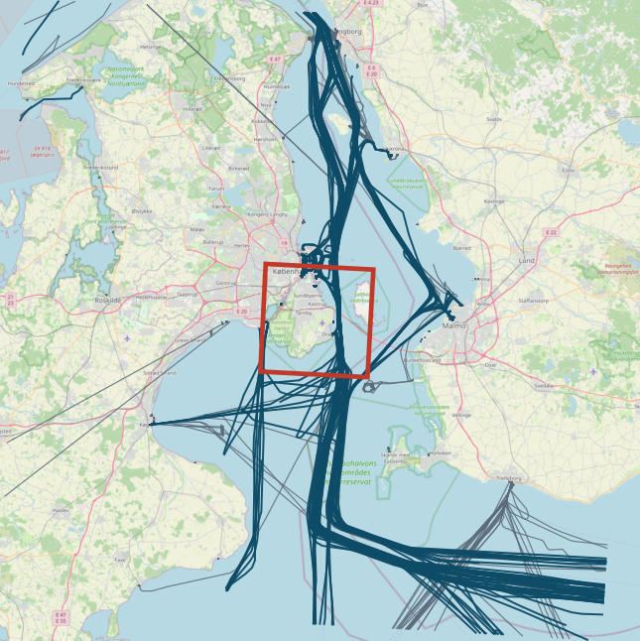
SPATIAL FILTER
Vessels Intersecting a Bounding Box
GET
/collections/ships/items?bbox=720000,6160000,738000,6178000
GET /collections/ships/items
?bbox=720000,6160000,738000,6178000
&limit=10000
// bbox = minx,miny,maxx,maxy in the storage CRS
// EPSG:25832 (metres)
// 170 of 2,833 trajectories cross the box
▸ bbox: keeps vessels whose trajectory intersects the envelope
▸ Index: pushed to the MobilityDB GiST index via the overlap operator
▸ CRS: coordinates are in the collection's storage CRS (EPSG:25832)
▸ Composable: datetime, subtrajectory, limit and after
Trajectories crossing the box (teal) over other traffic (grey); the box in red
MobilityAPI · OGC API – Moving Features
15
Notes:
The bbox query is a spatial pre-filter executed by MobilityDB's GiST index over the inline STBOX.

Slide 16
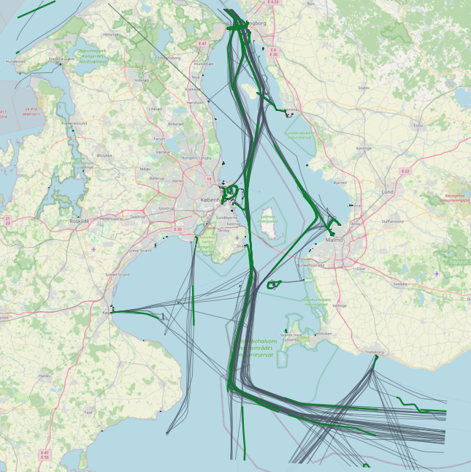
TEMPORAL SLICE
Restrict Trajectories to a Time Interval
GET
/collections/ships/items?subtrajectory=true
GET /collections/ships/items
?subtrajectory=true
&datetime=2026-02-26T14:00:00+01
/2026-02-26T15:00:00+01
// datetime is an RFC 3339 interval (start/end)
// subtrajectory=true clips each trajectory to the
// window with atTime, instead of filtering trips
▸ subtrajectory: clips each trajectory to the datetime interval via atTime
▸ datetime: RFC 3339 interval; a bare instant is also accepted
▸ Gap aware: rows whose values fall entirely in a temporal gap are dropped
▸ Validation: subtrajectory requires a bounded interval
Subtrajectories within a one-hour window (green) over full trajectories (grey)
MobilityAPI · OGC API – Moving Features
16

Slide 17
WRITES
Create · Append · Delete
POST
/collections/ships/items
DELETE
/collections/ships/items/900001
{ "type": "Feature", "id": "900001",
"properties": { "name": "demo" },
"temporalGeometry": {
"type": "MovingPoint", "interpolation": "Linear",
"datetimes": ["2026-02-26T10:00:00+01", ...],
"coordinates": [[600000, 6330000], ...] } }
201 { "message": "created", "id": "900001" }
204 remove the feature
▸ merge: append uses MobilityDB merge, which rejects time overlap; the tier maps that to 409
▸ Derived measures: velocity and distance are computed from the geometry and are read-only; change the geometry to change them
▸ Member delete: DELETE /…/tgsequence/{id} drops one geometry member by index via deleteTime; DELETE on the item removes the whole feature
POST
/collections/ships/items/900001/tgsequence
// append a temporally-disjoint sub-trajectory
200 { "message": "appended", "id": "900001" }
// overlapping the existing time span:
409 { "code": "409",
"description": "the sub-trajectory overlaps
the existing temporal geometry in time" }
MobilityAPI · OGC API – Moving Features
17
Notes:
Writes: POST creates, DELETE removes, and POST tgsequence appends a temporally-disjoint sub-trajectory via merge (overlap returns 409). In-place replace (PUT) is an extension, shown on the Additional features slide. Derived-property writes and primitive deletes return 501 with the reason.

Slide 18
TEMPORAL GEOMETRY
The Temporal-Geometry Sequence
GET
/collections/ships/items/1/tgsequence
Selectors on this resource
200 OK
{
"type": "TemporalGeometrySequence",
"crs": { "type": "Name", "properties": {
"name": "urn:ogc:def:crs:EPSG::25832" } },
"geometrySequence": [
{ "id": 1, "type": "MovingPoint", "datetimes": ["2026-02-26T13:28:08+01", ...],
"coordinates": [[721000.4, 6178001.2], ...],
"lower_inc": true, "upper_inc": true }
],
"interpolation": "Linear"
}
▸ datetime: clip the sequence to an interval (atTime)
▸ leaf: return the geometry at one or more instants
▸ POST: append a temporally-disjoint sub-trajectory
Temporal geometry
▸ The temporal geometry is the trajectory itself
▸ Returned as MovingFeaturesJSON by asMFJSON
MobilityAPI · OGC API – Moving Features
18

Slide 19
DERIVED MEASURES
Distance · Velocity · Acceleration
GET
/collections/ships/items/1/tgsequence/1/velocity
200 OK
{ "name": "velocity", "type": "TReal", "form": "m/s",
"description": "Speed over ground ...",
"valueSequence": [
{ "datetimes": ["2026-02-26T13:28:08+01", ...],
"values": [22.78, 11.03, ...],
"interpolation": "Stepwise" } ],
"links": [ { "rel": "self", ... } ] }
▸ velocity: speed over ground from speed(trip), piecewise-constant (Stepwise)
▸ distance: cumulative length from cumulativeLength(trip) (Linear)
▸ acceleration: not fabricated, because with linear position the speed is a step function whose derivative is not a finite function
▸ Exact: each measure is a MobilityDB function reshaped into an OGC temporalProperty (TReal)
GET
/collections/ships/items/1/tgsequence/1/acceleration
501
{ "code": "501", "description":
"acceleration is not derivable: linearly
interpolated position gives a piecewise-constant
speed, whose derivative is zero within each
segment and undefined at the vertices" }
MobilityAPI · OGC API – Moving Features
19
Notes:
distance and velocity are exact MobilityDB functions. Acceleration returns 501 because the derivative of a piecewise-constant speed is zero within segments and undefined at the vertices; the server does not fabricate it by resampling speed to linear.

Slide 20
TEMPORAL PROPERTIES
Time-Varying Attributes per Feature
GET
/collections/ships/items/1/tproperties
Property type
200 OK
{
"temporalProperties": [
{ "name": "fuel", "type": "TReal", "form": "L" },
{ "name": "cargo_temp", "type": "TReal", "form": "Cel" },
{ "name": "load", "type": "TReal", "form": "t" }
],
"numberReturned": 3,
"links": [ { "rel": "self", ... } ]
}
TBoolean · TText · TInteger · TReal
▸ Stored: user-supplied attributes — fuel, cargo temperature, load — held as native MobilityDB temporal values
▸ Writable: POST creates a property, POST appends values via merge, DELETE removes it
▸ valueSequence: datetimes and values with each segment's true interpolation
▸ leaf / datetime: leaf selects values at given instants (Discrete); datetime clips to an interval
GET
/collections/ships/items/1/tproperties/fuel?leaf=...
{ "name": "fuel", "type": "TReal", "form": "L",
"valueSequence": [
{ "datetimes": ["2026-02-26T13:28:08+01"],
"values": [22.78],
"interpolation": "Discrete" } ] }
MobilityAPI · OGC API – Moving Features
20
Notes:
GET tproperties lists the derived temporal properties; GET tproperties/{name} returns its valueSequence. The leaf selector returns Discrete values at given instants.

Slide 21
CONFORMANCE
Declared Classes, API Definition, Errors
Conformance classes
API definition
OGC error responses
▸ movingfeatures / conf / common
▸ / conf / mf-collection
▸ / conf / movingfeatures
▸ ogcapi-common-1 / conf / core
▸ ogcapi-common-2 / conf / collections
▸ /api: an OpenAPI 3.0 definition
▸ service-desc: linked from the landing page
▸ Landing: self, service-desc, conformance, data
▸ Clients discover the surface at runtime
▸ 400: invalid parameters or body
▸ 404: collection / feature not found
▸ 409: sub-trajectory overlaps in time
▸ 501: measure not derivable / derived write
▸ Body: { "code", "description" }
MobilityAPI · OGC API – Moving Features
21
Notes:
The server declares the three Moving Features conformance classes plus OGC Common core and collections, serves an OpenAPI definition at /api, and returns the OGC exception schema on errors.

Slide 22
SCALE
Streaming Keeps Memory Bounded
STANDARD ITEMS RESOURCE
393 MB
▸ Streaming: the FeatureCollection is written row by row from a cursor, so memory is bounded for any size
▸ Keyset pagination: next links advance by id with no OFFSET, constant cost through large collections
▸ Index-using filters: bbox and datetime push to the MobilityDB GiST index; subtrajectory clips with atTime
in one streamed response
≈18 MB
resident, bounded by the stream not the result size
Why it scales
Streaming and keyset pagination keep memory bounded for any collection size, a property of the standard items resource and not of the result size
MobilityAPI · OGC API – Moving Features
22
Notes:
Scale and the lakehouse on one slide. The standard items resource streams from a cursor with keyset pagination and index-using filters, so a 393 MB response holds about 18 MB resident. Beyond the standard and excluded from conformsTo: a bulk export (NDJSON, or Parquet with trajectory WKB plus a bbox and time sidecar, advertised via the enclosure link) and an in-place replace (PUT).

Slide 23
EXTENSIONS · NOT IN conformsTo
Opt-in Capabilities Beyond the Standard
▸ POST /…/bulk bulk-insert a batch of (vehicleId, position, time, …) observations in one request
▸ GET /…/export lakehouse feed: NDJSON or GeoParquet with trajectory WKB and a bbox/time sidecar
▸ PUT /…/items/{id} in-place replace of a feature
▸ GeoJSON and GeoParquet accepted in and out, alongside the MF-JSON default
▸ gzip / deflate / br / zstd compressed request and response bodies
▸ POST / PUT / DELETE /collections create, update and drop a collection and its feature table
▸ POST / DELETE /…/tproperties store and remove user-supplied TReal / TInt / TText / TBool attributes
MobilityAPI · OGC API – Moving Features
23

Slide 24
EXTENSIONS · NOT IN conformsTo
Bulk Ingest
POST
/collections/buses/bulk
Every minute a city posts each bus's position as a point and timestamp; one request appends them all.
POST /collections/buses/bulk // every bus, one minute
Content-Encoding: gzip
[ { "id": "bus_42", "point": [4.3517, 50.8466], "t": "...T10:00:00Z" },
{ "id": "bus_57", "point": [4.3490, 50.8501], "t": "...T10:00:00Z" },
... 812 vehicles ... ]
201 { "observations": 812, "featuresCreated": 12, "featuresExtended": 800 }
ENCODING
▸ Formats the body is GeoJSON or GeoParquet (MF-JSON default), the same records either way
▸ Compression gzip / deflate / br / zstd, decoded before parsing
▸ Append each record becomes one instant via appendInstant; the batch is atomic
▸ Unknown ids create a moving feature; out-of-order overlaps return 409
▸ GeoParquet ingest mirrors GET /export, so one file can backfill a whole collection
MobilityAPI · OGC API – Moving Features
24

Slide 25
STREAMING · OGC API – MOVING FEATURES – PART 4
Continuous Queries over Moving Features
▸ Stream Extension: a continuous query subscribes to a moving feature’s temporal property or position
▸ Register → stream: the query returns a cquery link; results arrive as Server-Sent Events, one instant at a time
▸ Transform: a lifted scalar operation (ln, exp, ×, +) applied to a streaming tfloat — pointwise and exact
▸ Windowed aggregate: AVG · SUM · MIN · MAX · COUNT over COUNT, TUMBLING or HOPPING windows
▸ StreamEngine seam: in-process MEOS (cgo), Apache Flink or Kafka — the same cquery link, SSE stream and lifecycle
MobilityAPI · OGC API – Moving Features
25

Slide 26
STREAMING · ANIMATED TUTORIAL
Animated Fleet over Live AIS
▸ Shared data: the same one day of Danish AIS as the static tutorial, loaded once as the ships collection
▸ Streamed positions: each vessel’s WGS84 track is delivered as SSE; MEOS.js (WebAssembly) interpolates it in the browser
▸ Live speed: every dot is coloured by its windowed-average speed over ground (AIS SOG), accumulating as it streams
▸ Growing chart: a per-vessel speed chart grows with each observation — the colours of the MEOS.js example, live
▸ Thin tier: DeckGL and MapLibre render the fleet; the tier streams only stored positions, the browser does the temporal work
MobilityAPI · OGC API – Moving Features
26

Slide 27
MULTI-ENGINE
One Tier, Many MEOS Engines
Thin OGC API – Moving Features tier
MF-JSON / WKB wire format · streaming · keyset paging · index pushdown · no MEOS in the tier
▼ serves any MEOS-backed engine; the engine becomes a configuration choice
MobilityDB
MobilityDuck
MobilitySpark
MobilityFlink
PostgreSQL
DuckDB
Apache Spark
Apache Flink
Transactional serving over a live database
Embedded, Parquet-native lakehouse queries
Distributed batch over very large histories
Streaming, real-time moving features
Operational
Operational
Operational
Planned
shared MEOS types, the MF-JSON / WKB wire format, and a canonical named-function SQL dialect; the same tier fronts transactional databases, streaming engines, and lakehouses
MobilityAPI · OGC API – Moving Features
27
Notes:
The thin-tier pattern generalises across the MEOS ecosystem: the tier speaks MF-JSON and WKB and keeps all temporal work in the engine, so the storage and compute engine becomes a configuration choice. MobilityDB is implemented today; MobilityDuck (embedded lakehouse), MobilitySpark (distributed batch) and MobilityFlink (streaming, real time) reuse the same surface.

Slide 28
ENGINE PROFILE
MobilityDB · PostgreSQL
Transactional serving over a live MobilityDB database
The reference OGC output every other engine is matched against
▼ the engine is a configuration choice — a DSN scheme and a build tag select it
Connector
Build & deploy
SQL dialect
Sweet spot
pgx pool
static binary
identity
OLTP + index
Live server connection; pgx.ErrNoRows maps onto the tier's ErrNoRows.
Default build — static and cgo-free; no engine libraries linked.
Canonical named-function SQL runs as-is; no name or type translation.
Live transactional reads and writes; GiST / SP-GiST index pushdown.
server
default
as-is
live
The reference engine: the canonical MEOS named-function SQL served verbatim — MobilityDuck and MobilitySpark return this exact OGC output.
MobilityAPI · OGC API – Moving Features
28

Slide 29
ENGINE PROFILE
MobilityDuck · DuckDB
Embedded, Parquet-native analytics with no server
Identical OGC output to PostgreSQL over the same canonical SQL
▼ the engine is a configuration choice — a DSN scheme and a build tag select it
Connector
Build & deploy
SQL dialect
Sweet spot
go-duckdb
-tags duckdb
identity
lakehouse
Embedded and in-process via database/sql; selected by a duckdb:// DSN.
MobilityDuck and spatial extensions LOADed per connection.
Same canonical SQL as PostgreSQL; trajectory GeoJSON cast to text for a uniform scan.
Parquet-native analytical queries over local files; no database server.
embedded
LOAD
as-is
Parquet
Same thin tier, same canonical SQL, same Go response assembly — only the connector changes; identical OGC output to PostgreSQL.
MobilityAPI · OGC API – Moving Features
29

Slide 30
ENGINE PROFILE
MobilitySpark · Apache Spark
Distributed batch over very large movement histories
The same canonical SQL as PostgreSQL and DuckDB, over Spark Connect
▼ the engine is a configuration choice — a DSN scheme and a build tag select it
Connector
Build & deploy
SQL dialect
Sweet spot
Spark Connect
-tags spark
remap
distributed
Selected by a spark:// DSN; compiles against spark-connect-go.
Placeholders inlined — Spark Connect's Sql takes no bind parameters.
Canonical names mapped to the MobilitySpark camelCase idiom; identifiers quoted with backticks; box accessors dispatch stbox vs tbox in one UDF via the WKB type tag.
Batch analytics over very large histories; th3index per-engine spatial indexing.
Connect
no params
remap
th3index
Same thin tier and Go assembly; the dialect maps the canonical names to MobilitySpark's camelCase idiom, quotes identifiers with backticks, and inlines the placeholders Spark Connect does not bind.
MobilityAPI · OGC API – Moving Features
30

Slide 31
MOBILITYSPARK · BENCHMARK & LIVE SERVE
Live over Spark Connect — GET /collections served end to end through the Go tier over a Spark Connect server (sc://), reading the staged ships collection: Go tier -> Spark Connect -> MobilitySpark, no MEOS in the tier.
Common-basis batch benchmark — BerlinMOD, the th3index cell prefilter, no native indexes, 500 trips:
MobilityDB 243 s vs Spark 795 s (same dataset, same canonical queries).
Point and columnar-filter queries: single-digit milliseconds on MobilityDB; the NxN meet queries (q05, q07) dominate both engines and converge them where neither has a spatial index.
The H3 cell is computed once in the dataset and reused by every engine — the streaming engines map the same per-event cell, the batch engines the per-trip th3index.

Slide 32
RECAP
The Standard Surface, Recapped
COLLECTIONS
MOVING FEATURES
QUERYING
✓ list (GET)
✓ retrieve (GET)
✓ registry-backed
✓ insert (POST)
✓ retrieve / stream
✓ delete (DELETE)
✓ keyset paging
✓ bbox spatial filter
✓ datetime interval / instant
✓ subtrajectory clipping
✓ leaf selector
TEMPORAL GEOMETRY
DERIVED MEASURES
CONFORMANCE & SCALE
✓ get sequence (GET)
✓ append sub-trajectory (POST)
✓ datetime / leaf clip
✓ member delete (DELETE)
✓ distance
✓ velocity
✓ acceleration → 501 (not derivable)
✓ exact, as TReal
✓ 5 conformance classes
✓ OpenAPI at /api
✓ streaming + keyset
✓ index-using filters
MobilityAPI · OGC API – Moving Features
31

Slide 33
Thanks for Listening
Questions?
32

Slide 34
REFERENCES
Find Out More
OGC API – Moving Features – Part 1: Core
https://docs.ogc.org/is/22-003r3/22-003r3.html
MobilityDB
https://github.com/MobilityDB/MobilityDB · https://mobilitydb.com
MEOS / ecosystem overview
https://libmeos.org
AIS data — Danish Maritime Authority
http://aisdata.ais.dk
MobilityAPI tutorial notebook
https://github.com/MobilityDB/MobilityAPI/blob/master/tutorial/tutorial.ipynb
MobilityAPI — Python implementation (PyMEOS)
https://github.com/MobilityDB/MobilityAPI-Python
OGC MF API reference implementation — aistairc/mf-api
https://github.com/aistairc/mf-api
MobilityAPI · OGC API – Moving Features
33

