Slide 1


MobilityAPI
An OGC API – Moving Features server for mobility data, built on MobilityDB
Complete feature walkthrough · canonical AIS example (Danish Maritime Authority)
github.com/MobilityDB/MobilityAPI
Notes:
MobilityAPI exposes MobilityDB mobility data as REST resources following the OGC API – Moving Features – Part 1: Core standard. This deck walks through the complete implemented feature surface using one day of Danish AIS ship-trajectory data, and contrasts two ways to serve the same MobilityDB: a PyMEOS Python tier and a thin compiled Go tier.

Slide 2
WHAT IT IS
From SQL Extension to REST API
▸ MobilityDB is a PostgreSQL / PostGIS extension for managing temporal and spatio-temporal (mobility) data — vehicles, vessels, pedestrians
▸ MobilityAPI exposes that data as REST resources for clients that don't speak SQL or the PostgreSQL wire protocol
▸ OGC-compliant implements the OGC API – Moving Features – Part 1: Core standard (collections, items, temporal geometries, temporal properties)
▸ Built on PyMEOS for the temporal-data conversion layer between JSON and MobilityDB types
▸ Serves browser applications, mobile clients, microservices and ETL pipelines
REQUEST FLOW
HTTP client
browser · mobile · ETL
▼
MobilityAPI
REST · OGC API – Moving Features
▼
PyMEOS
temporal-data conversion
▼
MobilityDB / PostgreSQL
tgeompoint · STBOX · TSTZSPAN
MobilityAPI · OGC API – Moving Features
02
Notes:
Positioning: MobilityAPI is the HTTP/OGC façade in front of MobilityDB; PyMEOS does the JSON<->temporal-type conversion.

Slide 3
SAME DATA, TWO INTERFACES
MobilityDB SQL vs MobilityAPI REST
PostgreSQL / MobilityDB
MobilityAPI
INSERT INTO temporal_geometries
(feature_id, geometry_type, trajectory, interpolation)
VALUES (
'219000429', 'MovingPoint',
tgeompoint '[Point(645829 6058110)@2024-08-07 06:00+00,
Point(651280 6058390)@2024-08-07 06:25+00,
Point(656731 6058670)@2024-08-07 06:50+00]',
'Linear'
);
POST /collections/ships/items
Content-Type: application/json
{
"type": "Feature",
"id": "219000429",
"temporalGeometry": {
"type": "MovingPoint",
"datetimes": ["2024-08-07T06:00:00+00",
"2024-08-07T06:25:00+00",
"2024-08-07T06:50:00+00"],
"coordinates": [[645829, 6058110],
[651280, 6058390],
[656731, 6058670]],
"interpolation": "Linear"
}
}
Identical trajectory — the REST client never writes SQL or opens a database connection.
MobilityAPI · OGC API – Moving Features
03

Slide 4
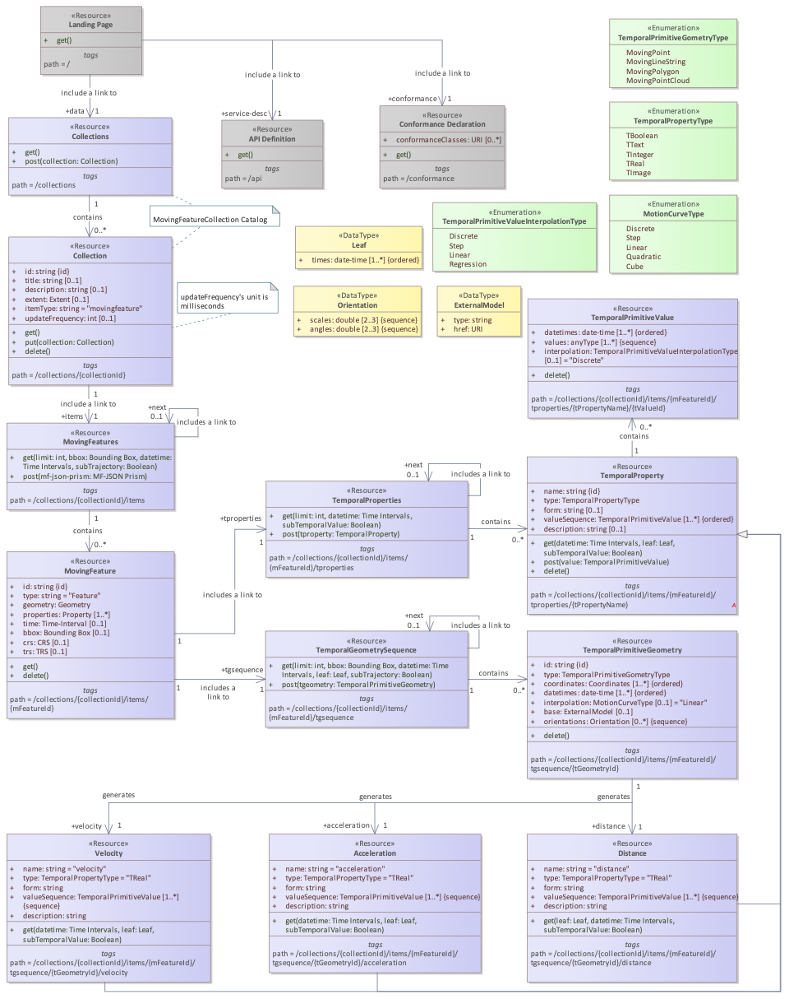
STANDARD
OGC API – Moving Features Data Model
▸ Collection a named group of moving features (itemType movingfeature)
▸ MovingFeature an item with id, properties, crs / trs
▸ TemporalGeometry a MovingPoint — parallel coordinates / datetimes + interpolation
▸ TemporalProperties time-varying attributes attached to a feature
▸ Query resources derived measures over a temporal geometry
Class diagram — OGC API – Moving Features – Part 1: Core (fig. 1)
MobilityAPI · OGC API – Moving Features
04
Notes:
The OGC data model maps one-to-one onto MobilityAPI's REST resources.

Slide 5
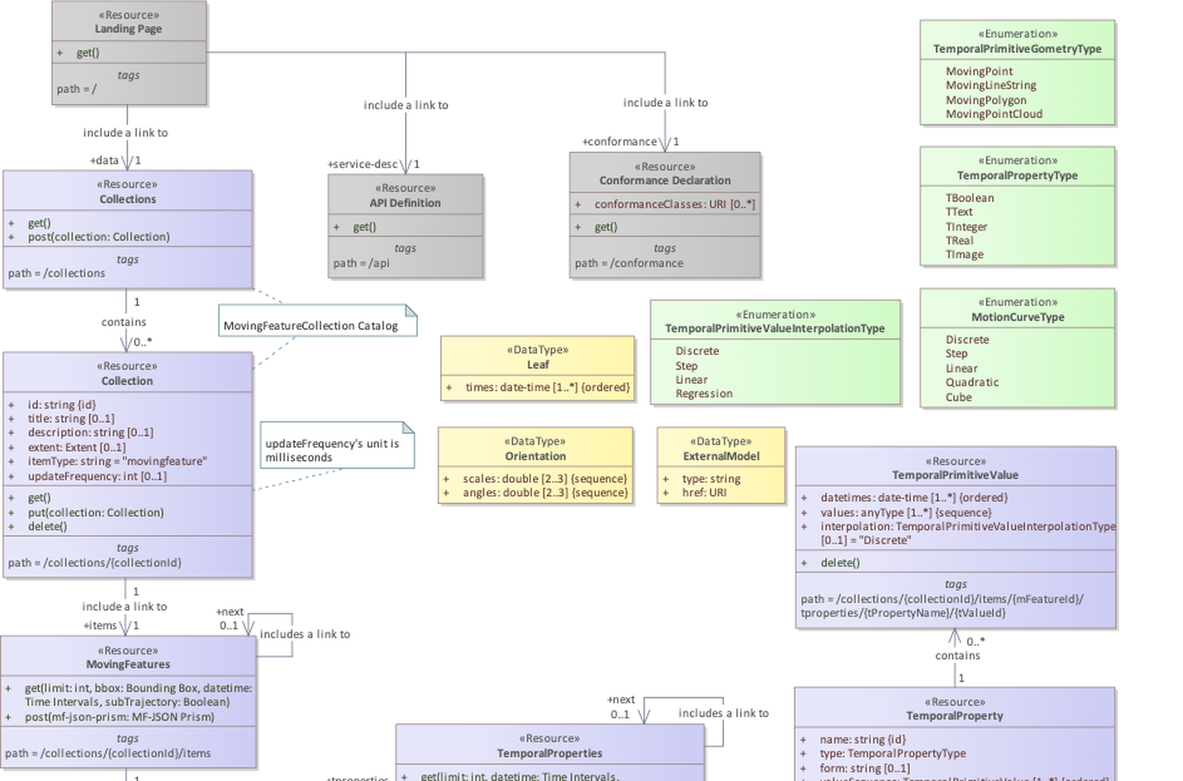
OGC DATA MODEL — DETAIL
upper half · 1 / 2
MobilityAPI · OGC API – Moving Features
4.1
Notes:
Zoomed view of the OGC API – Moving Features class diagram (fig. 1) for presenting class-level detail.

Slide 6
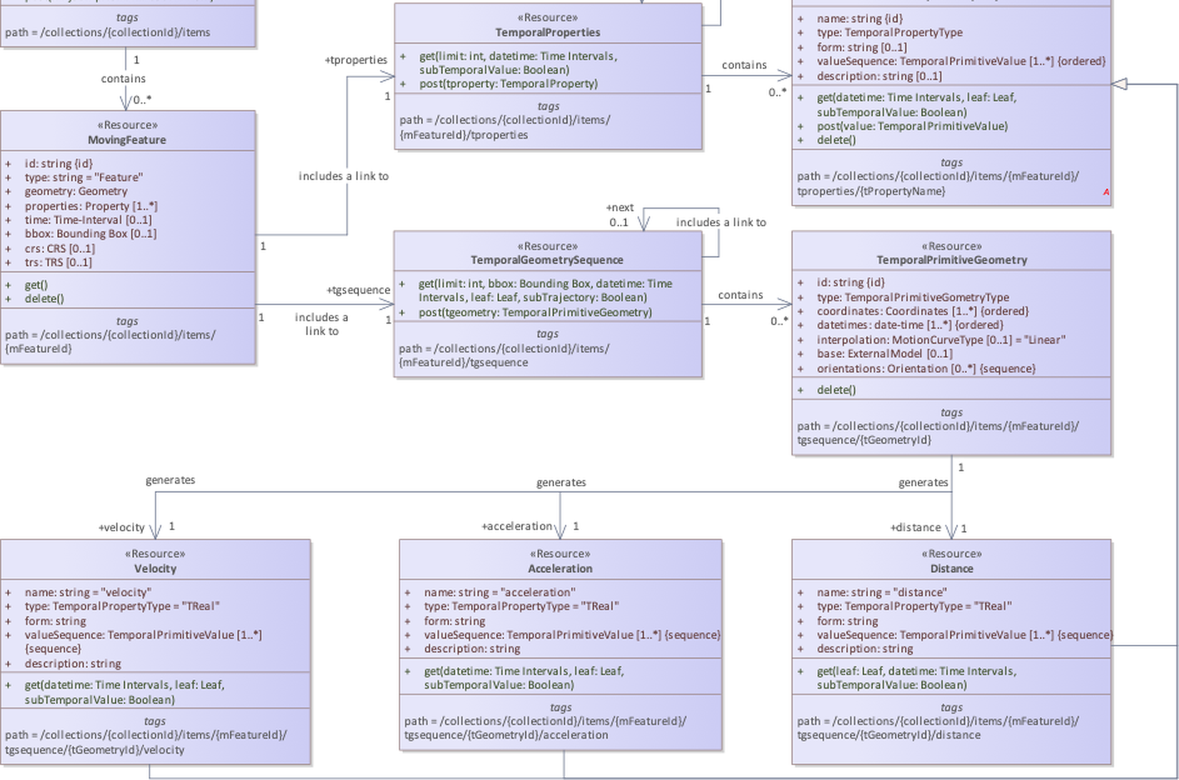
OGC DATA MODEL — DETAIL
lower half · 2 / 2
MobilityAPI · OGC API – Moving Features
4.2
Notes:
Zoomed view of the OGC API – Moving Features class diagram (fig. 1) for presenting class-level detail.

Slide 7
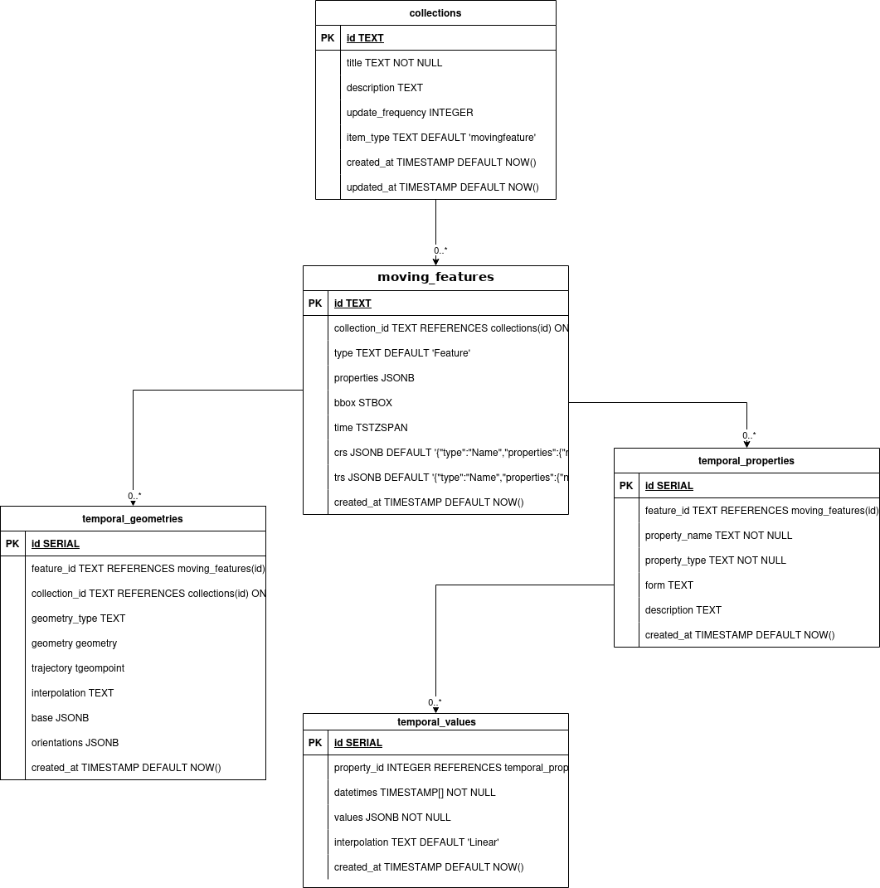
UNDER THE HOOD
How MobilityAPI Persists Moving Features
▸ collections metadata: title, description, itemType, updateFrequency
▸ moving_features one row per feature; bbox is an STBOX, time is a TSTZSPAN
▸ temporal_geometries trajectory stored as a MobilityDB tgeompoint
▸ temporal_properties / temporal_values time-varying attribute streams
Tables created on first POST /collections — STBOX / TSTZSPAN / tgeompoint are native MobilityDB types.
MobilityAPI · OGC API – Moving Features
05

Slide 8
BACKING SCHEMA — DETAIL
The Five PostgreSQL Tables in Full
collections
moving_features
temporal_properties
PK id TEXT
title TEXT
description TEXT
update_frequency INTEGER
item_type TEXT
created_at TIMESTAMP
updated_at TIMESTAMP
PK id TEXT
FK collection_id TEXT
type TEXT
properties JSONB
bbox STBOX
time TSTZSPAN
crs JSONB
trs JSONB
created_at TIMESTAMP
PK id SERIAL
FK feature_id TEXT
property_name TEXT
property_type TEXT
form TEXT
description TEXT
created_at TIMESTAMP
temporal_geometries
LEGEND
PK id SERIAL
FK feature_id TEXT
FK collection_id TEXT
geometry_type TEXT
geometry geometry
trajectory tgeompoint
interpolation TEXT
base JSONB
orientations JSONB
created_at TIMESTAMP
temporal_values
PK primary key FK foreign key
FK columns reference collections /
moving_features / temporal_properties
Highlighted = native MobilityDB / PostGIS:
STBOX · TSTZSPAN · tgeompoint · geometry
PK id SERIAL
FK property_id INTEGER
datetimes TIMESTAMP[]
values JSONB
interpolation TEXT
created_at TIMESTAMP
MobilityAPI · OGC API – Moving Features
5.1
Notes:
Crisp, presentable view of the backing schema for walking the audience through each table and its columns.

Slide 9
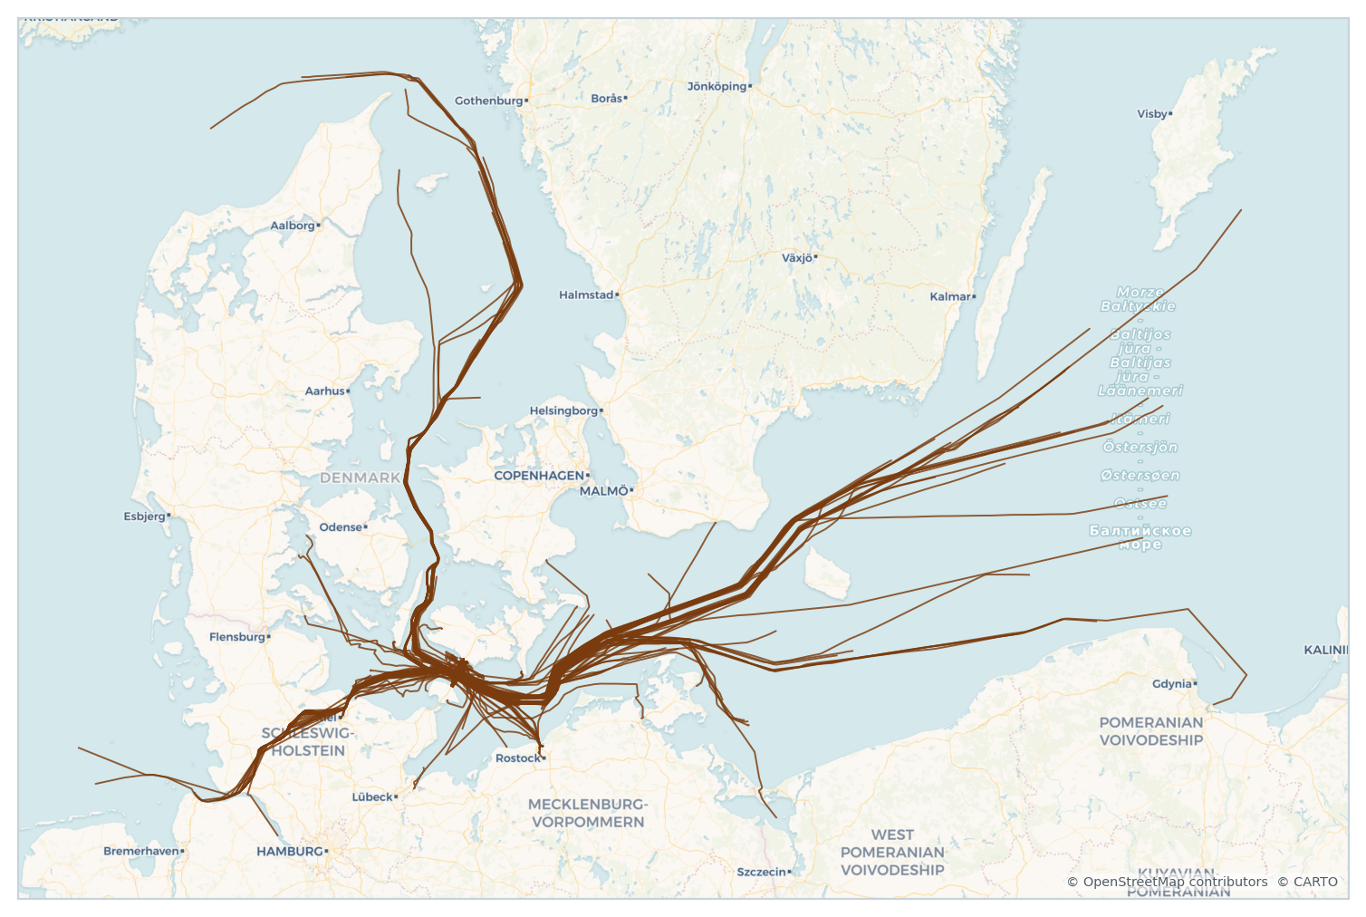
CANONICAL EXAMPLE
One Day of Danish AIS Ship Traffic
▸ Source Danish Maritime Authority AIS feed (aisdata.ais.dk)
▸ Window 2024-08-07 — a single day of observations
▸ 143 vessels each one a MovingPoint trajectory
▸ CRS EPSG:25832 (ETRS89 / UTM 32N, metres)
▸ Temporal properties speed (sog), course (cog) and heading per vessel
143 vessel trajectories across Danish and Baltic waters
MobilityAPI · OGC API – Moving Features
06
Notes:
This is the canonical AIS dataset used across the MobilityDB ecosystem tutorials.

Slide 10
REFERENCE
The Complete Endpoint Surface
COLLECTIONS
DERIVED QUERIES
GET
POST
/collections
GET
…/tgsequence/{tGeometryId}/distance
GET
PUT
DELETE
/collections/{collectionId}
GET
…/{tGeometryId}/velocity · /acceleration
MOVING FEATURES
TEMPORAL PROPERTIES
GET
POST
/collections/{collectionId}/items
GET
POST
…/{mFeatureId}/tproperties
GET
DELETE
…/items/{mFeatureId}
GET
POST
DELETE
…/tproperties/{tPropertyName}
DELETE
…/tproperties/{tPropertyName}/{tValueId}
TEMPORAL GEOMETRY
GET
POST
…/{mFeatureId}/tgsequence
DELETE
…/tgsequence/{tGeometryId}
MobilityAPI · OGC API – Moving Features
07
Notes:
Every implemented endpoint and HTTP method. The following slides demonstrate each group against the AIS dataset.

Slide 11
WALKTHROUGH
Building the Ships Collection
Create → insert → query → derive → delete, end to end over HTTP
Notes:
Section divider: the live demo against the ships collection.

Slide 12
COLLECTIONS
Create a Collection · List Collections
POST
/collections
GET
/collections
{
"title": "ships",
"description": "Ship trajectories from the Danish
Maritime Authority (one day of AIS).",
"itemType": "movingfeature",
"updateFrequency": 1000
}
200 OK
{
"collections": [
{
"id": "ships",
"title": "ships",
"itemType": "movingfeature",
"updateFrequency": 1000,
"links": [ { "rel": "self", ... },
{ "rel": "items", ... } ]
}
],
"links": [ { "rel": "self", ... } ]
}
201 Created
{
"id": "ships", "title": "ships",
"itemType": "movingfeature", "updateFrequency": 1000,
"extent": null,
"links": [
{ "href": ".../collections/ships",
"rel": "self", "type": "application/json" },
{ "href": ".../collections/ships/items",
"rel": "items", "type": "application/json" }
]
}
MobilityAPI · OGC API – Moving Features
09
Notes:
POST /collections registers the collection and returns HATEOAS links. GET /collections lists every registered collection.

Slide 13
COLLECTIONS
Retrieve · Replace · Delete a Collection
GET
/collections/ships
PUT
/collections/ships
200 OK
{
"id": "ships",
"title": "ships",
"description": "Ship trajectories ...",
"itemType": "movingfeature",
"updateFrequency": 1000,
"extent": null,
"links": [ { "rel": "self", ... },
{ "rel": "items", ... } ]
}
Content-Type: application/json
{
"title": "ships",
"description": "Danish AIS — 2024-08-07 (updated)",
"itemType": "movingfeature",
"updateFrequency": 2000
}
200 OK
{ "id": "ships", "updateFrequency": 2000, ... }
DELETE
/collections/ships
▸ PUT replaces the full collection resource
▸ DELETE cascades to items, temporal geometries and properties
200 OK // collection and all its items removed
MobilityAPI · OGC API – Moving Features
10

Slide 14
MOVING FEATURES
Insert Vessels as a FeatureCollection
POST
/collections/ships/items
{
"type": "FeatureCollection",
"features": [
{
"type": "Feature",
"id": "205106000",
"properties": { "Name": "MARCUS", "ShipType": "Cargo",
"IMO": "9313656", "Destination": "PL GDN" },
"crs": { "type": "name",
"properties": { "name": "urn:ogc:def:crs:EPSG::25832" } },
"trs": { "type": "Link",
"properties": { "type": "ogcdef",
"href": ".../def/uom/ISO-8601/0/Gregorian" } },
"temporalGeometry": {
"type": "MovingPoint",
"datetimes": ["2024-08-07T11:04:09+00", ...],
"coordinates": [[521540.85, 5995709.13], ...],
"interpolation": "Linear"
}
}
]
}
201 Created
{
"message": "Created 1 features",
"ids": ["205106000"]
}
▸ Accepts a single Feature or a FeatureCollection
▸ MovingFeaturesJSON payload is validated on insert
▸ id is the vessel MMSI; properties are free-form
▸ Location header returned per created feature
MobilityAPI · OGC API – Moving Features
11
Notes:
POST items ingests one or many MovingPoint features. The notebook streams the AIS file in small batches.

Slide 15
MOVING FEATURES
List · Retrieve · Delete Vessels
GET
/collections/ships/items?limit=50
200 OK
{ "type": "FeatureCollection",
"features": [
{ "type": "Feature", "id": "205106000",
"geometry": { "type": "LineString", "coordinates": [...] },
"properties": { "Name": "MARCUS", "ShipType": "Cargo" },
"bbox": [521540.8, 5995709.1, 569588.8, 6024716.7],
"crs": { ... }, "trs": null,
"time": ["2024-08-07 11:04:09+00", "2024-08-07 16:43:09+00"],
"links": [
{ "rel": "self", ... },
{ "rel": ".../temporal-geometry", ... },
{ "rel": ".../temporal-properties", ... } ] }
] }
GET
…/items/{mFeatureId}
DELETE
…/items/{mFeatureId}
single feature movement (asMFJSON) · remove one vessel
GET …/items returns the FeatureCollection (limit caps page size)
MobilityAPI · OGC API – Moving Features
12

Slide 16
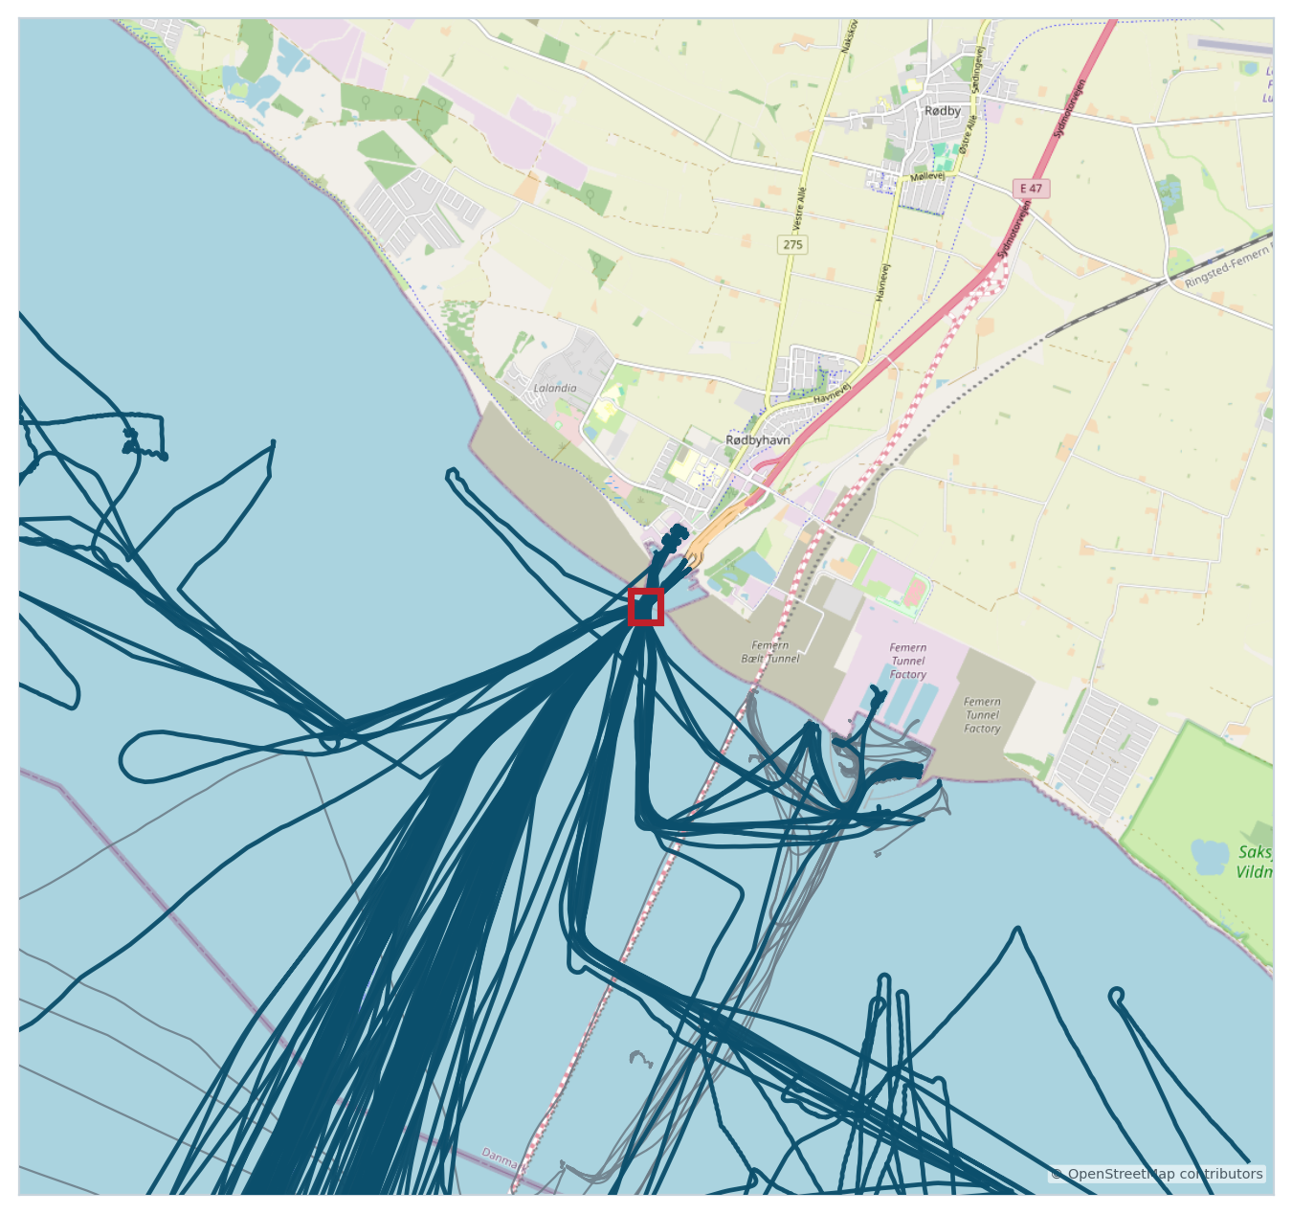
SPATIAL FILTER
Vessels Intersecting a Bounding Box
GET
/collections/ships/items?bbox=…
GET /collections/ships/items
?bbox=651135,6058230,651422,6058548
&limit=97
// bbox = minx,miny,maxx,maxy in the storage CRS
// EPSG:25832 (metres) — here a tight envelope
// around Rødby ferry harbour, SE Denmark
▸ bbox keeps vessels whose trajectory intersects the envelope
▸ CRS coordinates are in the collection's storage CRS (EPSG:25832)
▸ 21 of 143 vessels match the Rødby harbour envelope
▸ Composable with limit, datetime and subTrajectory
Trajectories crossing the Rødby harbour envelope (teal); context in grey
MobilityAPI · OGC API – Moving Features
13
Notes:
The bbox query is a spatial pre-filter executed by MobilityDB's STBOX index.

Slide 17
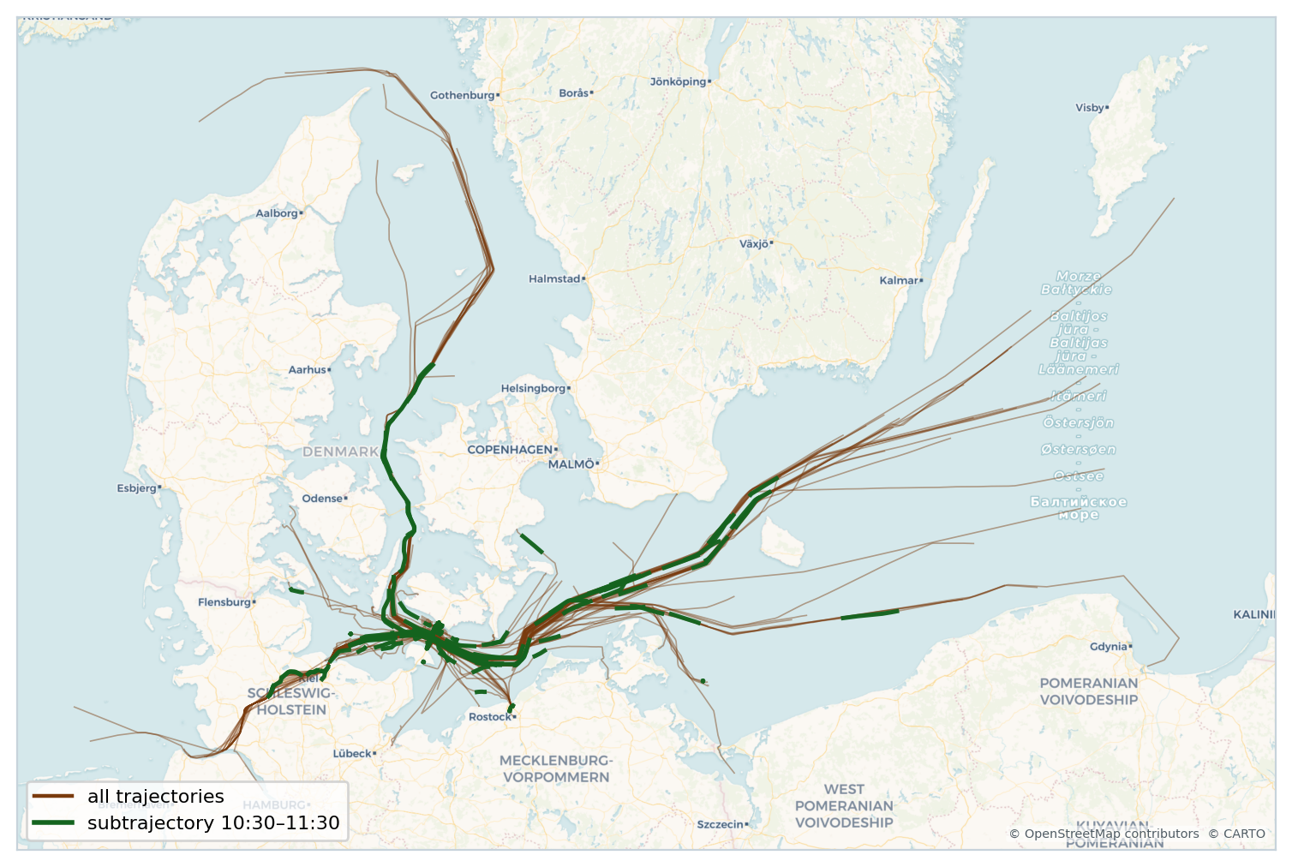
TEMPORAL SLICE
Restrict Trajectories to a Time Interval
GET
…/items?subTrajectory=true
GET /collections/ships/items
?subTrajectory=true
&datetime=2024-08-07T10:30:00+00
/2024-08-07T11:30:00+00
// datetime is an RFC 3339 interval (start/end)
// subTrajectory=true clips each vessel to the
// requested window instead of filtering whole trips
▸ subTrajectory clips each trajectory to the datetime interval
▸ datetime RFC 3339 interval; a bare instant is also accepted
▸ Validation subTrajectory requires a bounded interval; cannot combine with leaf
Subtrajectories 10:30–11:30 (green) over all trajectories (brown)
MobilityAPI · OGC API – Moving Features
14

Slide 18
TEMPORAL GEOMETRY
The Temporal-Geometry Sequence
GET
…/{mFeatureId}/tgsequence
Methods on this resource
200 OK
{
"type": "TemporalGeometrySequence",
"geometrySequence": [
{ "id": 360,
"type": "MovingPoint",
"datetimes": ["2024-08-07T11:04:09+00", ...],
"coordinates": [[521540.85, 5995709.13], ...],
"interpolation": "Linear",
"base": null }
],
"links": [ { "rel": "self", ... } ],
"numberMatched": 1, "numberReturned": 1
}
GET
return the TemporalGeometrySequence for a vessel
POST
append a temporal primitive geometry
DELETE
remove one primitive geometry by tGeometryId
▸ Each sequence element carries an id used by the derived-measure queries
▸ DELETE targets …/tgsequence/{tGeometryId} — the TemporalPrimitiveGeometry instance
MobilityAPI · OGC API – Moving Features
15

Slide 19
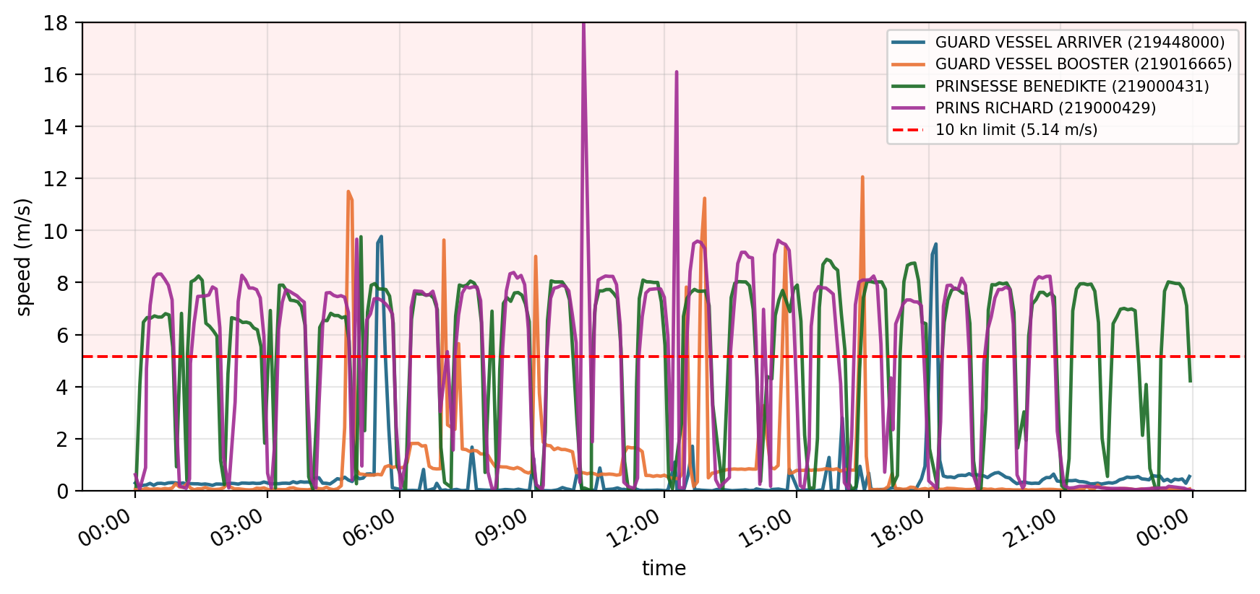
DERIVED MEASURES
Distance · Velocity · Acceleration
GET
…/tgsequence/{tGeometryId}/velocity
200 OK
{
"type": "TReal",
"values": [
{ "time": "2024-08-07T06:00:00+00", "value": 0.79 },
{ "time": "2024-08-07T06:25:00+00", "value": 6.14 },
{ "time": "2024-08-07T06:50:00+00", "value": 0.00 }
],
"unit": "m/s",
"queryType": "velocity",
"links": [ { "rel": "self", ... } ]
}
distance
velocity
acceleration
Velocity profiles of Rødby ferries vs a 10-knot (5.14 m/s) limit
interchangeable queryType values — computed by MobilityDB (e.g. speed()).
MobilityAPI · OGC API – Moving Features
16
Notes:
distance/velocity/acceleration are the three derived-measure queryTypes over a temporal primitive geometry; the response is a temporal real (TReal).

Slide 20
TEMPORAL PROPERTIES
Time-Varying Attributes per Feature
GET
…/{mFeatureId}/tproperties
Methods on this group
200 OK
{
"temporalProperties": [
{ "name": "sog", "type": "TReal" },
{ "name": "cog", "type": "TReal" },
{ "name": "heading", "type": "TReal" }
],
"links": [ { "rel": "self", ... } ]
}
GET
POST
/tproperties
list properties · add a new one
GET
POST
/tproperties/{name}
read · append values to one property
DELETE
/tproperties/{name}
drop a whole property
DELETE
/tproperties/{name}/{tValueId}
GET
…/tproperties/sog
drop one primitive value
{ "name": "sog", "type": "TReal",
"valueSequence": [
{ "datetimes": ["2024-08-07T11:04:09+00", ...],
"values": [12.4, 11.8, 0.6, ...] } ] }
Property types: TBoolean · TText · TInteger · TReal · TImage
AIS speed (sog), course (cog) and heading ride along as TReal property streams.
MobilityAPI · OGC API – Moving Features
17
Notes:
The entire temporal-properties group (GET/POST/DELETE at three levels) — omitted from the tutorial notebook — is implemented.

Slide 21
CONFORMANCE
Validation, Errors & Hypermedia Links
MovingFeaturesJSON validation
OGC error responses
Hypermedia (HATEOAS)
▸ Payload validated on every insert
▸ Mandatory fields and types checked before persisting
▸ Property type restricted to TBoolean / TText / TInteger / TReal / TImage
▸ subTrajectory + leaf combinations rejected
▸ 400 invalid JSON or parameters
▸ 404 collection / feature / geometry not found
▸ 409 resource already exists
▸ 500 internal server error
▸ Body: { "code", "description" }
▸ Every resource carries links
▸ rel: self, items,
▸ …/rel/ogc/1.0/temporal-geometry,
▸ …/rel/ogc/1.0/temporal-properties
▸ Clients navigate without hard-coding paths
MobilityAPI · OGC API – Moving Features
18

Slide 22
CONTEXT
Where MobilityAPI Fits in the MEOS Ecosystem
MobilityAPI
the HTTP / OGC API – Moving Features layer
▼ consumes PyMEOS
MobilityDB
MobilityDuck
Language bindings
PostgreSQL / PostGIS extension
DuckDB extension
PyMEOS · JMEOS · meos-rs
GoMEOS · MEOS.NET · MEOS.js
▼ all bind to MEOS
MEOS
canonical C library — type system + computations
MobilityAPI · OGC API – Moving Features
19
Notes:
MobilityAPI is the HTTP/OGC layer; MobilityDB and MobilityDuck are peer SQL layers; all sit on the shared MEOS C core.

Slide 23
TWO TIERS, ONE DATABASE
Two Ways to Serve the Same MobilityDB
PyMEOS tier
Go tier
JSON to type glue in Python; the database does the work
thin net/http + pgxpool; no MEOS in the tier (no cgo, no PyMEOS)
HTTP client
HTTP client
browser · mobile · ETL
browser · mobile · ETL
▼
▼
Python (PyMEOS)
Go (net/http + pgxpool)
JSON to temporal-type conversion
asMFJSON reads · tgeompointFromMFJSON writes
▼
▼
MobilityDB (C)
MobilityDB (C)
tgeompoint · STBOX · TSTZSPAN
tgeompoint · STBOX · TSTZSPAN
Both tiers keep every temporal computation in C (the database); only the HTTP / runtime tier differs. The Go tier holds no MEOS: reads stream asMFJSON assembled in SQL, writes call tgeompointFromMFJSON, and a roughly 50-line crs / interpolation adapter is the only application logic, shipped as a single static binary.
MobilityAPI · OGC API – Moving Features
20
Notes:
The architecture choice: PyMEOS Python tier vs a thin compiled Go tier. Both run identical SQL against the same MobilityDB; the database does all temporal work and (de)serialization. The Go tier carries no MEOS in-process.

Slide 24
SCALABILITY
Concurrency Ceiling: Same Database, Same SQL
Endpoint
Concurrency
Go req/s
Python req/s
▸ 47 to 64x faster on Go for tier-bound endpoints (/health, /collections), where the cost is per-request runtime overhead the compiled, no-GIL, goroutine-per-request model absorbs
▸ Heavy asMFJSON raw throughput converges on the database (pool x asMFJSON); the Python tier sheds load under concurrency while Go serves every request at the DB-bound ceiling
▸ Shared bottleneck the database is the limit for heavy serialization; the tier decides front-end behaviour under load
/health (pure tier)
200
85,950
1,337
/collections (light DB)
200
30,709
649
one trajectory
100
2,434
547
ten full trajectories (asMFJSON)
50
90 (100% served)
sheds ~half the load
Same MobilityDB (500 AIS vessel trajectories), identical SQL; the only variable is the HTTP / runtime tier. Load: hey, warm cache, localhost.
MobilityAPI · OGC API – Moving Features
21
Notes:
Measured throughput and reliability. Tier-bound endpoints run 47 to 64x faster on Go. On the heavy asMFJSON endpoint, raw throughput converges on the database, but the Python tier sheds roughly half the load at concurrency 50 while Go completes 100 percent. The database is the shared bottleneck; the tier decides front-end behaviour under load.

Slide 25
SCALE AND LAKEHOUSE
Built for Very Large Databases
▸ Streaming responses the FeatureCollection is written row by row from a server-side cursor, so memory is bounded for any result size
▸ Keyset pagination next links advance by id with no OFFSET, so paging stays constant cost through arbitrarily large collections
▸ Index-using filters bbox and datetime push to the MobilityDB GiST index via the overlap operator; subTrajectory clips with atTime
▸ Lakehouse feed a streaming NDJSON export that DuckDB, MobilityDuck, and Spark ingest directly, then convert to Parquet or Arrow in the lake
393 MB
streamed in one export
18 MB
resident memory, bounded by the stream and not the result size
Every temporal computation stays in MobilityDB (C); the Go tier is a single static binary that holds no MEOS. A step toward the Data Lake House architecture in the MobilityDB ecosystem.
MobilityAPI · OGC API – Moving Features
22
Notes:
Built for very large databases: streaming responses keep memory bounded (a 393 MB export held about 18 MB resident), keyset pagination pages through arbitrarily large collections, bbox and datetime filters use the MobilityDB index, and a streaming NDJSON export feeds the lakehouse (DuckDB, MobilityDuck, Spark, then Parquet or Arrow). All temporal work stays in the database.

Slide 26
GUIDANCE
When to Use Which Tier
PyMEOS / Python tier
Thin compiled tier (Go)
▸ Fine for moderate load and the fastest path to build
▸ PyMEOS in process is the JSON to temporal-type glue; MobilityDB does the computation
▸ Front-end ceiling is set by the Python runtime model under high concurrency
▸ Scalable choice under high concurrency: a thin Go tier over MobilityDB SQL
▸ Fat DB, thin API in the pg_featureserv / PostgREST tradition: the database holds the logic, the tier just serves
▸ Single static binary no cgo, no MEOS in the tier; reads use asMFJSON, writes use tgeompointFromMFJSON
The comparison used a controlled threaded-Python baseline. A FastAPI / uvicorn or multi-worker deployment would raise the Python ceiling, but the structural advantage of the compiled, no-GIL tier on light endpoints holds.
MobilityAPI · OGC API – Moving Features
23
Notes:
Honest guidance. The Python tier is fine for moderate load and fastest to build; a thin compiled tier is the scalable choice under high concurrency, in the fat-DB / thin-API tradition. The baseline was a controlled threaded-Python server; a FastAPI/uvicorn or multi-worker deployment would raise the Python ceiling, but the structural advantage on light endpoints holds.

Slide 27
RECAP
Everything MobilityAPI Implements
COLLECTIONS
MOVING FEATURES
QUERYING
✓ create (POST)
✓ list (GET)
✓ retrieve (GET)
✓ replace (PUT)
✓ delete (DELETE)
✓ insert Feature / FeatureCollection
✓ list + paginate (limit)
✓ retrieve single
✓ delete
✓ MovingFeaturesJSON validation
✓ bbox spatial filter
✓ datetime instant / interval
✓ subTrajectory clipping
✓ leaf parameter
TEMPORAL GEOMETRY
DERIVED MEASURES
TEMPORAL PROPERTIES
✓ get sequence (GET)
✓ append primitive (POST)
✓ delete primitive (DELETE)
✓ distance
✓ velocity
✓ acceleration
✓ → TReal series
✓ list / add
✓ read / append values
✓ delete property
✓ delete one value
MobilityAPI · OGC API – Moving Features
24

Slide 28
Thanks for Listening
Questions?

Slide 29
REFERENCES
Find Out More
OGC API – Moving Features – Part 1: Core
https://docs.ogc.org/is/22-003r3/22-003r3.html
MobilityAPI source
https://github.com/MobilityDB/MobilityAPI
MobilityDB
https://github.com/MobilityDB/MobilityDB · https://mobilitydb.com
PyMEOS (temporal-data layer)
https://github.com/MobilityDB/PyMEOS
MEOS / ecosystem overview
https://libmeos.org
AIS data — Danish Maritime Authority
http://aisdata.ais.dk
MobilityAPI · OGC API – Moving Features
26

