Slide 1
Dictionary
Road to pythonist

Slide 2
Dictionary
Dictionary is another data structure. Dictionary is different than other data structures. Python’s dictionary allows you to connect pieces of related information and after in a dictionary, how to modify information. Because dictionaries can store almost limitless data.

Slide 3
Working in Dictionary
A Dictionary is a collection of KVP (Key-Value Pairs). Each key is connected to a value and you can use a key to access the value associated with that key. A key’s value can be a number, a string, a list or even another Dictionary.
You can use any object that you can create in python as a value in a dictionary.
A dictionary is wrapped up in braces ‘{ }’ with a series of KVP inside the braces.
A KVP is a set of values associated with each other. When you provide a key, Python returns the value associated with the key. Every key is connected to its value by a colon ( : ) and separated by comma.

Slide 4
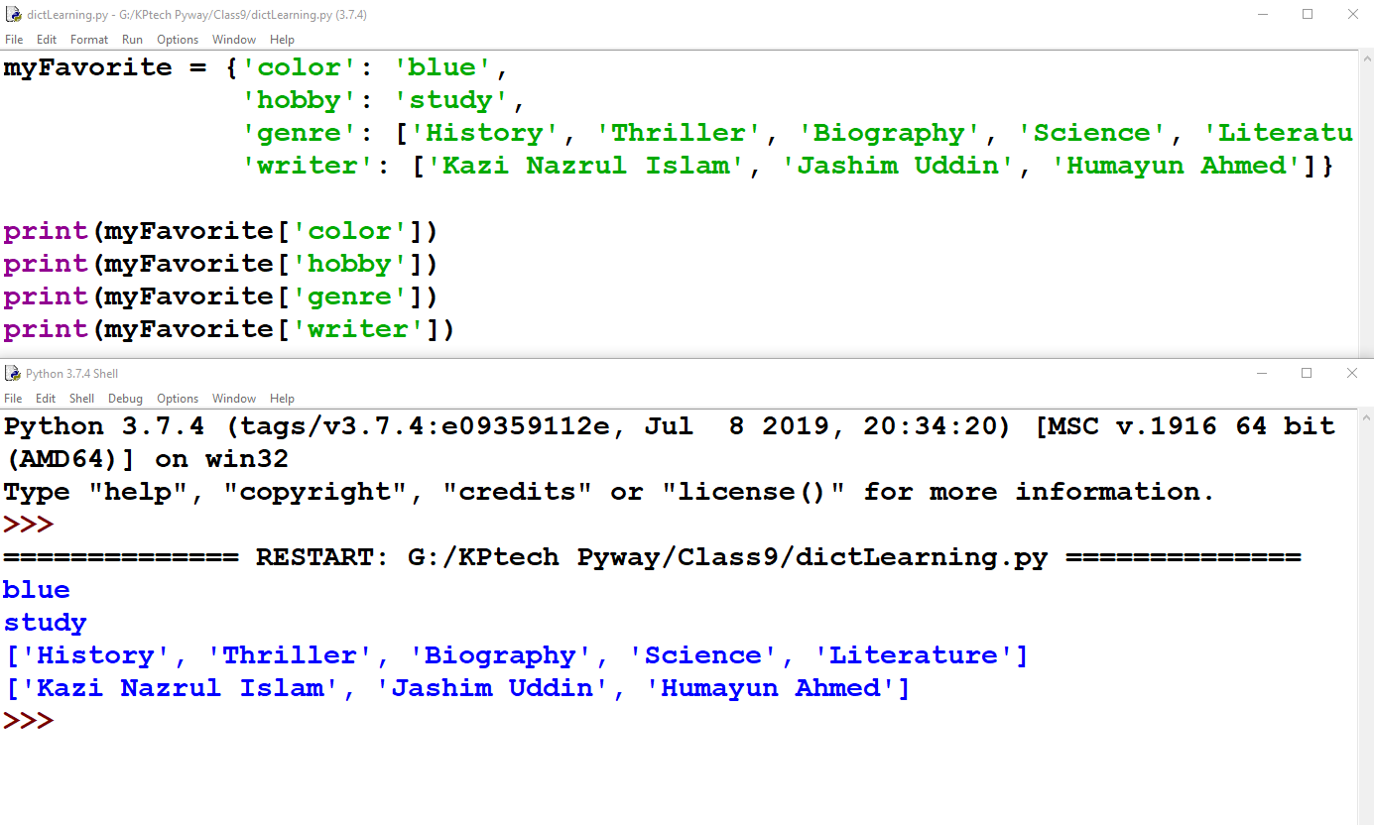
Example

Slide 5
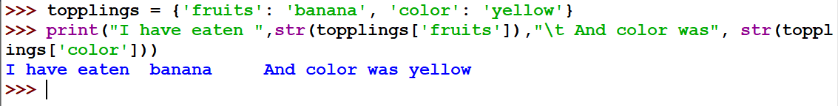
Accessing Value in Dictionary
To get access in a value associated with a key, write the name of the dictionary and then place the key inside a set of square brackets.

Slide 6
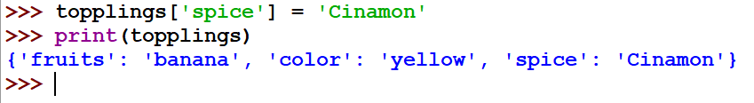
Adding new KVP
Dictionary is a dynamic data structure where you can add new KVP to a dictionary at any time.
To add a new KVP, just follow this dictionary_name[‘Key name’]= value

Slide 7
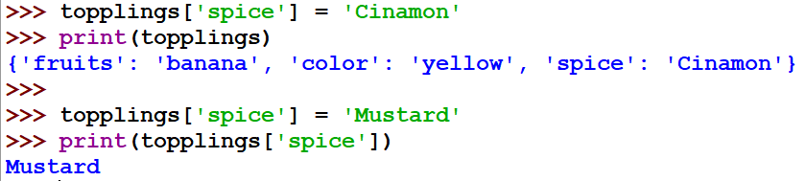
Modifying values
To modify a value in dictionary, use the key name and then follow the step like you did in previous.

Slide 8
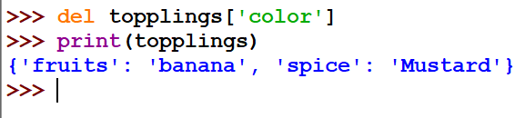
Remove KVP
When you no longer need an information from dictionary, you can use ‘del’ keyword to remove a KVP. ‘del’ needs the dictionary_name[‘key name’]

Slide 9
Looping through Dictionary
To explore entire dictionary Keys and Values, we need to use looping through the dictionary. There are several techniques of looping through dictionary.
➔ Looping through All KVP
➔ Looping through All Keys
➔ Looping through All Values
➔ Looping through Keys in Order

Slide 10
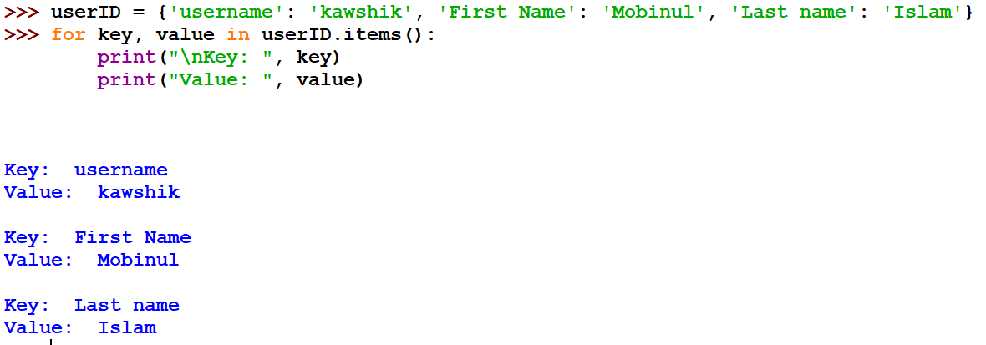
Looping through All KVP
To see all the information about a dictionary, create names for two variables that will hold the key and value in each KVP. In loop, includes the dictionary name with the method ‘item( )’ which will return the list of all KVP.

Slide 11
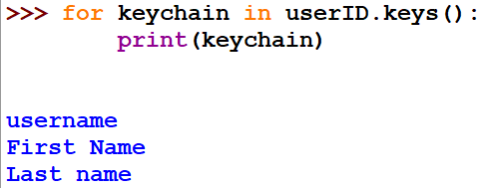
Looping through All Keys
The method ‘keys( )’ will show only the keys of the dictionary.

Slide 12
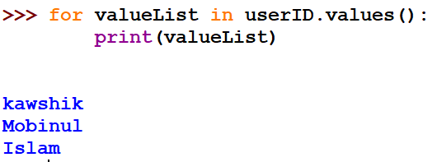
Looping through All Values
Similar of previous except a method ‘values( )’ uses to see the list of all values of keys of dictionary.

Slide 13
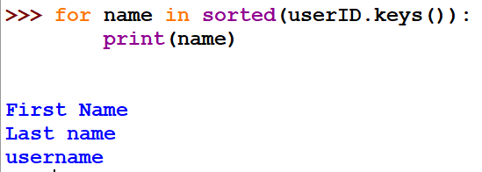
Looping through Keys in Order
A dictionary always maintain a clear connection between Key-Value, but not in predictable order. That’s why if you want to see the values in a ordered list, use ‘sorted( )’ method before dictionary name.

Slide 14
