Slide 1
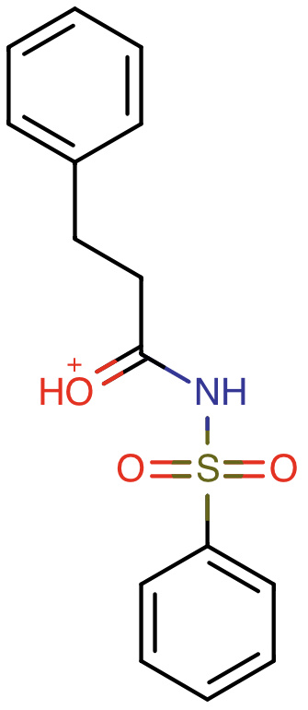
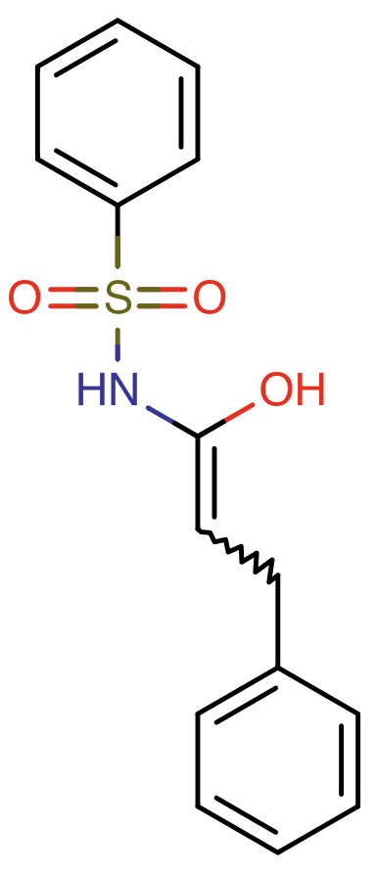
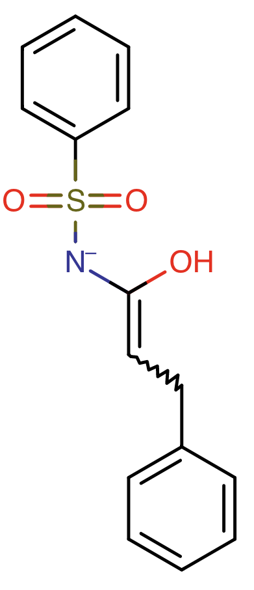
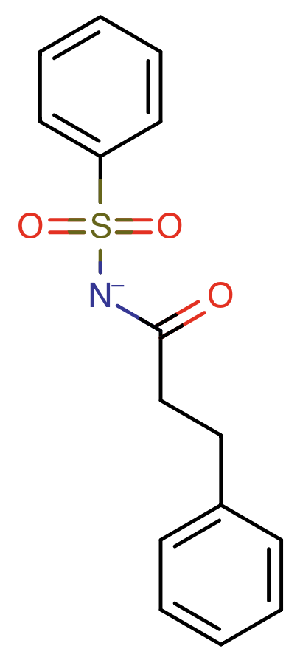
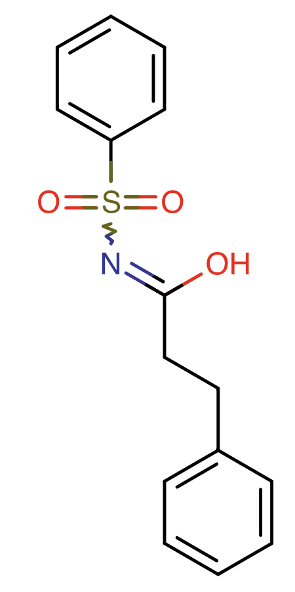
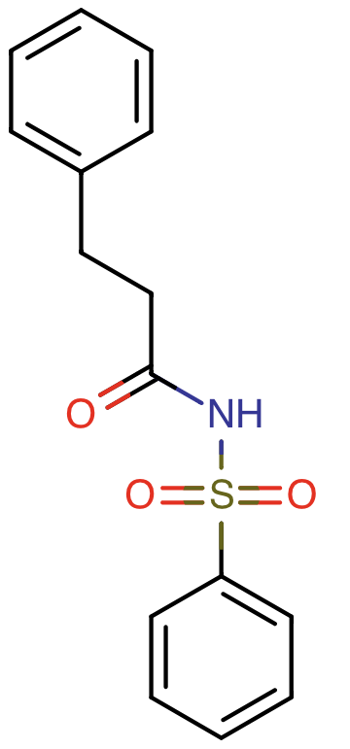
F
(+1)
B
(0)
A
(-1 )
SM25
SM25_micro005
SM25_micro000
SM25_micro003
pKa_{FB}
pKa_{BA}
pKa_{FD}
pKa_{BC}
D
(0)
C
(-1 )
SM25_micro002
pKa_{DA}
SM25_micro001
pKa_{FE}
pKa_{DC}
E
(0)
pKa_{EA}
SM25_micro004
pKa_{EC}

Slide 2
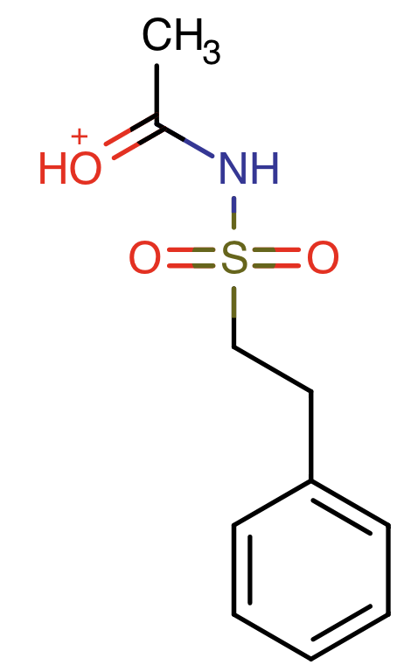
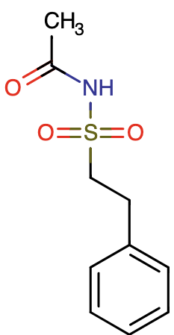
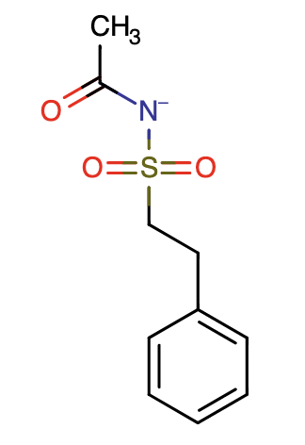
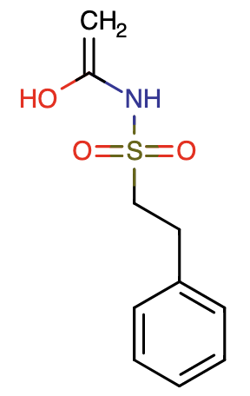
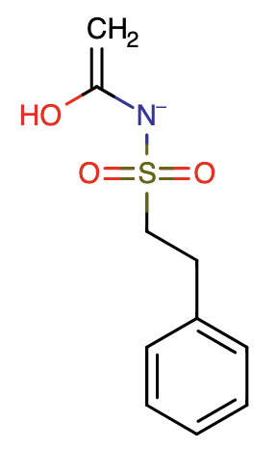
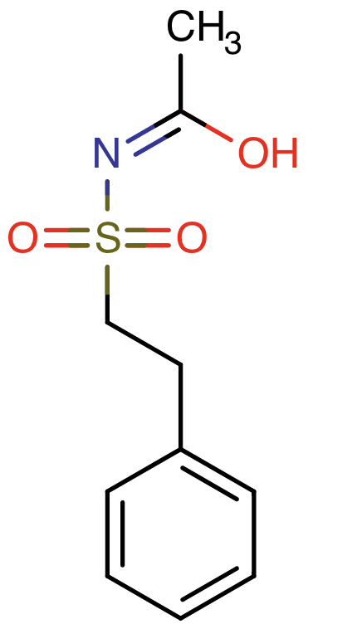
SM26
F
(+1)
B
(0)
A
(-1 )
SM26_micro005
SM26_micro000
SM26_micro001
pKa_{FB}
pKa_{BA}
pKa_{BC}
pKa_{FD}
D
C
(0)
pKa_{DA}
(-1 )
SM26_micro002
SM26_micro003
pKa_{FE}
pKa_{DC}
E
(0)
pKa_{EA}
SM26_micro004
pKa_{EC}

Slide 3
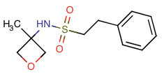
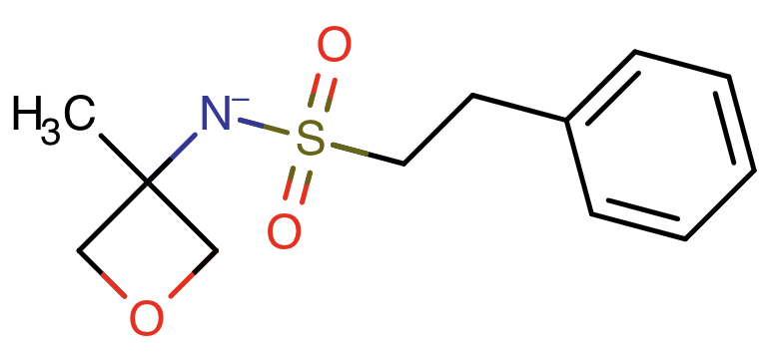
SM27
B
(0)
A
(-1 )
SM27_micro000
SM27_micro001
pKa_{BA}

Slide 4
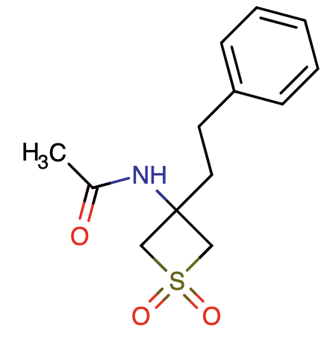
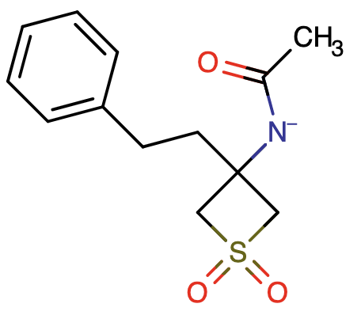
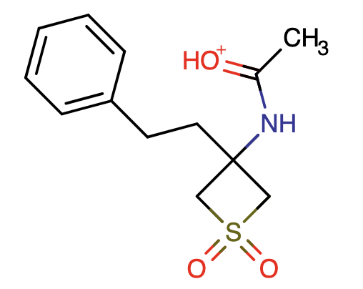
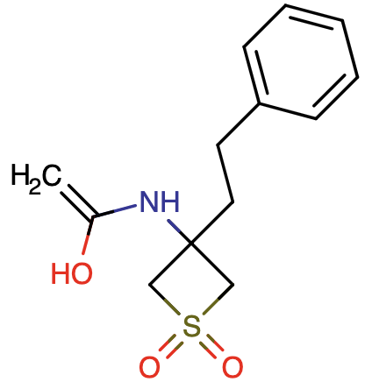
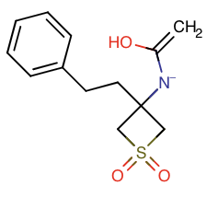
SM28
B
A
(-1)
(0)
SM28_micro000
pKa_{BA}
SM28_micro002
C
(+1)
pKa_{CB}
SM28_micro003
pKa_{BE}
E
(-1)
D
(0)
pKa_{DA}
SM28_micro004
SM28_micro001
pKa_{CD}
pKa_{DE}

Slide 5
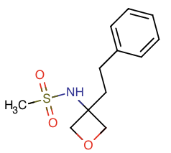
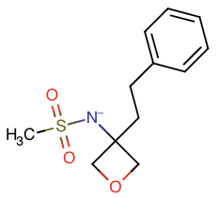
SM29
B
(0)
A
(-1 )
SM29_micro000
SM29_micro001
pKa_{BA}

Slide 6
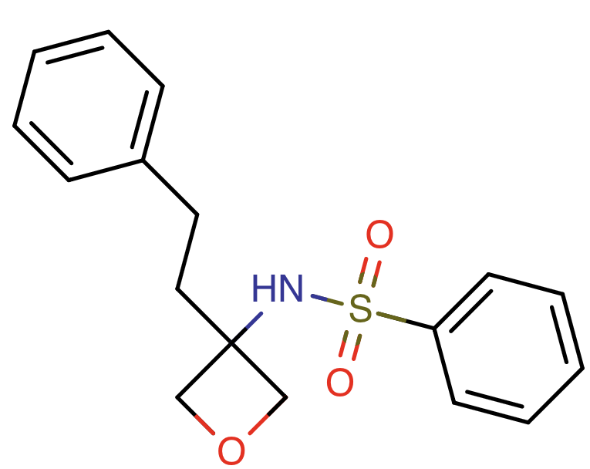
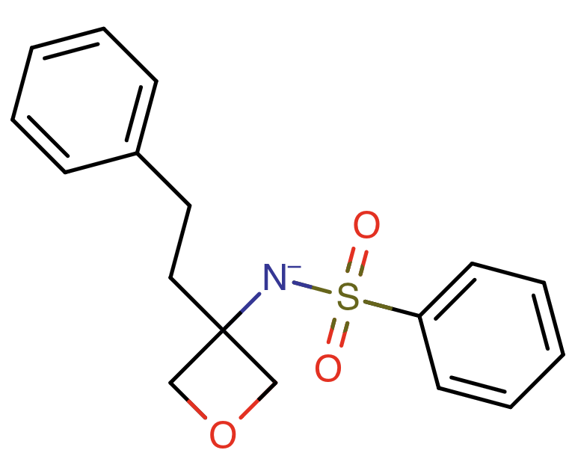
SM30
B
(0)
A
(-1 )
SM30_micro000
SM30_micro001
pKa_{BA}

Slide 7
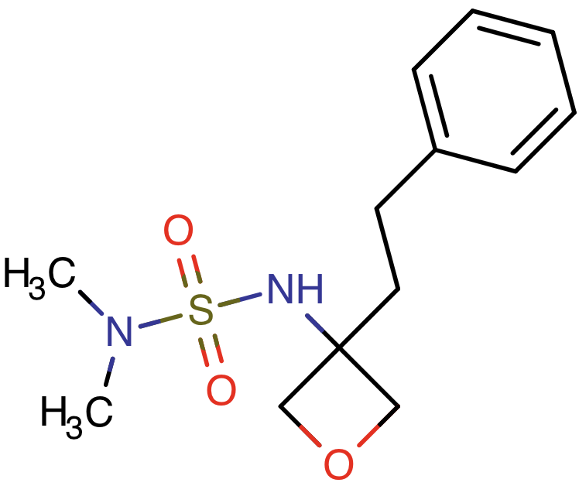

SM31
B
(0)
A
(-1 )
SM31_micro000
SM31_micro001
pKa_{BA}

Slide 8
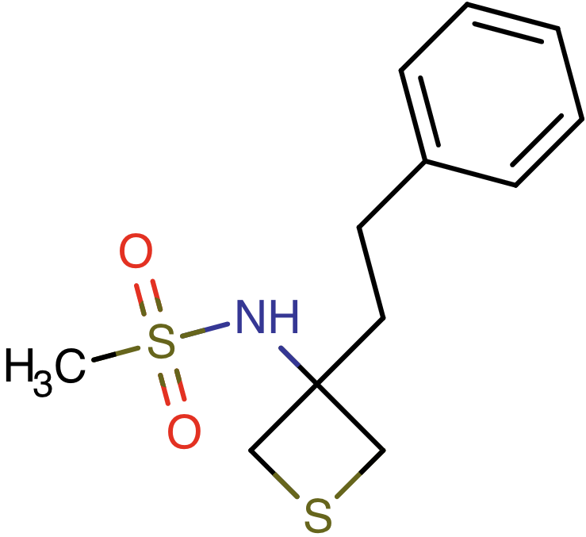
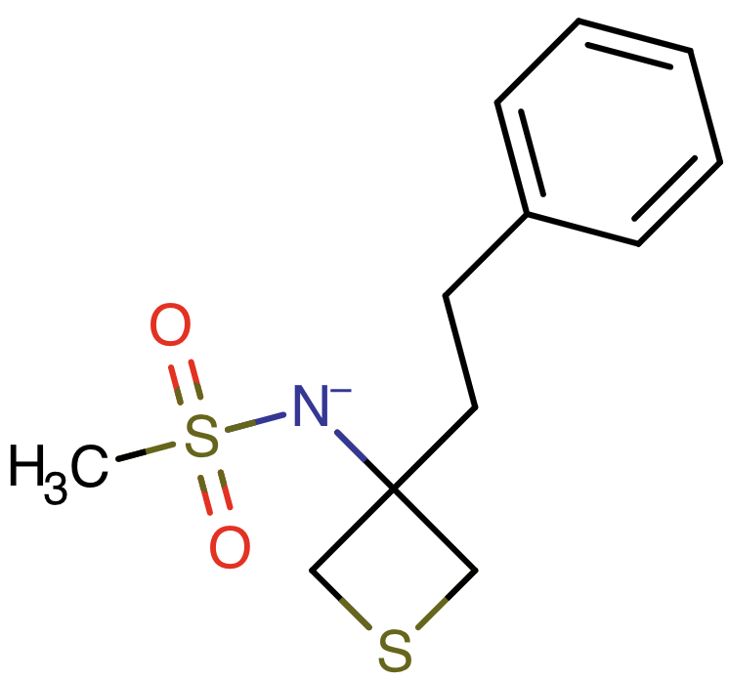
SM32
B
(0)
A
(-1 )
SM32_micro000
SM32_micro001
pKa_{BA}

Slide 9
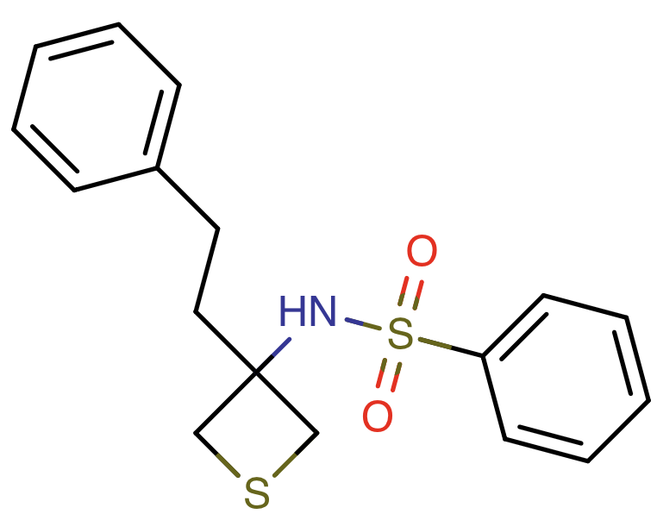
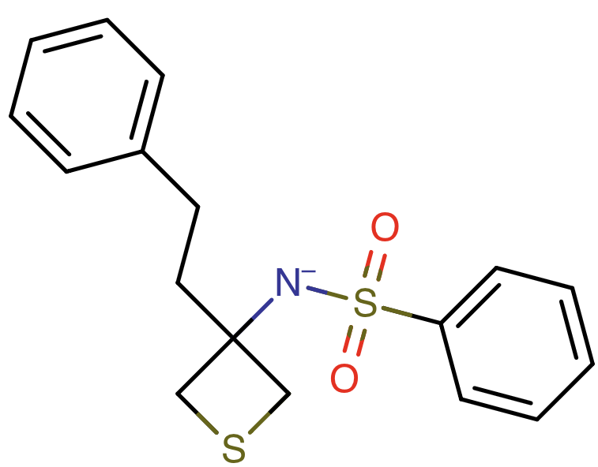
SM33
B
(0)
A
(-1 )
SM33_micro000
SM33_micro001
pKa_{BA}

Slide 10
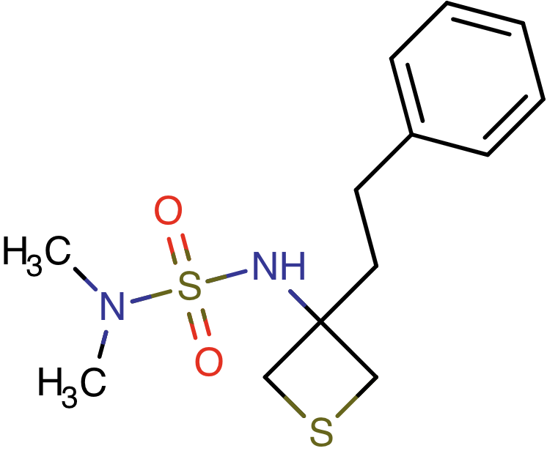
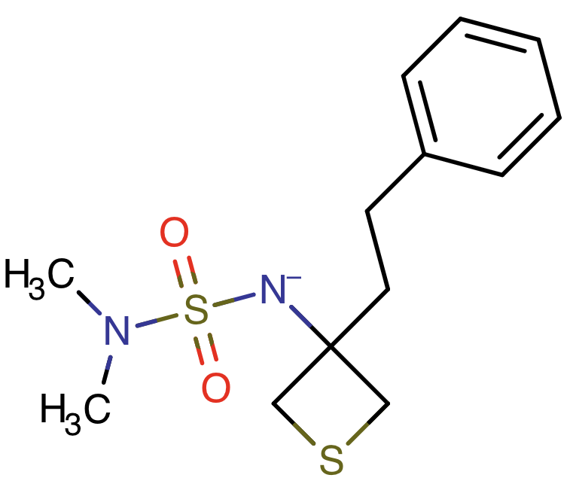
SM34
B
(0)
A
(-1 )
SM34_micro000
SM34_micro001
pKa_{BA}

Slide 11
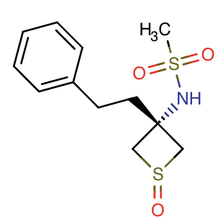
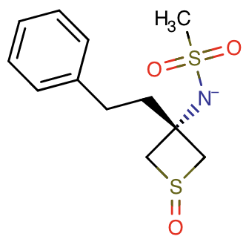
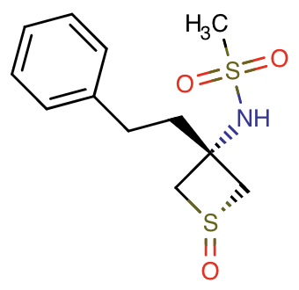
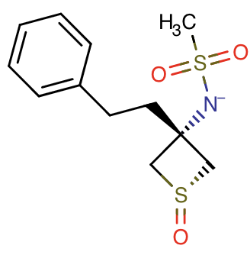
SM35
B
(0)
A
(-1)
SM35_micro000
SM35_micro001
pKa_{BA}
pKa_{BC}
pKa_{DA}
D
(0)
C
(-1)
SM35_micro002
SM35_micro003
pKa_{DC}

Slide 12
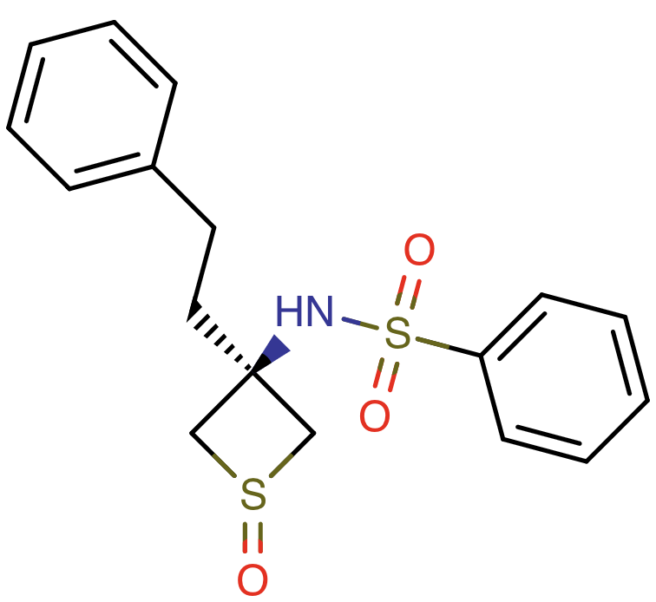
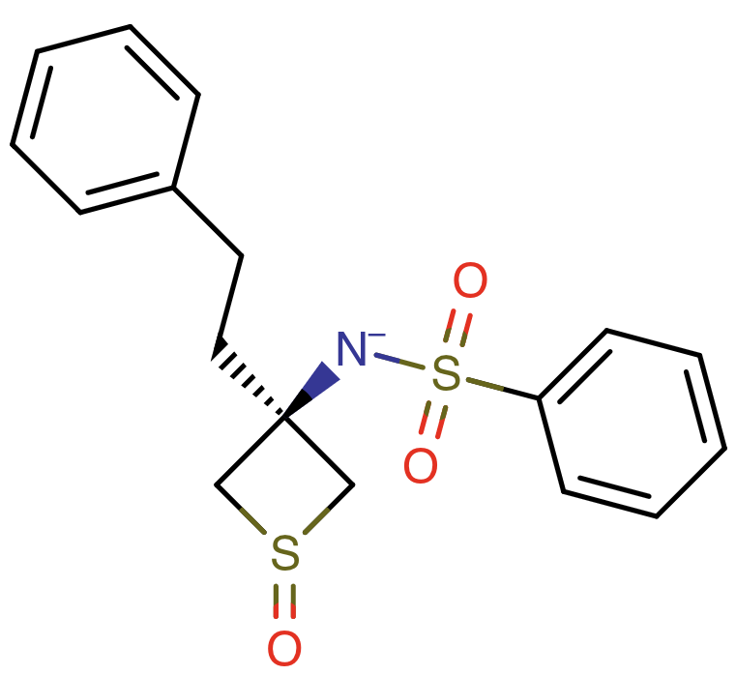
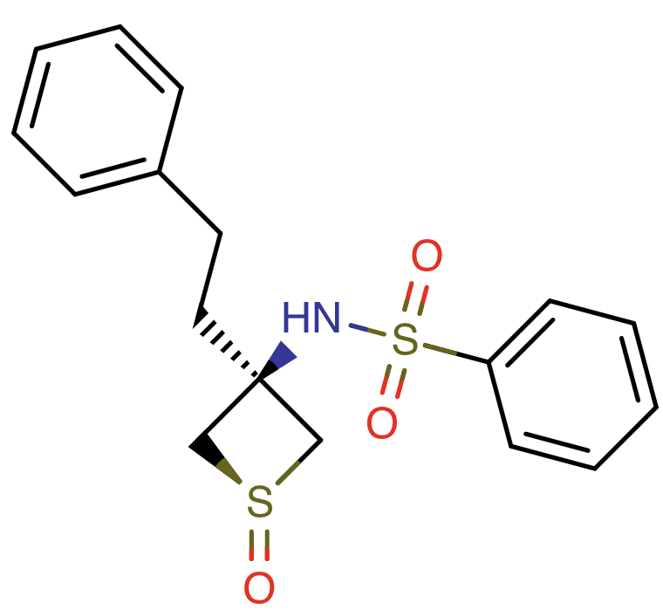

SM36
B
(0)
A
(-1 )
SM36_micro000
SM36_micro001
pKa_{BA}
pKa_{BC}
pKa_{DA}
D
(0)
C
(-1 )
SM36_micro002
SM36_micro003
pKa_{DC}

Slide 13
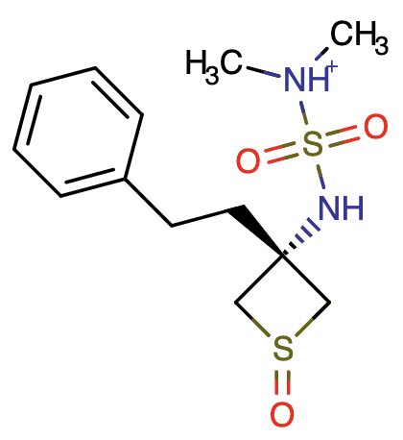
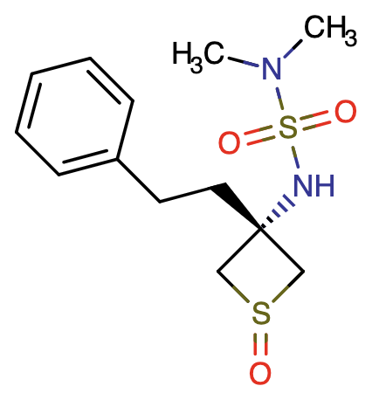
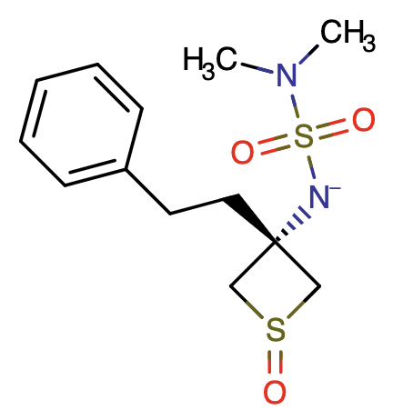

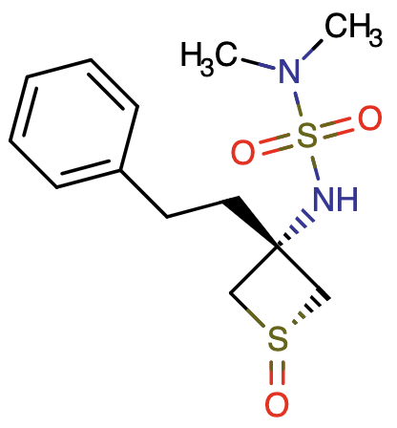
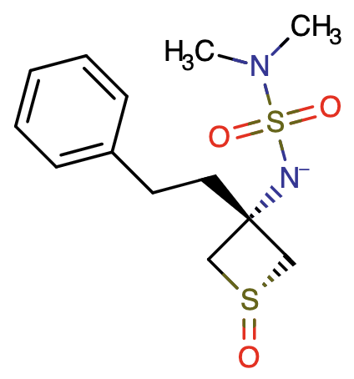
SM37
C
pKa_{CB}
B
pKa_{BA}
A
(0)
(+1)
pKa_{CD}
pKa_{BF}
(-1)
SM37_micro000
SM37_micro002
SM37_micro001
pKa_{EB}
pKa_{DA}
E
D
F
pKa_{ED}
pKa_{DF}
(+1)
(0)
(-1)
SM37_micro005
SM37_micro003
SM37_micro004

Slide 14
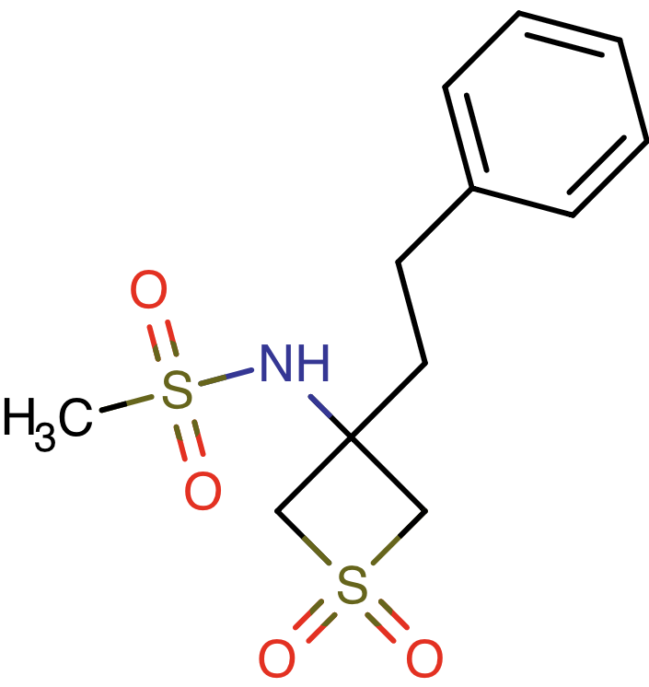
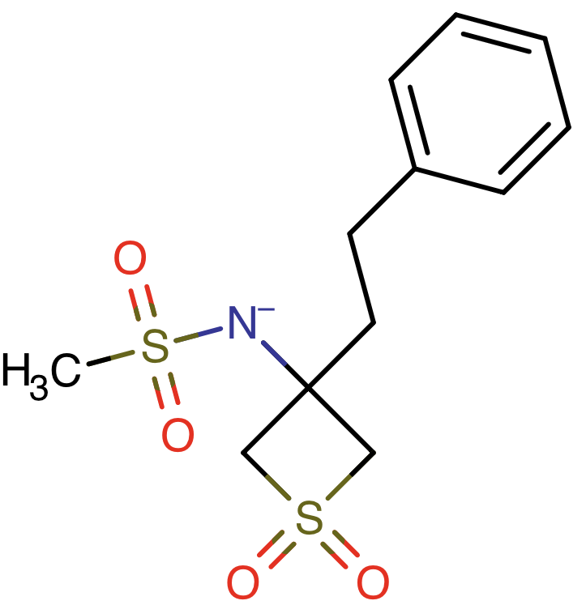
SM38
B
(0)
A
(-1 )
SM38_micro000
SM38_micro001
pKa_{BA}

Slide 15
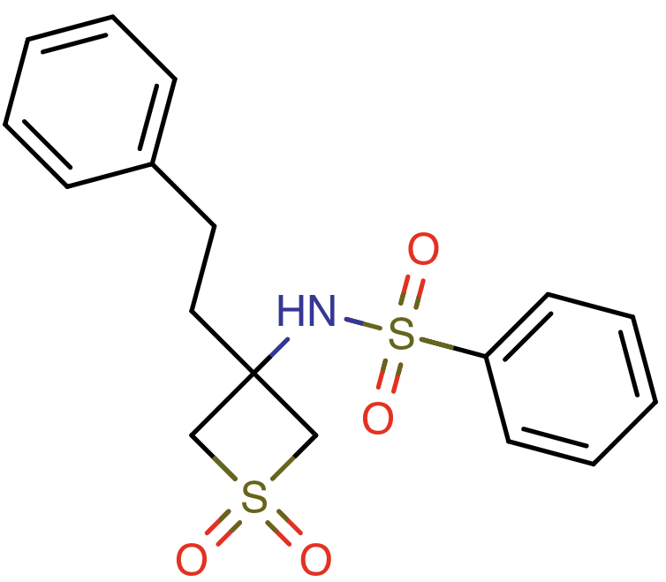
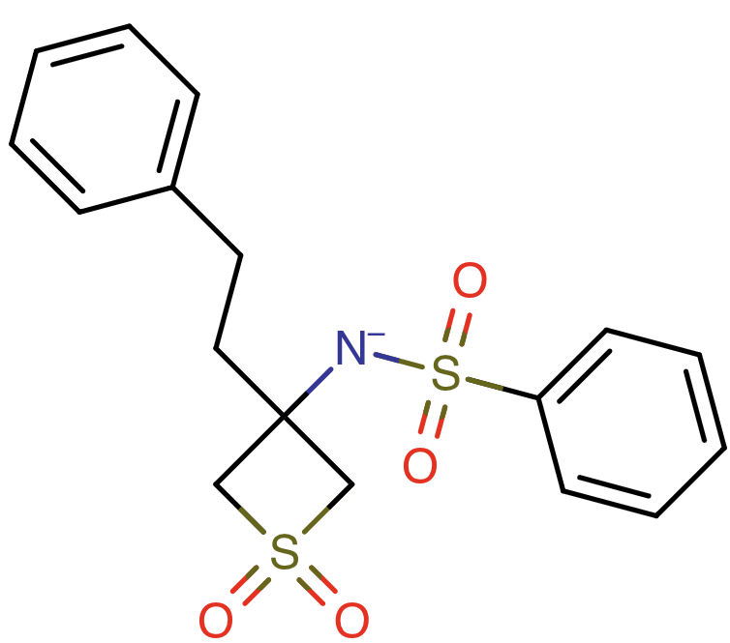
SM39
B
(0)
A
(-1 )
SM39_micro000
SM39_micro001
pKa_{BA}

Slide 16
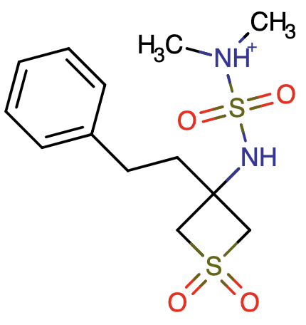
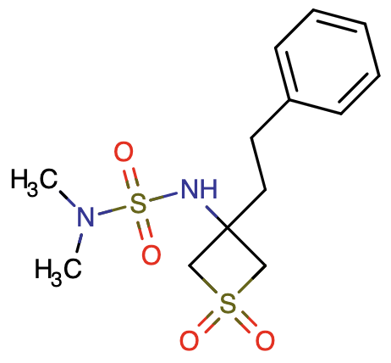
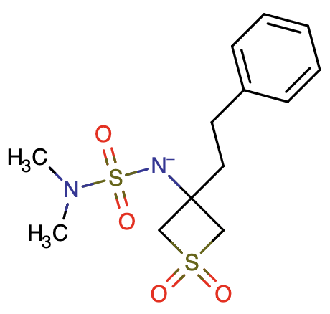
SM40
C
(+1 )
B
(0)
A
(-1 )
SM40_micro002
SM40_micro000
SM40_micro001
pKa_{CB}
pKa_{BA}

Slide 17
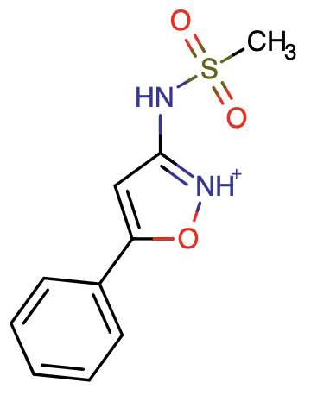


SM41
C
(+1 )
B
(0)
A
(-1 )
SM41_micro002
SM41_micro000
SM41_micro001
pKa_{CB}
pKa_{BA}

Slide 18




SM42
C
(+1 )
B
(0)
A
(-1 )
SM42_micro002
SM42_micro000
SM42_micro001
pKa_{CB}
pKa_{BA}
D
(0 )
pKa_{CD}
pKa_{DA}
SM42_micro003

Slide 19






SM43
D
C
B
(0 )
A
(+2)
(+1 )
(-1 )
SM43_micro003
SM43_micro002
SM43_micro000
SM43_micro001
pKa_{CB}
pKa_{BA}
pKa_{DC}
pKa_{CE}
pKa_{DF}
F
pKa_{FB}
E
pKa_{EA}
(+1 )
(0 )
SM43_micro005
SM43_micro004
pKa_{FE}

Slide 20



SM44
C
(+1 )
B
(0)
A
(-1 )
SM44_micro002
SM44_micro000
SM44_micro001
pKa_{CB}
pKa_{BA}

Slide 21



SM45
C
(+1 )
B
(0 )
A
(-1 )
SM45_micro002
SM45_micro000
SM45_micro001
pKa_{CB}
pKa_{BA}

Slide 22





SM46
D
(+2)
C
(+1 )
B
(0 )
A
(-1 )
SM46_micro003
SM46_micro002
SM46_micro000
SM46_micro001
pKa_{DC}
pKa_{CB}
pKa_{BA}
pKa_{DE}
E
(+1 )
pKa_{EB}
SM46_micro004

