Slide 1
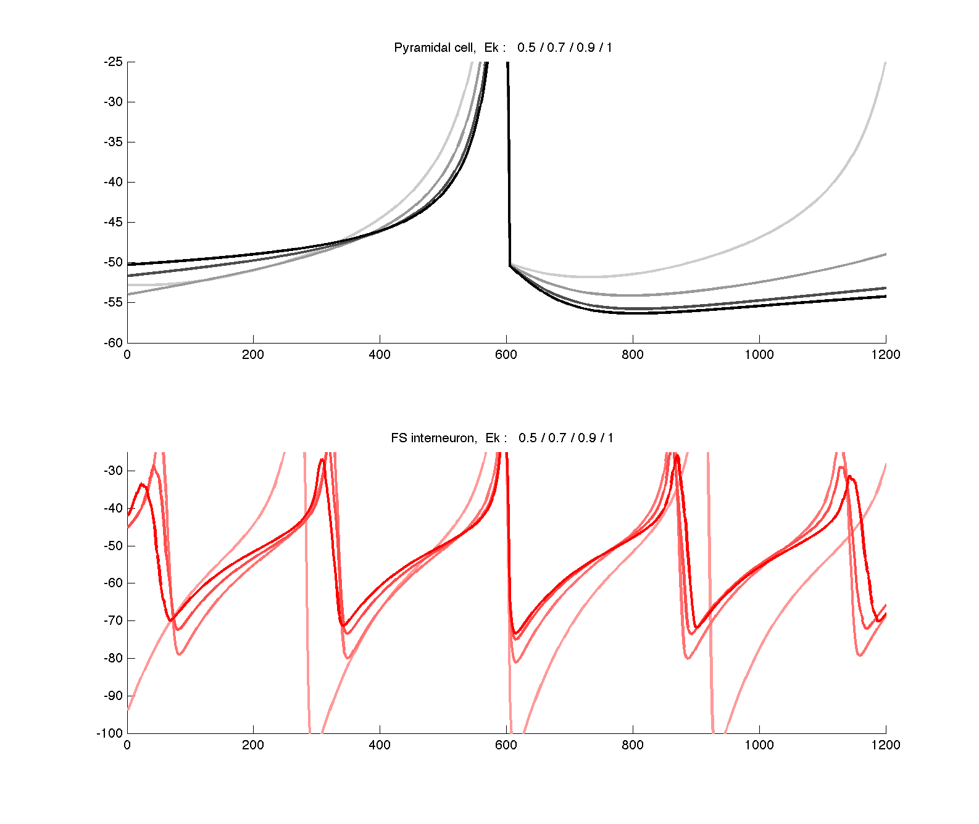
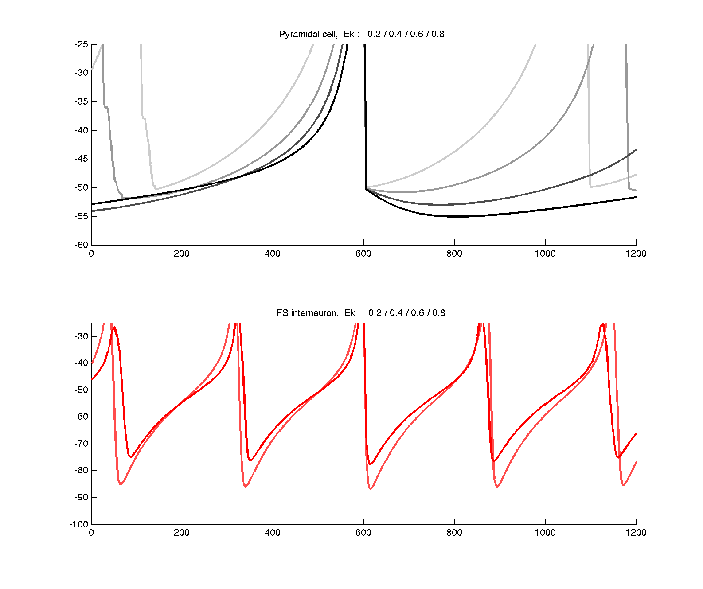
Change of Ek on spike waveform

Slide 2
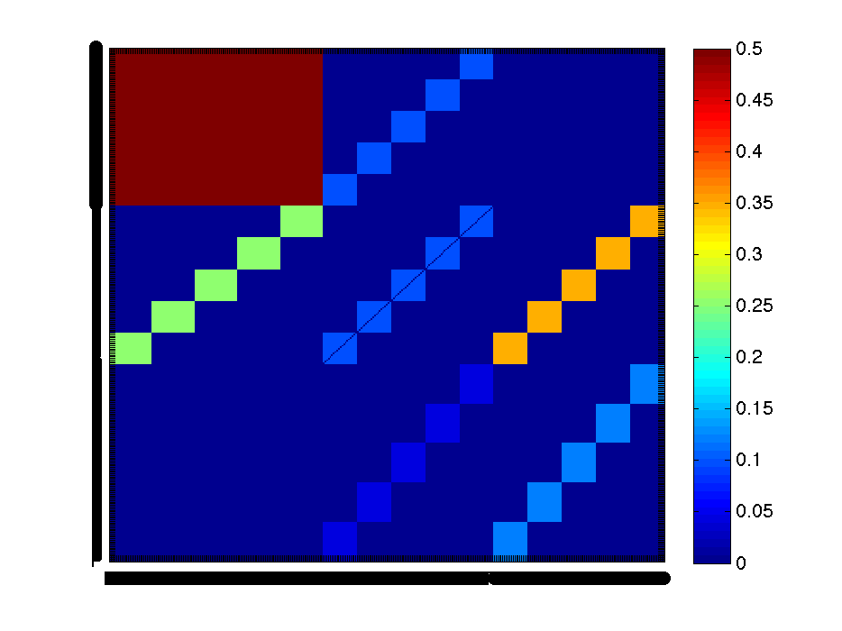
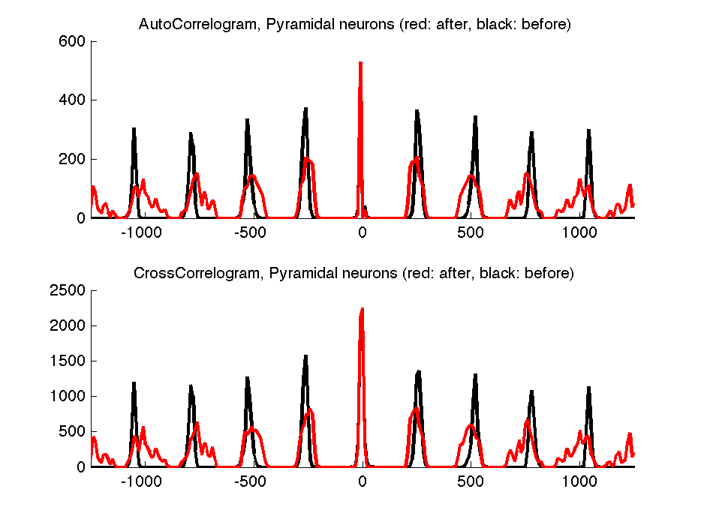
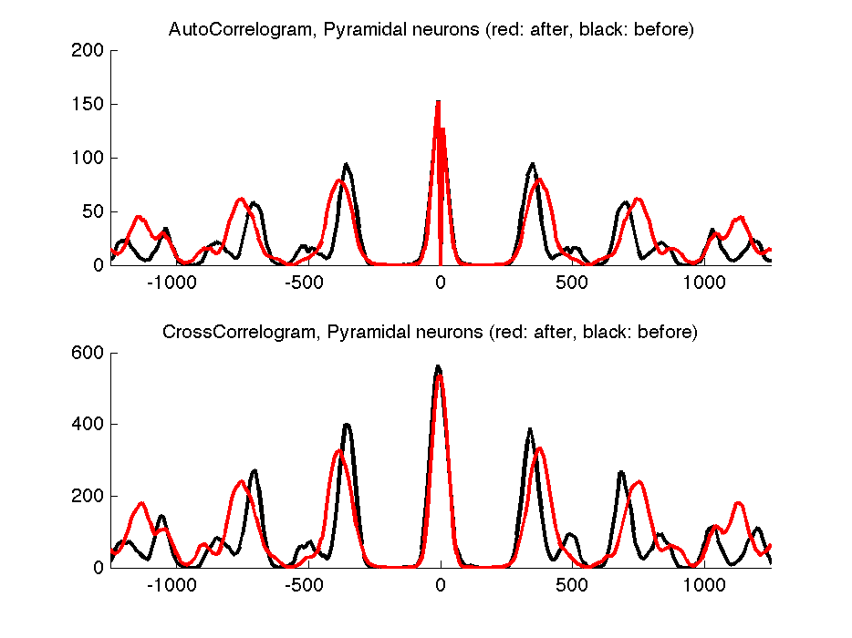


0.5 to 0.9
0.9 to 0.5
Connected modules
0.5 to 0.9
0.9 to 0.5

Slide 3
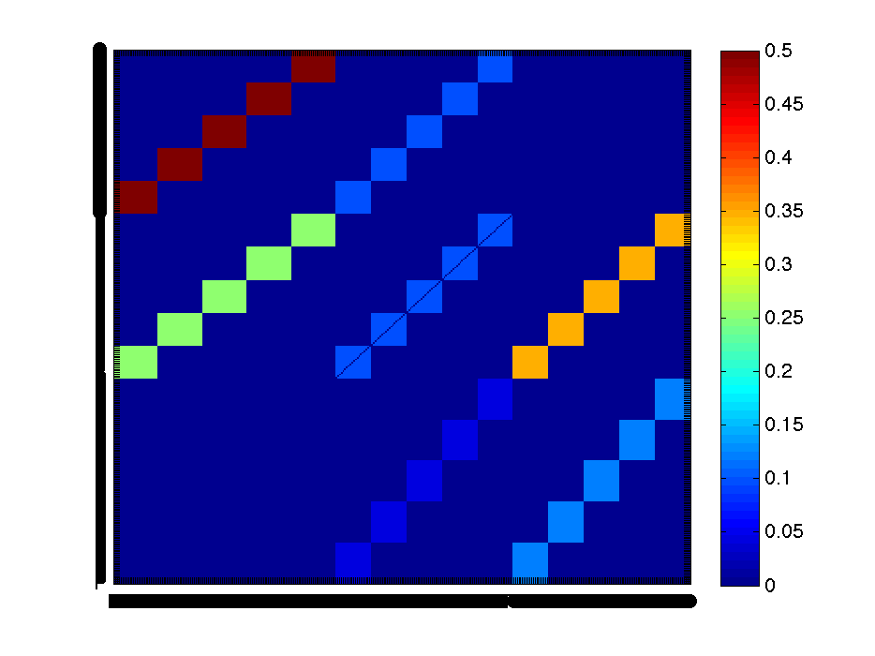
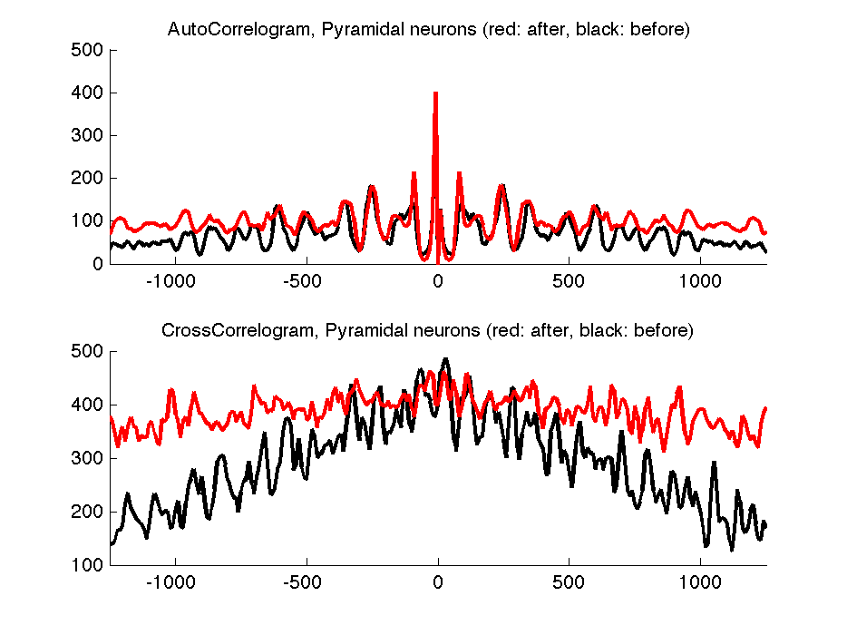
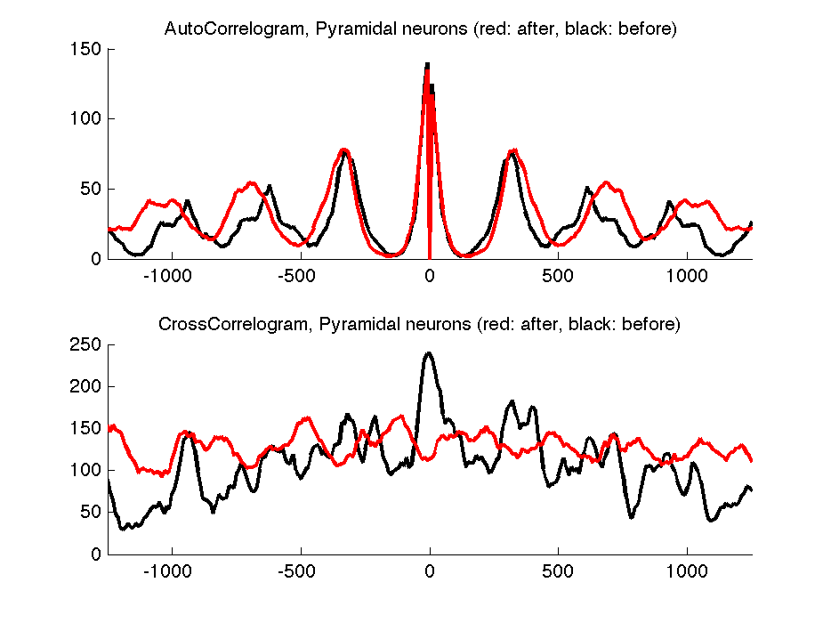


0.5 to 0.9
0.9 to 0.5
Separated modules
0.5 to 0.9
0.9 to 0.5

