Slide 1
Mouse 61

Slide 2
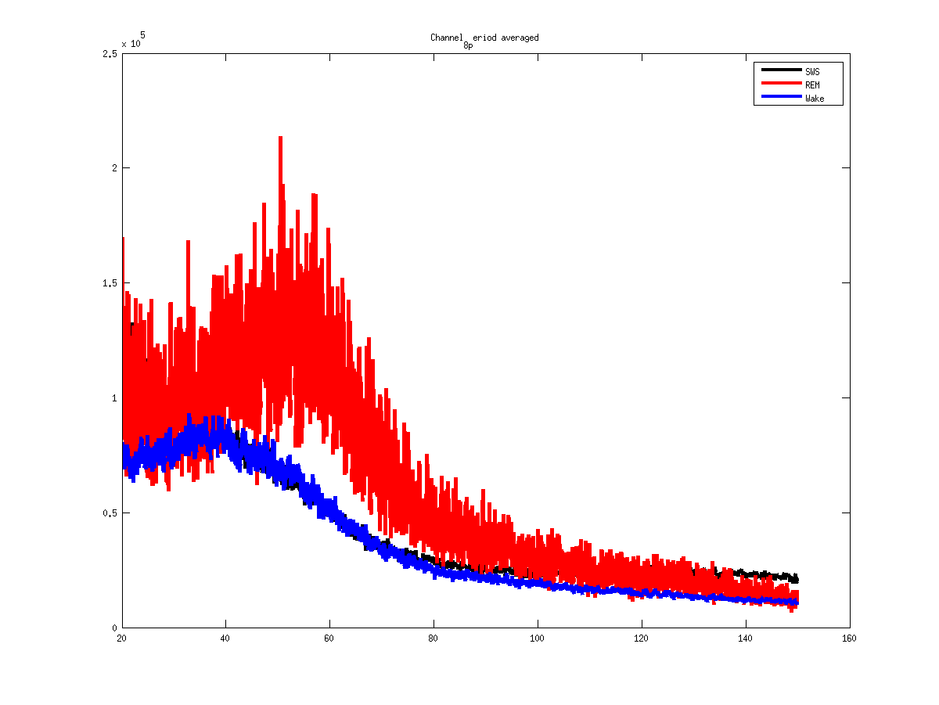
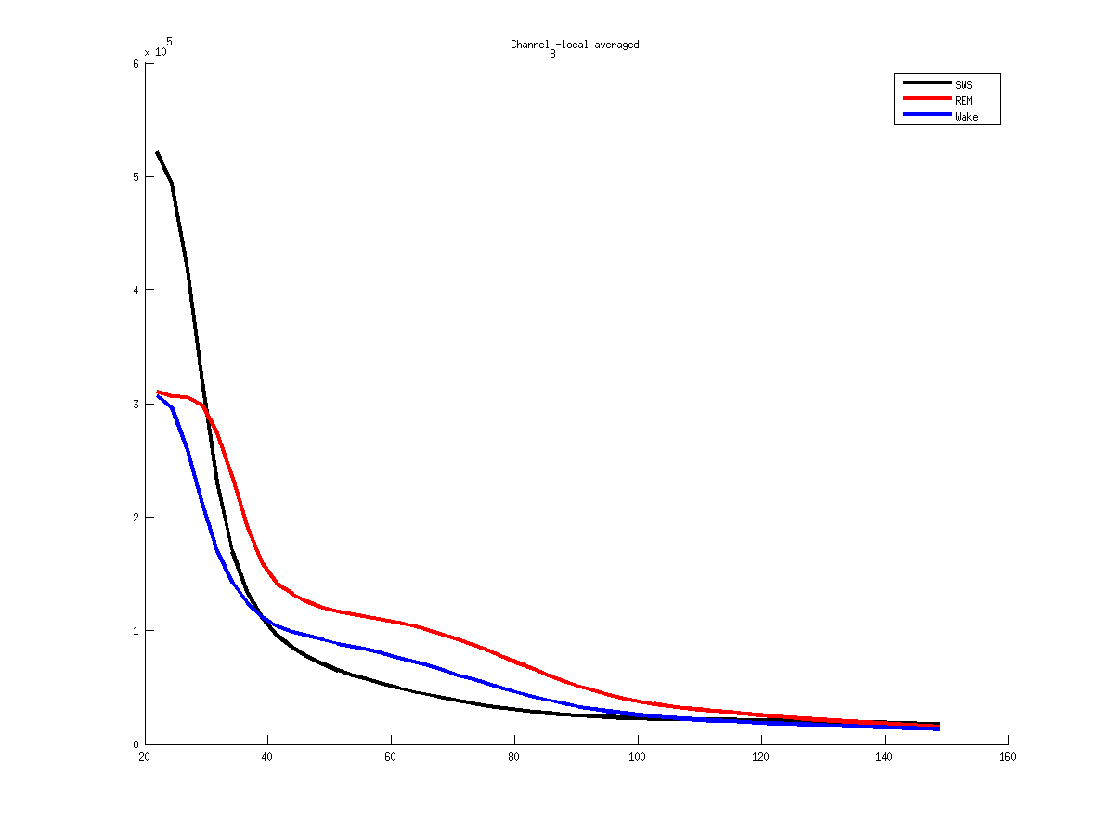
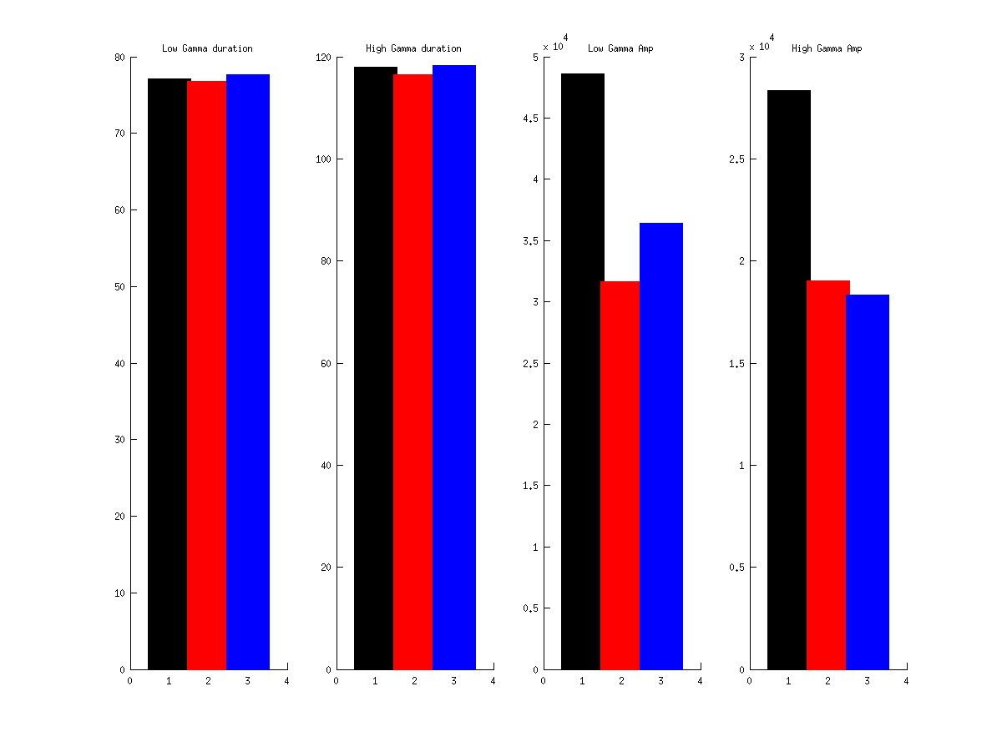
8
Notes:
Mouse 61
2013 04 30
Voie 8 - Hpc

Slide 3
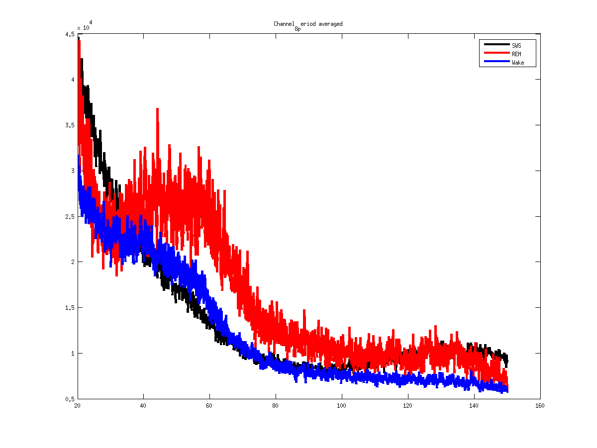
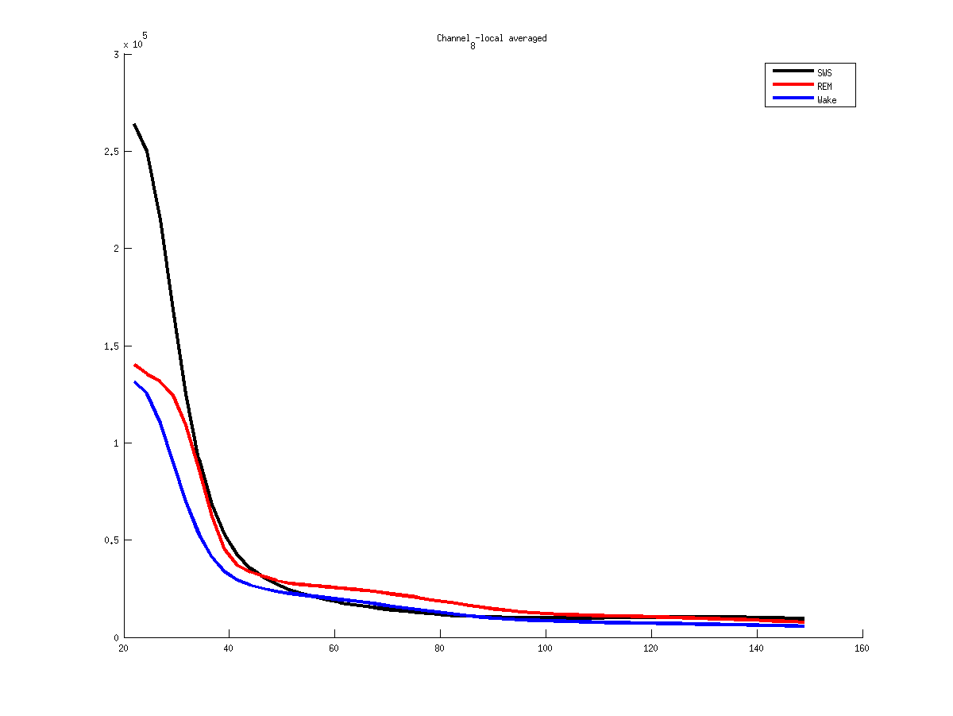
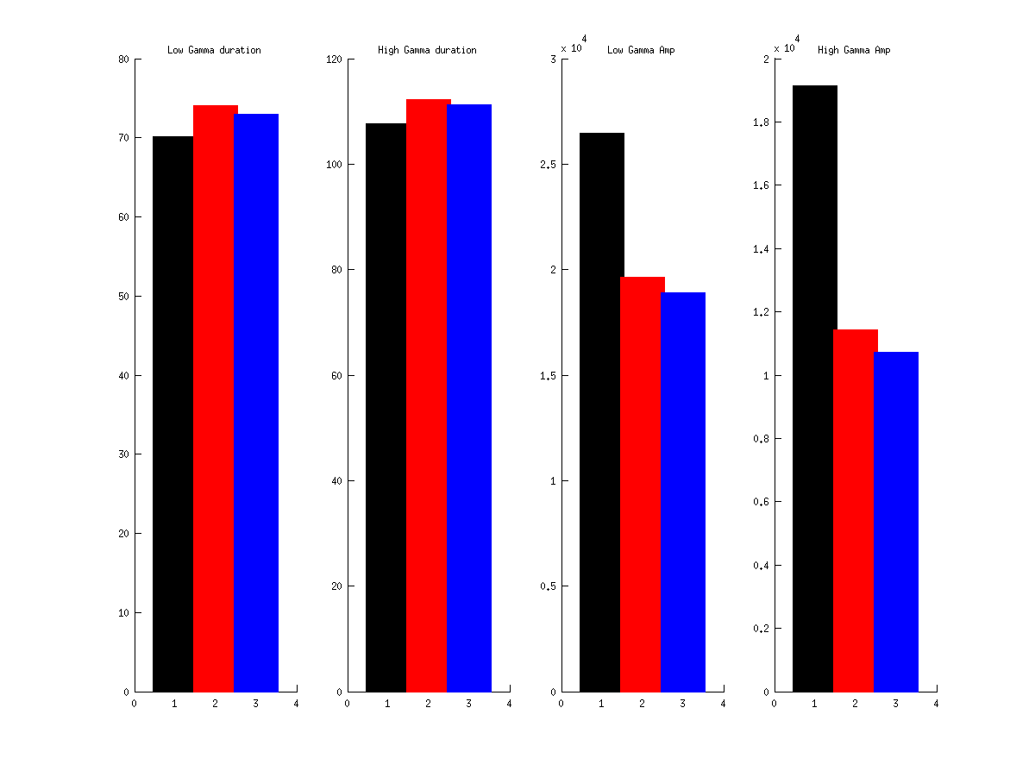
8
Notes:
Mouse 61
2013 04 15
8 - Hpc

Slide 4
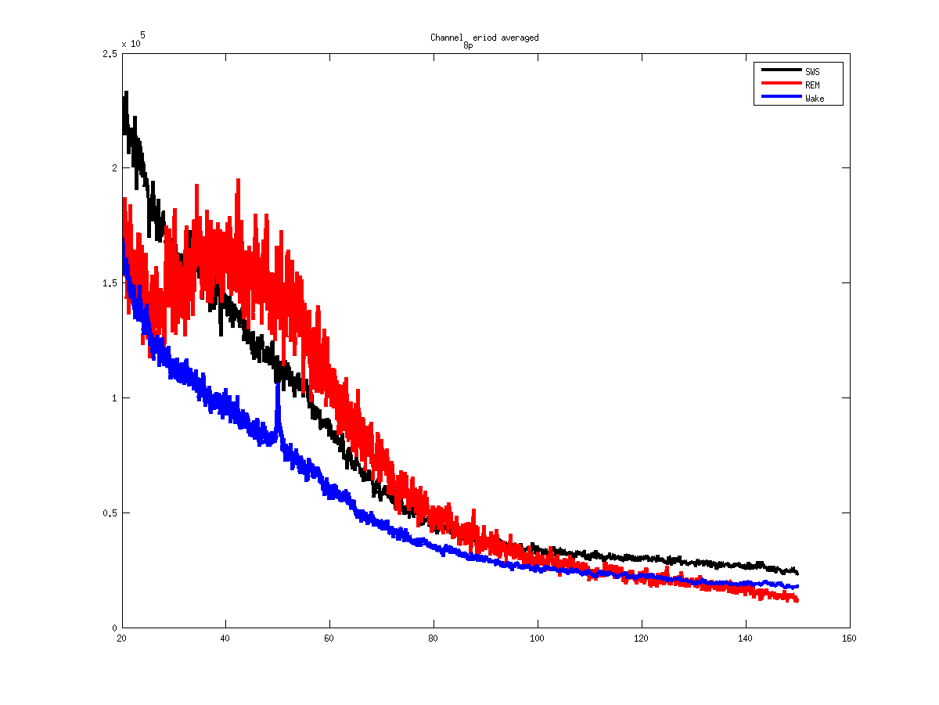
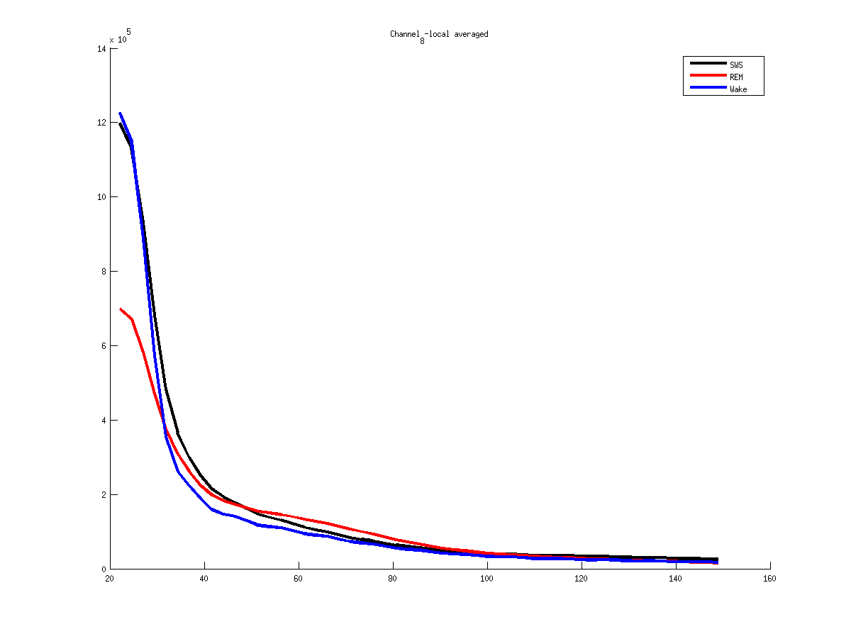
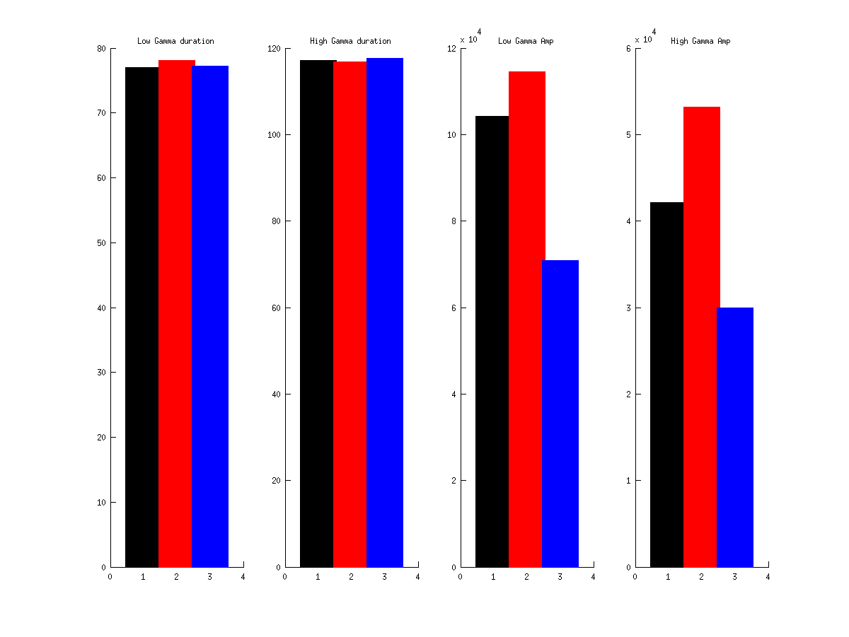
8
Notes:
Mouse 61
2013 04 22
8 - Hpc

Slide 5
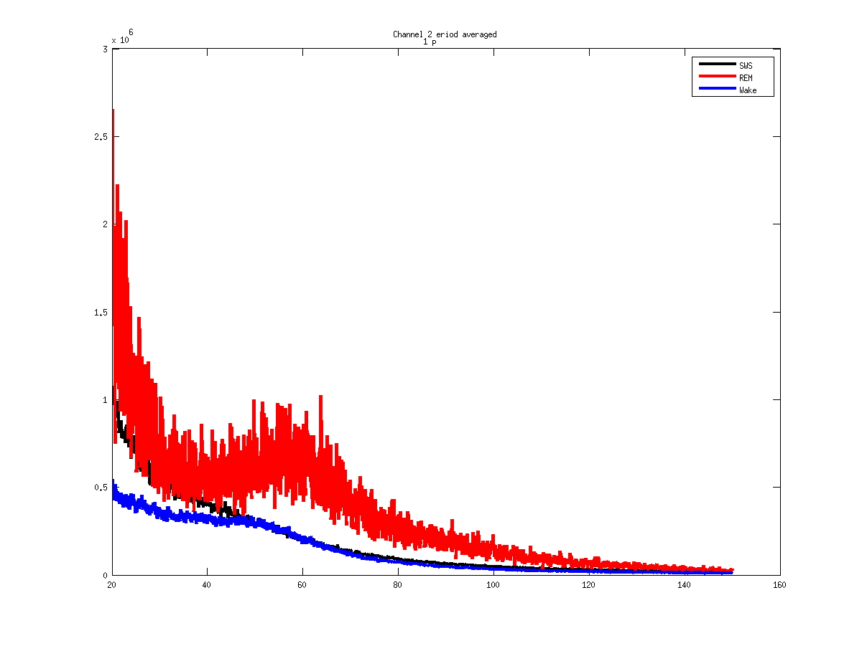
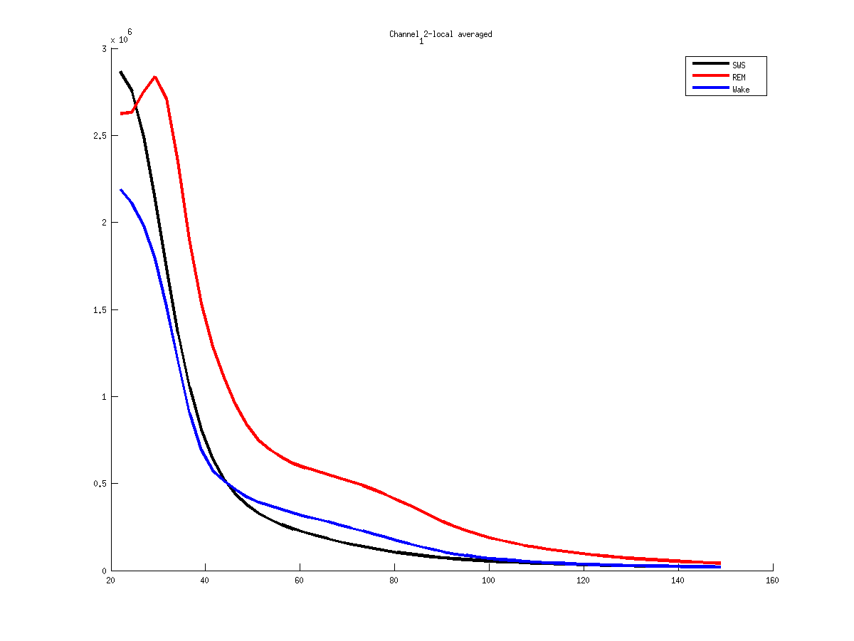
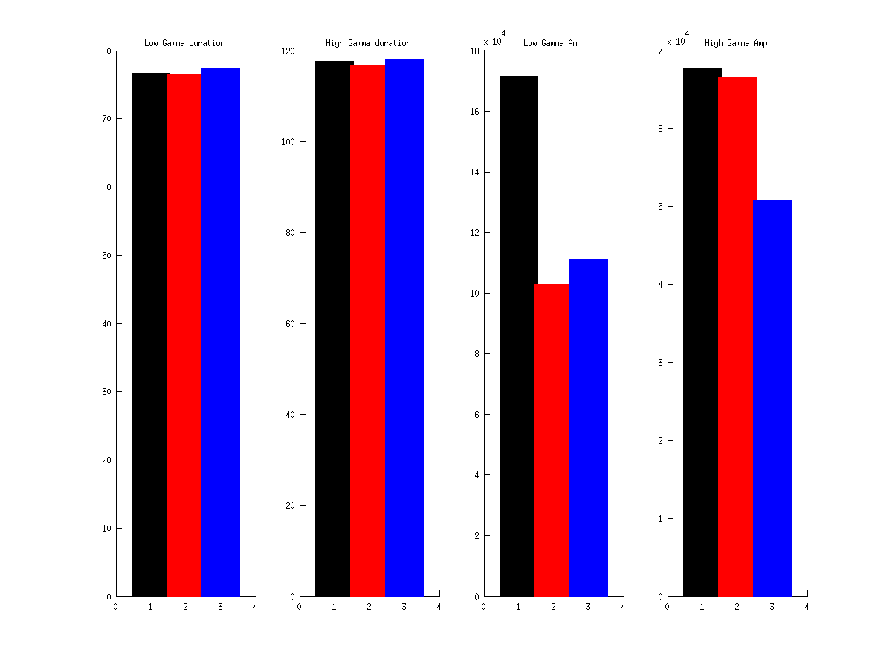
12
Notes:
Mouse 61
2013 04 30
Voie 12 - Hpc

Slide 6
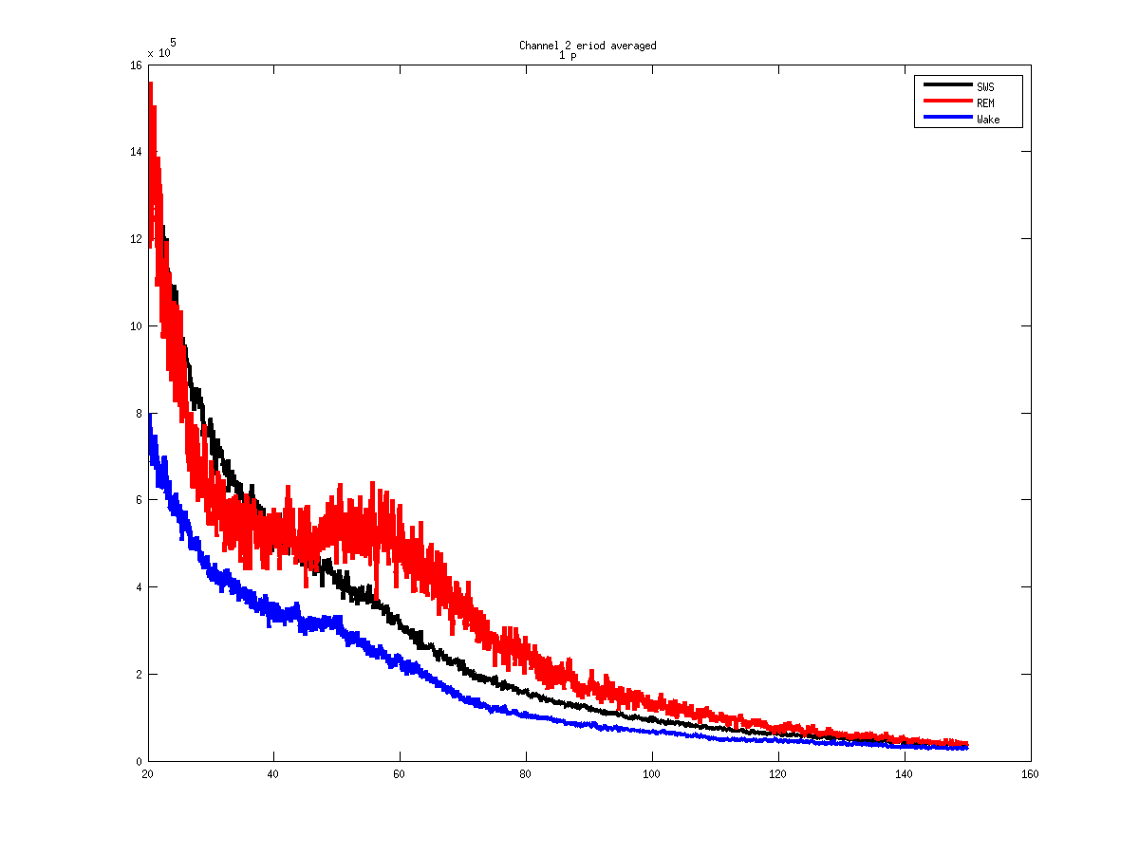
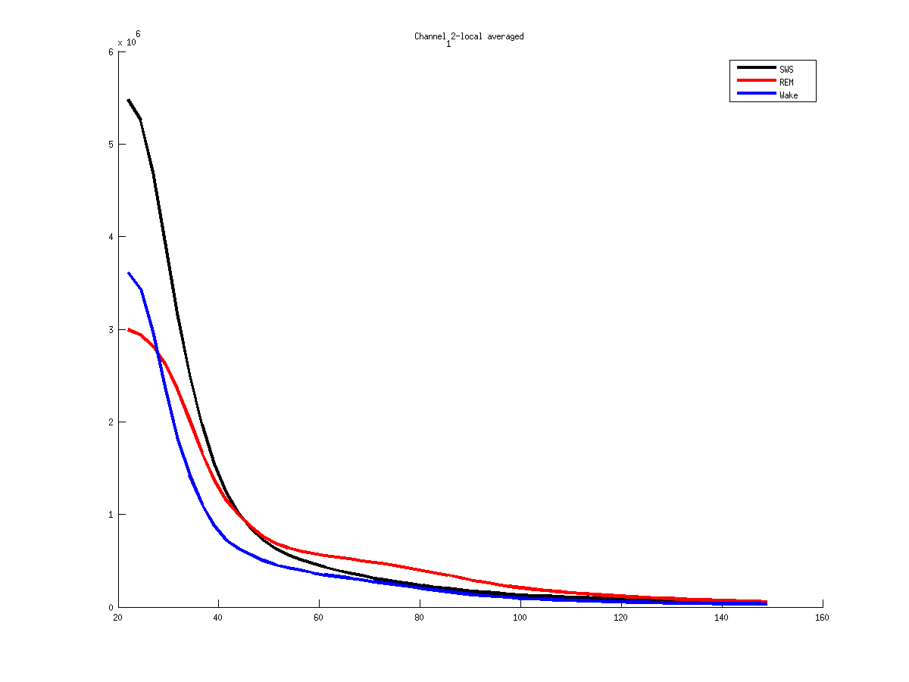
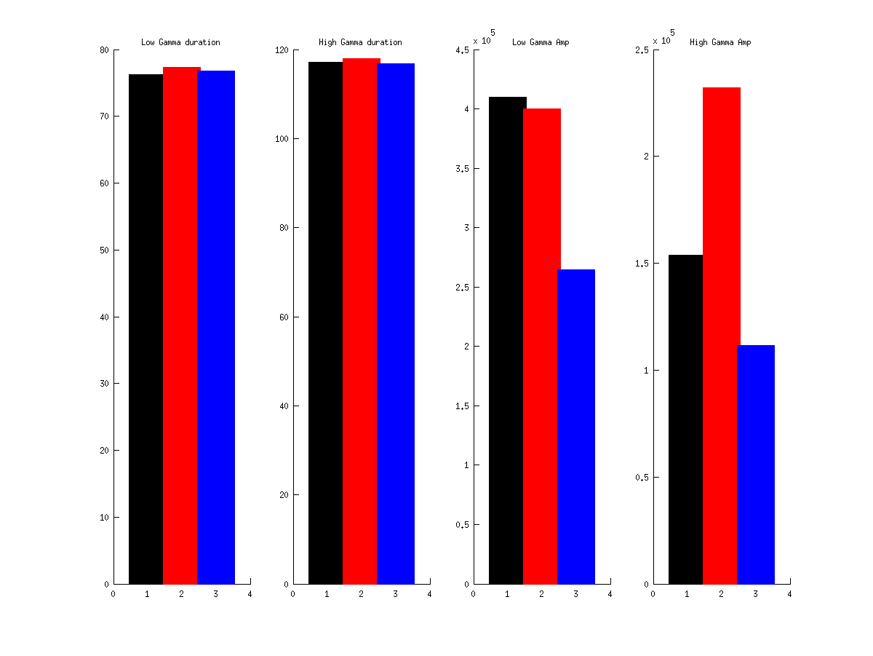
12
Notes:
Mouse 61
2013 04 22
12 - Hpc

Slide 7
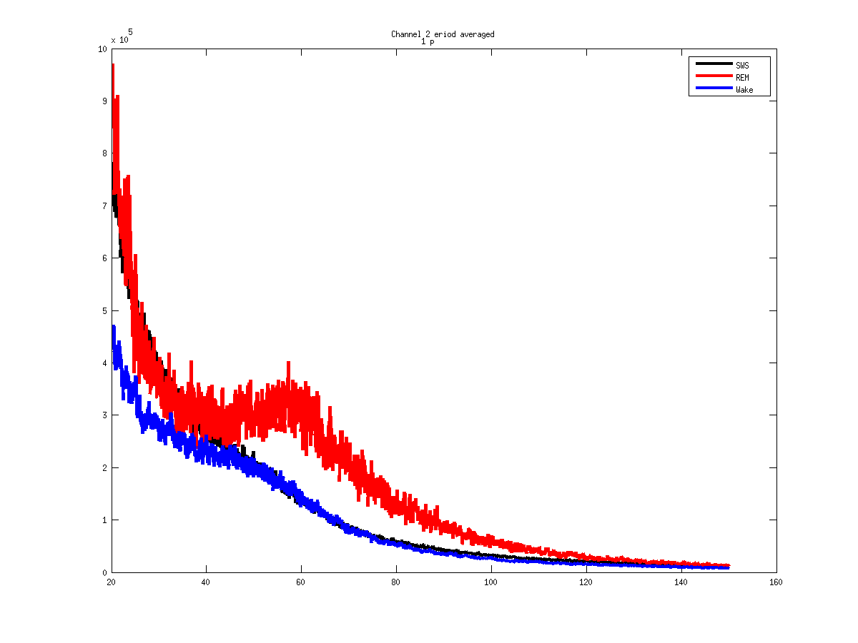
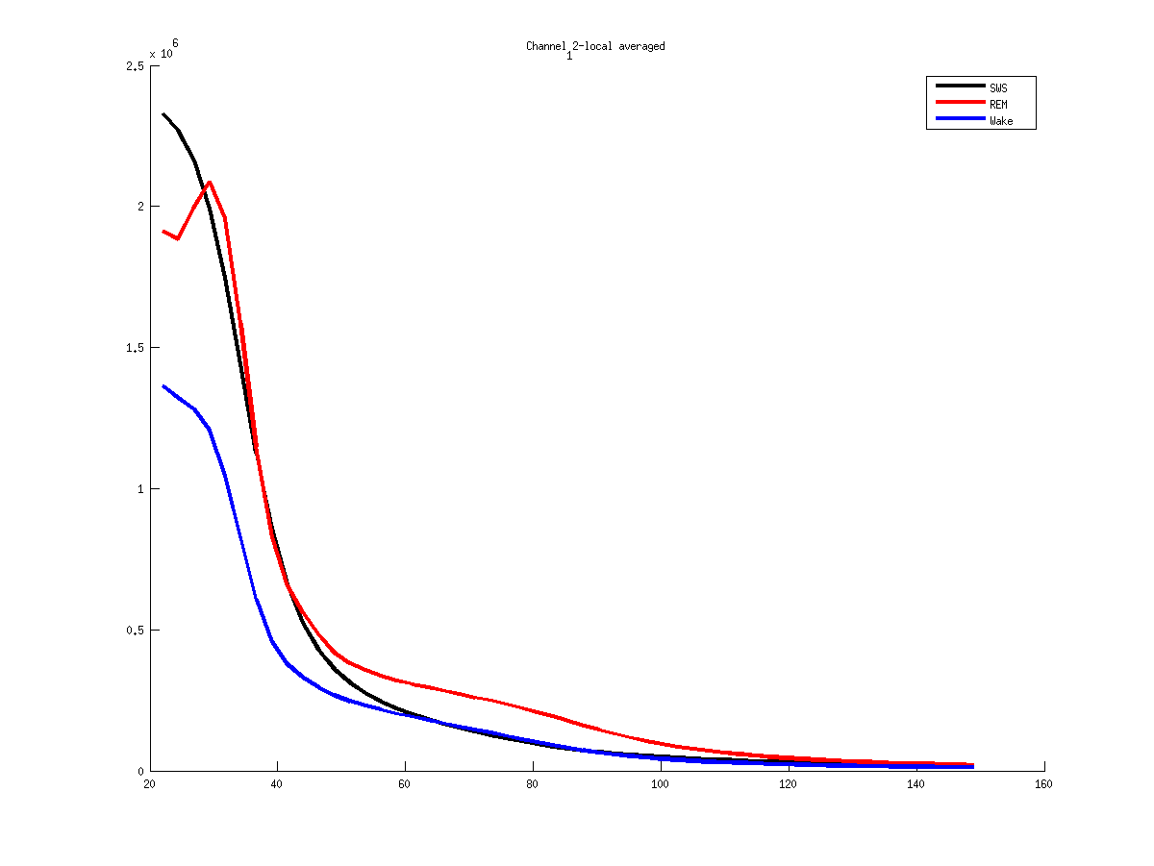
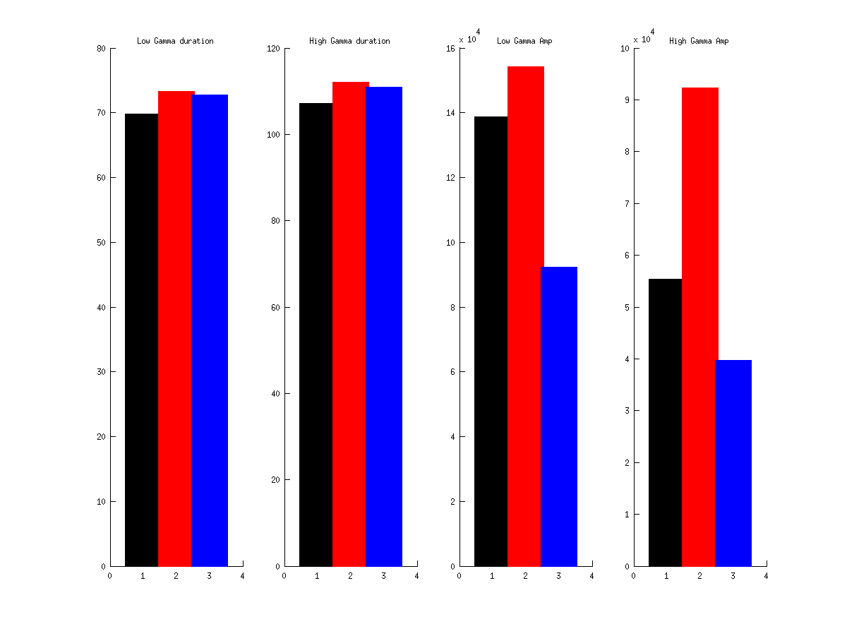
12
Notes:
Mouse 61
2013 04 15
12 - Hpc

Slide 8
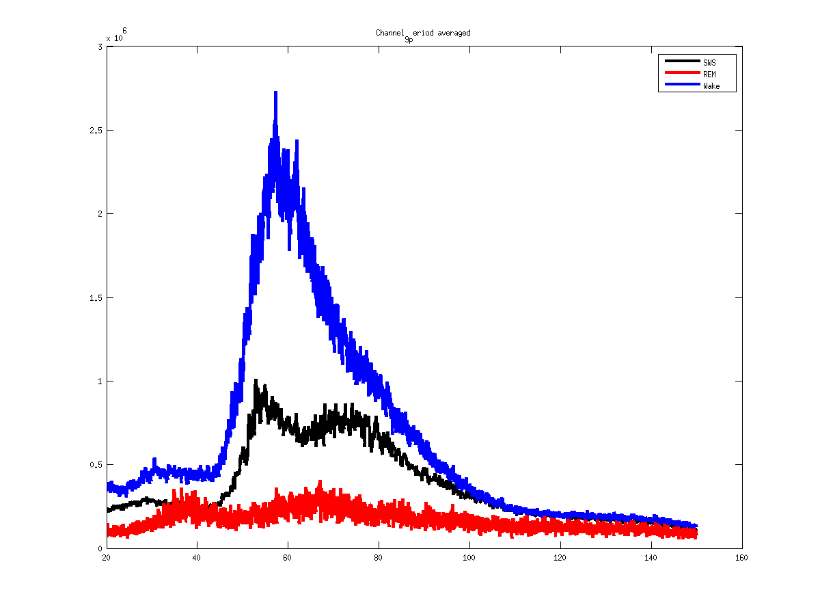
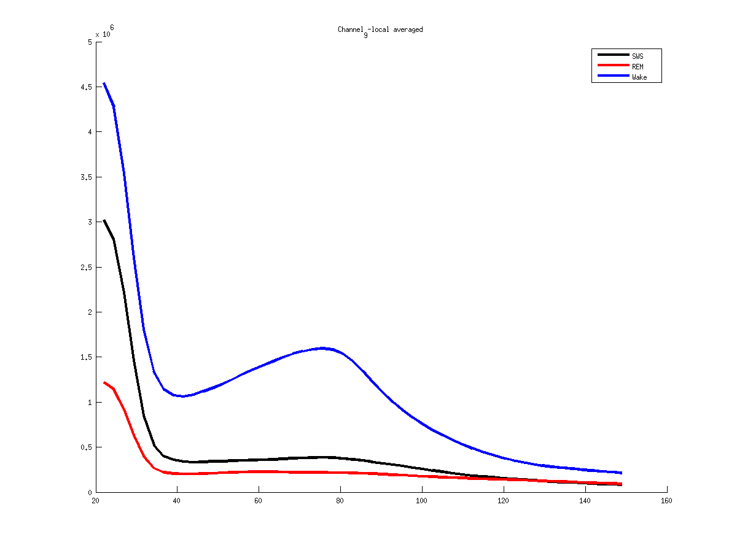
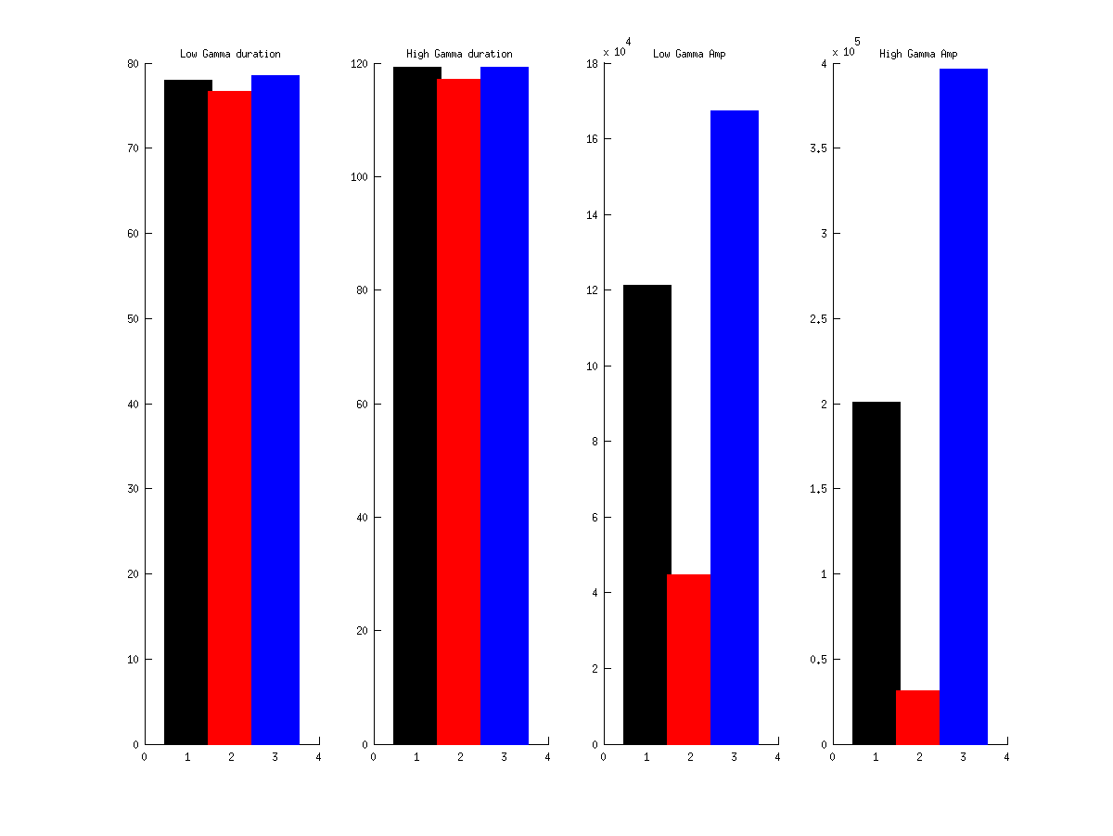
9
Notes:
Mouse 61
2013 04 30
9 -Bulb

Slide 9
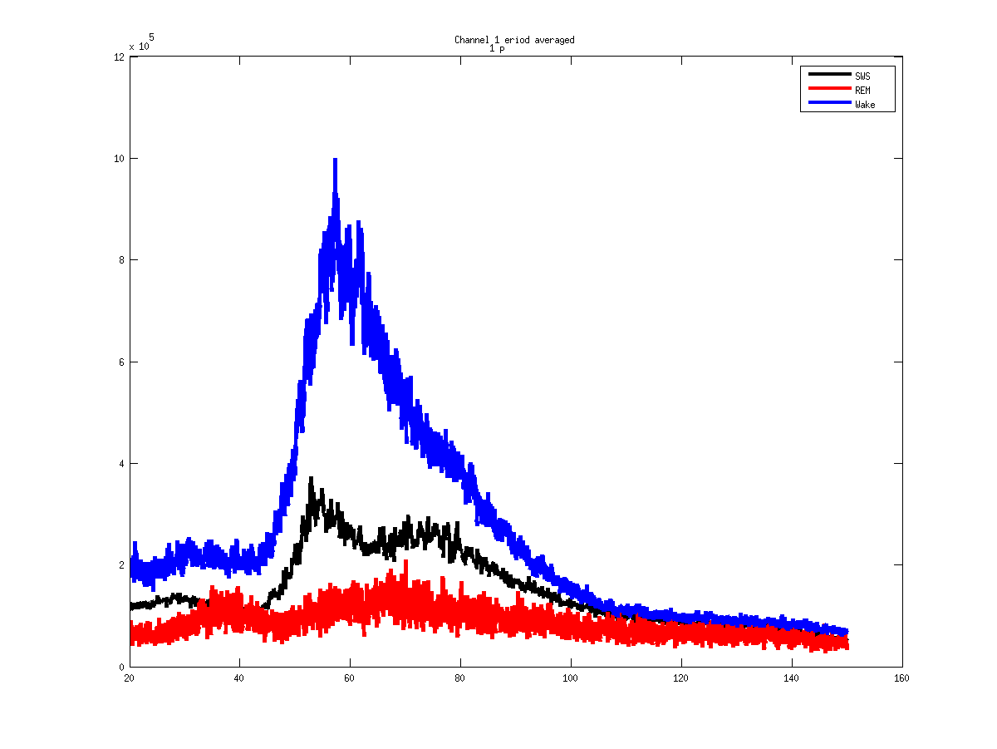
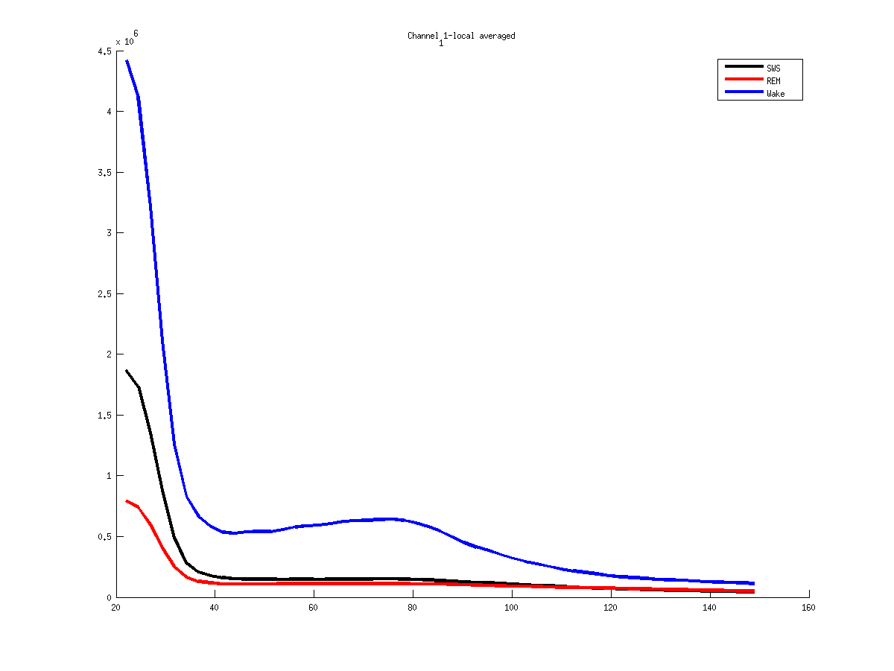
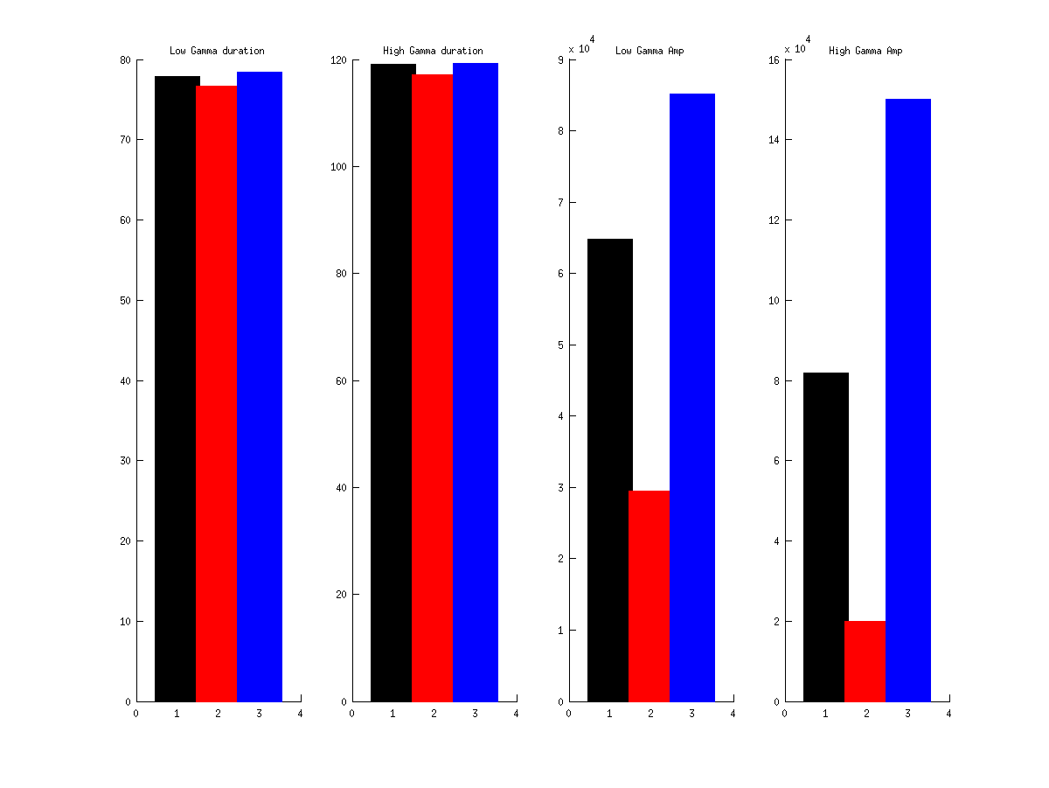
9
Notes:
Mouse 61
2013 04 30
11 -Bulb

Slide 10
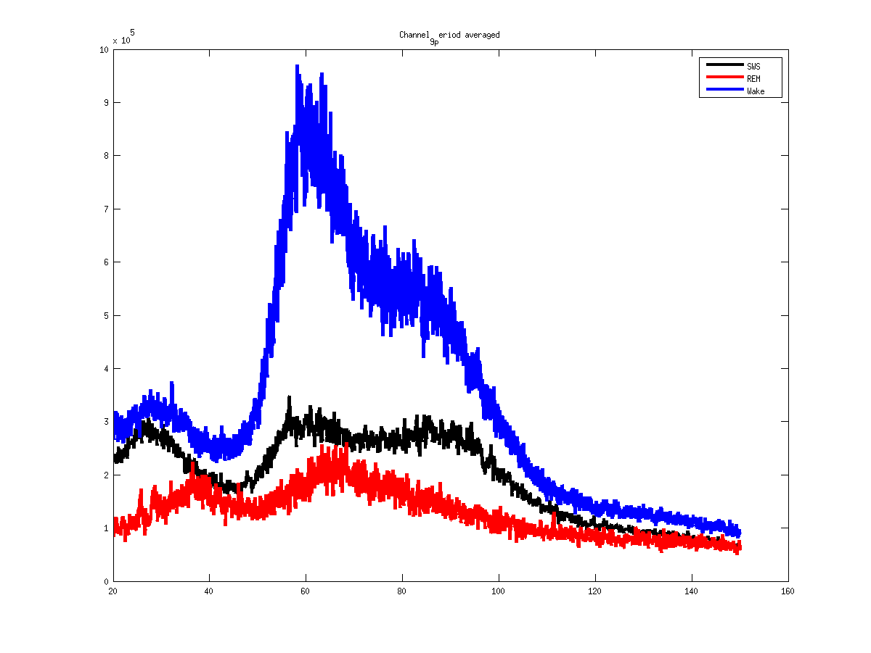
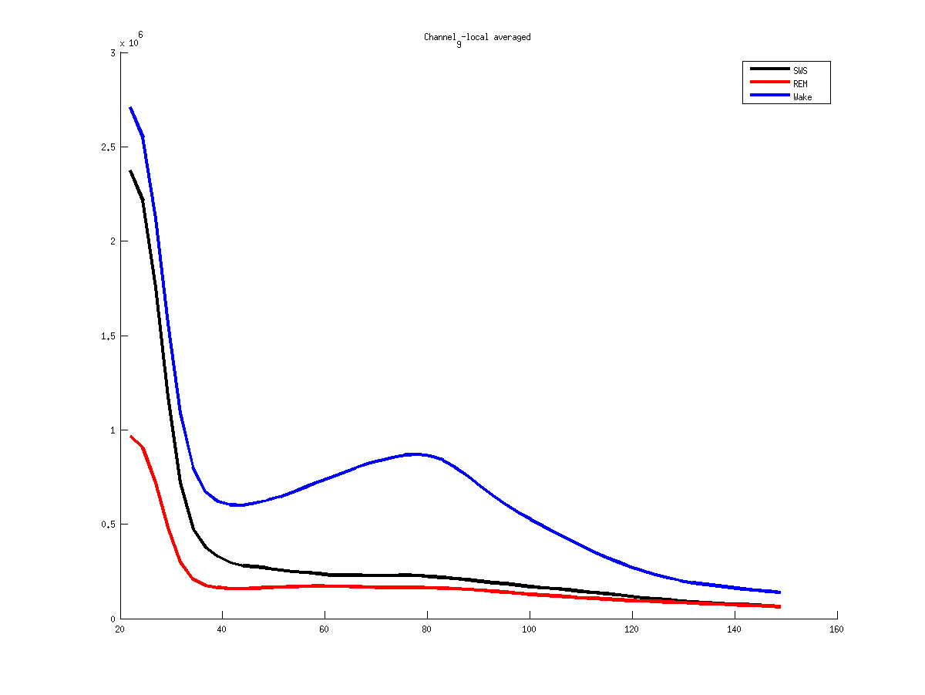
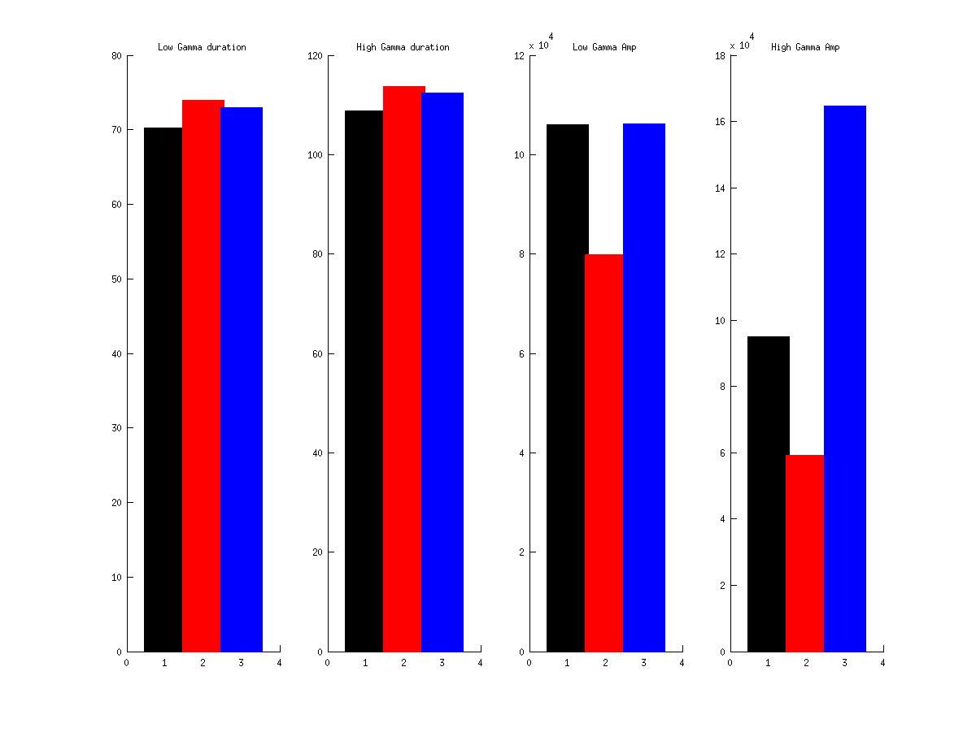
9
Notes:
Mouse 61
2013 04 15
9 - Bulb

Slide 11
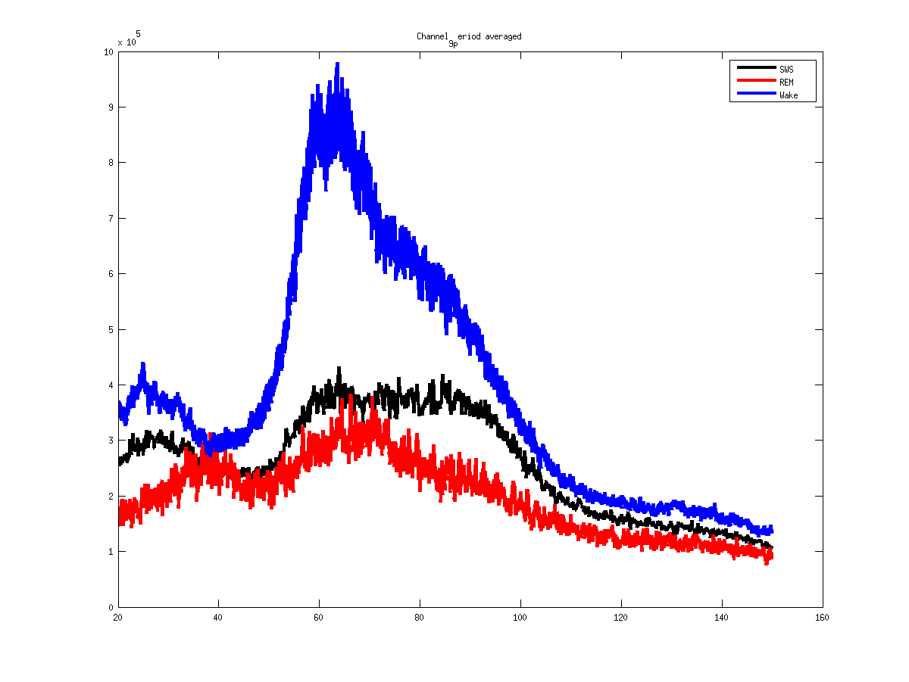
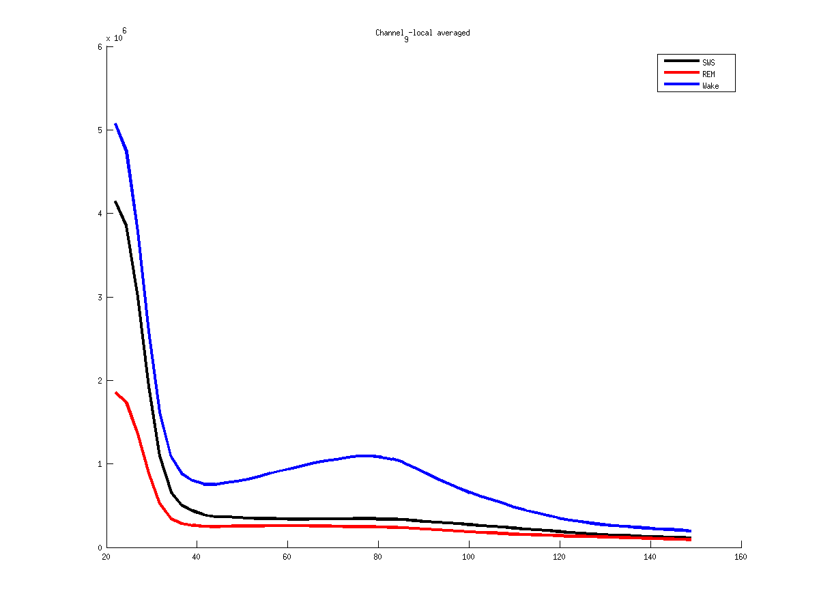
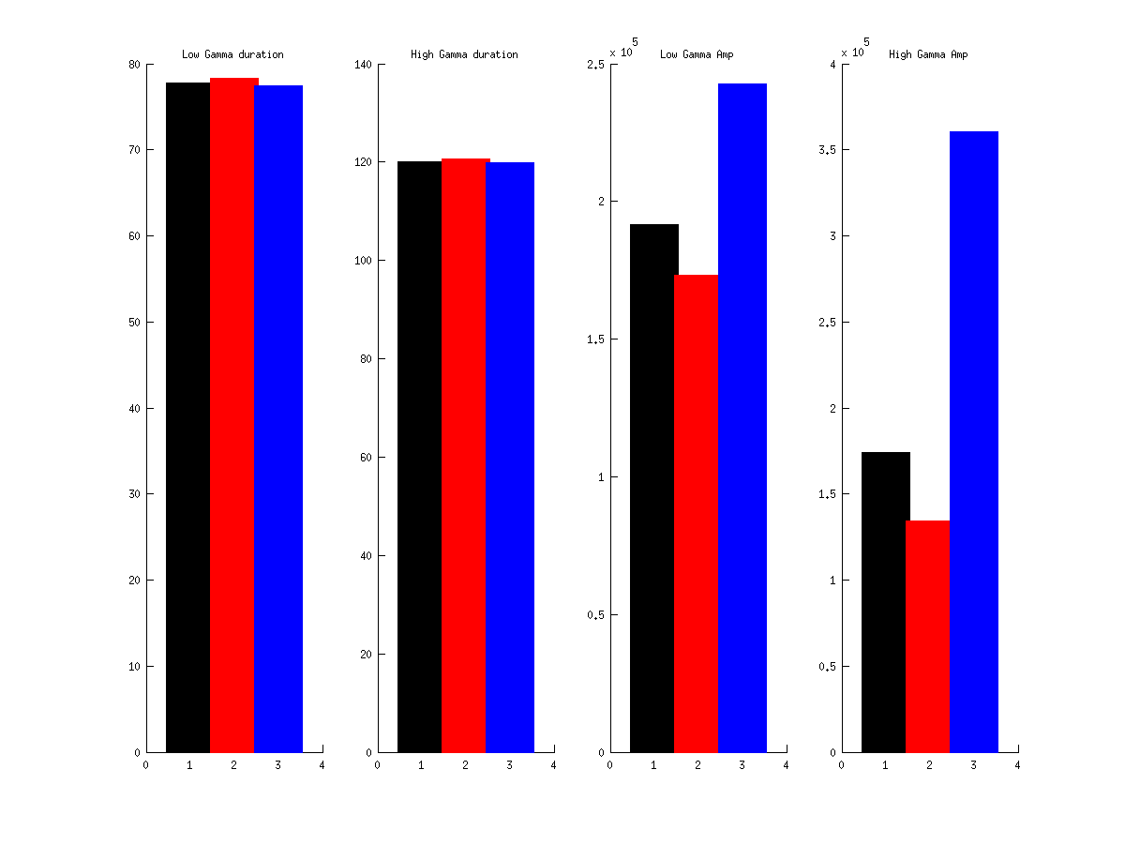
9
Notes:
Mouse 61
2013 04 22
9 - Bulb

Slide 12
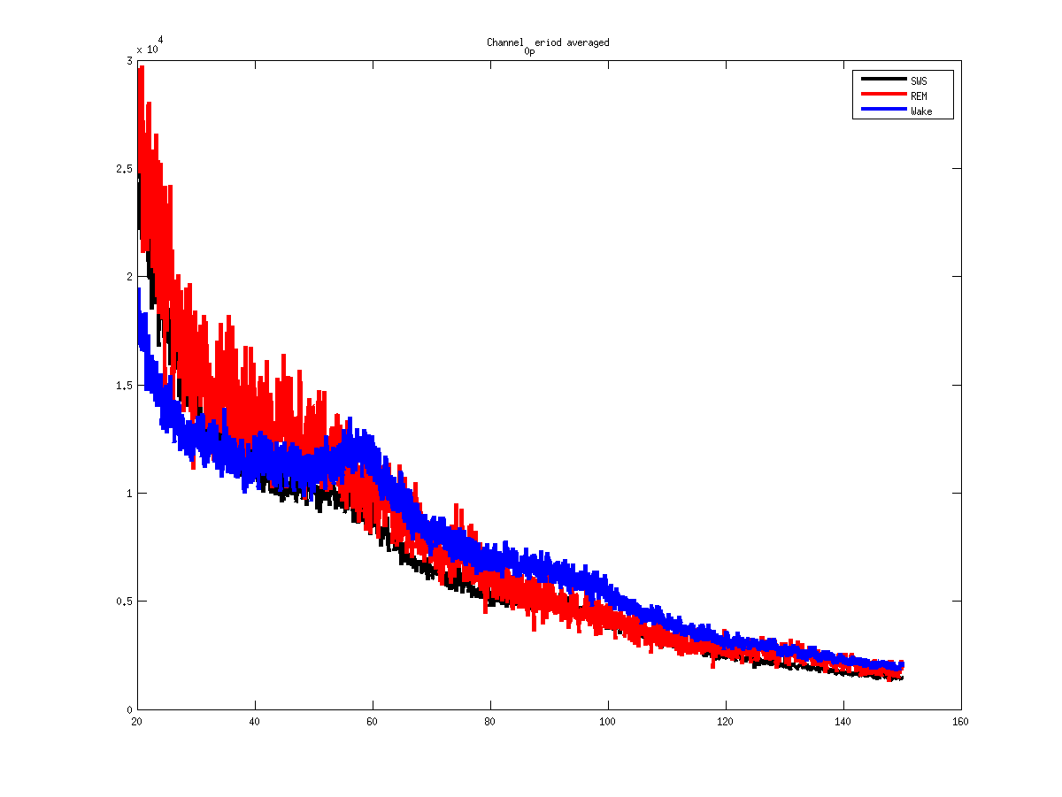
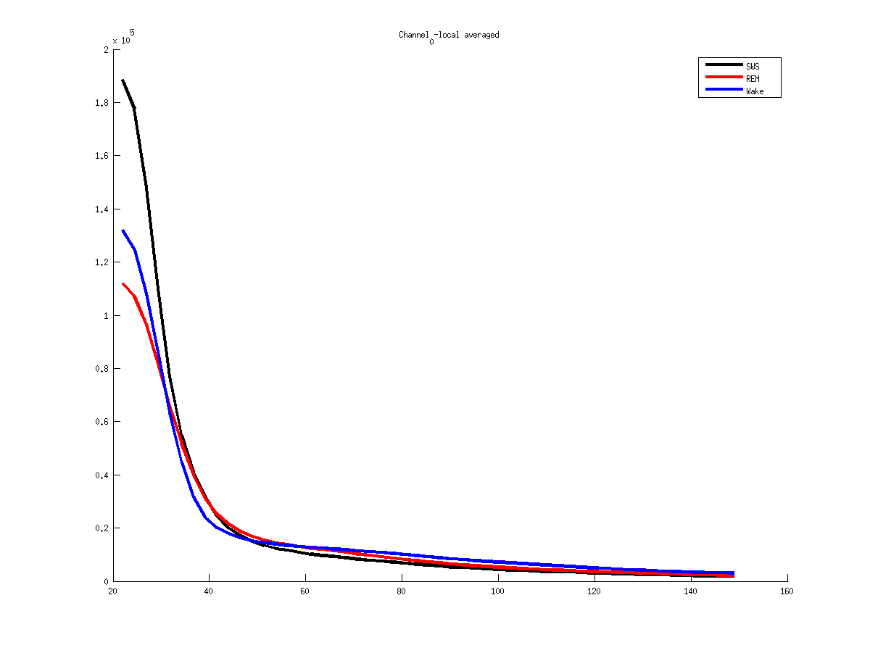
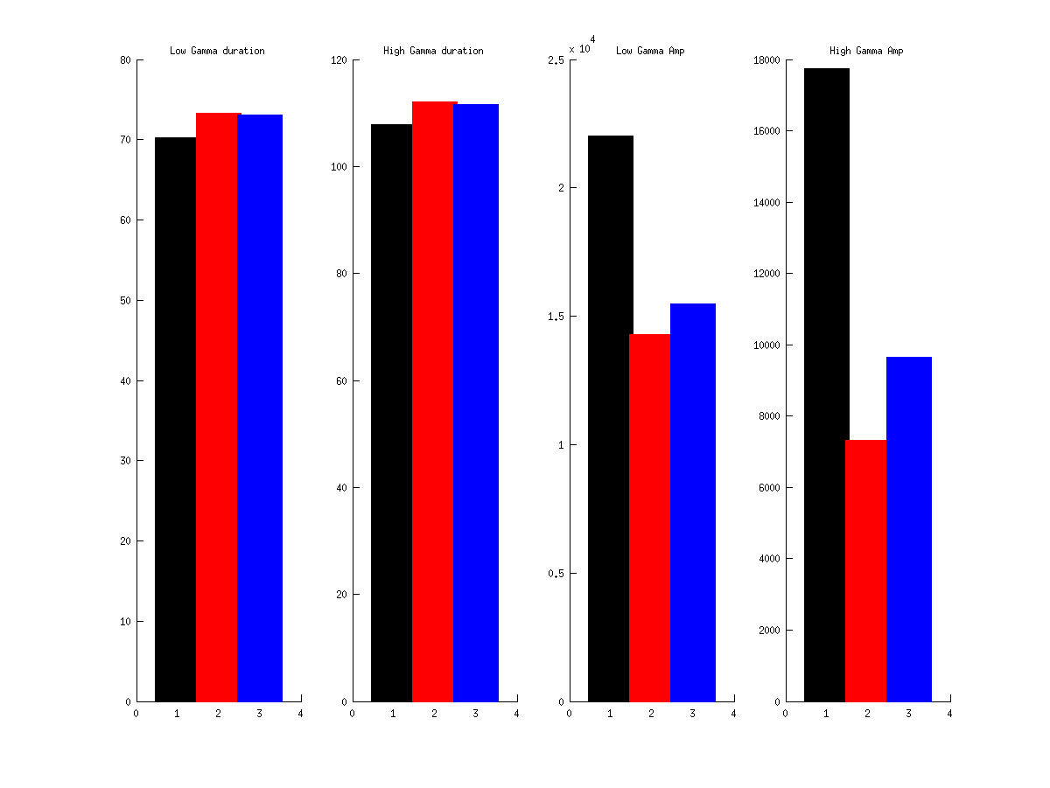
0
Notes:
Mouse 61
2013 04 15
0 - PFc

Slide 13
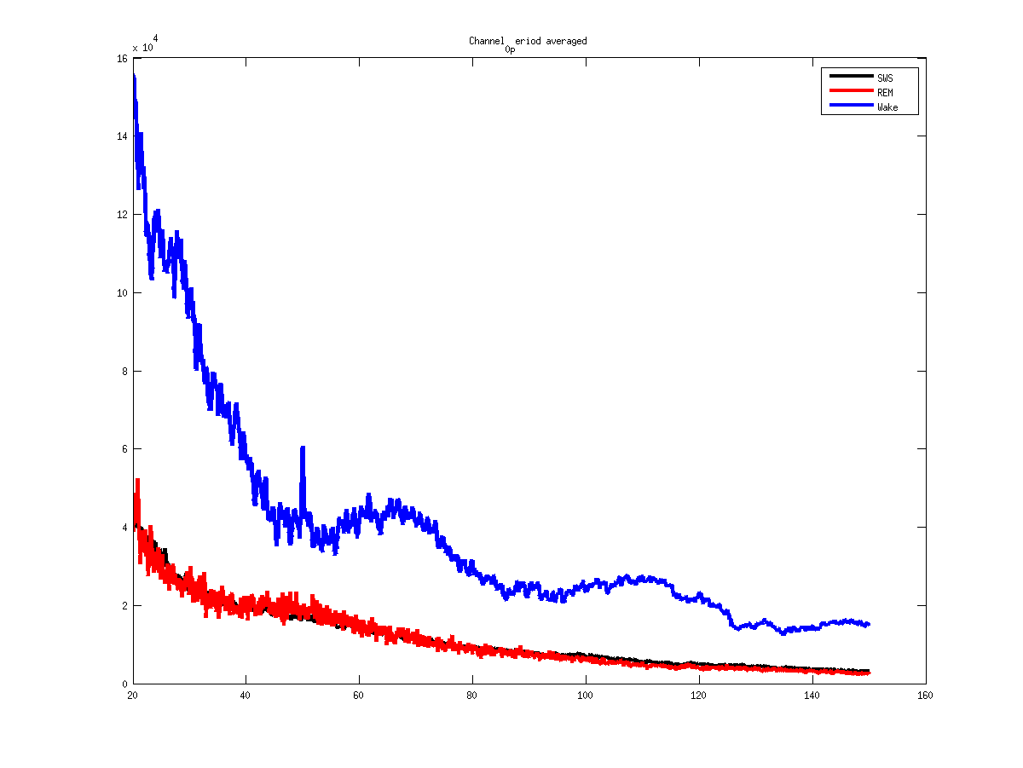
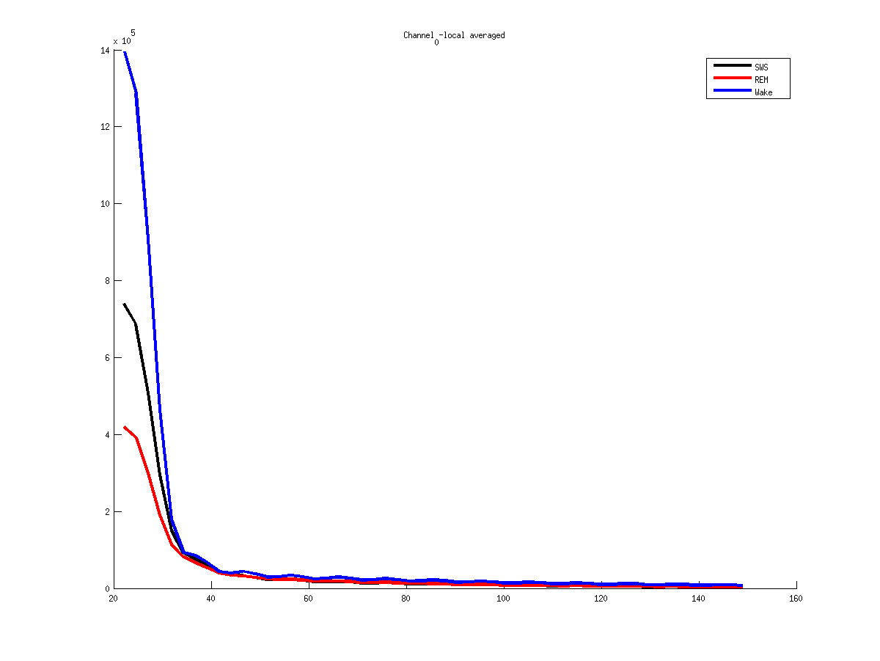
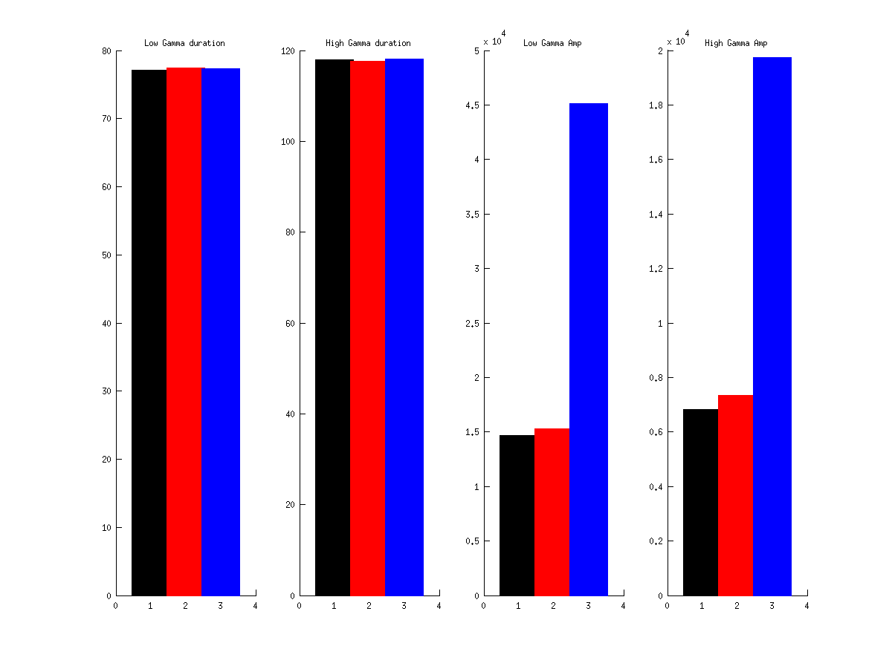
0
Notes:
Mouse 61
2013 04 22
0 - Pfc

Slide 14
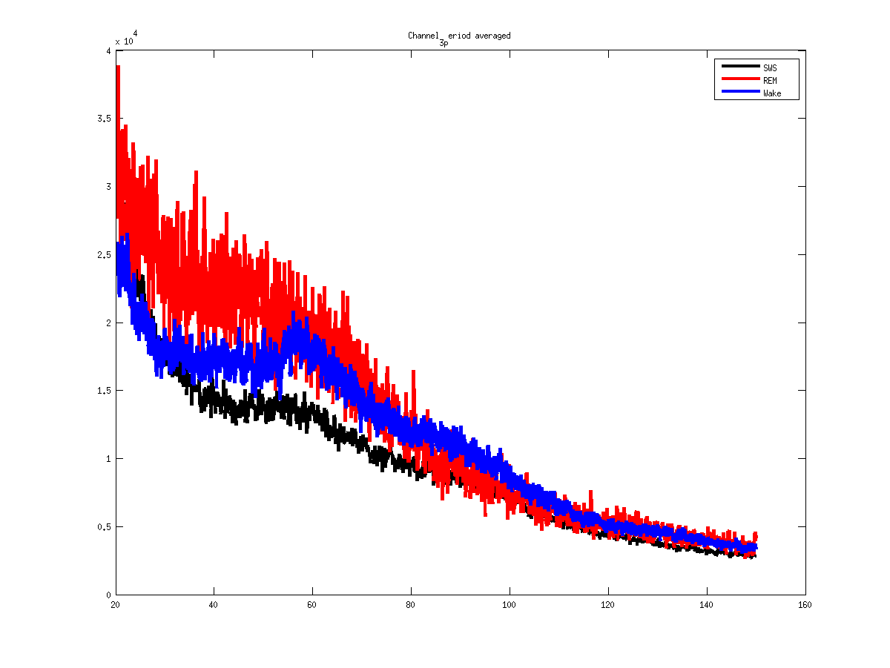
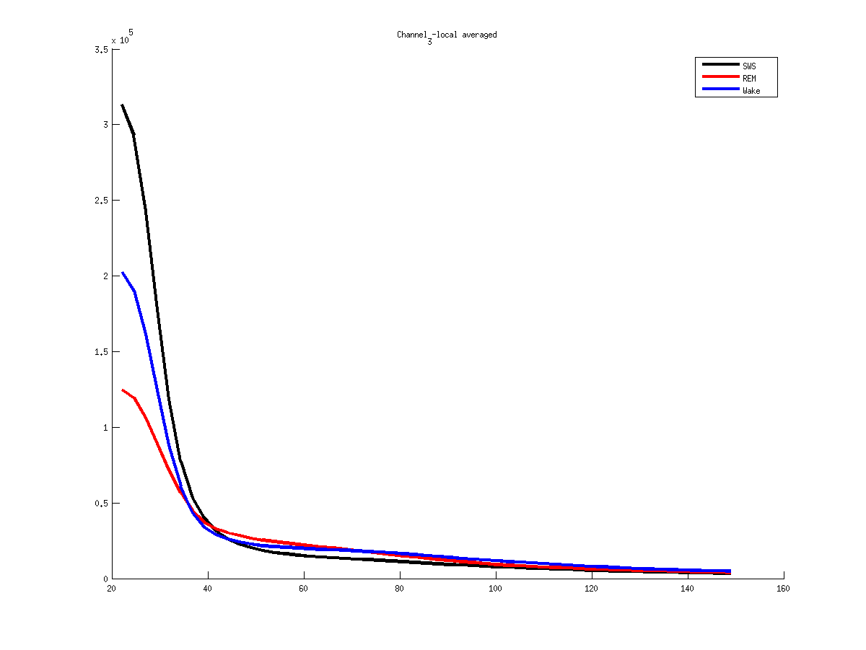
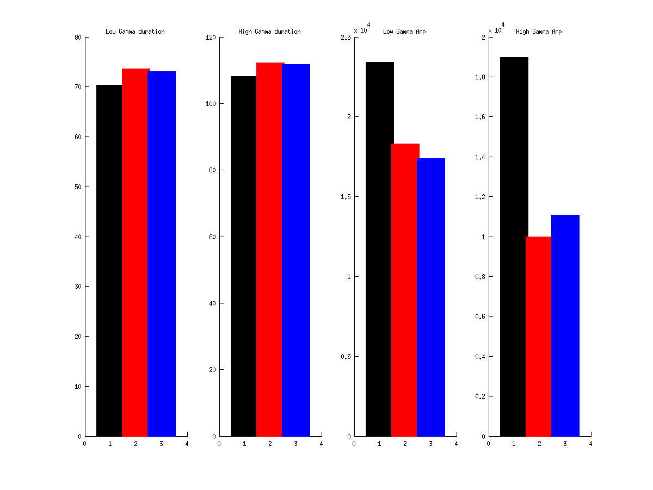
3
Notes:
Mouse 61
2013 04 15
3 - PFc

Slide 15
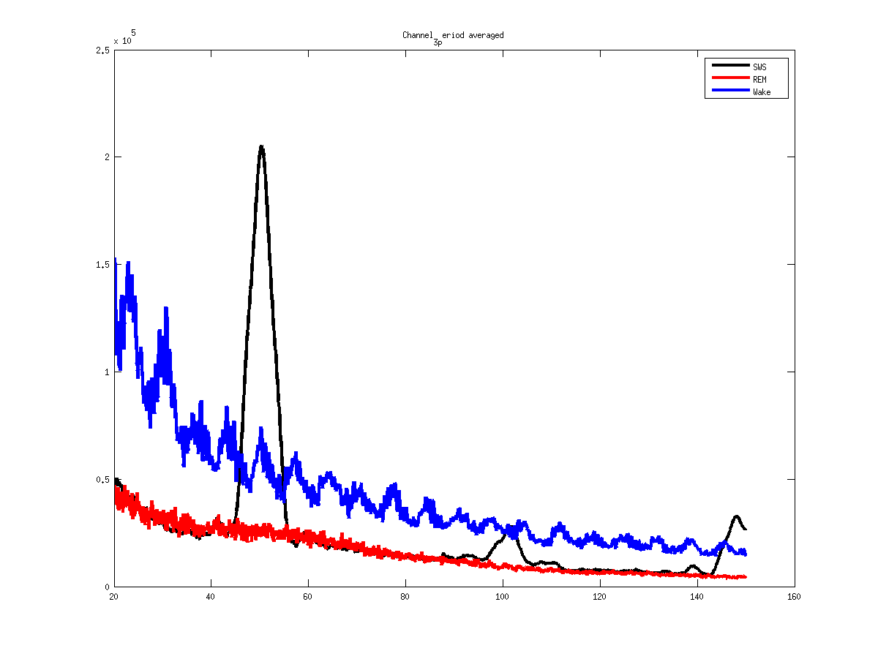
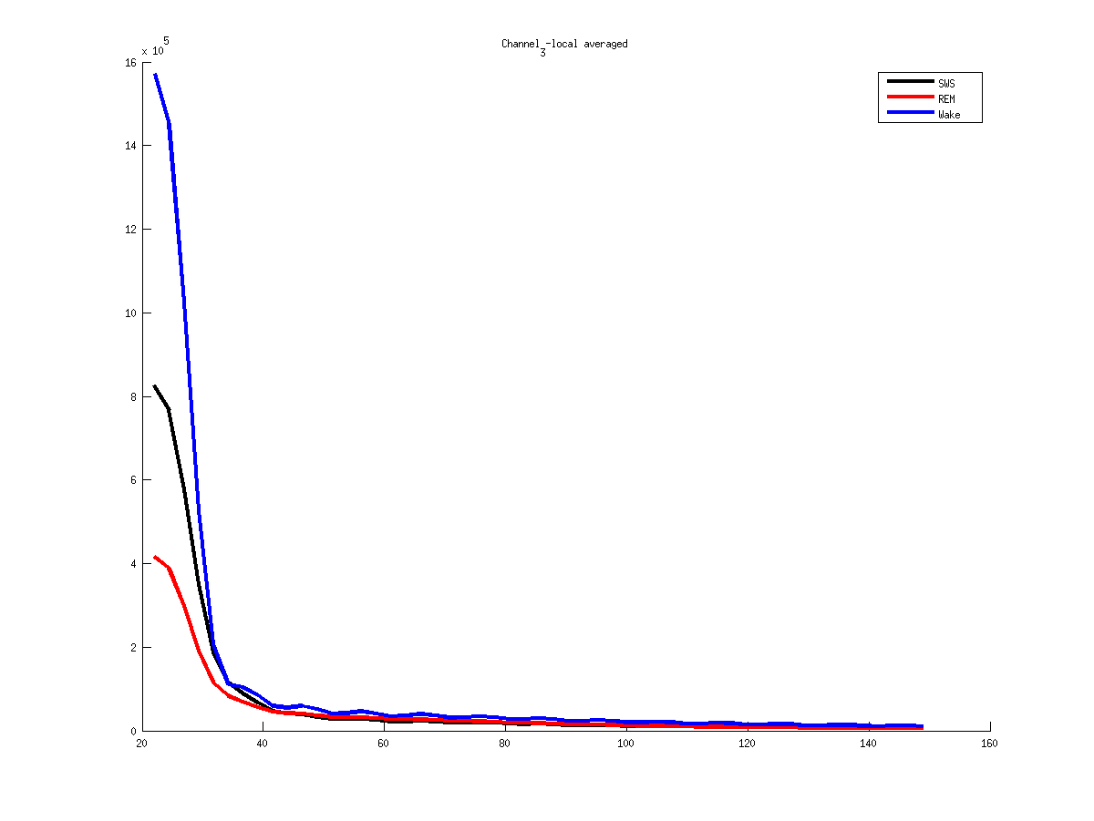
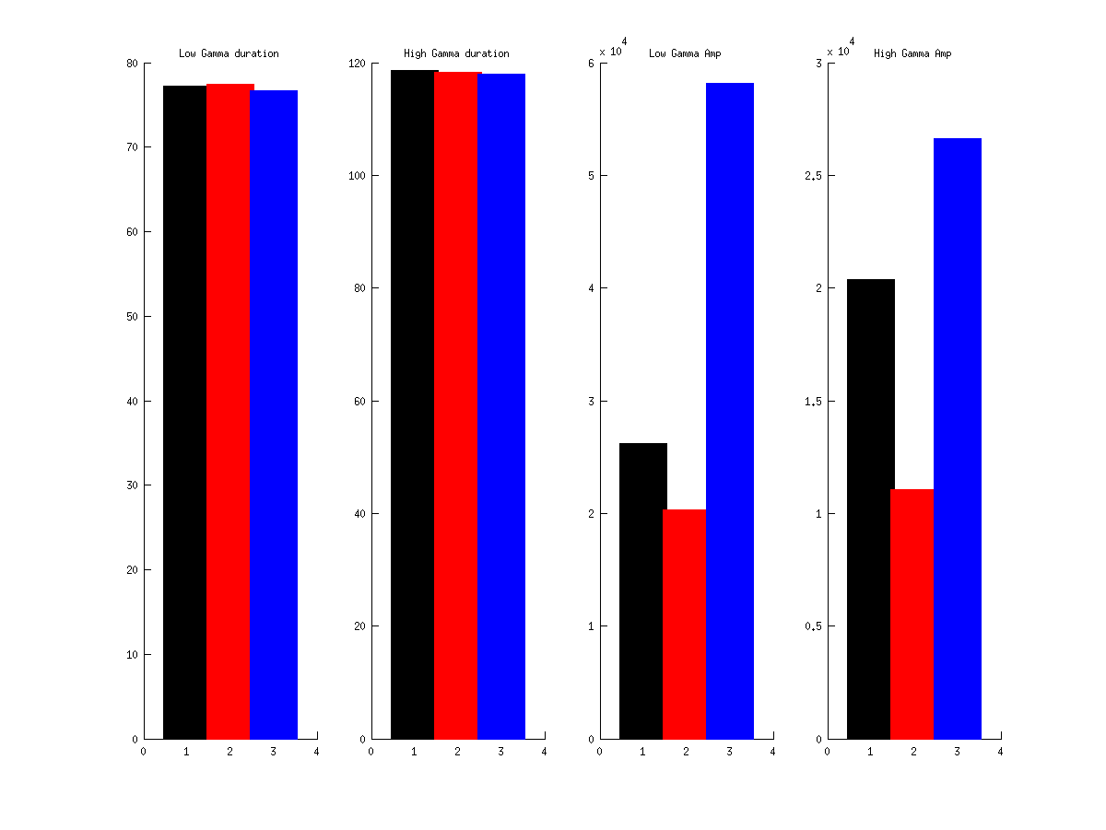
3
Notes:
Mouse 61
2013 04 22
3 – Pfc
Problem ????

Slide 16
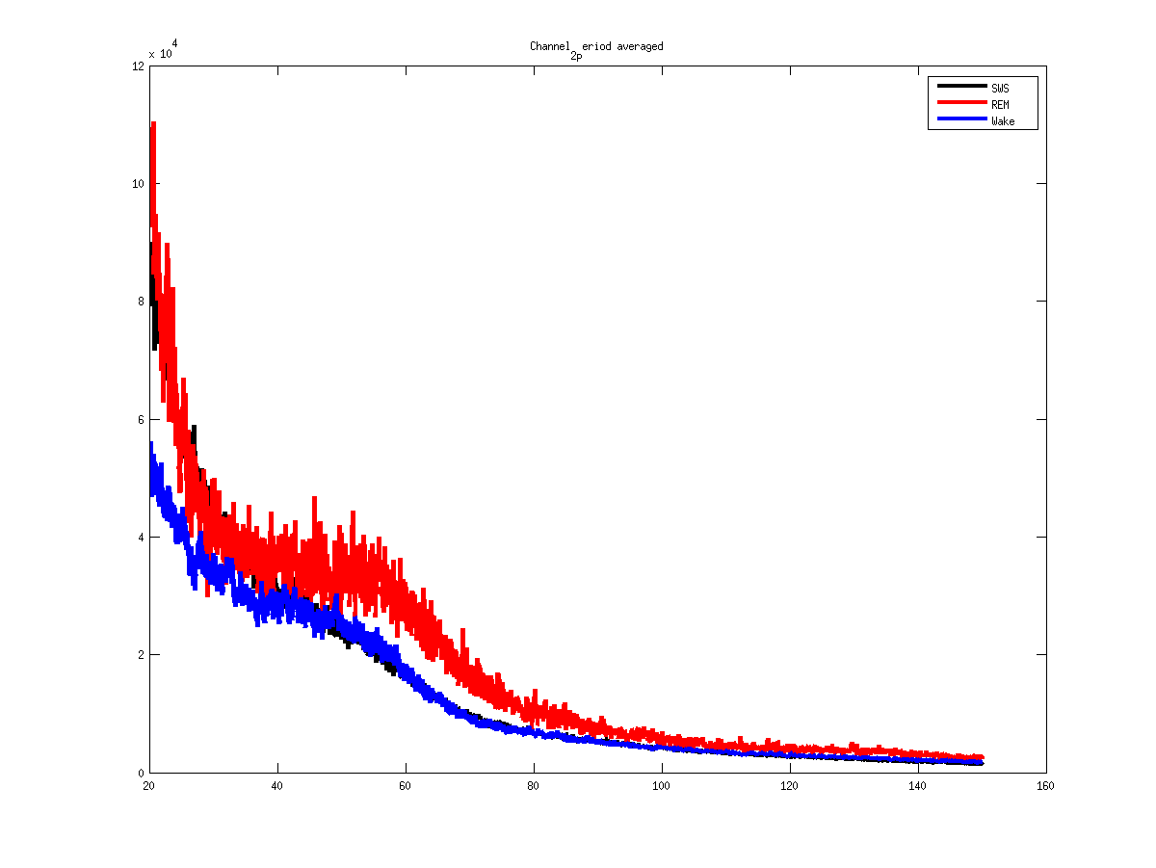
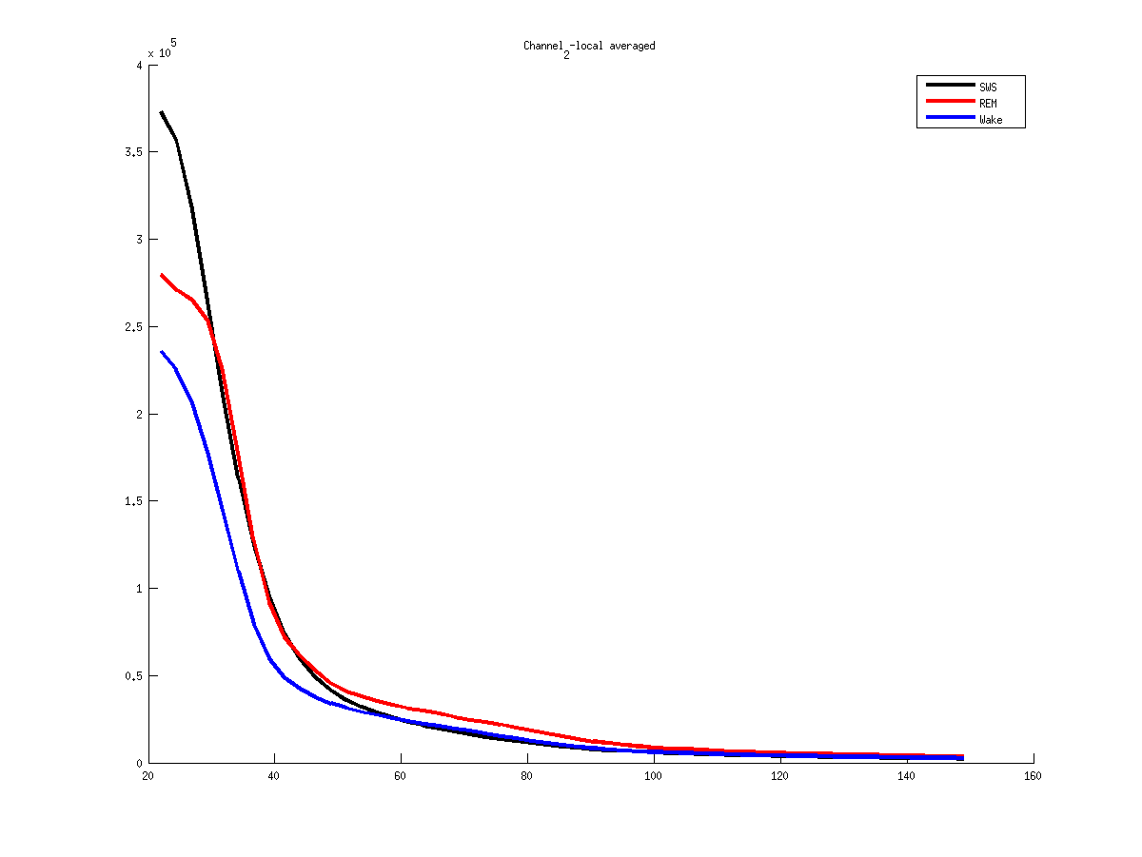
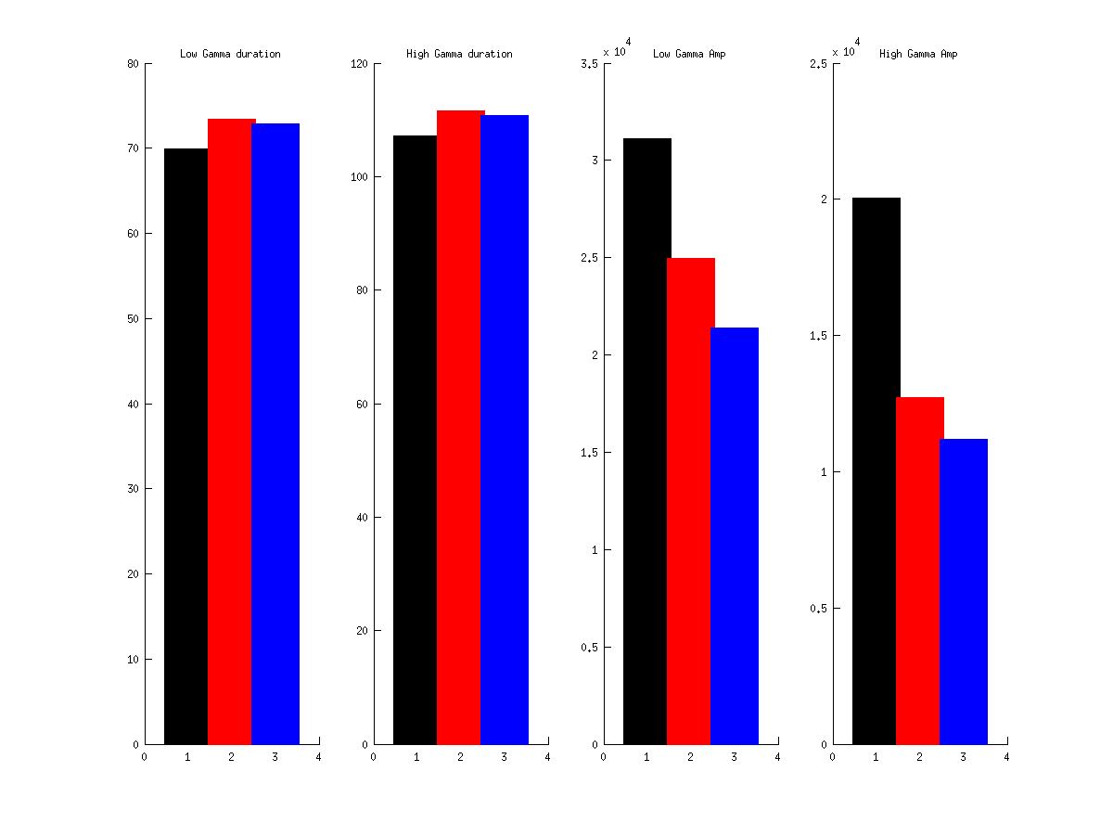
2
Notes:
Mouse 61
2013 04 15
2 - PaC

Slide 17
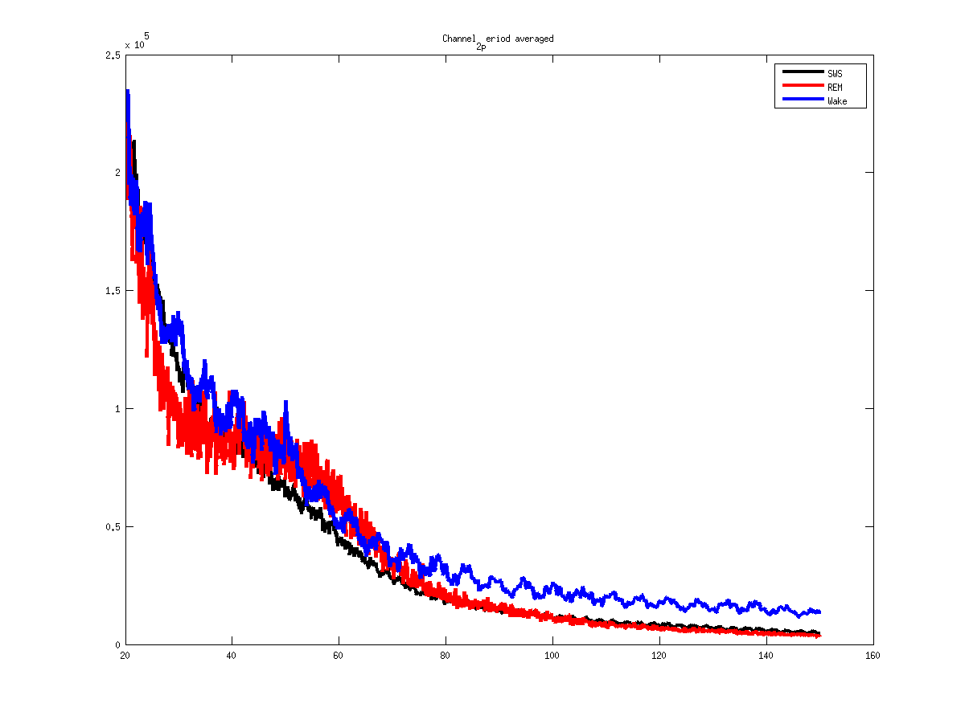
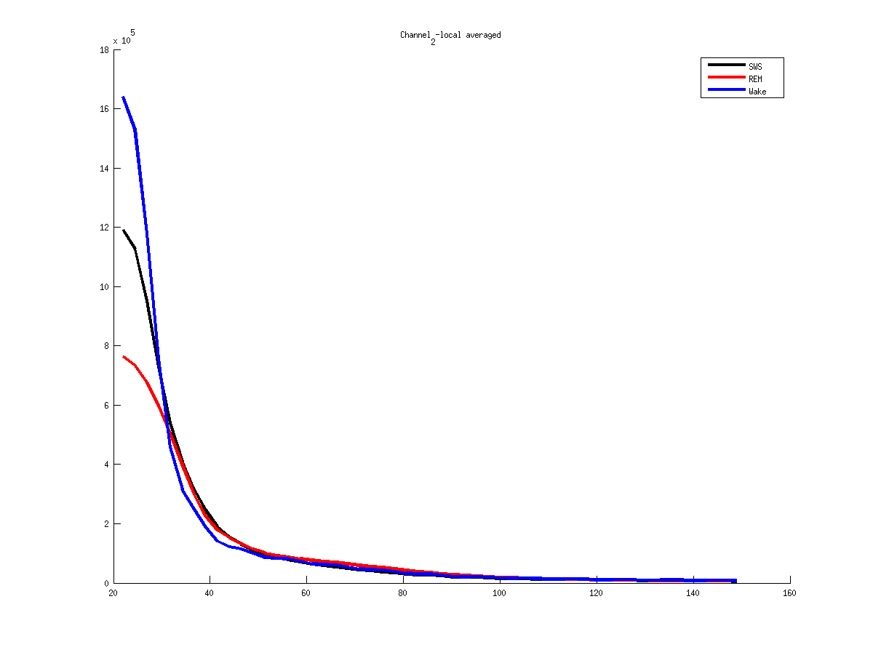
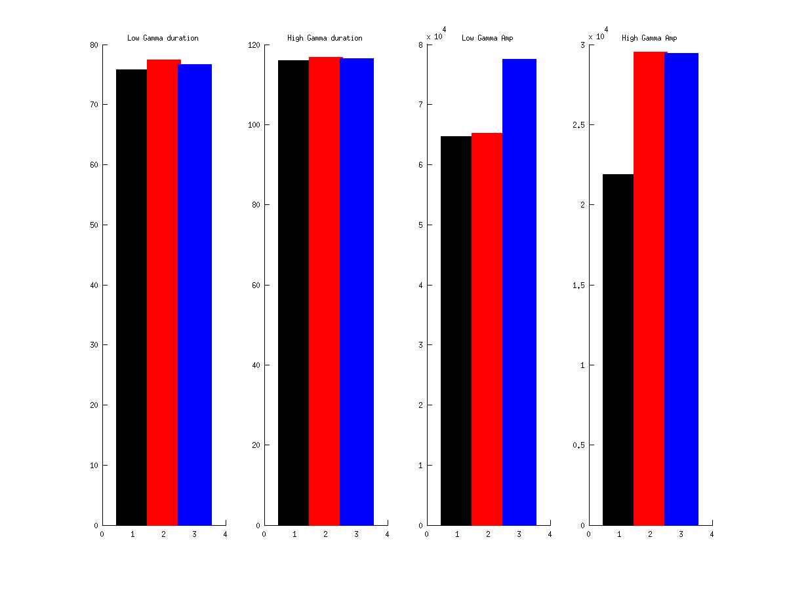
2
Notes:
Mouse 61
2013 04 22
2 - Pac

Slide 18
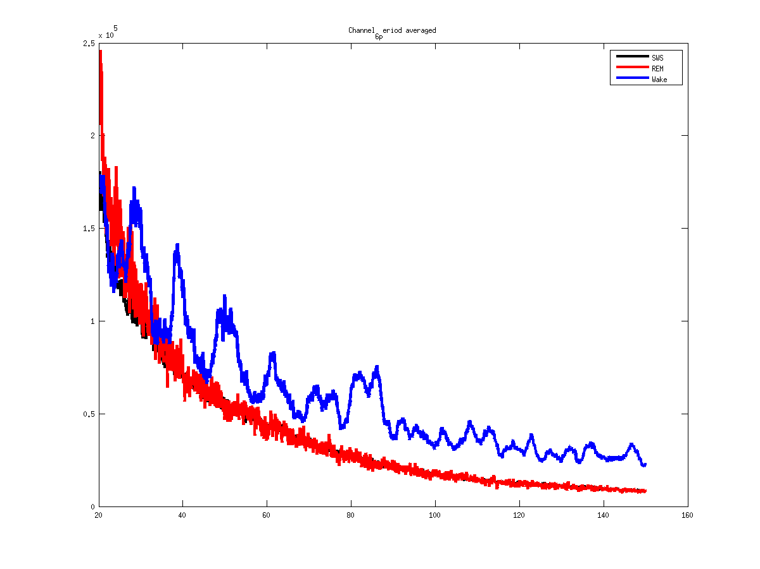
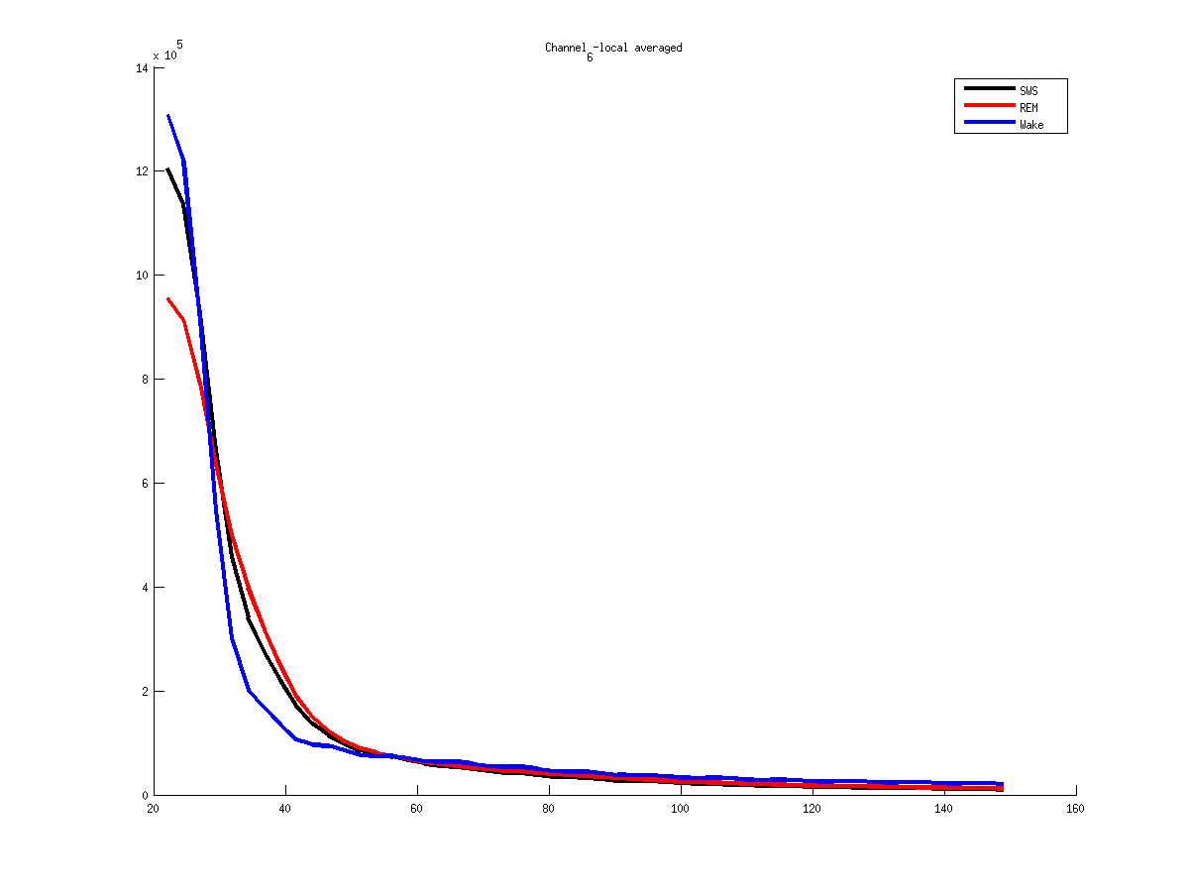

6
Notes:
Mouse 61
2013 04 22
6 - PaC

Slide 19
6
Notes:
Mouse 61
2013 04 22
6 - PaC

Slide 20



6
Notes:
Mouse 61
2013 04 15
6 – PaC

Slide 21



11
Notes:
Mouse 61
2013 04 22
11 – Bulb
Problem avec 50Hz

Slide 22
Mouse 51

Slide 23



15
Notes:
Mouse 51
2013 02 20
15 - Bulb

Slide 24



15
Notes:
Mouse 51
2013 02 21
15 – Bulb

Slide 25




2
Notes:
Mouse 51
2013 02 20
2 – Bulb sup – repsi less obvious

Slide 26



2
Notes:
Mouse 51
2013 02 21
2 – Bulb sup – repsi less obvious

Slide 27



30
Notes:
Mouse 51
2013 02 20
30 - Au

Slide 28



30
Notes:
Mouse 51
2013 02 21
30 – AuTh

Slide 29



20
Notes:
Mouse 51
2013 02 21
20 – PFC

Slide 30



21
Notes:
Mouse 51
2013 02 21
21 – PFC

Slide 31



23
Notes:
Mouse 51
2013 02 21
20 – PaC

Slide 32



24
Notes:
Mouse 51
2013 02 21
24 – AuC

Slide 33



26
Notes:
Mouse 51
2013 02 21
26 – AuC

Slide 34



28
Notes:
Mouse 51
2013 02 21
28 – PaC

Slide 35
Mouse 60

Slide 36



7
Notes:
Mouse 60
2013 04 22
7 Bulb

Slide 37


5
Notes:
Mouse 60
2013 04 22
5 Bulb

Slide 38



1
Notes:
Mouse 60
2013 04 22
1 Bulb

Slide 39



2
Notes:
Mouse 60
2013 04 22
2 Pfc

Slide 40



11
Notes:
Mouse 60
2013 04 22
11 PaCx

Slide 41



4
Notes:
Mouse 60
2013 04 22
4 Pfc

Slide 42



8
Notes:
Mouse 60
2013 04 22
8 Hpc

