Slide 1
Python
(week2 CH2 & 3)

Slide 2
Interactive and script mode
Know the differences
Feel free to have fun and test with interactive mode
Use script mode to save a file and execute
Tips
UNIX scripts start with a shebang on the first line to call the interpreter
Windows scripts will ignore the shebang as a comment
#! – is called a shebang
#!/usr/bin/env python3.6 - can be used to call a script with the local environment
#!/usr/local/bin/python3.6 – requires python3.6 installed in /usr/local/bin

Slide 3
Types & Casting
How can I see what type a variable is?
>>> type('Hello, World!')
<class 'str'>
>>> type(17)
<class 'int'>
But I wanted it to be an integer? How can I change that?
>>> a="17"
>>> int(a)
17
>>> type(a)
<class 'str'>

Slide 4
Cast in an expression
>>> a="17"
>>> type(a)
<class 'str'>
>>> int(a)
17
>>> type(a)
<class 'str'>
>>> b = a + 1
Traceback (most recent call last):
File "<stdin>", line 1, in <module>
TypeError: must be str, not int
>>> b = int(a) + 1
>>> print(b)
18
>>> type(b)
<class 'int'>

Slide 5
Some quick syntax things
Comments
# comment
Casting
blah = “27”
int(blah)
27 <-returned as an integer
Variable Names and Keywords
Variable names can be long
Must begin with a letter
The beginning letter should be lowercase (you’ll see why later)
The underscore _ character is often used for multiple works this_is_a_variable_name

Slide 6
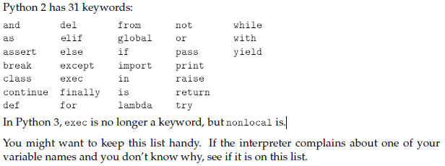
Python keywords

Slide 7
Operators
Look like this +, -, *, / , **
The operators +, -, *, / and ** perform addition, subtraction, multiplication, division and exponentiation

Slide 8
Order of operations
When more than one operator appears in an expression, the order of evaluation depends
on the rules of precedence. For mathematical operators, Python follows mathematical
convention. The acronym PEMDAS is a useful way to remember the rules:
• Parentheses have the highest precedence and can be used to force an expression to
evaluate in the order you want. Since expressions in parentheses are evaluated first,
2 * (3-1) is 4, and (1+1)**(5-2) is 8. You can also use parentheses to make an
expression easier to read, as in (minute * 100) / 60, even if it doesn’t change the
result.
• Exponentiation has the next highest precedence, so 2**1+1 is 3, not 4, and 3*1**3 is
3, not 27.
• Multiplication and Division have the same precedence, which is higher than
Addition and Subtraction, which also have the same precedence. So 2*3-1 is 5, not
4, and 6+4/2 is 8, not 5.
• Operators with the same precedence are evaluated from left to right (except exponentiation).
So in the expression degrees / 2 * pi, the division happens first and the
result is multiplied by pi. To divide by 2p, you can use parentheses or write degrees
/ 2 / pi.
I don’t work very hard to remember rules of precedence for other operators. If I can’t tell
by looking at the expression, I use parentheses to make it obvious. –Author, Alan Downey

Slide 9
Strings
The + operator works with strings
It concatenates strings
The * operator works with strings
It prints multiple copies of a string

Slide 10
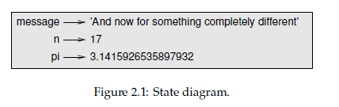
State diagrams
An assignment statement creates new variables and gives them values:
>>> message = 'And now for something completely different'
>>> n = 17
>>> pi = 3.1415926535897932
This example makes three assignments. The first assigns a string to a new variable named message; the second gives the integer 17 to n; the third assigns the (approximate) value of p to pi.
A common way to represent variables on paper is to write the name with an arrow pointing to the variable’s value. This kind of figure is called a state diagram because it shows what state each of the variables is in (think of it as the variable’s state of mind). Figure 2.1 shows the result of the previous example.

Slide 11
Functions (making your own)
def is a keyword that indicate this is a function definition
def print_lyrics():
Print (“I’m a lumberjack, and I’m okay.”)
Print (“I sleep all night and I work all day.”)
The name of the function is print_lyrics
The first line of the function is called the header
The rest is called the body(Which can contain any number of statements)
By convention, the indentation is always four spaces
Strings are enclosed in double quotes
Defining a function creates a variable with the same name (of type function)

Slide 12
Functions use
Functions can be used in other functions
def repeat_lyrics():
print_lyrics()
End the function with an empty line

Slide 13
Flow of execution
Begins at the first statement of a program
Statements are executed one at a time, in order, top to bottom
A function call is like a detour in the flow of execution
Jumps to the body of the function
Executes all the statements
Comes back to pick up where it left off
How to read a program, tips
When you read a program, you don’t always want to read from top to bottom
Sometimes it makes sense to follow the flow of execution

Slide 14
Parameters and Args
Inside the function, the arguments are assigned to variables called parameters
def print_twice(bruce):
print bruce
variables and parameters are local
They exist only inside a function
They are destroyed after execution

Slide 15
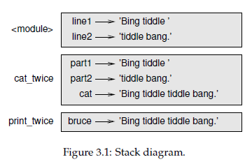
Stack diagrams
>>> line1 = 'Bing tiddle '
>>> line2 = 'tiddle bang.'
>>> cat_twice(line1, line2)
Bing tiddle tiddle bang.
Bing tiddle tiddle bang.
*strings bruce, part1, part2 must already be defined
def print_twice(bruce):
print (bruce)
print (bruce)
def cat_twice(part1, part2):
cat = part1 + part2
return cat
print_twice(bruce)
print(cat_twice(cat))

Slide 16
Stack diagrams explained
The frames are arranged in a stack indicates which function called which and so on.
print_twice was called by
cat_twice and
cat_twice was called by
__main__
__main__ which appears as <module>, main is the start of a module

Slide 17
Imports
To use the math.pi module
import math <- use as math.pi
from math import pi <- use pi and does not import any other functions
from math import * <- use as math.pi (and imports all modules)
import math as tomato <- uses tomato.pi and imports all other functions as tomato.<function_name>

Slide 18
Debugging Tips
Save your program before execution
Why? Be sure you are running the version you are editing
Use spaces always in Python

